Slide 1


Lightweight Application-Level Crash Consistency
on Transactional Flash Storage
Changwoo Min, Woon-Hak Kang†, Taesoo Kim, Sang-Won Lee†, Young Ik Eom†
Georgia Institute of Technology
†Sungkyunkwan University

Slide 2
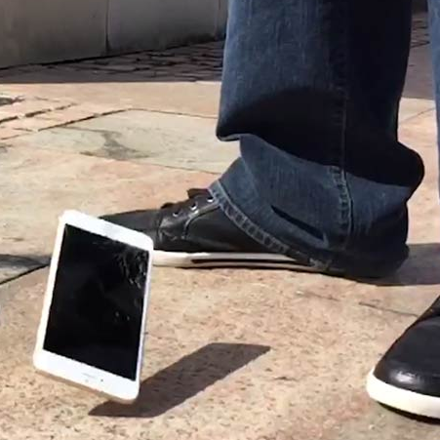

Application's data is not consistent after random failures
Mobile Phone
Bank Account
Power Outage
Hardware Errors
Software Panics (OS, Device Driver)
Hang
while booting
Financial loss

Slide 3
Example: inserting records in two databases
write(/db1, “new”);
write(/db2, “new”);
Application
For each database
Allocates new data block (bitmap)
Fills data block with user data (data)
Sets location of data block (inode)
Random failures?
→ Data corruption!
File System
/db1 data block is allocated.
bitmap
inode
data
Storage Device
/db1
/db2

Slide 4
How to Achieve Crash Consistency
: The Case of SQLite
atomic_update {
write(/db1, “new”);
write(/db2, “new”);
}
Logging (i.e., journaling) & Crash Recovery
“Write logs first before writing data in place”
Ordering & durability
: 11 fsync()
Maintaining three log files
: for each DB and their master
: 3 create() & 3 unlink()
Redundant write
: 7 write()

Slide 5
How to Achieve Crash Consistency
: The Case of SQLite
// create master journal
open(/master.jnl);
write(/master.jnl, “/db1,/db2”);
fsync(/master.jnl);
fsync(/);
// update db1
open(/db1.jnl);
write(/db1.jnl, “old”);
fsync(/db1.jnl);
fsync(/);
write(/db1.jnl, “master.jnl”);
fsync(/db1.jnl);
write(/db1, “new”);
fsync(/db1);
// update db2
open(/db2.jnl);
write(/db2.jnl, “old”);
fsync(/db2.jnl)
fsync(/);
write(/db2.jnl, “master.jnl”);
fsync(/db2.jnl);
write(/db2, “new”);
fsync(/db2);
// clean up journals
unlink(/master.jnl);
fsync(/);
unlink(/db1.jnl);
unlink(/db1.jnl);
atomic_update {
write(/db1, “new”);
write(/db2, “new”);
}

Slide 6
Cost of Crash Consistency
: The Case of SQLite
Written Pages
Database update: 2 pages

Slide 7
Cost of Crash Consistency
: The Case of SQLite
Written Pages
SQLite journaling: 3 pages
Database update: 2 pages

Slide 8
Cost of Crash Consistency
: The Case of SQLite
Written Pages
Ext4 journaling+metadata: 33.6 pages
SQLite journaling: 3 pages
Redundant disk writes
per single data page write
Database update: 2 pages
Write Amplification = 38.6/2 = 19.3

Slide 9
Cost of Crash Consistency
: The Case of SQLite
Notoriously slow!
xsyncfs [Nightingale:OSDI06]
OptFS [Chidambaram:SOSP13]
DuraSSD [Kang:SIGMOD14]
...
Disk Flush
fsync() + FS journaling: 12.7

Slide 10
Problem: complex, redundant software stack for crash consistency
How can we simplify mechanisms for application crash consistency?

Slide 11
Problem: complex, redundant software stack for crash consistency
How can we simplify mechanisms for application crash consistency?
Can we use atomic updates of multi pages
provided by transactional flash?

Slide 12
Transactional Flash 101
NAND Flash SSD
  No in-place update
  Log-structured write
  Mapping table: logical address → physical address
Mapping
Table
LBN | PBN
Pn
P1
write(Pn)
write(P1)
Flash
Chips
P1
...
Pn
P1
...
Pn
Old copy of P1, … , Pn
New copy of P1, … , Pn

Slide 13
Transactional Flash 101
Transactional Flash SSD
  Atomic multi-page write by atomically updating the mapping table at commit request
    write(txid, page), commit(txid), abort(txid)
  H/W implementation or S/W emulation
commit(txid)
Mapping
Table
LBN | PBN
Pn
P1
write(txid, Pn)
write(txid, P1)
Flash
Chips
P1
...
Pn
P1
...
Pn
Old copy of P1, … , Pn
New copy of P1, … , Pn

Slide 14
Our Solution: CFS, a new file system using transactional flash
Simplifying
applications' crash consistency
using atomic multi-page write
of transactional flash

Slide 15
Our Solution: CFS
atomic_update {
write(/db1, “new”);
write(/db2, “new”);
}
Written Pages
Disk Flush
Performance

Slide 16
Our Solution: CFS
atomic_update {
write(/db1, “new”);
write(/db2, “new”);
}
write(/db1, “new”);
write(/db2, “new”);
+ cfs_begin();
+ cfs_commit();
Written Pages
Disk Flush
Performance
16.7x
12.9x
12.7x

Slide 17
Outline
Introduction
CFS Design
Evaluation
Conclusion

Slide 18
CFS Architecture
Application
(e.g., DBMS, K/V)
cfs_begin()
cfs_commit()
cfs_abort()
Application
(e.g., DBMS, K/V)
Journaling
File System
(e.g., ext4)
CFS
Journaling
write(txid, LBA)
commit(txid)
abort(txid)
Block Storage
(e.g., HDD/SSD)
Transactional Flash
Removing redundant journaling with new primitives
provided by transactional flash

Slide 19
Four Challenges
Finding a set of pages for atomic updates
File system metadata consistency in every case
Concurrency control among atomic updates
Legacy application support without any modification

Slide 20
#1. Unit of Atomic Write
: Atomic Propagation Group
+ cfs_begin();
write(/db1, “new”);
write(/db2, “new”);
+ cfs_commit();
Application
Updated data and file system metadata
pages need to be atomically updated.
Use atomic multi-page write operations
→ Atomic Propagation Group
For each database
Allocates new data block (bitmap)
Fills data block with user data (data)
Sets location of data block (inode)
File System
bitmap
inode
data
Transactional
Flash
/db1
/db2

Slide 21
Example: Two apps. are running
+ cfs_begin();
write(/db1, “new”);
write(/db2, “new”);
+ cfs_commit();
+ cfs_begin();
write(/db3, “new”);
...
Application
What if /db3 bitmap locates in the /db2 bitmap?
bitmap
inode
data
/db1
Transactional
Flash
/db2
/db3
/db3 data block is allocated.

Slide 22
Problem: entangled disk pages
1. cfs_commit()
- /db1 and /db2 are persistent
bitmap
inode
data
/db1
/db2
2. Sudden Power Outage
- /db3 changes are lost.
/db3
/db3 data block is allocated.
Incorrect bitmap
- Free block is marked as allocated.

Slide 23
Problem: entangled disk pages
bitmap
/db1
False Sharing of
Metadata Pages
/db2
/db3
+ cfs_begin();
write(/db1, “new”);
write(/db2, “new”);
+ cfs_commit();
+ cfs_begin();
write(/db3, “new”);
...
- sudden power outage

Slide 24
#2. Metadata False Sharing
: In-Memory Metadata Logging
Operational Logging for in-memory metadata change
  toggle_bit(free_block_bitmap, LBA)
  sub(free_block_count, 1)
Maintain two versions of in-memory metadata to selectively propagate only relevant changes to storage
  Memory version: on-going modification
  Storage version: committed version, used for storage IO

Slide 25
REDO or UNDO operational logs
cfs_commit() {
storage version += REDO(logs);
write(txid, storage version);
commit(txid);
}
cfs_abort() {
memory version -= UNDO(logs);
abort(txid);
}

Slide 26


Example: Two apps. are running
Bitmap for db3 is not written.
Bitmap for db3 is reverted.
Operational Log
for Atomic Propagation Group
bitmap
In-Memory
Metadata
Memory
Version
App 1 | App 2
Turn on a bit
Turn on a bit
Storage
Version
cfs_commit()
cfs_abort()
Transactional
Flash
Selective Propagation of Metadata Change

Slide 27
#3. Isolation? Concurrency Control?
: Leave It to Application
cfs_begin();
write(/my_file, “200”);
...
/my_file
cfs_begin();
val = read(/my_file);
...
100
200
What val should be either of 100 or 200?
It depends on application semantics.

Slide 28


#3. Isolation? Concurrency Control?
: Leave It to Application
> START TRANSACTION
> UPDATE account
SET deposit='200'
> ...
> COMMIT
/bank_account
> START TRANSACTION
> SELECT deposit
FROM account
> ...
> COMMIT
100
200
Deposit of bank account must be 200.
KV→begin_transaction(...);
KV→set(“account.likes”,
“200”);
...
KV→end_transaction(...);
/sns_account
KV→begin_transaction(...);
KV→get(“account.deposit”);
…
...
KV→end_transaction(...);
100
200
Likes of SNS account can be either of 100 or 200.

Slide 29
#3. Isolation? Concurrency Control?
: Leave It to Application
Isolation and crash-consistency are orthogonal.
  Even the SQL standard defines four different isolation levels.
CFS does not provide its own concurrency control mechanism.
  If needed, use existing synchronization primitives (e.g., mutex, RW lock, etc).

Slide 30
#4. Legacy Application Support
System-Wide Atomic Propagation Group
  Every update from legacy applications belongs.
  Automatically committed by sync() or page flusher
CFS supports legacy applications
without any modification.

Slide 31
Outline
Introduction
CFS Design
Evaluation
Conclusion

Slide 32
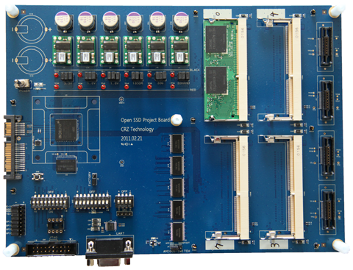
Implementation
CFS
  5.8k LoC modification of ext4 on Linux 3.10
  Capture logs by inserting 182 places in ext4
Transactional Flash
  OpenSSD: 8KB, 128 pages/block, 8GB w/ SATA2
  X-FTL/SSD [Kang:SIGMOD'13]

Slide 33



Real Application & Workloads
Mobile
Database
+ RLBench
+ Facebook
Text
Editor
CFS is easy-to-use!
: 317 LoC changes out of 3.5 million
SQL
Database
+ SysBench
+ LinkBench
Package
Installer
Key/Value
Store
+ kctreetest
+ db_bench
apt-get

Slide 34
SQLite
+ Facebook App. SQL Trace
Write Amplification
Disk Flush
Performance
4.8x
4.1x
4x
Ext4: ordered journal mode
SQLite: rollback journal mode

Slide 35
MariaDB
+ LinkBench
Write Amplification
Disk Flush
Performance
2.1x
2x
17.6x
Ext4: ordered journal mode

Slide 36
KyotoCabinet
+ db_bench
Write Amplification
Disk Flush
Performance
4.8x
2.2x
2.7x
Ext4: ordered journal mode

Slide 37
Conclusion
Current mechanisms for crash consistency is complex, slow, and error-prone.
CFS simplifies application's crash consistency using transactional flash.
  Atomic propagation group
  In-memory metadata logging
Our evaluation shows
  Less write: 2 ~ 4x↓
  Less disk flush: 3 ~ 17x↓
  Higher performance: 2 ~ 5x↑

Slide 38
Thank you!
Changwoo Min
changwoo@gatech.edu
Woon-Hak Kang†, Taesoo Kim, Sang-Won Lee†, Young Ik Eom†
Georgia Institute of Technology
†Sungkyunkwan University
Questions?

