Slide 1
Dynamic-prelink

Slide 2
Program startup
Performance VS Security (fork & exec)
Importance
Method
Mechanism
Performance
Enhance the performance of dynamic linker
The element of overhead
1. binary I/O
2. Relocation
3. symbol lookup
Prelink
- relocation skip
- symbol lookup skip
Can’t be operated together
Security
Randomize the memory address layout
increase the entropy
Be hard to access into specific memory
Address Space Layout Randomization
(ASLR)
- defense the brute force attack
- defense the Return-to-libc

Slide 3
Dynamic linker
The effect on the performance of program startup in the dynamic linker
before main(): spend almost time in the dynamic linker
A: relocation
B: File I/O
C: context in the dynamic linker before jump the context of libraries
D: resolving GOT
after main() : resolve Global Offset Table(GOT) and find symbol
Possibility to enhance the overhead of dynamic linker
Relocation & caching symbol lookup ( A )
Resolving GOT in the runtime ( D )
Libraries init call
Program running
Kernel
Dynamic linker
C
E
D
B
A
exec()
entry of ld.so
finish ld.so’s startup
entry of main()
finish executable’s
launching

Slide 4
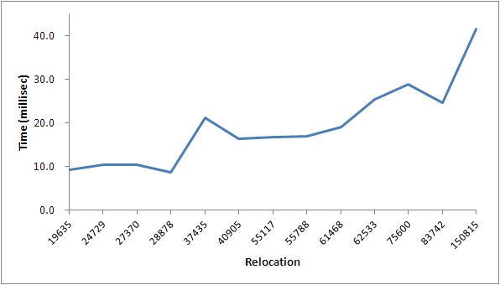
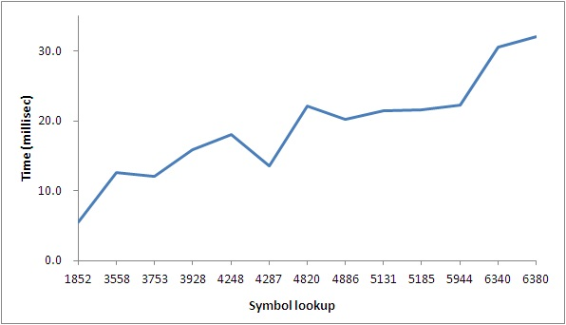
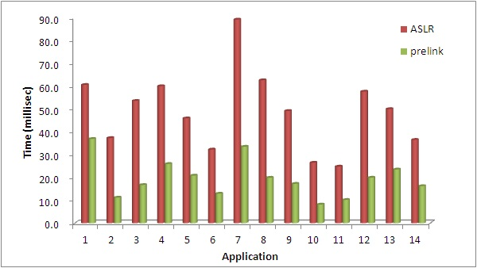
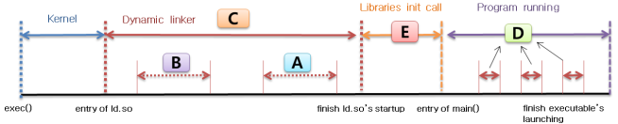
Prelink
Prelink ( introduced by Jakub Jelnek )
The mechanism to reduce the program startup
Idea
Fix the base address by modifying the binaries
Complete the relocation, resolving symbol before runtime
Effect
increase 60% on average in dynamic linker (Intel i3 2core)
Andorid -> booting time 3 sec , 5% save (ref. ACM 2011 wireless network security)
GtK+ applications of linux -> 83% -89% save (ref. prelink paper)
The effect on the dynamic linker according to the number of symbol and relocation
The effect of prelink on the dynamic linker during program startup

Slide 5
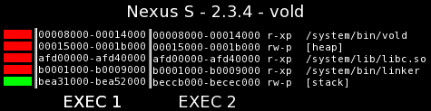
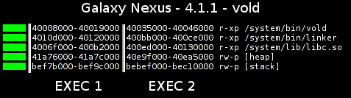
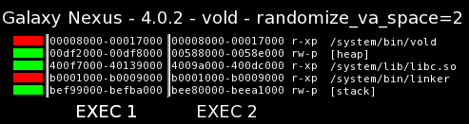
Latest trend
Latest OSes do not apply prelink due to the security
Android
Before Ice-cream(4.0) -> prelinking in the whole system
Ice-cream -> partial ASLR
Jelly-bean -> full ASLR
Windows
Before Vista -> prelinking
After Vista -> ASLR
OS X, iOS
Before OS X 10.8, iOS 4.3 -> preload ( similar prelink )
After OS X 10.8, iOS 4.3 -> ASLR
Linux
Apply PaX ASLR
ASLR
Fixed address
Ref: https://www.duosecurity.com/blog/a-look-at-aslr-in-android-ice-cream-sandwich-4-0

Slide 6
Prelink vulnerability
Issue
Fixed address of each binaries
In all of the process, always load binaries into the same address
Prelinking for One of the program influence all programs
Ex> libc.so is linked almost program, but prelinked libc.so is loaded into the same address
Vulnerability
Return-to-libc (RTL) : be easy to attack ROP program because the address map of libc.so is exposed in the all processes
Brute force attack
Stack overflow
Attack
Stack Heap
NOP sled
GOT attack
main()
mmap()
RTL attack

Slide 7
Motivation
Question
Why can’t use ASLR and prelink together on the same system?
Answer > Prelink fixes the program header of all shared libraries related specific program.
One of prelinked program prevents operating ASLR of another program.
Needs
The importance between the security and the performance is different according to the property of program.
Improvement model
Designs the mechanism that ASLR and prelink are able to be operated together.
contribution
Each program is able to be prelinked by using the different address map
Prelinked programs do not disturb ASLR of common program.
A program is able to selectively switch loading mechanisms to ASLR or prelink

Slide 8
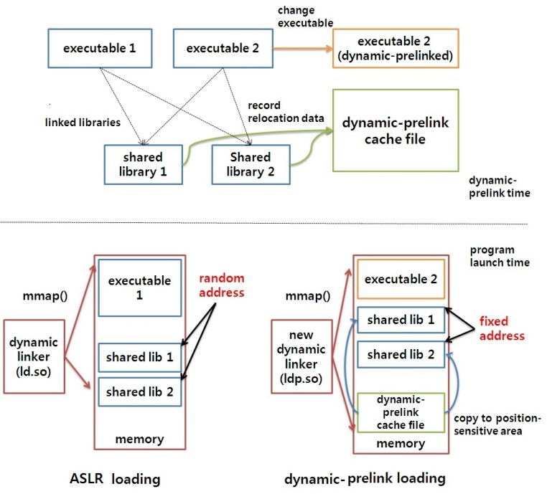
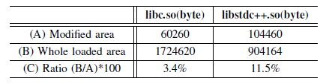
Dynamic-prelink
Possibility
Almost shared libraries is composed to Position Independent Code (PIC).
The ratio of ELF’s a sections related relocation is small (libc : 3.4%, libstdc++ : 11.5%)
Create the cache file and write relocation file instead of modifying binaries.
Copy the data of cache file to the relocation section in the runtime.
The ratio of relocation section
The structure of dynamic-prelink

Slide 9
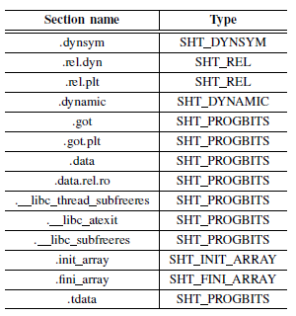
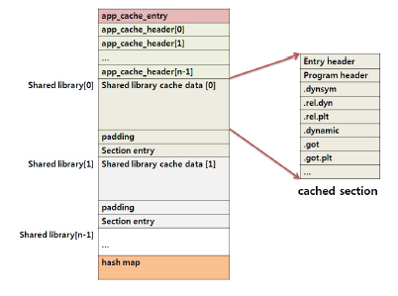
Method & Analysis
Analyze relocation section
Divide with ELF’s sections composed PIC
The location-independent section
The location-sensitive section
The relocation section
Dynamic-prelink cache file
The cache file to manage prelinking data
Format
app_cache_entry:
app_cache_header:
section_header:
cached section:
hash map:
Relocation section
Dynamic-prelink cache file

Slide 10
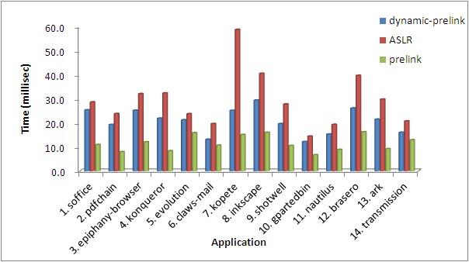


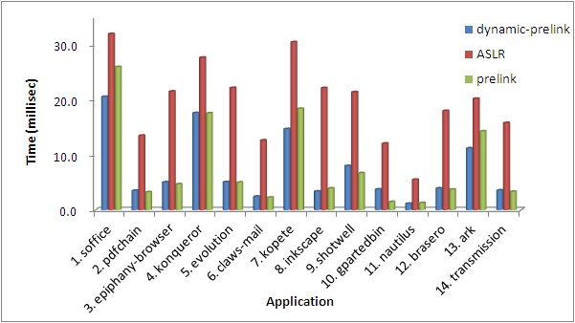
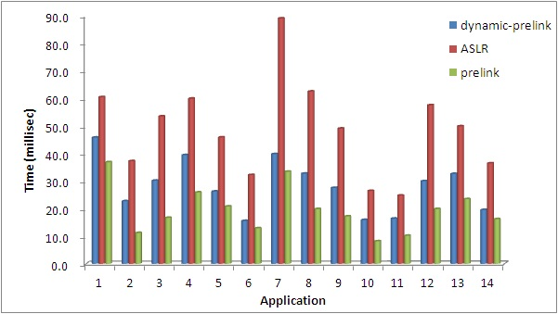
Experimental Results
Evaluation for the dynamic linker
Increase the performance about 42% than ASLR
( Original prelink: about 60% saved )
ASLR << dynamic-prelink < prelink
Analysis
The overhead of dynamic-prelink :
dynamic-prelink cache file
Original prelink and prelink present the same performance except the overhead of cache file.
Executing time before enter executable's main()
Executing time during symbol resolving in the GOT
The whole executing time in the dynamic linker

Slide 11
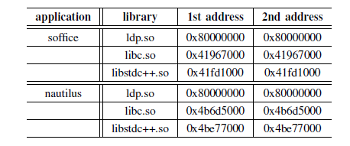
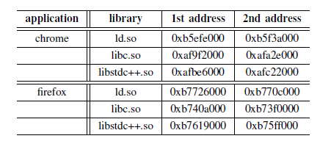
Experimental Results
Address layout
Dynamic-prelinked program is loaded into independent memory address.
Dynamic-prelinked programs do not disturb ASLR of common program.
Fixed address layout of shared libraries of two dynamic-prelinked programs
The memory address layout of loaded programs using ASLR in running programs which dynamic-prelinking is applied to

Slide 12
Conclusion
Conclusion
Each program is able to be prelinked by using the different address map
Dynamic-prelinked programs do not disturb ASLR of common program.
Performance
ASLR << Dynamic-prelink < prelink
Dynamic-prelink is the mechanism that ASLR and prelink are able to be operated together
A program is able to selectively switch loading mechanisms to ASLR or prelink
 | Dynamic-prelink | Prelink
Performance | Better 42% than ASLR | Better 42% than ASLR
ASLR | ASLR and prelink are operated together | ASLR and prelink are not operated together
Address layout | Dynamic-prelinked programs have different memory address layout per each program | all prelinked programs is loaded into the same memory address

Slide 13
Reference
[1] Jelinek, Jakub. Prelink. Technical report, Red Hat, Inc., 2004. available at http://people.redhat.com/jakub/prelink. pdf, 2003.
[2] Bojinov, Hristo, et al. ”Address space randomization for mobile devices.” Proceedings of the fourth ACM conference on Wireless network security. ACM, 2011.
[3] van Veen, Sander Mathijs. ”Concurrent Linking with the GNU Gold Linker.” (2013).
[4] Shacham, Hovav, et al. ”On the effectiveness of address-space randomization.” Proceedings of the 11th ACM conference on Computer and communications security. ACM, 2004.
[5] Spengler, Brad. ”Pax: The guaranteed end of arbitrary code execution.”(2003).
[6] Loosemore, Sandra, et al. The GNU C libraryreference manual. Free software foundation, 2001.
[7] Chamberlain, Steve, and Ian Lance Taylor. ”Using ld: the GNU Linker.” (2003).
[8] ”Apple OS X Mountain Lion Core Technologies Overview”. June 2012. Retrieved 3 December 2013.
[9] Dai Zovi, Dino A. ”Apple iOS 4 security evaluation.” Black Hat USA (2011).
[10] ”Android Security”. Android Developers. Retrieved 9 December 2013.
[11] Windows, I. S. V. ”Software Security Defenses.” (2012).
[12] Payer, Mathias. ”Too much PIE is bad for performance.” (2012).
[13] Tool Interface Standards Committee. ”Executable and Linkable Format (ELF).” Specification, Unix System Laboratories (2001).
[14] John Moser. Prelink and address space randomization, 2006. http://lwn.net/Articles/190139/.
[15] De Raadt, Theo. ”Exploit mitigation techniques.” (2005).
[16] Xu, Haizhi, and Steve J. Chapin. ”Improving address space randomization with a dynamic offset randomization technique.” Proceedings of the 2006 ACM symposium on Applied computing. ACM, 2006.

Slide 14
Q&A

