Slide 1


SFS: Random Write Considered Harmful in Solid State Drives
Changwoo Min^{1, 2}, Kangnyeon Kim¹, Hyunjin Cho², Sang-Won Lee¹, Young Ik Eom¹
¹Sungkyunkwan University, Korea
²Samsung Electronics, Korea

Slide 2
Outline
Background
Design Decisions
Introduction
Segment Writing
Segment Cleaning
Evaluation
Conclusion

Slide 3
Flash-based Solid State Drives
Solid State Drive (SSD)
A purely electronic device built on NAND flash memory
No mechanical parts
Technical merits
Low access latency
Low power consumption
Shock resistance
Potentially uniform random access speed
Remaining two problems limiting wider deployment of SSDs
Limited life span
Random write performance

Slide 4
Limited lifespan of SSDs
Limited program/erase (P/E) cycles of NAND flash memory
Single-level Cell (SLC): 100K ~ 1M
Multi-level Cell (MLC): 5K ~ 10K
Triple-level Cell (TLC): 1K
As bit density increases
→ cost decreases, lifespan decreases
Starting to be used in laptops, desktops and data centers.
Contain write intensive workloads

Slide 5
Random Write Considered Harmful in SSDs
Random write is slow.
Even in modern SSDs, the disparity with sequential write bandwidth is more than ten-fold.
Random writes shortens the lifespan of SSDs.
Random write causes internal fragmentation of SSDs.
Internal fragmentation increases garbage collection cost inside SSDs.
Increased garbage collection overhead incurs more block erases per write and degrades performance.
Therefore, the lifespan of SSDs can be drastically reduced by random writes.

Slide 6
Optimization Factors
SSD H/W
Larger over-provisioned space → lower garbage collection cost inside SSDs
Higher cost
Flash Translation Layer (FTL)
More efficient address mapping schemes
Purely based on LBA requested from file system
Less effective for the no-overwrite file systems
Lack of information
Applications
SSD-aware storage schemes (e.g. DBMS)
Quite effective for specific applications
Lack of generality
Applications
File System
Flash Translation Layer
(FTL)
SSD H/W
We took a file system level approach to directly exploit file block level statistics and provide our optimizations to general applications.

Slide 7
Outline
Background
Design Decisions
Log-structured File System
Eager on writing data grouping
Introduction
Segment Writing
Segment Cleaning
Evaluation
Conclusion

Slide 8
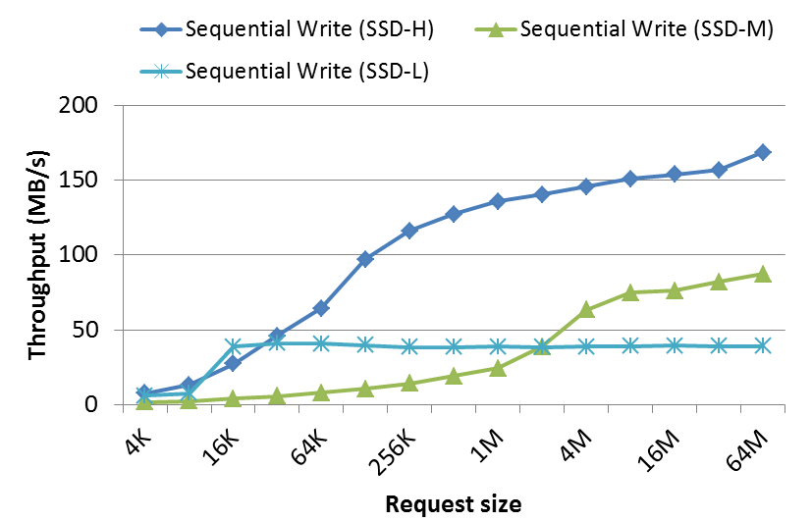
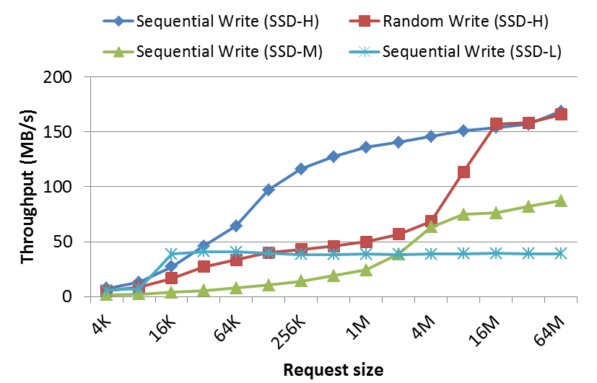
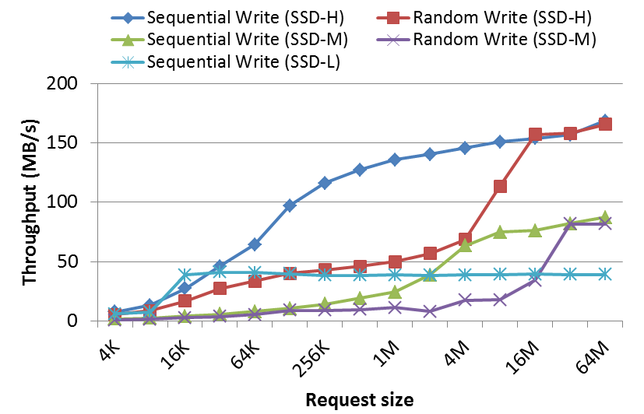
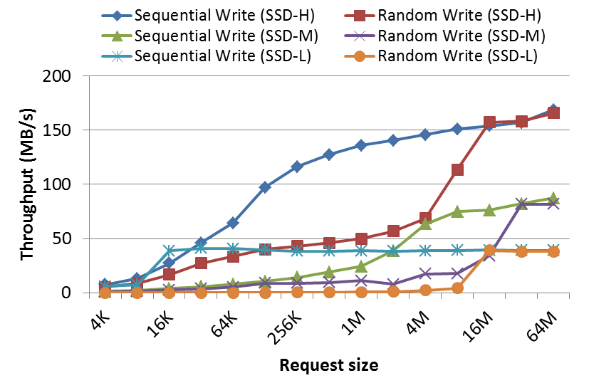
Performance Characteristics of SSDs
If the request size of the random write are same as erase block size, such write requests invalidate whole erase block inside SSDs.
Since all pages in an erase block are invalidated together, there is no internal fragmentation.
The random write performance becomes same as sequential write performance when the request size is same as erase block size.

Slide 9
Log-structured File System
How can we utilize the performance characteristics of SSD in designing a file system?
Log-structured File System
It transforms the random writes at file system level into the sequential writes at SSD level.
If segment size is equal to the erase block size of a SSD, the file system will always send erase block sized write requests to the SSD.
So, write performance is mainly determined by sequential write performance of a SSD.

Slide 10
Eager on writing data grouping
To secure large empty chunk for bulk sequential write, segment cleaning is needed.
Major source of overhead in any log-structured file system
When hot data is colocated with cold data in the same segment, cleaning overhead significantly increases.
Disk segment (4 blocks)
1
2
3
4
5
6
7
8
1
3
7
8
Four live blocks should be moved to secure an empty segment.
1
3
7
8
2
4
5
6
1
3
7
8
No need to move blocks to secure an empty segment.
Traditional LFS writes data regardless of hot/cold and then tries to separate data lazily on segment cleaning.
If we can categorize hot/cold data when it is first written, there is much room for improvement.
➔ Eager on writing data grouping

Slide 11
Outline
Background
Design Decisions
Introduction
Segment Writing
Segment Cleaning
Evaluation
Conclusion

Slide 12
SFS in a nutshell
A log-structured file system
Segment size is multiple of erase block size
Random write bandwidth = Sequential write bandwidth
Eager on writing data grouping
Colocate blocks with similar update likelihood, hotness, into the same segment when they are first written
To form bimodal distribution of segment utilization
Significantly reduces segment cleaning overhead
Cost-hotness segment cleaning
Natural extension of cost-benefit policy
Better victim segment selection

Slide 13
Outline
Background
Design Decisions
Introduction
Segment Writing
Segment Cleaning
Evaluation
Conclusion

Slide 14
On Writing Data Grouping
Colocate blocks with similar update likelihood, hotness, into the same segment when they are first written.
Dirty Pages: t
1
2
3
4
5
6
1. Calculate hotness
1
2
How to measure hotness?
3
4
5
6
Hot group
Cold group
2. Classify blocks
1
3
How to determine grouping criteria?
4
5
2
6
3. Write large enough groups
1
3
4
5
Disk segment (4 blocks)
Dirty Pages: t+1
2
6

Slide 15

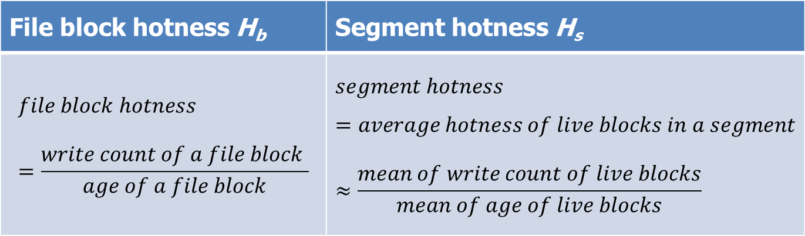
Measuring Hotness
Hotness: update likelihood
Frequently updated data ➔ hotness ↑
Recently updated data ➔ hotness ↑
$hotness=\frac{write count}{age}$
File block hotness H_{b} | Segment hotness H_{s}

Slide 16
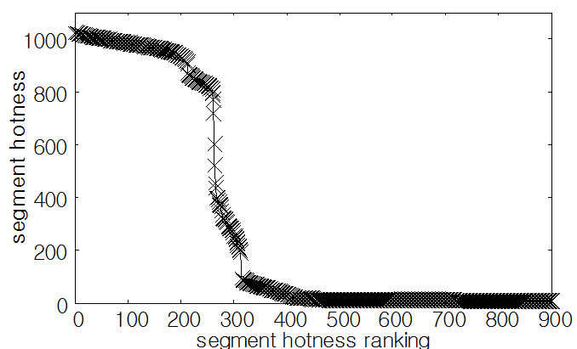
Determining Grouping Criteria : Segment Quantization
The effectiveness of block grouping is determined by the grouping criteria.
Improper criteria may colocate blocks from different groups into the same segment, thus deteriorates the effectiveness of grouping.
Naïve solution does not work.
hot group
hot group
warm group
warm group
cold group
cold
group
read-only
group
read-only group
equi-width partitioning
equi-height partitioning

Slide 17
Iterative Segment Quantization
Find natural hotness groups across segments in disk.
Mean of segment hotness in each group is used as grouping criterion.
Iterative refinement scheme inspired by k-means clustering algorithm
Runtime overhead is reasonable.
32MB segment → only 32 segments for 1GB disk space
For faster convergence, the calculated centers are stored in meta data and loaded at mounting a file system.
Randomly select initial center of groups
Assign each segment to the closest center.
Calculate a new center by averaging hotnesses in a group.
Repeat Step 2 and 3 until convergence has been reached or three times at most.

Slide 18
Process of Segment Writing
Segment Writing
Segment writing is invoked in four case:
every five seconds
flush daemon to reduce dirty pages
segment cleaning
sync or fsync
write request
1. Iterative segment quantization
2. Classify dirty blocks according to hotness
hot
blocks
warm
blocks
cold
blocks
read-only
blocks
Writing of the small groups will be deferred until the size of the group grows to completely fill a segment.
Eventually, the remaining small groups will be written at creating a check-point.
3. Only groups large enough to completely fill a segment are written.

Slide 19
Outline
Background
Design Decisions
Introduction
Segment Writing
Segment Cleaning
Evaluation
Conclusion

Slide 20
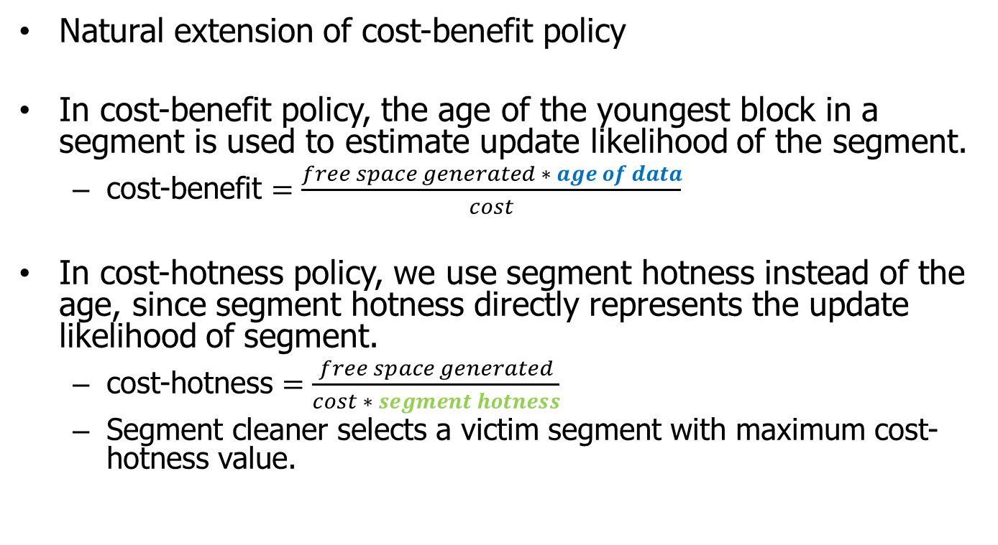
Cost-hotness Policy
Natural extension of cost-benefit policy
In cost-benefit policy, the age of the youngest block in a segment is used to estimate update likelihood of the segment.
cost-benefit $=\frac{free space generated ∗ age of data}{cost}$
In cost-hotness policy, we use segment hotness instead of the age, since segment hotness directly represents the update likelihood of segment.
cost-hotness $=\frac{free space generated}{cost ∗ segment hotness}$
Segment cleaner selects a victim segment with maximum cost-hotness value.

Slide 21
Writing Blocks under Segment Cleaning
Live blocks under segment cleaning are handled similarly to typical writing scenario.
Their writing can also be deferred for continuous re-grouping
Continuous re-grouping to form bimodal segment distribution.

Slide 22
Scenario of Data Loss in System Crash
There are possibility of data loss for the live blocks under segment cleaning in system crash or sudden power off.
dirty pages
1
3
7
8
1
3
7
8
2
4
1
3
7
8
2
4
disk segment
1
2
4
1
2
3
4
1
2
3
4
1
2
4
3
7
8
2
3
4
1. Segment cleaning. Live blocks are read into the page cache.
2. Hot blocks are written.
3. System Crash!!
➔ Block 2, 4 will be lost since they do not have on-disk copy.

Slide 23
How to Prevent Data Loss
Segment Allocation Scheme
Allocate a segment in Least Recently Freed (LRF) order.
Check if writing a normal block could cause data loss of blocks under cleaning.
This guarantees that live blocks under cleaning are never overwritten before they are written elsewhere.
2. If so, write the live blocks under cleaning first regardless of grouping.
dirty pages
1
3
7
8
2
4
1. Check if live blocks under cleaning is originated from S^{t+1}?
`
`
`
`
1
3
7
8
2
4
disk segment
1
2
3
4
1
2
4
2
4
2
3
4
1
2
3
4
1
2
3
4
2
4
1
3
7
8
S^{t}: currently allocated segment
S^{t+1}: segment that will be allocated next time
S^{t}: currently allocated segment
S^{t+1}: segment that will be allocated next time

Slide 24
Outline
Background
Design Decisions
Introduction
Segment Writing
Segment Cleaning
Evaluation
Conclusion

Slide 25
Evaluation
Server
Intel i5 Quad Core, 4GB RAM
Linux Kernel 2.6.37
SSD
Configuration
4 data groups
Segment size: 32MB
 | SSD-H | SSD-M | SSD-L
Interface | SATA | SATA | USB 3.0
Flash Memory | SLC | MLC | MLC
Max. Sequential Writes (MB/s) | 170 | 87 | 38
Random 4KB Writes (MB/s) | 5.3 | 0.6 | 0.002
Price ($/GB) | 14 | 2.3 | 1.4

Slide 26
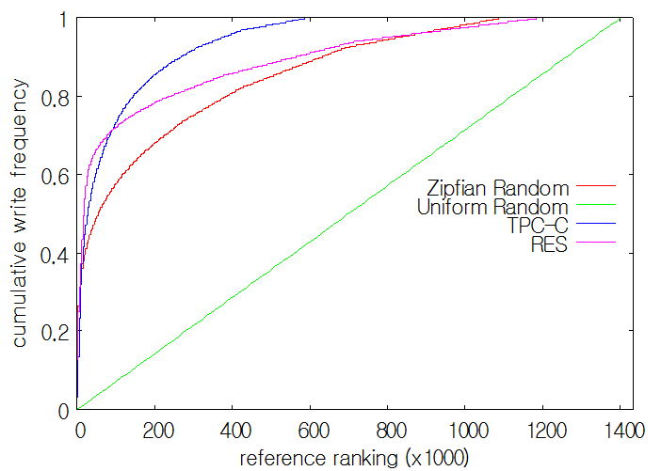
Workload
Synthetic Workload
Zipfian Random Write
Uniform Random Write
No skewness → worst-case scenario of SFS
Real-world Workload
TPC-C benchmark
Research Workload (RES) [Roseli2000]
Collected for 113 days on a system consisting of 13 desktop machines of research group.
Replaying workload
To measure the maximum write performance, we replayed write requests in the workloads as fast as possible in a single thread and measured throughput at the application level.
Native Command Queuing (NCQ) is enabled.

Slide 27
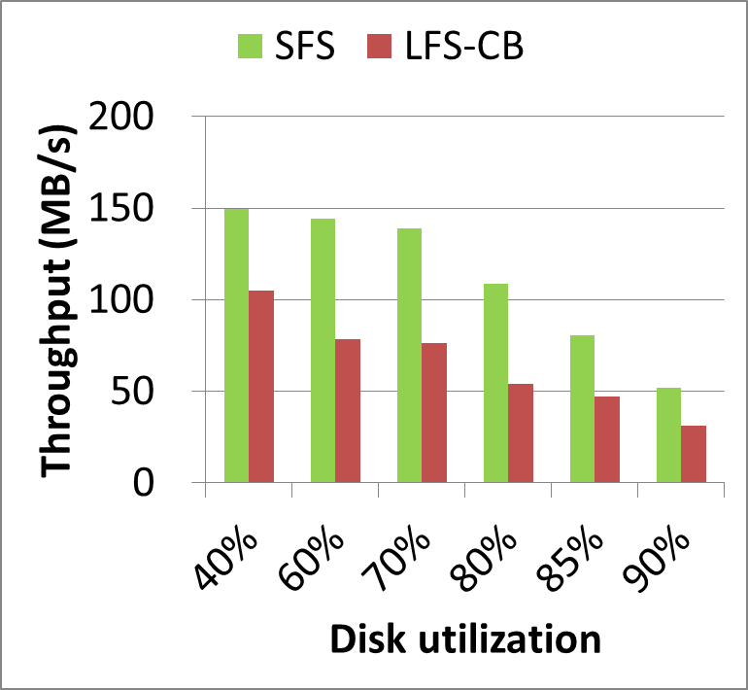
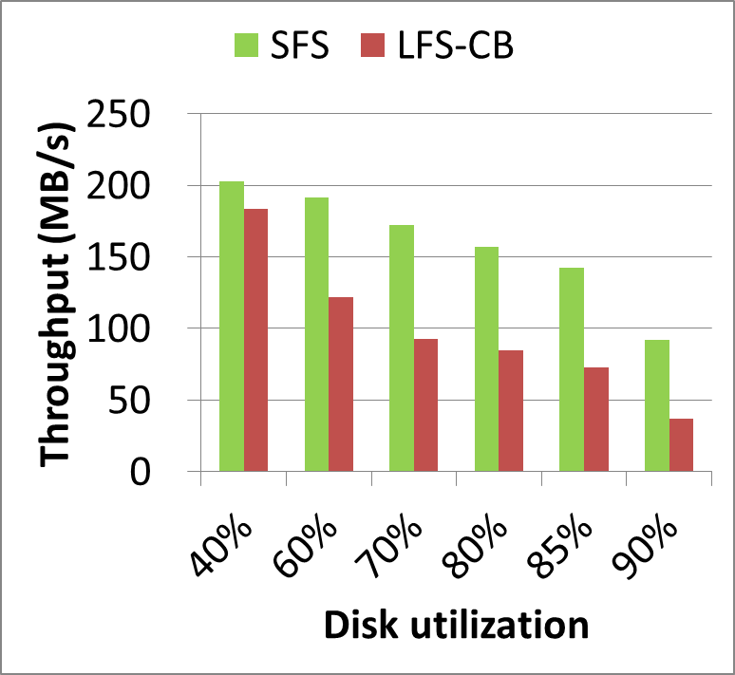
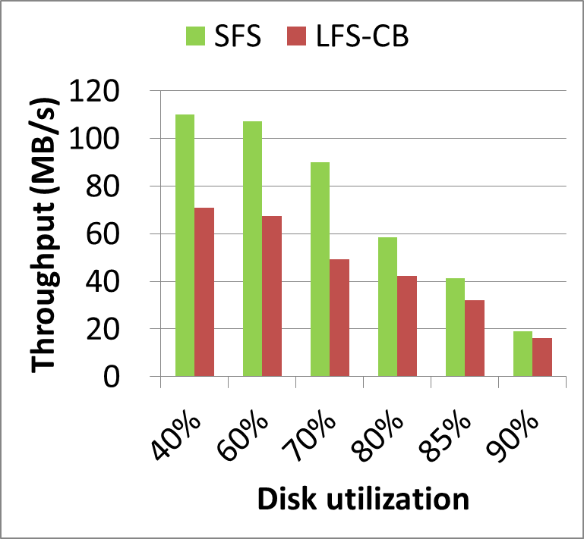
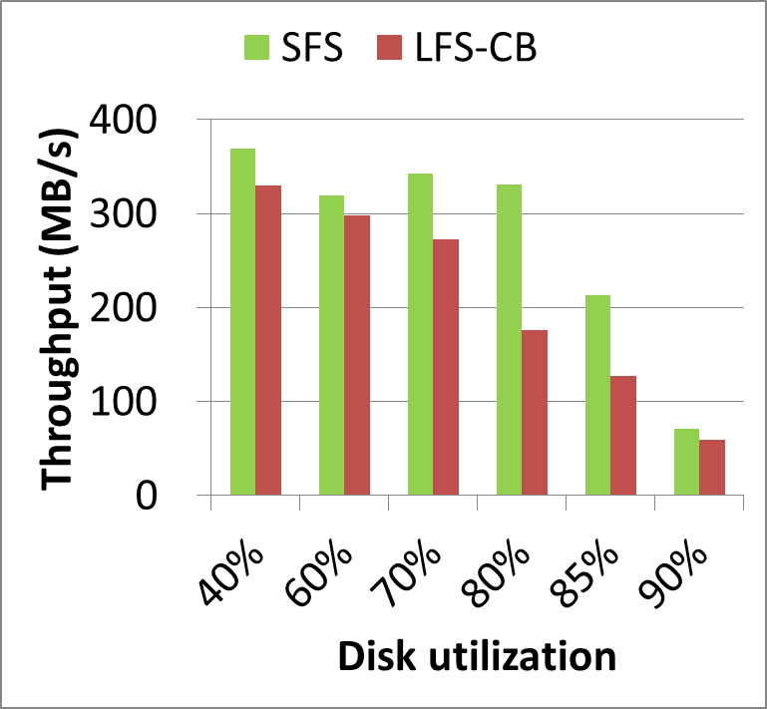
Throughput vs. Disk Utilization
2x
1.9x
1.7x
2.5x
Zipfian Random Write
TPC-C
1.9x
1.4x
1.2x
1.2x
Uniform Random Write
RES
* SSD-M

Slide 28
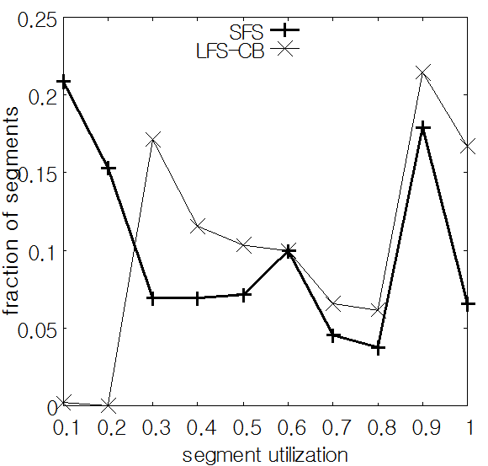
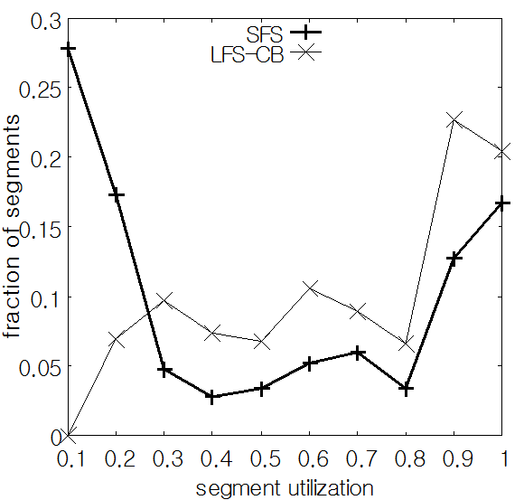
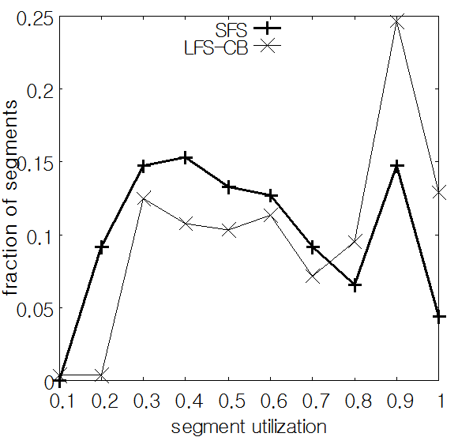
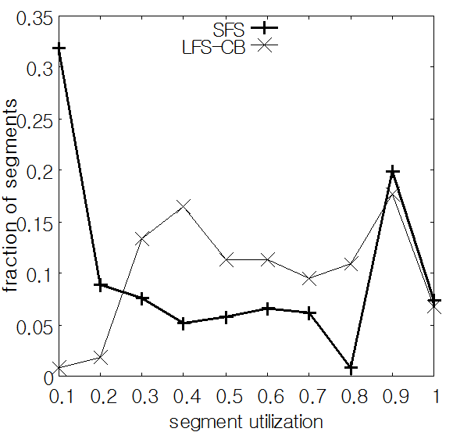
Segment Utilization Distribution
nearly empty
nearly full
Zipfian Random Write
TPC-C
Uniform Random Write
RES
* Disk utilization is 70%.

Slide 29
Comparison with Other File Systems
workload
Ext4
In-place-update file system
Btrfs
No overwrite file system
➔ Measured Throughput
File System
blktrace
Coarse grained hybrid mapping FTL
FAST FTL [Lee’07]
Full page mapping FTL
➔ Measured Write Amplification and Block Erase Count
FTL Simulator

Slide 30
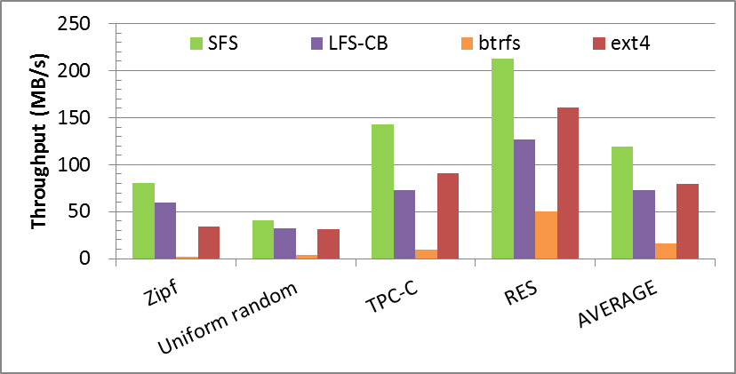
Throughput under Different File Systems
1.3x
1.7x
1.6x
1.5x
1.6x
1.4x
2x
4.2x
2.4x
1.3x
1.3x
14.6x
7.3x
10.6x
48x
* Disk utilization is 85%. / SSD-M

Slide 31
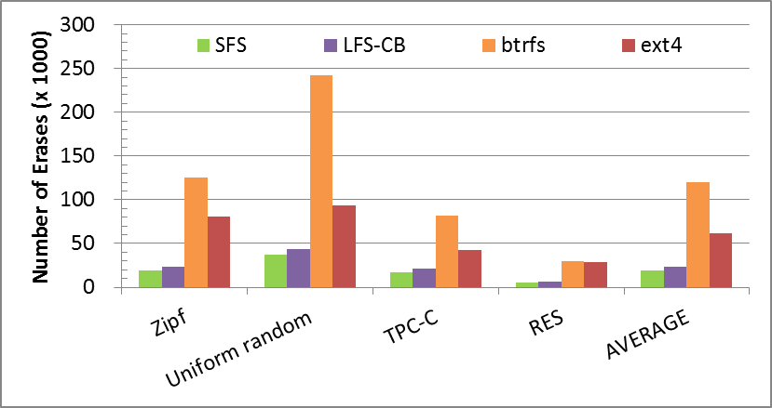
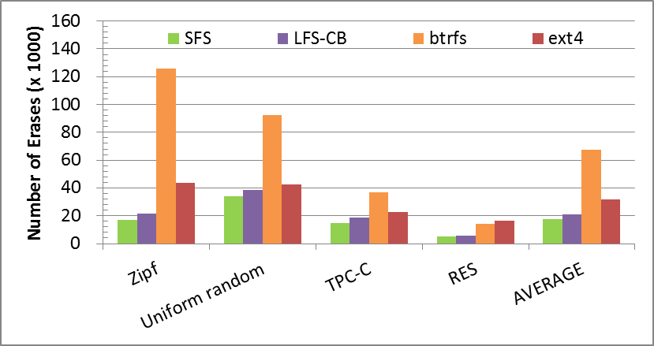
Block Erase Count
6.4x
7.5x
2.7x
6.7x
6.1x
3.8x
4.3x
2.5x
4.9x
2.6x
1.1x
1.3x
2.4x
1.1x
2.6x
3.1x
1.3x
1.2x
1.5x
1.2x
1.8x
2.8x
5.4x
3.3x
1.4x
1.2x
1.2x
5.2x
1.2x
1.2x
Coarse Grained Hybrid Mapping FTL: FAST FTL
Full page mapping FTL
* Disk utilization is 85%.

Slide 32
Outline
Background
Design Decisions
Introduction
Segment Writing
Segment Cleaning
Evaluation
Conclusion

Slide 33
Conclusion
Random write on SSDs causes performance degradation and shortens the lifespan of SSDs.
We present a new file system for SSD, SFS.
Log-structured file system
On writing data grouping
Cost-hotness policy
We show that SFS considerably outperforms existing file systems and prolongs the lifespan of SSD by drastically reducing block erase count inside SSD.
Is SFS also beneficial to HDDs?
Preliminary experiment results are available on our poster!

Slide 34
Thank you! Questions?

