Slide 1
Tiny Little Things for Manycore Scalability : Scalable Locking and Lockless Data Structures
Changwoo Min
multics69@skku.edu
https://sites.google.com/site/multics69/
Sungkyunkwan University, Korea
August 19, 2014

Slide 2
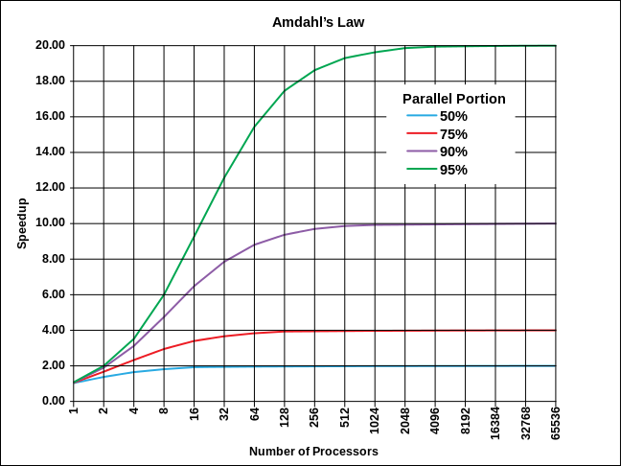
What does hurt manycore scalability?
Sequential Parts of a Parallel Program!!!
Amdahl’s Law: S = 1 / (1 – p + p/n)
90% parallelizable software
10 processors: 5.3x speedup
20 processors: 6.9x speedup
40 processors: 8.2x speedup

Slide 3


Where are sequential parts?
Anywhere!!!
Applications
Memory allocator
- Buddy structure
OS Kernel
- VMA (virtual memory area)
- File descriptor table
- Dentry cache
Libraries (libc, malloc, …)
OS Kernel (VM, FS, …)

Slide 4
Why are they sequential?
Algorithm is sequential in nature.
Accessing and manipulating shared data structures.

Slide 5
How to safely access shared data structures
Coarse-grained lock

Slide 6
How to safely access shared data structures
Coarse-grained lock
Fine-grained lock

Slide 7
How to safely access shared data structures
Coarse-grained lock
Fine-grained lock
Scalable fine-grained lock

Slide 8
How to safely access shared data structures
Coarse-grained lock
Fine-grained lock
Scalable fine-grained lock
Lockless data structures

Slide 9
Outline
Background
More Background
Scalable Locking Techniques
Lockless Data Structures
Conclusion

Slide 10
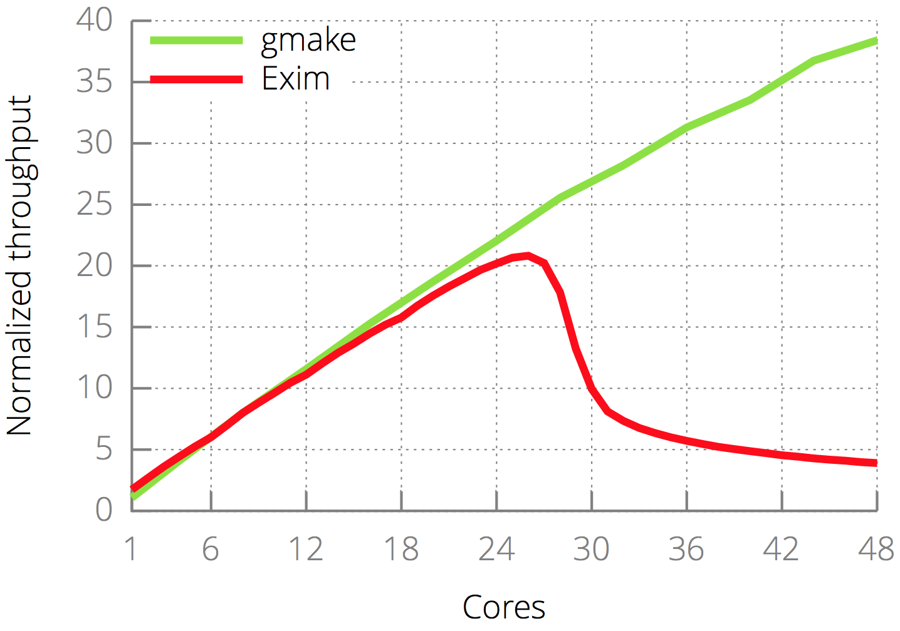
Does this really matter?
One contended
cache line
Not performance saturation but performance collapse

Slide 11
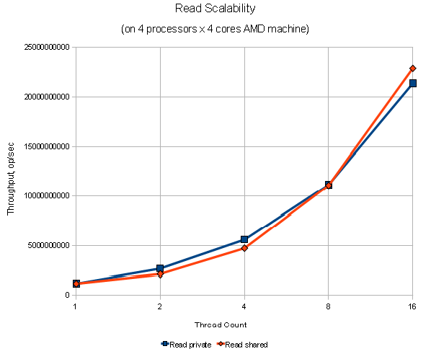
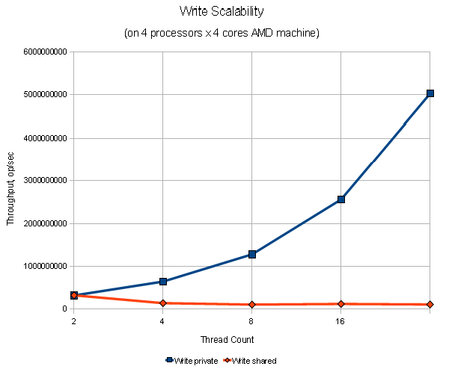


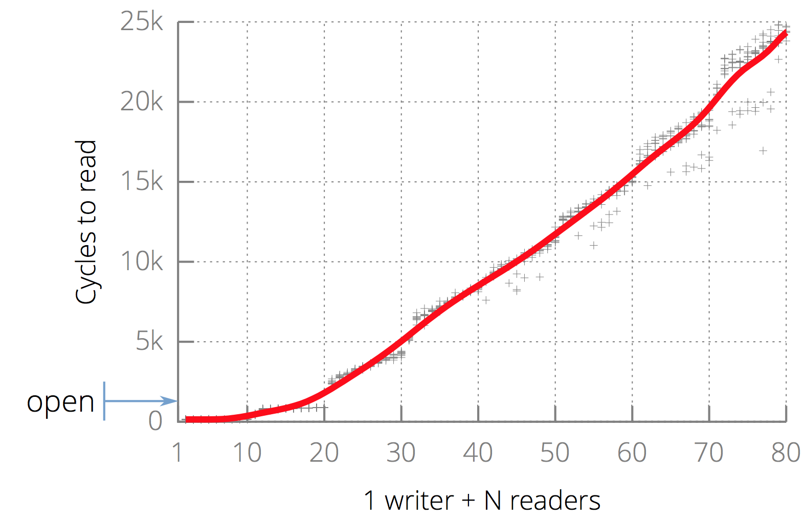
Memory Access is NOT Scalable.
1. Read operations are scalable.
2. Write operations are NOT scalable.
Read private
Read shared
Write private
Write shared
3. Write operations interfere read operations.
A single contended cache line can cause contention meltdown!!!

Slide 12
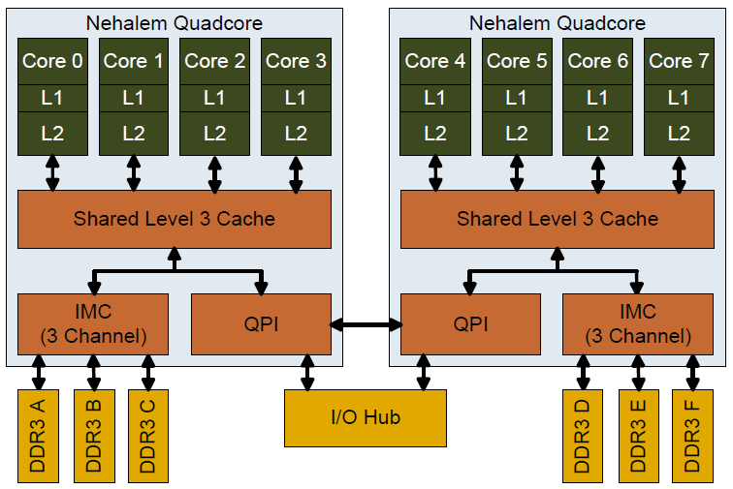
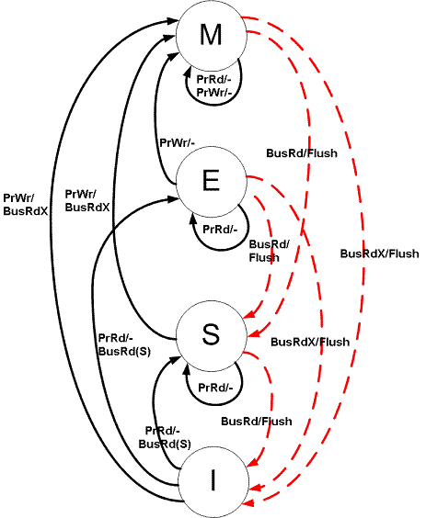
Why this happens?
Cache coherent traffic dominates!!!
Writing a cache line in a popular MESI protocol:
Writer’s cache: Shared → Exclusive
All readers’ cache line: Shared → Invalidate
Minimize core-to-core communication by minimizing contended cache lines!!!

Slide 13
Outline
Background
More Background
Scalable Locking Techniques
Ticket Lock, MCS Queue Lock, …
Lockless Data Structures
Conclusion

Slide 14
Efficient and Scalable Spinlock Algorithms

Slide 15
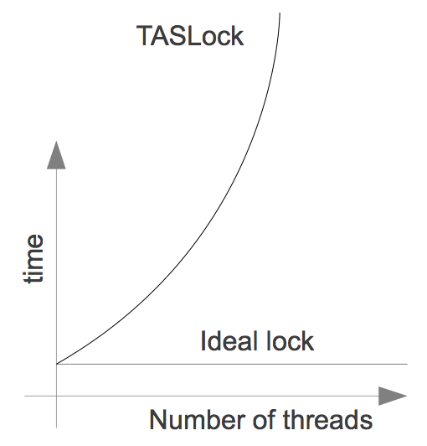
Test-And-Set Lock
bool locked = false;
void lock() {
while( !T&S(locked) );
}
void unlock() {
locked = false;
}
T&S(*addr) {
old = *addr;
*addr = 1;
return (old == 0);
}
Performance is far from ideal.
Each T&S call invalidates cached copy of locked for all threads.
High contention of interconnect

Slide 16
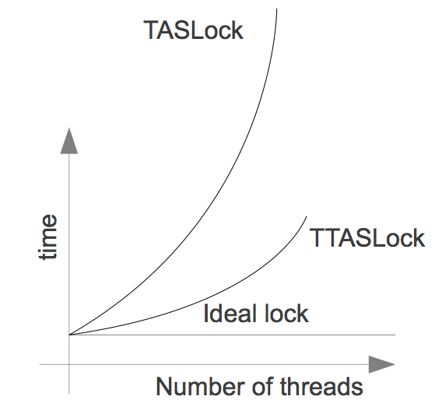
Test-and-Test-And-Set Lock
bool locked = false;
void lock() {
while(true) {
while(locked);
if( T&S(locked) ) return;
}
}
void unlock() {
locked = false;
}
T&S(*addr) {
old = *addr;
*addr = 1;
return (old == 0);
}
Only perform T&S only if there is a chance of success.
Cache invalidated less often.
Still contention with more threads.

Slide 17
Backoff Scheme
bool locked = false;
void lock() {
while(true) {
while(locked);
if( T&S(locked) ) return;
sleep for a while.
}
}
void unlock() {
locked = false;
}
T&S(*addr) {
old = *addr;
*addr = 1;
return (old == 0);
}
On failure to acquire lock:
Backoff for a random amount of time.
Reduces contention
On high contention threads try less often.
Randomization makes sure threads wake up at different times.
Thread might wait longer than necessary!!!

Slide 18

Ticket Lock
F&I(*addr) {
old = *addr;
*addr++;
return old;
}
int now_serving = 0;
int next_ticket = 0;
void lock() {
my_ticket = F&I(next_ticket);
while(my_ticket! = now_serving);
}
void unlock() {
now_serving++;
}
now_serving
next_ticket
Guaranteed FIFO order (fairness)
Traffic can be quite low
Only one process issues “invalidation”
Traffic is not guaranteed to be O(1) per lock acquire
When now_serving is updated, all competing processors get read-misses
All competing processors need to read now_serving from the memory

Slide 19
MCS Lock
Node *tail = NULL;
thread_local Node *node = new Node();
void lock() {
old_tail = SWAP(tail, node);
if (old_tail != NULL) {
node->locked = true;
old_tail->next = node;
while (node->locked) ;
}
}
SWAP(*addr, new) {
old = *addr;
*addr = new;
return old;
}
tail
next
next
next
locked
true
true
Locks are in a linked list.
Each CPU enqueues its own private lock variable into a queue and spins on it.
No contention

Slide 20
MCS Lock (cont’d)
void unlock() {
if (node->next == NULL) {
if ( CAS(tail, node, NULL) )
return;
while (node->next == NULL) ;
}
node->next->locked = false;
node->next = NULL;
}
CAS(*addr, old, new) {
if (*addr != old)
return false;
*addr = new;
return true;
}
tail
next
next
next
locked
true
false
true
On lock release, the releaser unlocks the next lock in the queue.
Only have a cache line invalidation on actual unlock.
No starvation (order of lock acquisitions defined by list)
If no successor exists, reset tail.

Slide 21
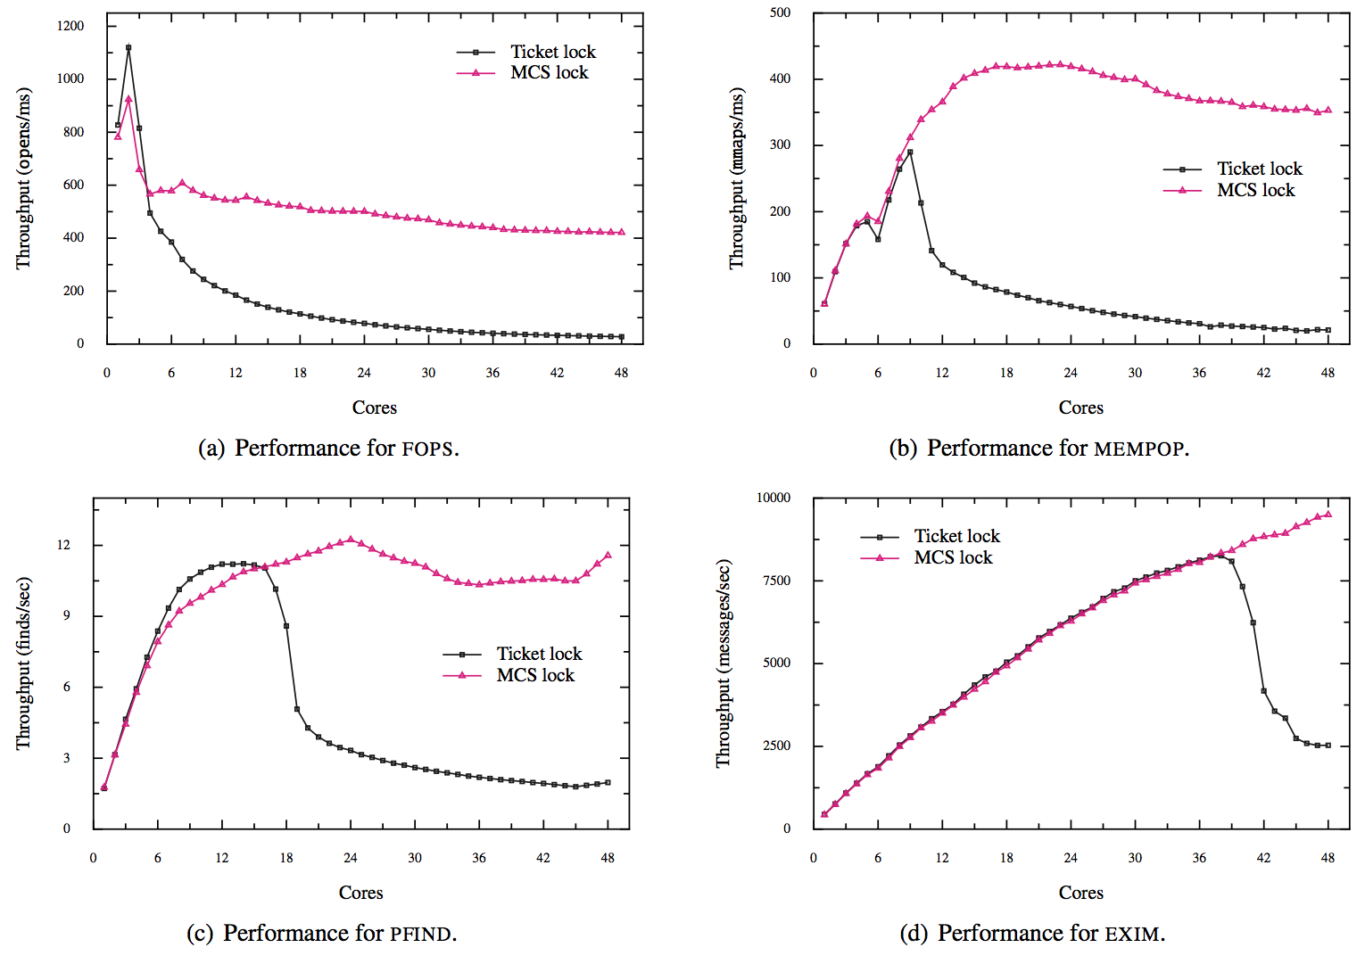
Performance Comparison between Ticket Locks and MCS Locks

Slide 22
Spinlock in Linux Kernel
Test-and-
Test-And-Set lock
“On an 8 core (2 socket) Opteron, spinlock unfairness is extremely noticeable, with a userspace test having a difference of up to 2x runtime per thread, and some threads are starved or "unfairly" granted the lock up to 1,000,000 (!) times. “
2.6.25 (April 2008)
Ticket lock
“I understand that in the past, such proposals have been defeated by two main arguments:
That it is generally preferable to use smart algorithms that can avoid lock contention altogether, rather than spending effort on the lock itself to deal with the contention, and
That the lightly contended case matters more to real workloads than the highly contended case, and that the most well known scalable spinlock algorithms tend to be relatively slow in the lightly contended case.
I am hoping for a different result this time around based on the following counter-arguments:
There are situations where the lock contention is directly driven by user events, with little opportunity to reduce it in-kernel. One example might be when the user requests that the kernel acquires or releases semaphores on its behalf using sysv IPC APIs - it is hard to imagine how the kernel could mitigate spinlock contention issues for the user.
More importantly, the queue spinlock implementation I am proposing seems to behave well both under light and heavy contention. It uses one single atomic operation on the lock side, and (on x86) only a single memory store on the unlock side, with fairly short code sections on both sides, and just compares well with the ticket spinlock on the benchmarks I have tried. “
3.15 (July 2014)
qspinlock, variant of MCS lock

Slide 23
Outline
Background
More Background
Scalable Locking Techniques
Lockless Data Structures
RCU (Ready-Copy-Update), LECD Queue
Conclusion

Slide 24
Concurrent Data Structures
Read-mostly data structures ➔ RCU (Read-Copy-Update)
Update-mostly data structures ➔ LECD Queue

Slide 25
Read-Copy-Update (RCU) : A Case for Read-Mostly Concurrent Data Structures
Notes:
Hello everyone.
I am Changwoo Min from Sungkyunkwan University in Korea.
I am very honored to present our work on, “Can lock-free and combining techniques co-exist? A novel approach on concurrent queue”.
This talk is about a practical and scalable concurrent FIFO queue algorithm.

Slide 26

Lock-based List fails…
Even using a scalable read-write lock, readers and a writer cannot co-exist in the list.
Reader
Reader
Reader
Writer
1
2
3
4
5
Waiting
Locked list
Reader
Writer
Reader
1
2
3
100
5
Waiting
Locked list

Slide 27
Read-Copy-Update (RCU)
RCU supports concurrency between a single updater and multiple readers.
Optimize for reader performance.
RCU ensures that reads are coherent by maintaining multiple version of objects and ensuring that they are not freed up until all pre-existing read-side critical sections complete.
Reader
Reader
Reader
1
2
3
4
5
Writer
4
100

Slide 28
A Read-Copy-Update Primer
Lock-free reads + Single pointer update + Delayed free
1
2
3
head
length() {
rcu_read_lock(); {
p = head;
for(i=0;p;p=p->next,i++) ;
} rcu_read_unlock();
return i;
}
pop_n(n) {
for(p=head;p&&n;p=p->next,n--)
call_rcu(free, p);
head = p;
}
No locks, no barriers
rcu_read_lock() just sets the status of a thread “reading” RCU data.
Update exactly one pointer, which is atomic.
Free delayed until all readers return (e.g., by waiting for all CPU’s to schedule)

Slide 29
When is it safe to run delayed free?
Time
Reader
Reader
Reader
Removal
Reclamation
Change
Grace Period
Change Visible
to All Readers
Threads
call_rcu(free,p1)
call_rcu(free,p2)
free(p1)
free(p2)
Quiescent State
Efficient and scalable grace period detection is a key challenge.
→ Some obvious solutions, such as reference counting, never work.

Slide 30
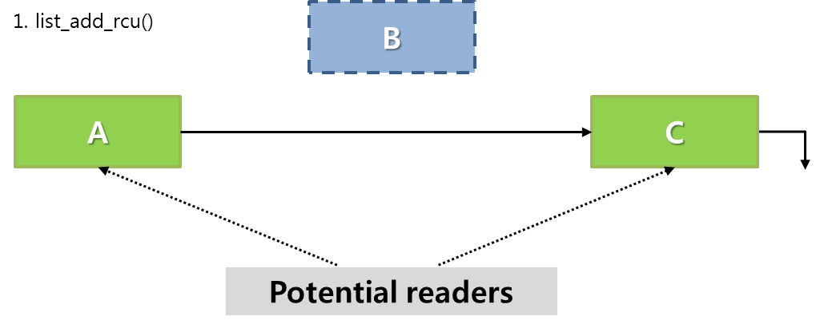
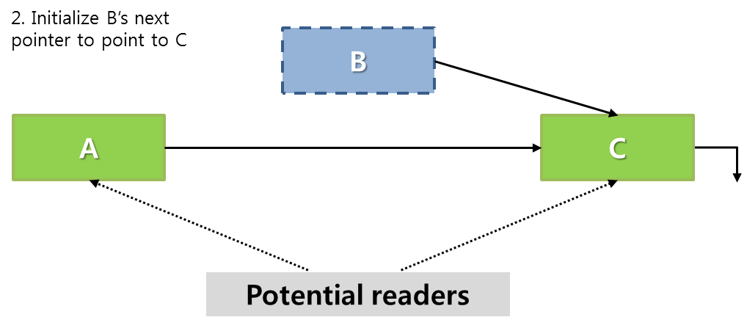
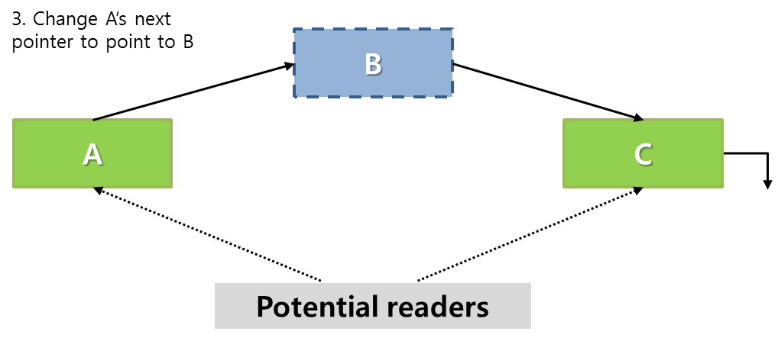
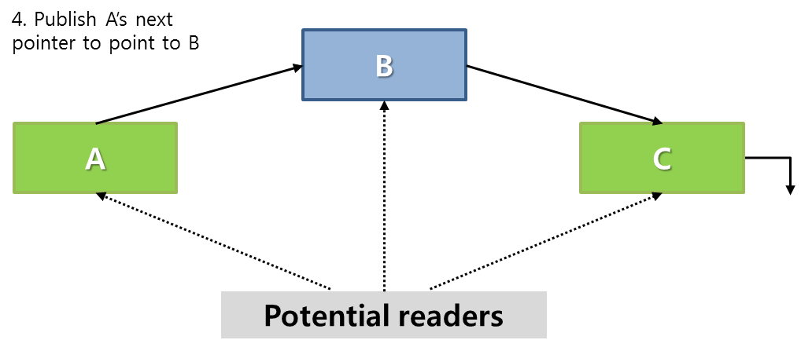
Example: RCU Linked List
list_add_rcu()

Slide 31
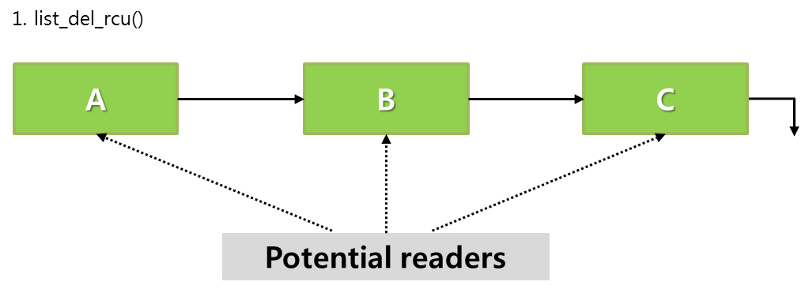
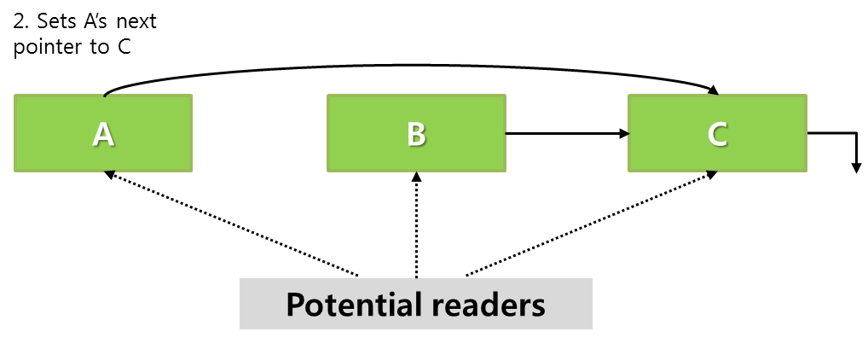
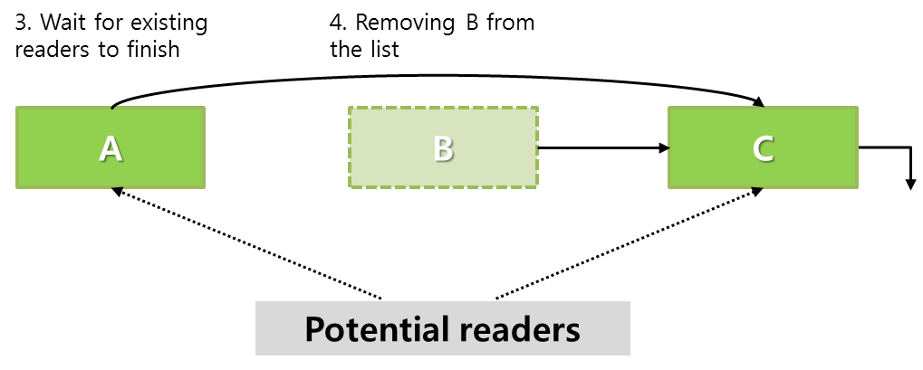
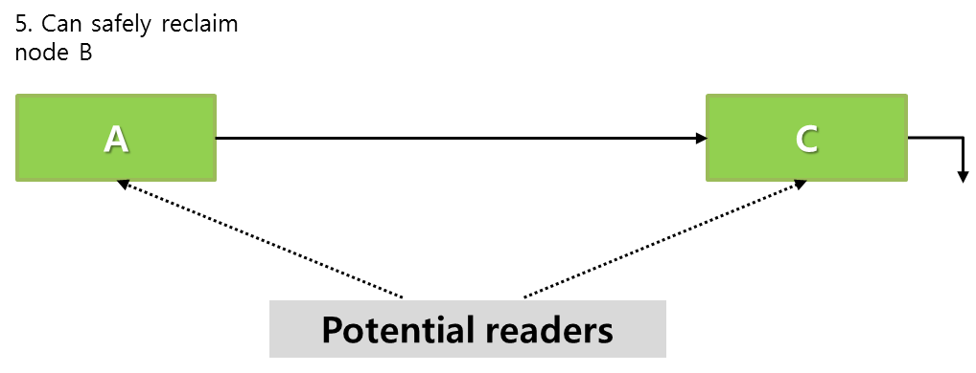
Example: RCU Linked List (cont’d)
list_del_rcu()

Slide 32
More Examples
Hash table
Red-Black tree
…
How to redesign data structures based on RCU constraints:
Lock-free read + Single pointer update + Delayed free

Slide 33
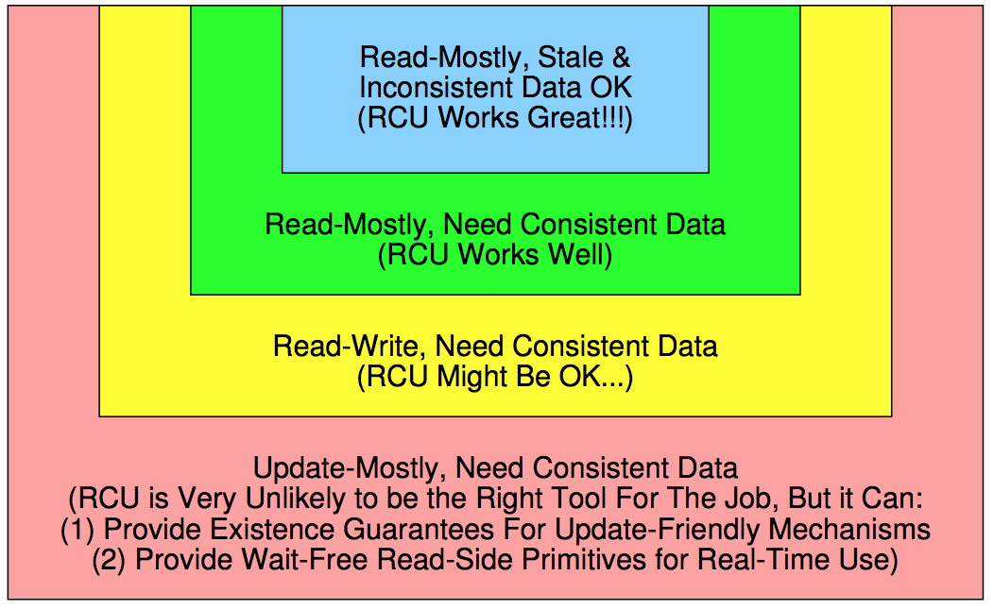
RCU Areas of Applicability

Slide 34
LECD Queue : A Case for Update-Mostly Concurrent Data Structures
Notes:
Hello everyone.
I am Changwoo Min from Sungkyunkwan University in Korea.
I am very honored to present our work on, “Can lock-free and combining techniques co-exist? A novel approach on concurrent queue”.
This talk is about a practical and scalable concurrent FIFO queue algorithm.

Slide 35
Concurrent FIFO Queue Algorithm
dequeue
H = Head
Head = H→next
return H→next
enqueue
T = Tail
T→next = new
Tail = new
Head
Head
Tail
Tail
next
next
next
next
Update three control variables
: Head, Tail, Tail→next
Notes:
Queue algorithms support <CLICK> enqueue operation and dequeue operation.
Eventually, the two operations update three control variables, Head, Tail and Tail’s next.

Slide 36
Concurrent FIFO Queue Algorithm
Head
Head
Tail
Tail
next
next
next
next
next
next
Update three shared control variables concurrently
: Head, Tail, Tail→next
Scalable Concurrent Queue
: How to avoid the contended hot spots?
Essential Building Block of Libraries and Runtimes
: e.g., Java Concurrency Package, Boost C++ Library
Notes:
Essentially, concurrent queue algorithm is a method to concurrently update the three shared variables while preserving FIFO queue semantics.
<CLICK> Scalability can be achieved by preventing the three control variables from being contended hot spots.
<CLICK> Since concurrent queues are one of the most widely used concurrent data structure and essential building block of libraries and runtimes such as java concurrency package and Boost C++ library, they should be scalable and practical.

Slide 37
Research Efforts for 25+ Years
Lock-Free Approaches
Combining Approaches
R.K. Treiber
: IBM Almaden TR
1986
Yew et al.
: Software Combining Tree
1987
1988
Mellor-Crummey
: Fetch-and-Φ Algorithms
1899
Key Intuition
Higher Degree of Parallelism
→ Higher Scalability
Use hardware atomic instructions, such as compare-and-swap (CAS), to maximize the degree of parallelism.
1990
Key Intuition
Higher Degree of Parallelism
→ Higher Synchronization Cost
→ Lower Scalability
→ Batch processing by a thread
One designated thread, or a combiner, performs batch processing of requests from other concurrent threads.
1991
1992
1993
1994
Michael and Scott
: MS Queue
1995
1996
1997
1998
Oyama et al.
: Combining Stack
1999
2000
Ladan-Mozes and Shavit
: Optimistic Queue
2001
Shalev and Shavit
: Predictive log-synchronization
2002
2003
Moir et al.
: Elimination Backoff Queue
2004
2005
Hendler et al.
: FC Queue (Flat Combining)
2006
2007
Hoffman et al.
: Baskets Queue
2008
Fatourou and Kallimanis
: P-Sim
2009
2010
Morrison and Afek
: LCRQ, LCRQ+H
2011
Fatourou and Kallimanis
: H Queue (H Sync)
2012
2013
Notes:
In order to find out efficient way to concurrently update the three shared variables, our community has devoted more than a quarter of century.
Previous studies on concurrent queues can be largely classified into lock-free approaches and combining approaches.
These two approaches started from quite opposite intuition and thus have quite opposite pros and cons.
Among lock-free queues, <CLICK> Michael-Scott queue is most widely used in practice.
<CLICK> The most recent literature is LCRQ which is proposed this year and which relies on Intel x86 dependent atomic instructions.
Among combining approaches, <CLICK> FC queue, which is based on flat combining, and <CLICK> H Queue, which is based on H Sync, are representative.
<CLICK> The key intuition of lock-free approach is to maximize parallel execution to improve scalability.
To maximize parallel execution without using locks, they rely on hardware atomic instructions, such as compare-and-swap or CAS.
<CLICK> In contrast, combining approaches take opposite direction.
The high synchronization cost under high degree of parallelism could result in lower scalability.
Therefore, in combining approaches, one designated thread, or a combiner, performs batch processing of requests from other concurrent threads.
Let’s take look into each approach a little bit detail.

Slide 38
Lock-Free Approaches : MS Queue [Michael and Scott, PODC’96]
dequeue
enqueue
H = Head
N = H→next
Head = H→next
CAS(Head, H, N)
return N
Head
Tail
T = Tail
N = T→next
CAS(T→next, N, new)
CAS(Tail, T, new)
next
next
next
Update the shared variables by using CAS atomic instruction.
In the CAS, only one thread will succeed and all the others will fail and retry until they succeed.
Since the failing threads use not only computational resources but also the memory bus, they also slow down the succeeding thread.
Exponential Backoff Scheme
Spreads out CAS retries over time.
Needs manual tuning of the backoff parameters for a particular workload and machine combination. ➔ Neither Java Concurrency Package nor Bootst C++ Library supports this.
Research focus has been on how to reduce CAS retries per operation.
[Ladan-Mozes+,DISC’04], [Moir+,SPAA’05], [Hoffman+, OPODIS’09], [Morrison+, PPoPP’13]
Notes:
Michael-Scott queue or MS queue updates the shared variables by using CAS atomic instruction.
<CLICK> However, in the CAS operations, only one thread will succeed and all the others will fail and retry until they succeed.
Since the failing threads use not only computational resources but also the memory bus, which is a shared resource in cache-coherent multiprocessors, they also slow down the succeeding thread.
<CLICK> To mitigate such negative impact of the useless parallelism, exponential backoff scheme is most widely used.
It spreads out CAS retries over time.
However, it requires manual tuning of the backoff parameters for a particular workload and machine combination.
Due to the difficulty of such manual parameter tuning, neither Java concurrency package nor Boost C++ library supports the exponential backoff scheme.
<CLICK> After the MS queue, research focus has been on how to reduce CAS retries per operation.

Slide 39
Combining Approaches
Concurrent Threads
Sequential Data Structure
: e.g., Queue
Batch processing of requests for pending threads and itself.
Waiting for the completion of the requested operation by the combiner
Head
Tail
Combiner
next
next
next
next
next
A combining technique is essentially a universal construction, which is used to construct a concurrent data structure from a sequential implementation.
In most research, combining-based queues are constructed from the two-lock queue presented by [Michael and Scott, PODC’96].
The combining techniques could outperform lock-free techniques when the synchronization cost overshadows the benefits of parallel execution.
However, they completely lose opportunities to exploit the advantages of parallel execution.
Research focus has been on how to minimize the overhead of manipulating requests.
[Shalev+, EuroSys’06], [Hendler+, SPAA’10] , [Fatourou+, SPAA’11], [Fatourou+, PPoPP’12]
Notes:
<CLICK> A combining technique is essentially a universal construction, which is used to construct a concurrent data structure from a sequential implementation.
In most research, combining-based queues are constructed from the two-lock queue presented by Michael and Scott.
<CLICK> Among concurrent threads which are accessing a sequential data structure, for example queue,
<CLICK> one thread is designated as a combiner and the others wait for the completion of the requested operation by the combiner in the form of spinning.
<CLICK> The combiner performs batch processing of the requests for pending threads and itself.
<CLICK> The combining techniques could outperform lock-free techniques when the synchronization cost overshadows the benefits of parallel execution.
However, they completely lose opportunities to exploit the advantages of parallel execution.
<CLICK> Research focus on this approach has been on how to minimize the overhead of manipulating requests.

Slide 40
Summary
Lock-Free Approaches
1986
Combining Approaches
1987
1988
Pros: Taking Advantage of Parallel Execution
Cons: Manual Parameter Tuning to Avoid Contended Hot Spots
1899
Pros: Low Synchronization Cost of Single Threaded Execution
Cons: Losing Opportunities to Exploit the Advantages of Parallel Execution
1990
1991
1992
1993
1994
1995
1996
1997
1998
1999
2000
2001
2002
2003
2004
Lock-free Enqueue and Combining Dequeue (LECD) Queue Algorithm
2005
2006
2007
2008
2009
2010
2011
2012
2013
Notes:
In summary,
<CLICK> While the lock-free approaches can take advantage of parallel execution, they suffer from manual parameter tuning for particular workload and machine combination to avoid contended hot spots.
<CLICK> In contrast, while the combining approaches can reduce synchronization cost by single threaded execution of a combiner, they completely lose opportunities to exploit the advantages of parallel execution.
<CLICK> Our approach is to synergistically use both of lock-free and combining techniques in designing a concurrent queue.
We propose LECD queue, which stands for lock-free enqueue and combining dequeue.
In our LECD queue, enqueue operations are performed in a lock-free manner and dequeue operations are performed in a combining manner.

Slide 41
LECD Queue
Background & Motivation
LECD Queue
Evaluation
Summary
Notes:
I will explain LECD queue in detail.

Slide 42
Enqueue Operation
Head
Tail
Tail
Tail
Tail
Permanent Dummy
New Node
New Node
New Node
next
next
next
next
next
next
new→next = null;
old_tail = SWAP(&Tail, new);
old_tail→next = new;
Update Tail by using SWAP atomic instruction
Unlike CAS, SWAP always succeeds.
No retry → No exponential backoff scheme is needed.
No parameter tuning is needed.
SWAP is supported in most architectures, including Intel x86, ARM, and Sparc.
Except for the SWAP, concurrent threads are independent.
Enjoy the advantages of parallel execution!
Notes:
Enqueue operation in LECD queue is performed in a lock-free manner by using SWAP atomic instruction.
<CLICK> We first set the next of a new node to NULL,
<CLICK> and then update Tail to the new node by using the SWAP atomic instruction.
As a result of the SWAP atomic instruction, we can atomically read the old tail.
<CLICK> finally, we update old tail’s next to the new node.
Since SWAP atomic instcution always succeeds unlike CAS, the retry loop or contention management such as backoff schemes are not needed.
Therefore, manual parameter tuning is not needed.
Moreover, SWAP is also supported in most hardware architectures, including Intel x86, ARM and SPARC, so our algorithm can work on various hardware architectures.
Finally, except for the SWAP, since concurrent threads are independent <CLICK>, we can enjoy the advantages of parallel execution.

Slide 43
Dequeue Operation
Head
Tail
Permanent Dummy
next
next
next
next
next
ReqTail
Request
List
A last request in the list is a dummy request.
The initial dummy request is set to COMBINE.
result
rnext
status
COMBINE
A dequeuing thread first appends a new dummy request in WAIT.
Depending on the status of the previous request, the dequeuing thread takes different role.
case COMBINE: takes the role of the combiner
case WAIT: waits for the completion of dequeue until the status is changed to DONE.
At the end of combining operation, the status of the last dummy request is set to COMBINE for a subsequent dequeuer to take the role of the combiner.
Notes:
As I said earlier, combining techniques are used in our dequeue operation.
To manage dequeue request from concurrent threads, we manages a request list.
<CLICK> A last request in the list is a dummy request and initial dummy request is set to COMBINE.
<CLICK> A dequeuing thread first appends a new dummy request in WAIT and then
<CLICK> depending on the status of the previous request, it takes different role.
If the status is in COMBINE, it takes the role of the combiner and performs a batch operation for the pending requests.
If the status is in WAIT, it waits for the completion of dequeue by the combiner until the status is changed to DONE.
<CLICK> At the end of combining operation, the status of the last dummy request is set to COMBINE for a subsequent dequeuer to take the role of the combiner.
From now on, I will explain how to efficiently add a request in the list and how the combiner works.

Slide 44
Appending a New Dummy Request
Head
Tail
Permanent Dummy
next
next
next
next
next
ReqTail
ReqTail
ReqTail
Request
List
result
result
rq→rnext = null;
prv_rq = SWAP(&ReqTail, rq);
prv_rq→rnext = rq;
result
result
result
rnext
rnext
rnext
rnext
rnext
Status
COMBINE
status
WAIT
status
COMBINE
status
WAIT
status
WAIT
Thread 1
Thread 2
Use the same technique used in the enqueue operation.
SWAP, no failure, no retry, no backoff scheme → no parameter tuning
Notes:
To append a new dummy request, we use the same technique used in the enqueue operation.
We manage RequestTail which points to the end of a request list.
The RequestTail is updated by using SWAP atomic instruction as we did in the enqueue operation.
<CLICK> We first set the next of a new request to NULL,
<CLICK> and then update RequestTail to the new request by using the SWAP atomic instruction.
As a result of SWAP atomic instruction, we can atomically read the previous tail request.
<CLICK> Finally, we update previous tail’s next to the new request.
Therefore, this process also have the same advantages with the enqueue operation.
No backoff parameter tuning is needed.
<CLICK> As I said earlier, after appending a new dummy request, a thread behaves differently depending on the status of the previous request.

Slide 45
Combining Dequeue Operations
Head
Tail
Permanent Dummy
next
next
next
next
next
next
ReqTail
Request
List
result
result
result
result
rnext
rnext
rnext
rnext
status
WAIT
status
DONE
status
COMBINE
status
COMBINE
status
WAIT
status
WAIT
status
DONE
status
DONE
A combiner thread processes pending requests and changes the status to DONE.
After processing the requests, if the queue does not become empty, update Head’s next to the next of the last dequeued node.
Change the status of the last dummy request to COMBINE for a subsequent dequeuer to take the role of the combiner.
Notes:
If a thread takes the role of combiner, the combiner thread process pending requests <CLICK> and changes the status to DONE for the waiting threads to proceed.
After processing the requests, if the queue does not become empty, <CLICK> the combiner updates Head’s next to the next of the last dequeued node. <CLICK>
Before finishing the combining operation, the combiner change the status of the last dummy request to COMBINE <CLICK> for a subsequent dequeuer to take the role of the combiner. <CLICK-AND-WAIT>

Slide 46
NUMA-Aware Optimization
Head
Tail
next
next
next
next
next
Request List
for Cluster 0
Request List
for Cluster 1
ReqTail
ReqTail
result
result
result
result
result
result
rnext
rnext
rnext
rnext
rnext
rnext
status
COMBINE
status
WAIT
status
WAIT
status
COMBINE
status
WAIT
status
WAIT
NUMA
Architecture
NUMA Cluster 0
NUMA Cluster 1
CORE 0
CORE 1
CORE 0
CORE 1
Local $
Local $
Local $
Local $
Shared $
Shared $
Local DRAM
Local DRAM
Shared Bus - Interconnect
In NUMA architectures, remote memory accesses take longer than local memory accesses.
Typically, around 1.7x in Intel x86
Per-Cluster Request Lists
Concurrent combiners from different clusters are coordinated by a global combining lock.
No cross-cluster traffic while accessing request list.
Notes:
In Non-Uniform Memory Access or NUMA architectures, <CLICK> remote memory accesses take longer than local memory accesses.
In typical Intel x86 systems, remote memory accesses take about 1.7x longer than local memory accesses.
To exploit such performance characteristics of NUMA architectures, we manages request list for each NUMA cluster.
Since each request list for each NUMA cluster can have an active combiner, concurrent combiners from different clusters are coordinated by a global combining lock <CLICK>.
Though our NUMA-aware optimization has additional locking overhead, no cross-cluster traffic is generated while accessing per-cluster request lists.
Due to the reduced cross-cluster traffic, we can expect additional performance improvement.

Slide 47
Summary
Lock-Free Enqueue
Using SWAP atomic instruction
Maximize the advantages of parallel execution
No failure → No retry → No parameter tuning
Combining Dequeue
SWAP is also used to add a request in the list.
Per-cluster combining to reduce costly cross-cluster traffic in NUMA architectures
Synergistic Interactions between Enqueue and Dequeue
Concurrent enqueue
A thread will mostly spend its time to dequeue.
Higher degree of combining for dequeue operations
Dequeue combining operations become more efficient.
Notes:
In summary, our enqueue operation is based on SWAP atomic instruction to maximize the advantages of parallel execution.
Since SWAP always succeeds unlike CAS, there is nether backoff schemes nor backoff parameter tuning.
In our dequeue operation, we first add a new dummy request by using SWAP as we did in enqueue operation.
In NUMA architecture, combining operations are per-cluster to reduce costly cross-cluster traffic.
Interestingly, there are synergistic interactions between enqueue and dequeue operations.
Since lock-free concurrent enqueue operations execute in parallel, threads can spend the most time executing dequeue operations.
Thus, this contributes to increasing the degree of parallelism.
Also, the higher degree of combining makes the combining operation more efficient.
Our experimental results show how the enqueue and dequeue operations interact.

Slide 48
Evaluation
Background & Motivation
LECD Queue
Evaluation
Summary
Notes:
Let’s move on to the evaluation.

Slide 49
Evaluated Algorithms
Lock-Free Queues
MS Queue [Michael and Scott, PODC’96]
Exponential backoff scheme
Combining-Based Queue
H Queue [Fatourou and Kallimanis, PPoPP’12]
Constructed from the two-lock queue by replacing the locks to H-Synch combining constructs.
Notes:
We compare LECD queue with best performing queues reported in the recent literature.
For lock-free queues, we first evaluated Michael-Scott queue which is most widely used.
And we also evaluated LCRQ and LCRQ+H proposed this year.
LCRQ is a Intel x86 dependent queue which relies on fetach-and-add and CAS2 atomic instructions.
LCRQ+H is a NUMA-aware optimized version of LCRQ which requires manual parameter tuning for a particular workload and machine combination.
In LCRQ+H, if a thread is running on different cluster to the currently scheduled cluster, the thread voluntarily yields for the fixed amount of time and then preempts the scheduled cluster.
For MS queue and LCRQ+H, we manually found the best performing parameters for each benchmark.
The backoff parameters for MS queue and the fixed yielding time for LCRQ+H.
For combining based queue, we evaluated H queue which is a best performing combining based queue and which is constructed from the two-lock queue by replacing the locks to H-Synch combining constructions.

Slide 50
Overall Performance Results
LECD Queue
H Queue
: 1.6x
MS Queue (backoff)
: 14.3x

Slide 51
Summary
25+ years problem revisited
LECD queue is proposed.
Synergistic use of both lock-free and combining techniques
Neither manual parameter tuning nor dedicated memory management schemes are needed.
Encouraging results
MS Queue with backoff: 14.3x
H Queue: 1.6x
Notes:
Let me conclude this talk.
We revisited the more than 25 years old problem and proposed LECD queue, which synergistically uses both lock-free and combining techniques.
LECD queue requires neither manual parameter tuning nor dedicated memory manage schemes.
Therefore, our algorithm is quite practical.
In term of scalability, we achieved very encouraging results comparing to most widely used MS queue, H queue which is the best performing combining based queue, and LCQ+H which is parameter tuned Intel x86 dependent queue.
We believe that integrating lock-free and combining techniques can guide the design of future concurrent algorithms.

Slide 52
Outline
Background
More Background
Scalable Locking Techniques
Lockless Data Structures
Conclusion

Slide 53
Conclusion
Tiny little things can collapse EVERYTHING!!!
Performance,
design of operating system, programming model,
and many more

Slide 54
Thank You! Questions?

