Slide 1
X-FTL: Transactional FTL for SQLite Databases
Woon-Hak Kang, Sang-Won Lee, Bongki Moon,
Gi-Hwan Oh, and Changwoo Min
Notes:
Good morning everyone.
My name is Woon-hak Kang, from sungkyunkwan university, korea.
I’m very happy to be here to present our work on Transactional FTL for SQLite databases.
We call this scheme as X-FTL for short.
This is a joint work with Prof. Sang-Won Lee, Gi-hwan oh, changwoo min at Sungkyunkwan University, and Prof. Bongki Moon at Seoul national university

Slide 2
Outline
Introduction
Motivation
Problem definition
Flash characteristics and opportunities
X-FTL for SQLite databases
Architecture and implementation
Performance evaluation
Conclusion
Notes:
The outline of this talk is organized as follows.
First introduction.
-----
After presenting a brief introduction and motivation,
I will explain the architecture and implementation of X-FTL.
Then, I will present the performance evaluation result.
After that, I will conclude this talk with conclusion.

Slide 3

Introduction (1/3)
SQLite is the standard database for smartphones
Google Android, Apple iOS
Almost every apps uses SQLite
Why SQLite?
Development productivity
Solid transactional support
Lightweight runtime footprint
SQLite takes a simpler but costlier journaling approach to transactional atomicity
Notes:
SQLite is the de-facto standard database for Smartphones.
With growing popularity of the Google Android and Apple iOS,
SQLite has became the most deployed embedded database in the world.
SQLite is heavily used by almost every apps such as Gmail, Facebook, web browser, and even Angry birds.
There are the reasons why SQLite is so popular :
First it is development productivity by SQL interface,
and It provides solid transactional support.
Finally, SQLite has very lightweight runtime footprint,
so that it is adequate for resource constrained smartphone environment.
But, in order to support transactional atomicity,
it takes a simple mechanism which is similar to the shadow paging scheme.
This less complicated schemes are costlier in terms of run-time IO performance.

Slide 4
Introduction (2/3)
Two journaling modes in SQLite
Rollback journal mode (RBJ)
Write ahead logging (WAL) ( ≠ Aries-style physiological WAL)
SQLite journaling mode is the main cause of slow performance in smartphone applications
Kim [USENIX FAST12], Lee [ACM EMSOFT 12]
70% of all write requests are from SQLite and mostly random
eMMC flash card is the default storage in smartphones
SQLite optimization is the practical and critical problem
We propose a transactional FTL for SQLite, X-FTL
Notes:
More concretely, for transactional atomicity, SQLite is now providing two journaling modes,
Rollback journal mode and Write ahead logging.
They are basically variants of shadow paging technique.
I would like to note that WAL mode in SQLite is different from Aries-style physiological logging.
In SQLite WAL mode, it is a physical snapshot of any updated pages.
According to a few recent work,
it is observed that the slow performance in many smartphone applications is not mainly because of CPU, DRAM and network performance, but because of low performance of the SQLite, which is mainly due to its journaling modes.
Especially for rollback journal mode, 70% of all write requests to storage comes from SQLite databases.
And, they are mostly random writes
Thus, taking into account that Smartphones are using eMMC flash card as its default storage,
we believe that SQLite optimization on flash storage is the practical and critical problem in this era of mobile computing.
In order to optimize SQLite on flash storage, we propose a transactional FTL for SQLite database, called X-FTL.

Slide 5
Introduction (3/3):Contributions
Identify a performance problem in SQLite and its causes
Develop new solution for flash-aware atomic propagation
Implement X-FTL using OpenSSD platform
Extend the storage interface for transactional atomicity
Demonstrate SQLite and ext4 file system can benefit from X-FTL with only minimal changes in their code
Show that 2 and more speedup can be achieved in SQLite
Notes:
This slides shows our contributions.
First, we observe that the simple implementation strategy of transactional atomicity in SQLite is the root cause of phenomenal tardy responses in smartphone applications.
And based on this observation, we develop new solution for flash-aware atomic propagation.
We recognize that copy-on-write strategy in modern FTLs can be used to support the transactional atomicity of SQLite almost for free.
And implement X-FTL inside flash storage using OpenSSD platform.
And we propose extended abstractions for transactional atomicity at the storage device level.
Also, we demonstrate that SQLite and ext4 file system can benefit from X-FTL with only minimal changes in their code.
Finally, we show that using a comprehensive set of synthetic and realistic workloads, generally 2 or more speedup over two existing SQLite journal modes can be achieved.

Slide 6
Outline
Introduction
Motivation
Problem definition
Flash characteristics and opportunities
X-FTL for SQLite databases
Architecture and implementation
Performance evaluation
Conclusion
Notes:
Now, I will explain the motivation of this work.

Slide 7
Transactional Atomicity in SQLite (1/5)
A transaction updates one or more pages
{P1, ..., Pn}
Steal and force policies are taken in SQLite
Atomic propagation of updated page(s) by TXs is crucial for commit, abort, and recovery in SQLite
Notes:
First let me explain the transactional atomicity semantic in SQLite.
We assume that a transaction updates one or more pages.
By the way, for buffer replacement,
SQLite takes the steal policy,
and for the commit policy it takes the force policy.
Therefore, In order to support commit, abort, and recovery in SQLite,
it is crucial to guarantee the atomic propagation of one or more pages updated by a transaction from RAM buffer to persistent storage.

Slide 8
Transactional Atomicity in SQLite (2/5)
For example, two pages (P1,P2) are updated by a transaction
Transactional atomicity is all or nothing
Force policy need to write both pages at commit (ALL)
Steal policy allows to overwrite P1 prior to commit so that we need to undo P1’s write upon abort (NOTHING)
Recovery from crash checks whether both pages are successfully written, and if not, need to undo (ALL or NOTHING)
Transaction commit
P2_new
P1_new
P2_new
RAM
P1_new
P2_old
P1_old
Transaction abort
Steal
Recovery from crash
need to undo P1’s write
Storage
P1_old
P2_old
Notes:
Then, what is the transactional atomicity which SQLite wants to achieve?
Let us briefly explain this using an example.
For example, two pages, P1 and P2, are updated by a transaction.
According to force policy,
SQLite needs to write both pages at transaction commit.
Steal policy allows to overwrite P1 prior to commit,
So that we need to undo P1’s write upon transaction abort.
If there’s a system failure,
It checks whether both pages are successfully written, and if not, need to undo.
In summary, the transactional atomicity of SQLite is to propagate one or more pages updated by a transaction in either all or nothing.

Slide 9
Transactional Atomicity in SQLite (3/5)
Two journal modes
Rollback journal (RBJ, default) and Write Ahead Logging(WAL)
Why SQLite’s own journaling modes, instead of file system journaling?
Portability : every file system does not support journaling
Steal policy semantics
RAM
P1_new
P2_new
Storage
P1_old
P2_old
Journal File
(Rollback/WAL)
Notes:
In order to support the transactional atomicity,
SQLite operates usually in either rollback mode or write-ahead log mode.
One natural question is that Why does SQLite use its own journaling modes, instead of file system journaling such as ext4 ?
The first reason is for portability in case when a file system does not support journaling.
Next, and more importantly, the semantic of the existing solutions for atomic writes such as file system journaling is not enough to support the steal policy of database.
Please refer to the paper.

Slide 10
Transactional Atomicity in SQLite (4/5)
Rollback Journal (RBJ)
Old page images are backed up in RBJ file for undo
RBJ file should be deleted at commit time
Transaction commit is regarded as success only after RBJ file is deleted
Run-time overhead
RBJ file creation/deletion
3 fsync() operations per transaction
Two writes per each update page
A logical update can cause
22 physical page writes [Lee and Won 12]
Rollback Mode
Database File
Rollback File
TX Begin
File Creation
Write(P1)
P1_old
...
...
Write(Pn)
Pn_old
RAM
Commit
Transaction Commit
P1_old
P2_old
fsync()
P1_new
P2_new
Journal
Header
before Update
fsync()
P1_new
fsync() DB file
2 fsync()s RBJ file
...
Pn_new
Storage
fsync()
P1_old
P2_old
Journal file is deleted
File Deletion
- TX Completion -
RBJ file (per TX)
Notes:
Now I will explain two journal modes of SQLite.
First Rollback journal mode.
If a transaction updates pages in rollback journal mode,
the original content of the page is copied to the rollback journal before updating it in the database, so that the change can always be undone if the transaction aborts.
When transaction commits, SQLite syncs rollback journal file first,
then flushes updated pages to original database file.
Original database file is also required to sync before commit.
Rollback journal file should be deleted at commit time.
In addition, A transaction commit is regarded as success only after journal file is deleted.
there are some run-time overheads in rollback journal mode:
It is described in right figure.
First a journal file is created and deleted whenever a new transaction begins and ends.
Second, it invokes 3 fsync operations per transaction, and it incurs 2 writes per each updated page.
According to recent study, one logical page update in SQLite which runs in rollback journal mode, may invoke 22 physical page writes in the worst case.

Slide 11
Transactional Atomicity in SQLite (5/5)
Write Ahead Logging (WAL)
Recently introduced, and better performance than RBJ
WAL file is reused and shared by many transactions
New page images are appended to WAL file for redo
Check-point when it becomes full
No file creation/deletion overhead
less frequent fsync()
But, 2X writes per each updated page
WAL Mode
Database File
WAL File
...
P1_new
...
RAM
Pn_new
P1_new
P2_new
Transaction Commit
P1_old
P2_old
fsync()
- TX Completion -
...
after Update
WAL File full
FULL
fsync() DB file
Check point
fsync() WAL file
Commit Done
Storage
P1
...
Checkpoint
P1_old
P2_old
P1_new
P2_new
Pn
WAL file
fsync()
Notes:
Second, WAL mode.
This mode is recently introduced in SQLite for better performance for usual cases.
Unlike rollback journal, WAL journal is reused and shared by multiple transactions
if WAL journal file is once created, it is not deleted in each transaction commit.
If a transaction updates pages in WAL mode, the original content is preserved in the database and new page images are appended to WAL file for redo.
So that any committed change can always be redone by copying it from the wal file.
If modified images are successfully written and synced to wal file, a transaction is committed.
The size of WAL file is limited to one thousand pages by default.
When the wal file becomes full, new page copies need to be check-pointed to its corresponding location in the original database.
In the end of check-pointing, it is also required to sync database file.
From the performance perspective, unlike to Rollback journal mode, the WAL mode does not suffer from frequent journal file creation and deletion and it significantly reduces the number of costly fsync() calls.
But it still has the overhead of writing two pages to the storage per each updated page.

Slide 12
Flash Characteristics and Opportunities (1/2)
In-place update is not allowed in flash memory
FTLs take Copy-on-Write (CoW) strategy
Both old and new copy of a page co-exist
But, current FTLs change L2P address mapping at the granularity of page, not a set of pages
Can not support atomic propagation of multiple pages
LPN | PPN
... | ...
P1
P2
... | ...
Pn
... | ...
P1-> New Page
P2-> Old Page
Page Mapping
Table
TX’s update set = {P1, P2}
 |  |  | P1 | ... |  | P2 |  | Pn
Flash Chips
P1
P2
Old copy of P1, … , Pn
Notes:
Now, let us explain the characteristics of flash memory and its opportunity in terms of transactional atomicity in SQLite.
One of the unique characteristics of flash memory is that it does not allow any page to be overwritten in page.
Therefore, as a way to achieve better random update performance in flash memory storage, all modern FTLs take the copy-on-write strategy.
That is, for a given page update, they leave the existing old page intact and write the new page content into a clean page at another location.
Therefore, the old and new copy of a page are maintained at the flash storage for a while until the old page is reclaimed for garbage collection.
But, current FTLs change L2P address mapping at the granularity of page, not a set of pages.
As you can see on the figure,
If there’s system crash before finishing to write page P2,
mapping table entry of P1 is already changed to new copy of the page, but that of page P2 still points to the old page.
Therefore, they can not support the atomic propagation of multiple page updates.
Consequently, SQLite should have to use host level journaling to support transactional atomicity.

Slide 13
Flash Characteristics and Opportunities (2/2)
The net effect of CoW resembles shadow paging [Lorie 77]
CoW strategy provides an opportunity for transactional atomicity
What if FTL can support the atomic remapping of multiple page updates by one TX?
FTL need to provide transactional interface to the upper layer
For undo, old pages should be exempt from GC until TX commit
LPN | PPN
... | ...
P1
... | ...
Pn
... | ...
TX’s update set = {P1, P2, ..., Pn}
Page Mapping
Table
Atomic remapping!!
Old mapping
New mapping
 |  |  | P1 | ... |  | P2 |  | Pn
Flash Chips
P1
P2
Pn
Old copy of P1, … , Pn
New copy of P1, … , Pn
Notes:
Then, what is the opportunity of flash storage in terms of SQLite transactional atomicity?
The net effect of Copy-on-Write strategy taken by FTLs resemble shadow paging.
Therefore, Copy-on-Write strategy provides an excellent opportunity for supporting transactional atomicity of SQLite inside flash storage.
That is, if FTL support the transactional interface and can provide the atomic remapping of multiple pages updated by each transaction,
We can support the transactional atomicity of SQLite inside flash storage.
As illustrated in this figure, x-ftl can support atomic remapping from old pages to new pages.
This is the main idea of our X-FTL approach.
At this point, we would like to note two points.
First, as a way for host-side SW modules such as SQLite and file system to inform the FTL of the transactional semantics, we extended the existing simple read and write storage interface to incorporate transactional information.
Second, in order to support rollback and crash recovery,
we can guarantee that the old pages updated by active TXs should be preserved without being garbage collected until the corresponding transaction successfully commit.

Slide 14
Outline
Introduction
Motivation
Problem definition
Flash characteristics and opportunities
X-FTL for SQLite databases
Architecture and implementation
Performance evaluation
Conclusion
Notes:
Now, I will explain the architecture of X-FTL and its implementation.

Slide 15
X-FTL: Architecture (1/2)
X-FTL : Inside SSD
Transactional mapping table : X-L2P table
Page mapping table : L2P table (original FTL)
Transaction ID, Logical Page No, Physical Page No(new), Status
Garbage collection
Prevent active transaction pages from GC
Only pages invalidated by committed transactions
Atomic propagation of mapping information at commit
Atomic remapping of committed entries in X-L2P table to L2P table
-
Storage Interface
Read(Ti, Pi) , Write (Ti, Pi), Commit(Ti), Abort(Ti)
Page Mapping
Table (L2P)
Transactional
Page Mapping Table (X-L2P)
X-FTL
Write/
Read
LPN
PPN
TID
LPN
PPNnew
Status
Traditional FTL
with Garbage
Collection
:
:
Propagation
at commit
:
:
:
Commit/Abort
P1
Ti
P1
Active
:
:
:
:
:
Pn
Ti
Pn
Active
Recovery
:
:
:
:
:
P1
P2
Pn
P1
P2
Pn
Old copy of P1, … , Pn
New copy of P1, … , Pn
Notes:
--X-L2P
In order to support the atomic remapping, we introduced the transactional mapping table, as shown in the right side of this Figure.
We call it as X-L2P table for short.
Please note that the traditional page mapping table maintained by most modern FTLs still exists.
To provide transactional support at the storage level,
we added more information such as the transaction id,
the physical address of a page copied into a new location,
and the status of the transaction.
When a write request is given from the host, the new copy of the page is written in the flash, but its new mapping is not immediately reflected in the L2P table.
Instead, the new mapping Information is temporarily kept in X-L2P table until the transaction commit or abort.
--GC
an old page invalidated by a transaction will not be garbage-collected as long as the updater transaction remain active, because the old page may have to be used to rollback in case of the transaction aborted.
--Atomic remapping
If the updater transaction commits successfully, it carries out Atomic remapping of committed entries in X-L2P table to L2P table .

Slide 16
X-FTL: Architecture (2/2)
Extend storage API (SATA interface)
Transaction ID is passed to storage with Read/Write command
Add Commit/Abort command
Update P1, P2, … , Pn, Commit/Abort
Application
SQLite
File System Interface
Read(Pi), Write(Pi),
fsync, ioctl(abort)
-
File System
Read(Ti, Pi) , Write (Ti, Pi),
-
Storage Interface
Commit(Ti), Abort(Ti)
Page Mapping
Table (L2P)
Transactional
Page Mapping Table (X-L2P)
X-FTL
Write/
Read
LPN
PPN
TID
LPN
PPNnew
Status
Traditional FTL
with Garbage
Collection
:
:
Propagation
at commit
:
:
:
Commit/Abort
P1
Ti
P1
Active
:
:
:
:
:
Pn
Ti
Pn
Active
Recovery
:
:
:
:
:
P1
P2
Pn
P1
P2
Pn
Old copy of P1, … , Pn
New copy of P1, … , Pn
Notes:
This figure shows the overall architecture of our X-FTL scheme.
The additional information on transactions must be obviously passed from the transactions running on the host-side.
But it can not be done through the existing standard block storage interface.
So we have extended the SATA interface so that transaction id can be passed to the storage device.
Besides, in order to inform the status change of a host-side transaction to the storage, we added two new commands of commit and abort to the SATA interface.
Please see our paper for the detailed semantics of these extended storage interface.
--------------
These changes inside the flash device and storage interface, in turn, requires a minor cascaded changes to file system and SQLite.
so that SQLite can achieve its transactional atomicity on top of X-FTL.
For example, in order to execute the commit command, SQLite will invoke fsync() system call to the file system.
And then, file system will in turn pass it to the storage device using commit(t) interface we have newly introduced.
In comparison to the RBJ or WAL journal mode, each page updated by a committing transaction will be written just once in the flash chips.
--------------
As another example, in order to execute the abort command, SQLite will now call abort operations to the file system.
As far as we know, any file system does not support abort command and thus we implemented this feature via Ioctl system call.
When abort operation is invoked, file system will in turn pass it to our X-FTL through the Extended interface of Abort, which was implemented via using a trim command in SATA interface.

Slide 17
X-FTL: Implementation (1/2)
Changes made in SQLite ( < 50 lines)
Journal mode off
Commit = fsync, Abort = ioctl(ABORT)
Support abort transaction in journal mode off
Changes made in File system ( < 200 lines)
Use extended SATA command
Translate read(P)/write(P) to read(t,P)/write(t,P)
Transfer commit/abort to the storage
Transaction ID management – per file
Changes made in FTL firmware ( < 500 lines)
Implement X-FTL on the OpenSSD platform
Add X-FTL feature to Greedy FTL(page mapping FTL)
Maintain X-L2P table
Handle extended SATA command
Atomic remapping/Garbage Collection/Recovery
Notes:
Now, let me briefly explain the changes made in each layer.
First of all, if SQLite runs on X-FTL, it does not need journaling for transactional atomicity.
Thus, we simply turned the journal mode off.
We used fsync system call as a commit and ioctl call as abort for interface between SQLite and file system.
In X-FTL, a file system plays a messenger role in passing the transactional context of database from SQLite to X-FTL.
when a transaction requests a read or write operation, it is added transaction ID with logical address.
transaction ids are managed by the file system instead of SQLite.
In order to prototype X-FTL, we used the OpenSSD platform.
We added X-FTL feature to the Greedy FTL which is the default page mapping FTL provided in OpenSSD.
For details, Please refer to the paper.
--------------------
Note that in our current implementation, transaction ids are managed by the file system instead of SQLite.
Some of you might think this is unusual.
But, this implementation decision is made because SQLite does not run as a stand-alone server but instead is linked to an application as a library, and thus it is difficult for applications to manage transaction ids globally.
The OpenSSD provides the greedy FTL as its default FTL, which is a type of popular page mapping. Almost modern FTLs are using page mapping FTL because of its superior performance.
On top of the Greedy FTL, we implemented all features of X-FTL shown in the previous slide, including X-L2P table, the semantics of read/write/commit/abort, the extended storage interface For X-FTL, and atomic remapping, garbage collection, and recovery logic.

Slide 18
X-FTL: Implementation (2/2)
Commit Procedure in X-FTL
Storage Interface
commit(Ti)
return success
X-L2P
L2P
1. Change the status of
Ti’s entries in X-L2P
table to Committed.
TID | LPN | PPNnew | Status
: | : | : | :
Ti | P1 | .. | Active
: | : | : | :
Ti | Pn | .. | Active
: | : | : | :
LPN | PPN
: | :
P1 | ..
: | :
Pn | ..
: | :
Committed
4. Remap LPNs updated
by Ti with new PPNs
Committed
DRAM
3. Update the location of X-L2P
table in flash meta-block
X-L2P Address
2. Flush X-L2P table to
new location in flash
X-L2P Table (new)
X-L2P Address
X-L2P Address
Flash Chips
X-L2P Table (old)
Notes:
This slide illustrate the commit procedure in X-FTL.
1) When a commit command is received,
all the pages updated by Transaction t is already written to flash memory persistently.
2)
Thus, next steps are to change the status field of each entry from active to committed,
and flush all the entries created by t persistently to flash memory.
3)
Then, update location of X-L2P table in flash meta block.
4)
Finally, the L2P table is updated.

Slide 19
Transactional Atomicity in X-FTL
X-FTL vs. RBJ vs. WAL
 | fsync count | Write count
RBJ | 3 fsyncs per tx 2 syncs for journal 1 sync for db | 1 page write -> 2x page writes
WAL | 1 per tx and 1 per checkpoint 1 sync for journal 1 sync for db when checkpoint | 1 page write -> 2x page writes
X-FTL | 1 per tx 1 sync for db | 1 page write -> 1 page write
P1_new
P2_new
Transaction commit
RAM
P1_old
P2_old
fsync to DB file
Commit done
Storage
with X-FTL
P1_old
P2_old
Notes:
Let me briefly illustrate how SQLite works on top of X-FTL using the simple example of updating two pages.
In our X-FTL scheme.
When a transaction commits, SQLite flushes updated pages to original database file, then syncs database file.
Because the fsync system call is the commit signal between SQLite and file system,
the current transaction is considered as committed when the fsync successfully done.
The table on the slide summaries fsync count and write count compared between rollback journal mode, wal mode and X-FTL.
Under X-FTL scheme, only one fsync call is invoked per transaction,
and also only one write call made to the storage per each updated page.

Slide 20
Outline
Introduction
Motivation
Problem definition
Flash characteristics and opportunities
X-FTL for SQLite databases
Architecture and implementation
Performance evaluation
Conclusion
Notes:
Next performance evaluation

Slide 21
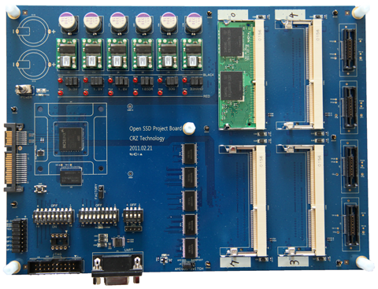
Performance Evaluation (1/4)
Evaluation setup
OpenSSD development platform :
MLC NAND : Samsung K9LCG08U1M
Page size : 8KB, Block : 128 pages
87.5 MHz ARM, 96KB SRAM, 64MB DRAM
Linux ext4 file system (kernel 3.5.2)
Intel core i7-860 2.8GHz and 2GB DDR3
SQLite 3.7.10
Workloads
Synthetic
TPC-H partsupply table, random update, adjust transaction length
Android smartphone
SQL trace using Android emulator, RL bench, Gmail, Facebook, web browser
Database
TPC-C (DBT2), read intensive, TPC-C original
File system benchmark
Flexible I/O(FIO), random write, adjust fsync frequency
http://www.openssd-project.org
Notes:
As I already said,
we implement X-FTL as a firmware inside the OpenSSD platform.
OpenSSD is equipped with Samsung MLC NAND flash memory chips with 8KB pages and 128 pages per block.
Our experiment was carried out on a Linux system running on Intel core i7.
Using a comprehensive set of synthetic and real workloads,
we measured the performance of SQLite running on X-FTL as well as that of two SQLite modes.
For real android smartphone applications, we used RL benchmark and the traces of Gmail, Facebook, and Web Browser.
In order to collect real SQL trace of gmail, facebook, and web browser,
We modified the source code of SQLite to capture all the transactions and their SQL statements.
And we intensively run each application for 8 hours.
Also to demonstrate X-FTL can be used for file system consistency,
We carried out file system benchmark using Flexible IO tool.
In this talk, we will provide only the result of synthetic workload and FIO benchmark.
In fact, the performance trends in other workloads are similar to that of the synthetic workload.
-------
RL benchmark is a well known benchmark for SQLite on smartphone.

Slide 22
Performance Evaluation (2/4)
Synthetic workloads
TPC-H partsupply table (60,000 tuples, 220 bytes tuple)
Random update, 1-20 page updated in a tx
3.0x
11.7x
Notes:
First let me explain the performance results using the synthetic workload.
Blue line represent the rollback journal,
This one is the WAL,
And the green one is the X-FTL results.
The synthetic workloads consist of transactions which randomly modify one or more tuples against the part-supply table from the TPC-H benchmark.
In this graph, the x-axis represents the number of updated pages in a transaction.
We carried out experiment by varying the number of updated pages within a transaction from 1 to 20.
The y-axis represents the execution time to complete one thousand transactions.
X-FTL shows faster execution time up to 3 folds than WAL mode, and more than 11 folds faster than rollback journal mode.
-------
This table contains 60,000 tuples of 220 bytes each.
GC validity means how many pages are valid before benchmark test,
for example, if gc validity is 50%, then 50% of pages is invalidated per block before test, and 50% of pages is valid so that they should be copy-backed when one of page in the block is updated.

Slide 23
Performance Evaluation (3/4)
Synthetic workloads
I/O activities inside OpenSSD
(# of updated pages per transaction = 5)
Notes:
The performance improvement in X-FTL mainly comes from the diminishing quantity of page writes.
In order to empirically validate this argument,
we counted the number of the physical flash write operations and the number of garbage collections inside OpenSSD for each SQLite mode.
As illustrated in these figures, the reduction of physical writes and garbage collections in X-FTL is very consistent with the performance trend in the previous slide.
From the left graph, we can observe that X-FTL generates less than half write count compared to WAL mode, and it generates about 7 times lower than Rollback journal mode.
Garbage collection also shows similar trend because the number of garbage collection is proportional to the number of writes.
I would like to note that because X-FTL can halve the number of write, it can double the lifetime of flash storage.

Slide 24
Performance Evaluation (4/4)
File system benchmark using FIO : random write test
X-FTL transaction : data and metadata pages
Linux ext4 file system journaling
Data (full) : data and metadata pages
Ordered (default) : metadata only
X-FTL provides the same consistency level of data journaling, better performance than ordered journaling
Notes:
X-FTL supports atomic update propagation not only for SQLite but also for other applications such as a file system.
We used the Flexible IO benchmark to evaluate the effects of X-FTL on the random write performance using ext4 file system.
In this experiment, the average IO per second of write operations was measured while a single thread was updating data pages randomly against a four gigabyte (4GB) sized file for 10 minutes.
The graph shows that benchmark results.
X-FTL shows around 1.5 folds and 3.5 folds higher throughput than ordered journaling and data journaling respectively.
From this, we can confirm that X-FTL can achieve the higher level of consistency in full journaling mode
While working faster than the ordered journaling mode.
-------------
Ordered journaling mode in ext4 file system only conducts metadata journaling in the file system journal area.
On the other hand, full data journaling conducts data page journaling as well as metadata journaling.

Slide 25
Outline
Introduction
Motivation
Problem definition
Flash characteristics and opportunities
X-FTL for SQLite databases
Architecture and implementation
Performance evaluation
Conclusion
Notes:
Conclusion

Slide 26
Conclusion
X-FTL: Transactional FTL for SQLite databases
Offload the transactional atomicity semantics from SQLite to flash storage
Leverage the copy-on-write strategy in modern FTLs
Achieve the transactional atomicity almost for free
Halves writes and doubles the lifetime
2 ~ 3x times faster than costly journaling schemes
Turn the weakness of flash memory (no in-place update) into a strong point (inherently atomic propagation of changes)
Notes:
In this paper, we propose a new transactional FTL for SQLite running on flash storage.
X-FTL offloads the transactional atomicity semantics from SQLite to flash storage.
By leveraging the copy-on-write strategy in modern FTLs, it can achieve the transactional atomicity almost for free.
Therefore, it can halve the write amount and thus double the lifetime of flash storage.
With X-FTL, we show that it is possible to turn the weakness of flash memory (that is, no in-place update characteristics Of flash memory) into a strong point (that is, an inherent atomic propagation of changes).
Based on X-FTL, we are now working on designing a full fledged file system which can guarantee data consistency without journaling.
And we think that we can seamlessly extend X-FTL framework to support more isolation levels in SQLite In a natural and efficient way.

Slide 27
Q & A

Slide 28
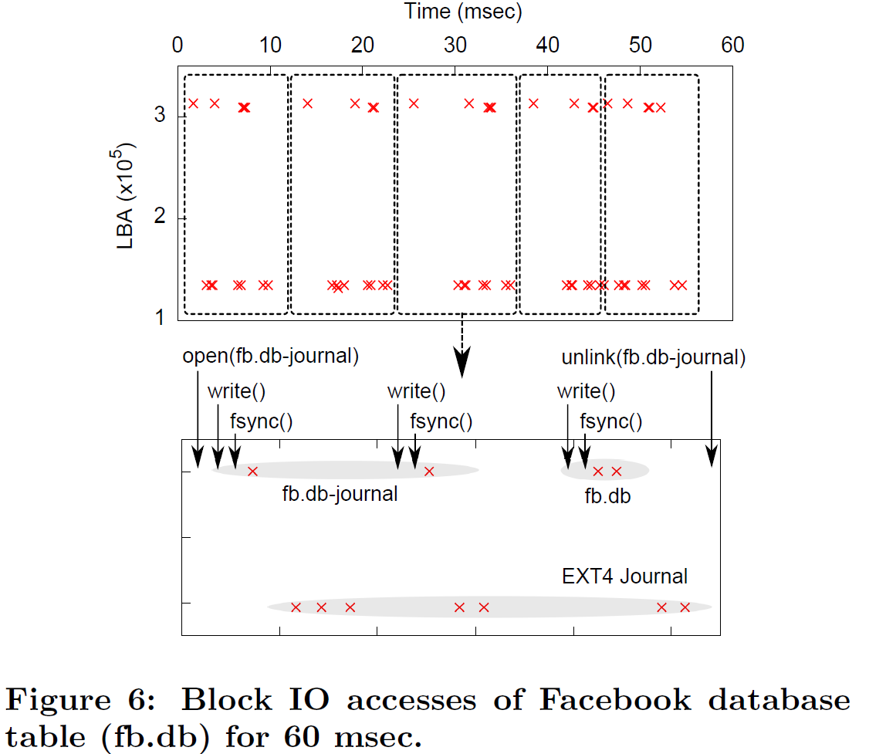
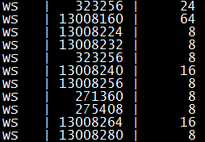
Why SQLite Performs so Poor?
1 update invokes write 22 pages
LBA
Length(sectors)
SQLite journal
FS journaling
SQLite Database(fb.db)
Figure from Smart Layers and Dumb Result:
IO Characterization of an Android-Based Smartphone [Lee and Won, 2012]

Slide 29
X-FTL: simplified architecture
Each layer do their best!
Eliminate overhead
Storage understand transactional semantic
Extended Storage API
Application
Application
Update P1, Pn, Commit/Abort
Update P1, Pn, Commit/Abort
SQLite
SQLite
DB Journaling
DB Journaling
File system
File system
fsync, ioctl(abort)
Read(Pi), Write(Pi)
Read(Pi), Write(Pi)
Linux EXT4
Linux EXT4
FS Journaling
FS Journaling
Commit(Ti), Abort(Ti)
Flash Storage
Flash Storage
Read(Pi) , Write (Pi)
Read(Ti, Pi) , Write (Ti, Pi)
Log-based FTL
X-FTL
CoW
CoW + Atomic remapping
Notes:
Extended storage API
SQLite와 같은 DB transactional semantic을 storage에서 직접 지원할 수 있게 됨.

Slide 30
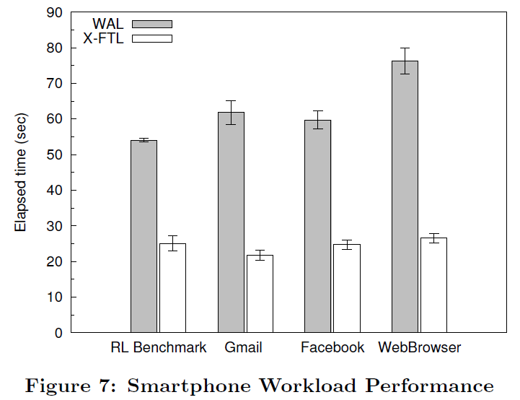
Performance Evaluation : Android
SQL trace using Android SDK

Slide 31
Performance Evaluation : Recovery
SQLite recovery
Sudden Power Off Recovery (SPOR) Test
Recovery time : restart times from crash
File system consistency test
Running FIO then SPOR test
Consistency check using fsck in Linux
Always pass whole stages (never report an error)
mode | Rollback | WAL | X-FTL
(msec) | 20.1 | 153.0 | 3.5
SQLite Restart Time
Notes:
X-FTL의 복구 성능 측정을 위해 SPOR test를 수행하였다.
Recovery time은 SQLite의 재시작 시간을 측정하였다 from crash.
SQLite를 이용한 recovery는 테이블에서 보는것과 같은 결과를 보였다.
Because the write-ahead log file is sized to one thousand pages by default,
the recovery time in write-ahead log mode was much longer than that in rollback mode.
The restart time of X-FTL was much shorter,
because it did not involve copying any data page from the database or log file.
논문에 제시하지 않았으나,
file system consistency test도 수행하였다.
FIO의 수행도중 SPOR test를 수행하였으며,
consistency check는 linux의 fsck를 사용하였다.
수행결과 fsck검사의 모든 stage를 통과하였으며, error를 전혀 report하지 않았다.

