Slide 1

Debugging and Programming Support for
Non-volatile Memory Software
Xinwei Fu
Committee Members:
Ali R. Butt (Chair), Changwoo Min (Co-chair)
Dongyoon Lee, Danfeng Yao, Xun Jian

Slide 2
My Research
Non-volatile Memory (NVM)
DRAM + Disk
Persistent index, key-value store, file system …….
NVM Programming is HARD
My research:
Make NVM programming EASY
NVM Bug detector

Slide 3
Outline
Background and Motivation
Detecting Single-thread NVM Bugs (submitted to SOSP’21)
Detecting Multi-threaded NVM Bugs (plan to submit to ASPLSO’21)
Publications & Timeline

Slide 4
NVM: DRAM + Disk
NVM has arrived!
Persistent
Byte-addressable
Low access latency
High capacity
Benefits
Direct manipulation of persistent data in memory
No file system overhead
Program is able to recover to a consistent state after failure
Usage
Used to increase main memory capacity (Volatile)
Used as durable storage and directly in user space!

Slide 5
NVM Program
flush (x86: clwb): write back a cache line from cache to memory
fence (x86: sfence): ordering guarantee between flushes
1. X = 1
2. flush (&X)
3. fence()
4. Y = 1
5. flush (&Y)
6. fence()
Volatile
Cache
X = 1
Y = 1
NVM
X = 1
Y = 1

Slide 6

NVM Programming is HARD
Incorrect NVM program leads to serious consequences: data inconsistency, loss
Bugs are too hard to find:
A large number of possible crashed NVM states
Traditional debugger (gdb) doesn’t take into consider crash consistency
Supposing all write data are all zero at the beginning and are in different cachelines
X1 = 1
flush (&X1)
fence()
X2 = 1
flush (&X2)
fence()
Possible states:
X1 = 1, X2 = 0
X1 = 1, X2 = 1
X1 = 1
X2 = 1
flush (&X1)
flush (&X2)
fence()
Possible states:
X1 = 0, X2 = 0
X1 = 1, X2 = 0
X1 = 0, X2 = 1
X1 = 1, X2 = 1
X1 = 1
…
Xn = 1
flush (&X1)
…
flush (&Xn)
fence()
Possible states:
2^n cases
Crash: app crash, system crash, sudden power failure

Slide 7
NVM Bug Classification
NVM bug survey
Open source NVM software
Code, commits, issues, pull requests
NVM bug classification
Correctness Bugs
Performance Bugs
Multi-threaded Bugs

Slide 8
Correctness Bug – Ordering Bugs
Persistence Ordering Bugs
LevalHash [OSDI’18]
Each bucket has arrays of
Keys
Values
Tokens (valid flags)
insert(k, v):
……
key[x] = k;
value[x] = v;
token[x] = true;
flush(key[x]);
flush(value[x]);
fence();
flush(token[x]);
fence();
Volatile
Cache
key[x] = k
value[x] = v
read(k):
……
if (token[x] && key[x] == k) {
return value[x];
}
……
token[x] = true
NVM
token[x] = true
Check token first then read key-val
Persist key-val before updating token

Slide 9
Correctness Bug – Atomicity Bug
Persistence Atomicity Bug
LevalHash [OSDI’18]
Each bucket has arrays of
Keys
Values
Tokens (valid flags)
update(k, v):
……
key[y] = k;
value[y] = v;
token[y] = true;
token[x] = false;
flush(key[y]);
flush(value[y]);
fence();
flush(token[x]);
fence();
Volatile
Cache
key[y] = k
value[y] = v
token[y] = true
read(k):
……
if (token[x] && key[x] == k) {
return value[x];
}
……
key[x] = k
value[x] = v0
token[x] = true
NVM
key[y] = k
value[y] = v
token[y] = true
Each token guards a key-val pair
Updating 2 tokens should be atomic

Slide 10
Performance Bug
Unpersisted performance bugs
Place volatile data that does not require persistence in NVM
Extra Flush/Fence performance bugs
An extra flush or fence instruction on an NVM variable causes unnecessary high overhead
Extra logging performance bugs
Logging the same NVM region redundantly within a transaction will unnecessarily degrade performance

Slide 11
Multi-threaded Bug
Pattern: use unpersist data from another thread
Root Cause: visible point and durable point are not atomic
T1 T2
Lock-free persistent linked list
insert(new_node):
……
last_node = get_last();
old = last_node->next;
if (CAS(last_node->next, old, new_node)) {
flush(last_node->next);
fence();
return;
}
……
Volatile
Cache
H
t1
t2
NVM
H
t1
t2
CAS (compare-and-swap atomic instruction) is the visible point
Fence is the durable point

Slide 12
Related Works
Summary:
Exhaustive searching
Enumerate all possible crash states
[Pros] no false negative
[Cons] not scalable
Manual efforts
Rely on users’ guidance to validate a bug
[Pros] make bug validation process simple
[Cons] not automatic and not precise

Slide 13
Related Works
Yat [ATC’14]
exhaustive searching
user-provided checkers
X1 = 1 ...
Xn = 1
flush (&X1) …
flush (&Xn)
fence()
2^n Crashed NVM Images
User-provided
Checker

Slide 14
Related Works
Yat [ATC’14]
exhaustive searching
user-provided checkers
X1 = 1 ...
Xn = 1
flush (&X1) …
flush (&Xn)
fence()
2^n Crashed NVM Images
User-provided
Checkers
PMTest [ASPLOS’19]
XFDetector [ASPLOS’20]
user-provided checkers
isPersisted (X)
isOrderedBefore(X, Y)
Runtime
Tracking each NVM objects

Slide 15
Related Works
Yat [ATC’14]
exhaustive searching
user-provided checkers
X1 = 1 ...
Xn = 1
flush (&X1) …
flush (&Xn)
fence()
2^n Crashed NVM Images
User-provided
Checkers
PMTest [ASPLOS’19]
XFDetector [ASPLOS’20]
user-provided checkers
isPersisted (X)
isOrderedBefore(X, Y)
Runtime
Tracking each NVM objects
Agamotto [OSDI’20]
symbolic execution
user-provided checkers
Symbolic
Execution
Runtime
Tracking each NVM objects
User-provided
checkers

Slide 16
Motivation
Observations:
NVM programming is hard
Current debugging and programming support for NVM is insufficient
My dissertation question: How to make NVM programming easy?
My research goal:
An automatic, scalable and precise NVM bug detector
Long-term vison of my research: Help community build bug-free NVM software

Slide 17
Outline
Background and Motivation
Detecting Single-thread NVM Bugs (submitted to SOSP’21)
Challenges
Design
Implementation
Evaluation
Detecting Multi-threaded NVM Bugs (plan to submit to ASPLSO’21)
Publications & Timeline

Slide 18
Challenge 1: Achieve scalability without manual efforts
Previous works: exhaustive searching or user-provided checkers
Our goal: automatic, scalable and precise
Question: How to automatically prune the test space?
Inference of Likely Invariant
Infer like invariant from the code
Only test crash states violating inferred invariants
“likely” invariant is not necessary to be true
Check token first then read key-val
read(k):
……
if (token[x] && key[x] == k) {
return value[x];
}
……
Persist key-val before updating token
Each token guards a key-val pair
Updating 2 tokens should be atomic

Slide 19
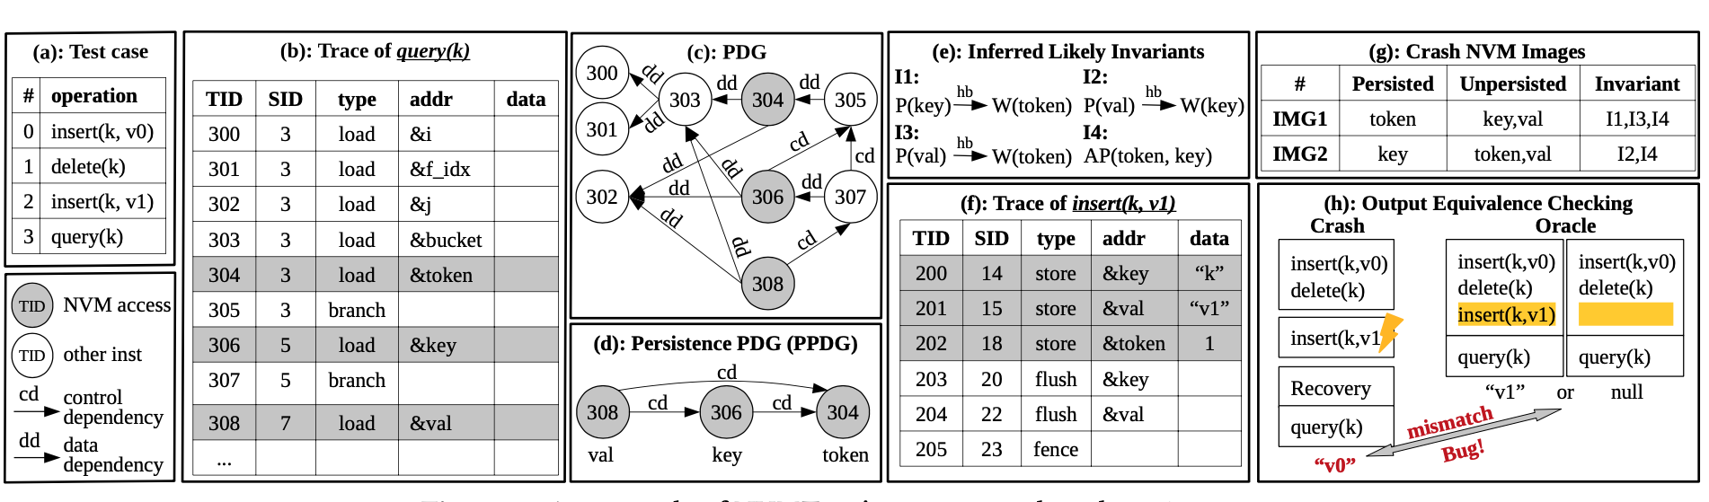
Challenge 2: Validation without manual efforts
Previous works: user-provided checkers
Goal: automatic, scalable and precise
Question: How to automatically validate a crashed state?
Validation with Metamorphic Testing
Domain-specific knowledge:
all-or-nothing semantic
Output difference checking

Slide 20
Outline
Background and Motivation
Detecting Single-thread NVM Bugs (submitted to SOSP’21)
Challenges
Design
Implementation
Evaluation
Detecting Multi-threaded NVM Bugs (plan to submit to ASPLSO’21)
Publications & Timeline

Slide 21
Overview
Tracing
Memory
Accesses
Inferring Likely Invariants
Generating Crash NVM Images
Metamorphic Testing Based Validation
Program
Correctness Bugs
Test Cases
Trace-based Performance Bug Detection
Performance Bugs

Slide 22
Tracing Memory Accesses
LLVM compiler pass
Execute the instrumented binary with a test case to collect trace
Load
Store with updated value
Branch
Call/return
Flush
Fence

Slide 23
Inferring Likely Invariants
Correlate program dependence to NVM correctness conditions.
Y = X + 1; // both X and Y are on NVM
W(Y) is data-dependent on R(X)
Implicit correctness condition: X should be persistent before writing Y
Inferred Likely Invariant: P(X) happens before W(Y)
Only test a crash state violating the invariant: Y is persistent but X is not persistent

Slide 24
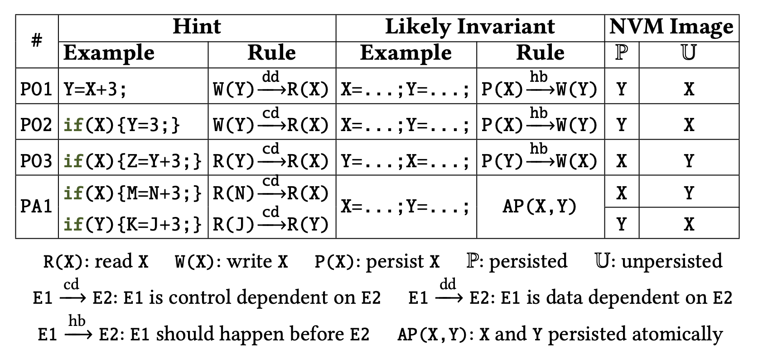
Inferring Likely Invariants
PO1: A data dependency implies a persistence ordering
PO2: A control dependency implies a persistence ordering
PO3: A guarded read implies a persistence ordering
PA1: Guardian implies persistence atomicity

Slide 25
Inferring Likely Invariants
Program Analysis for Invariant Inference
Static analysis: register-level data and control dependency
Dynamic trace analysis: memory-level data dependency

Slide 26
Generating Crash Images
How to guarantee each crash NVM state is valid?
Cache and NVM simulation
Starting from the empty cache and NVM states
Simulates the effects of store, flush and fence along the trace
How to detect invariant violations?
Check before simulating each fence instruction

Slide 27
Metamorphic Testing Based Consistency Validation
Domain-specific knowledge: all-or-nothing semantic
Output difference checking

Slide 28
Outline
Background and Motivation
Detecting Single-thread NVM Bugs (submitted to SOSP’21)
Challenges
Design
Implementation
Evaluation
Detecting Multi-threaded NVM Bugs (plan to submit to ASPLSO’21)
Publications & Timeline

Slide 29
Implementation
Program dependency analysis: Giri [ASPLOS’13]
PMDK: libpmem, limpmemobj
mmap virtual address: PMEM_MMAP_HINT
3600 lines of C++, 4400 lines of Python

Slide 30
Outline
Background and Motivation
Detecting Single-thread NVM Bugs (submitted to SOSP’21)
Challenges
Design
Implementation
Evaluation
Detecting Multi-threaded NVM Bugs (plan to submit to ASPLSO’21)
Publications & Timeline

Slide 31
Evaluation Questions
Can our detector detect new bugs?
Is our detector scalable?
How does our detector improve the state-of-the-arts?

Slide 32
Tested Applications
20 NVM programs
highly optimized persistent key-value indexes
concurrent persistent indexes converted by RECIPE [SOSP’19]
Intel PMDK applications
Persistent server program
Low-level persistence primitives and High-level persistence transactions
Single-thread, lock-based, lock-free
Test cases
2000 random operations

Slide 33
Detected Correctness Bugs
Question: Can our detector detect new bugs?
Summary
48 (38 new) correctness bugs from 18 programs
26 persistence ordering bugs and 22 persistence atomicity bugs
All confirmed by the developers
Diverse impact
Lost, unexpected, duplicated key-value pairs
Unexpected operation failure
Inconsistent structure

Slide 34
Detected Correctness Bugs
Fixing persistence ordering bugs
Adding required persistence primitives
Reordering persistence primitives
Fixing persistence atomicity bugs
Merge multiple writes into one word-size write
Crash-inconsistency-tolerable
Crash-inconsistency-recoverable
Logging/transaction
All those bug fixes are complicated and require deep understanding of the applications.

Slide 35
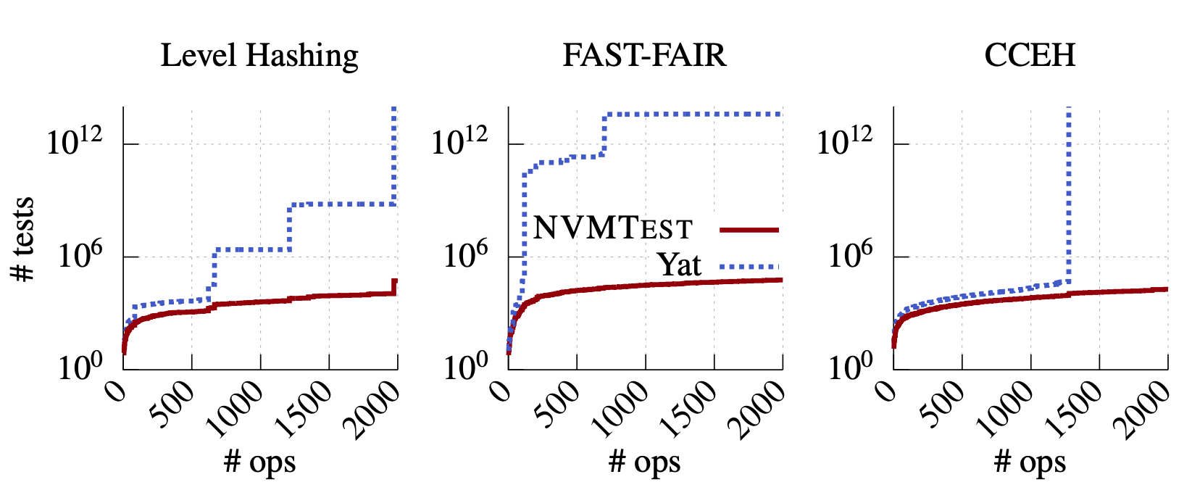
Scalability
Question: Is our detector scalable?
Comparison with Exhaustive Searching approach (Yat)
Comparison with Random Searching
100 Million (1 week)
Detect one or two of the bugs

Slide 36
Bug Detection Effectiveness Comparison
Question: How does our detector improve the state-of-the-arts?
Comparison with Agamotto [OSID’20] (Symbolic Execution)
Our tool detected two more correctness bugs
Missing application-specific checkers
Comparison with PMTest [ASPLOS’19], XFDetector [ASPLSO’20] (User-provided checkers)
Our tool detected one more correctness bug
Our tool filtered out a false positive reported by PMTest and XFDetector

Slide 37
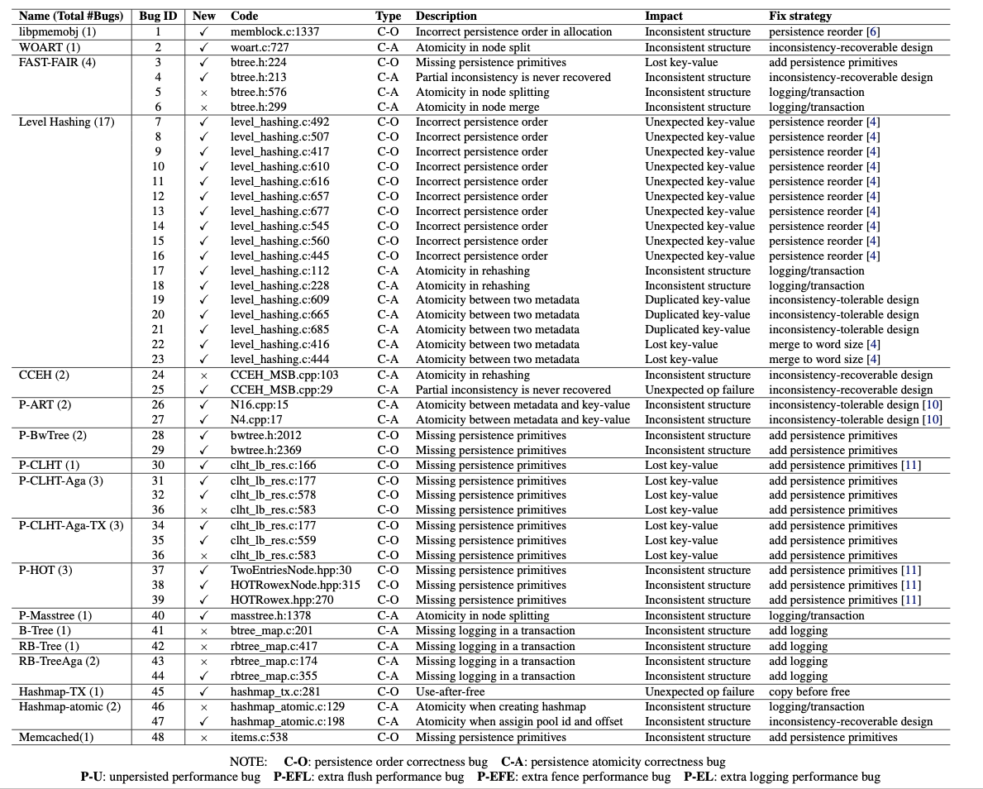
More result in the document
……

Slide 38
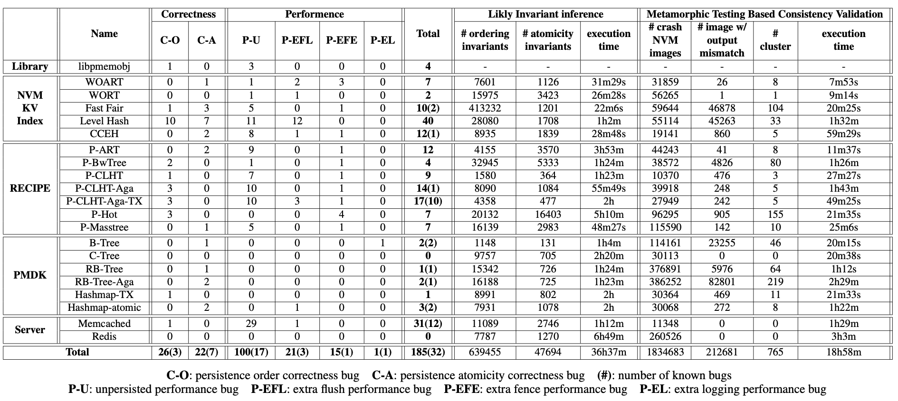
More result in the document

Slide 39
Summary
Single-thread NVM bug detector
Automatic, scalable and precise
Likely invariants
Metamorphic testing
20 NVM programs evaluated
47 (36 new) correctness bugs and 158 (113 new) performance bugs
Our tool is the first tool that can detect application-specific NVM bugs from the general application-agnostic rules without requiring any user-provided checkers nor suffering from the test space explosion problem.

Slide 40
Outline
Background and Motivation
Detecting Single-thread NVM Bugs (submitted to SOSP’21)
Detecting Multi-threaded NVM Bugs (plan to submit to ASPLSO’21)
Publications & Timeline

Slide 41
Multi-threaded Bug
Pattern: use unpersist data from another thread
Root Cause: visible point and durable point are not atomic
Lock-free persistent linked list
insert(new_node):
……
last_node = get_last();
old = last_node->next;
if (CAS(last_node->next, old, new_node)) {
flush(last_node->next);
fence();
return;
}
……
Diverse impact
Lost, unexpected, duplicated key-value pairs
Unexpected operation failure
Inconsistent structure
More difficult to find:
Crash may happen any time
Non-deterministic in thread scheduling
CAS is the visible point
Fence is the durable point

Slide 42
Design Discussion
Static Solution:
Not precise: point-to analysis, happen-in-parallel analysis
Dynamic Solution:
Conduct executions to reveal the bug pattern
Input:
Initial image (Prefix)
Two concurrent operations
Thread scheduling
Questions:
How to generate the input (prefix and two concurrent operations)?
How to guide the thread scheduling to reveal the bug pattern?

Slide 43
Our Solution
Search the bug pattern in a single-thread execution trace
Optimistically generate the input and the thread scheduling plan
Validate the plan in a real multi-threaded execution.
Single-thread Trace
// operation 1
……
// operation 100
CAS(X)
flush(x)
fence()
……
// operation 200
Read(X)
CAS(Y)
flush(Y)
fence()
……
Input
Multi-threaded validation
Prefix
operation 1
……
operation 99
operation 101
……
operation 199
Thread 1
CAS(X)
flush(X)
fence()
Thread 2
Read(X)
CAS(Y)
flush(Y)
fence()
Two concurrent operations
Operation 100
Operation 200
Break point

Slide 44
Proposed Evaluation
Concurrent persistent indexes (8) and key-value stores (3):
Fast Fair
Level Hash
CCEH
RECIPE: P-ART, P-BwTree, P-CLHT, P-HOT and P-Masstree
PMDK pmemkv: cmap, csmap and robinhood
Questions to answer:
Can our detector detect new bugs?
How effective is our detector?
How does our tool improve the state-of-the-arts?
Current status:
I have finished the majority of the implementation
We plan to submit this work to ASPLOS’21

Slide 45
Outline
Background and Motivation
Detecting Single-thread NVM Bugs (submitted to SOSP’21)
Detecting Multi-threaded NVM Bugs (plan to submit to ASPLSO’21)
Publications & Timeline

Slide 46
Publications
Debugging and Programming Support for NVM
[In Submission] Xinwei Fu, Wook-Hee Kim, Ajay Paddayuru Shreepathi, Mohannad Ismail, Sunny Wadkar, Changwoo Min, Dongyoon Lee, “NVMMTest: A Systematic Crash Consistency Testing Framework for Non-Volatile Memory Software”
[ATC’21] R. Madhava Krishnan, Wook-Hee Kim, Xinwei Fu, Sumit Kumar Monga, Hee Won Lee, Minsung Jang, Ajit Mathew, and Changwoo Min, “TIPS: Making Volatile Index Structures Persistent with DRAM-NVMM Tiering”
[ASPLOS’20] R.Madhava Krishnan, Jaeho Kim, Ajit Mathew, Xinwei Fu, Anthony Demeri, Changwoo Min and Sudarsun Kannan, “Durable Transactional Memory Can Scale with TimeStone”
Event-driven Architecture Runtime and Reliability
[ATC’19] Xinwei Fu, Talha Ghaffar, James C. Davis and Dongyoon Lee, “EdgeWise: A Better Stream Processing Engine for the Edge”
[CGO’18] Xinwei Fu, Dongyoon Lee, and Changhee Jung, “nAdroid: Statically Detecting Ordering Violations in Android Applications”

Slide 47
Ph.D. Timeline
2016
Research area: Event-driven Architecture Runtime and Reliability
Previous projects:
A static data race detector for Android applications
A stream processing engine for edge computing
CGO’18 (lead)
ATC’19 (lead)
2019
Research area: Debugging and Programming Support for NVM
Previous projects:
A scalable durable transactional memory system
A framework to making volatile index structures persistent
A crash-consistency bug detector for single-thread NVM software
ASPLOS’20 (contribute)
ATC’21 (contribute)
In submission (lead)
2021
Research area: Debugging and Programming Support for NVM
Current project:
A crash-consistency bug detector for multi-threaded NVM software

Slide 48
Q&A
Thank you for your attention!
I am looking forward to your questions!

Slide 49
Inferring Likely Invariants
PO1: A data dependency implies a persistence ordering
PO2: A control dependency implies a persistence ordering
PO3: A guarded read implies a persistence ordering
PA1: Guardian implies persistence atomicity

Slide 50
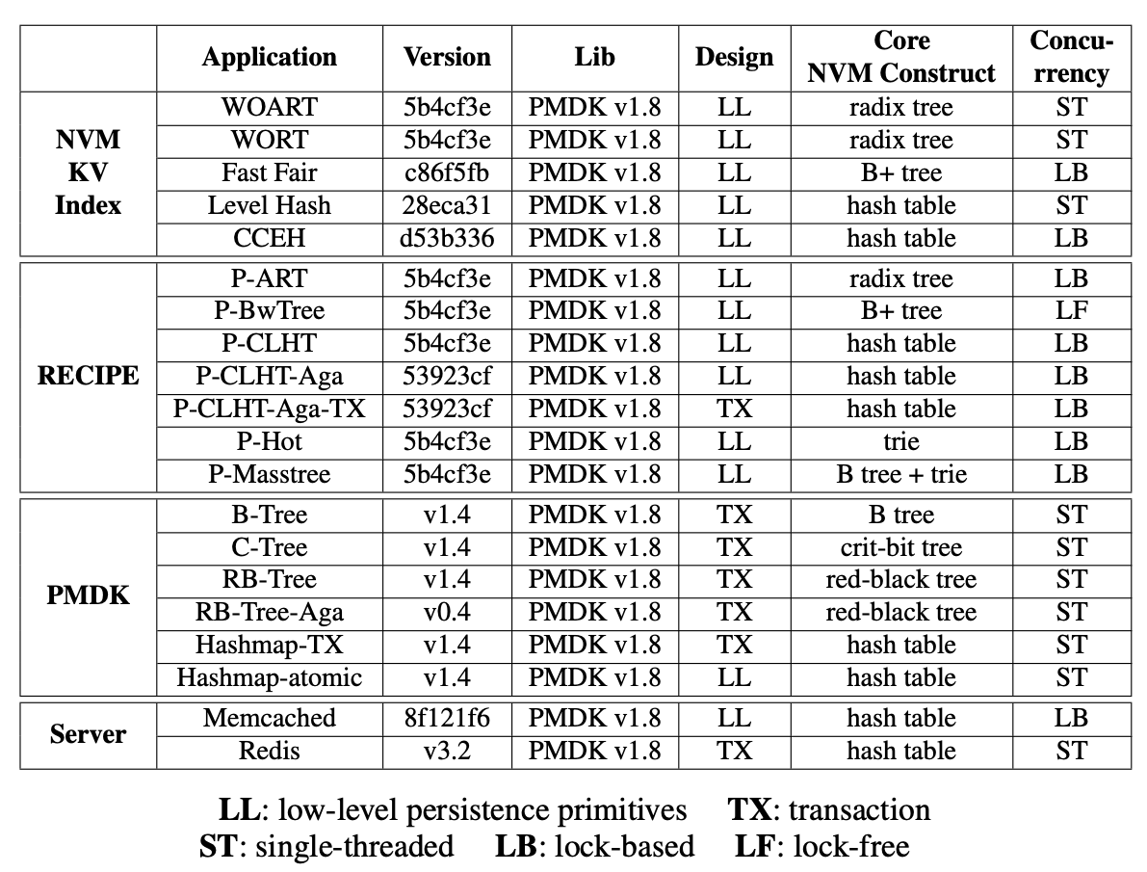
Evaluation Methodology
Tested NVM programs
20 NVM programs
Test cases
2000 random operations
Setup
64-bit Fedora 29
two 16-core
Xeon Gold 5218 (2.3GHz)
192 GB DRAM
512 GB NVM

Slide 51
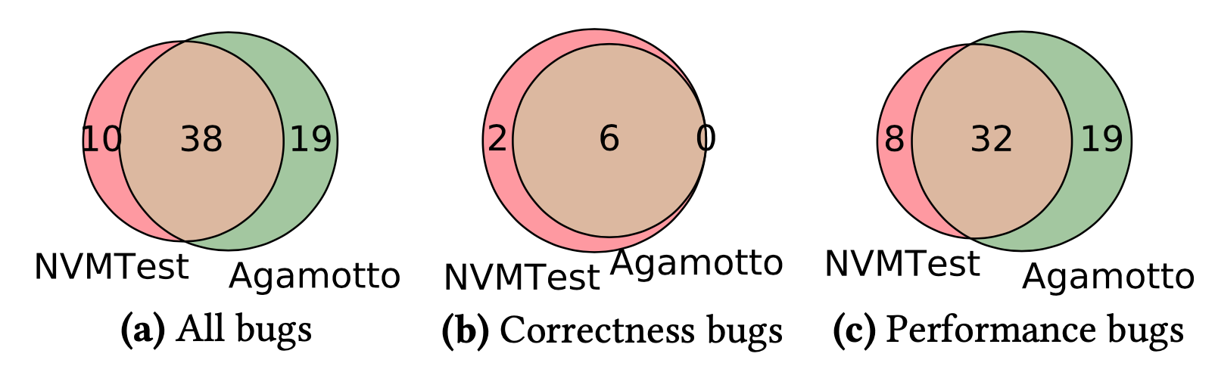
Bug Detection Effectiveness Comparison
Comparison with Agamotto [OSID’20] (Symbolic Execution)
Comparison with PMTest [ASPLOS’19], XFDetector [ASPLSO’20] (User-provided annotations)
We detected one more bug and also filtered out a false positive detected by PMTest and XFDetector

Slide 52
Multi-threaded Bug
Pattern: use unpersisted data from another thread
Root cause:
Visible point and Durable point
are not atomic
Lock-based fix
Lock-free fix

Slide 53
Design

