Slide 1

Sustainable Canvas
This research is part of the project SustainableCloud (OCENW.M20.243) of the research programme Open Competition programme which is (partly) financed by the Dutch Research Council (NWO).

Slide 2
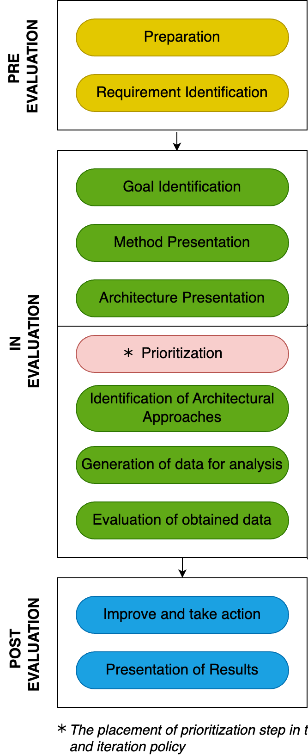
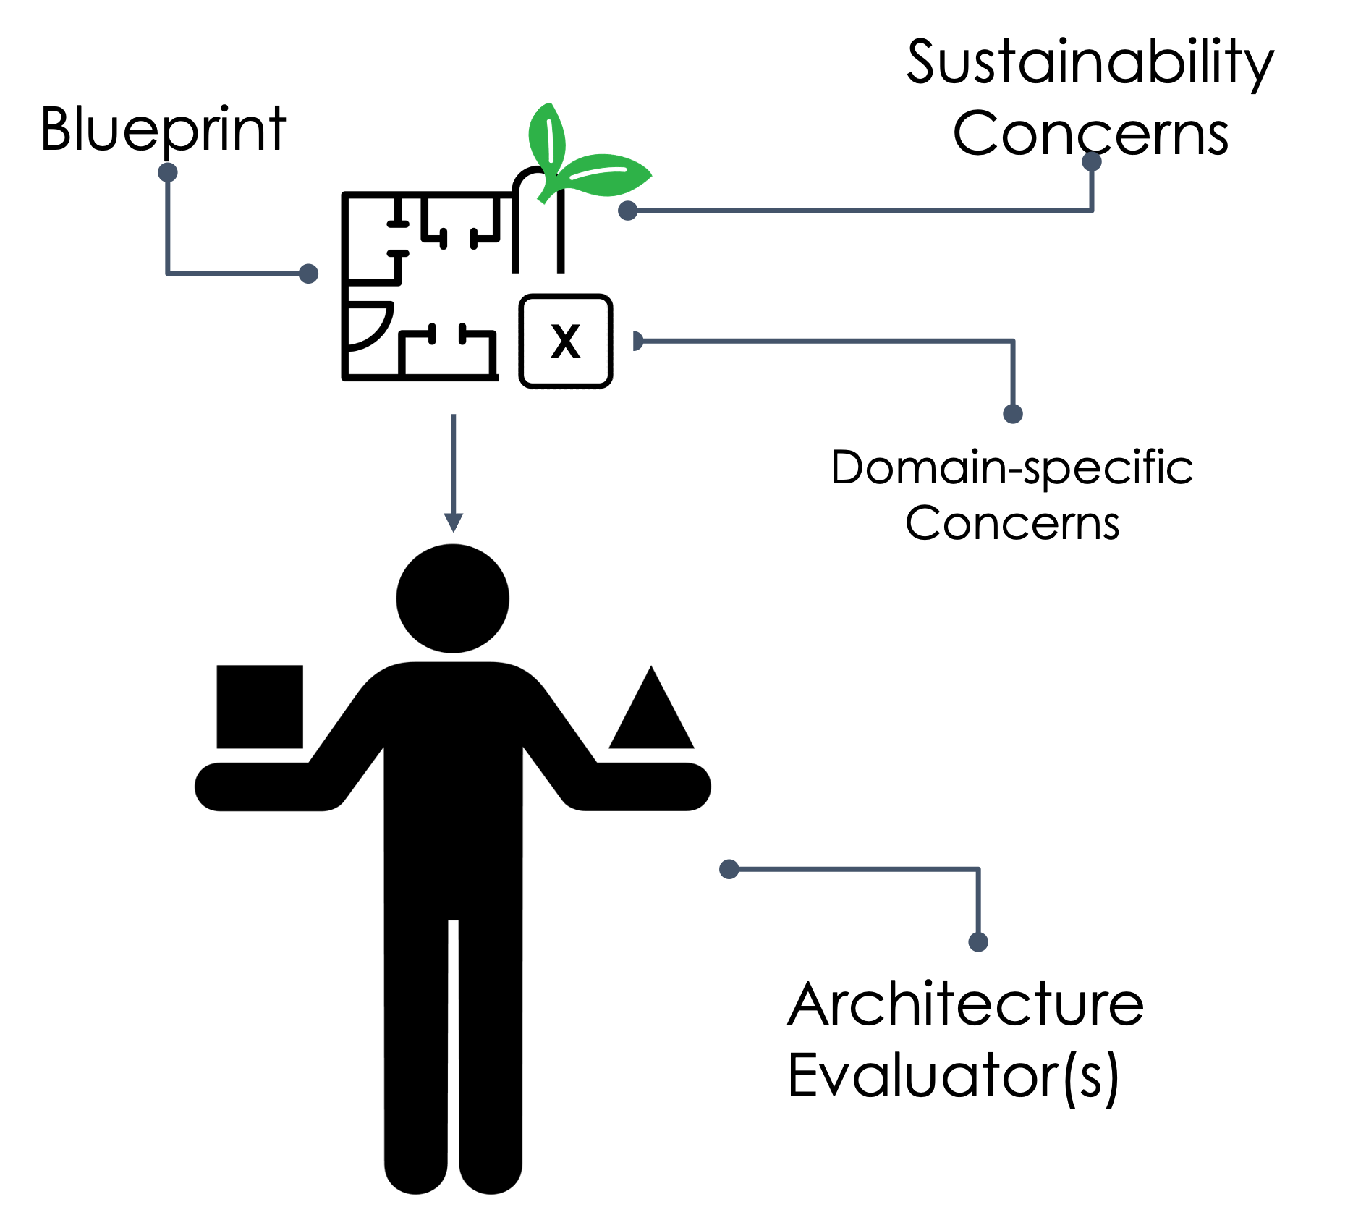





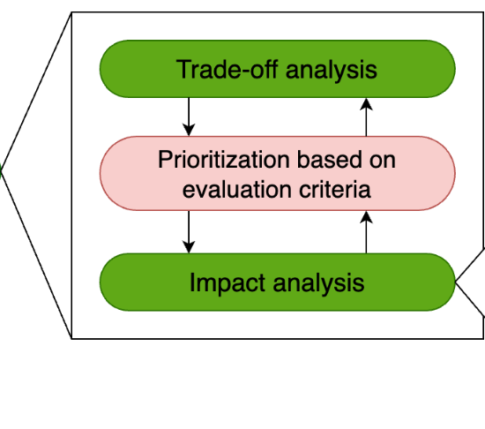
Blueprint (How SA evaluation works?)
Immediate
4D
Enabling
Systemic
“preserving function of a system over a defined time period”
Inter QA trade-off analysis
Intra Dimension impact of QA trade-offs
Inter-dimension impact of QA trade-offs
Reprioritize

Slide 3
Information needed
Document design decisions into a template
Requires 2 architectural views (deployment view + ___)
Architectural decisions, rationale, trade-offs if any
Prioritize requirements (+sustainability) - a small Quality attribute workshop
Software Architecture Evaluation for Sustainability (of the extracted design decisions)

