Slide 1


Web Scraping Project on
Health Accessibility and Affordability Insights
Presented by:
Shreya Joshi

Slide 2
About me
Background
B.Tech in Agricultural Engineering
Objective
I want to learn Data Science because it blends my engineering background with analytical problem-solving. I enjoy working with data to uncover patterns and make informed decisions, and Data Science gives me the tools to create real-world impact while transitioning into a tech-focused career.
Work experience
I have professional experience as a teacher.
While I’m a fresher in Data Science, I’m actively working on hands-on projects and building strong analytical and technical skills to transition into this field.
linkedin url :
https://www.linkedin.com/in/shreya-joshi-b84376350?utm_source=share&utm_campaign=share_via&utm_content=profile&utm_medium=android_app
github url :https://github.com/S2023-maker

Slide 3

Data Source: practo.com
Website link: https://www.practo.com/
Tools used : Python · Selenium · Pandas · Matplotlib · Seaborn

Slide 4

Dataset Description
Practo is a digital healthcare platform and one of India’s largest online healthcare services websites.
It helps patients find doctors, book appointments, consult online, and access health-related services in one place.
The dataset contains 568 records and 11 columns.
Covering doctor details like name, specialization, experience, locality, city, hospital name, consultation fee, rating, working hours, timing category, and time duration across 10+ Indian cities.

Slide 5
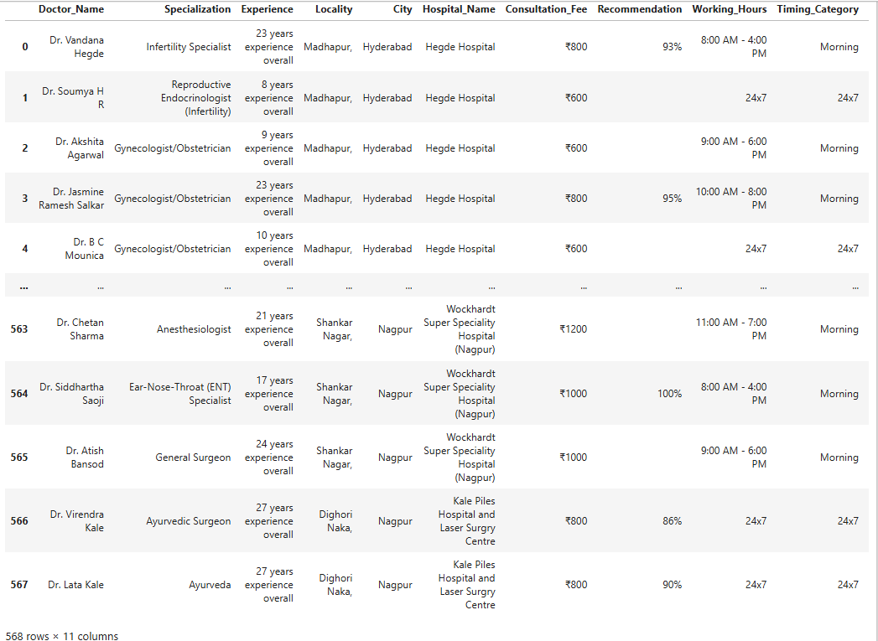
Raw Dataset after Extraction

Slide 6
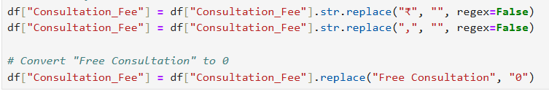
Column Transformation
Consultation_Fee
Recommendation → Rating
Locality
The Consultation_Fee column was cleaned by removing the ₹ symbol and commas, making the values easier to process numerically.
The text value "Free Consultation" was replaced with 0 to maintain numerical consistency.
Experience
Hospital_Name

Slide 7
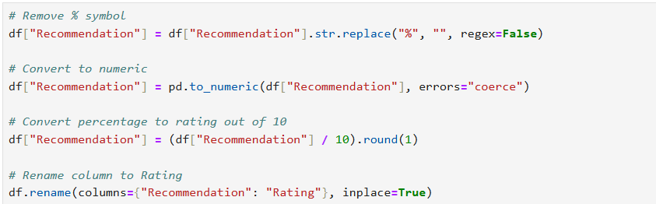
Column Transformation
Recommendation → Rating
Recommendation → Rating
Locality
Experience
The % symbol was removed from the Recommendation column to clean the values.
The column was converted into numeric format to enable mathematical operations.
The percentage values were transformed into a rating scale out of 10 for easier interpretation.
Finally, the column name was changed from Recommendation to Rating to better represent the converted values.
Hospital_Name

Slide 8
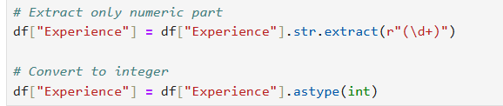
Column Transformation
Locality
Recommendation → Rating
Removed commas from the Locality column.
Removed leading and trailing spaces using str.strip() to clean the text values.
Experience
Experience
Hospital_Name
Extracted the numeric values from the Experience column using a regular expression.
Converted the extracted values into integer type for numerical analysis.

Slide 9
Column Description
Column | Type | Description
Doctor_Name | Object | Full name of the doctor
2. Specialization | Object | Medical specialization / department
3. Experience | Integer | Years of professional experience
4. Locality | Object | Area/locality of the hospital
5. City | Object | City where hospital is located
6. Hospital_Name | Object | Name of the hospital or clinic
7. Consultation_Fee | Float | Fee charged per consultation (₹)
8. Rating | Float | Patient rating out of 10
9. Working_Hours | Object | Operational hours of the doctor
10. Timing_Category | Object | Morning / 24x7 classification
11. Time_Duration | Float | Duration of working hours

Slide 10
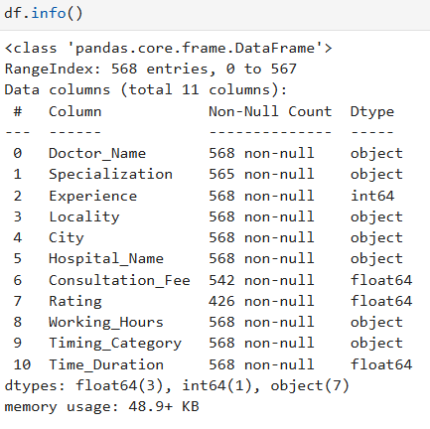
df.info( )
Output is showing the dataset after column transformation but before handling missing values and duplicates.
Consultation_Fee still has 26 missing values
Rating still has 142 missing values
Duplicates are not yet removed

Slide 11
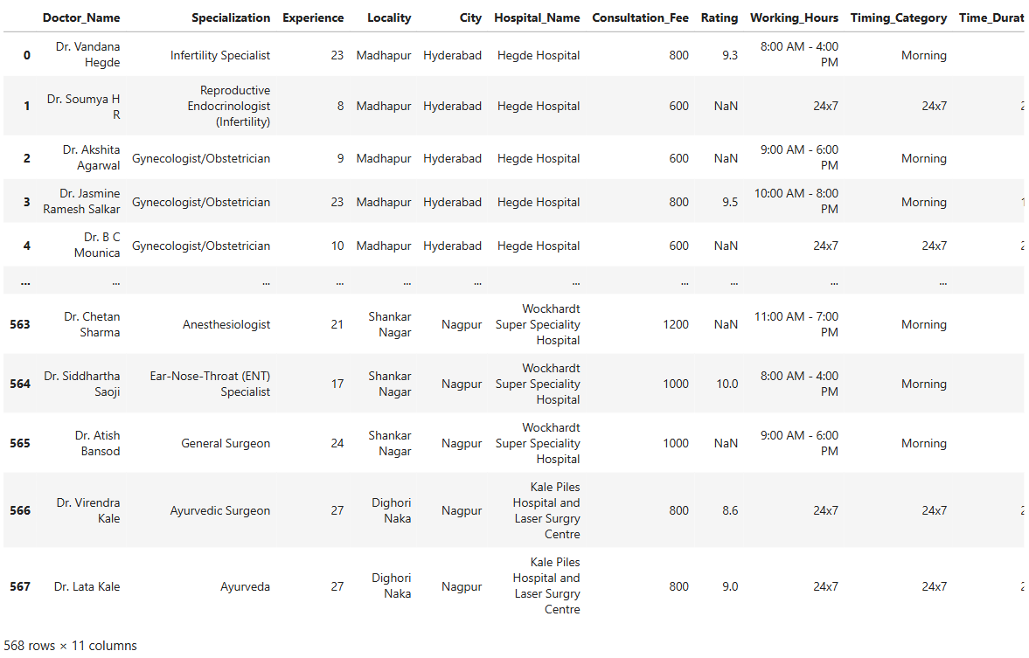
EDA
Data Cleaning & Preparation

Slide 12
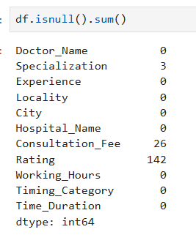
Observation
Finding missing values
Most columns have no missing values, indicating good data completeness.
Specialization has 3 missing values.
Consultation_Fee has 26 missing values.
Rating has the highest missing values with 140 entries.

Slide 13
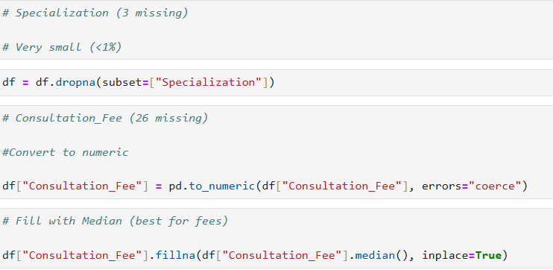
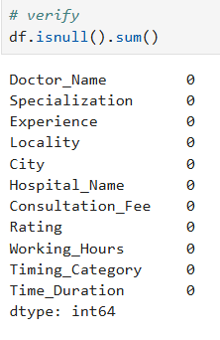
Removed rows where Specialization was missing using dropna().
Handling missing values
Converted the Consultation_Fee column to numeric format for proper analysis.
Filled missing values in Consultation_Fee with the median value to handle missing data.
Filled missing values in Rating with its median to maintain dataset consistency.
Verified the dataset using df.isnull().sum() to ensure missing values were handled.

Slide 14
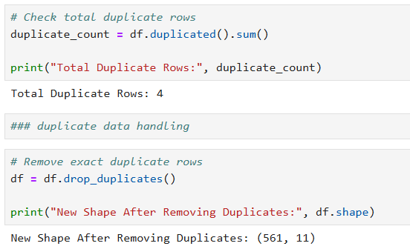
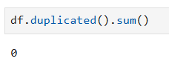
Observation
Checking for duplicate values
The dataset initially contained 4 duplicate rows.
These duplicate records were removed to ensure data uniqueness.
After cleaning, the dataset size became (rows, columns) and 0 duplicate rows remain.

Slide 15
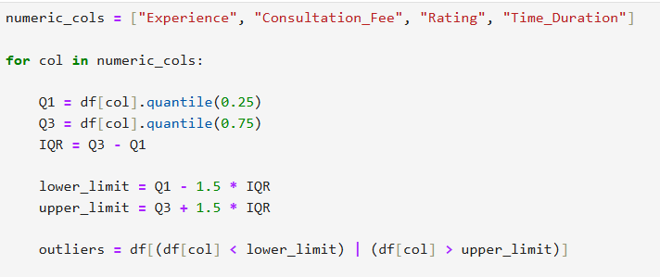
Outlier Detection & Treatment
Observation
Outlier analysis was performed on the numeric columns.
Experience: 4 outliers were detected outside the range 3 to 63
Consultation_Fee: 65 outliers were detected outside the range 0 to 3000.
Rating: 56 outliers were detected outside the range 2.9 to 10.
Time_Duration: 133 outliers were detected outside the range 8 to 24.

Slide 16
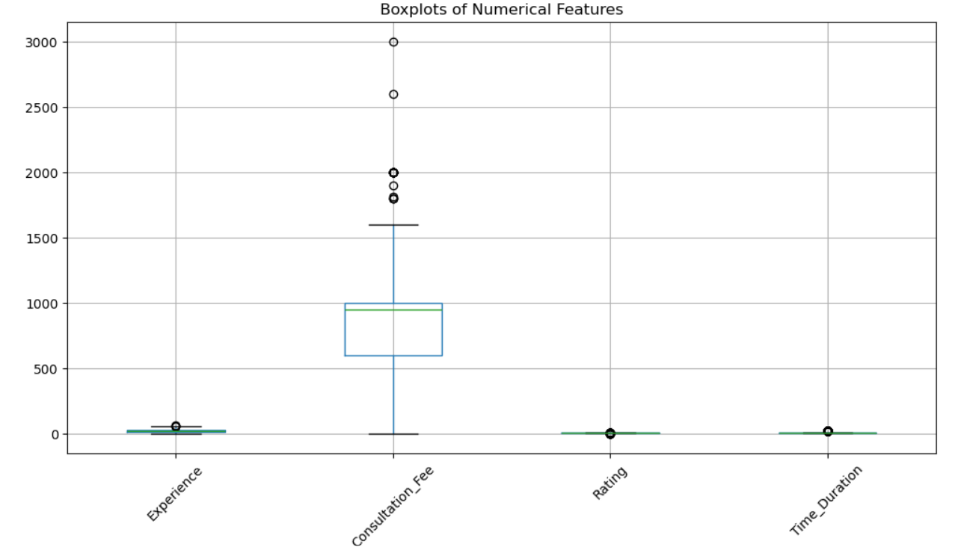
Observation

Slide 17
Observation
Outliers Were Not Removed
Outliers in Experience, Consultation_Fee, Rating, and Time_Duration were not removed because they represent real-world variations in healthcare services rather than data errors. Removing them could lead to loss of important information and misrepresentation of the dataset.
1. Experience - Removing these values would hide the presence of senior and highly experienced doctors, which is important for healthcare analysis.
2. Consultation Fee - Some hospitals provide free consultations (₹0) as part of promotions or public healthcare services. Highly specialized doctors or premium hospitals may charge higher consultation fee
3. Rating - Ratings are based on patient feedback and satisfaction.
4. Time Duration - Some hospitals operate 24 hours, especially emergency and multi-specialty hospitals. Smaller clinics may operate only a few hours per day, while larger hospitals may have extended consultation hours.

Slide 18
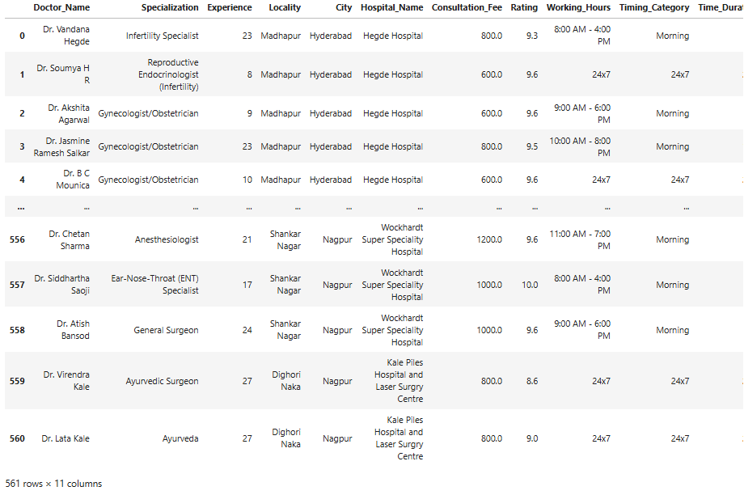
After Cleaning
Dataset has 561 rows and 11 Columns

Slide 19
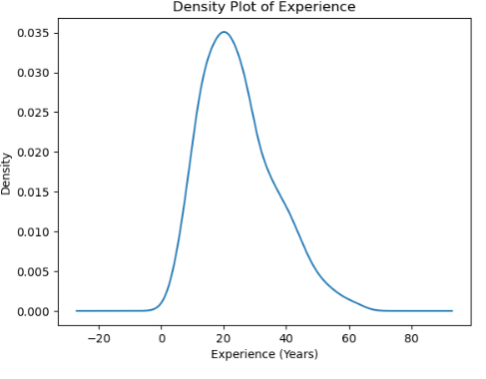
Observation: Density Plot of Doctor Experience
The distribution of doctor experience appears right-skewed (positively skewed).
Univariate Analysis
Density Plot of Experience
Observation and Insights
Most doctors have experience concentrated between 15 to 30 years, where the density is highest.
The peak of the curve occurs around 20 years, indicating that many doctors in the dataset have moderate professional experience.
A smaller number of doctors have very high experience (above 40–50 years), which creates the long right tail in the distribution.
This suggests that the healthcare workforce mainly consists of mid-career professionals, with fewer extremely senior doctors.

Slide 20
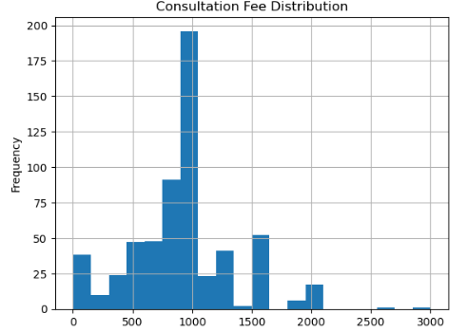
Observation: Density Plot of Doctor Experience
The distribution of doctor experience appears right-skewed (positively skewed).
Consultation Fee Distribution
Observation and Insights
Most consultation fees are concentrated between ₹500 and ₹1000, indicating that this is the common price range for doctor consultations.
A small number of hospitals or specialists charge higher fees (₹1500–₹3000), creating the long right tail in the distribution.
There are also very low or zero consultation fees, which may represent free consultations or promotional services.
Overall, the distribution shows that while moderate consultation fees are most common, there is significant variation depending on the hospital, specialization, and service quality.

Slide 21
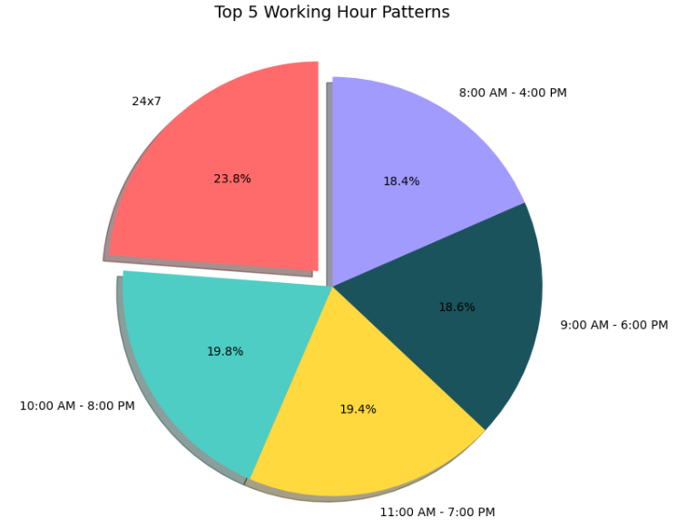
Observation: Density Plot of Doctor Experience
The distribution of doctor experience appears right-skewed (positively skewed).
Top 5 working Hour Patterns
Observation and Insights
24x7 availability has the highest share at 24.4%, indicating many doctors offer round-the-clock consultation.
8:00 AM – 4:00 PM accounts for 20.5% of the working hours.
11:00 AM – 7:00 PM and 9:00 AM – 6:00 PM have similar distributions at 19.4% and 19.3% respectively.
10:00 AM – 8:00 PM has the lowest share among the top patterns at 16.4%.

Slide 22
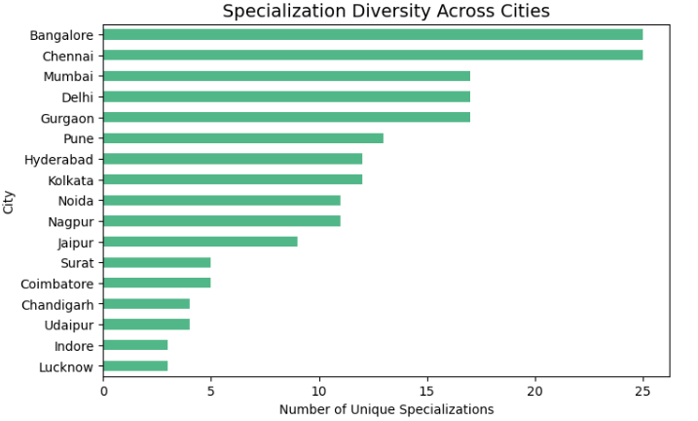
Observation: Density Plot of Doctor Experience
The distribution of doctor experience appears right-skewed (positively skewed).
Bivariate Analysis
Specialization Diversity Across Cities
Observation and Insights
Chennai and Bangalore have the highest specialization diversity, indicating well-developed healthcare ecosystems with a wide range of medical services.
Cities such as Mumbai, Pune, Kolkata, Hyderabad and Delhi demonstrate moderate specialization diversity, reflecting balanced availability of healthcare services.
Smaller cities like Coimbatore, Surat, Udaipur, Chandigarh, Lucknow, and Indore have fewer unique specializations, which may indicate limited access to specialized healthcare services.

Slide 23
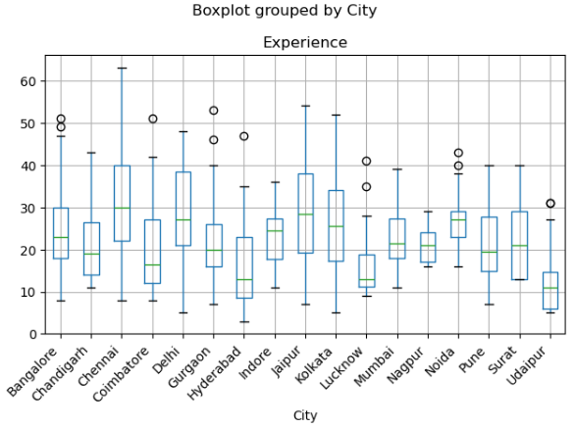
Observation: Density Plot of Doctor Experience
The distribution of doctor experience appears right-skewed (positively skewed).
Box Plot grouped by City
Observation and Insights
Chennai, Delhi, and Jaipur display a higher median experience, indicating that many doctors in these cities have substantial professional experience.
Cities such as Bangalore, Kolkata, and Pune show moderate experience levels, with a balanced spread of junior and experienced doctors.
Several cities show outliers with very high experience, representing senior doctors with many years of practice.
The spread of the boxes indicates variation in experience levels within each city, reflecting a mix of early-career and highly experienced healthcare professionals.

Slide 24
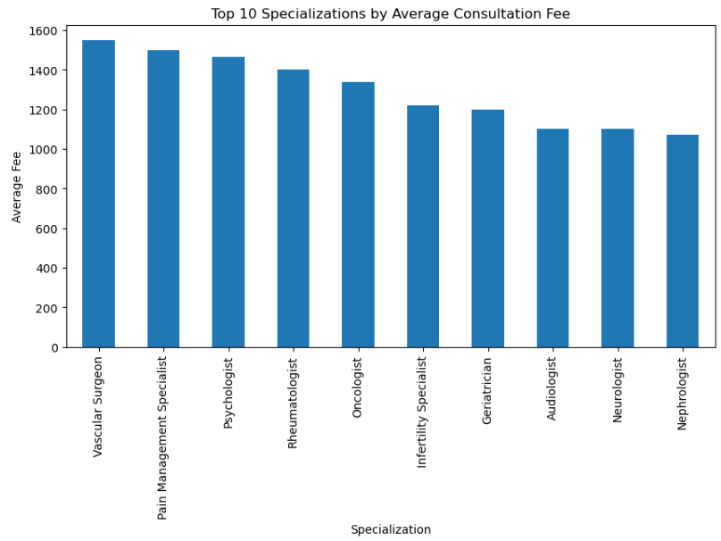
Observation: Density Plot of Doctor Experience
The distribution of doctor experience appears right-skewed (positively skewed).
Top 10 Specializations by Average Consultation Fee
Observation and Insights
Vascular Surgeons have the highest average consultation fee, indicating the specialized and complex nature of vascular treatments.
Geriatricians, Neurologists, and Internal Medicine specialists have moderately high consultation fees, as they handle a wide range of complex health conditions.
Nephrologists and Pulmonologists also appear in the top 10, reflecting the demand for specialists dealing with kidney and respiratory-related diseases.

Slide 25
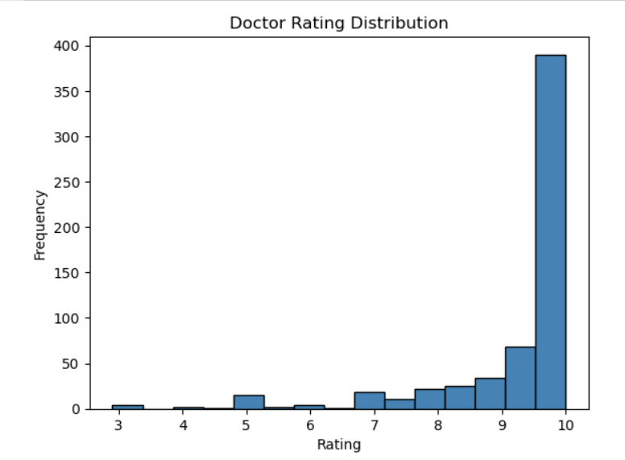
Observation: Density Plot of Doctor Experience
The distribution of doctor experience appears right-skewed (positively skewed).
Doctor Rating Distribution
Observation and Insights
The vast majority of doctors are rated close to 10 Rating 10 has ~385 doctors — by far the most frequent value Very few doctors have ratings below 7
Nearly 400 doctors have a perfect 10 rating This is unusually high and suggests possible data quality issues or a biased rating system

Slide 26
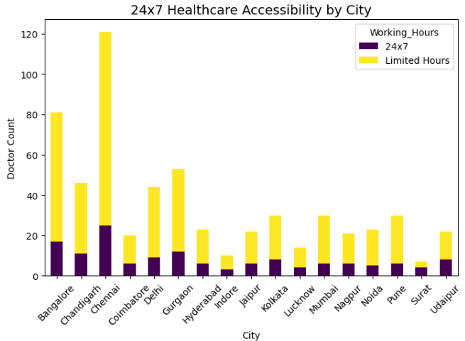
Observation: Density Plot of Doctor Experience
The distribution of doctor experience appears right-skewed (positively skewed).
Multivariate Analysis
24 x 7 Healthcare Accessibility by City
Observation and Insights
The chart compares 24x7 healthcare availability with limited-hour healthcare services across different cities.
Chennai has the highest number of healthcare facilities overall, including the largest number of 24x7 services, indicating strong healthcare accessibility.
Bangalore and Gurgaon also show relatively higher 24x7 availability, suggesting better emergency healthcare support in these metropolitan areas.
Smaller cities like Surat, Udaipur, and Indore have lower counts of both 24x7 and limited-hour facilities, indicating comparatively limited healthcare infrastructure.

Slide 27
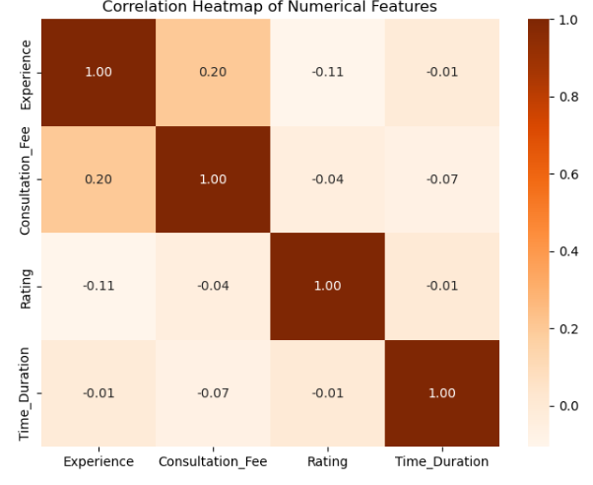
Observation: Density Plot of Doctor Experience
The distribution of doctor experience appears right-skewed (positively skewed).
Correlation Heatmap of Numerical Features
Observation and Insights
The heatmap shows the relationships between Experience, Consultation Fee, Rating, and Time Duration.
The correlations between variables are very weak, indicating that most factors such as experience, consultation fee, ratings, and working hours operate independently in the dataset

Slide 28
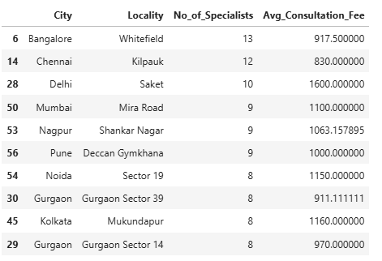
Observation: Density Plot of Doctor Experience
The distribution of doctor experience appears right-skewed (positively skewed).
Observation and Insights
The analysis shows that some localities combine high specialist availability with moderate consultation fees, providing better healthcare accessibility and affordability.
Certain areas with fewer specialists still have significantly higher consultation fees, reflecting differences in hospital infrastructure, specialization demand, and healthcare market conditions across cities.

Slide 29
Key Insights & Conclusions
🏙️
Metro Dominance
💰
Fee Disparity
⭐
High Satisfaction
Chennai & Bangalore lead in doctor count, specialization diversity, and 24x7 availability.
Consultation fees range from ₹0 to ₹3,000. Specialized roles (Vascular, Oncology) charge 2–3 times average.
Most doctors are rated 9–10/10, indicating consistent patient satisfaction across the dataset.
🕐
Limited 24x7 Care
👨‍⚕️
Experienced Workforce
📍
Top Localities
Only ~24% of doctors offer round-the-clock services — emergency access remains a nationwide gap.
Average experience peaks around 20 years. Senior doctors (40+) still receive excellent ratings.
T Nagar (Chennai), Whitefield (Bangalore), and Kilpauk (Chennai) are key healthcare hubs.

Slide 30

THANK
YOU

