Slide 1

Smart Tourism and IoT
Ali Sharaf Ahmed

Slide 2
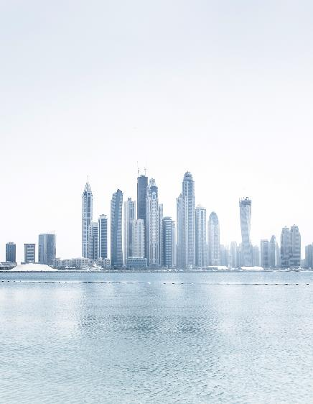

SMART TOURISM Using SMARTPHONES’
Travel Assistance
Impact of IOT

Slide 3
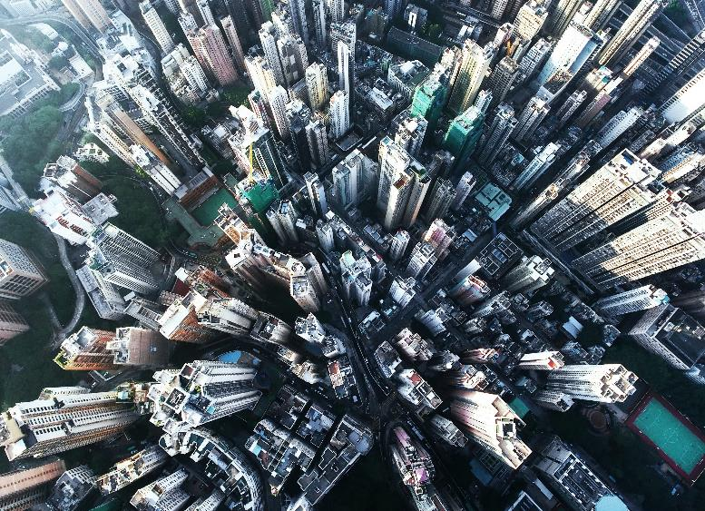

Introduction
The term "smart tourism" refers to the application of cutting-edge technology, such as the Internet of Things (IoT), to enhance the visitor experience, increase operational effectiveness, and support environmentally friendly travel strategies. As part of the Internet of Things (IoT), numerous sensors and gadgets, including smartphones, wearables, and beacons, are connected to the internet and to one another in order to facilitate real-time data gathering, analysis, and communication.

Slide 4
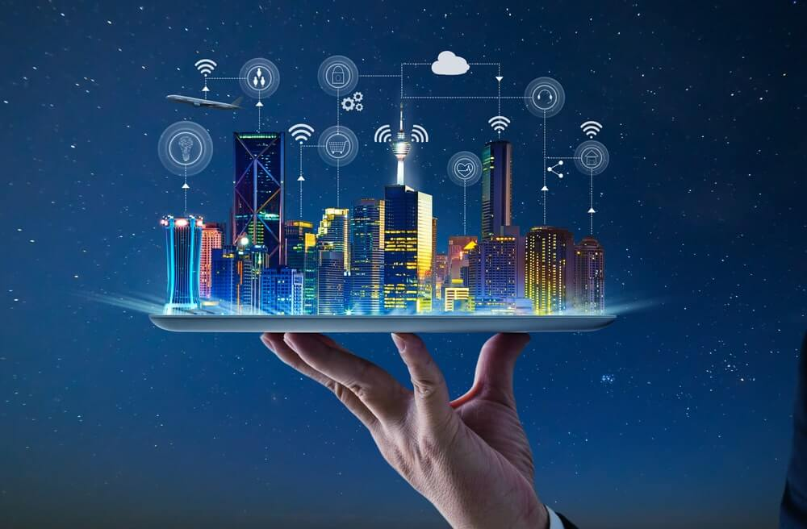
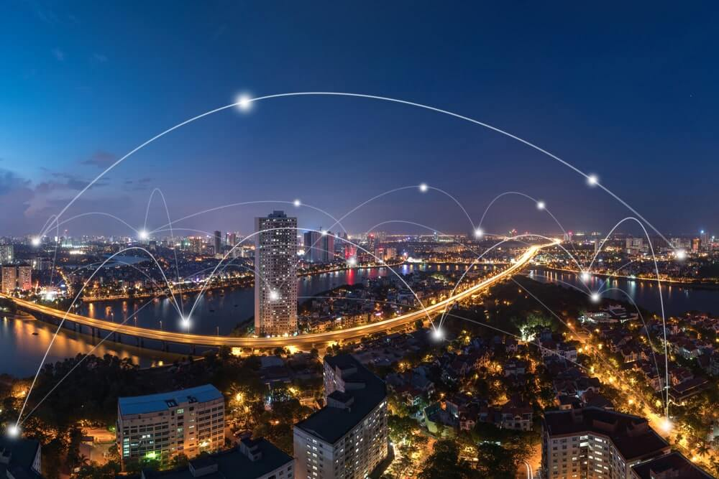
IoT technology may give useful insights on visitor behavior and preferences when used in the tourism industry, allowing firms to provide individualized and contextualized services.
This might contain anything from tailored suggestions for nearby sites to targeted promotions and discounts to up-to-the-minute information on weather and transit schedules.
IoT and smart tourism may also enhance resource management and operational effectiveness for tourist locations, lowering waste and environmental impact while enhancing the overall guest experience.
Overall, IoT and Smart Tourism provide the tourist sector with great prospects to use technology to enhance the effectiveness, sustainability, and personalization of services offered to visitors.

Slide 5

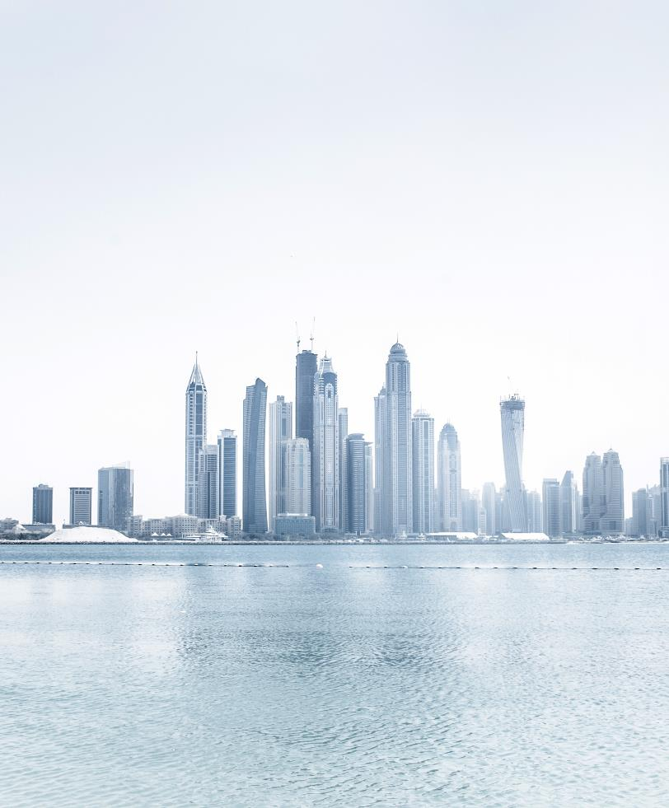

SMART TOURISM Using SMARTPHONES’
What is SMART TOURISM Using SMARTPHONES’??
Smartphone-based smart tourism refers to the use of portable electronics to improve the tourist experience and offer passengers individualized advice and real-time information.

Slide 6
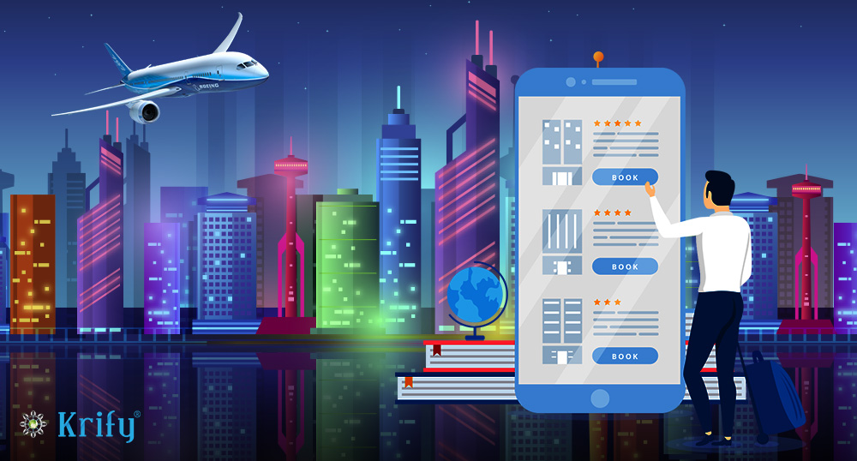
Importance of Smartphones in Travel
Accessibility: Smartphones enable quick decision-making for visitors by giving them access to a variety of information and services, such as reviews, local attractions, and timetables for public transit.
Social Media and Communication: Smartphones give visitors a means to share their trip experiences and memories with friends and family through social media and messaging applications.
Sustainable Tourism: Smartphones may encourage eco-friendly tourist methods by promoting digital maps and guides that eliminate the need for printed materials and paper waste.
Data Collection: For tourism-related organizations and locations, smartphones offer a useful data source that enables them to better understand tourist behavior and preferences and adjust their offerings appropriately.

Slide 7
Mobile applications used in Smart Tourism
Mobile applications are becoming a necessary tool for modern travel in the digital era. Travelers now have access to a variety of mobile applications created to improve their tourist experience thanks to the growing usage of smartphones. These apps offer real-time information and tailored suggestions to passengers using a variety of technologies, including augmented reality, location-based services, and language translation.
Examples:
Travel Booking and Planning Apps: Travelers may arrange flights, lodging, and activities using apps like Expedia, Booking.com, and Airbnb. These apps also provide suggestions for custom vacation itineraries.
Location-Based Services: Location-based services are used by apps like Google Maps and TripAdvisor to offer real-time details about nearby events, restaurants, and attractions in addition to instructions and ratings.
Local Tourist Board Apps: Numerous locations have created their own smartphone applications that give travelers bargains and discounts while also giving information about nearby attractions, events, and transportation.

Slide 8

Travel Assistance
The services and support offered to travelers to aid them in planning and navigating their journey are referred to as travel assistance. These services could include reserving lodging and travel arrangements, offering suggestions and guidance for travel, providing aid in case of an emergency, and assisting with lost or stolen property. Travel agencies, tour operators, travel insurance providers, and even mobile applications can offer aid with trip arrangements.

Slide 9
Examples on Travel Assistant
Trip Planning: Travel support services can aid passengers with trip planning by offering details on available modes of transportation, lodging alternatives, and local attractions.
Emergency Assistance: In the event of unexpected medical problems, lost or stolen property, or other unanticipated circumstances, travel aid companies can offer emergency support.
Language Assistance: Travel assistance companies can give language support services to passengers visiting foreign countries to aid with conversation and translation.
Travel Alerts: Providers of travel support can also provide travelers real-time travel notifications, such as details on the weather, delays in transit, and security threats.

Slide 10
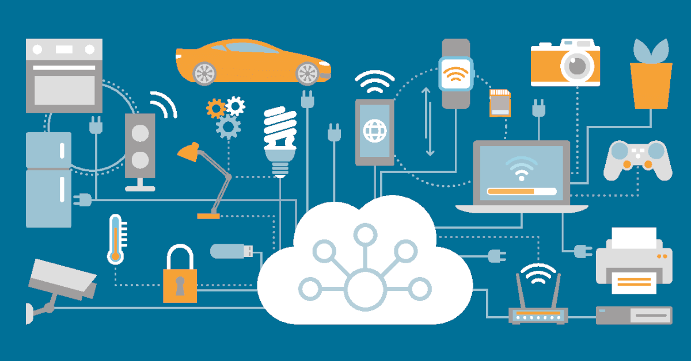
Impact of IOT
The Internet of Things (IoT) has a huge influence on tourism, giving firms in the industry the chance to improve the travel experience for customers.
IoT also aids environmentally friendly tourist activities like reducing trash and using less electricity.
IoT makes it possible to customize the trip experience, simplifies the travel procedure, and enhances security and safety in tourist areas.
Overall, IoT presents a wealth of prospects for innovation and development in the travel and tourism sector, offering travelers a more customized, effective, and sustainable travel experience while also enhancing the financial performance of the sector's enterprises.

Slide 11
IoT has the potential to have a big influence on the tourism industry, providing fresh ways to improve the travel experience for both travelers and tourism-related enterprises.
These are some observations on how IoT affects tourism:
Smart Transportation: IoT-enabled transportation systems may offer real-time data on traffic and transit choices while also assisting in route optimization and congestion reduction.
Smart Accommodations: IoT may be utilized to improve the guest experience in hotels by offering intelligent amenities and individualized services depending on visitors' wants and preferences.
Connected Destinations: IoT may be used to link diverse locations and points of interest, giving visitors a seamless travel experience and making it simpler to traverse foreign locations.
Efficiency: IoT-enabled solutions can assist simplify travel procedures, facilitating speedier and simpler exploration of new locations and attractions by visitors.

Slide 12
Summary
The idea of "smart tourism" involves using technology to develop and enhance the travel and tourist sector.
The goal is to give visitors individualized and engaging experiences via the use of different digital technologies, including mobile applications, social media, the internet of things (IoT), and artificial intelligence (AI). Travel should be more effective, convenient, and pleasurable for visitors.
Smart tourism also helps the tourism sector by boosting profits, cutting expenses, and enhancing sustainability. In general, smart tourism works to improve every link in the tourist value chain by utilizing technology to provide a seamless and integrated travel experience.

Slide 13
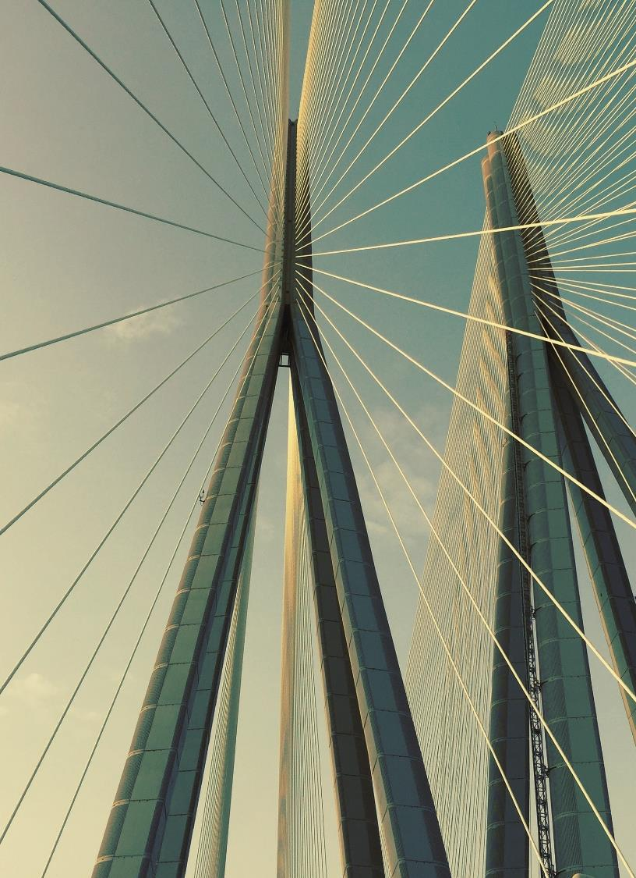
Thank you
Ali Sharaf Ahmed
Ali9.ahmed@live.uwe.ac.uk

