Slide 1
Matrix Addition and Multiplication
By Sebastian Capuyan

Slide 2
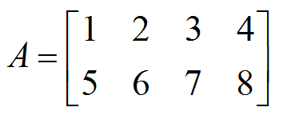
What is a Matrix?
-A Matrix is a two dimensional array of numbers, expressions, or symbols.
-Matrix size is always denoted by “rows x columns.”
-The Matrix below would be considered a 2x4 Matrix.
-The defined sets of rows and columns can be used to identify specific elements within the matrix.

Slide 3
Identify Elements in Matrix
-To identify the element in the matrix we often say first the row that the element is in and then the column that the element is in.
-For example “2” would be 1st row, 2nd column.
-For example “8” would be 2nd row, 4nd column.

Slide 4
Matrix Addition
- One of the simplest operations performed on Matrices (plural of Matrix).
-Before adding two Matrices, check if they are of the same size (same amount of rows and columns).
-Matrix addition is undefined for adding two matrices of different sizes.
-The definition of matrix addition is…
(From Discrete Math and Its Applications)

Slide 5

Example of Addition
-Though the definition may sound wordy, Matrix addition is quite simple!
-Just add the two elements from each matrix that share the same spot.
-This is why only Matrices of equal size may be added together.

Slide 6
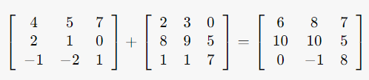
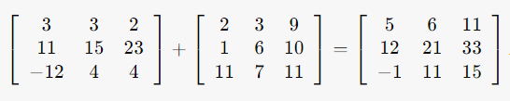
More Examples of Addition

Slide 7
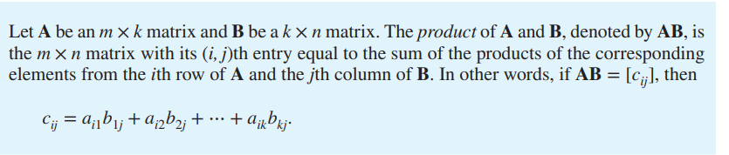
Matrix Multiplication
- A bit more complex…
-The basic definition of matrix multiplication is…
(From Discrete Math and Its Applications)

Slide 8
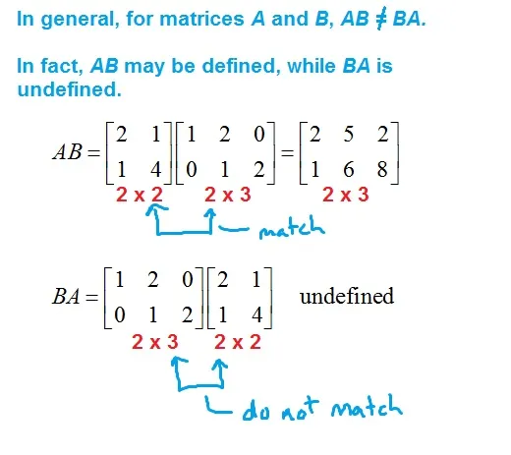
Matrix Multiplication (cont.)
-That explanation is a bit complicated to understand so let’s break it down.
-Matrices can only be multiplied if the number of columns of the first matrix matches the number of rows from the second matrix.
-One example would be that you could multiply a 2x3 matrix by a 3x5 matrix, but not a 3x2 matrix by a 3x5 matrix.
-This property makes matrix multiplication noncommutative unlike addition.
-This means that the order in which you multiply matrices matter.
-One example would be that you can not multiply a 3x5 matrix by a 2x3 matrix, although you could multiply them if your switch the order.
(From MathBootCamps)

Slide 9
Matrix Multiplication (cont.)
-The resultant matrix from multiplying two matrices has the number of rows from the first matrix and the number of columns from the second matrix.
-For example multiplying a 2x3 matrix by a 3x5 matrix will give a 2x5 matrix.
-Another example would be multiplying a 3x4 matrix by a 4x5 matrix will give a 3x5 matrix.

Slide 10
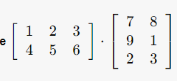
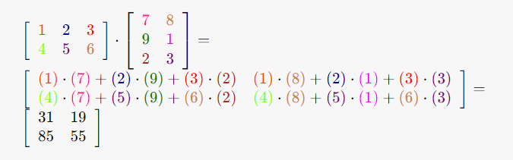
How to Multiply Matrices
Best shown in an example…
(From eMathHelp)

Slide 11

Application of Matrix Addition/Multiplication in the World
-Physics.
-In physics, matrices are used to represent vectors as individual components (x, y, and z).
-Vectors are things such as force, position, velocity, acceleration, etc.

Slide 12
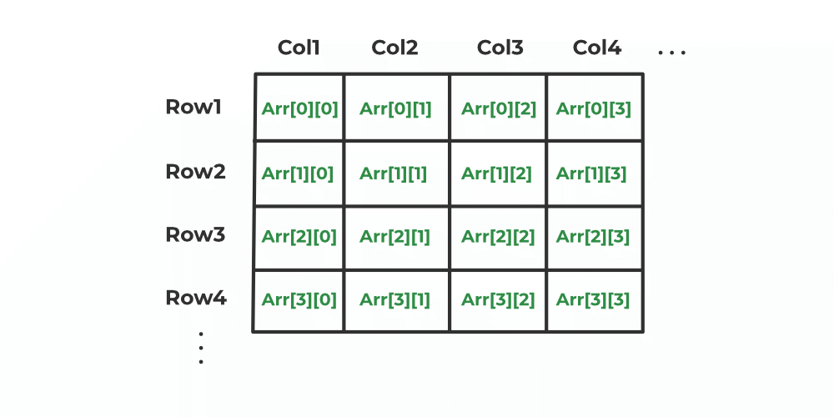
Application of Matrix Addition/Multiplication in the World
-Computer Science
-In Computer Science, matrices are often represented as a 2D array.
-2D arrays can be used to store data such as numbers or values.
-Can even be used to represent vectors from physics in order to simplify matrix addition and multiplication without doing the work by hand.
(From Geeks4Geeks)

Slide 13
References Used
“C++ Return 2D Array from Function.” GeeksforGeeks, GeeksforGeeks, 22 Dec. 2022, www.geeksforgeeks.org/cpp-return-2d-array-from-function/#.
“Matrix Multiplication Calculator.” eMathHelp, www.emathhelp.net/en/calculators/linear-algebra/matrix-multiplication-calculator/. Accessed 5 Dec. 2023.
“Multiplying Matrices.” MathBootCamps, 25 Sept. 2017, www.mathbootcamps.com/multiplying-matrices/.
Rosen, Kenneth H. “Matrices.” Discrete Mathematics and Its Applications, McGraw-Hill Education, New York, NY, New York, 2019, pp. 188–190.

Slide 14
Thank You!

