Slide 1
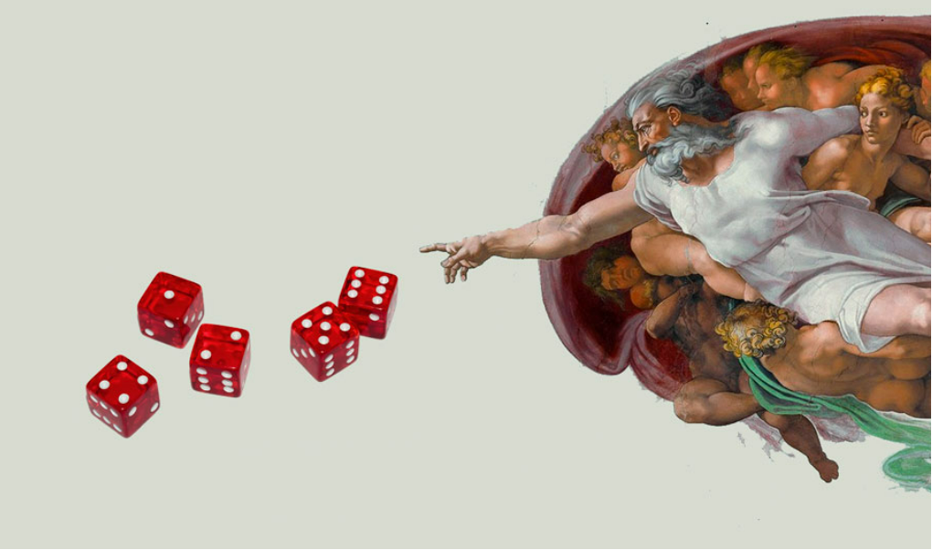
Embracing the Unpredictable
A Journey into Randomness and Probability
By Anas Griba

Slide 2
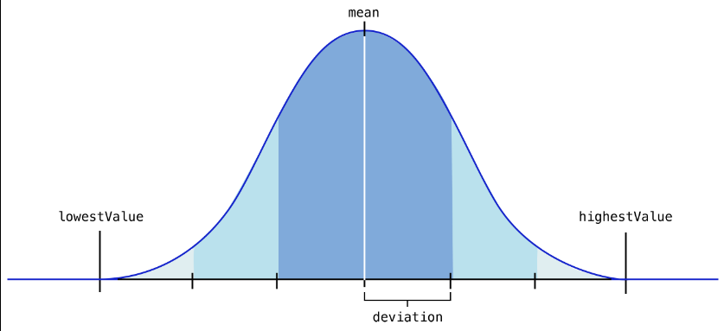
What is Randomness?
Randomness is the absence of a discernible pattern or predictability in events. It permeates our universe, from the probabilistic behavior of quantum particles to the chaotic unpredictability of macroscopic phenomena like weather patterns.

Slide 3
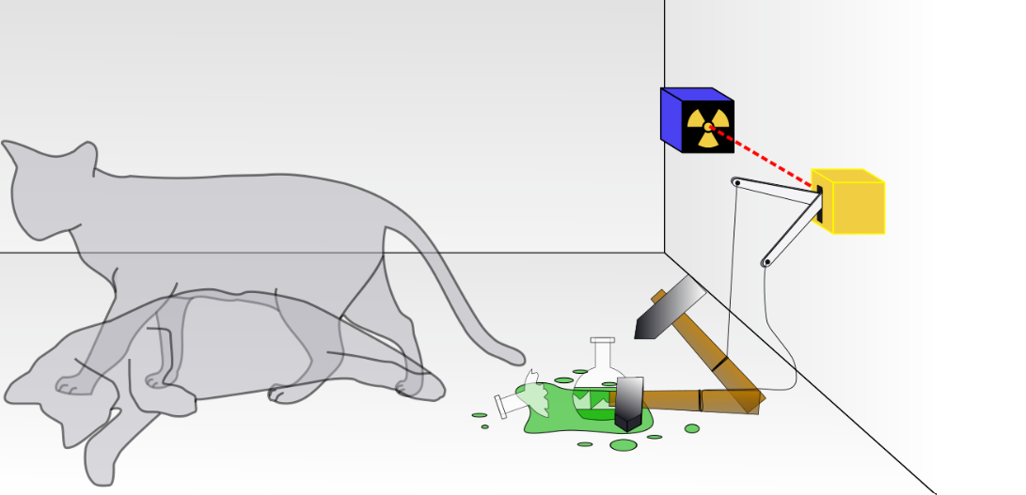
Randomness in Our Universe
At the quantum level, particles do not follow deterministic paths. Quantum mechanics, a fundamental theory in physics, introduces the concept of uncertainty. The Heisenberg Uncertainty Principle asserts that it is impossible to simultaneously know the precise position and momentum of a particle. Instead, we can only describe these properties probabilistically, highlighting the inherently random nature of quantum events.
randomness plays a crucial role in genetic variation. Mutations during DNA replication introduce unpredictable changes, contributing to the diversity of species. This inherent randomness in genetic processes is a driving force behind evolution, showcasing how the seemingly chaotic nature of randomness can lead to the emergence of new traits and species over time.

Slide 4
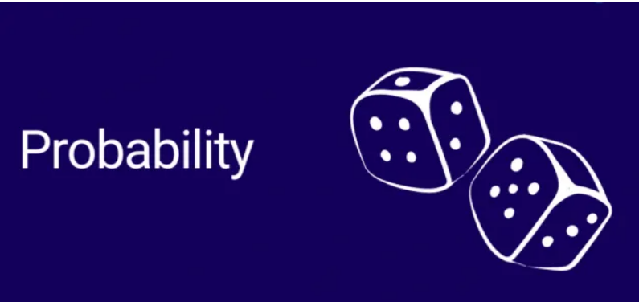
Mathematical Probability
Probability is a mathematical measure quantifying the likelihood of an event occurring. It is a way of expressing uncertainty and assigning numerical values to various outcomes within a given set of possibilities.
Sample Space: The set of all possible outcomes of an experiment. It represents the universe of potential events.
Events: Subsets of the sample space, representing specific outcomes or combinations of outcomes.
Probability Space: The combination of the sample space and the assignment of probabilities to each event, ensuring that the total probability sums to 1.

Slide 5
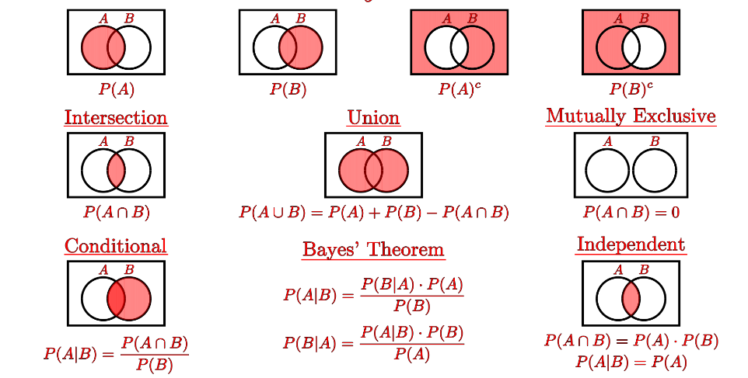
Probability Formulas
The basic probability formula is fundamental in understanding the likelihood of an event:
Conditional Probability
Conditional probability deals with the likelihood of an event occurring given that another event has already occurred:
​
Multiplication Rule for Independent Events
For independent events, the probability of both events occurring is calculated by multiplying their individual probabilities:

Slide 6

Bridging Probability and Randomness
Assigning Probabilities: Random variables are used to model and analyze uncertain situations. They are variables whose values depend on the outcomes of a random phenomenon. Assigning probabilities to these variables helps in understanding and predicting the range of possible outcomes.
Probability Distributions: The relationship between randomness and probability is further explored through probability distributions. These distributions describe the likelihood of different values a random variable can take, providing a comprehensive view of the associated uncertainty.

Slide 7

Using Probability to our Advantage
Poker as an Example: Probability plays a pivotal role in strategic decision-making, especially in games of skill like poker. Players use probabilities to assess the likelihood of various outcomes, informing their choices during different stages of the game.
Understanding Odds: In poker, understanding the odds of drawing specific cards or the likelihood of opponents holding certain hands empowers players to make more informed decisions. This knowledge is crucial for successful long-term play.
In Business: Beyond the gaming table, probability is a valuable tool in business decision-making. It aids in risk assessment, project planning, and financial forecasting. By incorporating probability into decision models, individuals and organizations can navigate uncertainty more effectively.
Personal Finance: Probability concepts are also applicable in personal finance. Assessing the probability of different investment outcomes or the likelihood of achieving financial goals helps individuals make sound financial decisions.

Slide 8
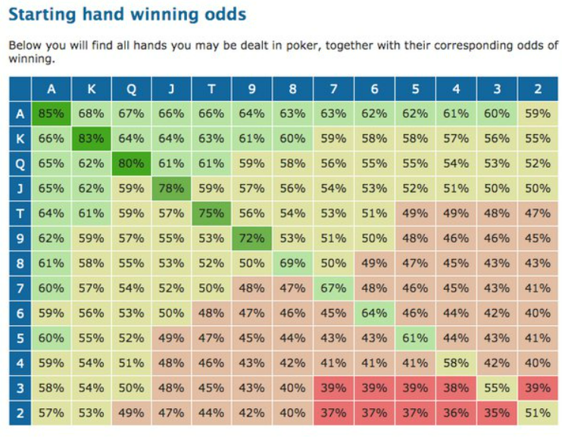

Slide 9

Conclusion
Mathematical Foundation: Probability emerged as a robust mathematical framework, providing a means to measure and understand uncertainty. From basic probability formulas to complex probability distributions, these mathematical tools bridge the gap between randomness and quantifiable outcomes.
Takeaway: Whether at the poker table or in real-world scenarios, probability empowers individuals to make informed decisions. By understanding and leveraging the likelihood of different outcomes, we gain a strategic advantage in navigating uncertainties.

