Slide 1
TEAM CAIRO · PROJECT REPORT
INCIDENT COMMANDER · PRE-FINAL · 2026
INCIDENT
COMMANDER
2026
V0.4 · PRE-FINAL ASSESSMENT DECK
VALUE-OF-INFORMATION | HUMAN-GATED INTERVENTION | VERIFIABLE EVIDENCE CHAIN
Period: Jul – Aug 2026 | vs. hackathon pre-final spec
Basis: Working prototype · 8-bundle authored corpus · live-LLM verified
PREPARED BY
REPORTING PERIOD
ISSUE DATE
DOCUMENT
REPORTING BASIS
Team Cairo
2026.07 — 2026.08
August 2026
Pre-Final Assessment V0.4
8-bundle corpus

Slide 2
02 | THE PROBLEM · WHY MORE TELEMETRY DOESN'T HELP
02 / 13
AIOps tools collect more telemetry when investigations stall — but sometimes more data does not resolve ambiguity.
VERDICT
Passive observation saturates. Engineers rely on intuition to stop.
When two hypotheses stay statistically indistinguishable given all available telemetry, no additional passive check separates them. Existing tools do not expose this saturation point as an auditable decision.
OF INCIDENTS
AIOPS TOOLS
MTTR INFLATION
≈50%
0
2×
end with a contested or unresolved cause
expose a formal 'stop observing' signal
typical when investigations hit passive-evidence saturation
This is a decision-theoretic gap. Not an observability gap.
The engineer's implicit question — "is it worth checking one more thing, or should I act?" — has a formal answer in Value-of-Information theory.
PREPARED BY
REPORTING PERIOD
DOCUMENT
Team Cairo
2026.07 – 2026.08
Pre-Final V0.4 · Slide 02

Slide 3
03 | THE INSIGHT · VALUE-OF-INFORMATION AS THE DECISION LAYER
03 / 13
Every candidate next action is scored by expected information gain net of cost and risk.
DECISION FUNCTION
VoI(a) = EIG(a) − λ · cost(a) − μ · risk(a)
COST WEIGHT
RISK WEIGHT
STAGNATION FLOOR
λ = 0.05
μ = 1.00
ε = 0.05 nats
Observations are cheap — small deduction
Intervention dominates only when observation collapses
Below this, no observation is expected to move the posterior
THEORETICAL FOUNDATION
Howard (1966) — Information Value Theory · Chaloner & Verdinelli (1995) — Bayesian Experimental Design · Pearl (2009) — Causal vs Correlational Evidence
PREPARED BY
REPORTING PERIOD
DOCUMENT
Team Cairo
2026.07 – 2026.08
Pre-Final V0.4 · Slide 03

Slide 4
04 | THE MECHANISM · AGENTS DISAGREE; ADJUDICATOR DECIDES
04 / 13
Specialist agents argue different theories. The adjudicator scores every candidate action and picks the argmax.
STAGE 1
STAGE 2
STAGE 3
STAGE 4
Three biased agents
VoI adjudicator
Probe · Intervention
Sealed verdict
change · telemetry · history
EIG − λ·cost − μ·risk
gated on human approval
Merkle + Ed25519
HOW THE HONESTY LAYER WORKS
Passive checks continue while informative. When VoI collapses, only then does the intervention gate appear.
Nothing destructive fires without an explicit human click. The verdict is Merkle-rooted over cited evidence and Ed25519-signed — verifiable offline in one command, from a standalone tool.
GUARDRAILS
K = 4 probes · T = 45s wall clock · τ = 0.15 margin · ε = 0.05 nats · intervention envelope: 5% traffic, 60s bound, auto-revert
PREPARED BY
REPORTING PERIOD
DOCUMENT
Team Cairo
2026.07 – 2026.08
Pre-Final V0.4 · Slide 04

Slide 5
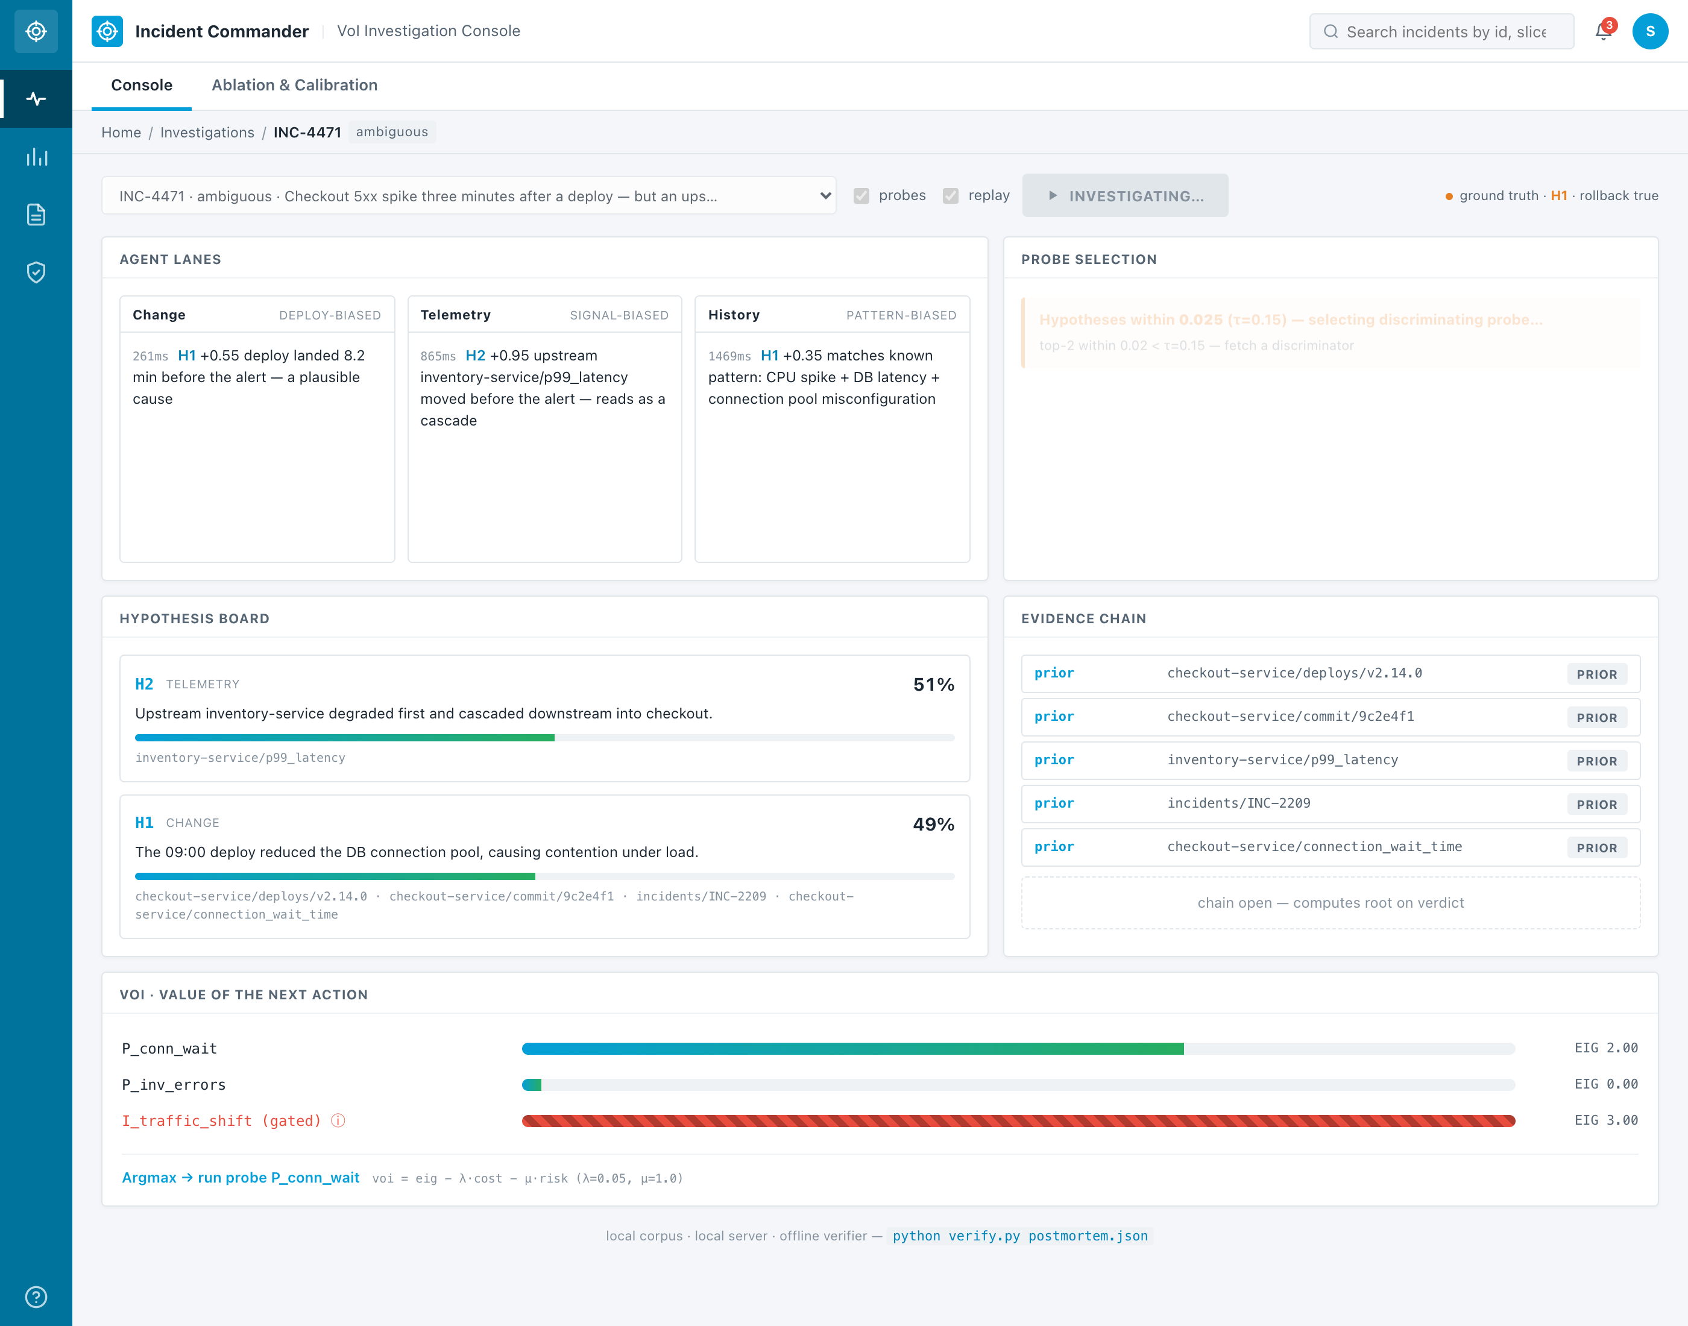
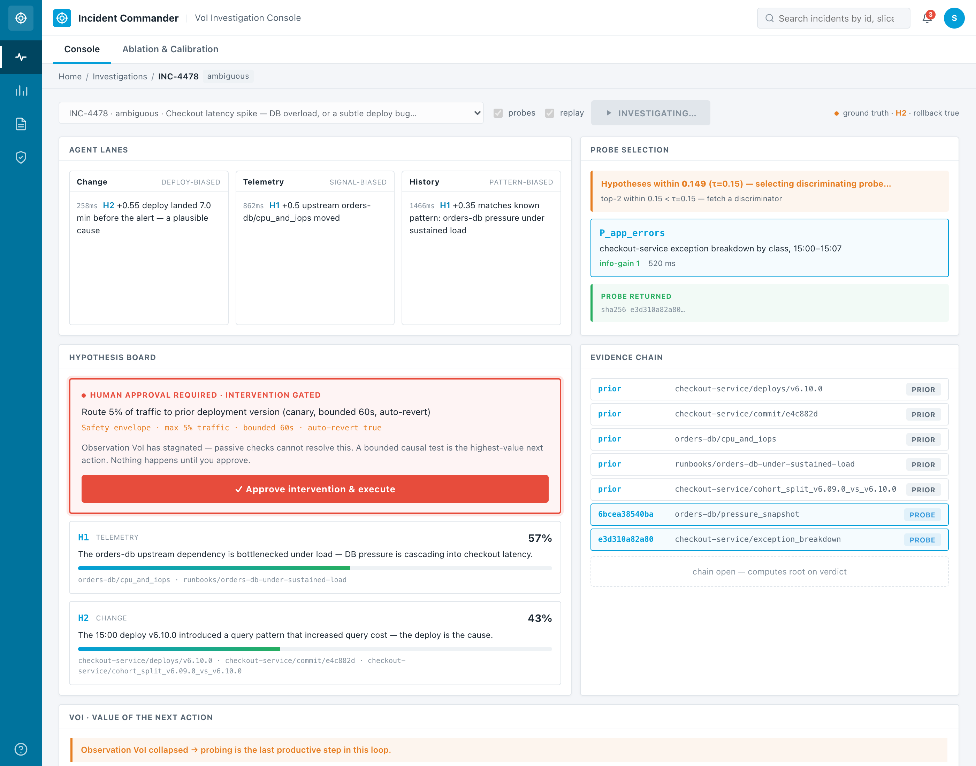
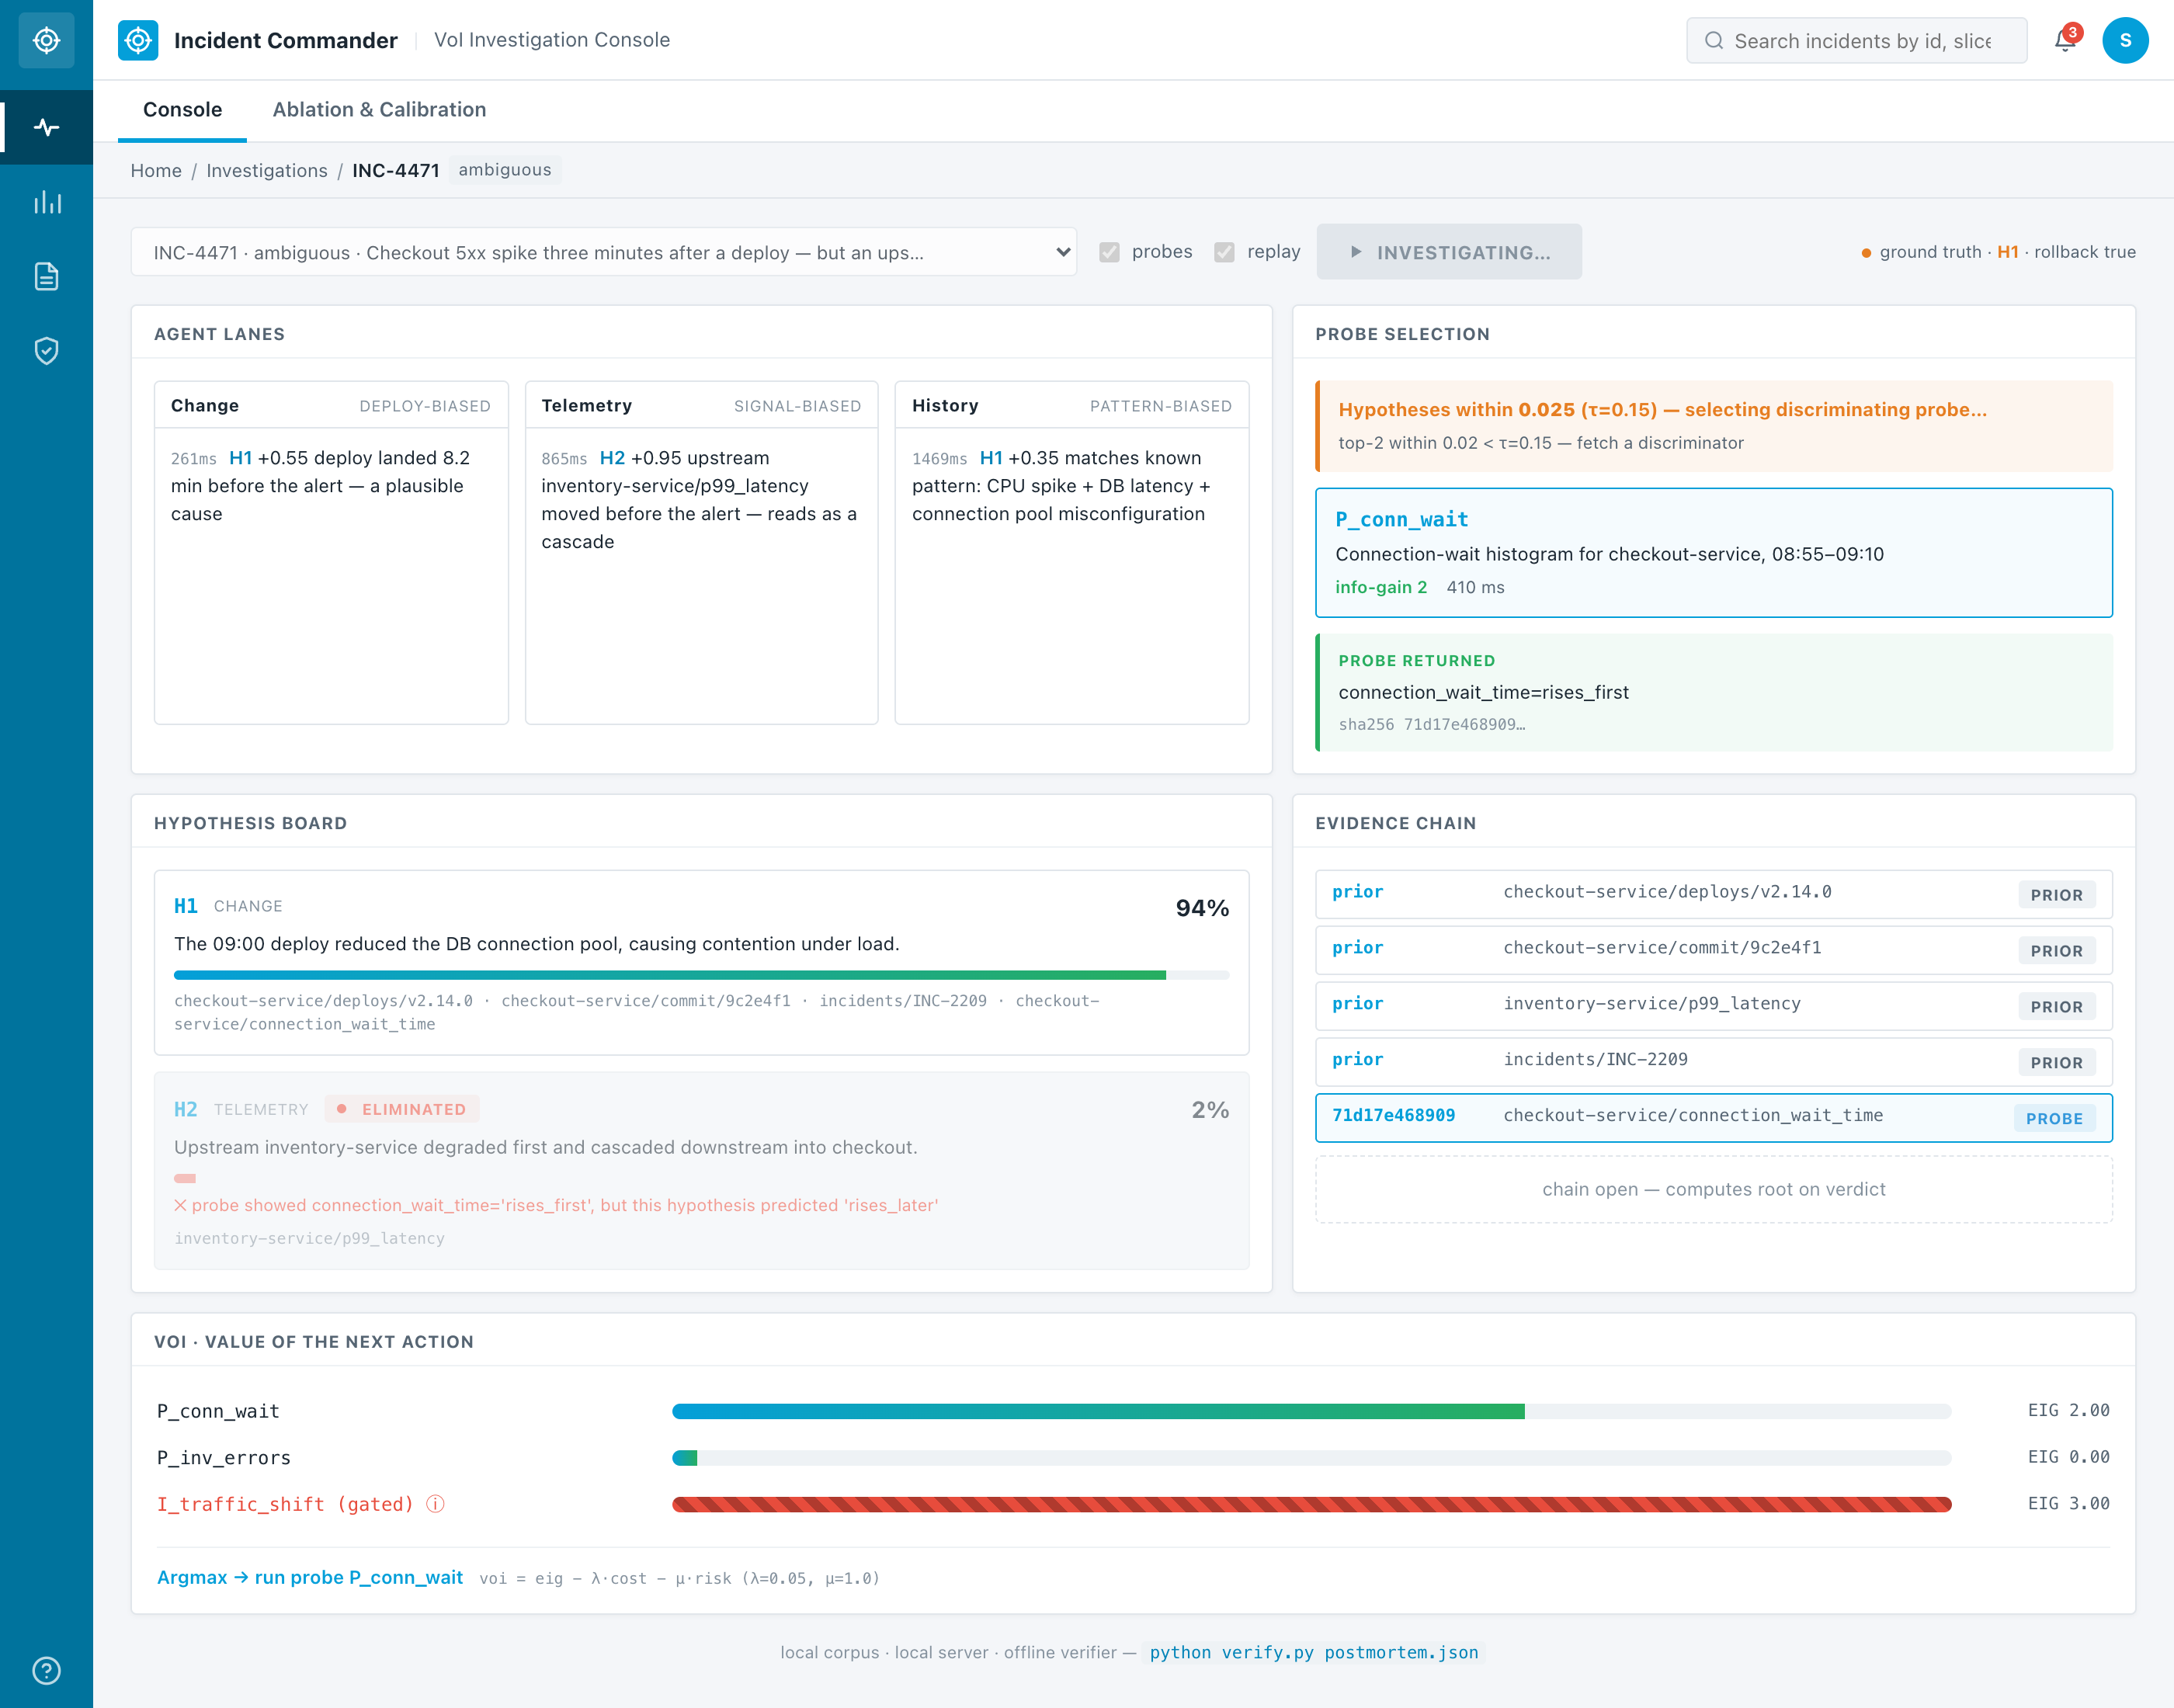
05 | LIVE DEMONSTRATION · THREE MOMENTS TO WATCH FOR
05 / 13
Best shown running. Watch for: the tie, the pause, the seal.
MOMENT 01
MOMENT 02
MOMENT 03
Ambiguity detected
Observation saturates
Verdict sealed
Two hypotheses within τ. System picks the highest-info probe.
Passive checks exhausted. Human-gated intervention offered.
Merkle root + Ed25519 signature. Verifiable offline.
PREPARED BY
REPORTING PERIOD
DOCUMENT
Team Cairo
2026.07 – 2026.08
Pre-Final V0.4 · Slide 05 · Live demo begins here

Slide 6
06 | THE PROOF · ABLATION ACROSS 12 BUNDLES, 24 RUNS
06 / 13
Turn probes off — zero percent. Turn them on — one hundred.
On the ambiguous and adversarial slices, specifically designed to be unresolvable by first-glance evidence.
Δ ACCURACY · HARD SLICES
TOP-1 · POLICY ON
FP ROLLBACK · ADVERSARIAL
BRIER SCORE · POLICY ON
+100%
100%
100 → 0%
0.004
0 % → 100 % (0/6 → 6/6)
12 / 12 bundles correct
off → on, harmful action removed
baseline 0.287 · calibration
PREPARED BY
REPORTING PERIOD
DOCUMENT
Team Cairo
2026.07 – 2026.08
Pre-Final V0.4 · Slide 06 · Illustrative, not publication-grade

Slide 7
07 | PROGRESS TO DATE · WORKING PROTOTYPE · EVERY CLAIM IS RUNNABLE
07 / 13
What is built, in the language of the four evaluation criteria.
MECHANISM
SAFETY
TRUST
VoI-guided policy
Human-gated intervention
Verifiable evidence chain
Three biased agents; info-gain probe selection; bounded loop (K=4, T=45s, τ=0.15).
Specified 5% canary envelope, 60s bound, auto-revert. Nothing fires without approval.
Merkle root + Ed25519 signature. Offline verifier prints VERIFIED or TAMPERED.
REASONING
EVALUATION
EXPERIENCE
Deterministic + live-LLM
8 bundles, 5 slices
Enterprise console + replay
Reproducible offline. Live path via OpenRouter → Claude failover, JSON-validated.
Ablation harness produces reproducible metrics; per-slice breakdown in appendix.
Cisco-language operator UI. Full replay mode for deterministic on-stage demos.
RUNNABLE
python -m ic.harness · python -m ic.investigate INC-4471 -o postmortem.json · python verify.py postmortem.json
PREPARED BY
REPORTING PERIOD
DOCUMENT
Team Cairo
2026.07 – 2026.08
Pre-Final V0.4 · Slide 07

Slide 8
08 | LIMITATIONS · STATED PLAINLY, BEFORE YOU HAVE TO ASK
08 / 13
Four disclosures. Each is a deliberate choice, not an oversight.
CORPUS SIZE
EXECUTION SURFACE
12 authored bundles across 5 slices
Intervention runs against fixture data
Ground truth may be easier to reach than in an unfamiliar production system. Numbers are illustrative, not publication-grade.
Same simulation model as our probes. A container-orchestrated canary executor is Phase 2 — item four on the roadmap.
BASELINE
CONSTANTS
OFF is a proxy, not a competitor benchmark
λ, μ, ε are hand-tuned
The OFF condition approximates unassisted investigation. We do not benchmark against Dynatrace, Datadog, or PagerDuty directly.
Not learned or calibrated against organization-specific cost structures. Making them organization-configurable is on the roadmap.
Naming these on this slide preempts the hostile version of the question in Q&A.
PREPARED BY
REPORTING PERIOD
DOCUMENT
Team Cairo
2026.07 – 2026.08
Pre-Final V0.4 · Slide 08

Slide 9
09 | ROADMAP · SIX LADDER STAGES SHIPPED · THREE REMAIN
09 / 13
The nine-step production ladder from docs/ROADMAP.md. Each remaining stage names its tool.
✓
Policy engine + verification loop + CIS
shipped Sep 12–16
OPA + Rego gate replaces the Approve button. Verification re-checks recovery; failure auto-reverts. Customer-Impact Score routes urgency without ever touching diagnosis.
✓
Dynamic LLM triage + OTLP adapter + corpus 8→12
shipped Sep 14–19
LLM generates hypotheses live from raw context with anti-hallucination filter. Spec-compliant OTLP JSON ingested via NiFi flow. Four new bundles exercise every new capability.
3
Live OTel Collector + shadow mode
≈ 2 weeks
OTLP adapter is DONE — remaining work is wiring a real OpenTelemetry Collector to NiFi and adding the shadow-mode toggle that runs against real incidents without executing.
4
Argo Rollouts execution + formal EIG
≈ 4 weeks
Interventions fire against a real k8s canary controller (Argo Rollouts). Divergence heuristic in probe selection is replaced by formal Expected Information Gain (Chaloner & Verdinelli).
PREPARED BY
REPORTING PERIOD
DOCUMENT
Team Cairo
2026.07 – 2026.08
Pre-Final V0.4 · Slide 09

Slide 10
The decision policy is what runs today.
Executing on it further — real infrastructure, larger corpus, organization-calibrated weights — is Phase 2, and we are explicit about the line.
Thank you — questions welcome.
Repository: github.com/S2800-0/Incident-commander
PREPARED BY
REPORTING PERIOD
DOCUMENT
Team Cairo
2026.07 – 2026.08
Pre-Final V0.4 · Slide 10 · Close

Slide 11
11 | APPENDIX A · ARCHITECTURE
11 / 13
Where each concern lives.
BACKEND
FRONTEND
Python 3.13 · Pydantic · FastAPI + WS · cryptography
Vite · React + TypeScript · Recharts
Deterministic reasoning engine + Anthropic SDK (drives both Claude and OpenRouter's Anthropic-compatible endpoint). SHA-256 Merkle + Ed25519 for the evidence chain.
Cisco enterprise design language: navy rail, white workspace, single-accent palette. Full replay mode with client-side pause on gate_pending event.
REASONING LAYER
CORPUS
Deterministic first · live-LLM lens
Schema-versioned JSON bundles
The analytical engine derives every score from evidence payloads — so the ablation is reproducible with no API key. Live-LLM routes through a single choke point: strict JSON validation, one retry, provider failover.
Every bundle authored against a documented invariant: the discriminating signal must live only in the probeable tier. Authoring guide + LLM-assisted first-draft workflow ships with the repo.
PREPARED BY
REPORTING PERIOD
DOCUMENT
Team Cairo
2026.07 – 2026.08
Pre-Final V0.4 · Slide 11

Slide 12
12 | APPENDIX B · PER-SLICE ABLATION RESULTS · 12 BUNDLES, 24 RUNS
12 / 13
The full ablation on the wider corpus. Deployment-induced remains the easy case; hard slices still need probes.
Slice | Bundles | Policy ON | Policy OFF
ambiguous | 4 | 100% (4/4) | 0% (0/4)
adversarial red-herring | 2 | 100% (2/2) | 0% (0/2)
cascading dependency | 1 | 100% (1/1) | 0% (0/1)
resource exhaustion | 2 | 100% (2/2) | 0% (0/2)
deployment induced | 3 | 100% (3/3) | 100% (3/3)
all bundles | 12 | 100% (12/12) | 25% (3/12)
For each of the 6 hard-slice bundles, OFF picks the wrong hypothesis; ON picks the right one.
PREPARED BY
REPORTING PERIOD
DOCUMENT
Team Cairo
2026.07 – 2026.08
Pre-Final V0.4 · Slide 12

Slide 13
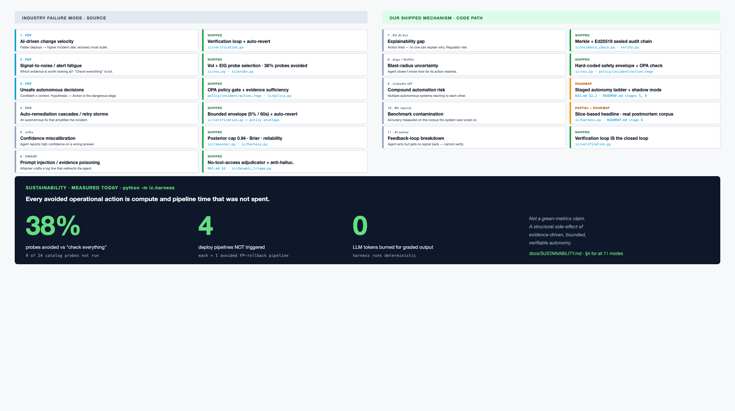
13 | APPENDIX C · INDUSTRY FAILURE MODES · WHAT WE DON'T FALL INTO
13 / 13
Eleven documented failure modes in the agentic-AI DevOps literature. Each maps to a shipped module.
PREPARED BY
REPORTING PERIOD
DOCUMENT
Team Cairo
2026.07 – 2026.09
Pre-Final V0.5 · Slide 13

