Slide 1
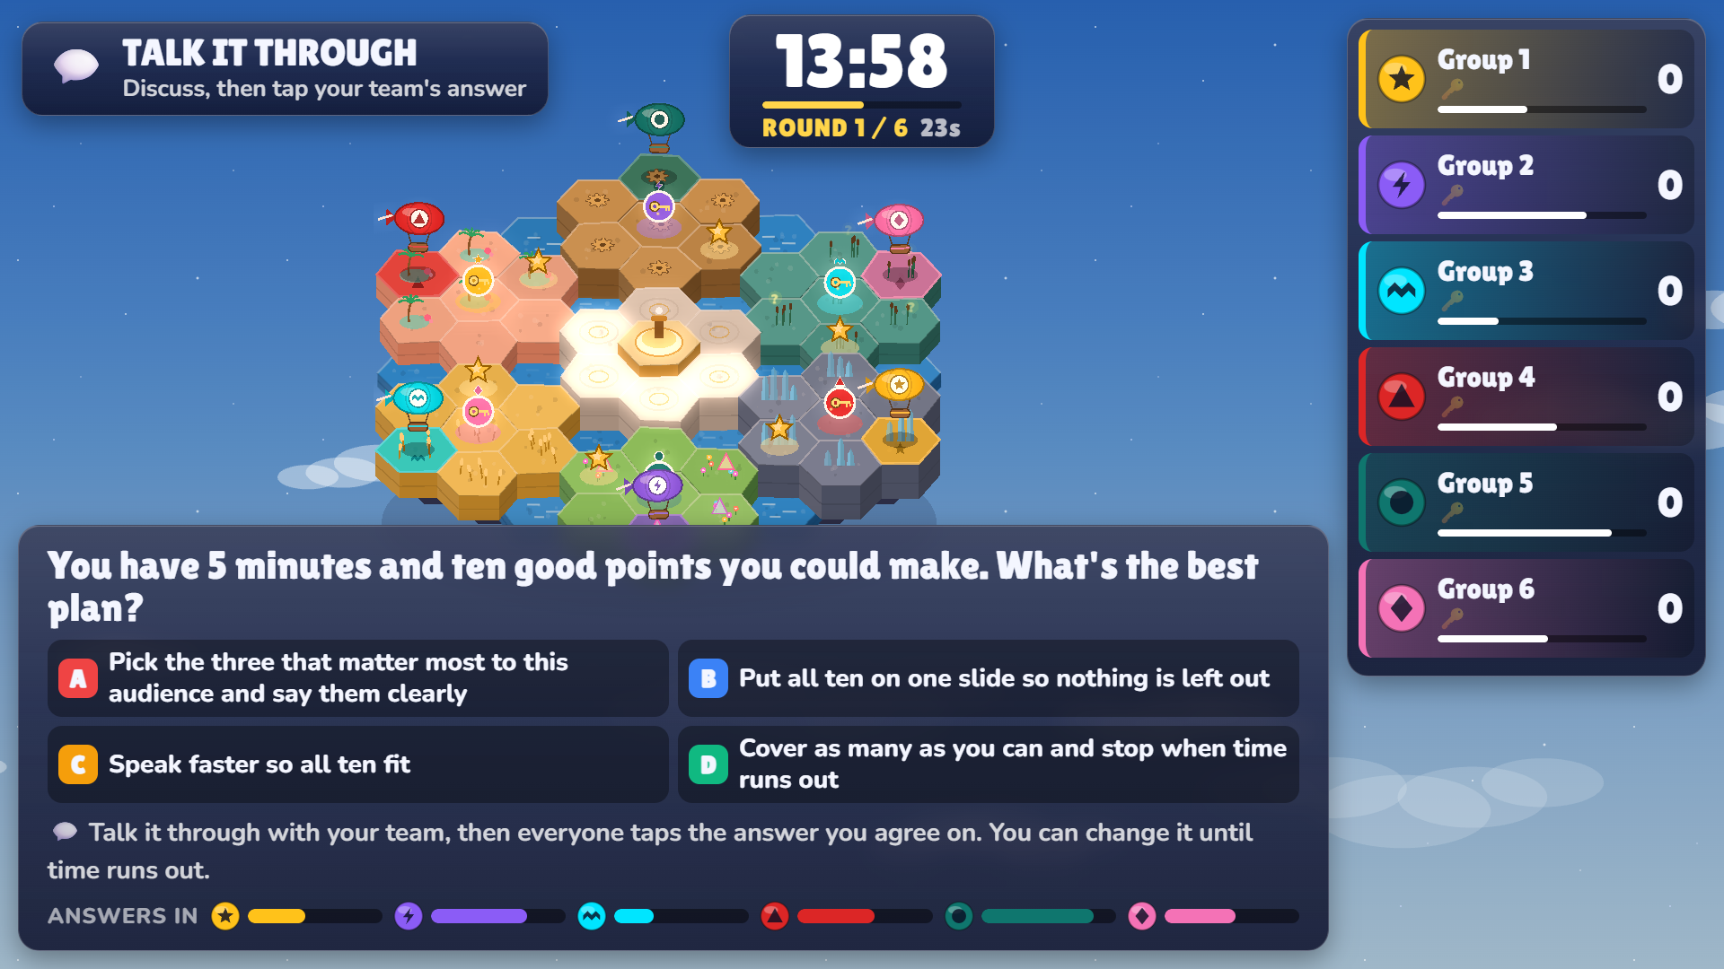
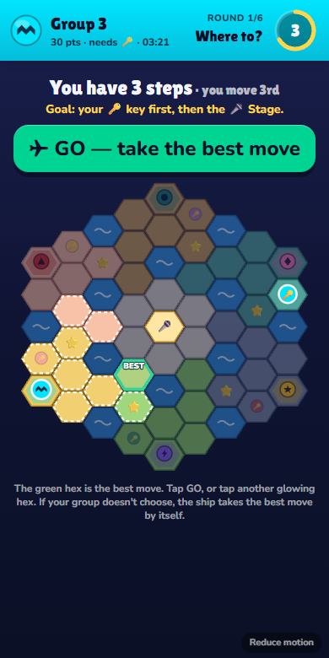
ACTIVITY 3 · OUR OWN GAME
SPOTLIGHT
ISLES
Talk it through. Pitch it well. Reach the Stage.
15 minutes
6 groups
Everyone pitches once
One big screen. Your phone is the controller.
Facilitated by [your names here]
GSOE9010 · Week 5 · Presentation Skills · Activity 3
1 / 5
Notes:
FACILITATOR 1. "The topic today is presentation skills. For our third activity we made a game. The purpose is to use everything from the first two activities together: decide what good presenting looks like, give a short talk, and mark other people's talks." Keep it to 20 seconds. Don't read the slide.

Slide 2
WHY A GAME?
Facilitation is gathering everyone's best thinking
So we built an activity where the room does the talking, and we guide.
1
2
3
Everyone talks
Everyone presents
Everyone assesses
45 seconds to discuss before anyone taps. There is no prize for being fastest.
A spin picks two groups each pitch round. Every group pitches exactly once.
You mark each pitch on three criteria, the same way your own talks are marked.
You can change your answer until time runs out
Your group chooses its own speaker
Hook · Clarity · Confidence
Our job: ask, listen, keep time. Your job: think out loud.
GSOE9010 · Week 5 · Presentation Skills · Activity 3
2 / 5
Notes:
FACILITATOR 2. "As facilitators our job isn't to talk the whole time. It's to get the best thinking out of all of you. So in this game: everyone talks, everyone presents, everyone assesses." Ask the room: "In your experience, what makes a group discussion go quiet?" Take one or two answers, by name, and acknowledge them.

Slide 3
WHAT YOU'LL LEAVE WITH
By the end of 15 minutes you can…
Spot the stronger technique
in a real presenting situation, and say why.
THE GOAL
1
1
2
3
Give a 40-second talk
with a hook, one clear message and a confident finish.
2
Home
your island
Key
opposite island
Stage
in the middle
Mark a talk fairly
against clear criteria, not on who you like.
Every round, every group moves 2 steps.
Right answer or good pitch: move 3.
3
Every group can reach the Stage. The earlier you arrive, the bigger the bonus. Most points wins.
GSOE9010 · Week 5 · Presentation Skills · Activity 3
3 / 5
Notes:
FACILITATOR 3. Say the three outcomes in your own words, then the goal: "Fly to your key on the far island, then to the Keynote Stage in the middle. You move every round, and further when you answer or pitch well." Check understanding: ask one group to repeat the goal back.

Slide 4
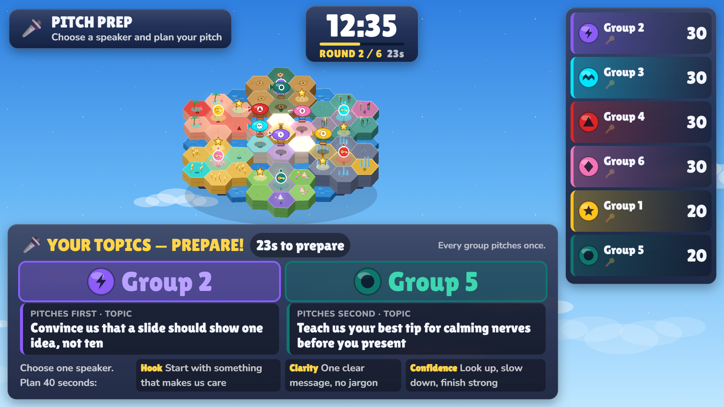
HOW IT WORKS
Six rounds: talk, then pitch
ROUNDS 1 · 3 · 5
ROUNDS 2 · 4 · 6
Group question
Group pitch
1
A presenting scenario with four options
1
A spin picks two groups
2
45 seconds: discuss and agree
2
48 seconds to prepare your topic
Your topic is on the big screen.
You'll be marked on Hook, Clarity and Confidence.
3
Half your group right: move 3 steps
3
40 seconds to speak; the room gives stars
Moving is one tap: your phone shows the best hex in green, press GO. During pitches: phones down, eyes up.
GSOE9010 · Week 5 · Presentation Skills · Activity 3
4 / 5
Notes:
FACILITATOR 4. Walk through one question round and one pitch round. "There's no prize for speed, so talk first, tap second." "When the spin picks your group, your topic appears. Choose ONE speaker and plan together." Pause after asking "Any questions about how a round works?" and wait a full five seconds before moving on.

Slide 5
READY?
Let's play. Join now.
JOIN IN FOUR STEPS
WHILE YOU PLAY, WE WILL
1
Scan the QR code on the next screen
Read every question and topic aloud
2
Type a nickname
Be at your table
to help the discussion, not to give answers
3
Pick your group number
Keep the clock
the game ends at exactly 15:00
4
Sit together, phones ready
Finish with your results
what the room found hardest, and three takeaways
Goal: get your key, reach the Keynote Stage. Most points wins.
GSOE9010 · Week 5 · Presentation Skills · Activity 3
5 / 5
Notes:
ALL FACILITATORS. One of you switches to the game's host screen (the QR code is there). Floor coaches go to the tables now and help people join: "Have you picked your group number?" When every group has at least one player, press START. The 15:00 clock begins.

