Slide 1
GPA1-B
5/11/2026
Brandon Schamberg

Slide 2
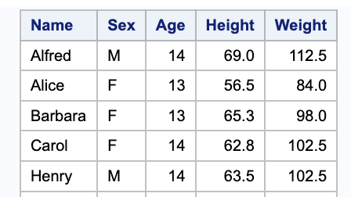

Slide 3
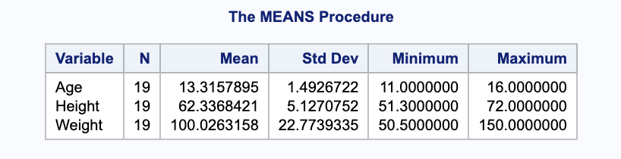

Slide 4
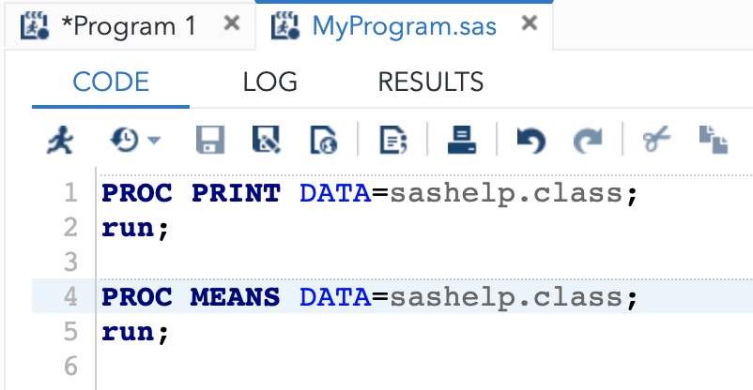

Slide 5
Text added for git diff

