Slide 1
LLM code authorship: five classes
Which LLM wrote this C program?
20,000 programs from LLM-AuthorBench
Five classes with 4,000 programs each
Our topic: attributing LLM-generated code.
Four classical classifiers plus a CodeT5 encoder classifier.
Saeed Alshehhi, Khalifa Alblooshi, Maitha Alblooshi
Fatima Alnuaimi, Fatima Alsadi
https://github.com/S3eeDTR/LLM-AuthorBench-Assignment
Source: github.com/LLMauthorbench/LLMauthorbench
Notes:
Source: https://github.com/LLMauthorbench/LLMauthorbench ; paper https://arxiv.org/abs/2506.17323 . The authors describe code generation from 300 parameterized C-programming templates, followed by deduplication and compilation filtering. We treat code as text. The five labels are gpt-4.1, deepseek-chat, claude-3.5-haiku, gemini-2.5-flash-preview-05-20 and llama-3.3-70b-instruct. AI assistance was used for code and writing. The instructor approved the dataset choice by email. Dataset reuse licence remains unverified; individual contributions remain to be documented.

Slide 2
Data preparation
Split | Programs | Task groups
Training | 13,150 | 181
Validation | 2,978 | 38
Test | 3,872 | 40
TF-IDF: Term Frequency–
Inverse Document Frequency
50,000 patterns of 3–5 characters
Fit using training code only
0 empty programs
0 exact source duplicates
Five labels in every split
Saved groups keep related prompt variants together.
No shared group, exact prompt or source hash across splits.
Groups are inferred. Some semantic overlap may remain.
Notes:
Sources: data/splits.csv, results/split_counts.csv and class_counts.csv. We filter the prior seed-42 split to five labels. Grouping originally normalized prompt parameters, used audited task aliases and merged similar descriptions. Provenance: Git commit 33b42098d3bfdeddd8d94c77326a22fb8847be0a, src/prepare_data.py. There are no official task IDs. Groups can overmerge and unrecognized paraphrases may overlap. Full dataset has eight labels; the selected subset has 20,000 complete, unique source programs. Case retained; sklearn character analysis collapses repeated whitespace.

Slide 3
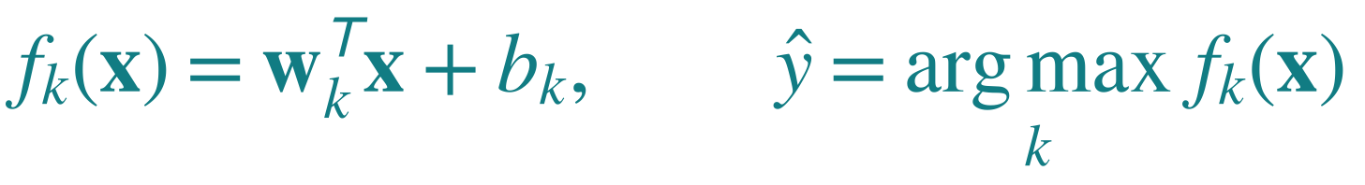
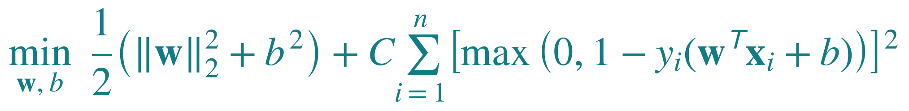
Experiment 1: how Linear SVM learns
Naive Bayes: baseline Logistic Regression: linear probability model
Support Vector Machine: linear margin model Random Forest: trees
Train five one-vs-rest classifiers. Predict the class with the largest score.
x: TF-IDF weights w: learned feature weights b: learned offset
yᵢ: +1 for this author, −1 for the others C = 1 in our code
First term limits weight size. The sum penalizes margin violations.
Toy example: yᵢ f(xᵢ) = 0.6 gives loss (1 − 0.6)² = 0.16.
LinearSVC uses squared-hinge loss and regularizes the intercept (scale = 1).
Notes:
Sources: assignment.py and https://scikit-learn.org/stable/modules/generated/sklearn.svm.LinearSVC.html . Explain aloud: each code sample becomes a vector x of TF-IDF weights. For a chosen author, multiply each feature by its learned weight, add the contributions, then add b. The superscript T means transpose and w-transpose-x is a dot product. k indexes authors; i indexes training programs. For each author y is +1 for that author and -1 for the other four. The training algorithm minimizes J over w and b. Norm squared means sum of squared weights; sigma means sum over training examples. Our defaults use L2 penalty, squared-hinge loss, one-vs-rest, fit_intercept=True and intercept_scaling=1, so b squared is part of the regularization term. C=1 controls the relative cost of margin violations. If signed score y*f is at least 1, loss is zero. At 0.6 loss is 0.16; at -0.5 loss is 2.25. These are invented teaching examples, not measured model outputs. Five class scores are compared by argmax; scores are not calibrated probabilities. NB alpha=1; LR C=1 max_iter=3000; RF 150 trees max_depth=40 min_samples_leaf=2 max_features=sqrt. Shared splits and feature matrix keep the comparison fair. The equation explains the mechanism, not proof of why SVM wins on this dataset.

Slide 4
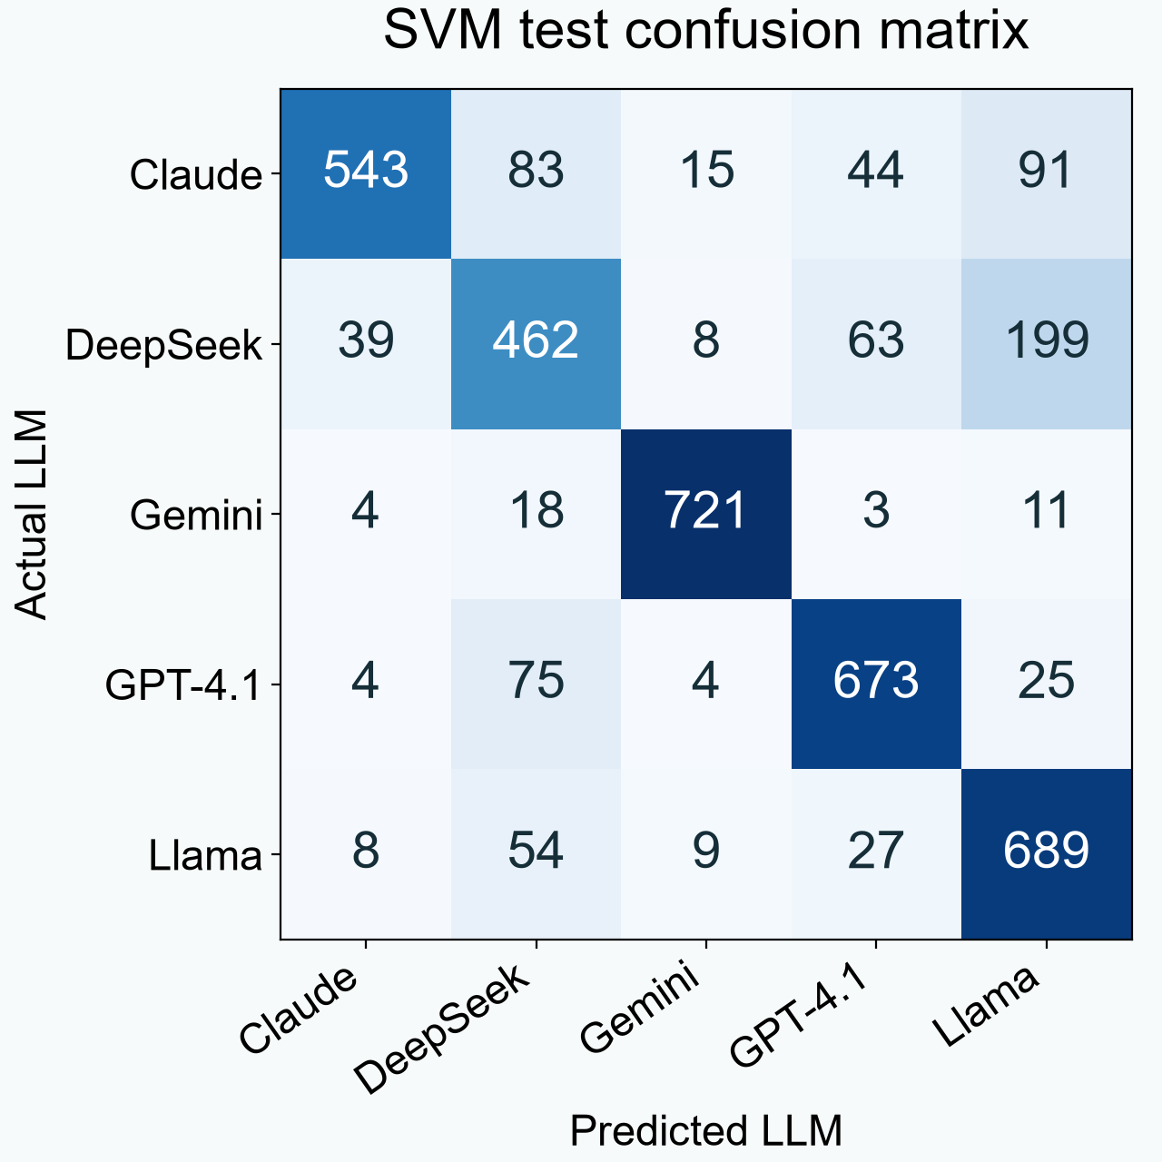
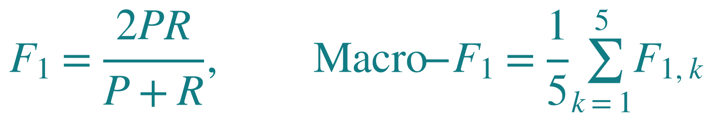
Five-model results: SVM remains best
Model | Accuracy | Macro-F1 | Time (s) | Size (MB)
Naive Bayes | 62.68% | 0.6278 | 0.12 | 2.898
Logistic Regression | 76.89% | 0.7704 | 15.17 | 0.863
Linear SVM | 79.75% | 0.7970 | 5.36 | 1.767
Random Forest | 69.01% | 0.6796 | 20.11 | 9.935
CodeT5 encoder | 76.96% | 0.7725 | 292* | 438.5
CodeT5: best epoch 3 of 5, validation F1 0.7998
Encoder + mean pooling; first 256 tokens
*CodeT5: GPU wall time, raw checkpoint. Others: CPU fit time, compressed classifiers.
Notes:
Sources: results/metrics.csv and results/experiment_1_original/Linear SVM_test_confusion.csv. Matrix shows raw counts for 3,872 test programs. Labels abbreviated: Claude is claude-3.5-haiku, DeepSeek is deepseek-chat, Gemini is gemini-2.5-flash-preview-05-20, GPT-4.1 is gpt-4.1 and Llama is llama-3.3-70b-instruct. Rows are actual labels, columns predictions. SVM selected using validation Macro-F1 0.8062. Timings and compressed classifier sizes exclude shared TF-IDF. Single split, no significance claim. CodeT5 source: user-supplied codet5_results (1).zip, verified against all 3,872 saved test row IDs and true labels. Architecture: Salesforce/codet5-base encoder, masked mean pooling, dropout 0.1 and five-class linear head. 256-token limit, batch 16, AdamW learning rate 2e-5, weight decay 0.01, seed 42, five epochs, best validation epoch 3 at 0.7997564. Test accuracy 0.7696281, Macro-F1 0.7725136. Training wall time 291.706s on A100 40GB includes validation/saving and is not directly comparable with CPU fit timings. Downloaded best_model (1).pt is 438,494,134 bytes, or 438.494 MB. This is an uncompressed PyTorch state dictionary containing encoder and head weights; classical sizes use joblib compression. Serialization differs, so these are stored file sizes rather than a controlled memory comparison. Same split, different representation and truncation; not a paper reproduction. P is precision and R is recall. CodeT5 narrowly exceeds LR but trails SVM by 2.45 F1 percentage points.

Slide 5
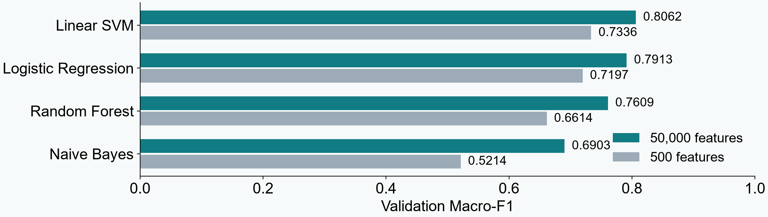
Ablation: restrict the code-pattern vocabulary
Prediction: fewer patterns would narrow SVM’s lead over LR.
Observed: 1.49 to 1.39 percentage points. Rankings did not change.
Weak support for the gap prediction, not a full explanation.
Removing comments also hurt all models without changing ranks.
Notes:
Sources: results/feature_comparison.csv and results/feature_interpretation.md. Hypothesis: distributed character patterns partly explain the SVM advantage. One limit of 500 was chosen and committed before execution in the original development history, with no sweep. Original code and comments retained. Validation SVM-LR gap falls from 1.48692356 to 1.38818655 percentage points: a change of only 0.09873701 points. All validation and test ranks remain SVM, LR, RF, NB. Test SVM F1 falls from 0.7970261 to 0.7169088. This exploratory single-split result is weak directional support, not a ranking reversal or a statistically established causal explanation. Restricting vocabulary also changes normalization and the forest sqrt candidate-feature count. The prior comment-removal prediction failed: validation gap widened from 1.49 to 3.03 points. Both outcomes are retained and reported.

