Slide 1
Gabriel Nikol
Towards Implementing a MQTT-Gateway for Semi-Constrained Devices

Slide 2
Content
Motivation
Related Work
  HTTP, MQTT, MQTT-SN
  Device Types
  MQTT-SN Architecture
  MQTT-SN Client Life Cycle
  Transmission Protocols
MQTT-SN Gateway Implementation
  Core Components
  Linux Gateway Implementation
  Unit and Regression Tests
  BLESocket
Conclusion
Future Work

Slide 3
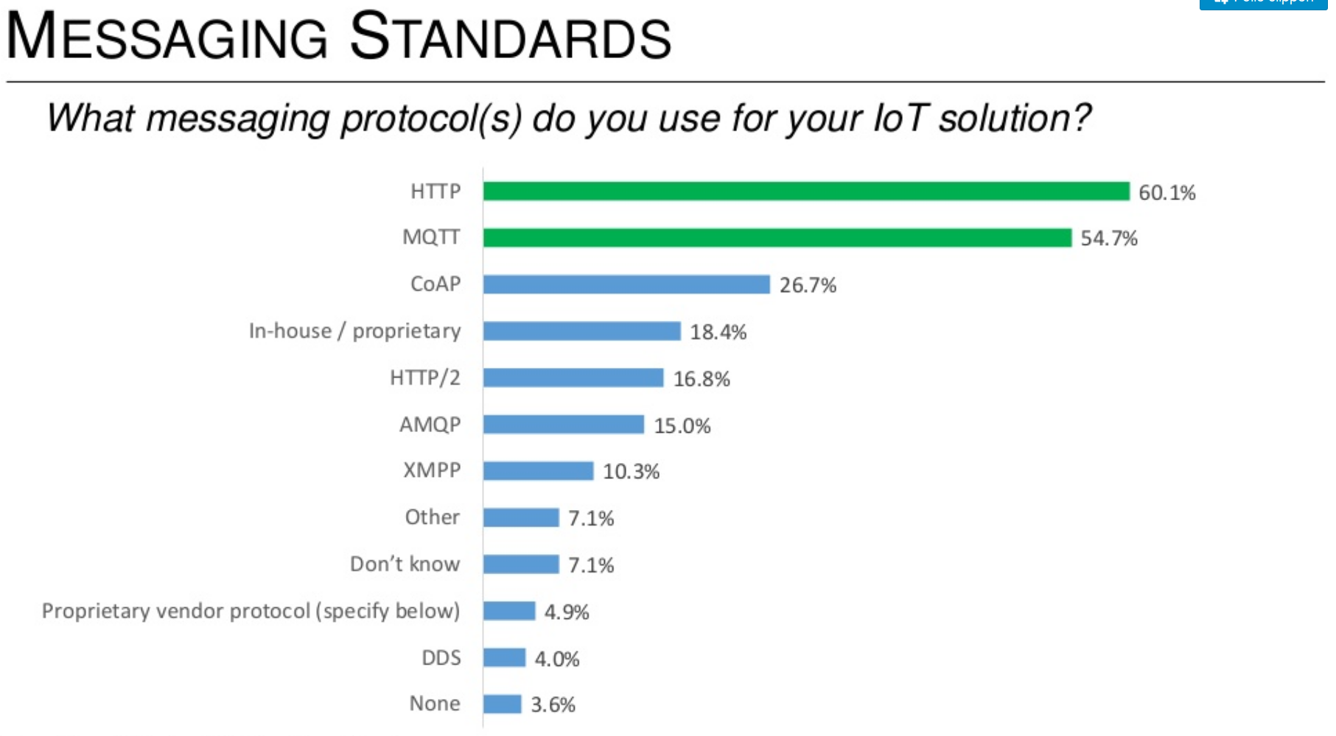
Most used Messaging Standards

Slide 4
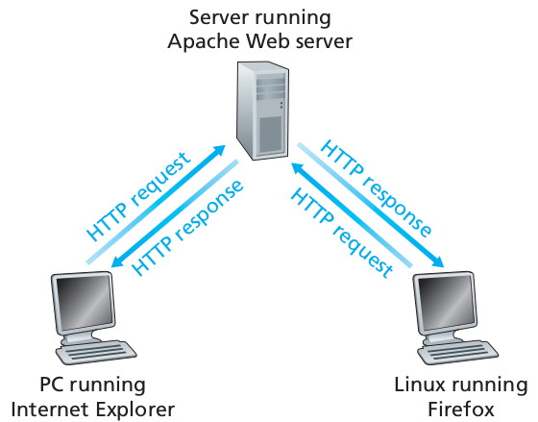
HTTP
Client-Server paradigm
Addressable Resources (URI)

Slide 5
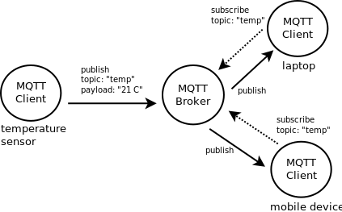
MQTT
Publish-subscribe paradigm
Data centric approach

Slide 6
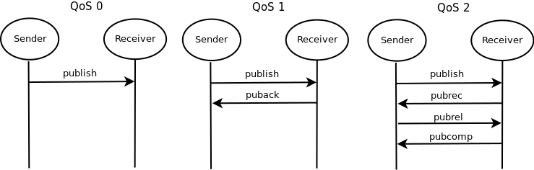
MQTT QoS
QoS 0 (at most once)
QoS 1 (at least once)
QoS 2 (exactly once)

Slide 7
MQTT-SN
Version of MQTT
Not connection oriented
Supports short topic names + pre-defined topic
QoS -1 like QoS 0 but without connect
Supports sleeping clients

Slide 8

Comparing HTTP, MQTT and MQTT-SN
Comparing packet sizes in TCP/IP Model

Slide 9

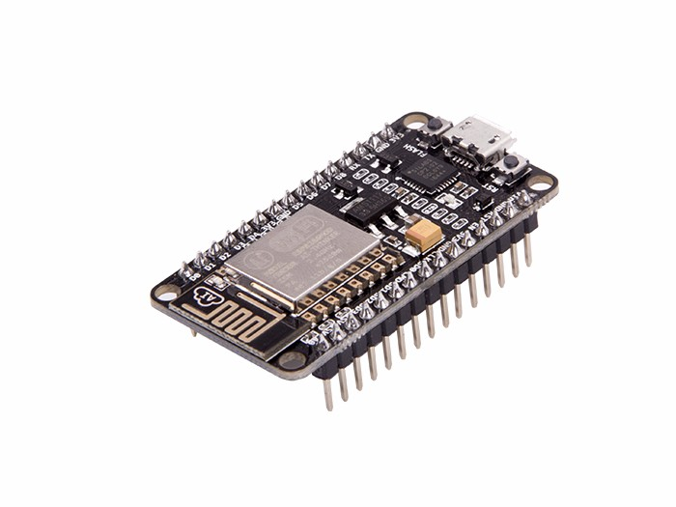

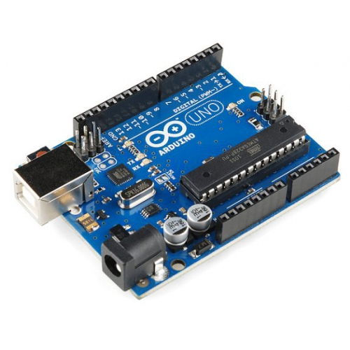
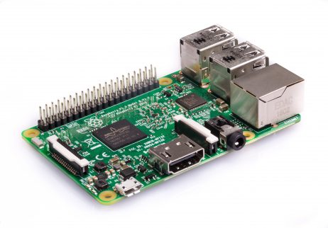

IoT Devices

Slide 10
Device Types
Constrained Devices
  Limited resources (FLASH, CPU, RAM, Energy)
Semi-Constrained Devices
  Limited resource (FLASH, CPU, RAM, not Energy)
Unconstrained Devices
  Nealy unlimited resources (HDD, CPU, RAM)

Slide 11
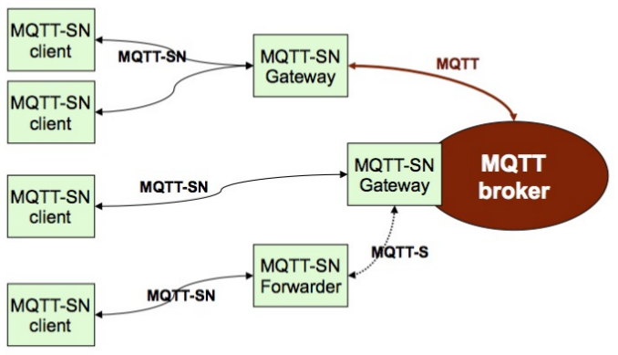
MQTT-SN Architecture
Three MQTT-SN components:
client, gateway, forwarder

Slide 12
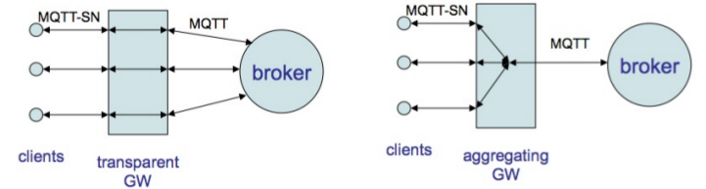
MQTT-SN Architecture
Two kinds of gateways:
  transparent and aggregating

Slide 13
MQTT-SN Client Life Cycle
MQTT-SN client is a constrained device
  find a MQTT-SN Gateway via advertisement or searching a gateway
  connect to the MQTT-SN gateway with a will message
  register topics
  subscribe to topics
  send and receive publishes
  unsubscribe from topics
  sleep
  wake up and collect queued publishes
  sleep and wake up frequently
  power source is empty - will message is published

Slide 14





Transmission Protocols

Slide 15
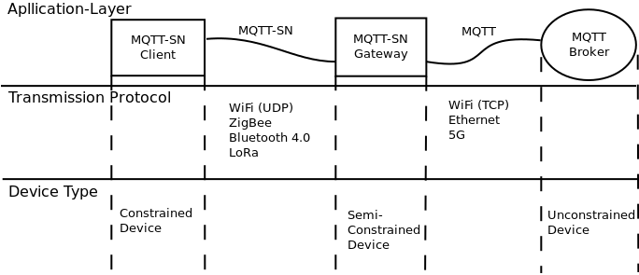
IoT Overview

Slide 16
MQTT-SN Gateway Implementation

Slide 17
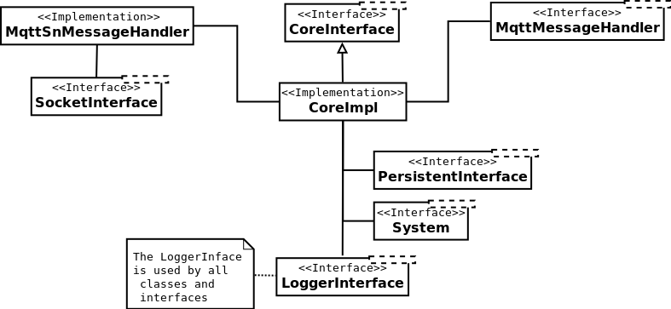
Core Components
MqttSnMessageHandler + CoreInterface
  Environment Independent

Slide 18
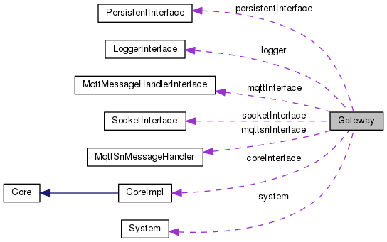
Gateway class

Slide 19
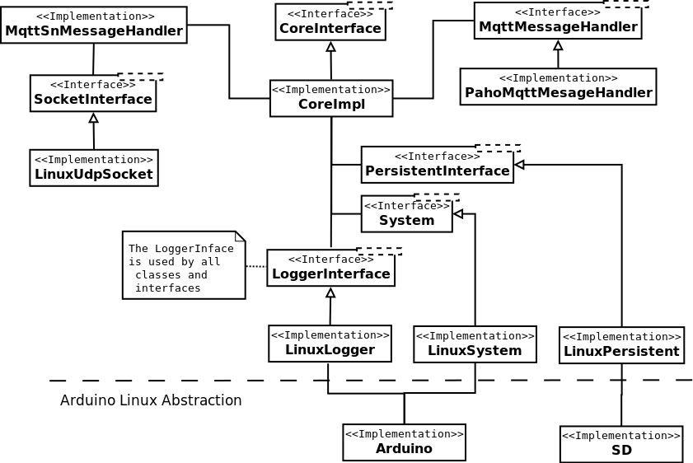


Linux Gateway Implementation

Slide 20



Automated Unit and Regression Testing
Using GoogleTest and GoogleMock
Starting tests inside IDE CLion
Writing a MqttSnTestClient + PahoMqttTestMessageHandler

Slide 21
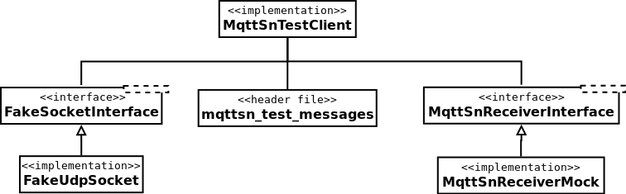
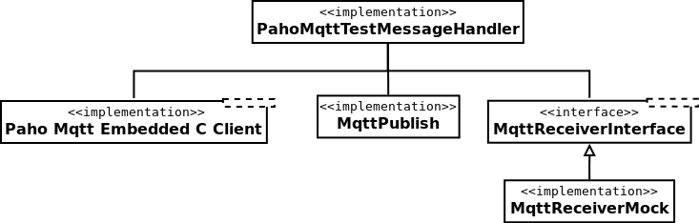
Test Clients

Slide 22
Test Results
Total: 96 unit tests
61 test pass
35 test fail
But:
  Important functionality is tested and working

Slide 23
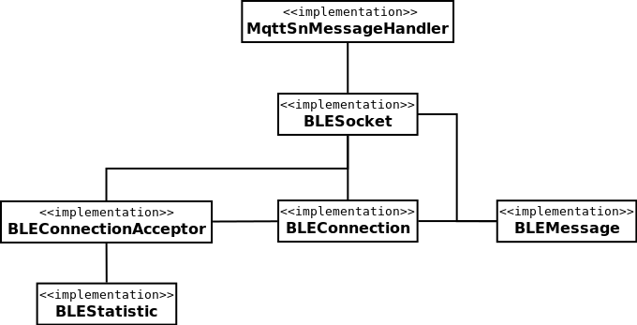
BLESocket
Drop in replacement for LinuxUdpSocket

Slide 24
Conclusion
Project successfull:
implemented a MQTT-SN Gateway Prototype
Runs on Linux and with little changes on Arduino/ESP8266
Partially tested
SocketInterface can be exchanged

Slide 25
Future Work
Implement more transmission procotols: ZigBee, LoRa
Support more platforms: Mbed, RTOS
Implement: QoS 2 and will update
Enhance unit tests
  More tests
  Fix broken parts
Add stress tests and learn the limits of the design

Slide 26
Thank you for your Attention
Ideas or Suggestions?

