Slide 1
Objectives
Define statistics
Aware of wide range of applications of statistics in Business & Computer science
Difference between Descriptive statistics and Inferential statistics.
Population and samples
Types of data

Slide 2
The objective of Statistics is to make inferences (predictions, decisions) about a population based upon information contained in a sample.
Mendenhall

Slide 3
Statistics
Two meanings
* Specific numbers
* Method of analysis

Slide 4
Statistics
Specific number
Numerical measurement determined by a set of data
Example: Thirty three percent of people polled believed that present education system is good

Slide 5
Statistics
Method of analysis
a collection of methods for planning experiments, obtaining data, and then organizing, summarizing, presenting, analyzing, interpreting, and drawing conclusions based on the data
Notes:
page 4 of text

Slide 6
What is Meant by Statistics?
Statistics is the science of collecting, organizing, presenting, analyzing, and interpreting numerical data to assist in making more effective decisions.

Slide 7
Statistics in Business
Accounting – Auditing and cost estimation
Economics – Regional, National and International
Finance –Investments and management
Management – Human resources, Compensation and quality management
Marketing

Slide 8
Population
The entire group of individuals is called the population.
A collection of persons, objects or items under study

Slide 9
Sample
Usually populations are so large that a researcher cannot examine the entire group. Therefore, a sample is selected to represent the population in a research study.
The goal is to use the results obtained from the sample to help answer questions about the population.

Slide 10
Population vs. Sample
Population
Sample
All the items or individuals about which you want to draw conclusion(s)
A portion of the population of items or individuals

Slide 11
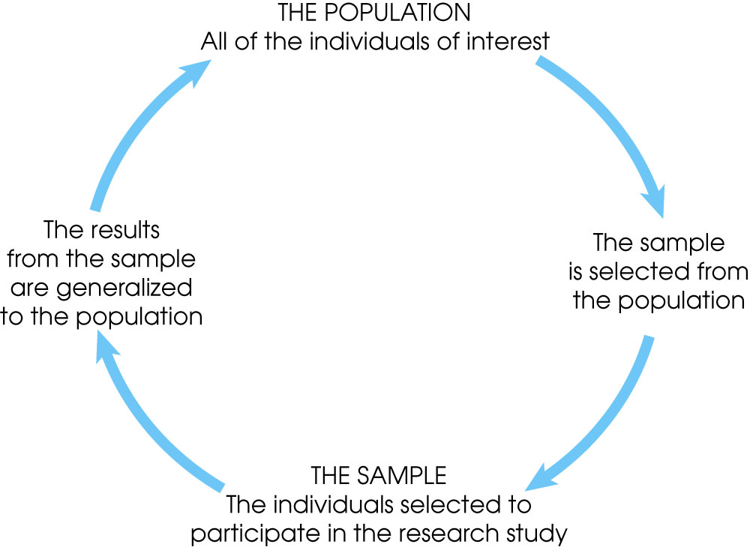
Notes:
Figure 1.1
The relationship between a population and a sample.

Slide 12
Variables
A variable is a characteristic or condition that can change or take on different values.
Most research begins with a general question about the relationship between two variables for a specific group of individuals.

Slide 13
Definitions
Quantitative data /variable
numbers representing counts or measurements
Notes:
page 6 of text

Slide 14
Definitions
Quantitative data
Measurable value
Qualitative (or categorical or attribute) data
can be separated into different categories that are distinguished by some nonnumeric characteristics

Slide 15
Definitions
Quantitative data:
Discrete
data result when the number of possible values is either a finite number or a ‘countable’ number of possible values
0, 1, 2, 3, . . .
Continuous
(numerical) data result from infinitely many possible values that correspond to some continuous scale that covers a range of values without gaps, interruptions, or jumps
Notes:
Understanding the difference between discrete versus continuous data will be important in Chapters 4 and 5.
When measuring data that is continuous, the result will be only as precise as the measuring device being used to measure.

Slide 16
Definitions
Discrete
The number of children in a class room
Age at date of birth
Continuous
Height
Weight
Age
Distance
Income

Slide 17
Qualitative data- examples
Color.
Gender
Religion

Slide 18
Types of Variables
Variables
Qualitative
Quantitative
Examples:
Marital Status
Political Party
Eye Color
(Defined categories)
Discrete
Continuous
Examples:
Number of Children
Defects per hour
(Counted items)
Examples:
Weight,Height,Age
Voltage
(Measured characteristics)

Slide 19
FOUR BASIC SCALES OF MEASUREMENT
Nominal Scales
Ordinal Scales
Interval Scales
Ratio scales

Slide 20
Levels of Measurement
A nominal scale classifies data into distinct categories in which no ranking is implied.
Categorical Variables Categories
Personal Computer Ownership
Type of Stocks Owned
Internet Provider
Yes / No
Growth / Value / Other
AT&T, Verizon, Time Warner Cable

Slide 21

Definitions
Nominal level of measurement
characterized by data that consist of names, labels, or categories only. The data cannot be arranged in an ordering scheme (such as low to high)
Example: Nominal scale
Eye color: Blue, green, or brown
No rank or order to the categories
Presence or absence of a disease
Gender
Notes:
page 7 of text

Slide 22
Definitions
Ordinal level of measurement
involves data that may be arranged in some order, but differences between data values either cannot be determined or are meaningless
Notes:
Understanding the differences between the levels of data will help students later in determining what type of statistical tests to use.
Nominal and ordinal data should not be used for calculations (even when assigned ‘numbers’ for computerization) as differences and magnitudes of differences are meaningless.

Slide 23

Levels of Measurement (con’t.)
An ordinal scale classifies data into distinct categories in which ranking is implied
Categorical Variable Ordered Categories
Student class designation | Freshers, Junior, Senior
Product satisfaction | Satisfied, Neutral, Unsatisfied
Faculty rank | Professor, Associate Professor, Assistant Professor, Instructor
Student Grades | A, B, C, D, F

Slide 24
Levels of Measurement (con’t.)
An interval scale is an ordered scale in which the difference between measurements is a meaningful quantity but the measurements do not have a true zero point.
A ratio scale is an ordered scale in which the difference between the measurements is a meaningful quantity and the measurements have a true zero point.

Slide 25
Measurement Scales
Interval scale
Designates an equal-interval ordering
No true zero point
The distance between 1 and 2 is the same as the distance between 49 and 50
Fahrenheit temperature scale: 0 F does not mean no temperature
60 degrees F is not twice as warm as 30 degrees

Slide 26
Definitions
ratio level of measurement
the interval level modified to include the natural zero starting point (where zero indicates that none of the quantity is present). For values at this level, differences and ratios are meaningful.
Example: Height, weight,Salary….

Slide 27
Levels of Measurement
Nominal - categories only
Ordinal - categories with some order
Interval - differences but no natural starting point
Ratio - differences and a natural starting point
Notes:
review of four levels of measurement

Slide 28
Two phases of statistics:
Descriptive Statistics:
Describes the characteristics of a product or process using information collected on it.
Inferential Statistics (Inductive):
Draws conclusions on unknown process parameters based on information contained in a sample.
Uses probability

Slide 29
FUNCTIONS OF STATISTICS
To Compare
To find the association
To find the correlation
To predict
To find the reliablility & Validity

Slide 30
Why study statistics?
Data are everywhere
Statistical techniques are used to make many decisions that affect our lives
No matter what your career, you will make professional decisions that involve data. An understanding of statistical methods will help you make these decisions efectively

