Slide 1
Operating System

Slide 2
An Operating System (OS) is an interface between a computer user and computer hardware.

Slide 3
An operating system is a software which performs all the basic tasks like file management, memory management, process management, handling input and output, and controlling peripheral devices such as disk drives and printers.

Slide 4
An operating system is software that enables applications to interact with a computer's hardware.
The software that contains the core components of the operating system is called the kernel.

Slide 5
The primary purposes of an Operating System are to enable applications (softwares) to interact with a computer's hardware and to manage a system's hardware and software resources.
Some popular Operating Systems include Linux Operating System, Windows Operating System, VMS, OS/400, AIX, z/OS, etc.
Today, Operating systems is found almost in every device like mobile phones, personal computers, mainframe computers, automobiles, TV, Toys etc.

Slide 6
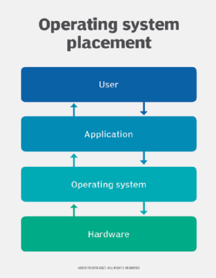

Slide 7
Definitions
An Operating System is the low-level software that supports a computer's basic functions, such as scheduling tasks and controlling peripherals.
An operating system (OS) is system software that manages computer hardware, software resources, and provides common services for computer programs.

Slide 8
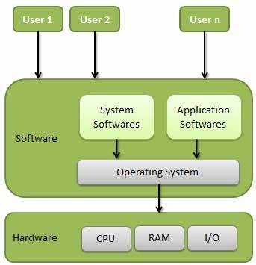

Slide 9
Viewpoints of Operating System
The operating system may be observed from the viewpoint of the user or the system. It is known as the user view and the system view. There are mainly two types of views of the operating system. These are as follows:
User View
System View

Slide 10
User View
The user view depends on the system interface that is used by the users.
Some systems are designed for a single user to monopolize the resources to maximize the user's task.
In these cases, the OS is designed primarily for ease of use, with little emphasis on quality and none on resource utilization.

Slide 11
User View
The user viewpoint focuses on how the user interacts with the operating system through the usage of various application programs.

Slide 12
System View
The OS may also be viewed as just a resource allocator.
A computer system comprises various sources, such as hardware and software, which must be managed effectively.
The operating system manages the resources, decides between competing demands, controls the program execution, etc.
According to this point of view, the operating system's purpose is to maximize performance.

Slide 13
System View
The operating system is responsible for managing hardware resources and allocating them to programs and users to ensure maximum performance.
The system viewpoint focuses on how the hardware interacts with the operating system to complete various tasks.

Slide 14
The hardware and the operating system interact for a variety of reasons, including:
1. Resource Allocation
The hardware contains several resources like registers, caches, RAM, ROM, CPUs, I/O interaction, etc.
These are all resources that the operating system needs when an application program demands them.
Only the operating system can allocate resources, and it has used several tactics and strategies to maximize its processing and memory space.

Slide 15
The hardware and the operating system interact for a variety of reasons, including:
2. Control Program
The control program controls how input and output devices (hardware) interact with the operating system.
The user may request an action that can only be done with I/O devices; in this case, the operating system must also have proper communication, control, detect, and handle such devices.

Slide 16
Main Structural Elements:
Processor: Controls the operation of the computer and performs its data processing functions. When there is only one processor, it is often referred to as the central processing unit (CPU).
Main memory: Stores data and programs. This memory is typically volatile; that is, when the computer is shut down, the contents of the memory are lost. In contrast, the contents of disk memory are retained even when the computer system is shut down. Main memory is also referred to as real memory or primary memory

Slide 17
Main Structural Elements:
3. I/O modules: Move data between the computer and its external environment. The external environment consists of a variety of devices, including secondary memory devices (e.g., disks), communications equipment, and terminals.
4. System bus: Provides for communication among processors, main memory, and I/O modules.

Slide 18
Processor is an integrated electronic circuit that performs the calculations that run a computer.
A processor performs arithmetical, logical, input/output (I/O) and other basic instructions that are passed from an operating system (OS).
Most other processes are dependent on the operations of a processor.

Slide 19
Processors are found in many modern electronic devices, including PCs, smartphones, tablets, and other handheld devices.
Their purpose is to receive input in the form of program instructions and execute trillions of calculations to provide the output that the user will interface with.

Slide 20
A processor includes an arithmetical logic and control unit (CU), which measures capability in terms of the following:
      Ability to process instructions at a given time.
      Maximum number of bits/instructions.
      Relative clock speed.

Slide 21
Each processor is constituted of one or more individual processing units called “cores”.
Each core processes instructions from a single computing task at a certain speed, defined as “clock speed” and measured in gigahertz (GHz).

Slide 22
Since increasing clock speed beyond a certain point became technically too difficult, modern computers now have several processor cores (dual-core, quad-core, etc.).
They work together to process instructions and complete multiple tasks at the same time.

Slide 23
Modern desktop and laptop computers now have a separate processor to handle graphic rendering and send output to the display monitor device.

Slide 24
Since this processor, the GPU, is specifically designed for this task, computers can handle all applications that are especially graphic-intensive such as video games more efficiently.

Slide 25
A processor is made of four basic elements: the arithmetic logic unit (ALU), the floating point unit (FPU), registers, and the cache memories.
The ALU and FPU carry basic and advanced arithmetic and logic operations on numbers, and then results are sent to the registers, which also store instructions. Caches are small and fast memories that store copies of data for frequent use, and act similarly to a random access memory (RAM).

Slide 26
The CPU carries out operations through the three main steps of the instruction cycle: fetch, decode, and execute.
Fetch: the CPU retrieves instructions, usually from a RAM.
Decode: a decoder converts the instruction into signals to the other components of the computer.
Execute: the now decoded instructions are sent to each component so that the desired operation can be performed.

Slide 27
COMPUTER SYSTEM ARCHITECTURE
A computer system can be organized in a number of different ways, which we can categorize roughly according to the number of general-purpose processors used.
• Single-Processor Systems
• Multi-Processor Systems

Slide 28

Single-Processor Systems
A single processor system contains only one processor. So only one process can be executed at a time and then the process is selected from the ready queue. Most general purpose computers contain the single processor systems as they are commonly in use.

Slide 29
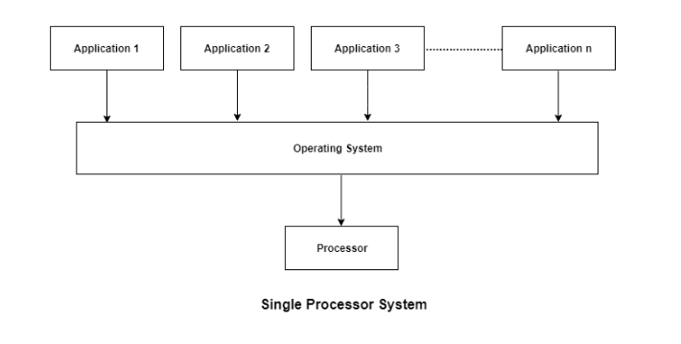

Slide 30
the system contains a single processor and only one process can be executed at a time.

Slide 31

Multiprocessor Systems
multiprocessor or parallel systems are increasing in importance nowadays.
These systems have multiple processors working in parallel that share the computer clock, memory, bus, peripheral devices etc.

Slide 32
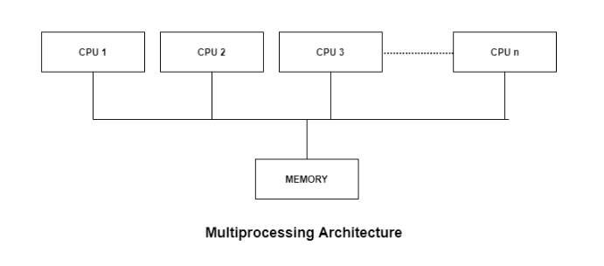

Slide 33
Advantages of Multiprocessor Systems
1. More reliable Systems
In a multiprocessor system, even if one processor fails, the system will not halt.
This ability to continue working despite hardware failure is known as graceful degradation.
For example: If there are 5 processors in a multiprocessor system and one of them fails, then also 4 processors are still working. So the system only becomes slower and does not ground to a halt.

Slide 34
Advantages of Multiprocessor Systems
2. Enhanced Throughput
If multiple processors are working in tandem, then the throughput of the system increases i.e. number of processes getting executed per unit of time increase.
If there are N processors then the throughput increases by an amount just under N.

Slide 35
Advantages of Multiprocessor Systems
3. More Economic Systems
Multiprocessor systems are cheaper than single processor systems in the long run because they share the data storage, peripheral devices, power supplies etc. If there are multiple processes that share data, it is better to schedule them on multiprocessor systems with shared data than have different computer systems with multiple copies of the data.

Slide 36
Differences Between Single Processor and Multiprocessor Systems
Single processor system contains only one processor while multiprocessor systems may contain two or more processors.
Single processor systems use different controllers for completing special tasks such as DMA (Direct Memory Access) Controller. On the other hand, multiprocessor systems have many processors that can perform different tasks.
This can be done in symmetric or asymmetric multiprocessing.

Slide 37
Differences Between Single Processor and Multiprocessor Systems
In Asymmetric Multiprocessing one Processor works as Master and Second Processor act as Slave
In Symmetric Multiprocessing each processor performs all the tasks within the operating system.

Slide 38
Differences Between Single Processor and Multiprocessor Systems
Single processor systems can be more expensive than multiprocessor systems. If n processor multiprocessor system is available, it is cheaper than n different single processor systems because the memory, peripherals etc. are shared.

Slide 39
Differences Between Single Processor and Multiprocessor Systems
Single processor systems are less reliable than multiprocessor systems because if the processor fails for some reason then system cannot work. In multiprocessor systems, even if one processor fails than the rest of the processors can pick up the slack. At most the throughput of the system decreases a little.

Slide 40
TYPES OF OPERATING SYSTEM
Based on their capabilities and the types of application supported, the operating systems can be divided into following four major categories.
Batch processing operating systems
Multi programming operating systems
Time sharing operating systems
Real time operating systems

Slide 41
TYPES OF OPERATING SYSTEM
1. Batch Operating System
This type of operating system does not interact with the computer directly.
There is an operator which takes similar jobs having the same requirement and groups them into batches.
It is the responsibility of the operator to sort jobs with similar needs.

Slide 42
TYPES OF OPERATING SYSTEM
1. Batch Operating System
A computer system with this operating system performs the following batch processing activities:
A job is a single unit that consists of a preset sequence of commands, data, and programs.
Processing takes place in the order in which they are received, i.e., first come, first serve.

Slide 43
TYPES OF OPERATING SYSTEM
1. Batch Operating System
A computer system with this operating system performs the following batch processing activities:
3. These jobs are stored in memory and executed without the need for manual information.
4. When a job is successfully run, the operating system releases its memory.

Slide 44
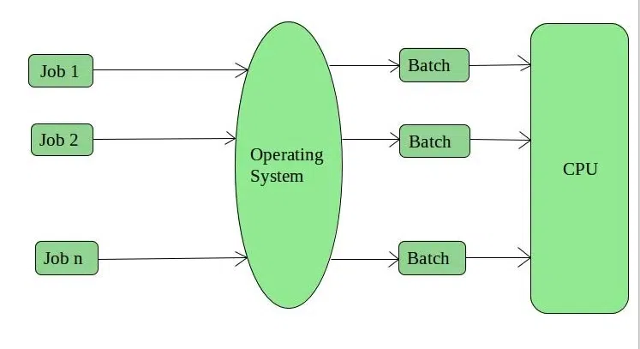
TYPES OF OPERATING SYSTEM
1. Batch Operating System

Slide 45
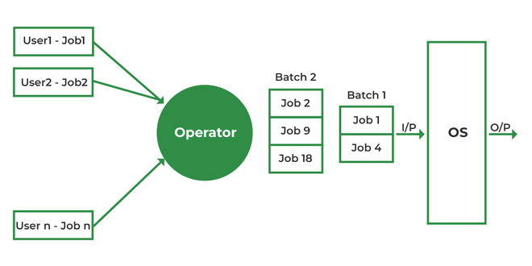

Slide 46
Benefits of the Batch Operating System
it can handle multiple users simultaneously
This makes it perfect for big projects with lots of separate tasks to be completed
By keeping all users in their own batches, the BOS prevents any direct communication between them – meaning no accidental interruptions or delays

Slide 47
Benefits of the Batch Operating System
it can handle large files more efficiently than a standard operating system.
This is because the BOS breaks down all tasks into smaller, more manageable chunks which can be processed one at a time.
As a result, the overall speed of the computer is improved and users don’t have to wait as long for their files to be processed.

Slide 48
Advantages of Batch Operating System:
The advantages of the batch operating system are:
There is no direct communication between users, meaning that there is no need for a dedicated communication line.
It is easy to use and does not require much maintenance.
It is very efficient in terms of resource usage.

Slide 49
Advantages of Batch Operating System:
Efficient use of resources: Batch processing operating systems allow for the efficient use of computing resources, as jobs are processed in batches and scheduled to run when resources are available.
High throughput: Batch processing operating systems can process a large number of jobs quickly, allowing for high throughput and fast turnaround times.

Slide 50
Advantages of Batch Operating System:
Reduced errors: As batch processing operating systems do not require user intervention, they can help reduce errors that may occur during manual job processing.
Simplified job management: Batch processing operating systems simplify job management by automating job submission, scheduling, and execution.

Slide 51
Advantages of Batch Operating System:
Cost-effective: Batch processing operating systems can be cost-effective, as they allow for the efficient use of resources and can help reduce errors and processing time.
Scalability: Batch processing operating systems can easily handle a large number of jobs, making them scalable for large organizations that require high-volume data processing.

Slide 52
Disadvantages of Batch Operating System:
– It can be slow due to the fact that users need to wait for their turn to use the resources.
– It can be difficult to manage multiple users.
– If one user is not done with their work, it can hold up the entire system.

Slide 53
Disadvantages:
There are many disadvantages to using batch operating systems, including:
Limited functionality: Batch systems are designed for simple tasks, not for more complex tasks. This can make them difficult to use for certain tasks, such as managing files or software.

Slide 54
Disadvantages:
Security issues: Because batch systems are not typically used for day-to-day tasks, they may not be as secure as more common operating systems. This can lead to security risks if the system is used by people who should not have access to it.

Slide 55
Disadvantages:
Interruptions Batch systems can be interrupted frequently, which can lead to missed deadlines or mistakes.
Inefficiency: Batch systems are often slow and difficult to use, which can lead to inefficiency in the workplace.

