Slide 1
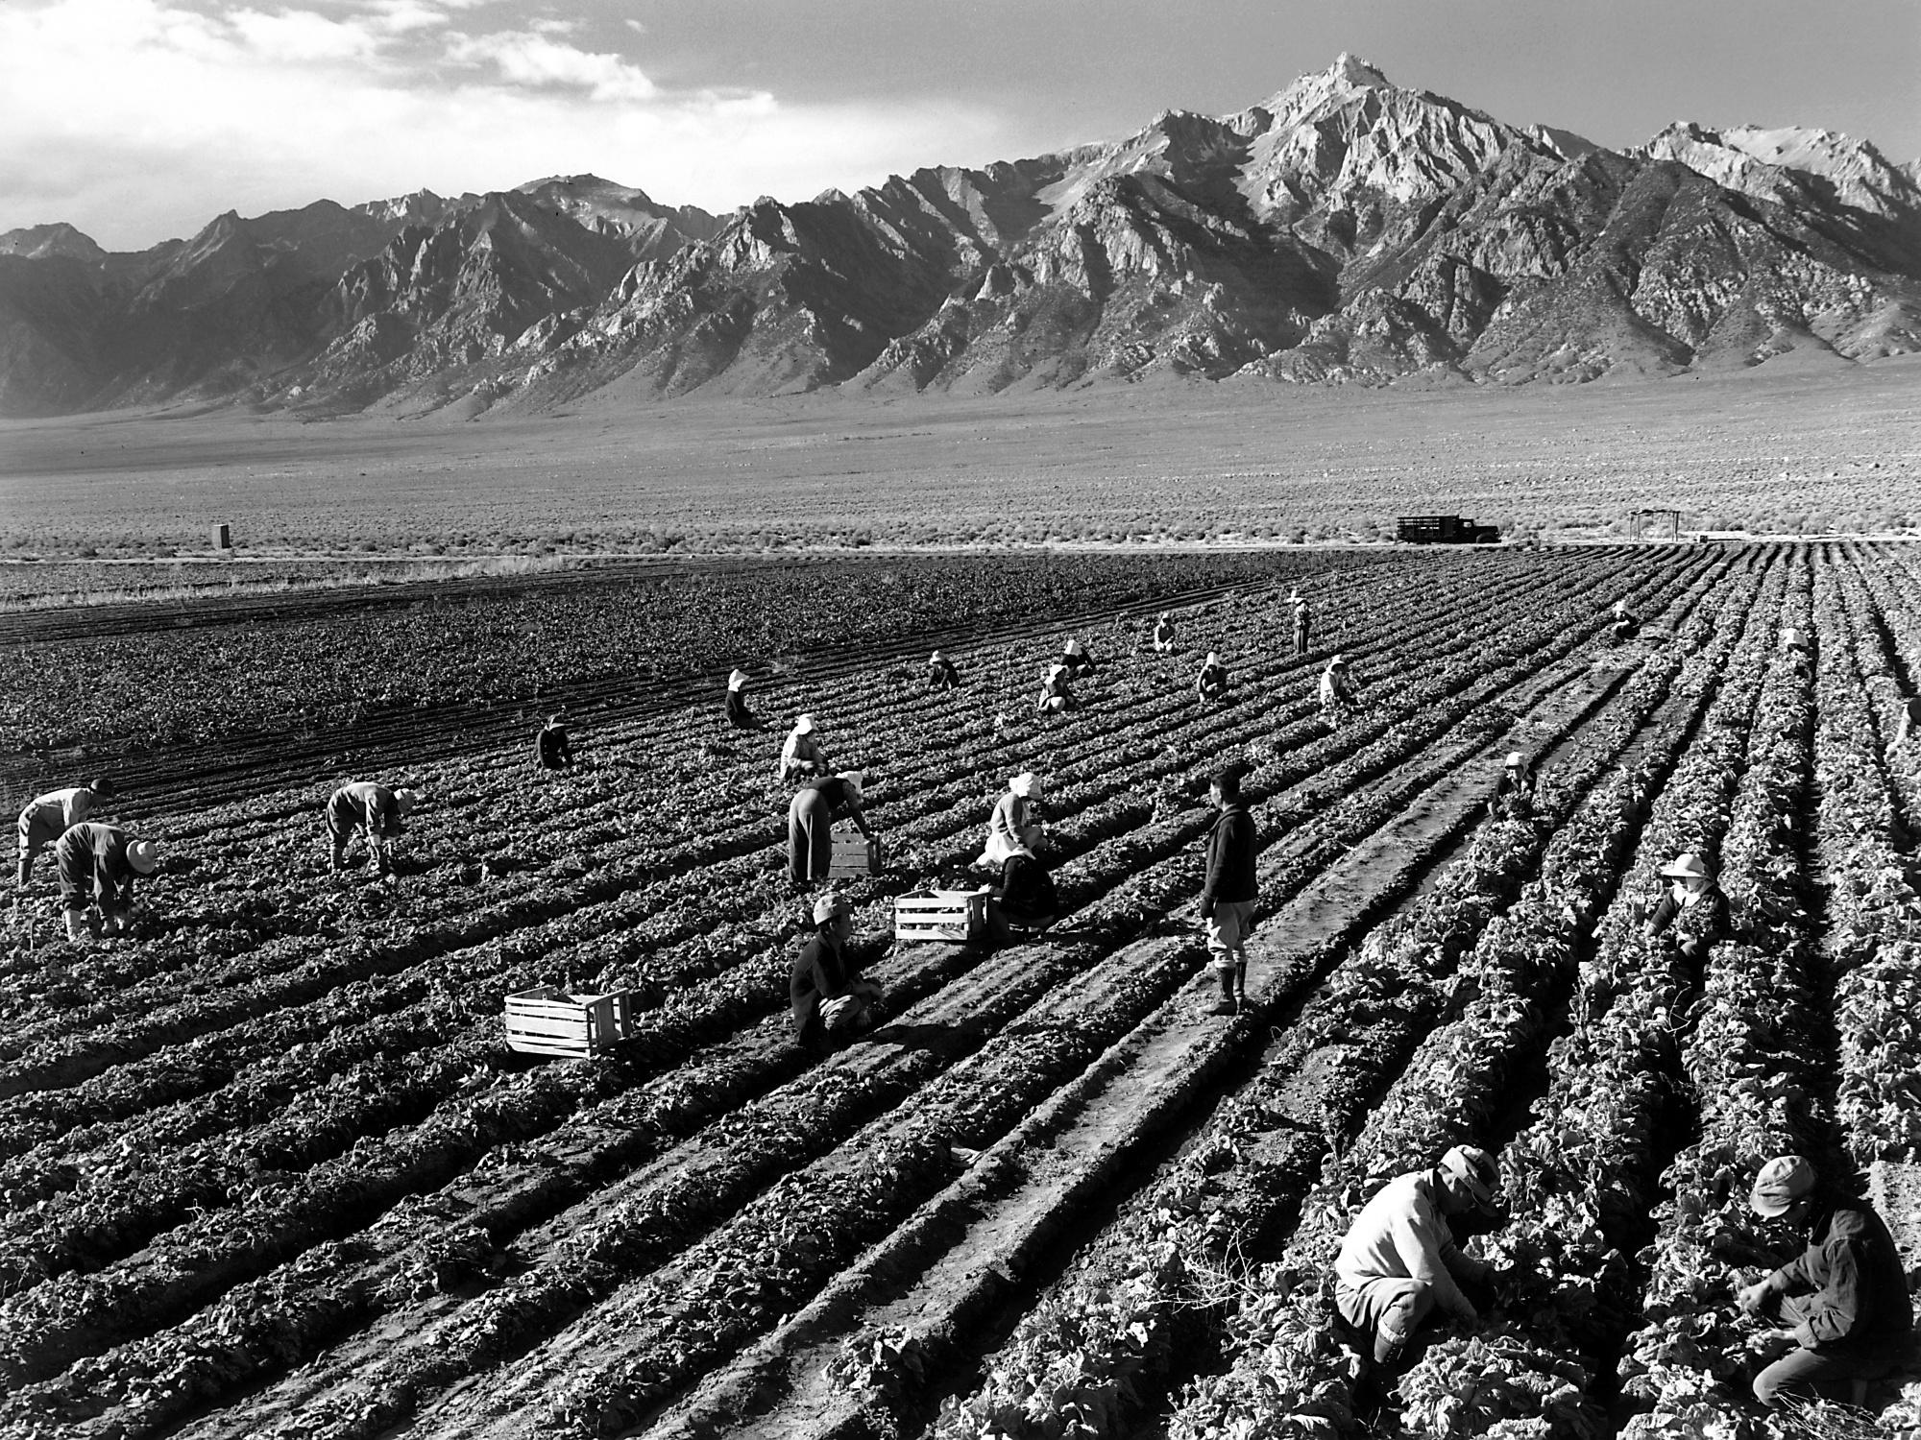
Smart Farming
AgTech Crop
Recommendation System

Slide 2
Introduction
Our model analyzes soil type, pH, salinity, water needs, and organic matter to provide customized insights for farms. The goal is to create user-friendly tools that help farmers choose the best crops based on soil and environmental conditions.

Slide 3
Data Cleaning and Preparation Process
Data Integration:
Combined all tables into a single table using a predefined SQL schema to ensure consistent and structured data.
Data Conversion:
Exported the table into CSV format for further analysis and processing.
Missing Data Handling:
Identified 189 fields with missing values in the dataset.
Replaced missing values
Data Sources:
Food and Agriculture Organization (FAO)
Google
ChatGPT

Slide 4
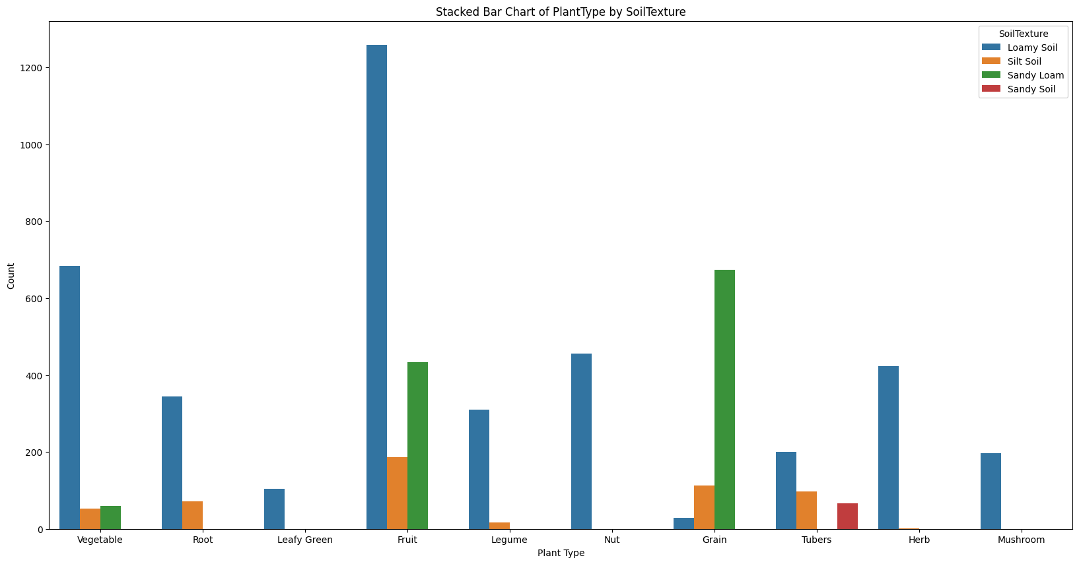
Visualization: Exploring environmental needs for Plant types

Slide 5
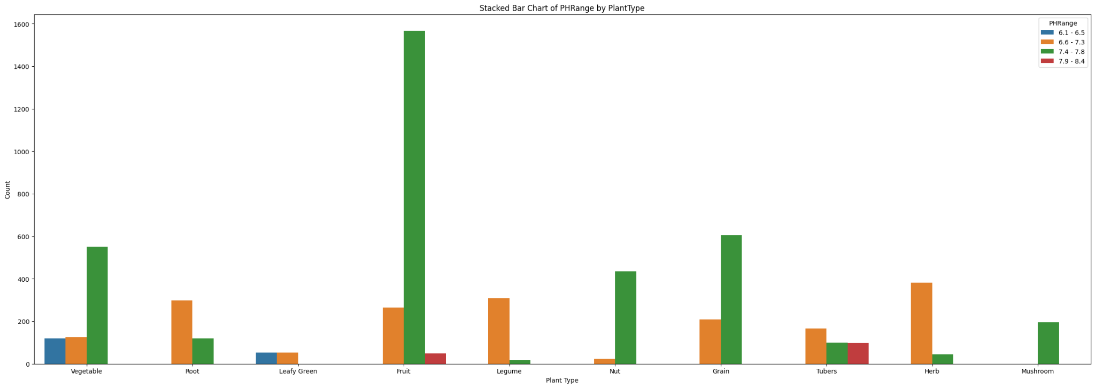

Slide 6
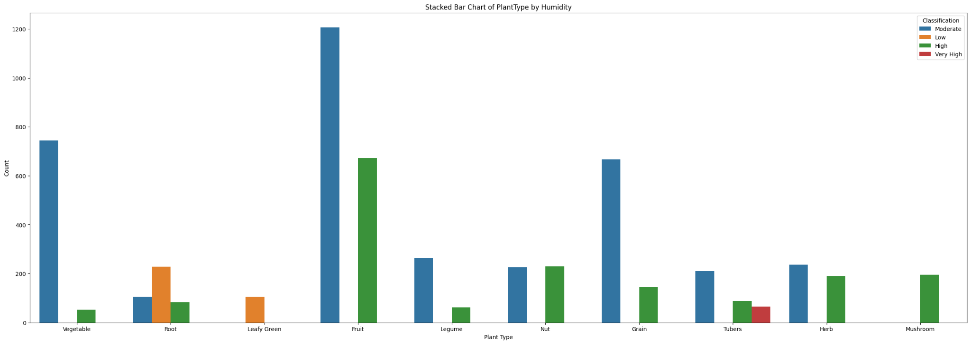

Slide 7
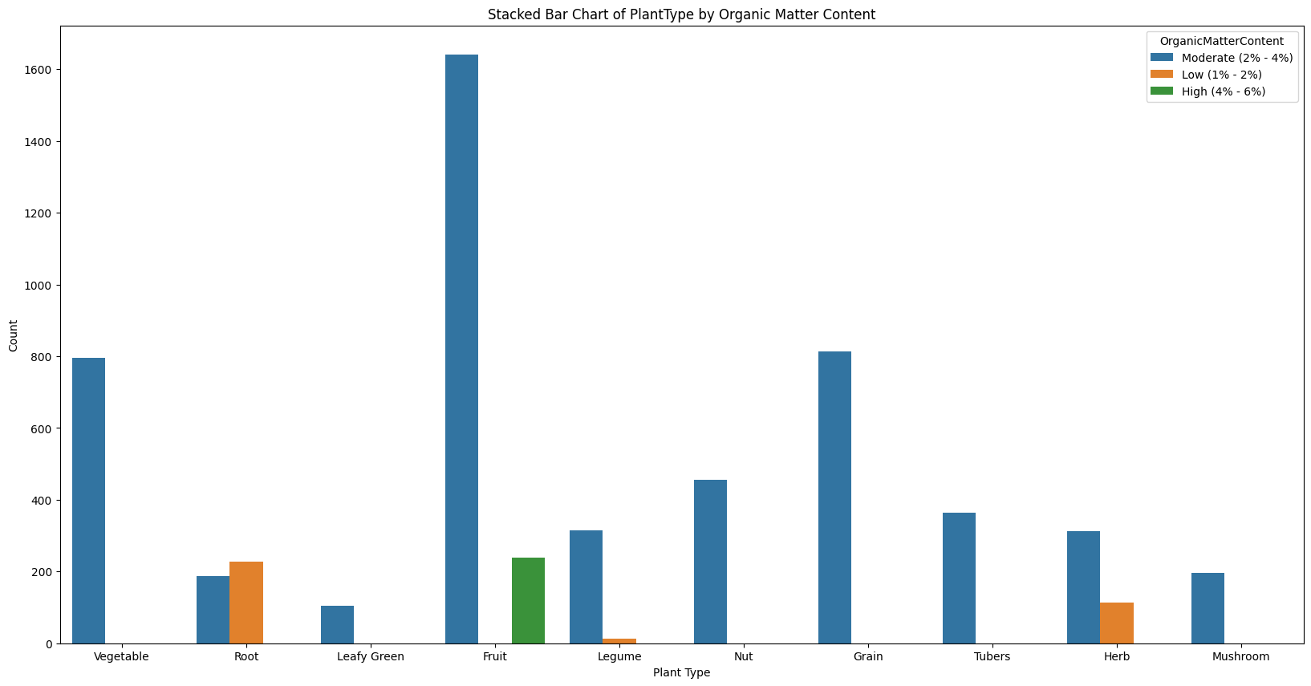

Slide 8
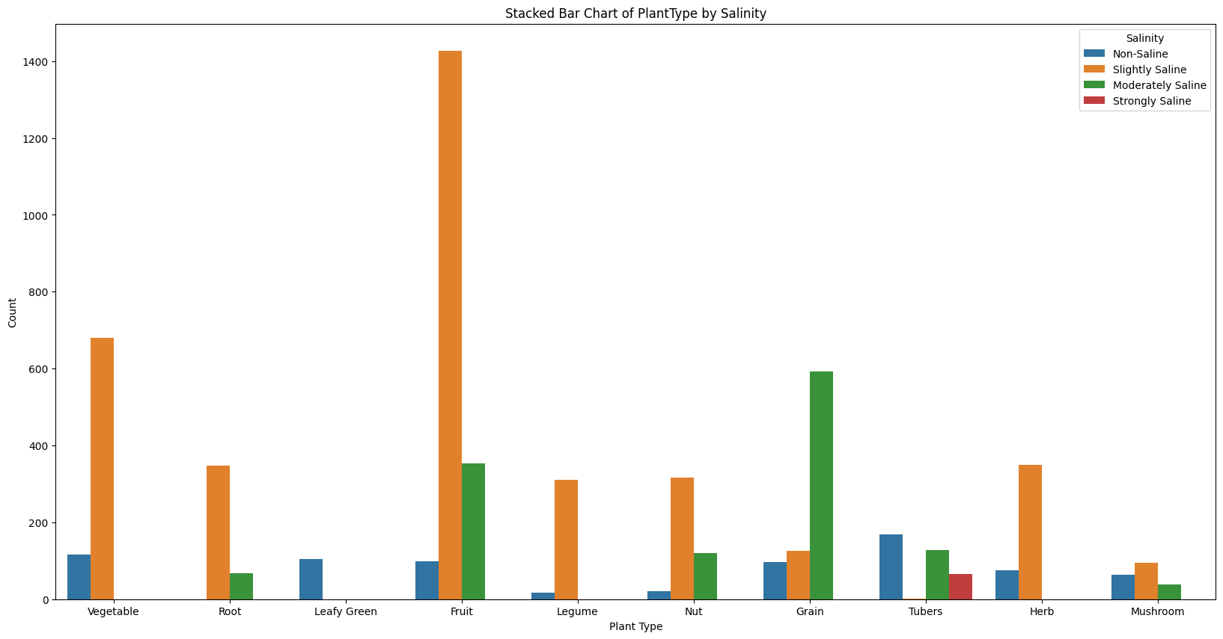

Slide 9
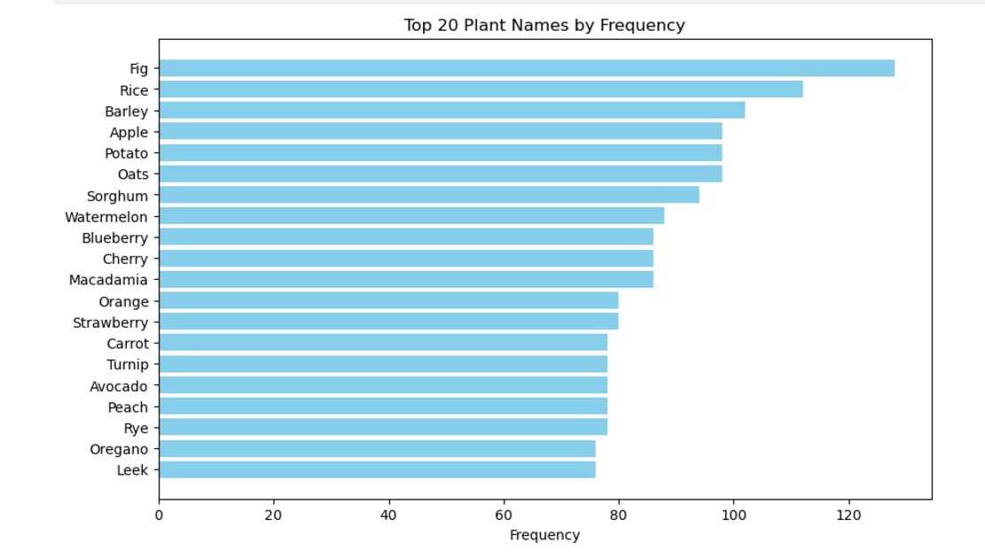

Slide 10
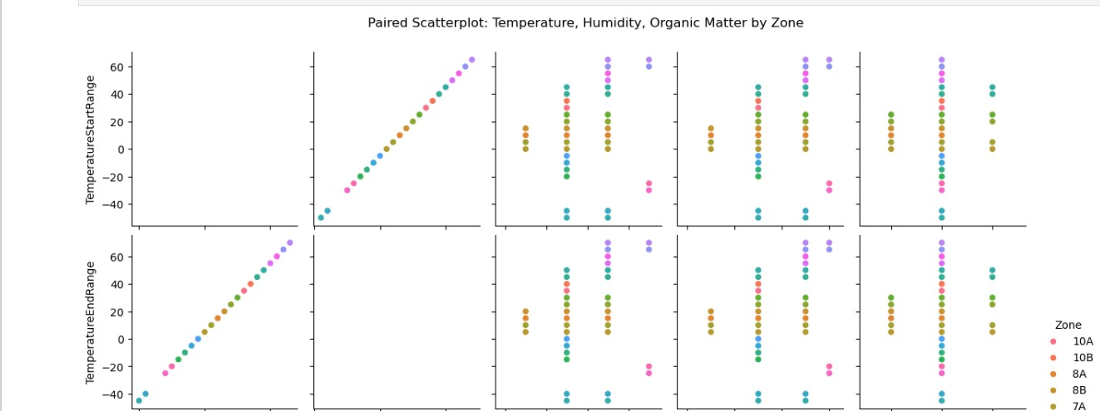

Slide 11
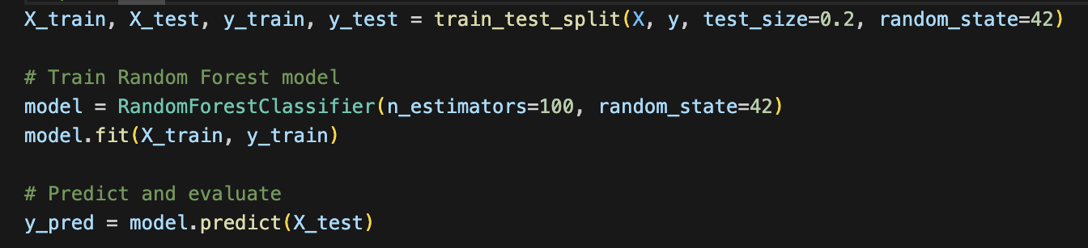
Model Development
Predictor Variables: PH Range ID, Soil Texture ID, Organic Matter ID, Salinity Levels ID, Temperature Range, Humidity Average
Output Variable: Plant Type ID
Model: Random Forest Classifier

Slide 12
Model Evaluation
Accuracy: 0.6589347079037801
Precision: 0.7590527923524892
Recall: 0.6589347079037801
F1-Score: 0.6299488969101291

Slide 13
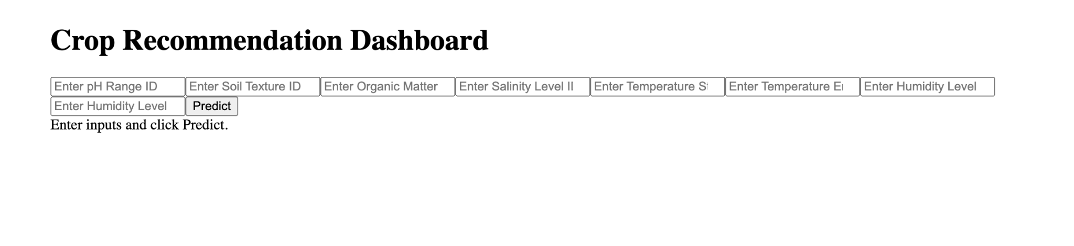
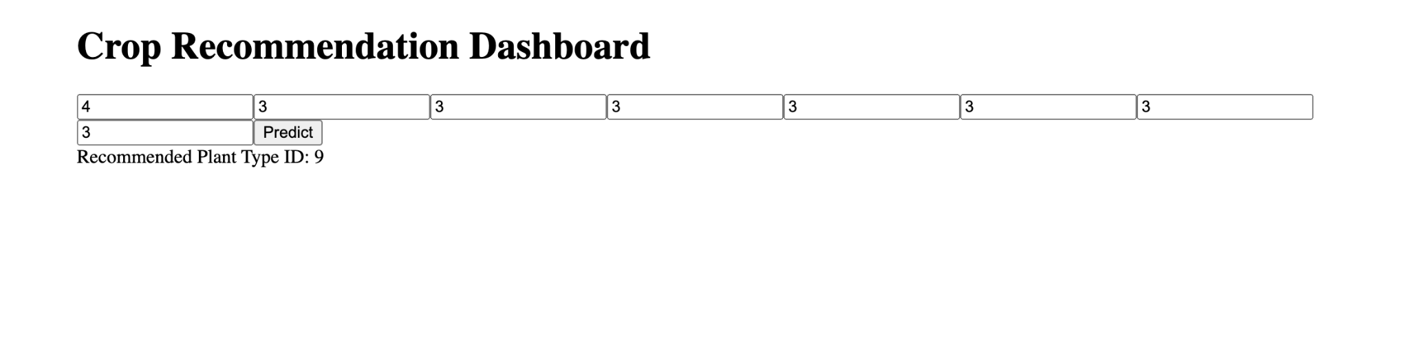

Slide 14
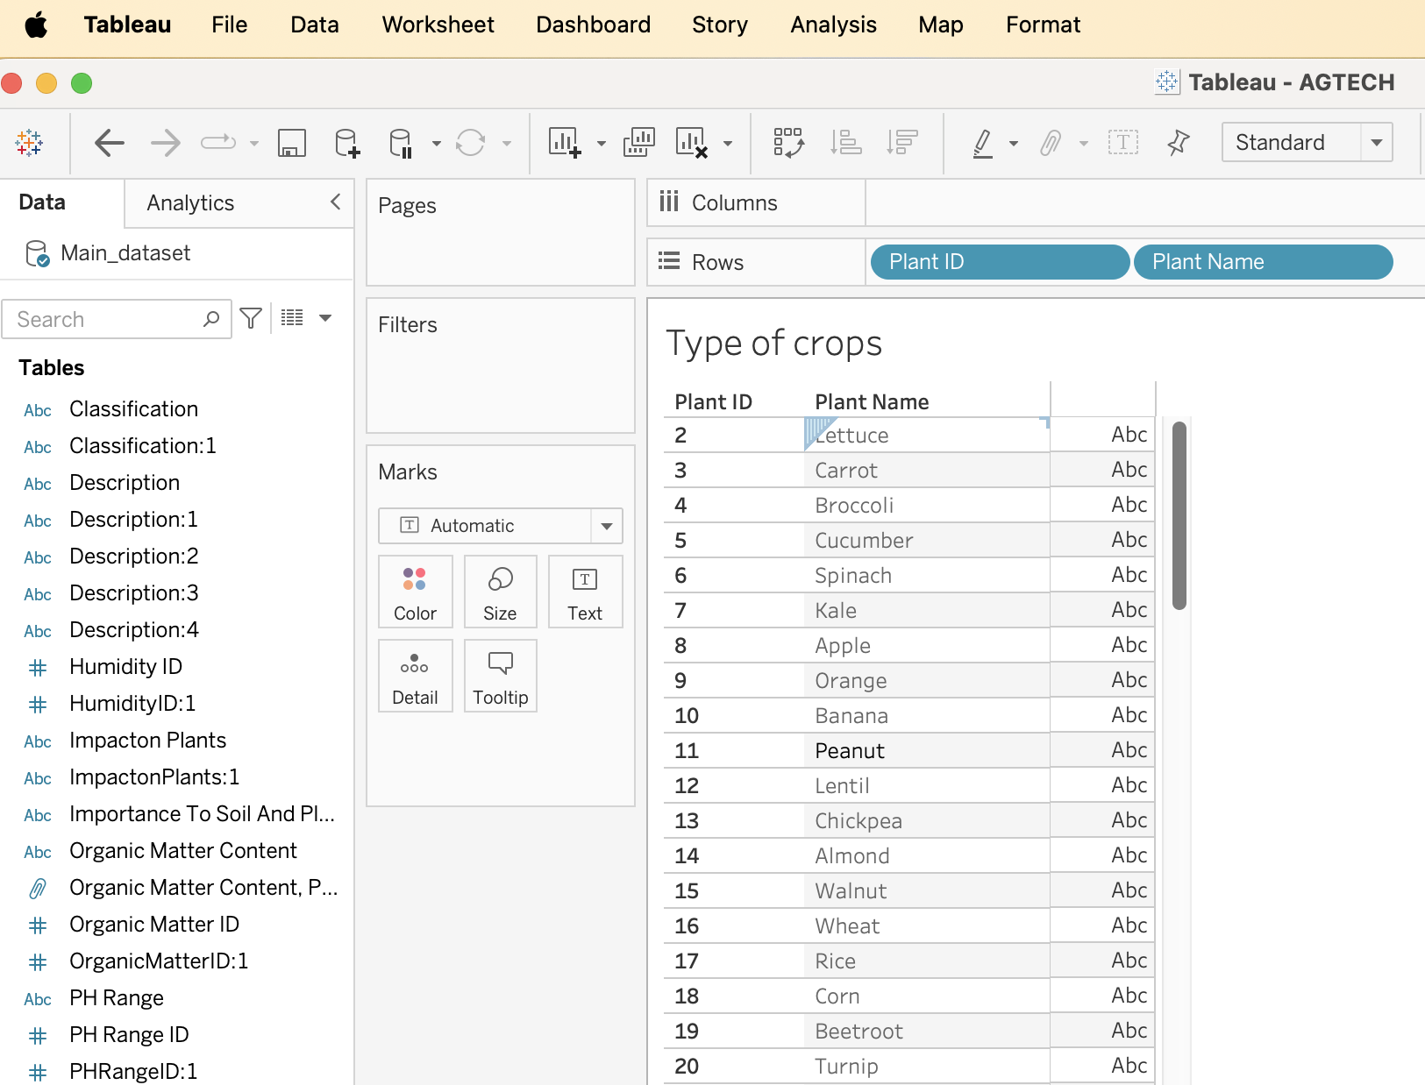
Plant ID to find the type of plants

Slide 15
