Slide 1

FOOD WASTE MANAGEMENT
Team Members Batch-B10 Guide:
D. Spandana Reddy [154G1A0585] Mrs.P.Shabana, M.Tech
G. Pujitha [154G1A0566] Assistant Professor.
V. Sharanya [154G1A0581]
K. Sowmya [164G5A0503]
Srinivasa Ramanujan Institute of Technology
Department of Computer Science & Engineering

Slide 2
ABSTRACT
Everyday people waste lots of food. In order to reduce the food wastage and distribute it among needy people a mobile based application is introduced.
In this project the donor can login and enter their location, amount of food and type of food available. Then a simple notification is sent to the agent.
After receiving the notification the agent nearby to that location can login and can gather the details of the donor.
After retrieving the details the agent collects food from the donor and can redistribute to the orphans or others.
This project of food redistribution is an enormously helpful social innovation that tackles food waste and food poverty. The user’s details are maintained confidential because it maintains a separate account for each user.

Slide 3
CONTENTS
Introduction
Objective
Existing System
Proposed Solution
Software requirements
Hardware requirements
Advantages and Disadvantages
Conclusion

Slide 4

INTRODUCTION
Food waste is considered as one of the predominant issue now a days.
One third of the food produced gets wasted around the globe.
Our streets, garbage bins
and landfills are the best
example to prove it.

Slide 5
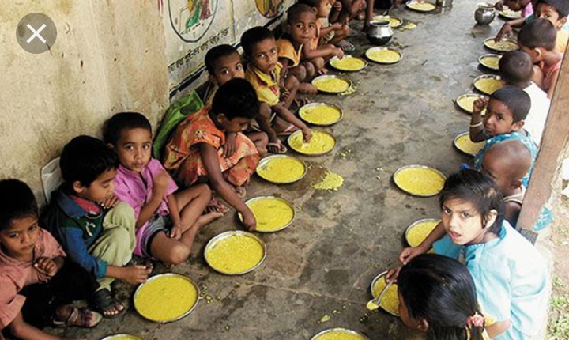
CONTINUES…
We see that millions of life are starving for food around us.
Hunger kills more people every year than any other deadly diseases.

Slide 6
OBJECTIVE
The objective of the project is to bridge the gap between the hungry and the food waste through donation.
This mobile based application allows excess food to be donated to the charities and orphans and feed the people starving for food.

Slide 7
EXISTING SYSTEM
Existing system provides a solution allowing the excess food to be donated from the food service industry to qualified charities.
The user can share the food to available registered trusted charity by finding the location nearer to them and can deliver themselves.

Slide 8
PROPOSED SOLUTION
The proposed solution is to select the particular one from the list of organizations that are nearer to our location.
Here we can share the details of the food available, time of expiry and a notification is sent to the agent in that organization.
Then the agent can login and collect the food and feed the hungry.

Slide 9
SOFTWARE REQUIREMENTS
IDE: Android Studio 2.1 or higher versions
Languages: Java(JDK 1.8.0), XML(1.0)
Database: Firebase
UML Diagrams: Visual Paradigm(version 12.1)
Operating System: Windows8 and above

Slide 10
HARDWARE REQUIREMENTS
For developing
Processor: core i5 or i3 processor
RAM: 8GB or 16 GB
Space on hard disk: Minimum 500GB
For Running
Device: Android emulator , Mobile

Slide 11
ADVANTAGES
By using this application we can feed hungry people.
Food wastage will be reduced.
Reduce the impacts of waste in environment.
DISADVANTAGES
Sometimes before delivery food can be wasted because of weather conditions.

Slide 12
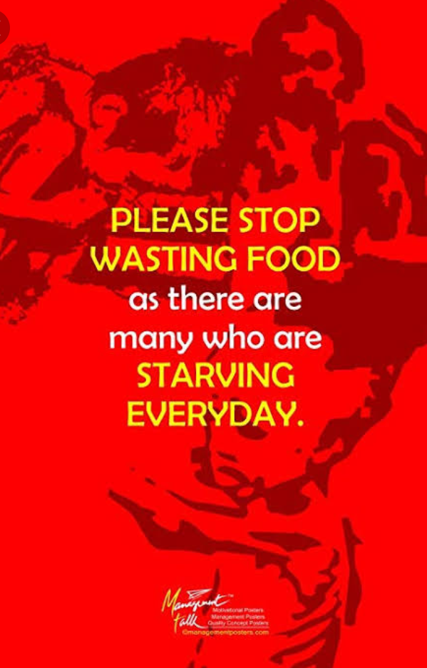
CONCLUSION
Food Waste Management is an edible food recovery project which serves surplus food from weddings, parties and other events to hungry people in the orphanages and old age homes.

Slide 13
Queries
?
Thank You

