Slide 1

FOOD WASTE MANAGEMENT
Team Members Batch-B10 Guide:
D. Spandana Reddy [154G1A0585] Mrs.P.Shabana, M.Tech
G. Pujitha [154G1A0566] Assistant Professor.
V. Sharanya [154G1A0581]
K. Sowmya [164G5A0503]
Srinivasa Ramanujan Institute of Technology
Department of Computer Science & Engineering

Slide 2
ABSTRACT
Everyday people waste lots of food. In order to reduce the food wastage and distribute it among needy people a mobile based application is introduced.
In this project the donor can login and enter their location, amount of food and type of food available. Then a simple notification is sent to the agent.
After receiving the notification the agent nearby to that location can login and can gather the details of the donor.
After retrieving the details the agent collects food from the donor and can redistribute to the orphans or others.
This project of food redistribution is an enormously helpful social innovation that tackles food waste and food poverty. The user’s details are maintained confidential because it maintains a separate account for each user.

Slide 3
CONTENTS
Problem Definition
Literature Survey
Limitations
Proposed Solution
Project Planning
Modules
References

Slide 4
PROBLEM DEFINITION
The problem definition of the project is to bridge the gap between the hungry and the food waste through donation.
This mobile based application allows excess food to be donated to the charities and orphans and feed the people starving for food.

Slide 5
LITERATURE SURVEY
EXISTING SYSTEM:
Currently, people donate stuff manually by visiting each organization number of times.
In order to reduce the problems of food wastage, some websites like rescuing leftovercuisine and annakshetra have taken efforts to help people donate their surplus food to shelters through their official website, wherein people can donate food, donate funds and also volunteer for various activities.

Slide 6
Continued…
Most people don't realize how much food they throw away every day — from uneaten leftovers to spoiled produce [1].
About 95 percent of the food we throw away ends up in landfills or combustion facilities. In 2013, we disposed more than 35 million tons of food waste [2].
The majority of the population today uses smartphones with active internet connection, which is the basic requirement for this product to function properly [3] .

Slide 7
LIMITATIONS
Over purchasing of food items.
Donor lack of knowledge about organizations who collects waste food.
Waste of money.
Impacts in environment.
Needy people starving for food for survival.

Slide 8
PROPOSED SOLUTION
The proposed application is android-based, developed on Android Studio using java and xml requires internet connection and will provide a platform for donors and seekers after they successfully register into the system.
If a user wishes to donate something, he/she can share the details in application. This message will be shown as notification in donations tab to the agents.

Slide 9
Continued…
This message will be stored in back end in the database.
Once a notification is sent, the orphanages who wish to claim the donations can reply to the donor and contact the donor.

Slide 10
PROJECT PLANNING
Week-1 : Requirements Gathering
Week-2 : Design and Analysis
Week-3 : Implementation
Week-4 : Testing and Verification
Week-5 : Documentation

Slide 11
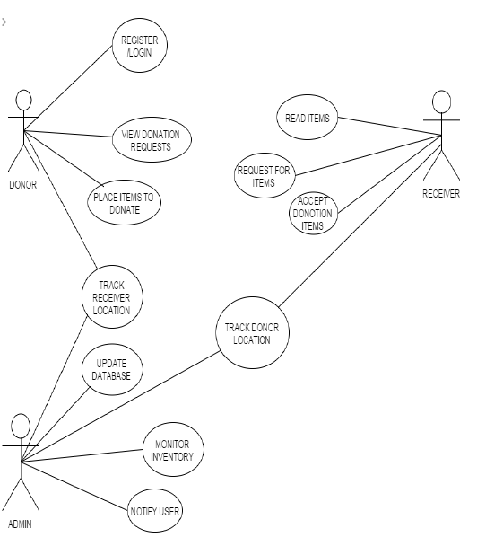
Usecase Diagram

Slide 12
MODULES
Donor:
Login to donor account
Provide the details of food available
Share the location
Agent:
Login to agent account
Receives the information of food
Collects the food
Admin:
Access the application database

Slide 13
REFERENCES
Bagherzadeh, Morvarid, Mitsuhiro Inamura, and Hyunchul Jeong. "Food waste along the food chain." (2014).
http://www.youthkiawaaz.com/2014/09/innovative-trick-dabbawalas-mumbai-feeding-many-hungry-children-city/&cat=General&ip=192.168.3.93&user=-&reason=Group
http://www.epa.gov/recycle/reducing-wasted-food-

Slide 14
Queries
?
Thank You

