Slide 1
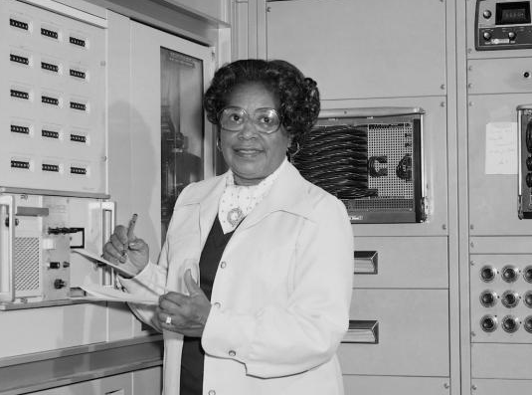
Gladys West – DID Essential work for GPS
MS in Mathematics Virginia State University, 1955
4th black employee at Naval Surface Warfare Center, 1956
Developed Earth geodesy models on IBM 3070 (stretch)
Data from her models was used in development of GPS
Ironically, she’s said to still use only paper maps.
More info: Link A, Link B, Link C

