Slide 1
Quantum Dot Oled
Submitted By: Rahul solanki

Slide 2
Quantum Dots
Quantum Dots:Quantum dots are small nanocrystals. When a high-energy light photon strikes quantum dots, they absorb it and emit a new photon.The color of this emitted photon depends on the size of the quantum dot – so manufacturers have to use the same material (just different sizes) for all colors, which makes manufacturing simpler and helps with uniform aging.
The physical reason for QD coloration is the quantum confinement effect and is directly related to their energy levels. The bandgap energy that determines the energy (and hence color) of the fluorescent light is inversely proportional to the square of the size of quantum dot. Larger QDs have more energy levels that are more closely spaced, allowing the QD to emit (or absorb) photons of lower energy (redder color).

Slide 3
Quantum Dots
In other words, the emitted photon energy increases as the dot size decreases, because greater energy is required to confine the semiconductor excitation to a smaller volume.
Newer quantum dot structures employ indium instead of cadmium, as the latter is not exempted for use in lighting by the European Commission RoHS directive and also because of cadmium's toxicity.

Slide 4
Working Principle
The idea of using quantum dots as a light source emerged in the 1990s. Early applications included imaging using QD infrared photodetectors, light emitting diodes and single-color light emitting devices.[12] Starting in the early 2000s, scientists started to realize the potential of developing quantum dots for light sources and displays.
QDs are either photo-emissive (photoluminescent) or electro-emissive (electroluminescent) allowing them to be readily incorporated into new emissive display architectures.Quantum dots naturally produce monochromatic light, so they are more efficient than white light sources when color filtered and allow more saturated colors that reach nearly 100% of color gamut.

Slide 5
OLED, QLED & QD OLED
OLED: An OLED (Organic Light Emitting Diodes) panel is made from organic (carbon-based) materials that emit light when electricity is applied. An OLED TV is made from millions of pixels, each made from red, green and blue tiny OLED materials.
OLED is a next-generation display technology.
current OLED TV panels are made by LG which is using a slightly different architecture.
Advantages: The contrast ratio is much better in an OLED (true blacks). OLEDs also feature much faster refresh rates and wider viewing angels.
Next-gen designs: OLEDs are thinner and lighter than LCD panels.
QLED:Electro-emissive or electroluminiscent quantum dot displays are an experimental type of display based on quantum-dot light-emitting diodes (QD-LED; also EL-QLED, ELQD, QDEL).
QD-OLED: QD-OLED is a hybrid display technology that aims to take the already very impressive qualities of OLED TV and improve on brightness and color through the use of quantum dots.

Slide 6
OLED, QLED & QD OLED
OLEDs typically consume less power (as only lit pixels draw power) - although this depends on the images viewed.
Next-gen designs: OLEDs are thinner and lighter than LCD panels.
Disadvantage:
A major disadvantage of OLED panels is burn-in and image retention.
Higher cost.
QLED: Current QLED TVs use the photo-luminescence qualities of quantum dots - the fact that they can absorb light at a certain wavelength and emit a light at a different wavelength

Slide 7
OLED, QLED & QD OLED
(specifically convert blue light to white). In a similar fashion to OLED materials, QDs also feature electro-luminescence, which means that light is emitted when electricity is applied.
Advantages: One of the advantages of the QD conversion is that the color light output is purer, and so the TVs can offer a wide color gamut.
Cheap as compared to an Oled Display.
QD OLED: QD-OLED is a hybrid display technology that aims to take the already very impressive qualities of OLED TV and improve on brightness and color through the use of quantum dots.

Slide 8
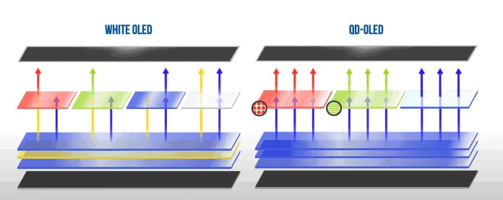
QD OLED vs OLED
color conversion in QD-OLED displays is done by quantum dots that are placed or patterned at a sub-pixel level over Blue OLEDs.
So, we have a blue emissive layer in the backplane where all pixels are blue. And then green and red quantum dot materials are printed on pixels that are needed to be green or red.

Slide 9
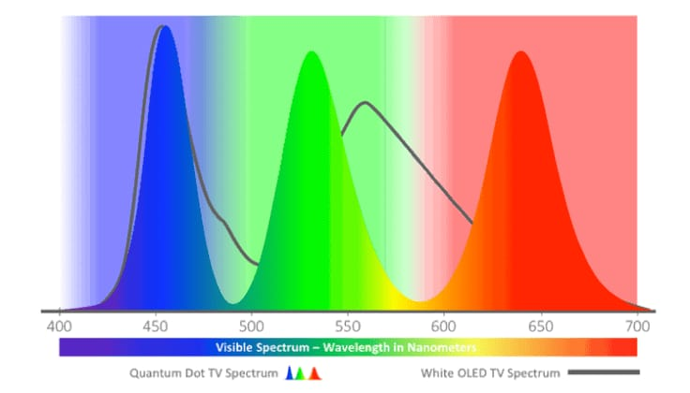
QD OLED vs OLED
Colors are converted on red sub-pixels by red quantum dots and green sub-pixel by green quantum dots. Using this technology, the end result is similar to what you’d get with individual Red, Green, and Blue sub-pixels as with AMOLED displays on phones.

Slide 10
Why OQ OLED Displays are Better
Quantum Dots as color converters are highly efficient and way better than color filters that can block up to 60% light.
Another benefit of this implementation over color filter is that as the Blue OLED lights get dimmer with time, the red and green light getting out of the quantum dots will dim proportionally.
So, over the lifetime of your TV, its display may get less bright but colors shall remain mostly unaffected. The use of Quantum dot also helps with wider color gamuts with fewer image artifacts, better brightness, and better HDR.

Slide 11
Disadvantages of QD OLED Displays
One problem is that Quantum dots on the QD OLED TVs get excited by UV light falling on the TV from the outside.
Secondly, Quantum Dot color conversion materials don’t always capture the entire blue light that is used to excite them and some of it may bleed into Red and Green subpixels.

Slide 12
When will we see QD OLED TVs
Right now, assuming the reports of Samsung and TCL’s QD-OLED plans are accurate, the logical timing would be some time in 2022, possibly as late as the fourth quarter.

Slide 13
Reference
https://www.google.com/amp/s/www.smartprix.com/bytes/qd-oled-vs-oled-vs-qled-vs-mini-led/%3famp
https://www.ossila.com/pages/what-is-an-oled
https://www.digitaltrends.com/home-theater/qd-oled-hybrid-display-technology-fully-explained/
https://en.m.wikipedia.org/wiki/Quantum_dot_display

