Slide 1
Visualizing Funnel Chart using Tableau
Presented by
Vamshi Krishna Girikala
44-599 Introduction to Data Visualization
April 13, 2017

Slide 2
Outline
What is a Funnel Chart?
What is Tableau?
Features of Tableau
Steps to use Tableau
Goals
Demonstration
Lessons Learned

Slide 3
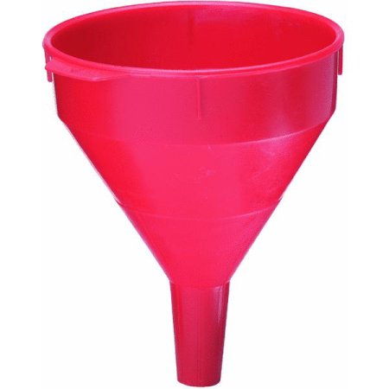
What is Funnel Chart ?
Funnel chart is used to visualize the progressive reduction of data as it passes from one phase to another
Funnel

Slide 4
What is Funnel Chart (Cntd)
The Funnel chart could be used to show anything that’s decreasing in size (ref:http://www.statisticshowto.com/funnel-chart/)
Examples
An order fulfillment process
A sales process from start to finish
Recruitment analysis
Analyzing the success of promotional campaign

Slide 5
What is Tableau?
Tableau is a rapid BI Software. It is a visual analysis solution that allows people to explore and analyze data with simple drag and drop operations. It is a user friendly interface that creates reports that look great right of the gate
Statistical Research
Data Processing
Data Science
Machine Learning

Slide 6
Features of Tableau
More than 10,000 organizations get rapid with Tableau in the office and on-the-go
Great Visualizations: Allows to connect to the data, visualize and creative interactive, sharable dashboards in a few clicks
Fast: we can create interactive dashboards, quick filters and calculations
Statistical Research
Data Processing
Data Science
Machine Learning

Slide 7
Advantages of Tableau
Speed
Ease of Use
Beautiful and Interactive dashboard
Easy publishing and sharing
Growing Market
Statistical Research
Data Processing
Data Science
Machine Learning

Slide 8
Goals
To visualize a funnel chart that can be used to analyze the visitor trends of a website
To visualize a funnel chart that can be used to analyze the average time spent on a particular page in a website
Statistical Research
Data Processing
Data Science
Machine Learning

Slide 9
Dataset
Page title | Page views | Unique page views | Avg. time in sec | Entrances | Bounce Rate | %Exit
San Francisco Police Department | 962 | 583 | 272 | 283 | 71.38% | 30.04%
San Francisco Police Department : 2015 | 549 | 408 | 236 | 155 | 87.74% | 40.44%
San Francisco Police Department : Administration | 2002 | 1599 | 232 | 411 | 69.34% | 24.08%
San Francisco Police Department : Airport | 1342 | 1090 | 232 | 396 | 65.91% | 29.96%
San Francisco Police Department : ALERT | 366 | 339 | 223 | 231 | 88.31% | 66.94%
Statistical Research
Data Processing
Data Science
Machine Learning
Total records: 102 Total attributes: 7
Data source: https://catalog.data.gov/dataset/web-analytics-for-sfgov-sites-2016-q1

Slide 10
Significance of funnel chart
To analyze the visitor trends of the San Francisco’s board of supervisors website
Significance: The funnel chart helps the owners or developers of the website to reorganize the website and eliminate the webpages that are least visited.

Slide 11
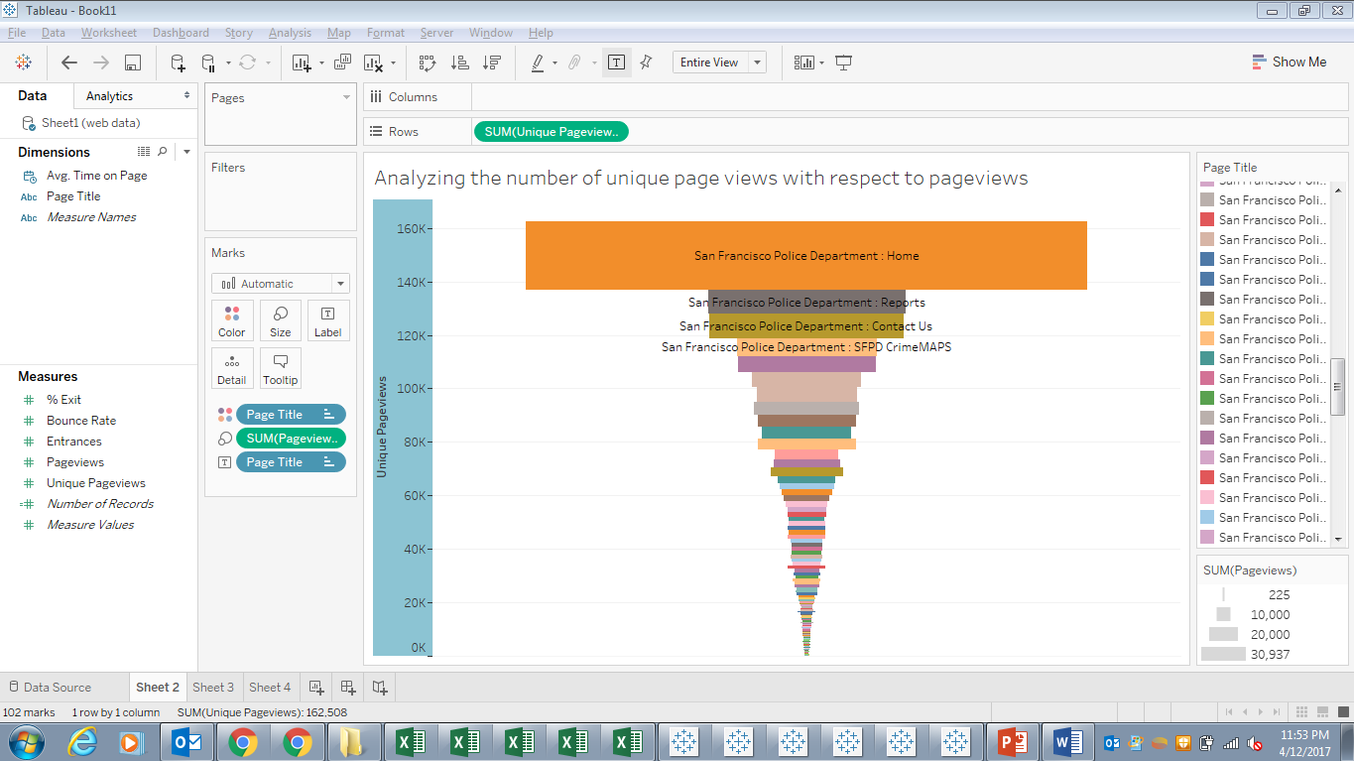
Solution of Goal1 using Tableau tool
Notes:
Github Link:

Slide 12
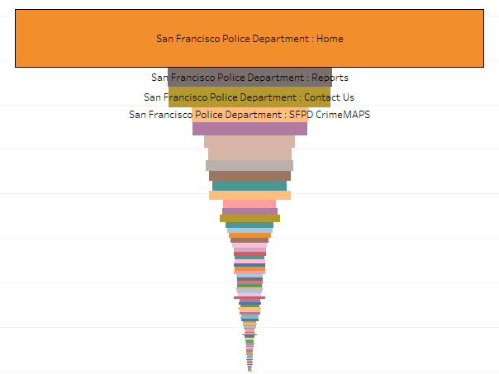
Dimensions
Page views
Unique page views

Slide 13
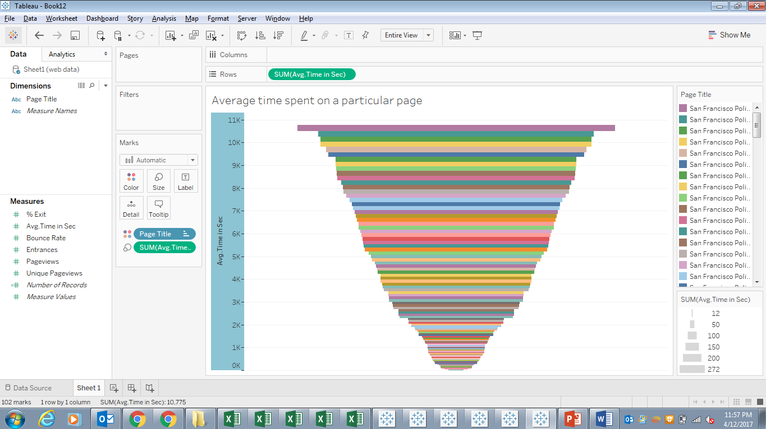
Solution of Goal2 using Tableau tool

Slide 14

Demonstration
Statistical Research
Data Processing
Data Science
Machine Learning

Slide 15
Lessons Learned
Researching and evaluating various data visualization tools
Preparing slides for presentation
How to visualize data using funnel chart
What data should be used for funnel charts
How to use Tableau tool
Statistical Research
Data Processing
Data Science
Machine Learning

Slide 16
Conclusions
Tableau is a user friendly tool which is used to visualize and analyze the data
Based on the data set and requirement appropriate type of chart should be selected

Slide 17
References
http://www.statisticshowto.com/funnel-chart/
http://www.fusioncharts.com/chart-primers/funnel-chart/
https://www.tableau.com/academic/students
Github link: https://github.com/S528127/FunnelChart

Slide 18
Statistical Research
Data Processing
THANK YOU
Data Science
Machine Learning

