Slide 1
Visualizing Spiral Diagrams using IBM Watson Analytics Tool
Presented by
Sushmitha Patlolla
44-599 Introduction to Data Visualization
April 11, 2017

Slide 2
Outline
What is a Spiral Diagram?
IBM Watson Analytics Tool
Features of Watson Analytics Tool
Steps to use the tool
Goal
Demonstration
Lessons learnt

Slide 3
What is a Spiral Diagram?
The spiral visualization shows you the key drivers
Add and explore a visualization for each key driver. Detailed information about what drives each behavior and outcome
A driver can be a single field or a combination of multiple fields
Notes:
The closer the driver is to the center, the stronger the influence that driver has on the target.

Slide 4
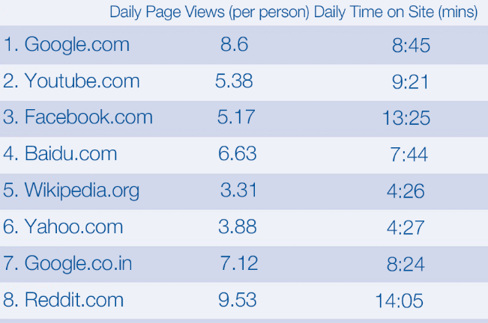
What is a Spiral Diagram? (contd.)
Notes:
Source – Alexa.com

Slide 5
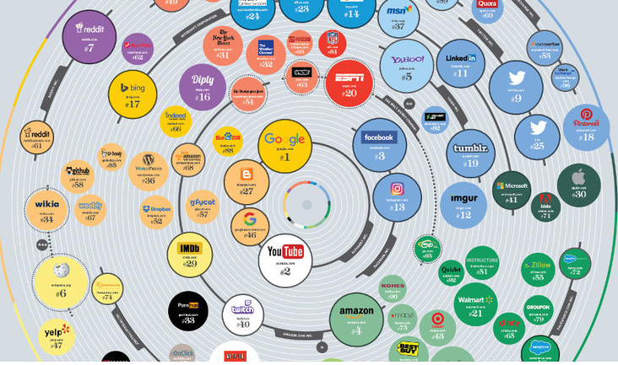
What is a Spiral Diagram? (contd.)
Notes:
https://www.weforum.org/agenda/2017/04/most-popular-websites-google-youtube-baidu?utm_content=buffer547c8&utm_medium=social&utm_source=facebook.com&utm_campaign=buffer

Slide 6
Significance
The spiral visualization shows the key drivers and predictive strength.
Predictive strength is a measurement to help one understand the importance of a field in relationship to its ability to help predict the outcome.

Slide 7
IBM Watson Analytics Tool
IBM Watson Analytic helps you to discover new insights about business or organization
The tool analyzes your data asset and provides several starting points to use
Starting points can be goals and outcomes
Statistical Research
Data Processing
Data Science
Machine Learning

Slide 8
Features of Watson Analytics Tool
Add discovery set: creates visualizations
Interactive exploration of data: graphical UI
Data can be dynamically sorted and filtered
Organize data in the discovery set
Use data groups and hierarchies
Create calculations on-the-go
Define relationships between different columns
Statistical Research
Data Processing
Data Science
Machine Learning

Slide 9
Steps To Use The Tool
Load the data asset onto the tool either via cloud or file-upload
Choose an outcome
Pre-defined outcome suggested by Watson
User-defined outcome
Select the spiral diagram visualization
Based on type of outcome, change the class variables as needed
Statistical Research
Data Processing
Data Science
Machine Learning

Slide 10
Goals
Based on the data set chosen, the goals are:
What drives Income?
What drives Customer Lifetime Value?
Data Source:
https://www.ibm.com/communities/analytics/watson-analytics-blog/marketing-customer-value-analysis/
Statistical Research
Data Processing
Data Science
Machine Learning

Slide 11
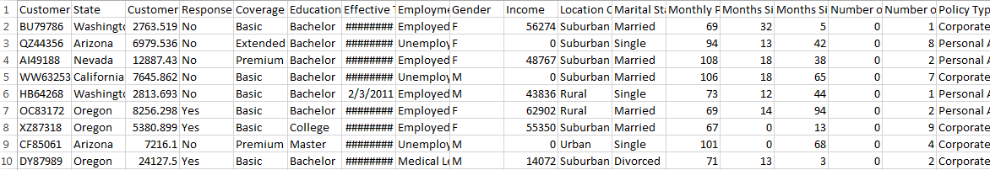
Sample Data-Set
Statistical Research
Data Processing
Data Science
Machine Learning
Total Records =1000 records

Slide 12
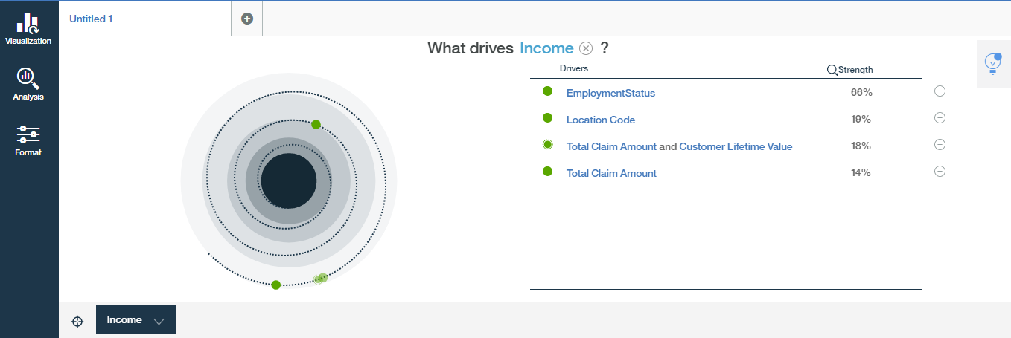
Spiral Diagram for Goal 01
Statistical Research
Data Processing
Data Science
Machine Learning

Slide 13
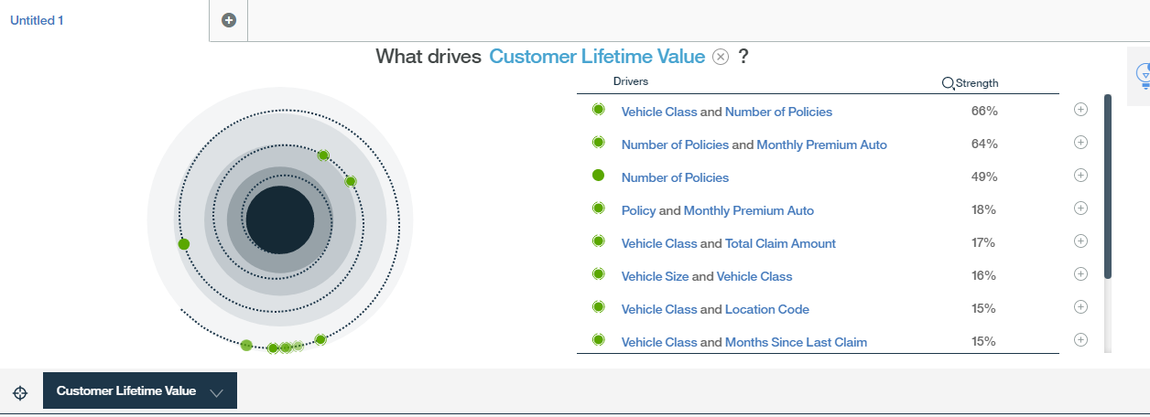
Spiral Diagram for Goal 02
Statistical Research
Data Processing
Data Science
Machine Learning

Slide 14

Demonstration

Slide 15
Advantages and Limitations
When analyzing we can check what other variables relate to the particular class.
One class at a time can be presented.
Statistical Research
Data Processing
Data Science
Machine Learning

Slide 16
Lessons Learned
Researching and evaluating data visualization tools
To use the IBM Watson Analytics tool
To create and read Spiral Diagrams
To document the worksheet
Preparing slides for presentation
Statistical Research
Data Processing
Data Science
Machine Learning

Slide 17
Conclusion
Watson tool is a powerful tool used to visualize data and analyze
Depending on the data set and the requirement appropriate type should be selected
Statistical Research
Data Processing
Data Science
Machine Learning

Slide 18
References
Tool :
https://watson.analytics.ibmcloud.com/card/modelc1b1e8e9-aca0-4d10-b87c-a5b4adb89f0c
Git hub link :
Statistical Research
Data Processing
Data Science
Machine Learning

Slide 19
Thank You

