Slide 1
Challenges of Securing Information
Securing information
No simple solution
Many different types of attacks
Defending against attacks is often difficult
Notes:
Challenges of Securing information
No simple solution
Many different types of attacks
Defending against attacks is often difficult

Slide 2
Today’s Security Attacks
Examples of recent attacks
Attack on a credit card processing company that handles prepaid debit cards
Taking control of wireless cameras
ATM machine attacks
Taking over Twitter accounts
Serial server attacks
Attackers using online sites such as Craigslist and eBay to lure victims to download malware
Penetration of Apple’s very own network
Notes:
Today’s Security Attacks
Examples of recent attacks
Attack on a credit card processing company that handles prepaid debit cards
Taking control of wireless cameras
ATM machine attacks
Taking over Twitter accounts
Serial server attacks
Attackers using online sites such as Craigslist and eBay to lure victims to download malware
Penetration of Apple’s very own network

Slide 3
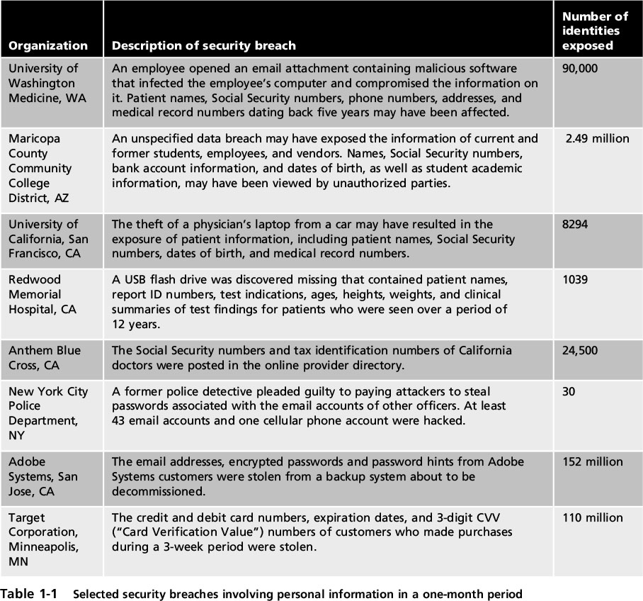
Today’s Security Attacks
Notes:
Today’s Security Attacks
Table 1-1 Selected security breaches involving personal information in a one-month period

Slide 4
Difficulties in Defending Against Attacks
Universally connected devices
Increased speed of attacks
Greater sophistication of attacks
Availability and simplicity of attack tools
Faster detection of vulnerabilities
Notes:
Difficulties in Defending Against Attacks
Universally connected devices
Increased speed of attacks
Greater sophistication of attacks
Availability and simplicity of attack tools
Faster detection of vulnerabilities

Slide 5
Difficulties in Defending Against Attacks
Delays in security updating
Weak security update distribution
Distributed attacks
Introduction of BYOD
User confusion
Notes:
Difficulties in Defending Against Attacks
Delays in security updating
Weak security update distribution
Distributed attacks
Introduction of BYOD
User confusion

Slide 6
Understanding Security
Security is:
The goal: free from danger
The process that achieves that freedom
Harm/danger comes from one of two sources:
A direct action that is intended to inflict damage
An indirect and unintentional action
Security increases often result in loss of
Notes:
Understanding Security
Security is:
The goal to be free from danger
The process that achieves that freedom
Harm/danger may come from one of two sources:
From a direct action that is intended to inflict damage
From an indirect and unintentional action
As security is increased, convenience is often decreased
The more secure something is, the less convenient it may become to use

Slide 7
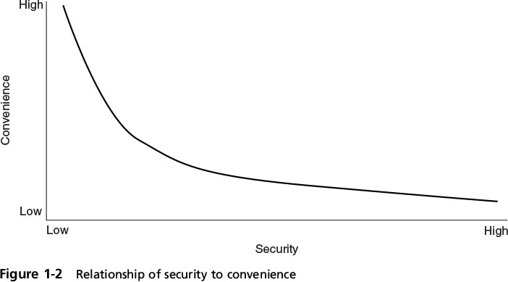
Understanding Security
Notes:
Understanding Security
Figure 1-2 Relationship of security to convenience

Slide 8
Defining Information Security
Information security
the tasks of securing digital information
Manipulated by a microprocessor
Stored on a storage device
Transmitted over a network
Information security goal:
ensure that protective measures are
are properly implemented
ward off attacks
prevent the total collapse of the system when an attack occurs
Notes:
Defining Information Security
Information security - the tasks of securing information that is in a digital format:
Manipulated by a microprocessor
Stored on a storage device
Transmitted over a network
Information security goal - to ensure that protective measures are properly implemented to ward off attacks and prevent the total collapse of the system when a successful attack occurs

Slide 9
Defining Information Security
Three types of information protection: (CIA)
Confidentiality
Only approved individuals may access information
Integrity
Information is correct and unaltered
Availability
Information is accessible to authorized users
Notes:
Defining Information Security
Three types of information protection: often called CIA
Confidentiality
Only approved individuals may access information
Integrity
Information is correct and unaltered
Availability
Information is accessible to authorized users

Slide 10
Defining Information Security
Protections implemented to secure information (AAA)
Authentication
Ensures the individual is who they claim to be
Authorization
Gives permission to specific technology resources
Accounting
Provides tracking of events
Notes:
Defining Information Security
Protections implemented to secure information
Authentication
Ensures the individual is who they claim to be
Authorization
Provides permission or approval to specific technology resources
Accounting
Provides tracking of events

Slide 11
Defining Information Security
Information security is achieved by a combination of three entities:
Information and the hardware
Software
Communications
These entities are protected in three layers:
Products
People
Policies and procedures
Notes:
Defining Information Security
Information security is achieved through a process that is a combination of three entities:
Information and the hardware
Software
Communications
These entities are protected in three layers:
Products
People
Policies and procedures

Slide 12
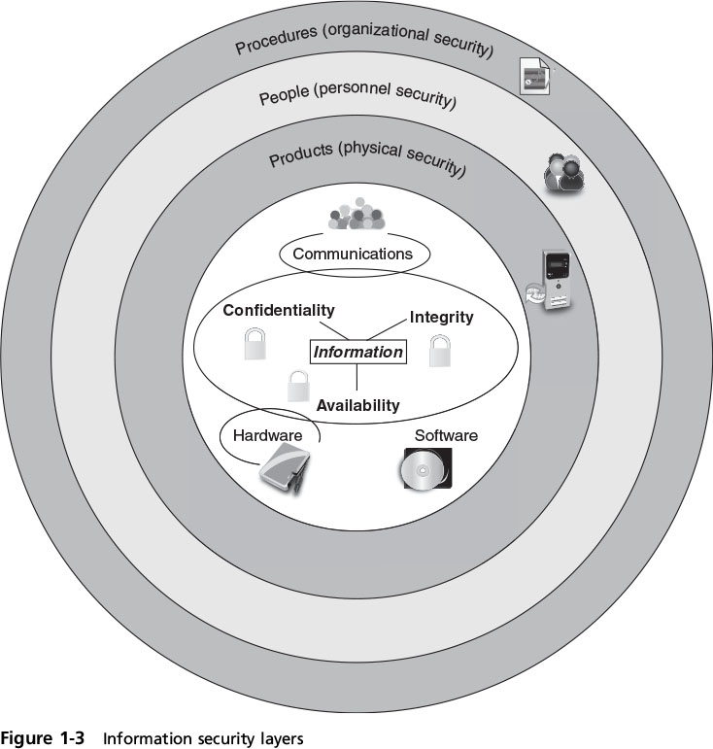
Defining Information Security
Notes:
Defining Information Security
Figure 1-3 Information security layers

Slide 13
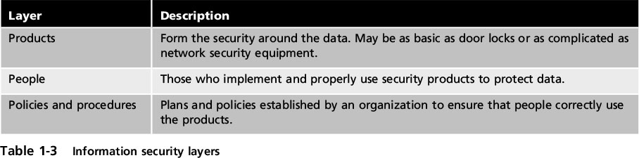
Defining Information Security
Notes:
Defining Information Security
Table 1-3 Information security layers

Slide 14
Information Security Terminology
Asset
Item that has value
Threat
Type of action that has the potential to cause harm
Threat agent
A person or element with power to carry out a threat
Notes:
Information Security Terminology
Asset
Item that has value
Threat
Type of action that has the potential to cause harm
Threat agent
A person or element with power to carry out a threat

Slide 15
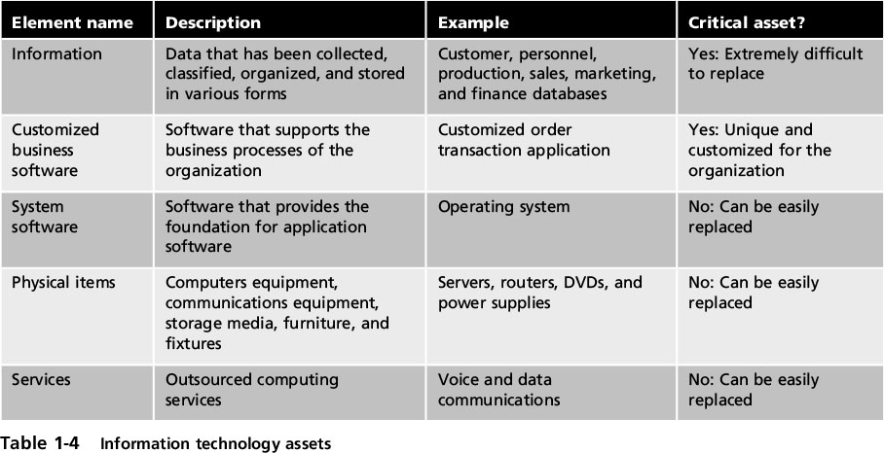
Information Security Terminology
Notes:
Information Security Terminology
Table 1-4 Information technology assets

Slide 16
Information Security Terminology
Vulnerability
Flaw or weakness that allows a threat agent to bypass security
Threat vector
The means by which an attack can occur
Threat likelihood
Likelihood that threat agent will exploit vulnerability
Risk
A situation that involves exposure to some type of danger
Notes:
Information Security Terminology
Vulnerability
Flaw or weakness that allows a threat agent to bypass security
Threat vector
The means by which an attack can occur
Threat likelihood
Likelihood that threat agent will exploit vulnerability
Risk
A situation that involves exposure to some type of danger

Slide 17
Information Security Terminology
Options to deal with risk:
Risk avoidance
identify risk, don’t engaging in activity
Acceptance
acknowledged risk but do not address it
Risk mitigation
attempt to make risk less serious
Deterrence
Inform attacker of the consequences
Transference
transfer risk to a third party
Notes:
Information Security Terminology
Options to deal with risk:
Risk avoidance - involves identifying the risk but not engaging in the activity
Acceptance - risk is acknowledged but no steps are taken to address it
Risk mitigation - the attempt to address the risks by making risk less serious
Deterrence - understanding the attacker and then informing him of the consequences of his actions
Transference - transferring the risk to a third party

Slide 18
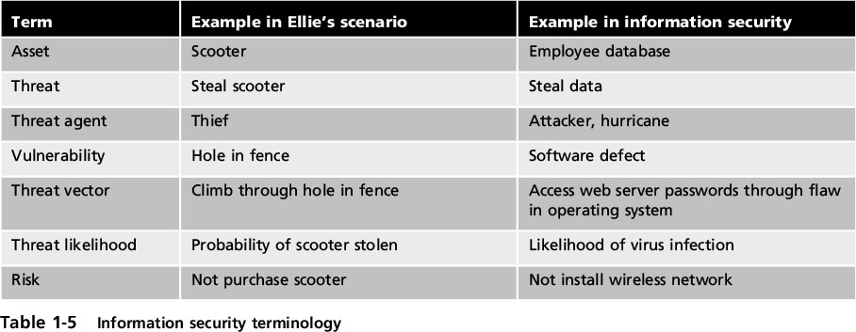
Information Security Terminology
Notes:
Information Security Terminology
Table 1-5 Information security terminology

Slide 19
Understanding the Importance of Information Security
Information security can be helpful in:
Preventing data theft
Thwarting identity theft
Avoiding the legal consequences of not securing information
Maintaining productivity
Foiling cyberterrorism
Notes:
10 AM ended here 8/31
Understanding the Importance of Information Security
Information security can be helpful in:
Preventing data theft
Thwarting identity theft
Avoiding the legal consequences of not securing information
Maintaining productivity
Foiling cyberterrorism

Slide 20
Thwarting Identity Theft
Identity theft
Stealing another person’s personal information
Usually using it for financial gain
Example:
Steal SSN
Create new credit card account
File fraudulent tax returns
Notes:
Thwarting Identity Theft
Identity theft
Stealing another person’s personal information
Usually using it for financial gain
Example:
Steal person’s SSN
Create new credit card account to charge purchases and leave them unpaid
File fraudulent tax returns

Slide 21
Avoiding Legal Consequences
Laws protecting electronic data privacy:
The Health Insurance Portability and Accountability Act of 1996 (HIPAA)
The Sarbanes-Oxley Act of 2002 (Sarbox)
The Gramm-Leach-Bliley Act (GLBA)
Payment Card Industry Data Security Standard (PCI DSS)
California’s Database Security Breach Notification Act (2003)
Notes:
Avoiding Legal Consequences
Laws protecting electronic data privacy:
The Health Insurance Portability and Accountability Act of 1996 (HIPAA)
The Sarbanes-Oxley Act of 2002 (Sarbox)
The Gramm-Leach-Bliley Act (GLBA)
Payment Card Industry Data Security Standard (PCI DSS)
California’s Database Security Breach Notification Act (2003)

Slide 22
Foiling Cyberterrorism
Cyberterrorism
premeditated,
politically motivated
Designed to:
Cause panic
Provoke violence
Result in financial catastrophe
Banking industry, power plants, air traffic control centers, and water systems
Notes:
Foiling Cyberterrorism
Cyberterrorism
Any premeditated, politically motivated attack against information, computer systems, computer programs, and data
Designed to:
Cause panic
Provoke violence
Result in financial catastrophe
May be directed at targets such as the banking industry, power plants, air traffic control centers, and water systems

Slide 23
Who Are the Attackers?
Hacker –
uses computer skills to attack computers
Black hat hackers
Violate computer security for personal gain and the goal is to inflict malicious damage
White hat hackers
Goal to expose security flaws, not to steal or corrupt data
Gray hat hackers
Goal is to break into a system without owner’s permission, but not for their own advantage
Notes:
Who Are the Attackers?
Hacker - person who uses computer skills to attack computers
Black hat hackers
Violate computer security for personal gain and the goal is to inflict malicious damage
White hat hackers
Goal to expose security flaws, not to steal or corrupt data
Gray hat hackers
Goal is to break into a system without owner’s permission, but not for their own advantage

Slide 24
Who Are the Attackers?
Categories of attackers
Cybercriminals
Script kiddies
Brokers
Insiders
Cyberterrorists
Hactivists
State-sponsored attackers
Notes:
Start here 11 AM and 10 AM on 1/11
Who Are the Attackers?
Categories of attackers
Cybercriminals
Script kiddies
Brokers
Insiders
Cyberterrorists
Hactivists
State-sponsored attackers

Slide 25
Cybercriminals
A network of attackers, identity thieves, spammers, financial fraudsters
More highly motivated
Willing to take more risk
Well-funded
More tenacious
The goal is financial gain
Cybercrime - targeted attacks against financial networks and the theft of personal information
Notes:
Cybercriminals
A network of attackers, identity thieves, spammers, financial fraudsters
More highly motivated
Willing to take more risk
Well-funded
More tenacious
The goal of a cybercriminal is financial gain
Cybercrime - targeted attacks against financial networks and the theft of personal information

Slide 26
Cybercriminals
Financial cybercrime is divided into two categories:
Individuals and businesses
Use stolen data, credit card numbers, online financial account information, or Social Security numbers to profit from victims
Businesses and governments
Attempt to steal research on a new product so they can sell it to an unscrupulous foreign supplier
Advanced Persistent Threat (APT) –
multiyear intrusion campaign
targets highly sensitive economic, proprietary, or national security information
Notes:
Cybercriminals
Financial cybercrime is divided into two categories:
Individuals and businesses
Use stolen data, credit card numbers, online financial account information, or Social Security numbers to profit from victims
Businesses and governments
Attempt to steal research on a new product so they can sell it to an unscrupulous foreign supplier
Advanced Persistent Threat (APT) - multiyear intrusion campaign that targets highly sensitive economic, proprietary, or national security information

Slide 27
Script Kiddies
Script kiddies
want to attack computers yet lack knowledge of computers and network needed to do so
download automated hacking software (scripts) from websites
Over 40 percent of attacks require low or no skills
Exploit kits
automated attack package
can be used without advanced computer knowledge
Script kiddies either rent or purchase them
Notes:
Script Kiddies
Script kiddies - individuals who want to attack computers yet they lack the knowledge of computers and network needed to do so
They download automated hacking software (scripts) from websites
Over 40 percent of attacks require low or no skills
Exploit kits - automated attack package that can be used without an advanced knowledge of computers
Script kiddies either rent or purchase them

Slide 28
Brokers
sell knowledge of a vulnerability to other attackers or governments
Often hired by vendor to uncover vulnerabilities
however they don’t report it to the vendor
sell information about vulnerabilities to highest bidder
Notes:
Brokers
Brokers - attackers who sell knowledge of a vulnerability to other attackers or governments
Often hired by the vendor to uncover vulnerabilities
Instead they do not report it to the vendor but sell the information about the vulnerabilities to the highest bidder

Slide 29
Insiders
Employees, contractors, and business partners
> 48 percent of breaches attributed to insiders
Examples:
Health care worker publicize celebrities’ health records
Disgruntled over upcoming job termination
Stock trader conceals losses using fake transactions
Employee bribed /coerced to stealing data before moving to a new job
Notes:
Insiders
Employees, contractors, and business partners
Over 48 percent of breaches attributed to insiders
Examples of insider attacks:
Health care worker may publicize celebrities’ health records
Disgruntled over upcoming job termination
Stock trader might conceal losses through fake transactions
Employees may be bribed or coerced into stealing data before moving to a new job

Slide 30
Cyberterrorists
Cyberterrorists
ideological or for the sake of principles or beliefs
Almost impossible to predict when or where
Targets may include:
A group of computers/ networks that can affect the largest number of users
Example:
The electrical power grid of a state or region
Notes:
Cyberterrorists
Cyberterrorists - an attacker whose motivation may be ideological or for the sake of principles or beliefs
Almost impossible to predict when or where the attack may occur
Targets may include:
A small group of computers or networks that can affect the largest number of users
Example:
Computers that control the electrical power grid of a state or region

Slide 31
Hactivists
Hactivists –
attack for ideological reasons
generally not as well-defined as a cyberterrorist’s motivation
Examples of hactivist attacks:
Breaking into a website/ changing the contents
Disabling a bank website
because it stopped accepting deposits into accounts belonging to the hactivists
Notes:
Hactivists
Hactivists - attackers who attack for ideological reasons that are generally not as well-defined as a cyberterrorist’s motivation
Examples of hactivist attacks:
Breaking into a website and changing the contents on the site to make a political statement
Disabling a website belonging to a bank because the bank stopped accepting payments that were deposited into accounts belonging to the hactivists

Slide 32
State-Sponsored Attackers
State-sponsored attacker –
commissioned by the government
attack enemies’ information systems
Target foreign governments or citizens considered hostile or threatening
Examples of attacks:
Targeting government or military computers
Citizens having email messages read without their knowledge
Notes:
State-Sponsored Attackers
State-sponsored attacker - an attacker commissioned by the governments to attack enemies’ information systems
May target foreign governments or even citizens of the government who are considered hostile or threatening
Examples of attacks:
Malware targeting government or military computers
Citizens having their email messages read without their knowledge

Slide 33
Attacks and Defenses
A wide variety of attacks can be launched
The same basic steps are used in most attacks
To protect computers against attacks, follow five fundamental security principles
Notes:
Attacks and Defenses
A wide variety of attacks can be launched
The same basic steps are used in most attacks
To protect computers against attacks follow five fundamental security principles

Slide 34
Steps of an Attack
Cyber Kill Chain outlines the steps of an attack:
1. Reconnaissance –
probe for info about the system:
types of hardware or software used
2. Weaponization –
create an exploit and package it into a payload
3. Delivery –
weapon transmitted to the target
4. Exploitation –
triggers the intruder’s exploit
5. Installation –
the weapon is installed to either attack the computer or install a remote “backdoor”
Notes:
Steps of an Attack
Cyber Kill Chain outlines the steps of an attack:
1. Reconnaissance - probe for information about the system: type of hardware or software used
2. Weaponization - attacker creates an exploit and packages it into a deliverable payload
3. Delivery - weapon is transmitted to the target
4. Exploitation - after weapon is delivered, the exploitation stage triggers the intruder’s exploit
5. Installation - the weapon is installed to either attack the computer or install a remote “backdoor”

Slide 35
Steps of an Attack
Cyber Kill Chain outlines the steps of an attack (cont’d):
6. Command and Control –
comprised system connects back to attacker so system can be remotely controlled by the attacker
7. Action on Objectives
attackers can start to take actions to achieve their original objectives
Notes:
Steps of an Attack
Cyber Kill Chain outlines the steps of an attack (cont’d):
6. Command and Control - the comprised system connects back to the attacker so that the system can be remotely controlled by the attacker
7. Action on Objectives - now the attackers can start to take actions to achieve their original objectives

Slide 36
Defenses Against Attacks
Five fundamental security principles for defenses:
Layering
Limiting
Diversity
Obscurity
Simplicity
Notes:
Defenses Against Attacks
Five fundamental security principles for defenses:
Layering
Limiting
Diversity
Obscurity
Simplicity

Slide 37
Layering
Must be created in layers
Single defense mechanism may circumvented
Less likely attacker can break through all layers
Layered security approach
Useful in resisting a variety of attacks
Provides the most comprehensive protection
Notes:
Layering
Information security must be created in layers
A single defense mechanism may be easy to circumvent
Making it unlikely that an attacker can break through all defense layers
Layered security approach
Can be useful in resisting a variety of attacks
Provides the most comprehensive protection

Slide 38
Limiting
Limit access to information:
Only those who must use data are granted access
Limited to only what they need to do their job
Methods of limiting access
Technology-based - such as file permissions
Procedural - such as prohibiting document removal from premises
Notes:
Limiting
Limiting access to information:
Reduces the threat against it
Only those who must use data should be granted access
Should be limited to only what they need to do their job
Methods of limiting access
Technology-based - such as file permissions
Procedural - such as prohibiting document removal from premises

Slide 39
Diversity
Closely related to layering
Layers must be different (diverse)
If attackers penetrate one layer:
techniques unsuccessful against other layers
Breaching one layer does not compromise whole system
Example of diversity
Use security products from different manufacturers
Notes:
Diversity
Closely related to layering
Layers must be different (diverse)
If attackers penetrate one layer:
Same techniques will be unsuccessful in breaking through other layers
Breaching one security layer does not compromise the whole system
Example of diversity
Using security products from different manufacturers

Slide 40
Obscurity
Obscuring inside details to outsiders
Example: not revealing details
Type of computer
Operating system version
Brand of software used
Difficult to devise attack if system details are unknown
Notes:
Obscurity
Obscuring inside details to outsiders
Example: not revealing details
Type of computer
Operating system version
Brand of software used
Difficult for attacker to devise attack if system details are unknown

Slide 41
Simplicity
Nature of information security is complex
Complex security systems:
Difficult to understand and troubleshoot
Often compromised for ease of use by trusted users
A secure system should be simple from the inside
But complex from the outside
Notes:
Simplicity
Nature of information security is complex
Complex security systems:
Can be difficult to understand and troubleshoot
Are often compromised for ease of use by trusted users
A secure system should be simple from the inside
But complex from the outside

