Slide 1
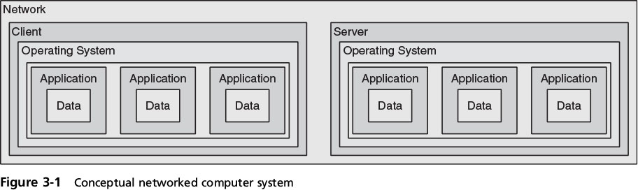
Application Attacks
Attacks on the applications in a networked computer system can be directed toward the server, the client, or both
Notes:
Application Attacks
Attacks on the applications in a networked computer system can be directed toward the server, the client, or both
Figure 3-1 Conceptual networked computer system

Slide 2
Server-Side Web Application Attacks
Securing server-side web apps
often more difficult than protecting other systems
Traditional network security devices can’t always block web app attacks
Many ignore the content of HTTP traffic
Zero-day attack
an attack that exploits previously unknown vulnerabilities, victims have not time to prepare for or defend against the attack
Notes:
Server-Side Web Application Attacks
Securing server-side web applications of often considered more difficult than protecting other systems
Traditional network security devices can block traditional network attacks, but cannot always block web application attacks
Many network security devices ignore the content of HTTP traffic
Zero-day attack - an attack that exploits previously unknown vulnerabilities, victims have not time to prepare for or defend against the attack

Slide 3
Server-Side Web Application Attacks
Many server-side web application attacks target the input that the applications accept from users
Such common web application attacks are:
Cross-site scripting
SQL injection
XML injection
Command injection/directory traversal
Notes:
Server-Side Web Application Attacks
Many server-side web application attacks target the input that the applications accept from users
Such common web application attacks are:
Cross-site scripting
SQL injection
XML injection
Command injection/directory traversal

Slide 4
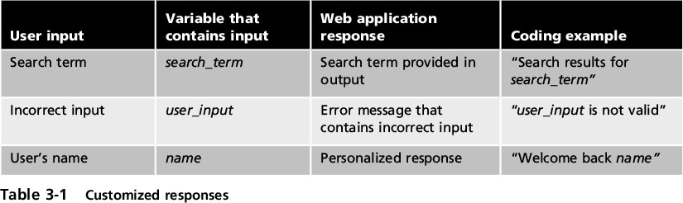
Cross-Site Scripting (XSS)
Injecting scripts into a Web application server to direct attacks at unsuspecting clients
Notes:
Cross-Site Scripting (XSS)
Injecting scripts into a Web application server to direct attacks at unsuspecting clients
Table 3-1 Customized responses

Slide 5
Cross-Site Scripting (XSS)
When victim visits injected Web site:
Malicious instructions are sent to victim’s browser
Some XSS attacks designed to steal info:
Retained by browser when visiting specific sites
An XSS attack requires a website meets two criteria:
Accepts user input without validating it
Uses input in a response in output to browser
Notes:
Cross-Site Scripting (XSS)
When victim visits injected Web site:
Malicious instructions are sent to victim’s browser
Some XSS attacks are designed to steal information:
Retained by the browser when visiting specific sites
An XSS attack requires a website meets two criteria:
Accepts user input without validating it
Uses input in a response

Slide 6
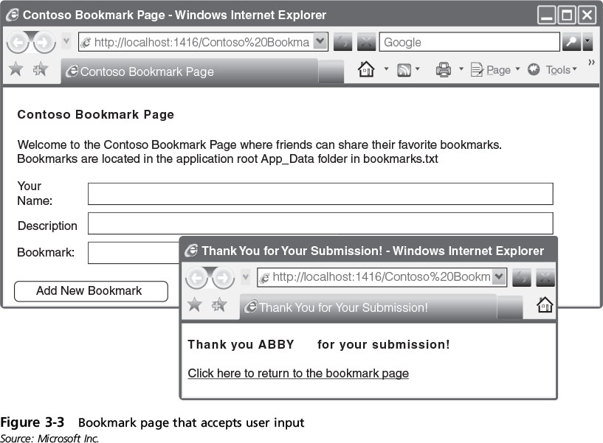
Cross-Site Scripting (XSS)
Notes:
Cross-Site Scripting (XSS)
Figure 3-3 Bookmark page that accepts user input

Slide 7
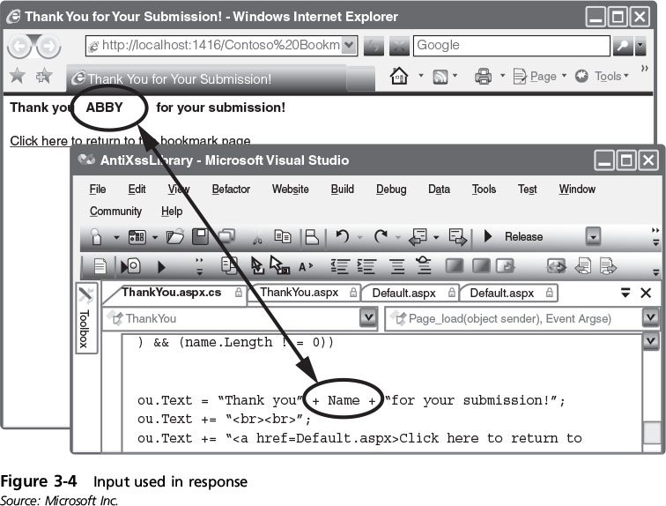
Cross-Site Scripting (XSS)
Notes:
Cross-Site Scripting (XSS)
Figure 3-4 Input used in responses

Slide 8
SQL Injection
Targets SQL servers
injecting malicious commands into them
SQL (Structured Query Language)
Used to manipulate data in relational database
Forgotten password example:
Attacker enters incorrectly formatted e-mail address
Response lets attacker know ifinput is being validated
Notes:
SQL Injection
Targets SQL servers by injecting malicious commands into them
SQL (Structured Query Language)
Used to manipulate data stored in relational database
Forgotten password example:
Attacker enters incorrectly formatted e-mail address
Response lets attacker know whether input is being validated

Slide 9
SQL Injection
Forgotten password example (cont’d.):
Attacker enters email field in SQL statement
Statement is processed by the database
Example statement:
SELECT fieldlist FROM table WHERE field = ‘whatever’ or ‘a’=‘a’
Result: All user email addresses will be displayed
Notes:
SQL Injection
Forgotten password example (cont’d.):
Attacker enters email field in SQL statement
Statement is processed by the database
Example statement:
SELECT fieldlist FROM table WHERE field = ‘whatever’ or ‘a’=‘a’
Result: All user email addresses will be displayed

Slide 10
XML Injection
Markup language
Method for adding annotations to text
HTML
Uses tags surrounded by brackets
Instructs browser to display text in specific format
XML
Carries data instead of indicating how to display it
No predefined set of tags
Users define their own tags
Notes:
XML Injection
Markup language
Method for adding annotations to text
HTML
Uses tags surrounded by brackets
Instructs browser to display text in specific format
XML
Carries data instead of indicating how to display it
No predefined set of tags
Users define their own tags

Slide 11
XML Injection
XML injection attack
Similar to SQL injection attack
Attacker discovers a Web site that does not filter user data
Injects XML tags and data into the database
Notes:
XML Injection
XML injection attack
Similar to SQL injection attack
Attacker discovers a Web site that does not filter user data
Injects XML tags and data into the database
XPath injection
Specific type of XML injection attack
Attempts to exploit XML Path Language queries that are built from user input

Slide 12
Directory Traversal/ Command Injection
Web server users typically restricted to wwwroot directory
Users may be able to access subdirectories:
But not parallel or higher level directories
Example
C:\Inetpub\wwwroot YES
C:\Inetpub\wwwroot\news YES
C:\Windows NO
Prevents unauthorized users from accessing sensitive files on the server
Notes:
Directory Traversal/ Command Injection
Web server users are typically restricted to the root directory
Users may be able to access subdirectories:
But not parallel or higher level directories
Directory traversal attack
Uses malformed input or takes advantage of software vulnerabilities
Attacker moves from root directory to restricted directories

Slide 13
Directory Traversal Attack
PHP Code:
<?php
$template = 'red.php';
if (isset($_COOKIE['TEMPLATE']))
$template = $_COOKIE['TEMPLATE'];
include ("/home/users/phpguru/templates/" . $template);
?>
HTTP Request:
GET /vulnerable.php HTTP/1.0
Cookie: TEMPLATE=../../../../../../../../../etc/passwd

Slide 14
Directory Traversal/ Command Injection
Command injection attack
Attacker enters commands to execute on a server
Attack can be launched through:
Vulnerability in web app accepting user input
Vulnerability in the web server OS software
Server security misconfiguration
Notes:
Stopped 11 am 9/12/16
Directory Traversal/ Command Injection
Command injection attack
Attacker enters commands to execute on a server
A directory traversal attack can be launched through:
A vulnerability in the web application program that accepts user input
A vulnerability in the web server OS software
A security misconfiguration on the server

Slide 15
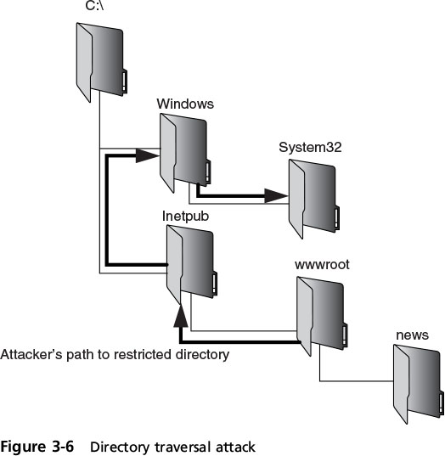
Directory Traversal/ Command Injection
Notes:
Directory Traversal/ Command Injection
Figure 3-6 Directory traversal attack

Slide 16
Client-Side Application Attacks
Web app attacks are server-side attacks
Client-side attacks
target vulnerabilities in client apps that interact with compromised server or process malicious data
Client initiates connection with the server, which could result in an attack
Notes:
Client-Side Application Attacks
Web application attacks are server-side attacks
Client-side attacks target vulnerabilities in client applications that interact with a compromised server or process malicious data
The client initiates connection with the server, which could result in an attack

Slide 17
Client-Side Attacks
Drive-by download
Client computer is compromised simply by viewing a Web page
Attackers inject content into vulnerable Web server
Gain access to server’s operating system
Attackers craft a zero pixel Iframe
(short for inline frame) to avoid visual detection
Embed HTML document inside main document
Client’s browser downloads malicious script
Instructs computer to download malware
Notes:
Client-Side Attacks
Drive-by download
Client computer is compromised simply by viewing a Web page
Attackers inject content into vulnerable Web server
Gain access to server’s operating system
Attackers craft a zero pixel Iframe (short for inline frame) to avoid visual detection
Embed an HTML document inside main document
Client’s browser downloads malicious script
Instructs computer to download malware

Slide 18
Client-Side Attacks
Header manipulation
HTTP header contains fields that characterize data being transmitted
Headers can originate from a Web browser
Browsers do not normally allow this
Attacker’s short program can allow modification
Examples of HTTP header manipulation
Referrer
Accept-language
Response splitting
Notes:
Client-Side Attacks
Header manipulation
HTTP header contains fields that characterize data being transmitted
Headers can originate from a Web browser
Browsers do not normally allow this
Attacker’s short program can allow modification
Examples of HTTP header manipulation
Referrer
Accept-language
Response splitting

Slide 19
Client-Side Attacks
Referer field indicates site that generated Web page
Attacker modifies field to hide the fact it came from another site
Accept-language field contents may be passed directly to an SQL database
Attacker could inject SQL command
Response splitting is one of the most common HTTP header manipulation attacks
Notes:
Client-Side Attacks
Referer field indicates the site that generated the Web page
Attacker can modify this field to hide the fact it came from another site
Accept-language field contents may be passed directly to an SQL database
Attacker could inject SQL command by modifying this header
Response splitting is one of the most common HTTP header manipulation attacks

Slide 20
Client-Side Attacks
Cookies
Cookies store user-specific information on user’s local computer
Types of cookies:
First-party cookie –
cookie created by Web site user is currently viewing
Third-party cookie –
advertisers place a cookie to record user preferences
Session cookie
stored in RAM and expires when browser is closed
Notes:
End 10 and 11 AM 1/23/17
Client-Side Attacks
Cookies
Cookies store user-specific information on user’s local computer
Types of cookies:
First-party cookie - cookie created by Web site user is currently viewing
Third-party cookie - site advertisers place a cookie to record user preferences
Session cookie - stored in RAM and expires when browser is closed

Slide 21
Client-Side Attacks
Types of cookies (cont’d):
Persistent cookie –
recorded on hard drive doesn’t expire when browser closes
Also called a tracking cookie
Locally shared object (LSO) –
can store up to 100 KB of data from a website
More complex than the data in a regular cookie
Also called a Flash cookie
Difficult to delete
Notes:
Client-Side Attacks
Types of cookies (cont’d):
Persistent cookie - recorded on computer’s hard drive and does not expire when the browser closes
Also called a tracking cookie
Locally shared object (LSO) - can store up to 100 KB of data form a website
More complex than the simple text found in a regular cookie
Also called a Flash cookie

Slide 22
Client-Side Attacks
Cookies pose security and privacy risks
First-party cookies may be stolen and used to impersonate the user
Used to tailor advertising
Can be exploited by attackers
Attachments
Files that are coupled with email messages
Commonly used to spread viruses, Trojans, etc.
Notes:
Client-Side Attacks
Cookies pose security and privacy risks
First-party cookies may be stolen and used to impersonate the user
Used to tailor advertising
Can be exploited by attackers
Attachments
Files that are coupled with email messages
Malicious attachments are commonly used to spread viruses, Trojans, and other malware

Slide 23
Client-Side Attacks
Session Hijacking
Attacker impersonates user by stealing\guessing session token
Session token is a random string
assigned to connection between user and web application
Attacker attempts to obtain the session token:
Using XSS or other attacks
Eavesdropping on the transmission
Guessing the session token
Notes:
Client-Side Attacks
Session Hijacking
Attacker attempts to impersonate user by stealing or guessing session token
Session token is a random string assigned to an interaction between user and web application
An attacker can attempt to obtain the session token:
By using XSS or other attacks to steal the session token cookie from the victim’s computer
Eavesdropping on the transmission
Guessing the session token

Slide 24
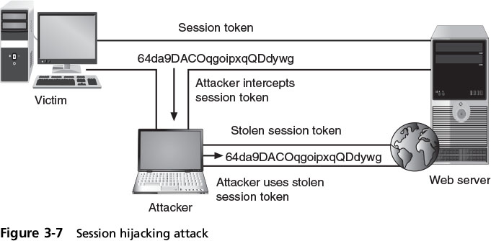
Client-Side Attacks
Notes:
Client-Side Attacks
Figure 3-7 Session hijacking attack

Slide 25
Client-Side Attacks
Malicious Add-ons
Plug-in - third party library that attaches to browser
can be embedded inside a webpage
Add-ons or extensions
add functionality to the web browser
Add-ons can do the following:
Create additional browser toolbars
Change browser menus
Process the content of every webpage that is loaded
Notes:
Client-Side Attacks
Malicious Add-ons
Plug-in - a third party library that attaches to a web browser and can be embedded inside a webpage
Add-ons or extensions - add functionality to the web browser
Add-ons can do the following:
Create additional web browser toolbars
Change browser menus
Be aware of other tabs open in the same browser
Process the content of every webpage that is loaded

Slide 26
Client-Side Attacks
Security risks exist when using add-ons
Attackers create malicious add-ons to launch attacks against the user’s computer
Malicious add-ons can be written by using Active X
ActiveX is a set of rules sharing info under Windows
Attackers can take advantage of ActiveX vulnerabilities to attack computers
Notes:
Client-Side Attacks
Security risks exist when using add-ons
Attackers can create malicious add-ons to launch attacks against the user’s computer
Malicious add-ons can be written by using Microsoft’s Active X
ActiveX is a set of rules for how applications under the Microsoft Windows OS should share information
Attackers can take advantage of vulnerabilities in ActiveX to perform malicious attacks on a computer

Slide 27
Impartial Overflow Attacks
Impartial overflow attacks
Designed to “overflow” areas of memory with instructions
“Impartial” means they can target either a server or a client
Types of overflow attacks:
Buffer overflow attacks
Integer overflow attacks
Arbitrary/remote code execution attacks
Notes:
Impartial Overflow Attacks
Impartial overflow attacks
Attacks designed to “overflow” areas of memory with instructions from the attacker
“Impartial” means they can target either a server or a client
Types of overflow attacks:
Buffer overflow attacks
Integer overflow attacks
Arbitrary/remote code execution attacks

Slide 28
Impartial Overflow Attacks
Buffer overflow attacks
A process attempts to store data in RAM beyond the boundaries of a fixed-length storage buffer
Extra data overflows into adjacent memory locations
Attacker overflows the buffer with the address pointing to the attacker’s malware code
Notes:
End 11 AM 9/14
Impartial Overflow Attacks
Buffer overflow attacks
Occur when a process attempts to store data in RAM beyond the boundaries of a fixed-length storage buffer
Extra data overflows into adjacent memory locations
An attacker can overflow the buffer with a new address pointing to the attacker’s malware code

Slide 29
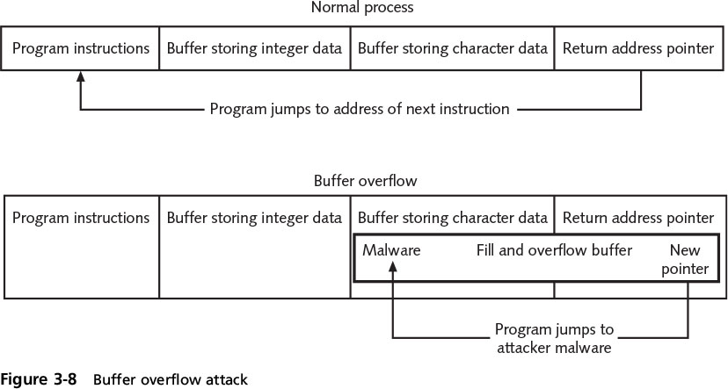
Impartial Overflow Attacks
Notes:
Impartial Overflow Attacks
Figure 3-8 Buffer overflow attack

Slide 30
Impartial Overflow Attacks
Integer Overflow Attack
An integer overflow is the condition that occurs when the result of an arithmetic operation exceeds the maximum size of the integer type used to store it
In an integer overflow attack:
An attacker changes the value of a variable to something outside the range that the programmer had intended by using an integer overflow
Could change amount owed to getting a refund!
Notes:
Impartial Overflow Attacks
Integer Overflow Attack
An integer overflow is the condition that occurs when the result of an arithmetic operation exceeds the maximum size of the integer type used to store it
In an integer overflow attack:
An attacker changes the value of a variable to something outside the range that the programmer had intended by using an integer overflow

Slide 31
Networking-Based Attacks
Attackers place a high priority on targeting networks
Exploiting a single vulnerability may expose hundreds or thousands of devices to an attacker
Types of networking-based attacks:
Denial of service
Interception
Poisoning
Attacks on access rights
Notes:
Networking-Based Attacks
Attackers place a high priority on targeting networks
Exploiting a single vulnerability may expose hundreds or thousands of devices to an attacker
Types of networking-based attacks:
Denial of service
Interception
Poisoning
Attacks on access rights

Slide 32
Denial of Service (DoS)
Denial of service (DoS)
Attempt to prevent authorized users from accessing a system by overwhelming it with requests
Most DoS attacks today are distributed denial of service (DDoS)
Using hundreds or thousands of zombie computers in a botnet to flood a device with requests
Notes:
End of class 1 PM 9/14/16
Denial of Service (DoS)
Denial of service (DoS)
A deliberate attempt to prevent authorized users from accessing a system by overwhelming it with requests
Most DoS attacks today are distributed denial of service (DDoS)
Using hundreds or thousands of zombie computers in a botnet to flood a device with requests

Slide 33



Denial of Service (DoS)
Ping flood attack
The ping utility is used to send large number of ICMP echo request messages
Multiple computers rapidly send a large number of ICMP echo requests to a server
Server drops legitimate connections and refuse new connections
Smaller and slower Web server!
Faster, more powerful computer!
ICMP echo requests
Notes:
Denial of Service (DoS)
Ping flood attack
The ping utility is used to send large number of ICMP echo request messages
In a ping flood attack, multiple computers rapidly send a large number of ICMP echo requests to a server
Server will drop legitimate connections and refuse new connections

Slide 34
Denial of Service (DoS)
Smurf attack
Trick devices to respond to false requests
But send them to an unsuspecting victim!
Attacker broadcasts ping request to all computers on the network
changes the return address (called spoofing)
All computers send response to the victim’s computer
t is overwhelmed and crashes or becomes unavailable to legitimate users
Notes:
Denial of Service (DoS)
Smurf attack
Tricks devices into responding to false requests to an unsuspecting victim
An attacker broadcasts a ping request to all computers on the network but changes the address from which the request came from (called spoofing)
Appears as if victim’s computer is asking for response from all computers on the network
All computers send a response to the victim’s computer so that it is overwhelmed and crashes or becomes unavailable to legitimate users

Slide 35
Denial of Service (DoS)
SYN flood attack
Takes advantage of procedures for initiating a session
Attacker sends SYN packets to the server
Modifies the source address of each packet to computer addresses that do not exist or cannot be reached
Notes:
End of class 11 AM 1/25/17
Denial of Service (DoS)
SYN flood attack
Takes advantage of procedures for initiating a session
In a SYN flood attack against a web server:
The attacker sends SYN segments in IP packets to the server
Attacker modifies the source address of each packet to computer addresses that do not exist or cannot be reached

Slide 36
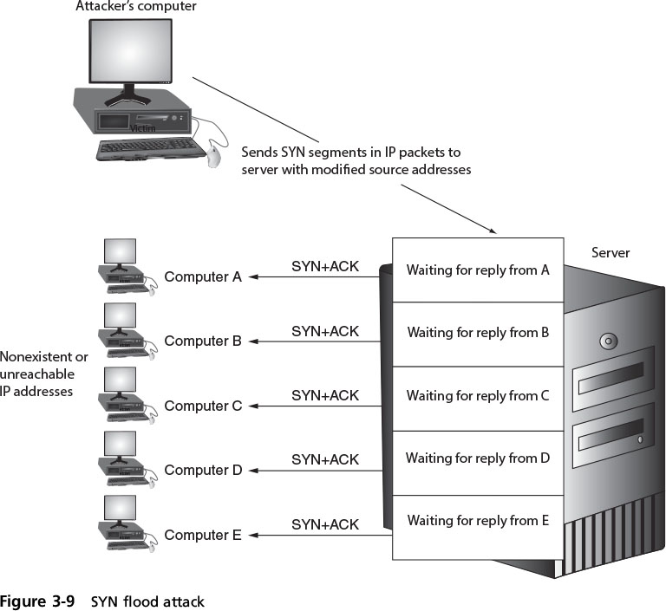
Denial of Service (DoS)
Notes:
Denial of Service (DoS)
Figure 3-9 SYN flood attack

Slide 37
Interception
Some attacks are designed to intercept network communications
Man-in-the-Middle attacks
Intercept legitimate packets and forge fictitious response
Two computers are sending and receiving data with a computer between them
In a passive attack, data is captured and recorded before sending it on to the original recipient
In an active attack contents of transmission are altered before they are sent to the recipient
Notes:
End of class 10 AM 1/25/17
Interception
Some attacks are designed to intercept network communications
Man-in-the-Middle attacks
Interception of legitimate communication and forging a fictitious response to the sender
Two computers are sending and receiving data with a computer between them
In a passive attack, data is captured and recorded before sending it on to the original recipient
In an active attack contents of transmission are altered before they are sent to the recipient

Slide 38
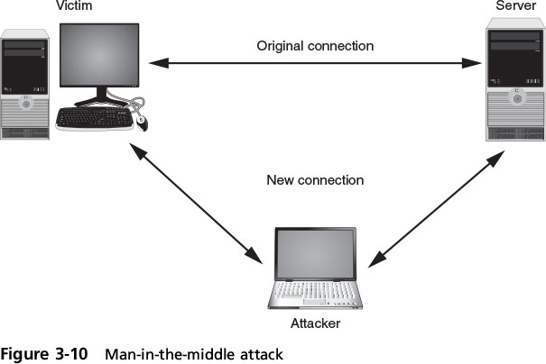
Interception
Notes:
Interception
Figure 3-10 Man-in-the-middle

Slide 39
Interception
Replay attacks
Attacker makes copy of transmission before sending it to the original recipient
Uses copy at a later time
Example: capturing logon credentials
More sophisticated replay attacks
Attacker captures network device’s message to server and then later sends original, valid message to server
Establishes a trust relationship between attacker and server
Notes:
End 10 AM 9/14/16
Interception
Replay attacks
Attacker makes copy of transmission before sending it to the original recipient
Uses copy at a later time
Example: capturing logon credentials
More sophisticated replay attacks
Attacker captures network device’s message to server and then later sends original, valid message to server
Establishes a trust relationship between attacker and server

Slide 40
Poisoning
Poisoning
The act of introducing a substance that harms or destroys
Two types of attacks inject “poison” into a normal network process to facilitate an attack:
ARP poisoning
DNS poisoning
Notes:
Poisoning
Poisoning
The act of introducing a substance that harms or destroys
Two types of attacks inject “poison” into a normal network process to facilitate an attack:
ARP poisoning
DNS poisoning

Slide 41
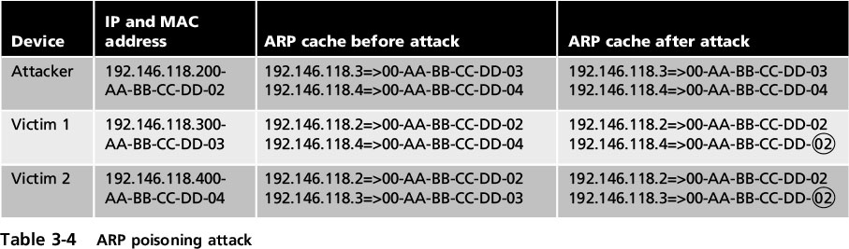
Poisoning
ARP Poisoning
Attacker modifies MAC address in ARP cache to point to different computer
Notes:
Poisoning
ARP Poisoning
Attacker modifies MAC address in ARP cache to point to different computer
Table 3-4 ARP poisoning attack

Slide 42
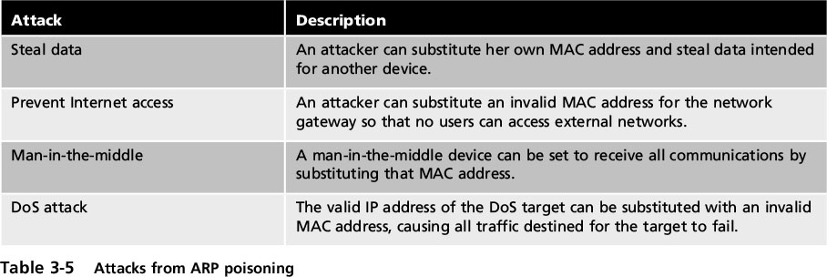
Poisoning
Notes:
Poisoning
Table 3-5 Attacks from ARP poisoning

Slide 43
Poisoning
DNS poisoning
Domain Name System
The current basis for name resolution to IP address
DNS poisoning substitutes DNS addresses
redirect a computer to another device
Two locations for DNS poisoning
Local host table
External DNS server
Notes:
Poisoning
DNS poisoning
Domain Name System is the current basis for name resolution to IP address
DNS poisoning substitutes DNS addresses to redirect a computer to another device
Two locations for DNS poisoning
Local host table
External DNS server

Slide 44
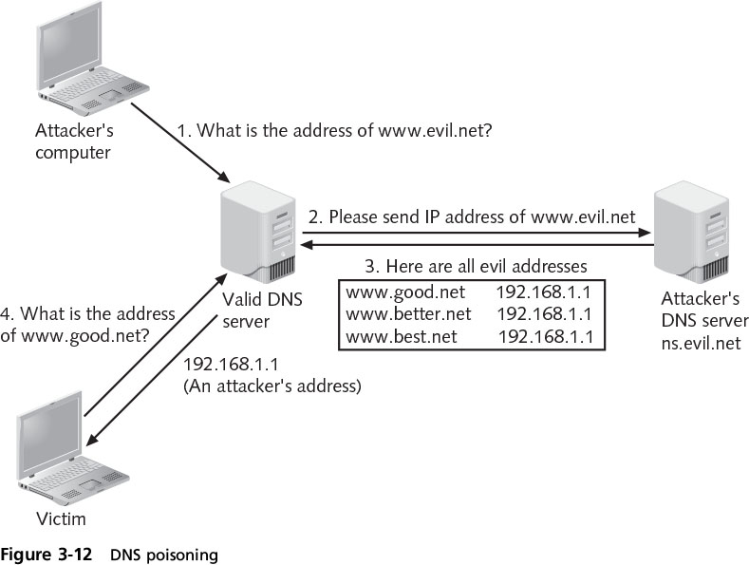
Poisoning
Notes:
Poisoning
Figure 3-12 DNS poisoning

Slide 45
Attacks on Access Rights
Access rights
Privileges to access hardware and software resources that are granted to users
Two attacks that target access rights:
Privilege escalation
Transitive access
Notes:
Attacks on Access Rights
Access rights
Privileges to access hardware and software resources that are granted to users
Two attacks that target access rights:
Privilege escalation
Transitive access

Slide 46
Attacks on Access Rights
Privilege escalation
Exploiting a software vulnerability to gain access to resources that the user normally would be restricted from accessing
Two types of privilege escalation:
When a lower privilege user accesses functions restricted to higher privilege users
When a user with restricted privilege accesses different restricted functions of a similar user
Notes:
Attacks on Access Rights
Privilege escalation
Exploiting a software vulnerability to gain access to resources that the user normally would be restricted from accessing
Two types of privilege escalation:
When a lower privilege user accesses functions restricted to higher privilege users
When a user with restricted privilege accesses different restricted functions of a similar user

Slide 47
Attacks on Access Rights
Transitive access
An attack involving a third party to gain access rights
Example: System 1 can access System 2, and because System 2 can access System 3, then System 1 can access System 3
Has to do with whose credentials should be used when accessing services
Different users have different access rights
Notes:
Attacks on Access Rights
Transitive access
An attack involving a third party to gain access rights
Example: System 1 can access System 2, and because System 2 can access System 3, then System 1 can access System 3
Has to do with whose credentials should be used when accessing services
Different users have different access rights

