Slide 1
Securing the Host
Securing the host involves:
Protecting the physical device
Securing the operating system (OS) software
Using antimalware software
Notes:
Securing the Host
Securing the host involves:
Protecting the physical device
Securing the operating system (OS) software
Using antimalware software

Slide 2
Securing Devices
Security control - any device or process that is used to reduce risk
Two levels of security controls:
Admin controls –
developing and ensuring that policies and procedures are carried out
Technical controls
controls that are carried out or managed by devices
There are five subtypes of controls (sometimes called activity phase controls)
Notes:
Securing Devices
Security control - any device or process that is used to reduce risk
Two levels of security controls:
Administrative controls - processes for developing and ensuring that policies and procedures are carried out
Technical controls - controls that are carried out or managed by devices
There are five subtypes of controls (sometimes called activity phase controls) described on the following slide

Slide 3
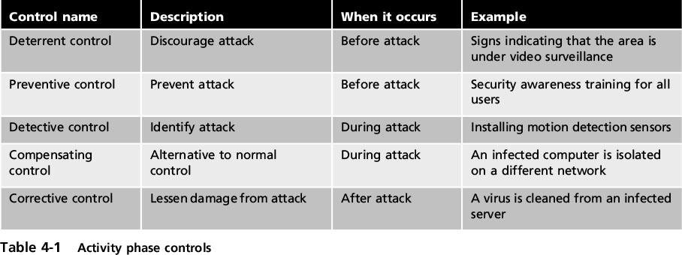
Securing Devices
Notes:
Securing Devices
Table 4-1 Activity phase controls

Slide 4
External Perimeter Defenses
External perimeter defenses
designed to restrict access to equipment areas
This type of defense includes:
Barriers
guards
Motion detection devices
Notes:
External Perimeter Defenses
External perimeter defenses are designed to restrict access to equipment areas
This type of defense includes:
Barriers
guards
Motion detection devices

Slide 5
External Perimeter Defenses
Barriers
Fencing –
a tall, permanent structure
often equipped with other deterrents
lighting and signage
Barricade
large concrete ones should be used
Guards
Humans are considered active security elements
Cameras to transmit to specific and limited set of receivers called closed circuit television (CCTV)
Notes:
End of 10 AM class 9/16/16
External Perimeter Defenses
Barriers
Fencing - usually a tall, permanent structure
Modern perimeter fences are equipped with other deterrents such as proper lighting and signage
Barricade - large concrete ones should be used
Guards
Human guards are considered active security elements
Video surveillance uses cameras to transmit a signal to a specific and limited set of receivers called closed circuit television (CCTV)

Slide 6
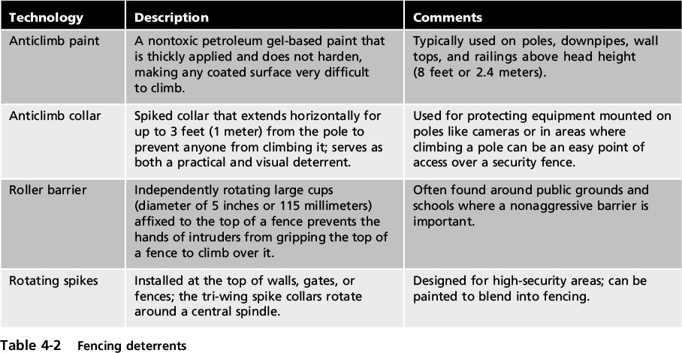
External Perimeter Defenses
Notes:
External Perimeter Defenses
Table 4-2 Fencing detergents

Slide 7
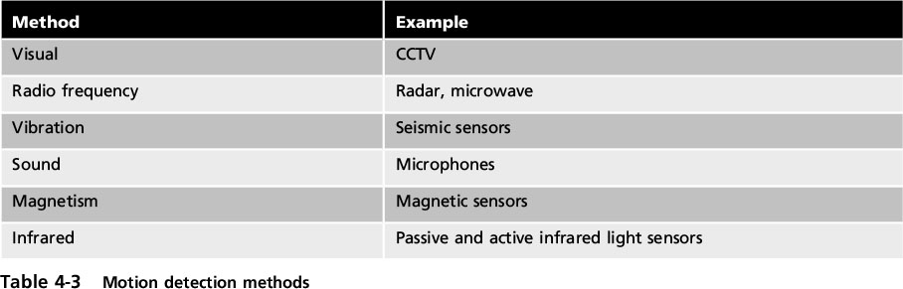
External Perimeter Defenses
Motion Detection
Determin object’s change in position in relation to its surroundings
This movement usually generates an audible alarm
Notes:
External Perimeter Defenses
Motion Detection
Determining an object’s change in position in relation to its surroundings
This movement usually generates an audible alarm
Table 4-3 Motion detection methods

Slide 8
Internal Physical Access Security
These protections include:
Hardware locks
Proximity readers
Access lists
Mantraps
Protected distribution systems for cabling
Notes:
Internal Physical Access Security
These protections include:
Hardware locks
Proximity readers
Access lists
Mantraps
Protected distribution systems for cabling

Slide 9
Internal Physical Access Security
Hardware locks
Standard keyed lock
provides minimal security
Deadbolt locks
provide additional security
require key to both open and lock the door
Cipher locks
combination locks
use buttons that must be pushed in the proper sequence
Can be programmed to allow a certain individual’s code to be valid on specific dates and times
Notes:
Internal Physical Access Security
Hardware locks
Standard keyed entry lock provides minimal security
Deadbolt locks provide additional security and require that a key be used to both open and lock the door
Cipher locks are combination locks that use buttons that must be pushed in the proper sequence
Can be programmed to allow a certain individual’s code to be valid on specific dates and times

Slide 10
Internal Physical Access Security
Recommended key management procedures
Inspect locks regularly
Issue keys only to authorized users
Keep track of issued keys
Master keys should not have identifying marks
Secure unused keys in a safe place
Establish a procedure to monitor use of locks and keys
Mark master keys with “Do Not Duplicate”
Change locks after key loss or theft
Notes:
Internal Physical Access Security
Recommended key management procedures
Inspect locks regularly
Issue keys only to authorized users
Keep track of issued keys
Master keys should not have identifying marks
Secure unused keys in a safe place
Establish a procedure to monitor use of locks and keys
Mark master keys with “Do Not Duplicate”
Change locks after key loss or theft

Slide 11
Internal Physical Access Security
Proximity Readers
Uses an object (physical token) to identify persons with authorization to access an area
ID badge emits a signal identifying the owner
Proximity reader receives signal
These badges are often fitted with RFID tags
Badge can remain in bearer’s pocket
Notes:
Internal Physical Access Security
Proximity Readers
Uses an object (physical token) to identify persons with authorization to access an area
ID badge emits a signal identifying the owner
Proximity reader receives signal
ID badges that can be detected by a proximity reader are often fitted with RFID tags
Badge can remain in bearer’s pocket

Slide 12
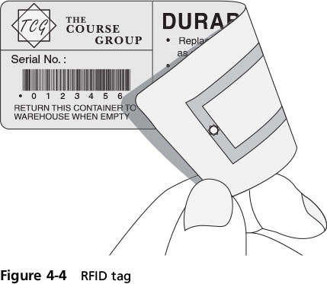
Internal Physical Access Security
Notes:
Internal Physical Access Security
Figure 4-4 RFID tag

Slide 13
Internal Physical Access Security
Access list
Record of individuals who have permission to enter secure area
Records time they entered and left
Mantrap
Separates secured area from unsecured area
Device monitors and controls two interlocking doors
Only one door may open at any time
Notes:
Internal Physical Access Security
Access list
Record of individuals who have permission to enter secure area
Records time they entered and left
Mantrap
Separates a secured from a nonsecured area
Device monitors and controls two interlocking doors
Only one door may open at any time

Slide 14
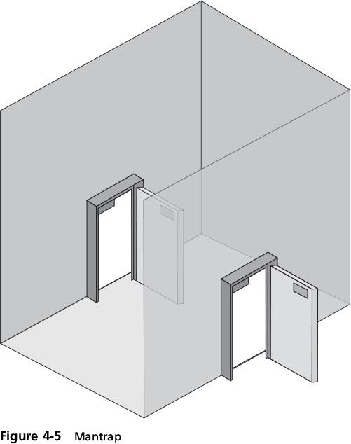
Internal Physical Access Security
Notes:
Internal Physical Access Security
Figure 4-5 Mantrap

Slide 15
Internal Physical Access Security
Protected Distribution Systems (PDS)
System of cable conduits used to protect classified info being transmitted between secure areas
Created by the U.S. Department of Defense (DOD)
Two types of PDS:
Hardened carrier PDS - conduit constructed of special electrical metallic tubing
Alarm carrier PDS - specialized optical fibers in the conduit sense acoustic vibrations that occur when an intruder attempts to gain access
Notes:
Internal Physical Access Security
Protected Distribution Systems (PDS)
A system of cable conduits used to protect classified information that is being transmitted between two secure areas
Created by the U.S. Department of Defense (DOD)
Two types of PDS:
Hardened carrier PDS - conduit constructed of special electrical metallic tubing
Alarm carrier PDS - specialized optical fibers in the conduit that sense acoustic vibrations that occur when an intruder attempts to gain access

Slide 16
Hardware Security
Hardware security - the physical security protecting the hardware of the host system
Most portable devices have a steel bracket security slot
Cable lock inserted into slot and secured to device
cable connected to the lock secured to a desk or chair
Locking cabinets
Can be prewired for power and network connections
Allow devices to charge while stored
Notes:
Hardware Security
Hardware security - the physical security protecting the hardware of the host system
Most portable devices have a steel bracket security slot
A cable lock can be inserted into slot and secured to device and a cable connected to the lock can be secured to a desk or chair
Locking cabinets
Can be prewired for power and network connections
Allow devices to charge while stored

Slide 17
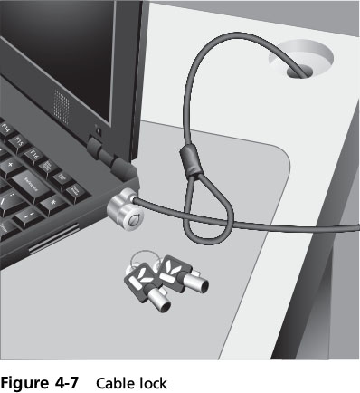
Hardware Security
Notes:
Hardware Security
Figure 4-7 Cable lock

Slide 18
Securing the Operating System Software
Five-step process for protecting operating system
1. Develop the security policy
2. Perform host software baselining
3. Configure operating system security settings
4. Deploy and manage security settings
5. Implement patch management
Notes:
Securing the Operating System Software
Five-step process for protecting operating system
1. Develop the security policy
2. Perform host software baselining
3. Configure operating system security settings
4. Deploy and manage security settings
5. Implement patch management

Slide 19
Securing the Operating System Software
Develop the security policy
Security policy –
document(s) that clearly define organization’s defense mechanisms
Every computer on the network must…
Perform host software baselining
Baseline - the standard or checklist against which systems can be evaluated
Configuration settings that are used for each computer in the organization
Notes:
End 11 AM class 1-30-17
Securing the Operating System
Develop the security policy
Security policy - a document(s) that clearly define organization’s defense mechanisms
Perform host software baselining
Baseline - the standard or checklist against which systems can be evaluated
Configuration settings that are used for each computer in the organization

Slide 20
Securing the Operating System Software
Configure operating system security and settings
Modern OSs have hundreds of different security settings that can be manipulated to conform to the baseline
Typical configuration baseline would include:
Changing insecure default settings
Eliminating unnecessary software, services, protocols
Enabling security features such as a firewall
Notes:
End of class 10 AM 1/30/17
Securing the Operating System Software
Configure operating system security and settings
Modern OSs have hundreds of different security settings that can be manipulated to conform to the baseline
Typical configuration baseline would include:
Changing insecure default settings
Eliminating unnecessary software, services, protocols
Enabling security features such as a firewall

Slide 21
Securing the Operating System Software
Deploy and Manage Security Settings
Tools to automate the process
Security template - collections of security configuration settings
Group policy - Windows feature provides centralized computer management; a single configuration may be deployed to many users
Notes:
End of class 10 AM and 11 AM 9/19/16
Deploy and Manage Security Settings
Tools to automate the process
Security template - collections of security configuration settings
Group policy - Windows feature providing centralized computer management; a single configuration may be deployed to many users

Slide 22
Securing the Operating System Software
Implement Patch Management
OS’s increase in size and complexity
New attack tools make secure functions vulnerable
Security patch - update to repair discovered vulnerabilities
Hotfix - addresses specific customer situation
Service pack - accumulates security updates and additional features
Patch Tuesday – Micrsoft releases security patches on 2nd (sometimes 4th) Tuesday each month
Notes:
Securing the Operating System Software
Implement Patch Management
Operating systems have increased in size and complexity
New attack tools have made secure functions vulnerable
Security patch - software security update to repair discovered vulnerabilities
Hotfix - addresses specific customer situation
Service pack - accumulates security updates and additional features

Slide 23
Securing the Operating System Software
Patches can create new problems
Thoroughly test before deploying
Automated patch update service
Manage patches locally
rather than rely on vendor’s online update service
Advantages of automated patch update service
Admins can force updates to install by specific date
Admins can approve updates for “detection” only
allows them to see which computers will require the update without actually installing it
Notes:
Securing the Operating System Software
Patches can sometimes create new problems
Vendor should thoroughly test before deploying
Automated patch update service
Manage patches locally rather than rely on vendor’s online update service
Advantages of automated patch update service
Administrators can force updates to install by specific date
Administrators can approve updates for “detection” only; allows them to see which computers will require the update without actually installing it

Slide 24
Securing the Operating System Software
Advantages of automated patch update service (cont’d)
Downloading patches from a local server instead of using the vendor’s online update service can save bandwidth and time
Specific types of updates that the organization does not test can be automatically installed
Users cannot disable or circumvent updates
Notes:
Securing the Operating System Software
Advantages of automated patch update service (cont’d)
Downloading patches from a local server instead of using the vendor’s online update service can save bandwidth and time
Specific types of updates that the organization does not test can be automatically installed
Users cannot disable or circumvent updates

Slide 25
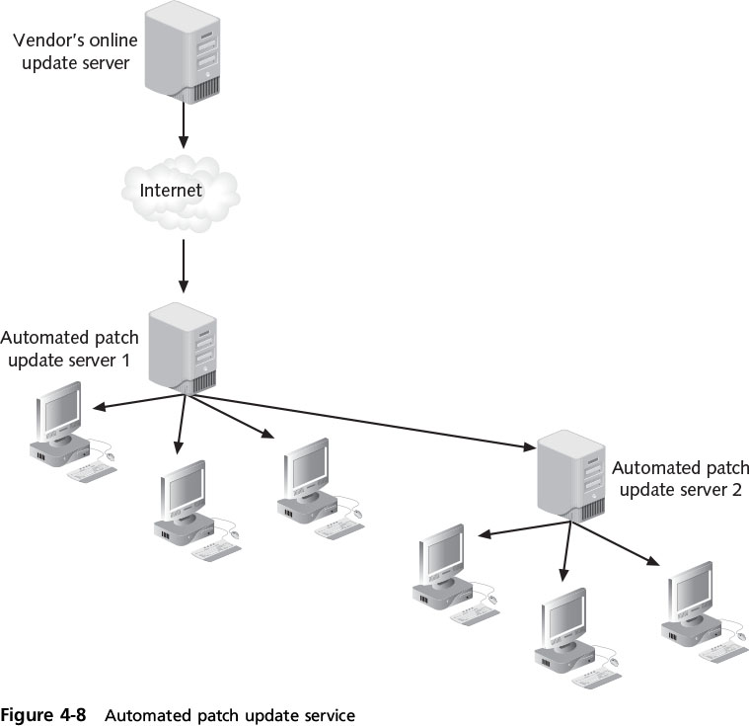
Securing the Operating System Software
Notes:
Securing the Operating System Software
Figure 4-8 Automatic patch update service

Slide 26
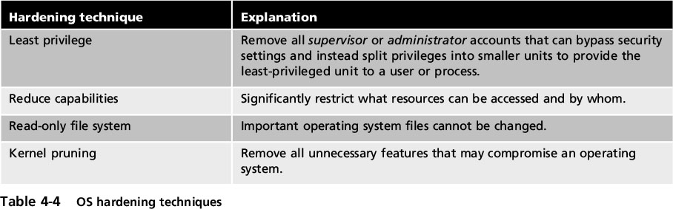
Securing the Operating System Software
Security Through Design
OS hardening - tightening security during the design and coding of the OS
Trusted OS - an OS that has been designed through OS hardening
Notes:
Securing the Operating System Software
Security Through Design
OS hardening - tightening security during the design and coding of the OS
Trusted OS - an OS that has been designed through OS hardening
Table 4-4 OS hardening techniques

Slide 27
Securing with Antimalware
Third-party antimalware software packages can provide added security
Antimalware software includes:
Antivirus
Antispam
Popup blockers
Antispyware
Host-based firewalls
Notes:
Securing with Antimalware
Third-party antimalware software packages can provide added security
Antimalware software includes:
Antivirus
Antispam
Popup blockers
Antispyware
Host-based firewalls

Slide 28
Antivirus
Antivirus (AV) - Software that examines a computer for infections
Scans new documents that might contain viruses
Searches for known virus patterns
Weakness of anti-virus
Vendor must continually search for new viruses, update and distribute signature files to users
Alternative approach: code emulation
Questionable code is executed in virtual environment to determine if it is a virus
Notes:
Antivirus
Antivirus (AV) - Software that examines a computer for infections
Scans new documents that might contain viruses
Searches for known virus patterns
Weakness of anti-virus
Vendor must continually search for new viruses, update and distribute signature files to users
Alternative approach: code emulation
Questionable code is executed in virtual environment to determine if it is a virus

Slide 29
Antispam
Spammers can distribute malware through email attachments
Spam can be used for social engineering attacks
Spam filtering methods
Bayesian filtering - divides email messages into two piles: spam and nonspam
Create a list of approved and nonapproved senders
Blacklist - nonapproved senders
Whitelist - approved senders
Blocking certain file attachment types
Notes:
Antispam
Spammers can distribute malware through email attachments
Spam can be used for social engineering attacks
Spam filtering methods
Bayesian filtering - divides email messages into two piles: spam and nonspam
Create a list of approved and nonapproved senders
Blacklist - nonapproved senders
Whitelist - approved senders
Blocking certain file attachment types

Slide 30
Pop-up Blockers and Antispyware
Pop-up - small window appearing over Web site
Usually created by advertisers
Pop-up blockers - a separate program as part of anti-spyware package
Incorporated within a browser
Allows user to limit or block most pop-ups
Alert can be displayed in the browser
Gives user option to display pop-up
Antispyware - helps prevent computers from becoming infected by different types of spyware
Notes:
Pop-up Blockers and Antispyware
Pop-up - small window appearing over Web site
Usually created by advertisers
Pop-up blockers - a separate program as part of anti-spyware package
Incorporated within a browser
Allows user to limit or block most pop-ups
Alert can be displayed in the browser
Gives user option to display pop-up
Antispyware - helps prevent computers from becoming infected by different types of spyware

Slide 31
Host-Based Firewalls
Firewall - designed to prevent malicious packets from entering or leaving computers
Sometimes called a packet filter
May be hardware or software-based
Host-based software firewall - runs as a program on local system to protect it
Application-based
Notes:
End of class 11 AM 2/1/17
Host-Based Firewalls
Firewall - designed to prevent malicious packets from entering or leaving computers
Sometimes called a packet filter
May be hardware or software-based
Host-based software firewall - runs as a program on local system to protect it
Application-based

Slide 32
Securing Static Environments
Static environment - devices in which additional hardware cannot easily be added or attached
Common devices in this category:
Embedded system - a computer system with a dedicated function within a larger electrical system
Game consoles
Smartphones
Mainframes
In-vehicle computer systems
SCADA (supervisory control and data acquisition)
Notes:
End of class 10 AM 2/1/17
Securing Static Environments
Static environment - devices in which additional hardware cannot easily be added or attached
Common devices in this category:
Embedded system - a computer system with a dedicated function within a larger electrical system
Game consoles
Smartphones
Mainframes
In-vehicle computer systems
SCADA (supervisory control and data acquisition)

Slide 33
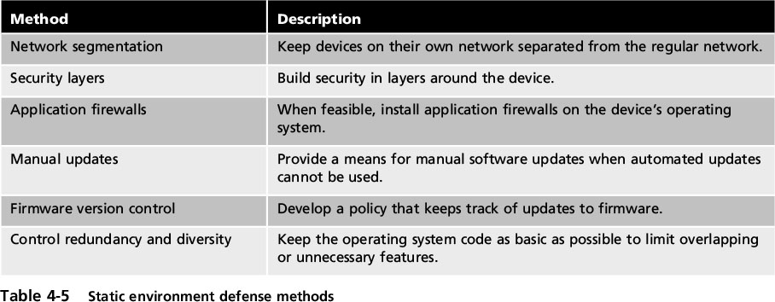
Securing Static Environments
Notes:
End of class 9/21/16 10 and 11 AM
Securing Static Environments
Table 4-5 Static environment defense methods

Slide 34
Application Security
Besides protecting OS software on hosts, there is a need to protect applications that run on these devices
Aspects of application security:
Application development security
Application hardening and patch management
Notes:
Application Security
Besides protecting OS software on hosts, there is a need to protect applications that run on these devices
Aspects of application security:
Application development security
Application hardening and patch management

Slide 35
Application Development Security
Security for applications must be considered through all phases of development cycle
Application configuration baselines
Standard environment settings can establish a secure baseline
Includes each development system, build system, and test system
Must include system and network configurations
Notes:
Application Development Security
Security for applications must be considered through all phases of development cycle
Application configuration baselines
Standard environment settings can establish a secure baseline
Includes each development system, build system, and test system
Must include system and network configurations

Slide 36
Application Development Security
Secure coding concepts
Coding standards
increase applications’ consistency, reliability, and security
allow developers to quickly understand and work with code developed by others
useful in code review process
Example of a coding standard:
To use a wrapper function (a substitute for a regular function used in testing) to write error-checking routines for preexisting system functions
Notes:
Application Development Security
Secure coding concepts
Coding standards increase applications’ consistency, reliability, and security
Coding standards allow developers to quickly understand and work with code that has been developed by different members of a team
Coding standards useful in code review process
Example of a coding standard:
To use a wrapper function (a substitute for a regular function used in testing) to write error-checking routines for preexisting system functions

Slide 37
Application Development Security
Errors and Exception Handling
Errors - faults that occur while application is running
Response to the user should be based on the error
The application should be coded so that each error is “caught” and effectively handled
Improper error handling in an application can lead to application failure
Notes:
Application Development Security
Errors and Exception Handling
Errors - faults that occur while application is running
Response to the user should be based on the error
The application should be coded so that each error is “caught” and effectively handled
Improper error handling in an application can lead to application failure

Slide 38
Application Development Security
The following may indicate potential error-handling issues:
Failure to check return codes or handle exceptions
Improper checking of exceptions or return codes
Handling all return codes or exceptions in the same manner
Error information that divulges potentially sensitive data
Fuzz testing (fuzzing) - a software testing technique that deliberately provides invalid, unexpected, or random data as inputs to a program
Notes:
Application Development Security
The following may indicate potential error-handling issues:
Failure to check return codes or handle exceptions
Improper checking of exceptions or return codes
Handling all return codes or exceptions in the same manner
Error information that divulges potentially sensitive data
Fuzz testing (fuzzing) - a software testing technique that deliberately provides invalid, unexpected, or random data as inputs to a program

Slide 39
Application Development Security
Input Validation
Verifying responses that the user makes to the application
Is the cause for XSS, SQL, or XML injection attacks
Cross-site request forgery (XSRF) - uses the user’s web browser settings to impersonate the user
User current authenticated on one sight is tricked to load a different webpage which will inherit the privileges of victim on original page
To prevent cross-site scripting, the program should trap for these user responses
Notes:
Application Development Security
Input Validation
A specific type of error handling is verifying responses that the user makes to the application
Improper verification is the cause for XSS, SQL, or XML injection attacks
Cross-site request forgery (XSRF) - an attack that uses the user’s web browser settings to impersonate the user
To prevent cross-site scripting, the program should trap for these user responses

Slide 40
Application Development Security
Input validation generally server-side
It is possible to have the client perform validation
all input validations and error recovery procedures performed by the user’s web browser
An approach to preventing SQL injection attacks is avoid using SQL relational databases
NoSQL - a nonrelational database that is better tuned for accessing large data sets
Notes:
End of class 10 AM 11 AM 9/26
Application Development Security
Input validation generally uses the server to perform the validation (server-side validation)
It is possible to have the client perform the validation (client-side validation)
In client-side validation all input validations and error recovery procedures are performed by the user’s web browser
An approach to preventing SQL injection attacks is avoid using SQL relational databases
NoSQL - a nonrelational database that is better tuned for accessing large data sets

Slide 41
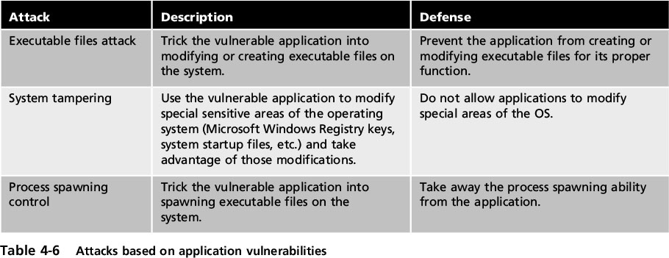
Application Hardening and Patch Management
Application hardening
Intended to prevent attackers from exploiting vulnerabilities in software applications
Notes:
Application Hardening and Patch Management
Application hardening
Intended to prevent attackers from exploiting vulnerabilities in software applications
Table 4-6 Attacks based on application vulnerabilities

Slide 42
Application Hardening and Patch Management
Patch management
Rare until recently
Users unaware of the existence of patches or where to acquire them
Very difficult to get vendors to agree on patching method!
More application patch management systems are being developed to patch vulnerabilities
Notes:
Application Hardening and Patch Management
Patch management
Rare until recently
Users were unaware of the existence of patches or where to acquire them
More application patch management systems are being developed to patch vulnerabilities

Slide 43
Securing Data
Work today involves electronic collaboration
Data must flow freely
Data security is important
Big Data –
collection of data sets so large and complex that it becomes difficult to process using traditional apps
Data loss prevention (DLP)
System of security tools used to recognize and identify critical data and ensure it is protected
Goal: protect data from unauthorized users
Notes:
Securing Data
Work today involves electronic collaboration
Data must flow freely
Data security is important
Big Data - refers to a collection of data sets so large and complex that it becomes difficult to process using traditional data processing apps
Data loss prevention (DLP)
System of security tools used to recognize and identify critical data and ensure it is protected
Goal: protect data from unauthorized users

Slide 44
Securing Data
DLP examines data as it resides in any of three states:
Data in use (example: creating a report from a computer)
Data in-transit (data being transmitted)
Data at rest (data that is stored on electronic media)
Notes:
Securing Data
DLP examines data as it resides in any of three states:
Data in use (example: creating a report from a computer)
Data in-transit (data being transmitted)
Data at rest (data that is stored on electronic media)

Slide 45
Securing Data
Most DLP systems use content inspection
A security analysis of the transaction within its approved context
Looks at security level of data,
who is requesting it
where it’s stored
when it was requested
where it’s going
DLP systems can also use index matching
Documents identified as needing protection are analyzed by DLP and complex computations are conducted based on the analysis
Notes:
Securing Data
Most DLP systems use content inspection
A security analysis of the transaction within its approved context
Looks at security level of data, who is requesting it, where the data is stored, when it was requested, and where it is going
DLP systems can also use index matching
Documents that have been identified as needing protection are analyzed by DLP and complex computations are conducted based on the analysis

Slide 46
Securing Data
Three types of DLP sensors:
DLP network sensors
installed on the perimeter of the network to protect data in-transit by monitoring all network traffic
DLP storage sensors
designed to protect data at-rest
DLP agent sensors
installed on each host device and protect data in-use
When a policy violation is detected by the DLP agent, it reports back to the DLP server
Actions can then be taken
Notes:
Securing Data
Three types of DLP sensors:
DLP network sensors - installed on the perimeter of the network to protect data in-transit by monitoring all network traffic
DLP storage sensors - designed to protect data at-rest
DLP agent sensors - installed on each host device and protect data in-use
When a policy violation is detected by the DLP agent, it is reported back to the DLP server
Different actions can then be taken

Slide 47
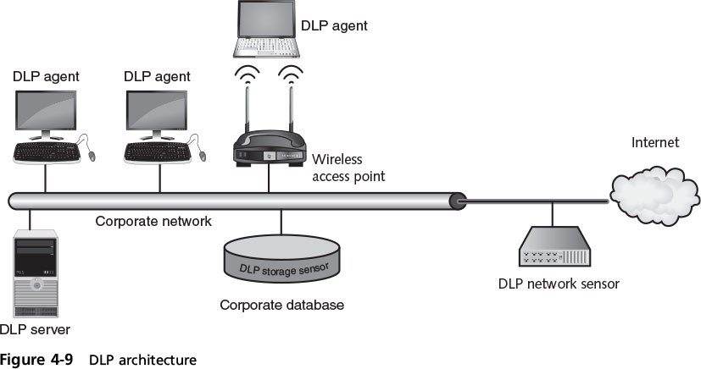
Securing Data
Notes:
Securing Data
Figure 4-9 DLP architecture

Slide 48
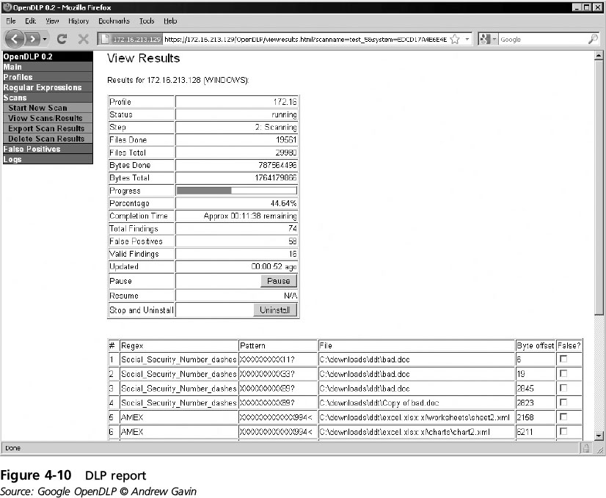
Securing Data
Notes:
Securing Data
Figure 4-10 DLP report

