Slide 1
What is Cryptography?
Cryptography
Scrambling information so it cannot be read
Transforms info into secure form
unauthorized persons can’t access it
Steganography
Hides the existence of data
An image, audio, or video file can contain hidden messages embedded in the file
Divide data and hide in unused portions of the file
Notes:
What is Cryptography?
Cryptography
Scrambling information so it cannot be read
Transforms information into secure form so unauthorized persons cannot access it
Steganography
Hides the existence of data
An image, audio, or video file can contain hidden messages embedded in the file
Achieved by dividing data and hiding in unused portions of the file
Cryptography
Scrambling information so it cannot be read
Transforms information into secure form so unauthorized persons cannot access it
Steganography
Hides the existence of data
An image, audio, or video file can contain hidden messages embedded in the file
Achieved by dividing data and hiding in unused portions of the file

Slide 2
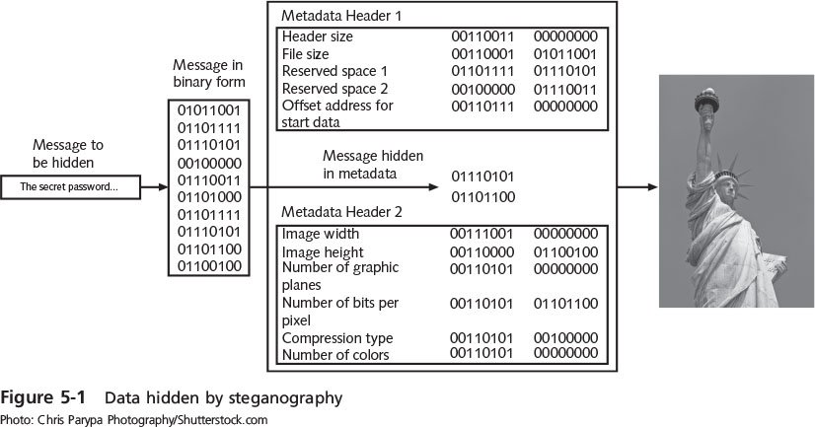
What is Cryptography?
Notes:
What is Cryptography?
Figure 5-1 Data hidden by steganography

Slide 3
What is Cryptography?
Origins of cryptography
Used by Julius Caesar
Encryption
Changing original text into a secret message using cryptography
Decryption
Changing secret message back to original form
Cleartext data
Data stored or transmitted without encryption
Notes:
What is Cryptography?
Origins of cryptography
Used by Julius Caesar
Encryption
Changing original text into a secret message using cryptography
Decryption
Changing secret message back to original form
Cleartext data
Data stored or transmitted without encryption

Slide 4
What is Cryptography?
Plaintext
Cleartext data to be encrypted
Plaintext data is input into a cryptographic algorithm
Consists of procedures based on a mathematical formula used to encrypt and decrypt the data
Key
A mathematical value entered into the algorithm to produce ciphertext (encrypted data)
The reverse process uses the key to decrypt the message
Notes:
What is Cryptography?
Plaintext
Cleartext data to be encrypted
Plaintext data is input into a cryptographic algorithm
Consists of procedures based on a mathematical formula used to encrypt and decrypt the data
Key
A mathematical value entered into the algorithm to produce ciphertext (encrypted data)
The reverse process uses the key to decrypt the message

Slide 5
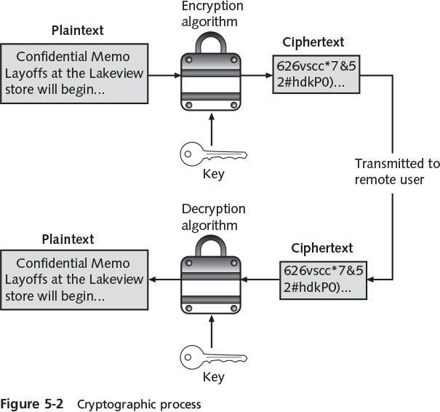
What is Cryptography?
Notes:
What is Cryptography?
Figure 5-2 Cryptographic process

Slide 6
Cryptography and Security
Cryptography can provide five basic protections
Confidentiality
Ensures only authorized parties can view it
Integrity
Ensures information is correct and unaltered
Availability
Ensures authorized users can access it
Authentication
Ensures sender can be verified through cryptography
Non-repudiation
Proves that a user performed an action
Different types of cryptography provide different types of protection!
Notes:
Cryptography and Security
Cryptography can provide five basic protections
Confidentiality
Ensures only authorized parties can view it
Integrity
Ensures information is correct and unaltered
Availability
Ensures authorized users can access it
Authentication
Ensures sender can be verified through cryptography
Non-repudiation
Proves that a user performed an action

Slide 7
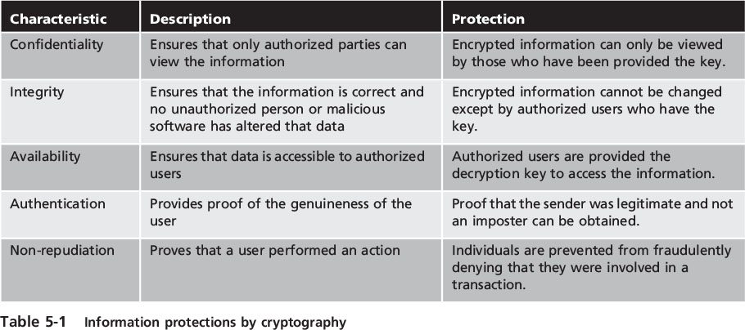
Cryptography and Security
Notes:
Cryptography and Security
Table 5-1 Information protections by cryptography

Slide 8
Cryptographic Algorithms
A fundamental difference in cryptographic algorithms is the amount of data processed at a time
Stream cipher - takes one character and replaces it with another
Block cipher - manipulates an entire block of plaintext at one time
Sponge function - takes as input a string of any length and returns a string of any requested variable length
Notes:
Cryptographic Algorithms
A fundamental difference in cryptographic algorithms is the amount of data processed at a time
Stream cipher - takes one character and replaces it with another
Block cipher - manipulates an entire block of plaintext at one time
Sponge function - takes as input a string of any length and returns a string of any requested variable length

Slide 9
Cryptographic Algorithms
Three categories of cryptographic algorithms
Hash algorithms
Symmetric cryptographic algorithms
Asymmetric cryptographic algorithms
Notes:
Cryptographic Algorithms
Three categories of cryptographic algorithms
Hash algorithms
Symmetric cryptographic algorithms
Asymmetric cryptographic algorithms

Slide 10
Hash Algorithms
Hash algorithms
It is the most basic type of cryptographic algorithm
Creates a unique “digital fingerprint” of a set of data and is commonly called hashing
This fingerprint, called a digest (sometimes called a message digest or hash), represents the contents
Its contents cannot be used to reveal original data set
Is primarily used for comparison purposes
Notes:
Hash Algorithms
Hash algorithms
It is the most basic type of cryptographic algorithm
Creates a unique “digital fingerprint” of a set of data and is commonly called hashing
This fingerprint, called a digest (sometimes called a message digest or hash), represents the contents
Its contents cannot be used to reveal original data set
Is primarily used for comparison purposes

Slide 11
Hash Algorithms
Secure hashing algorithm characteristics:
Fixed size
Short and long data sets have the same size hash
Unique
Two different data sets cannot produce the same hash
Original
Data set cannot be created to have a predefined hash
Secure
Resulting hash cannot be reversed to determine original plaintext
Notes:
Hash Algorithms
Secure hashing algorithm characteristics:
Fixed size
Short and long data sets have the same size hash
Unique
Two different data sets cannot produce the same hash
Original
Data set cannot be created to have a predefined hash
Secure
Resulting hash cannot be reversed to determine original plaintext

Slide 12
Hash Algorithm
Hashing is used to determine the integrity of a message or the contents of a file
Hashed Message Authentication Code (HMAC)
A hash variation providing improved security
Uses a “shared secret key” possessed by sender and receiver
Receiver uses a key to decrypt the hash
Notes:
Hash Algorithm
Hashing is used to determine the integrity of a message or the contents of a file
Hashed Message Authentication Code (HMAC)
A hash variation providing improved security
Uses a “shared secret key” possessed by sender and receiver
Receiver uses a key to decrypt the hash

Slide 13
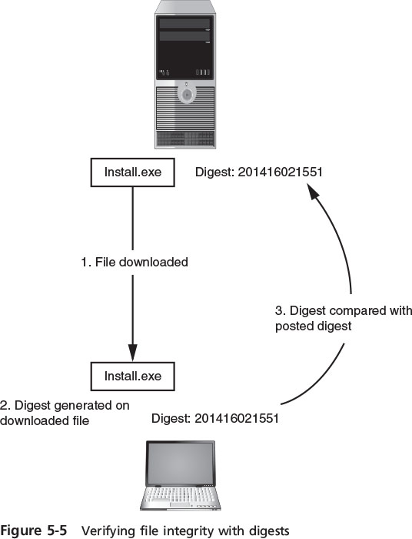
Hash Algorithm
Notes:
Hash Algorithm
Figure 5-5 Verifying file integrity with digests

Slide 14
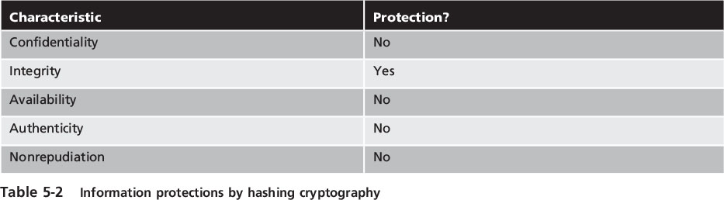
Hash Algorithm
Notes:
Hash Algorithm
Table 5-2 Information protections by hashing cryptography

Slide 15
Hash Algorithms
Most common hash algorithms
Message Digest
Secure Hash Algorithm
Whirlpool
RIPEMD
Notes:
Hash Algorithms
Most common hash algorithms
Message Digest
Secure Hash Algorithm
Whirlpool
RIPEMD

Slide 16
Hash Algorithms
Message Digest (MD)
One of the most common one-way hash algorithms
Three different versions
Message Digest 2 (MD2)
Takes plaintext of any length and creates 128 bit hash
Padding is added to make short messages 128 bits
Considered too slow today and rarely used
Message Digest 4 (MD4)
Has flaws and was not widely accepted
Notes:
Hash Algorithms
Message Digest (MD)
One of the most common one-way hash algorithms
Three different versions
Message Digest 2 (MD2)
Takes plaintext of any length and creates 128 bit hash
Padding is added to make short messages 128 bits
Considered too slow today and rarely used
Message Digest 4 (MD4)
Has flaws and was not widely accepted

Slide 17
Hash Algorithms
Message Digest 5 (MD5)
Designed to address MD4’s weaknesses
Message length padded to 512 bits
Weaknesses in compression function could lead to collisions
Some security experts recommend using a more secure hash algorithm
Secure Hash Algorithm (SHA)
More secure than MD
SHA-3 uses a sponge function instead of stream or block ciphers
Notes:
Hash Algorithms
Message Digest 5 (MD5)
Designed to address MD4’s weaknesses
Message length padded to 512 bits
Weaknesses in compression function could lead to collisions
Some security experts recommend using a more secure hash algorithm
Secure Hash Algorithm (SHA)
More secure than MD
SHA-3 uses a sponge function instead of stream or block ciphers

Slide 18
Hash Algorithms
Whirlpool
A recent cryptographic hash function
Adopted by standards organizations, including the International Organization for Standardization (ISO)
Creates a hash of 512 bits
Race Integrity Primitives Evaluation Message Digest (RIPEMD)
The primary design feature is two different and independent parallel chains of computation
The results are combined at end of process
Notes:
End of class 10 AM, 11 AM 2/8/17
Hash Algorithms
Whirlpool
A recent cryptographic hash function
Adopted by standards organizations, including the International Organization for Standardization (ISO)
Creates a hash of 512 bits
Race Integrity Primitives Evaluation Message Digest (RIPEMD)
The primary design feature is two different and independent parallel chains of computation
The results are combined at end of process

Slide 19
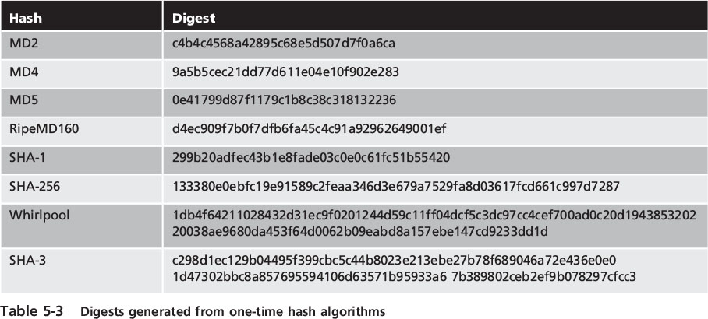
Hash Algorithms
Notes:
Hash Algorithms
Table 5-2 Digests generated from one-time hash algorithms

Slide 20
Symmetric Cryptographic Algorithms
Symmetric cryptographic algorithms - use the same single key to encrypt and decrypt a document
Original cryptographic algorithms were symmetric
Also called private key cryptography (the key is kept private between sender and receiver)
Common algorithms include:
Data Encryption Standard
Triple Data Encryption Standard
Advanced Encryption Standard
Several other algorithms
Notes:
Symmetric Cryptographic Algorithms
Symmetric cryptographic algorithms - use the same single key to encrypt and decrypt a document
Original cryptographic algorithms were symmetric
Also called private key cryptography (the key is kept private between sender and receiver)
Common algorithms include:
Data Encryption Standard
Triple Data Encryption Standard
Advanced Encryption Standard
Several other algorithms

Slide 21
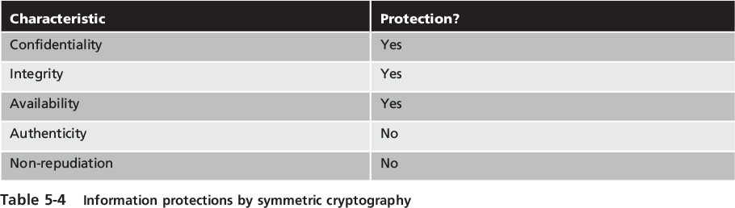
Symmetric Cryptographic Algorithms
Notes:
Symmetric Cryptographic Algorithms
Table 5-4 Information protection by symmetric cryptography

Slide 22
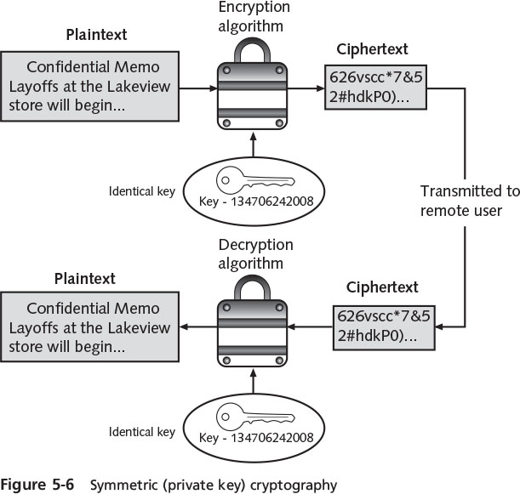
Symmetric Cryptographic Algorithms
Notes:
Symmetric Cryptographic Algorithms
Figure 5-6 Symmetric (private key) cryptography

Slide 23
Symmetric Cryptographic Algorithms
Data Encryption Standard (DES)
Based on product originally designed in early 1970s
Uses a 56-bit key and is a block cipher
Triple Data Encryption standard (3DES)
Designed to replace DES
Uses three rounds of encryption
Ciphertext of first round becomes input for second iteration
Most secure versions use different keys used for each round
Notes:
Symmetric Cryptographic Algorithms
Data Encryption Standard (DES)
Based on product originally designed in early 1970s
Uses a 56-bit key and is a block cipher
Triple Data Encryption standard (3DES)
Designed to replace DES
Uses three rounds of encryption
Ciphertext of first round becomes input for second iteration
Most secure versions use different keys used for each round

Slide 24
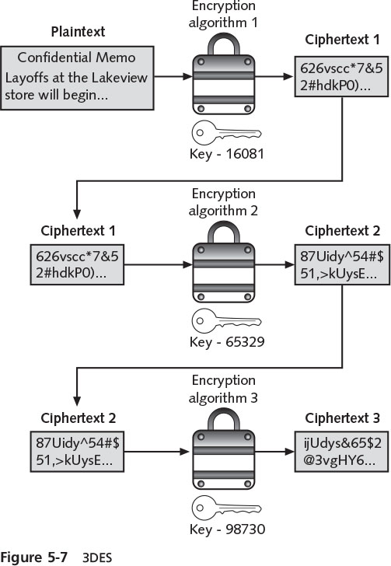
Symmetric Cryptographic Algorithms
Notes:
Symmetric Cryptographic Algorithms
Figure 5-7 3DES

Slide 25
Symmetric Cryptographic Algorithms
Advanced Encryption Standard (AES)
A symmetric cipher approved by the NIST in 2000 as a replacement for DES
Official encryption standard used by the U.S. government
Performs three steps on every block (128 bits) of plaintext
Designed to be secure well into the future
Notes:
Symmetric Cryptographic Algorithms
Advanced Encryption Standard (AES)
A symmetric cipher approved by the NIST in 2000 as a replacement for DES
Official encryption standard used by the U.S. government
Performs three steps on every block (128 bits) of plaintext
Designed to be secure well into the future

Slide 26
Symmetric Cryptographic Algorithms
Other Algorithms
Rivest Cipher (RC)
Family of cipher algorithms designed by Ron Rivest
International Data Encryption Algorithm (IDEA)
Used in European nations
Block cipher processing 64 bits with a 128-bit key with 8 rounds
Blowfish
Block cipher operating on 64-bit blocks with key lengths from 32-448 bits
No significant weaknesses have been identified
Notes:
Symmetric Cryptographic Algorithms
Other Algorithms
Rivest Cipher (RC)
Family of cipher algorithms designed by Ron Rivest
International Data Encryption Algorithm (IDEA)
Used in European nations
Block cipher processing 64 bits with a 128-bit key with 8 rounds
Blowfish
Block cipher operating on 64-bit blocks with key lengths from 32-448 bits
No significant weaknesses have been identified

Slide 27
Symmetric Cryptographic Algorithms
Other Algorithms (cont’d)
One-time pad (OTP)
Creates a truly random key to combine with the plaintext
Considered the only known method to perform encryption that cannot be broken mathematically
A “pad” is a long sequence of random letters
Notes:
End of class 10 AM 9/30/16
Symmetric Cryptographic Algorithms
Other Algorithms (cont’d)
One-time pad (OTP)
Creates a truly random key to combine with the plaintext
Considered the only known method to perform encryption that cannot be broken mathematically
A “pad” is a long sequence of random letters

Slide 28
Asymmetric Cryptographic Algorithms
Weakness of symmetric algorithms
Distributing and maintaining a secure single key among multiple users distributed geographically
Asymmetric cryptographic algorithms
Also known as public key cryptography
Uses two mathematically related keys
Public key available to everyone and freely distributed
Private key known only to individual to whom it belongs
Notes:
Asymmetric Cryptographic Algorithms
Weakness of symmetric algorithms
Distributing and maintaining a secure single key among multiple users distributed geographically
Asymmetric cryptographic algorithms
Also known as public key cryptography
Uses two mathematically related keys
Public key available to everyone and freely distributed
Private key known only to individual to whom it belongs

Slide 29
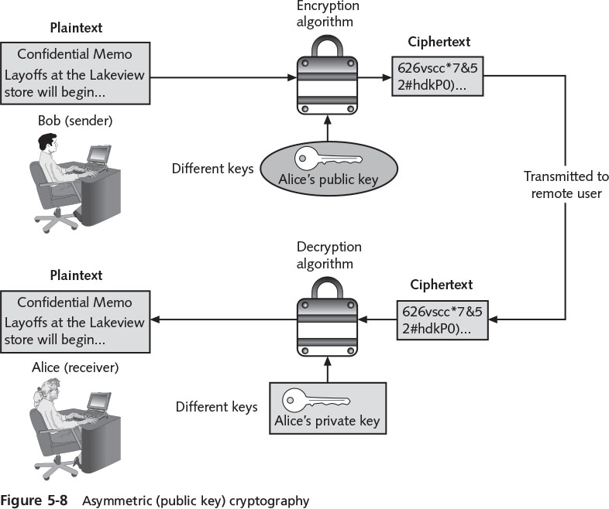
Asymmetric Cryptographic Algorithms
Notes:
Asymmetric Cryptographic Algorithms
Figure 5-8 Asymmetric (public key) cryptography

Slide 30
Asymmetric Cryptographic Algorithms
Important principles
Key pairs
Public key
Private key
Both directions - keys can work in both directions
Digital signature - an electronic verification
Verifies the sender
Prevents sender from disowning the message
Proves message integrity
Notes:
2/10/17
Asymmetric Cryptographic Algorithms
Important principles
Key pairs
Public key
Private key
Both directions - keys can work in both directions
Digital signature - an electronic verification
Verifies the sender
Prevents sender from disowning the message
Proves message integrity

Slide 31
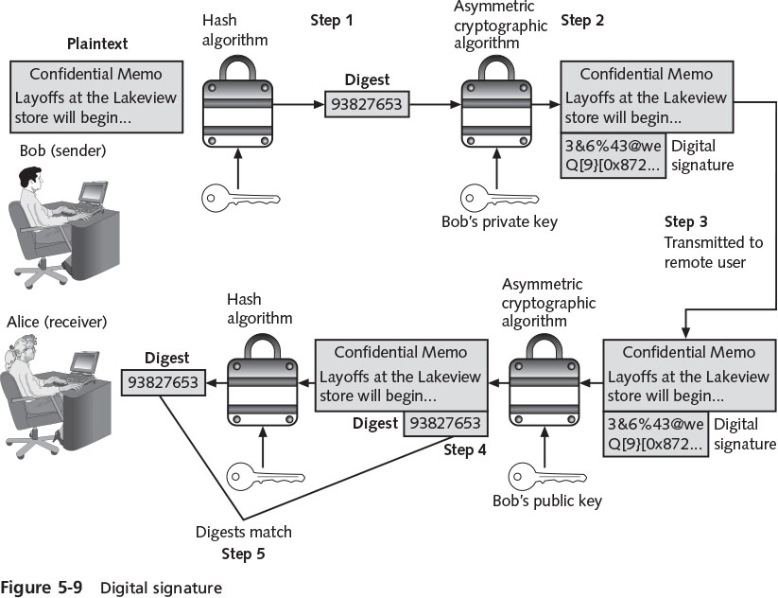
Asymmetric Cryptographic Algorithms
Notes:
Asymmetric Cryptographic Algorithms
Figure 5-9 Digital signature

Slide 32
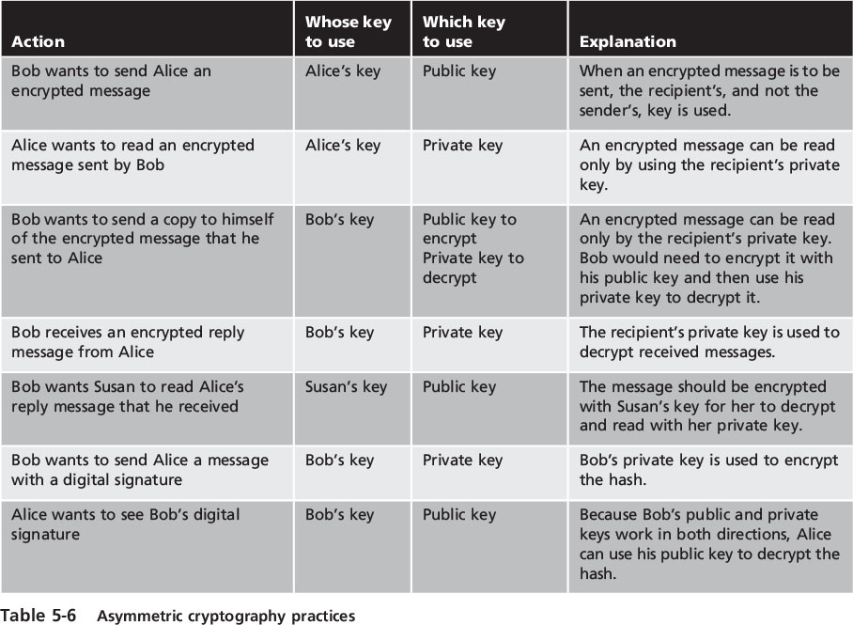
Asymmetric Cryptographic Algorithms
Notes:
Asymmetric Cryptographic Algorithms
Table 5-6 Asymmetric cryptography practices

Slide 33
Asymmetric Cryptographic Algorithms
RSA
Published in 1977 and patented by MIT in 1983
Most common asymmetric cryptography algorithm
Uses two large prime numbers
Elliptic curve cryptography (ECC)
Users share one elliptic curve and one point on the curve
Uses less computing power than prime number-based asymmetric cryptography
Key sizes are smaller
Notes:
Asymmetric Cryptographic Algorithms
RSA
Published in 1977 and patented by MIT in 1983
Most common asymmetric cryptography algorithm
Uses two large prime numbers
Elliptic curve cryptography (ECC)
Users share one elliptic curve and one point on the curve
Uses less computing power than prime number-based asymmetric cryptography
Key sizes are smaller

Slide 34
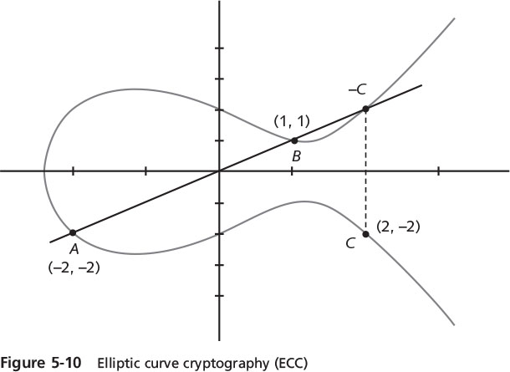
Asymmetric Cryptographic Algorithms
Notes:
Asymmetric Cryptographic Algorithms
Figure 5-10 Elliptic curve cryptography (ECC)

Slide 35
Asymmetric Cryptographic Algorithms
Quantum cryptography
Attempts to use the unusual and unique behavior of microscopic objects to enable user to securely develop and share keys
Does not depend on difficult mathematical problems
NTRUEncypt
Uses lattice-based cryptography which relies on a set of points in space
Faster than RSA and ECC
More resistant to quantum computing attacks
Notes:
Asymmetric Cryptographic Algorithms
Quantum cryptography
Exploits the properties of microscopic objects such as photons
Does not depend on difficult mathematical problems
NTRUEncypt
Uses lattice-based cryptography which relies on a set of points in space
Faster than RSA and ECC
More resistant to quantum computing attacks

Slide 36
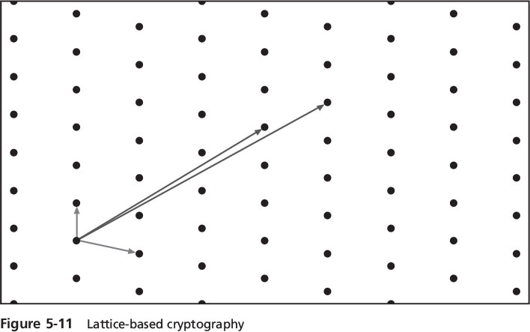
Asymmetric Cryptographic Algorithms
Notes:
Asymmetric Cryptographic Algorithms
Figure 5-1 Lattice-based cryptography

Slide 37
Asymmetric Cryptographic Algorithms
Key Exchange
There are different solutions for a key exchange that occurs within the normal communications channel (in-band) of cryptography:
Diffie-Hellman (DH)
Diffie-Hellman Ephemeral (DHE)
Elliptic Curve Diffie-Hellman (ECDH)
Perfect forward secrecy
Notes:
Asymmetric Cryptographic Algorithms
Key Exchange
There are different solutions for a key exchange that occurs within the normal communications channel (in-band) of cryptography:
Diffie-Hellman (DH)
Diffie-Hellman Ephemeral (DHE)
Elliptic Curve Diffie-Hellman (ECDH)
Perfect forward secrecy

Slide 38
Using Cryptography
Cryptography
Should be used to secure data that needs to be protected
Can be applied through either software or hardware
Notes:
Using Cryptography
Cryptography
Should be used to secure data that needs to be protected
Can be applied through either software or hardware

Slide 39
Encryption Through Software
File and File System Cryptography
Encryption software can be used to encrypt or decrypt files one-by-one
Protecting groups of files through file system cryptography can be performed using:
Pretty Good Privacy (PGP)
Widely used asymmetric cryptography system
Used for files and e-mails on Windows systems
GNU Privacy Guard (GPG)
Runs on Windows, UNIX, and Linux operating systems
Notes:
Encryption Through Software
File and File System Cryptography
Encryption software can be used to encrypt or decrypt files one-by-one
Protecting groups of files through file system cryptography can be performed using:
Pretty Good Privacy (PGP)
Widely used asymmetric cryptography system
Used for files and e-mails on Windows systems
GNU Privacy Guard (GPG)
Runs on Windows, UNIX, and Linux operating systems

Slide 40
Encryption Through Software
Microsoft Windows Encrypting File System (EFS)
Cryptography system for Windows
Uses NTFS file system
Tightly integrated with the file system
Encryption and decryption are transparent to the user
Users can set encryption attribute for a file in the Advanced Attributes dialog box
Storing the file in a file folder set for encryption will automatically encrypt the file
Use the Cipher.exe command-line utility to encrypt files
Notes:
Encryption Through Software
Microsoft Windows Encrypting File System (EFS)
Cryptography system for Windows
Uses NTFS file system
Tightly integrated with the file system
Encryption and decryption are transparent to the user
Users can set encryption attribute for a file in the Advanced Attributes dialog box
Storing the file in a file folder set for encryption will automatically encrypt the file
Use the Cipher.exe command-line utility to encrypt files

Slide 41
Encryption Through Software
Whole disk encryption
Protects all data on a hard drive
Example: BitLocker drive encryption software that is included in Microsoft Windows
BitLocker encrypts the entire system volume, including the Windows Registry
Prevents attackers from accessing data by booting from another OS or placing the hard drive in another computer
Notes:
Encryption Through Software
Whole disk encryption
Protects all data on a hard drive
Example: BitLocker drive encryption software that is included in Microsoft Windows
BitLocker encrypts the entire system volume, including the Windows Registry
Prevents attackers from accessing data by booting from another OS or placing the hard drive in another computer

Slide 42
Hardware Encryption
Software encryption can be subject to attacks to exploit its vulnerabilities
Cryptography can be embedded in hardware
Provides higher degree of security
Can be applied to USB devices and standard hard drives
Hardware encryption options include:
Trusted platform module
Hardware security model
Notes:
Hardware Encryption
Software encryption can be subject to attacks to exploit its vulnerabilities
Cryptography can be embedded in hardware
Provides higher degree of security
Can be applied to USB devices and standard hard drives
Hardware encryption options include:
Trusted platform module
Hardware security model

Slide 43
Hardware Encryption
USB device encryption
Encrypted hardware-based flash drives can be used
Will not connect a computer until correct password has been provided
All data copied to the drive is automatically encrypted
Tamper-resistant external cases
Administrators can remotely control and track activity on the devices
Stolen drives can be remotely disabled
Notes:
Hardware Encryption
USB device encryption
Encrypted hardware-based flash drives can be used
Will not connect a computer until correct password has been provided
All data copied to the drive is automatically encrypted
Tamper-resistant external cases
Administrators can remotely control and track activity on the devices
Stolen drives can be remotely disabled

Slide 44
Hardware Encryption
Hard disk drive encryption
Self-encrypting hard disk drives protect all files stored on them
The drive and host device perform authentication process during initial power up
If authentication fails, the drive can be configured to deny access or even delete encryption keys so all data is permanently unreadable
Notes:
Hardware Encryption
Hard disk drive encryption
Self-encrypting hard disk drives protect all files stored on them
The drive and host device perform authentication process during initial power up
If authentication fails, the drive can be configured to deny access or even delete encryption keys so all data is permanently unreadable

Slide 45
Hardware Encryption
Trusted Platform Module (TPM)
A chip on a computer’s motherboard that provides cryptographic services
Includes a true random number generator
Entirely done in hardware so it cannot be subject to software attack
Prevents computer from booting if files or data have been altered
Prompts for password if hard drive moved to a new computer
Notes:
Hardware Encryption
Trusted Platform Module (TPM)
A chip on a computer’s motherboard that provides cryptographic services
Includes a true random number generator
Entirely done in hardware so it cannot be subject to software attack
Prevents computer from booting if files or data have been altered
Prompts for password if hard drive moved to a new computer

Slide 46
Hardware Encryption
Hardware Security Module (HSM)
A secure cryptographic processor
Includes an onboard key generator and key storage facility
Performs accelerated symmetric and asymmetric encryption
Can provide services to multiple devices over a LAN
Notes:
End of class 10/3/16 11 AM
Hardware Encryption
Hardware Security Module (HSM)
A secure cryptographic processor
Includes an onboard key generator and key storage facility
Performs accelerated symmetric and asymmetric encryption
Can provide services to multiple devices over a LAN

