Slide 1
Bluetooth Basics
Bluetooth
Short-range radio frequency (RF) transmissions
Rapid ad-hoc, “on-the-fly” device pairings
Example: smartphone and a Bluetooth mouse
Personal Area Network (PAN) technology
Two types of Bluetooth network topologies
Piconet
Scatternet
Notes:
Bluetooth Attacks
Bluetooth
Wireless technology that uses short-range radio frequency (RF) transmissions
Provides rapid ad-hoc, “on-the-fly” device pairings
Example: smartphone and a Bluetooth mouse
Personal Area Network (PAN) technology
Two types of Bluetooth network topologies
Piconet
Scatternet

Slide 2
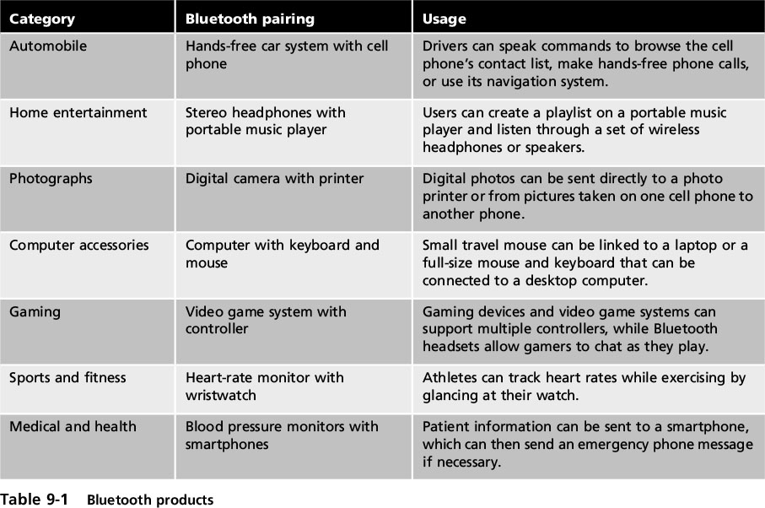
Bluetooth Basics
Notes:
Bluetooth Attacks
Table 9-1 Bluetooth products

Slide 3
Bluetooth Basics
Piconet
Established when two Bluetooth devices come within range of each other
One device (master) controls the wireless communication
Other device (slave) takes commands
Active slaves are sending transmissions
Parked slaves are connected but not actively participating
Notes:
Bluetooth Attacks
Piconet
Established when two Bluetooth devices come within range of each other
One device (master) controls all wireless traffic
Other device (slave) takes commands
Active slaves are sending transmissions
Parked slaves are connected but not actively participating

Slide 4
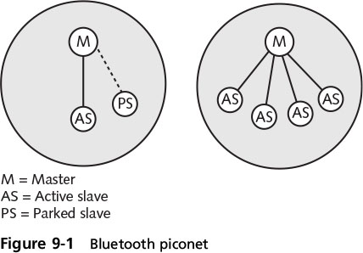
Bluetooth Basics
Notes:
Bluetooth Attacks
Figure 9-1 Bluetooth piconet

Slide 5
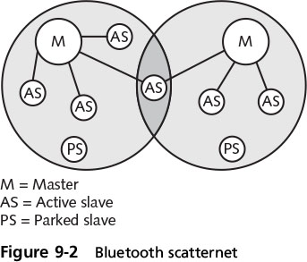
Bluetooth Basics
Scatternet
Group of piconets with connections between different piconets
Notes:
Bluetooth Attacks
Scatternet
Group of piconets with connections between different piconets
Figure 9-2 Bluetooth scatternet

Slide 6
Bluetooth Attacks
Bluejacking - attacker sends unsolicited messages to Bluetooth-enabled devices
Text messages, images, or sounds
Considered more annoying than harmful
No data is stolen
Notes:
Bluetooth Attacks
Bluejacking - an attack that sends unsolicited messages to Bluetooth-enabled devices
Text messages, images, or sounds
Bluejacking is considered more annoying than harmful
No data is stolen

Slide 7
Bluetooth Attacks
Bluesnarfing
Attack that accesses unauthorized information from a wireless device through a Bluetooth connection
Takes advantage of unprotected devices
They don’t require permission before pairing
Often between cell phones and laptops
Attacker can access e-mails, contacts, or other data by connecting to the Bluetooth device without owner’s knowledge
Notes:
Bluetooth Attacks
Bluesnarfing
An attack that accesses unauthorized information from a wireless device through a Bluetooth connection
Often between cell phones and laptops
Attacker copies e-mails, contacts, or other data by connecting to the Bluetooth device without owner’s knowledge

Slide 8
Near Field Communication (NFC) Attacks
Near field communication (NFC)
Set of standards primarily for smartphones and smart cards
VERY short range (few centimeters)
Can be used to establish communication between devices in close proximity
NFC devices are used in contactless payment systems
A consumer can pay for a purchase by simply tapping a store’s payment terminal with their smartphone
Notes:
End class 10/24 1 PM
Near Field Communication (NFC) Attacks
Near field communication (NFC)
A set of standards primarily for smartphones and smart cards that can be used to establish communication between devices in close proximity
NFC devices are used in contactless payment systems
A consumer can pay for a purchase by simply tapping a store’s payment terminal with their smartphone

Slide 9
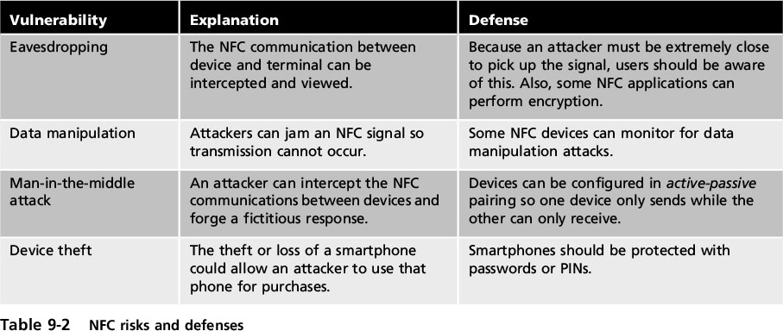
Near Field Communication (NFC) Attacks
Notes:
Near Field Communication (NFC) Attacks
Table 9-2 NFC risks and defenses

Slide 10
WLAN Attacks
(IEEE) WLANS
1997: release of IEEE 802.11
Standard for wireless local area networks (WLANs)
Higher speeds added in 1999: IEEE 802.11b
Notes:
End of class 10/14 10 AM 11 AM
WLAN Attacks
Institute of Electrical and Electronics Engineers (IEEE) WLANS
Most influential organization for computer networking and wireless communications
Dates back to 1884
Began developing network architecture standards in the 1980s
1997: release of IEEE 802.11
Standard for wireless local area networks (WLANs)
Higher speeds added in 1999: IEEE 802.11b

Slide 11
WLAN Attacks
IEEE 802.11a
Specifies maximum rated speed of 54Mbps using the 5GHz spectrum
IEEE 802.11g
Preserves stable and widely accepted features of 802.11b and increases data transfer rates similar to 802.11a
IEEE 802.11n
Ratified in 2009
Improvements: speed, coverage area, resistance to interference, and strong security
Notes:
WLAN Attacks
IEEE 802.11a
Specifies maximum rated speed of 54Mbps using the 5GHz spectrum
IEEE 802.11g
Preserves stable and widely accepted features of 802.11b and increases data transfer rates similar to 802.11a
IEEE 802.11n
Ratified in 2009
Improvements: speed, coverage area, resistance to interference, and strong security

Slide 12
WLAN Attacks
IEEE 802.11ac
Ratified in early 2014 and has data rates over 7 Gbps
Notes:
WLAN Attacks
IEEE 802.11ac
Ratified in early 2014 and has data rates over 7 Gbps
Table 9-3 IEEE WLAN standards

Slide 13
WLAN Attacks
WLAN Hardware
Wireless network interface card adapter
Same functions as wired adapter
Antenna sends and receives signals
Access point (AP) major parts
Antenna and radio transmitter/receiver send/receive wireless signals
Bridging software to interface wireless devices to other devices
Wired network interface connects by cable to standard wired network
Notes:
End of class 3/8/17
WLAN Attacks
WLAN Hardware
Wireless client network interface card adapter
Performs same functions as wired adapter
Antenna sends and receives signals
Access point (AP) major parts
Antenna and radio transmitter/receiver send and receive wireless signals
Bridging software to interface wireless devices to other devices
Wired network interface allows it to connect by cable to standard wired network

Slide 14
WLAN Attacks
WLAN Hardware (cont’d)
Access point (AP) functions
Acts as “base station” for wireless devices
A bridge between wireless and wired networks
Can connect to wired network by a cable
Wireless broadband routers
Single hardware device containing AP, firewall, router, and DHCP server
Also known as residential WLAN gateways
Notes:
WLAN Attacks
WLAN Hardware (cont’d)
Access point (AP) functions
Acts as “base station” for wireless network
Acts as a bridge between wireless and wired networks
Can connect to wired network by a cable
Wireless broadband routers
Single hardware device containing AP, firewall, router, and DHCP server
Also known as residential WLAN gateways

Slide 15
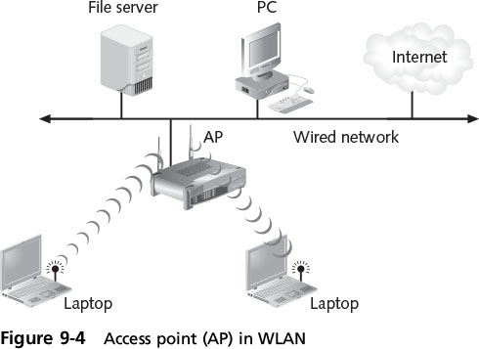
WLAN Attacks
Notes:
WLAN Attacks
Figure 9-4 Access point (AP) in WLAN

Slide 16
WLAN Attacks
In a wired network, a well-defined boundary protects data and resources
Boundary is known as a “hard edge”
WLANs in enterprises creates “blurred edges”
Types of wireless attacks
Rogue access points
Evil twins
Intercepting wireless data
Wireless replay attacks and denial of service attacks
Notes:
WLAN Attacks
In a network, a well-defined boundary protects data and resources
Boundary is known as a “hard edge”
The introduction of WLANs in enterprises has changed hard edges to “blurred edges”
Types of wireless attacks
Rogue access points
Evil twins
Intercepting wireless data
Wireless replay attacks and denial of service attacks

Slide 17
WLAN Attacks
Rogue access point
An unauthorized access point –
allows attacker to bypass network security configurations
Usually set up by insider (employee)
May be behind firewall
Evil twin
AP set up by attacker
Attempts to mimic an authorized AP (same SSID)
Attackers capture transmissions from users to evil twin AP
Notes:
WLAN Attacks
Rogue access point
An unauthorized access point that allows an attacker to bypass network security configurations
Usually set up by an insider (employee)
May be set up behind a firewall, opening the network to attacks
Evil twin
AP set up by an attacker
Attempts to mimic an authorized AP
Attackers capture transmissions from users to evil twin AP

Slide 18
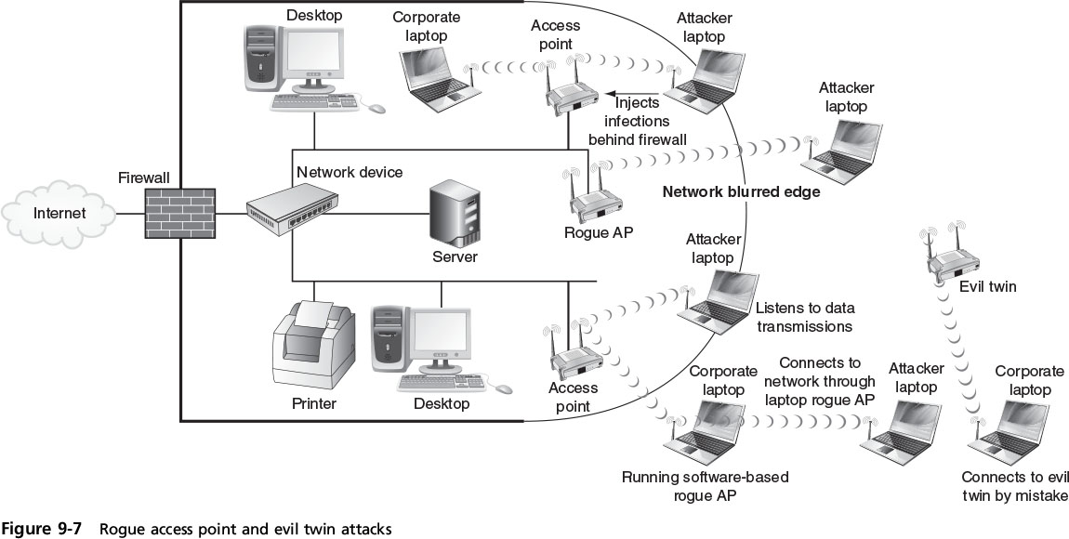
WLAN Attacks
Notes:
WLAN Attacks
Figure 9-7 Rogue access point and evil twin attacks

Slide 19
WLAN Attacks
Intercepting Wireless Data
Network interface card (NIC) adapter in promiscuous mode
Wireless traffic captured
packet read using a protocol analyzer
A wireless NIC in monitor mode can capture frames without being associated with an AP
Notes:
WLAN Attacks
Intercepting Wireless Data
Wireless traffic captured to decode and analyze packet contents by using a protocol analyzer
Network interface card (NIC) adapter must be in the correct mode in order for data to be captured
It is necessary for the wireless NIC to operate in monitor mode so that it can capture frames without first being associated with an AP
Monitor mode is also called RF Monitor or RFMON

Slide 20
WLAN Attacks
Wireless Replay Attack
Also known as “hijacking”
Passive attack, the attacker:
captures transmitted wireless data records
sends on to the original recipient without the attacker’s presence being detected
Can be accomplished using an evil twin AP
Notes:
WLAN Attacks
Wireless Replay Attack
Also known as “hijacking”
A passive attack in which the attacker captures transmitted wireless data, records it, and then sends it on to the original recipient without the attacker’s presence being detected
Can be accomplished using an evil twin AP

Slide 21
WLAN Attacks
Wireless Denial of Service Attack
Jamming - attackers flood the RF spectrum with enough interference to prevent device-to-AP communication
Spoofing - attackers create fictitious frame pretends to be from trusted client
Manipulating duration field values - attackers send a frame with high duration field, preventing other devices from transmitting for that period of time
Notes:
WLAN Attacks
Wireless Denial of Service Attack
RF jamming - attackers use intentional RF interference to flood the RF spectrum with enough interference to prevent a device from communicating with the AP
Spoofing - attackers craft a fictitious frame that pretends to come from a trusted client when it actually comes from the attacker
Manipulating duration field values - attackers send a frame with the duration field set to a high value, preventing other devices from transmitting for that period of time

Slide 22
WLAN Attacks
Wireless Home Attacks –
most home users fail to configure any security on home networks
Attackers can:
Steal data
Read wireless transmissions
Inject malware
Download harmful content
War driving
Search for wireless signals from an automobile or on foot using a portable computing device
Notes:
WLAN Attacks
Wireless Home Attacks - most home users fail to configure any security on their home networks
Attackers can:
Steal data
Read wireless transmissions
Inject malware
Download harmful content
War driving
Searching for wireless signals from an automobile or on foot using a portable computing device

Slide 23
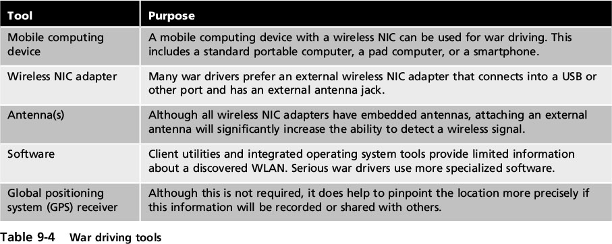
WLAN Attacks
Notes:
WLAN Attacks
Table 9-4 War driving tools

Slide 24
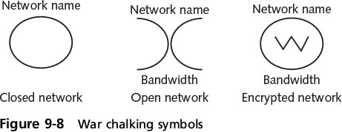
WLAN Attacks
War chalking
Documenting / advertising location of wireless LANs for others to use
Previously location marked drawing on sidewalks/walls
Today, locations are posted on Web sites
Notes:
WLAN Attacks
War chalking
Documenting and then advertising location of wireless LANs for others to use
Previously done by drawing on sidewalks or walls around network area
Today, locations are posted on Web sites
Figure 9-8 War chalking symbols

Slide 25
Vulnerabilities of IEEE 802.11 Security
Original IEEE 802.11 committee recognized wireless transmissions could be vulnerable
Implemented several wireless security protections in the standard
Left others to WLAN vendor’s discretion
Protections were vulnerable and led to multiple attacks
Notes:
End of class 3/10/17
Vulnerabilities of IEEE 802.11 Security
Original IEEE 802.11 committee recognized wireless transmissions could be vulnerable
Implemented several wireless security protections in the standard
Left others to WLAN vendor’s discretion
Protections were vulnerable and led to multiple attacks

Slide 26
Wired Equivalent Privacy (WEP)
IEEE 802.11 security protocol
designed to ensure that only authorized parties can view transmissions
Encrypts messages
Secret key shared between all clients and AP
WEP vulnerabilities
Only 64-bit or 128-bit number to encrypt
Initialization vector (IV) is only 24 of those bits
Short length makes it easier to break - repeats quickly
Notes:
Wired Equivalent Privacy (WEP)
IEEE 802.11 security protocol designed to ensure that only authorized parties can view transmissions
Encrypts plaintext into ciphertext
Secret key is shared between wireless client device and AP
WEP vulnerabilities
WEP can only use 64-bit or 128-bit number to encrypt
Initialization vector (IV) is only 24 of those bits
Short length makes it easier to break

Slide 27
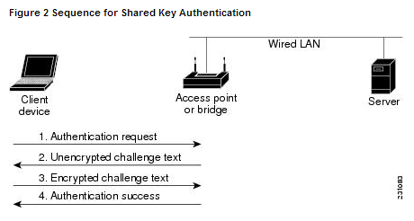
WEP - Shared Key Authentication
All clients use the same authentication key
Session initiated with a 4-way handshake.

Slide 28
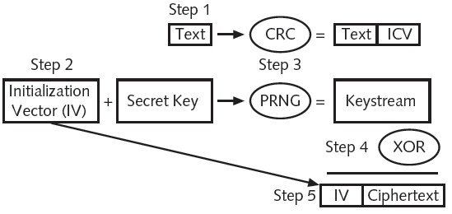
WEP - Encryption
Encrypts plaintext to ciphertext
Secret key shared between wireless client and AP
entered on devices before transmission.
CRC: cyclic redundancy check
ICV: integrity check value
PRNG=>pseudo random number generator (up to 128 bits)

Slide 29
WEP – Encryption (cont’d.)
WEP vulnerabilities
64-bit or 128-bit number to encrypt
Initialization vector (IV) only 24 of those bits
Short = it easy to break
Eventually, Init Vectors start repeating
24 bits →→ 16,777,216 possible values
AP transmitting at 11 Mbps → 700 packets per second
Different IV per packet, IVs repeat
Key stream attack (or IV attack)
Given how WEP works, an XOR on two ciphertexts = an XOR on two plaintexts
If one plaintext known, the other can be computed.

Slide 30
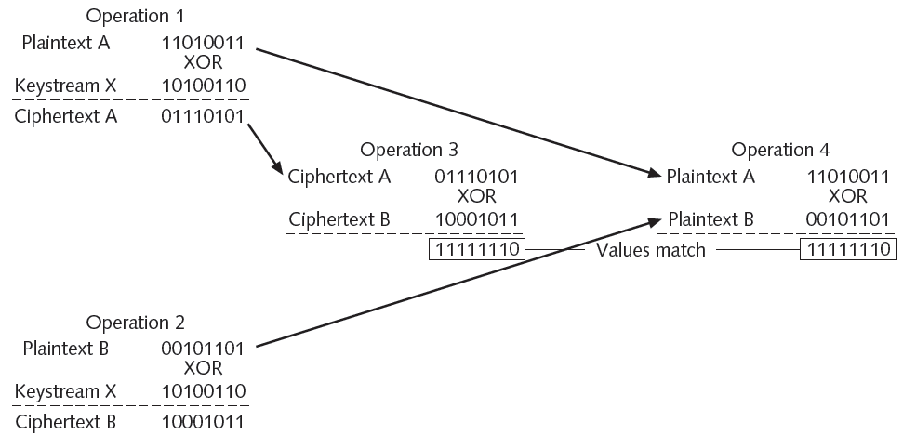
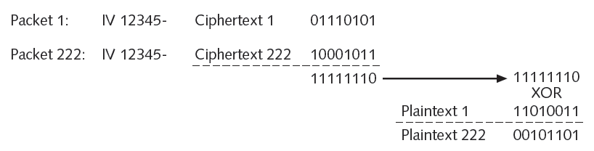
Packet 1 and 222 have same IV
Attacker knows plaintext 1
XOR ciphertexts
XOR result with KNOWN plaintext 1
Produces unknown plaintext 222

Slide 31
Wired Equivalent Privacy (WEP)
WEP vulnerabilities (cont’d.)
Violates cardinal rule of cryptography: avoid a detectable pattern
Attackers can see duplication when IVs start repeating
Notes:
Wired Equivalent Privacy (WEP)
WEP vulnerabilities (cont’d.)
Violates cardinal rule of cryptography: avoid a detectable pattern
Attackers can see duplication when IVs start repeating

Slide 32
Wi-Fi Protected Setup (WPS)
WPS provides an optional means of configuring security on WLANS (2007)
Two common WPS methods:
PIN method –PIN printed on a sticker of the wireless router or displayed via software wizard
User enters Pin and security configuration automatically occurs
Push-button method - user pushes buttons and security configuration takes place
Notes:
Wi-Fi Protected Setup (WPS)
WPS is an optional means of configuring security on WLANS
Two common WPS methods:
PIN method - utilizes a PIN printed on a sticker of the wireless router or displayed through a software wizard
User enters Pin and security configuration automatically occurs
Push-button method - user pushes buttons and security configuration takes place

Slide 33
Wi-Fi Protected Setup (WPS)
Design and implementation flaws:
No lockout limit for entering PINs
PIN is very short (8 characters)
Last PIN character is only a checksum
Wireless router reports the validity of the first and second halves of the PIN separately
Allows attacker to identify each half independently! (much faster)
Notes:
Wi-Fi Protected Setup (WPS)
Design and implementation flaws:
There is no lockout limit for entering PINs
The last PIN character is only a checksum
The wireless router reports the validity of the first and second halves of the PIN separately

Slide 34
MAC Address Filtering
Method of controlling WLAN access
Limit a device’s access to AP
Media Access Control (MAC) address filtering
Used by nearly all wireless AP vendors
Permits or blocks device based on MAC address
Vulnerabilities of MAC address filtering
Addresses exchanged in unencrypted format
Attacker can see MAC of approved device and spoof it
Managing large number of addresses is challenging
Notes:
MAC Address Filtering
Method of controlling WLAN access
Limit a device’s access to AP
Media Access Control (MAC) address filtering
Used by nearly all wireless AP vendors
Permits or blocks device based on MAC address
Vulnerabilities of MAC address filtering
Addresses exchanged in unencrypted format
Attacker can see address of approved device and substitute it on his own device
Managing large number of addresses is challenging

Slide 35
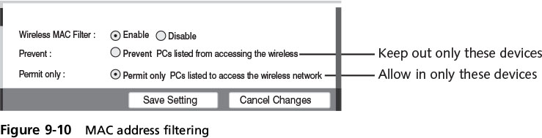
MAC Address Filtering
Notes:
MAC Address Filtering
Figure 9-10 MAC address filtering

Slide 36
Disabling SSID Broadcasts
Each device must be authenticated prior to connecting to the WLAN
Service Set Identifier (SSID)
The user-supplied network name of a wireless network;
default is to broadcast SSID so that devices can see it
The broadcast can be restricted
Some wireless security sources encourage users to configure their APs to prevent the broadcast of the SSID
Notes:
Disabling SSID Broadcasts
Each device must be authenticated prior to connecting to the WLAN
Service Set Identifier (SSID)
The user-supplied network name of a wireless network; usually broadcast so that any device can see it
The broadcast can be restricted
Some wireless security sources encourage users to configure their APs to prevent the broadcast of the SSID

Slide 37
Disabling SSID Broadcasts
Not advertising SSID provides a weak degree of security and has limitations:
SSID transmitted in other frames
May prevent users roaming from one AP coverage area to another
Not always possible to turn off SSID beaconing
Notes:
Disabling SSID Broadcasts
Not advertising the SSID only provides a weak degree of security and has limitations:
SSID can be discovered when transmitted in other frames
May prevent users from being able to freely roam from one AP coverage area to another
It’s not always possible to turn off SSID beaconing

Slide 38
Wireless Security Solutions
A unified approach to WLAN security was needed
IEEE and Wi-Fi Alliance developed security solutions
Resulting standards used today
IEEE 802.11i
WPA and WPA2
Notes:
Wireless Security Solutions
A unified approach to WLAN security was needed
IEEE and Wi-Fi Alliance began developing security solutions
Resulting standards used today
IEEE 802.11i
WPA and WPA2

Slide 39
Wi-Fi Protected Access (WPA)
Introduced in 2003 by the Wi-Fi Alliance
A subset of IEEE 802.11i
Goal: protect present and future wireless devices
Temporal Key Integrity Protocol (TKIP) Encryption
Used in WPA
Uses a longer 128 bit key than WEP
Dynamically generated for each new packet
Includes a Message Integrity Check (MIC), designed to prevent man-in-the-middle attacks
Notes:
Wi-Fi Protected Access (WPA)
Introduced in 2003 by the Wi-Fi Alliance
A subset of IEEE 802.11i
Design goal: protect present and future wireless devices
Temporal Key Integrity Protocol (TKIP) Encryption
Used in WPA
Uses a longer 128 bit key than WEP
Dynamically generated for each new packet
Includes a Message Integrity Check (MIC), designed to prevent man-in-the-middle attacks

Slide 40
Wi-Fi Protected Access (WPA)
Pre-shared Key (PSK) Authentication
After AP configured, client device must have same key value entered
Key shared prior to communication taking place
Uses a passphrase to generate encryption key
Entered on each AP and wireless device in advance
Not used for encryption
Serves as starting point for mathematically generating encryption keys
Notes:
10 AM 10/26 11 AM
Wi-Fi Protected Access (WPA)
Preshared Key (PSK) Authentication
After AP configured, client device must have same key value entered
Key is shared prior to communication taking place
Uses a passphrase to generate encryption key
Must be entered on each AP and wireless device in advance
Not used for encryption
Serves as starting point for mathematically generating the encryption keys

Slide 41
Wi-Fi Protected Access (WPA)
WPA Vulnerabilities
Key management
Key sharing is done manually w/o security protection
Keys must be changed on a regular basis
Keys must be disclosed to guest users and updated
Passphrases
passphrases of fewer than 20 characters subject to cracking
Notes:
Wi-Fi Protected Access (WPA)
WPA Vulnerabilities
Key management
Key sharing is done manually without security protection
Keys must be changed on a regular basis
Key must be disclosed to guest users
Passphrases
PSK passphrases of fewer than 20 characters subject to cracking

Slide 42
Wi-Fi Protected Access 2 (WPA2)
Second generation of WPA is known as WPA2
Introduced in 2004
Based on final 802.11i standard
AES-CCMP Encryption
Advanced Encryption Standard (AES) block cipher
AES performs three steps on every block (128 bits) of plaintext
13 rounds Bytes are substituted and rearranged
Notes:
Wi-Fi Protected Access 2 (WPA2)
Second generation of WPA is known as WPA2
Introduced in 2004
Based on final IEEE 802.11i standard
Allows wireless clients using TKIP to operate in the same WLAN
AES-CCMP Encryption
Advanced Encryption Standard (AES) block cipher
AES performs three steps on every block (128 bits) of plaintext
Within second step, multiple iterations are performed
Bytes are substituted and rearranged

Slide 43
Wi-Fi Protected Access 2 (WPA2)
AES-CCMP Encryption (cont’d)
Encryption protocol used for WPA2
Specifies the use of CCM with AES
The Cipher Block Chaining Message Authentication Code (CBC-MAC) component of CCMP provides data integrity and authentication
Both CCMP and TKIP use 128-bit key for encryption
Both methods use a 64-bit message integrity check (MIC) value
Notes:
Wi-Fi Protected Access 2 (WPA2)
AES-CCMP Encryption (cont’d)
Counter Mode with Cipher Block Chaining Message Authentication Code Protocol (CCMP) is the encryption protocol used for WPA2
Specifies the use of CCM with AES
The Cipher Block Chaining Message Authentication Code (CBC-MAC) component of CCMP provides data integrity and authentication
Both CCMP and TKIP use a 128-bit key for encryption
Both methods use a 64-bit MIC value

Slide 44
Wi-Fi Protected Access 2 (WPA2)
IEEE 802.1x authentication
Originally developed for wired networks
Provides greater degree of security by implementing port-based authentication
Blocks all traffic on a port-by-port basis until client is authenticated
Notes:
Wi-Fi Protected Access 2 (WPA2)
IEEE 802.1x authentication
Originally developed for wired networks
Provides greater degree of security by implementing port-based authentication
Blocks all traffic on a port-by-port basis until client is authenticated

Slide 45
Wi-Fi Protected Access 2 (WPA2)
Extensible Authentication Protocol (EAP)
A framework for transporting authentication protocols
Allows new protocols to be implemented!!!
Defines message format
Uses four types of packets
Request
Response
Success
Failure
Notes:
Wi-Fi Protected Access 2 (WPA2)
Extensible Authentication Protocol (EAP)
Created as a more secure alternative than CHAP and PAP
A framework for transporting authentication protocols
Defines message format
Uses four types of packets
Request
Response
Success
Failure

Slide 46
Wi-Fi Protected Access 2 (WPA2)
Two common EAP protocols:
Lightweight EAP (LEAP)
Proprietary method developed by Cisco Systems
Requires mutual authentication
used for WLAN encryption in Cisco client software
Vulnerable to specific types of attacks
No longer recommended by Cisco
Protected EAP (PEAP)
Simplifies deployment of 802.1x by using Microsoft Windows logins and passwords
Creates encrypted channel between client and authentication server
Notes:
Wi-Fi Protected Access 2 (WPA2)
Two common EAP protocols:
Lightweight EAP (LEAP)
A proprietary method developed by Cisco Systems
Requires mutual authentication used for WLAN encryption using Cisco client software
Can be vulnerable to specific types of attacks
No longer recommended by Cisco
Protected EAP (PEAP)
Simplifies deployment of 802.1x by using Microsoft Windows logins and passwords
Creates encrypted channel between client and authentication server

Slide 47
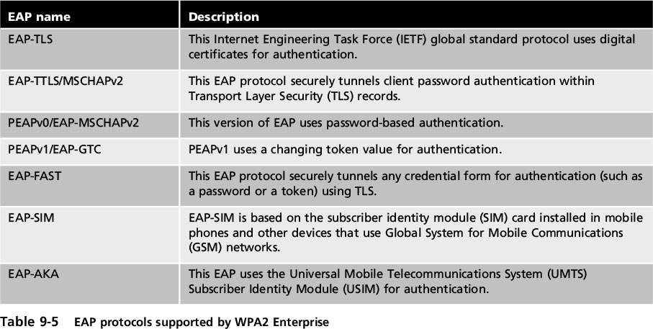
Wi-Fi Protected Access 2 (WPA2)
Notes:
Wi-Fi Protected Access 2 (WPA2)
Table 9-5 EAP protocols supported by WPA2 Enterprise

Slide 48
Additional Wireless Security Protections
Captive Portal APs
Uses a standard web browser to provide information
Gives the wireless user the opportunity to agree to a policy or present valid login credentials
ie: hotel authentication portal
Rogue AP Discovery Tools - 4 types of wireless probes can monitor airwaves for traffic:
Wireless device probe - laptop
Desktop probe
Access point probe - built into AP
Dedicated probe
Notes:
Additional Wireless Security Protections
Captive Portal APs
Uses a standard web browser to provide information
Gives the wireless user the opportunity to agree to a policy or present valid login credentials
Rouge AP Discovery Tools - 4 types of wireless probes can monitor airwaves for traffic:
Wireless device probe
Desktop probe
Access point probe
Dedicated probe

Slide 49
Additional Wireless Security Protections
Power level controls
Some APs allow adjustment of the power level at which the LAN transmits
Reducing power allows less signal to reach outsiders
Reduces interference between APs
Antennas
AP should be located near center of coverage area
Place high on a wall to reduce signal obstructions and deter theft
Notes:
Additional Wireless Security Protections
Power level controls
Some APs allow adjustment of the power level at which the LAN transmits
Reducing power allows less signal to reach outsiders
Antennas
AP should be located near center of coverage area
Place high on a wall to reduce signal obstructions and deter theft

Slide 50
Additional Wireless Security Protections
Site Surveys
An in-depth examination and analysis of a wireless LAN site
Reasons for conducting a site survey
Achieving the best possible performance from the WLAN
Determining the best location for APs
Ensuring coverage area will fulfill the organization’s requirements
Map existing radio interference
Enhance the security of a WLAN
Notes:
Additional Wireless Security Protections
Site Surveys
An in-depth examination and analysis of a wireless LAN site
Reasons for conducting a site survey
Achieving the best possible performance from the WLAN
Determining the best location for APs
Ensuring coverage area will fulfill the organization’s requirements
Map existing radio interference
Enhance the security of a WLAN

