Slide 1
Attacks Using Malware
Enters a computer system:
Without the owner’s knowledge or consent
Uses a threat vector to deliver “payload”
performs a harmful function once it is invoked
Malware is a general term that refers to a wide variety of damaging or annoying software
Notes:
Attacks Using Malware
Malicious software (malware)
Enters a computer system:
Without the owner’s knowledge or consent
Uses a threat vector to deliver a malicious “payload” that performs a harmful function once it is invoked
Malware is a general term that refers to a wide variety of damaging or annoying software

Slide 2
Attacks Using Malware
Attackers can mask malware by having it “mutate” or change
Three types of mutating malware:
Oligomorphic malware –
changes internal code to predefined mutation when executed
Polymorphic malware –
completely changes from original form when executed (scrambled while not running)
Metamorphic malware –
can rewrite its own code
appears different each time it is executed
Notes:
Attacks Using Malware
Attackers can mask the presence of their malware by having it “mutate” or change
Three types of mutating malware:
Oligomorphic malware - changes its internal code to a predefined mutation whenever executed
Polymorphic malware - completely changes from its original form whenever it is executed
Metamorphic malware - can rewrite its own code and thus appears different each time it is executed

Slide 3
Attacks Using Malware
Malware classified using primary trait
Circulation
spread rapidly to other systems to impact a large number of users
Infection
how it embeds itself into a system
Concealment
concealing its presence from scanners
Payload capabilities
actions the malware performs
Notes:
Attacks Using Malware
Malware can be classified by the using the primary trait that the malware possesses:
Circulation - spreading rapidly to other systems in order to impact a large number of users
Infection - how it embeds itself into a system
Concealment - avoid detection by concealing its presence from scanners
Payload capabilities - what actions the malware performs

Slide 4
Circulation/Infection
Three types of malware have the primary traits of circulation and/or infections:
Viruses
Worms
Trojans
Notes:
Circulation/Infection
Three types of malware have the primary traits of circulation and/or infections:
Viruses
Worms
Trojans

Slide 5
Viruses
Computer virus
reproduces itself on the same computer
Program virus
infects an executable program file
Macro
set of instructions grouped together as single command
A data file virus is a macro that is written in a script
Virus infection methods:
Appender infection - appends itself to end of a file
Easily detected by virus scanners
Notes:
Viruses
Computer virus - malicious computer code that reproduces itself on the same computer
Program virus - infects an executable program file
Macro - a series of instructions that can be grouped together as a single command
Common data file virus is a macro virus that is written in a script known as a macro
Virus infection methods:
Appender infection - virus appends itself to end of a file
Easily detected by virus scanners

Slide 6
Viruses
Virus infection methods (cont’d.)
Swiss cheese infection - inject themselves into executable code
Virus code “scrambled” = more difficult to detect
Split infection - splits into several parts
Parts placed at random positions in host program
The parts may contain unnecessary “garbage” to mask true purpose
Notes:
Viruses
Virus infection methods (cont’d.)
Swiss cheese infection - viruses inject themselves into executable code
Virus code is “scrambled” to make it more difficult to detect
Split infection - virus splits into several parts
Parts placed at random positions in host program
The parts may contain unnecessary “garbage” doe to mask their true purpose

Slide 7
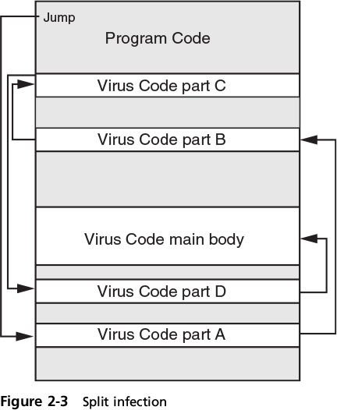
Viruses
Notes:
Viruses
Figure 2-3 Split infection

Slide 8
Viruses
Perform two actions:
Unload a payload to perform a malicious action
Reproduces itself
inserting its code into another file on the same computer
Examples of virus actions
Cause a computer to repeatedly crash
Erase files from or reformat hard drive
Turn off computer’s security settings
Reformat the hard disk drive
Notes:
Viruses
Viruses perform two actions:
Unloads a payload to perform a malicious action
Reproduces itself by inserting its code into another file on the same computer
Examples of virus actions
Cause a computer to repeatedly crash
Erase files from or reformat hard drive
Turn off computer’s security settings
Reformat the hard disk drive

Slide 9
Viruses
Cannot automatically spread to another computer
Relies on user action to spread
Attached to files
Spread by transferring infected files
Notes:
Viruses
Viruses cannot automatically spread to another computer
Relies on user action to spread
Viruses are attached to files
Viruses are spread by transferring infected files

Slide 10
Worms
Worm - Uses a computer network to replicate
Sends copies of itself to other network devices
Worms may:
Consume resources
Leave behind a payload to harm infected systems
Examples of worm actions
Deleting computer files
Allowing remote control of a computer by an attacker
Notes:
Worms
Worm - malicious program that uses a computer network to replicate
Sends copies of itself to other network devices
Worms may:
Consume resources or
Leave behind a payload to harm infected systems
Examples of worm actions
Deleting computer files
Allowing remote control of a computer by an attacker

Slide 11
Trojans
Trojan
executable program that does something other than advertised
Contain hidden code that launches an attack
Sometimes made to appear as data file
Example
User downloads “free calendar program”
Scans system for credit card numbers and passwords
Transmits information to attacker through network
Notes:
Trojans
Trojan horse (Trojan) - an executable program that does something other than advertised
Contain hidden code that launches an attack
Sometimes made to appear as data file
Example
User downloads “free calendar program”
Program scans system for credit card numbers and passwords
Transmits information to attacker through network

Slide 12
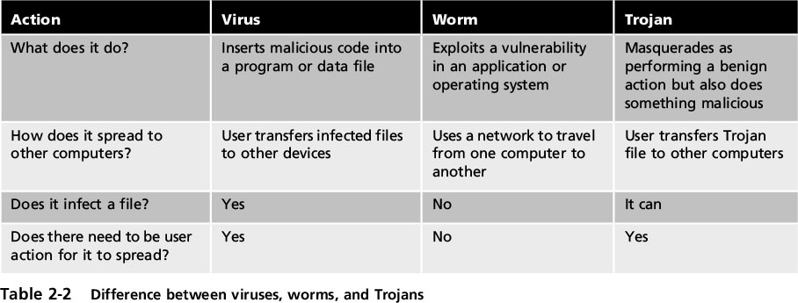
Trojans
Notes:
Trojans
Table 2-2 Difference between viruses, worms, and Trojans

Slide 13
Concealment
Rootkits –
software tools used by an attacker to hide actions or presence of other types of malicious software
Hide or remove traces of log-in records, log entries
May alter or replace OS files
with modified versions which ignore malicious activity
Users can’t trust computer that contains a rootkit
Rootkit is in charge/ hides what’s occurring oncomputer
Notes:
Concealment
Rootkits - software tools used by an attacker to hide actions or presence of other types of malicious software
Hide or remove traces of log-in records, log entries
May alter or replace operating system files with modified versions that are specifically designed to ignore malicious activity
Users can no longer trust their computer that contains a rootkit
The rootkit is in charge and hides what is occurring on the computer

Slide 14
Payload Capabilities
The destructive power of malware can be found in its payload capabilities
Primary payload capabilities include:
Collect data
Delete data
Modify system security settings
Launch attacks
Notes:
Payload Capabilities
The destructive power of malware can be found in its payload capabilities
Primary payload capabilities are to:
Collect data
Delete data
Modify system security settings
Launch attacks

Slide 15
Collect Data
Different types of malware designed to
collect important data from the user’s computer and
make it available to the attacker
This type of malware includes:
Spyware
Adware
Ransomware
Notes:
Collect Data
Different types of malware are designed to collect important data from the user’s computer and make it available at the attacker
This type of malware includes:
Spyware
Adware
Ransomware

Slide 16
Collect Data
Spyware –
gathers information without user consent
Uses the computer’s resources to collect/distribute personal or sensitive information
Keylogger –
captures and stores keystrokes
Attacker searches for useful information
passwords, credit card numbers, or personal information
Notes:
Stopped 10 AM 9/7
Spyware - software that gathers information without user consent
Uses the computer’s resources for the purposes of collecting and distributing personal or sensitive information
Keylogger - captures and stores each keystroke that a user types on the computer’s keyboard
Attacker searches the captured text for any useful information such as passwords, credit card numbers, or personal information

Slide 17
Collect Data
Keylogger can be a small hardware device or a software program
Hardware device
inserted between keyboard connection and USB port
Software keylogger
programs installed on the computer that captures info
Advantage of software keyloggers - they do not require physical access to the user’s computer
Often installed as a Trojan or virus,
can send captured data to the attacker via Internet
Notes:
Collect Data
A keylogger can be a small hardware device or a software program
As a hardware device, it is inserted between the computer keyboard connection and USB port
Software keyloggers are programs installed on the computer that silently capture information
An advantage of software keyloggers is that they do not require physical access to the user’s computer
Often installed as a Trojan or virus, can send captured information back to the attacker via Internet

Slide 18
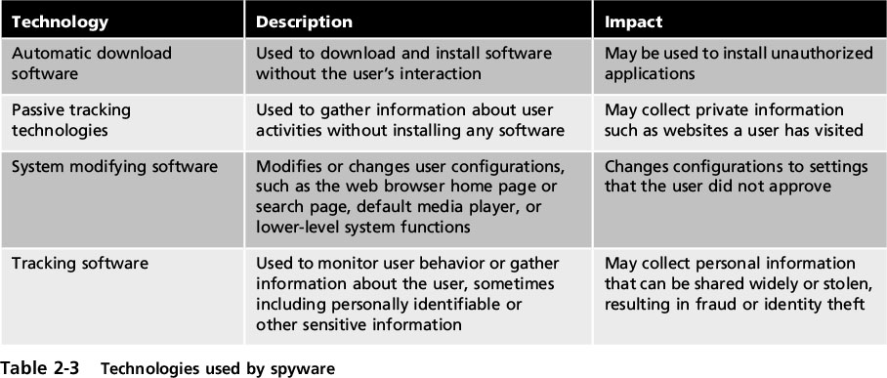
Collect Data
Notes:
Collect Data
Table 2-3 Technologies used by spyware

Slide 19
Collect Data
Adware
Delivers advertising content unexpected and unwanted by the user
Typically displays advertising banners and pop-up ads
May open new browser windows randomly
Can also perform tracking of online activities
Information often sold to advertisers
Notes:
Collect Data
Adware - program that delivers advertising content in manner unexpected and unwanted by the user
Typically displays advertising banners and pop-up ads
May open new browser windows randomly
Adware can also perform tracking of online activities
Information is gathered by adware and sold to advertisers

Slide 20
Collect Data
Ransomware –
prevents a user device from operating until fee is paid
Is highly profitable
~3 percent of infected users pay ransom
generating almost $5 million annually
A variation displays fictitious warning
There is a problem
Users must purchase software online to fix it
Notes:
Collect Data
Ransomware - prevents a user’s device from properly operating until a fee is paid
Is highly profitable
Nearly 3 percent of those users who have been infected pay the ransom without questions, generating almost $5 million annually
A variation of ransomware displays a fictitious warning that there is a problem and users must purchase additional software online to fix the problem

Slide 21
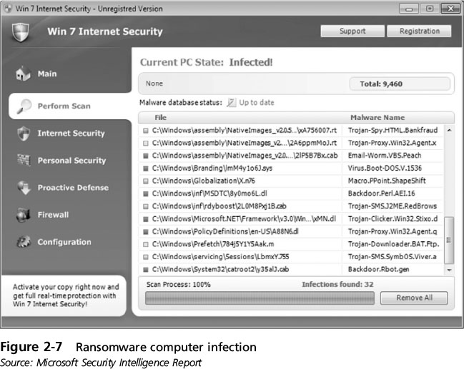
Collect Data
Notes:
Collect Data
Figure 2-7 Ransomware computer infection

Slide 22
Delete Data
Other malware deletes data on the computer
Logic bomb
Lies dormant until triggered by a logical event
Date, activity
Difficult to detect before it is triggered
Often embedded in large programs that aren’t routinely scanned
Notes:
Delete Data
The payload of other types of malware deletes data on the computer
Logic bomb - computer code that lies dormant until it is triggered by a specific logical event
Difficult to detect before it is triggered
Often embedded in large computer programs that are not routinely scanned

Slide 23
Modify System Security
Backdoor –
gives access to a computer, program, or service
circumvents normal security to give access
Allows the attacker to return at a later time and bypass security settings
Notes:
Modify System Security
Backdoor - gives access to a computer, program, or service that circumvents normal security to give program access
When installed on a computer, they allow the attacker to return at a later time and bypass security settings

Slide 24
Launch Attacks
Zombie
infected computer under remote control of an attacker
Groups of zombie computers gathered into logical computer network called a botnet under control of the attacker (bot herder)
Zombies wait for instructions through command and control (C&C) structure from bot herders
A common C&C mechanism used today is HTTP, which is more difficult to detect and block
Notes:
Launch Attacks
Zombie - an infected computer that is under the remote control of an attacker
Groups of zombie computers are gathered into a logical computer network called a botnet under the control of the attacker (bot herder)
Infected zombie computers wait for instructions through a command and control (C&C) structure from bot herders
A common C&C mechanism used today is HTTP, which is more difficult to detect and block

Slide 25
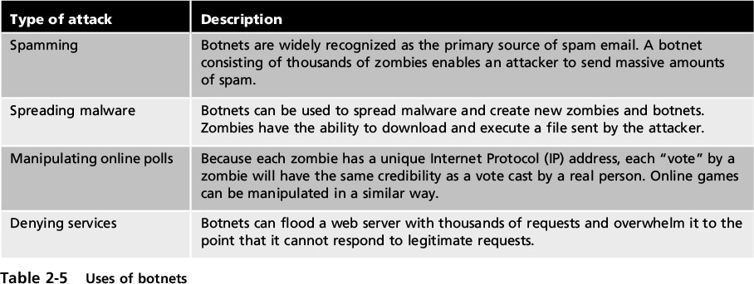
Zombie Attacks!
Notes:
Launch Attacks
Table 2-5 Uses of botnets

Slide 26
Social Engineering Attacks
Social engineering –
a means of gathering information for an attack
relies on the weaknesses of individuals
Attacks can involve psychological approaches as well as physical procedures
Notes:
Social Engineering Attacks
Social engineering - a means of gathering information for an attack by relying on the weaknesses of individuals
Social engineering attacks can involve psychological approaches as well as physical procedures

Slide 27
Psychological Approaches
Goal: persuade the victim to provide information or take action
Attackers use variety of techniques to gain trust without moving quickly:
Ask for only small amounts of information
Needs to be believable
Use slight flattery or flirtation to “soften up” victim
Attacker “pushes the envelope” to get information
Attacker may smile and ask for help
Notes:
Psychological Approaches
Psychological approaches goal: to persuade the victim to provide information or take action
Attackers use a variety of techniques to gain trust without moving quickly:
Attacker will ask for only small amounts of information
The request needs to be believable
Will use slight flattery or flirtation to “soften up” victim
Attacker “pushes the envelope” to get information
Attacker may smile and ask for help

Slide 28
Impersonation
Impersonation - pretends to be someone else:
Help desk support technician
Repairperson
Manager
Trusted third party
Fellow employee
Impersonate a person with authority
victims generally resist saying “no” to anyone in power
Notes:
Impersonation
Impersonation - attacker pretends to be someone else:
Help desk support technician
Repairperson
Manager
Trusted third party
Fellow employee
Attacker will often impersonate a person with authority because victims generally resist saying “no” to anyone in power

Slide 29
Phishing
Phishing –
sending email claiming to be from legitimate source
Try to trick user into giving private information
Many phishing attacks have common features:
Deceptive web links
Logos
Urgent request
Notes:
Phishing
Phishing - sending an email claiming to be from legitimate source
Tries to trick user into giving private information
Many phishing attacks have these common features:
Deceptive web links
Logos
Urgent request
Variations of phishing attacks
Pharming - automatically redirects user to a fraudulent Web site

Slide 30
Phishing
Variations of phishing attacks
Pharming - automatically redirects user to a fraudulent Web site
Spear phishing - target specific users
Whaling - going after the “big fish” (wealthy individuals)
Vishing (voice phishing)
Call victim with recorded “bank” message with callback number
Victim calls attacker’s number and enters private information
Notes:
Phishing
Variations of phishing (cont’d.)
Spear phishing - email messages target specific users
Whaling - going after the “big fish”
Targeting wealthy individuals
Vishing (voice phishing)
Attacker calls victim with recorded “bank” message with callback number
Victim calls attacker’s number and enters private information

Slide 31
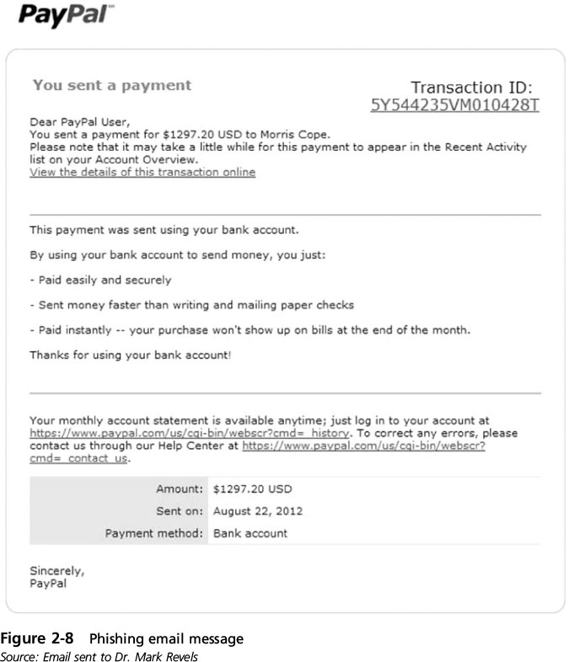
Phishing
Notes:
Phishing
Figure 2-8 Phishing email message

Slide 32
Spam
Spam - unsolicited e-mail
Primary vehicle for distribution of malware
A lucrative business
Cost spammers very little to send millions of spam messages
Filters
look for specific words and block the email
Image spam
uses graphical images to circumvent text-based filters
Often contains nonsense text so it appears legitimate
Notes:
End 1 PM class 9/9/16
Spam - unsolicited e-mail
Primary vehicles for distribution of malware
Sending spam is a lucrative business
Cost spammers very little to send millions of spam messages
Filters look for specific words and block the email
Image spam - uses graphical images of text in order to circumvent text-based filters
Often contains nonsense text so it appears legitimate

Slide 33
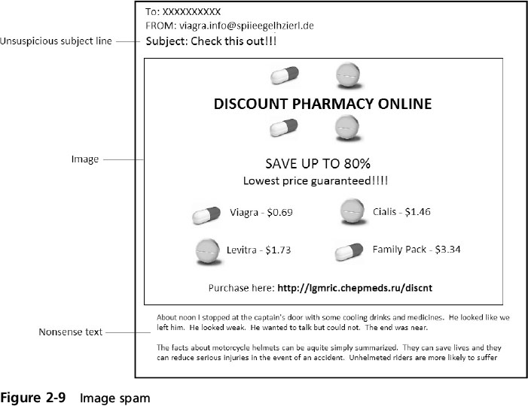
Spam
Notes:
Spam
Figure 2-9 Image spam

Slide 34
Hoaxes
Hoaxes –
a false warning, usually claiming to come from the IT department
Try to get victims to change settings on their computers to allow attacker to compromise system
May also provide a phone number for the victim to call for help, putting them in direct contact with attacker
Notes:
Hoaxes
Hoaxes - a false warning, usually claiming to come from the IT department
Attackers try to get victims to change configuration settings on their computers that would allow the attacker to compromise the system
Attackers may also provide a telephone number for the victim to call for help, which will put them in direct contact with the attacker

Slide 35
Typo Squatting
Typo squatting –
redirecting user to fictitious website based on a misspelling of the URL
Also called URL hijacking
Example: typing goggle.com instead of google.com
Attackers purchase the domain names similar to actual sites
May contain a survey that promises a chance to win prizes or will be filled with ads
Notes:
Typo Squatting
Typo squatting - redirecting a user to a fictitious website based on a misspelling of the URL
Also called URL hijacking
Example: typing goggle.com instead of google.com
Attackers purchase the domain names of sites that are spelled similarly to actual sites
Many may contain a survey that promises a chance to win prizes or will be filled with ads

Slide 36
Watering Hole Attack
Watering hole attack
Directed toward a small group of specific individuals who visit the same website
Attacker needs access to that system
Identifies and infects THAT system
Eventually, one of the targets is infected
Example:
Executives working for a manufacturing company visit a website, such as a parts supplier
Notes:
End 10 AM Sept 9 2016
Watering hole attack - a malicious attack that is directed toward a small group of specific individuals who visit the same website
Example:
Major executives working for a manufacturing company may visit a common website, such as a parts supplier to the manufacturer

Slide 37
Physical Procedures
Dumpster diving
Dig through trash to find info useful in an attack
Tailgating
Follow authorized individual through an access door
Employee could conspire with an attacker to allow him to walk in with him (called piggybacking)
Shoulder Surfing
Watching an authorized user enter a security code on a keypad
Notes:
Physical Procedures
Dumpster diving
Digging through trash to find information that can be useful in an attack
Tailgating
Following behind an authorized individual through an access door
An employee could conspire with an unauthorized person to allow him to walk in with him (called piggybacking)
Watching an authorized user enter a security code on a keypad is known as shoulder surfing

Slide 38
Physical Procedures
Notes:
Physical Procedures
Table 2-5 Uses of botnets

