Slide 1
Defining Digital Certificates
Digital signature
Used to prove a document originated from a valid sender
Weakness of using digital signatures
Only shows that the private key was used to encrypt the digital signature
Imposter could post a new public key under a sender’s name
Notes:
Defining Digital Certificates
Digital signature
Used to prove a document originated from a valid sender
Weakness of using digital signatures
They only show that the private key of the sender was used to encrypt the digital signature
Imposter could post a public key under a sender’s name

Slide 2
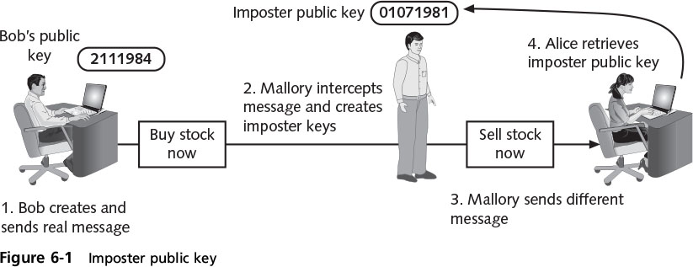
Defining Digital Certificates
Notes:
Defining Digital Certificates
Figure 6-1 Imposter public key

Slide 3
Defining Digital Certificates
Trusted third party
Helps solve the problem of verifying identity
Verifies owner IS who owns that public key
Helps prevent man-in-the-middle attack that impersonates owner of public key
A digital certificate is used to associate user’s identity to a public key
“digitally signed” by a trusted third party
Notes:
Defining Digital Certificates
Trusted third party
Used to help solve the problem of verifying identity
Verifies the owner and that the public key belongs to that owner
Helps prevent man-in-the-middle attack that impersonates owner of public key
A digital certificate is a technology used to associate a user’s identity to a public key
That has been “digitally signed” by a trusted third party

Slide 4
Defining Digital Certificates
Information contained in a digital certificate
Owner’s name or alias
Owner’s public key
Issuer’s name
Issuer’s digital signature
Digital certificate’s serial number
Expiration date of the public key
Notes:
Defining Digital Certificates
Information contained in a digital certificate
Owner’s name or alias
Owner’s public key
Issuer’s name
Issuer’s digital signature
Digital certificate’s serial number
Expiration date of the public key

Slide 5
Managing Digital Certificates
Technologies used for managing digital certificates
Certificate Authority (CA)
Registration Authority (RA)
Certificate Repository (CR)
Certificate Authority (CA)
The trusted third party agency
Issues digital certificates
Can be internal or external to an organization
Notes:
Managing Digital Certificates
Technologies used for managing digital certificates
Certificate Authority (CA)
Registration Authority (RA)
Certificate Repository (CR)
Certificate Authority (CA)
Serves as the trusted third party agency
Responsible for issuing digital certificates
A CA can be internal or external to an organization

Slide 6
Managing Digital Certificates
Duties of a CA
Generate, issue, an distribute public key certificates
Distribute CA certificates
Generate and publish certificate status information
Provide a means for subscribers to request revocation
Revoke public-key certificates
Maintain security, availability, and continuity of certificate issuance signing functions
Notes:
Managing Digital Certificates
Duties of a CA
Generate, issue, an distribute public key certificates
Distribute CA certificates
Generate and publish certificate status information
Provide a means for subscribers to request revocation
Revoke public-key certificates
Maintain security, availability, and continuity of certificate issuance signing functions

Slide 7
Managing Digital Certificates
A subscriber requesting a digital certificate
Generates public and private keys
Generates a Certificate Signing Request (CSR)
Specifically formatted encrypted message that validates the information the CA requires to issue a digital certificate
CA inserts public key into certificate
Certificate digitally signed with private key of CA
Notes:
10 AM 2/13/17
A subscriber requesting a digital certificate
Generates public and private keys
Generates a Certificate Signing Request (CSR)
A specifically formatted encrypted message that validates the information the CA requires to issue a digital certificate
CA inserts public key into certificate
Certificates are digitally signed with private key of issuing CA

Slide 8
Managing Digital Certificates
Registration Authority (RA)
Subordinate entity handles specific CA tasks
Creates improved workflow for CA
General duties of an RA
Receive, authenticate, and process certificate revocation requests
Identify and authenticate subscribers
Notes:
Managing Digital Certificates
Registration Authority (RA)
A subordinate entity designed to handle specific CA tasks
Offloading registration functions creates improved workflow for CA
General duties of an RA
Receive, authenticate, and process certificate revocation requests
Identify and authenticate subscribers

Slide 9
Managing Digital Certificates
General duties of an RA (cont’d.)
Obtain a public key from the subscriber
Verify that the subscriber possesses the private key corresponding to the public key
Primary function of an RA
Verify identity of an individual
Notes:
Managing Digital Certificates
General duties of an RA (cont’d.)
Obtain a public key from the subscriber
Verify that the subscriber possesses the asymmetric private key corresponding to the public key submitted for certification
Primary function of an RA
Verify identity of an individual

Slide 10
Managing Digital Certificates
Ways that a digital certificate requestor can identify themselves to an RA
E-mail
Insufficient for activities that must be very secure
Documents
Birth certificate, employee badge
In person
Government-issued passport or driver’s license
Notes:
Managing Digital Certificates
Means for a digital certificate requestor to identify themselves to an RA
E-mail
Insufficient for activities that must be very secure
Documents
Birth certificate, employee badge
In person
Providing government-issued passport or driver’s license

Slide 11
Managing Digital Certificates
Certificate Repository (CR)
Publicly accessible central directory of certificates
Can view certificate status
Can be managed locally by setting it up as a storage area connected to the CA server
Notes:
Managing Digital Certificates
Certificate Repository (CR)
Publicly accessible centralized directory of digital certificates
Can be used to view certificate status
Can be managed locally by setting it up as a storage area connected to the CA server

Slide 12
Managing Digital Certificates
Certificate Revocation
List of certificates that have been revoked
Reasons a certificate would be revoked
No longer used
Details have changed, such as user’s address
Private key has been lost or exposed
Certificate Revocation List (CRL)
List of certificate numbers that have been revoked
Searchable over internet
Notes:
Managing Digital Certificates
Certificate Revocation
Lists of digital certificate that have been revoked
Reasons a certificate would be revoked
Certificate is no longer used
Details of the certificate have changed, such as user’s address
Private key has been lost or exposed (or suspected lost or exposed)
Certificate Revocation List (CRL)
A list of certificate serial numbers that have been revoked

Slide 13
Managing Digital Certificates
Online Certificate Status Protocol (OCSP)
Real-time lookup of a certificate’s status
Called a request-response protocol
Browser sends certificate’s info to a trusted entity known as an OCSP Responder
Responder provides revocation info on certificate
Fails if Responder not available
OCSP stapling
Variation of OCSP
Web server includes a signed time-stamped OCSP response with certificate
Reduces browser work load
Notes:
Managing Digital Certificates
Online Certificate Status Protocol (OCSP)
Performs a real-time lookup of a certificate’s status
Called a request-response protocol
The browser sends the certificate’s information to a trusted entity known as an OCSP Responder
The OCSP Responder provides immediate revocation information on that certificate
OCSP stapling
A variation of OCSP where web servers send queries to the OCSP Responder server at regular intervals to receive a signed time-stamped response

Slide 14
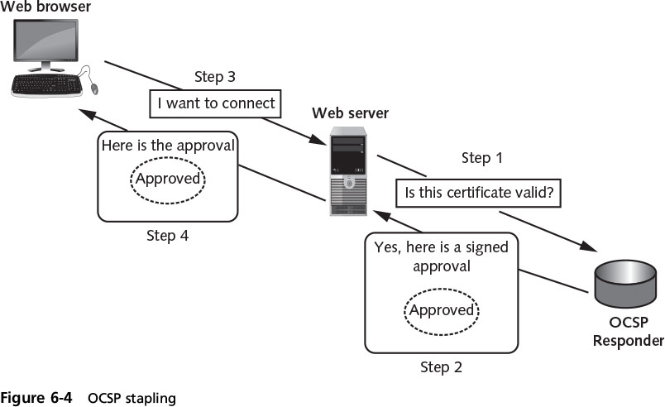
Managing Digital Certificates
Notes:
Managing Digital Certificates
Figure 6-4 OCSP stapling

Slide 15
Types of Digital Certificates
Different categories of digital certificates
The most common categories are:
Personal digital certificates
Server digital certificates
Software publisher digital certificates
Notes:
Types of Digital Certificates
Different categories of digital certificates
The most common categories are:
Personal digital certificates
Server digital certificates
Software publisher digital certificates

Slide 16
Types of Digital Certificates
Class 1: Personal Digital Certificates
Issued by an RA directly to individuals
Frequently used to secure e-mail transmissions
Typically only require name and e-mail address
Class 2: Server Digital Certificates
Issued from a Web server to a client
Ensure authenticity of the Web server and cryptographic connection to the Web server
Notes:
Types of Digital Certificates
Class 1: Personal Digital Certificates
Issued by an RA directly to individuals
Frequently used to secure e-mail transmissions
Typically only require user’s name and e-mail address to receive
Class 2: Server Digital Certificates
Issued from a Web server to a client
Ensure authenticity of the Web server
Ensure authenticity of the cryptographic connection to the Web server

Slide 17
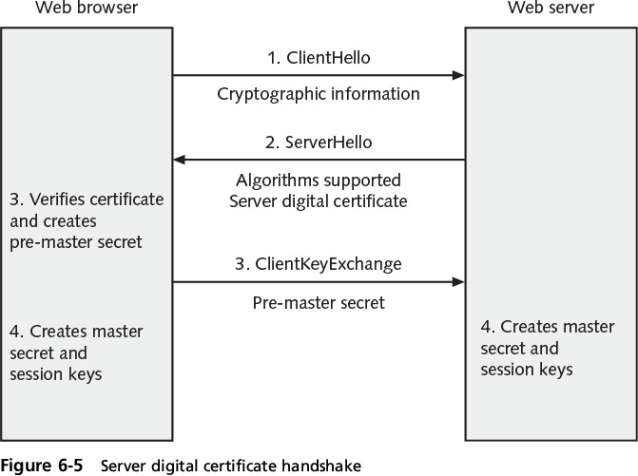
Types of Digital Certificates
Notes:
Types of Digital Certificates
Figure 6-5 Server digital certificate handshake

Slide 18
Types of Digital Certificates
Class 2: server digital certificates (cont’d.)
Server authentication and secure communication can be combined into one certificate
Displays padlock icon in the Web browser
Click icon to display info about the certificate
Extended Validation SSL Certificate (EV SSL)
More extensive verification of legitimacy of the business
Notes:
Types of Digital Certificates
Class 2: server digital certificates (cont’d.)
Server authentication and secure communication can be combined into one certificate
Displays padlock icon in the Web browser
Click padlock icon to display information about the digital certificate
Extended Validation SSL Certificate (EV SSL)
Requires more extensive verification of legitimacy of the business

Slide 19
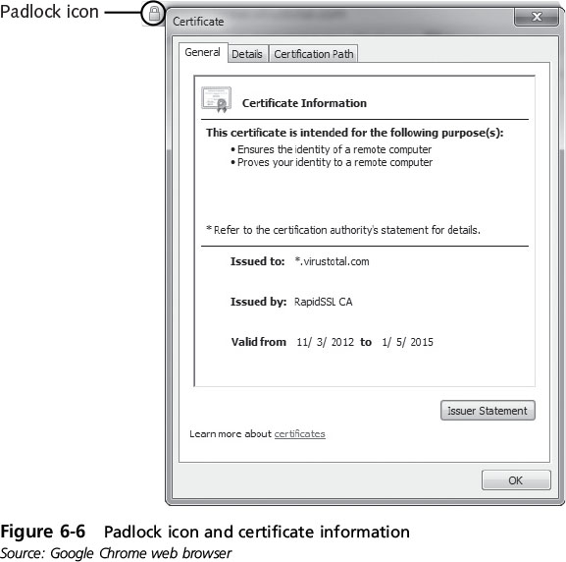
Types of Digital Certificates
Notes:
Types of Digital Certificates
Figure 6-6 Padlock icon and certificate information

Slide 20
Types of Digital Certificates
Class 3: Software Publisher Digital Certificates
Provided by software publishers
Purpose: Verify programs are secure and have not been tampered with
X.509 digital certificates
Standard - most widely accepted format for certificates
Certificates following standard can be read or written by any application that follows X.509
Notes:
Types of Digital Certificates
Class 3: Software Publisher Digital Certificates
Provided by software publishers
Purpose: to verify programs are secure and have not been tampered with
X.509 digital certificates
The standard for the most widely accepted format for digital certificates
Digital certificates following this standard can be read or written by any application that follows X.509
The current version is X.509 v3

Slide 21
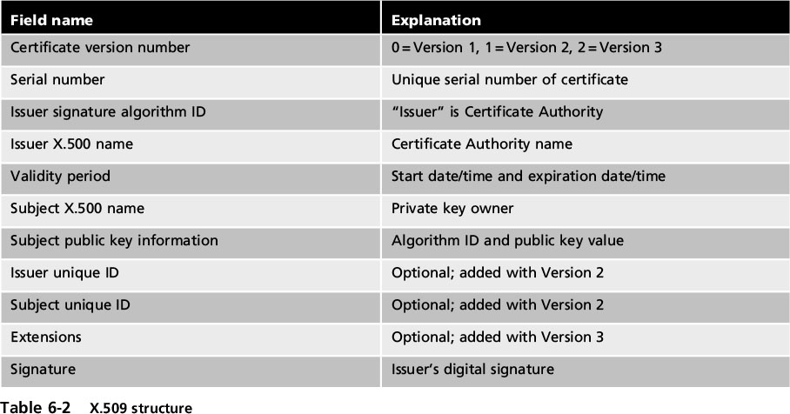
X.509 Certificate Fields
Notes:
Types of Digital Certificates
Table 6-2 X.509 structure

Slide 22
Public Key Infrastructure (PKI)
Important management tool for the use of:
Digital certificates:
Asymmetric cryptography
Aspects of PKI
Public-key cryptography standards
Trust models
Managing PKI
Notes:
Public Key Infrastructure (PKI)
Important management tool for the use of:
Digital certificates:
Asymmetric cryptography
Aspects of PKI
Public-key cryptography standards
Trust models
Managing PKI

Slide 23
What is Public Key Infrastructure?
Guidelines for a consistent way to manage digital certificates
Public key infrastructure (PKI) - framework for all entities involved in digital certificates
Certificate management actions facilitated by PKI
Create
Store
Distribute
Revoke
Notes:
End of class 1 PM 10/5/16
What is Public Key Infrastructure?
There is a need for a consistent means to manage digital certificates
Public key infrastructure (PKI) - a framework for all entities involved in digital certificates
Certificate management actions facilitated by PKI
Create
Store
Distribute
Revoke

Slide 24
Public-Key Cryptographic Standards (PKCS)
PKCS - A set of
standards defined by the RSA Corporation
Widely accepted in the industry
Based on the RSA public-key algorithm
Composed of the 15 standards detailed in Table 6-3 on page 241 of the text
Notes:
Public-Key Cryptographic Standards (PKCS)
PKCS - A numbered set of PKI standards defined by the RSA Corporation
Widely accepted in the industry
Based on the RSA public-key algorithm
PKCS is composed of the 15 standards detailed in Table 6-3 on page 241 of the text

Slide 25
Trust Models
Trust
Confidence in or reliance on another person or entity
Trust model
The type of trust relationship that can exist between individuals and entities
Direct trust
Trust model where a person knows the other person
Third-party trust
Individuals trust each other because each trusts a third party
Notes:
End of 10 AM, 11 AM 10/5/16
Trust Models
Trust
Confidence in or reliance on another person or entity
Trust model
Refers to the type of trust relationship that can exist between individuals and entities
Direct trust
A type of trust model where one person knows the other person
Third-party trust
Two individuals trust each other because each trusts a third party

Slide 26
Trust Models
Hierarchical Trust Model
Assigns a single hierarchy with one master CA called the root
Root signs all digital certificate authorities with a single key
Can be used in an organization where one CA is responsible for only that organization’s digital certificates
Limitation:
A single CA private key may be compromised rendering all certificates worthless
Notes:
Trust Models
Hierarchical Trust Model
Assigns a single hierarchy with one master CA called the root
The root signs all digital certificate authorities with a single key
Can be used in an organization where one CA is responsible for only that organization’s digital certificates
Hierarchical trust model limitation:
A single CA private key may be compromised rendering all certificates worthless

Slide 27
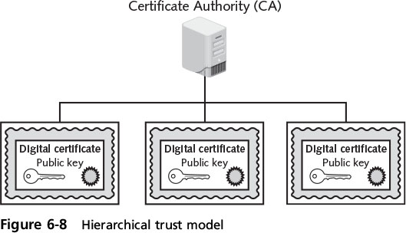
Trust Models
Notes:
Trust Models
Figure 6-8 Hierarchical trust model

Slide 28
Trust Models
Distributed Trust Model
Multiple CAs sign digital certificates
Eliminates limitations of hierarchical trust model
Bridge Trust Model
One CA acts as facilitator to interconnect other CAs
Facilitator CA does not issue digital certificates, instead it acts as hub between hierarchical and distributed trust model
Allows the different models to be linked
Notes:
Trust Models
Distributed Trust Model
Multiple CAs sign digital certificates
Eliminates limitations of hierarchical trust model
Bridge Trust Model
One CA acts as facilitator to interconnect connect all other CAs
Facilitator CA does not issue digital certificates, instead it acts as hub between hierarchical and distributed trust model
Allows the different models to be linked

Slide 29
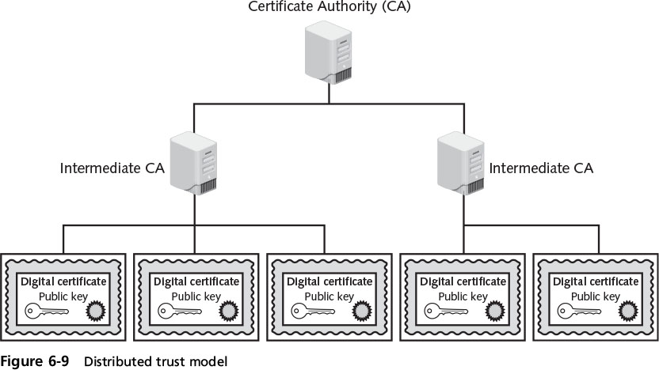
Trust Models
Notes:
Trust Models
Figure 6-9 Distributed trust model

Slide 30
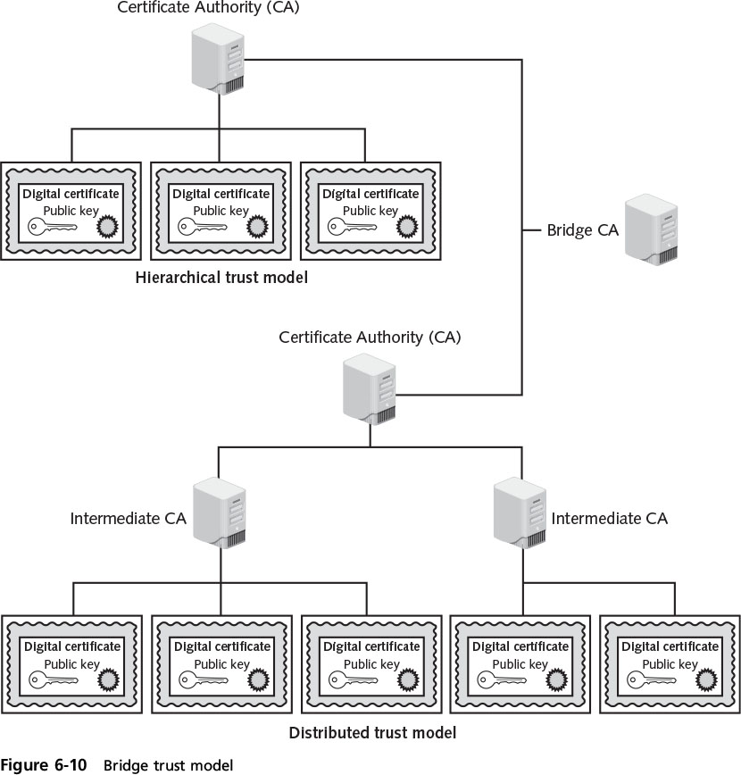
Trust Models
Notes:
Trust Models
Figure 6-10 Bridge trust model

Slide 31
Managing PKI
Certificate Policy (CP)
Published set of rules governing operation of a PKI
Recommends base security requirements for use and operation of CA, RA, and other PKI components
Certificate Practice Statement (CPS)
Document describing how the CA uses and manages certificates
Covers how to register for, how to issue, when to revoke, procedural controls and key pair management
Notes:
Managing PKI
Certificate Policy (CP)
A published set of rules that govern operation of a PKI
Provides recommended baseline security requirements for the use and operation of CA, RA, and other PKI components
Certificate Practice Statement (CPS)
A technical document that describes in detail how the CA uses and manages certificates
Also covers how to register for a digital certificate, how to issue them, when to revoke them, procedural controls and key pair management

Slide 32
Managing PKI
Certificate life cycle
Creation
Occurs after user is positively identified
Suspension
May occur when employee on leave of absence
Revocation
Certificate no longer valid
Expiration
Key can no longer be used
Notes:
Managing PKI
Certificate life cycle
Creation
Occurs after user is positively identified
Suspension
May occur when employee on leave of absence
Revocation
Certificate no longer valid
Expiration
Key can no longer be used

Slide 33
Key Storage
Means of public key storage
Embedding within digital certificates
Means of private key storage
Stored on user’s local system
Software-based storage may expose keys to attackers
Alternative: storing keys in hardware
Smart-cards
Tokens
Notes:
Key Storage
Means of public key storage
Embedding within digital certificates
Means of private key storage
Stored on user’s local system
Software-based storage may expose keys to attackers
Alternative: storing keys in hardware
Smart-cards
Tokens

Slide 34
Key Usage
Multiple pairs of dual keys can be created
If more security is needed than a single set of public/private keys
One pair used to encrypt information
Public key backed up in another location
Second pair used only for digital signatures
Public key in that pair would never be backed up
Notes:
Key Usage
Multiple pairs of dual keys can be created
If more security is needed than a single set of public/private keys
One pair used to encrypt information
Public key backed up in another location
Second pair used only for digital signatures
Public key in that pair would never be backed up

Slide 35
Key-Handling Procedures
Key escrow
Keys managed by a third party, such as a trusted CA
Private key is split and each half is encrypted
Halves sent to third party, stored in separate locations
User can retrieve and combine two halves of key for use as needed
Expiration
Keys expire after a set period of time
Notes:
Key-Handling Procedures
Key escrow
Keys are managed by a third party, such as a trusted CA
Private key is split and each half is encrypted
Two halves sent to third party, which stores each half in separate location
User can retrieve and combine two halves and use this new copy of private key for decryption
Expiration
Keys expire after a set period of time

Slide 36
Key-Handling Procedures
Renewal
Existing key can be renewed
A bit more vulnerable
Revocation
Keys can be revoked prior to expiration date
Revoked keys may not be reinstated
Recovery
Example: recover keys of an employee hospitalized for extended period
Key recovery agent (KRA) may be used
(trusted person can request the keys of others)
Group of people may be used (M-of-N control)
Notes:
Key-Handling Procedures
Renewal
Existing key can be renewed
Revocation
Keys may be revoked prior to its expiration date
Revoked keys may not be reinstated
Recovery
Need to recover keys of an employee hospitalized for extended period
Key recovery agent (KRA) may be used
Group of people may be used (M-of-N control)

Slide 37
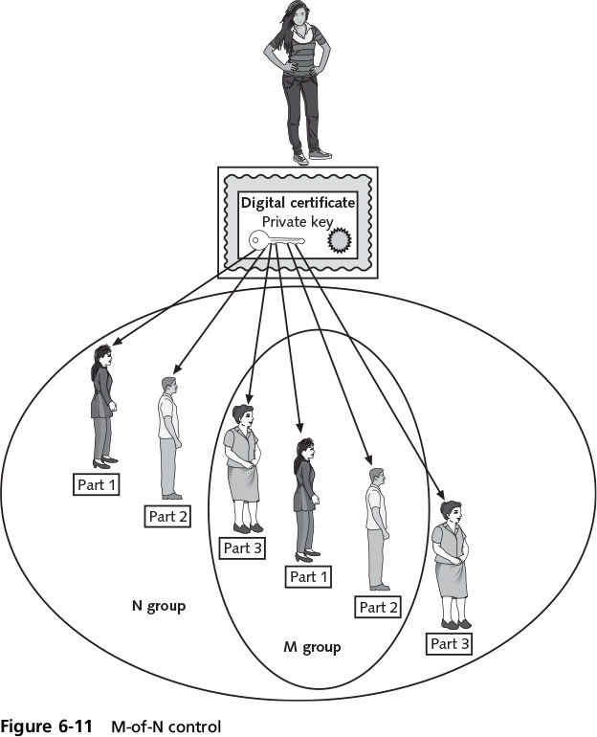
Key-Handling Procedures
Notes:
End of class 10 AM, 11 AM 2/15/17
Key-Handling Procedures
Figure 6-11 M-of-N control

Slide 38
Key-Handling Procedures
Suspension
Suspended for a set period of time and then reinstated
Destruction
Removes all public and private keys and user’s identification from the CA
Notes:
Key-Handling Procedures
Suspension
Suspended for a set period of time and then reinstated
Destruction
Removes all public and private keys and user’s identification from the CA

Slide 39
Cryptographic Transport Protocols
Secure Sockets Layer (SSL)
One of the most common transport algorithms
Developed by Netscape
Design goal was to create an encrypted data path between a client and a server
Transport Layer Security (TLS)
Versions starting with v1.1 are significantly more secure than SSL v3.0
Notes:
Cryptographic Transport Protocols
Secure Sockets Layer (SSL)
One of the most common transport algorithms
Developed by Netscape
Design goal was to create an encrypted data path between a client and a server
Transport Layer Security (TLS)
Versions starting with v1.1 are significantly more secure than SSL v3.0

Slide 40
Cryptographic Transport Protocols
Cipher suite
A named combination of the encryption, authentication, and message authentication code (MAC) algorithms that are used with SSL and TLS
Length of keys - a factor in determining the overall security of a transmission
Keys less than 2048 bits are considered weak
Keys 2048 bits are considered good
Keys 4096 bits are strong
Notes:
Cryptographic Transport Protocols
Cipher suite
A named combination of the encryption, authentication, and message authentication code (MAC) algorithms that are used with SSL and TLS
Length of keys - a factor in determining the overall security of a transmission
Keys of less than 2048 bits are considered weak
Keys of 2048 bits are considered good
Keys of 4096 bits are strong

Slide 41
Secure Shell (SSH)
Encrypted alternative to Telnet protocol used to access remote computers
A Linux/UNIX command interface and protocol
Client and server are authenticated using a digital certificate and passwords are encrypted
Notes:
Secure Shell (SSH)
An encrypted alternative to the Telnet protocol used to access remote computers
It is a Linux/UNIX-based command interface and protocol
SSH is a suite of three utilities: slogin, ssh, and scp
Client and server ends of the connection are authenticated using a digital certificate and passwords are encrypted
Can be used as a tool for secure network backups

Slide 42
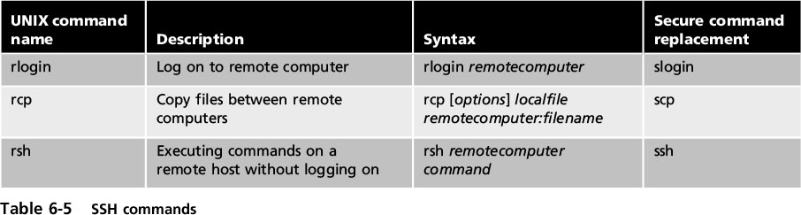
Secure Shell (SSH)
Notes:
Secure Shell (SSH)
Table 6-5 SSH commands

Slide 43
Hypertext Transport Protocol Secure (HTTPS)
A common use of TLS and SSL:
To secure Hypertext Transport Protocol (HTTP) communications between browser and Web server
The secure version is actually “plain” HTTP sent over SSL or TLS
Called Hypertext Transport Protocol Secure (HTTPS) uses port 443 instead of HTTP’s port 80
Users must enter URLs with https://
Notes:
Hypertext Transport Protocol Secure (HTTPS)
A common use of TLS and SSL:
To secure Hypertext Transport Protocol (HTTP) communications between browser and Web server
The secure version is actually “plain” HTTP sent over SSL or TLS
Called Hypertext Transport Protocol Secure (HTTPS) and uses port 443 instead of HTTP’s port 80
Users must enter URLs with https://

Slide 44
IP Security (IPsec)
Internet Protocol Security
A suite of protocols for securing IP communications
Encrypts and authenticates each packet of a session between hosts or networks
Implemented in Router or Firewall
considered to be a transparent protocol
It is transparent to the following:
Applications
Users
Software
Notes:
IP Security (IPsec)
Internet Protocol Security (IPsec)
A suite of protocols for securing IP communications
Encrypts and authenticates each IP packet of a session between hosts or networks
IPsec considered to be a transparent protocol
It is transparent to the following:
Applications
Users
Software

Slide 45
IP Security (IPsec)
Provides three areas of protection that correspond to three IPsec protocols:
Authentication
Confidentiality
Key management
Supports two encryption modes:
Transport - encrypts only the data portion of each packet and leaves the header unencrypted
Tunnel - encrypts both the header and the data portion
Notes:
IP Security (IPsec)
IPsec provides three areas of protection that correspond to three IPsec protocols:
Authentication
Confidentiality
Key management
Supports two encryption modes:
Transport - encrypts only the data portion of each packet and leaves the header unencrypted
Tunnel - encrypts both the header and the data portion

Slide 46
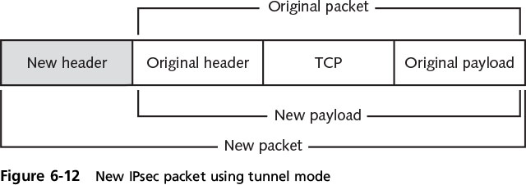
IP Security (IPsec)
Notes:
IP Security (IPsec)
Figure 6-12 New IPsec packet using tunnel mode

