Slide 1
Security Through Network Devices
Layered security
Multiple types of security devices to protect a network
Also called defense in depth
Layered security makes it more difficult for attacker
Must have tools, knowledge, and skills to break through EACH layer
Achieved by using networking devices or hardware designed for security
Notes:
Security Through Network Devices
Layered security
A defense that uses multiple types of security devices to protect a network
Also called defense in depth
A network with layered security will make it more difficult for an attacker
He must have all the tools, knowledge, and skills to break through the various layers
Layered network security can be achieved by using networking devices or hardware designed for security

Slide 2
Standard Network Devices
Security features found in network hardware
Provide basic level of security
Network devices classified based on their function in the OSI model
Standard released in 1978, revised in 1983, still used today
Defines how networks prepares data for delivery and how data is handled once received
Notes:
Standard Network Devices
Security features found in network hardware
Provide basic level of security
Network devices can classified based on their function in the OSI model
Standards released in 1978, revised in 1983, still used today
Illustrates how a network prepares data for delivery and how data is handled once received

Slide 3
Standard Network Devices
OSI model breaks networking steps into seven (or 5) layers
Each layer has different networking tasks
Cooperates with adjacent layers
Standard network devices classified by the OSI layer at which they function
Some devices include:
Switches, routers, load balancers, and proxies
Notes:
Standard Network Devices
OSI model breaks networking steps into seven layers
Each layer has different networking tasks
Each layer cooperates with adjacent layers
Standard network devices can be classified by the OSI layer at which they function
Some devices include:
Switches, routers, load balancers, and proxies

Slide 4
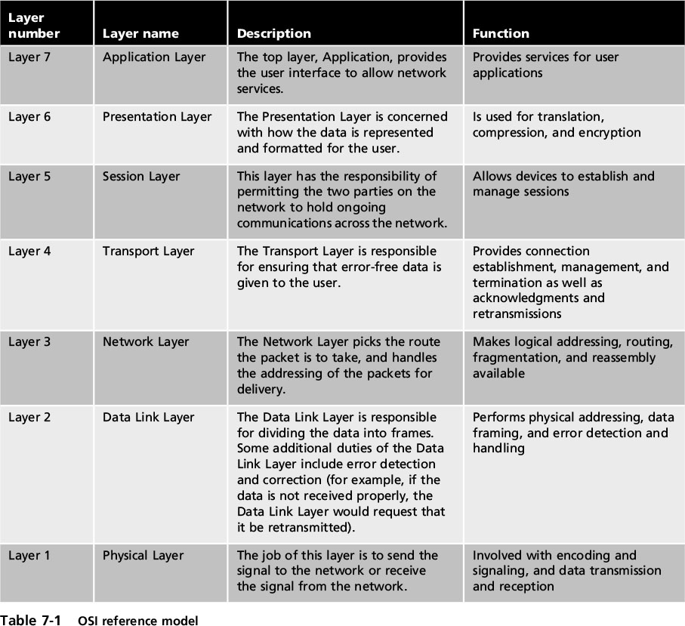
Standard Network Devices
Notes:
Standard Network Devices
Table 7-1 OSI references model

Slide 5
Standard Network Devices
Switches
A device that connects network devices together
Operates at Data Link Layer (Layer 2)
Can determine which device is connected to each port
Forward frames sent to that specific device (unicast) or frames sent to all devices (broadcast)
Uses MAC addresses to identify devices
Notes:
Standard Network Devices
Switches
A network switch is a device that connects network devices together
Operates at Data Link Layer (Layer 2)
Can determine which device is connected to each port
Can forward frames sent to that specific device (unicast) or frames sent to all devices (broadcast)
Uses MAC addresses to identify devices

Slide 6
Standard Network Devices
Switches (cont’d)
An attacker attached to a switch will see only frames that are directed to that device and not others
Earlier networks used hubs to connect devices to network
Repeated all frames to all attached network devices
Attackers could use protocol analyzer to capture all packets
Could decode and analyze packet contents
Notes:
Standard Network Devices
Switches (cont’d)
An attacker attached to a switch will see only frames that are directed to that device and not others
Earlier networks used hubs to connect devices to a network
Hubs repeated all frames to all attached network devices
Attackers could use a protocol analyzer to capture all packets
Protocol analyzers could decode and analyze packet contents

Slide 7
Standard Network Devices
Admin should be able to monitor network traffic
Helps identify and troubleshoot network problems
Traffic monitoring methods
Port mirroring
Administrator configures the switch to copy traffic from some or all ports to a monitoring port on the switch
Network tap (test access point)
Separate device installed between two devices
Notes:
Standard Network Devices
Network administrators should be able to monitor network traffic
Helps identify and troubleshoot network problems
Traffic monitoring methods
Port mirroring
Allows administrator to configure the switch to copy traffic that occurs on some or all ports to a designated monitoring port on the switch
Network tap (test access point)
Separate device installed between two network devices

Slide 8
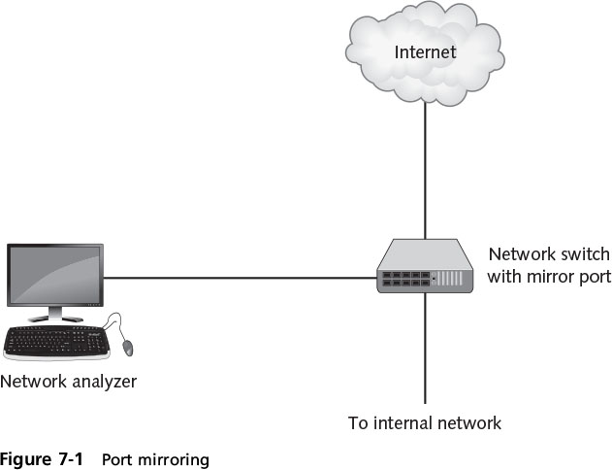
Standard Network Devices
Notes:
Standard Network Devices
Figure 7-1 Port mirroring

Slide 9
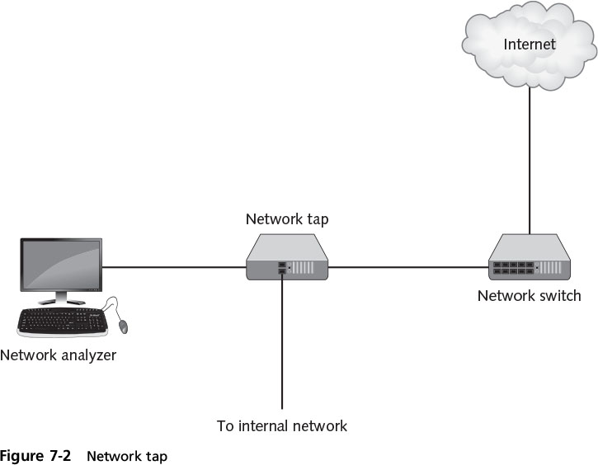
Standard Network Devices
Notes:
Standard Network Devices
Figure 7-2 Network tap

Slide 10
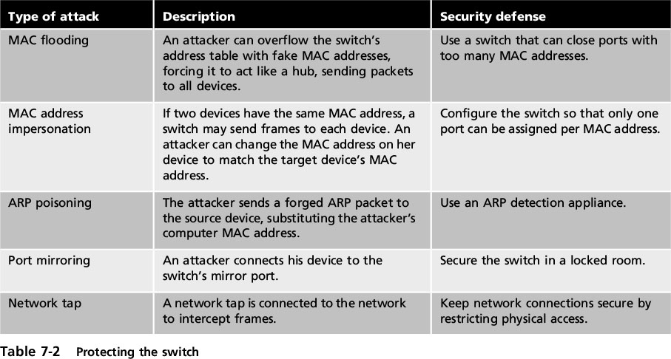
Standard Network Devices
Notes:
End of class 2/20/17
11 AM
Standard Network Devices
Table 7-2 Protecting the switch

Slide 11
Standard Network Devices
Routers
Forward packets across different computer networks
Operate at Network Layer (Layer 3)
Can be set to filter specific types of network traffic
Load balancers
Help evenly distribute work across a network
Allocate requests among multiple devices
Notes:
Standard Network Devices
Routers
Forward packets across different computer networks
Operate at Network Layer (Layer 3)
Can be set to filter out specific types of network traffic
Load balancers
Help evenly distribute work across a network
Allocate requests among multiple devices

Slide 12
Standard Network Devices
Advantages of load-balancing technology
Reduces probability of overloading a single server
Optimizes bandwidth of network computers
Reduces network downtime
Achieved through software or hardware device (load balancer)
Notes:
Standard Network Devices
Advantages of load-balancing technology
Reduces probability of overloading a single server
Optimizes bandwidth of network computers
Reduces network downtime
Load balancing is achieved through software or hardware device (load balancer)
Load balancers are grouped into two categories:
Layer 4 load balancers - act upon data found in Network and Transport layer protocols
Layer 7 load balancers - distribute requests based on data found in Application layer protocols

Slide 13
Standard Network Devices
Security advantages of load balancing
Detect and stop attacks directed at a server or app
Detect and prevent (DoS) and protocol attacks
Some can deny attackers info about the network
Hide HTTP error pages
Remove server id headers from HTTP responses
Notes:
Standard Network Devices
Security advantages of load balancing
Can detect and stop attacks directed at a server or application
Can detect and prevent denial-of-service (DoS) and protocol attacks
Some can deny attackers information about the network
Hide HTTP error pages
Remove server identification headers from HTTP responses

Slide 14
Standard Network Devices
Proxies - there are several types of proxies used in computer networking
Proxy server - a computer or an app program that intercepts requests from the internal network and processes request on behalf of the user
App-aware proxy - a special proxy server that “knows” the application protocols that it supports
Notes:
End of class 10 AM 2/20/17
Standard Network Devices
Proxies - there are several types of proxies used in computer networking
Proxy server - a computer or an application program that intercepts user requests from the internal network and processes that request on behalf of the user
Application-aware proxy - a special proxy server that “knows” the application protocols that it supports

Slide 15
Standard Network Devices
Advantages of proxy servers:
Increased speed
Reduced costs
Improved management
Stronger security
Reverse proxy
Does not serve clients
Routes incoming requests to the correct server
Notes:
Standard Network Devices
Advantages of proxy servers:
Increased speed
Reduced costs
Improved management
Stronger security
Reverse proxy
Does not serve clients
Routes incoming requests to the correct server

Slide 16
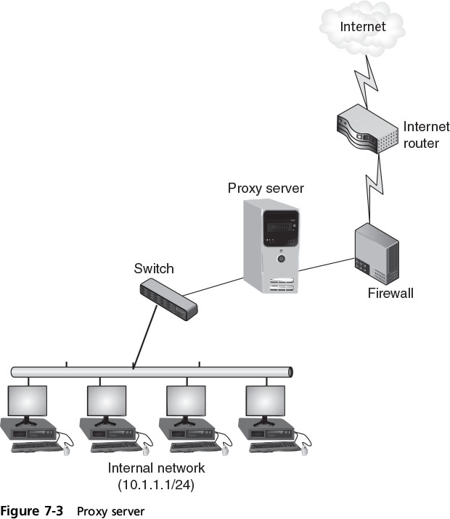
Standard Network Devices
Notes:
Standard Network Devices
Figure 7-3 Proxy server

Slide 17
Network Security Hardware
Specifically designed security hardware devices
Greater protection than standard networking devices
Network Firewalls
Can be software-based or hardware-based
Inspect packets and either accept or deny entry
Hardware firewalls usually outside the network security perimeter
Notes:
Network Security Hardware
Specifically designed security hardware devices
Provide greater protection than standard networking devices
Network Firewalls
Can be software-based or hardware-based
Both types inspect packets and either accept or deny entry
Hardware firewalls are usually located outside the network security perimeter

Slide 18
Network Security Hardware
Methods of firewall packet filtering
Stateless packet filtering
Inspects incoming packet and permit or deny based on conditions set by administrator
Stateful packet filtering
Keeps a record of the state connections in/out of network
Makes decisions based on the connection and conditions
Notes:
Network Security Hardware
Methods of firewall packet filtering
Stateless packet filtering
Inspects incoming packet and permits or denies based on conditions set by administrator
Stateful packet filtering
Keeps a record of the state of a connection
Makes decisions based on the connection and conditions

Slide 19
Network Security Hardware
Firewall actions on a packet
Allow (let packet pass through)
Drop (prevent the packet from passing into the network and send no response to sender)
Reject (prevent the packet from passing into the network but send a message to the sender)
Rule-based firewalls
Use a set of individual instructions to control actions
Notes:
Network Security Hardware
Firewall actions on a packet
Allow (let packet pass through)
Drop (prevent the packet from passing into the network and send no response to sender)
Reject (prevent the packet from passing into the network but send a message to the sender)
Rule-based firewalls
Use a set of individual instructions to control actions, called firewall rules
Each rule is a separate instruction processed in sequence telling the firewall what action to take

Slide 20
Network Security Hardware
Application-Aware Firewalls
Sometimes called a next-generation firewall (NGFW)
Operate at a higher level
identify applications sending packets through firewall
make decisions about actions to take
Web app firewall
Special application-aware firewall that
looks deeply into packets that carry HTTP traffic
Can block specific sites or types of HTTP traffic
Notes:
Network Security Hardware
Application-Aware Firewalls
Sometimes called a next-generation firewall (NGFW)
Operate at a higher level by identifying applications that send packets through the firewall and make decisions about actions to take
Web application firewall
Special type of application-aware firewall that looks deeply into packets that carry HTTP traffic
Can block specific sites or specific types of HTTP traffic

Slide 21
Network Security Hardware
Spam filters
Enterprise-wide spam filters
block spam before it reaches the host
Email systems use two protocols
Simple Mail Transfer Protocol (SMTP)
Handles outgoing mail
Post Office Protocol (POP)
Handles incoming mail
Notes:
Network Security Hardware
Spam filters
Enterprise-wide spam filters block spam before it reaches the host
Email systems use two protocols
Simple Mail Transfer Protocol (SMTP)
Handles outgoing mail
Post Office Protocol (POP)
Handles incoming mail

Slide 22
Network Security Hardware
Spam filters installed with the SMTP server
Typically SMTP server listens on port 25
Filter configured to listen on port 25
Pass non-spam e-mail to SMTP server listening on another port
This prevents SMTP server from notifying spammer of failed message delivery
Notes:
Network Security Hardware
Spam filters installed with the SMTP server
Filter configured to listen on port 25
Pass non-spam e-mail to SMTP server listening on another port
This method prevents SMTP server from notifying spammer of failed message delivery

Slide 23
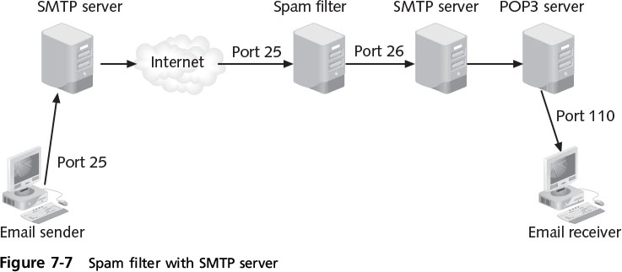
Network Security Hardware
Notes:
Network Security Hardware
Figure 7-7 Spam filter with SMTP server

Slide 24
Network Security Hardware
IF Spam filters installed on the POP3 server instead
All spam passes through SMTP server and is delivered to user’s mailbox
Results in increased costs
Storage, transmission, backup, deletion
Third-party entity contracted to filter spam
All email directed to third-party’s remote spam filter
E-mail cleansed before being redirected to organization
Notes:
End of class 10/10/16 11 AM
Network Security Hardware
Spam filters installed on the POP3 server
All spam must first pass through SMTP server and be delivered to user’s mailbox
Can result in increased costs
Storage, transmission, backup, deletion
Third-party entity contracted to filter spam
All email directed to third-party’s remote spam filter
E-mail cleansed before being redirected to organization

Slide 25
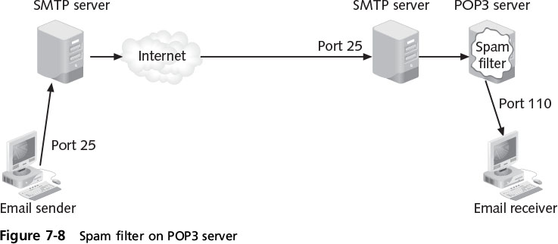
Network Security Hardware
Notes:
10AM End of class 10/10/16 Network Security Hardware
Figure 7-8 Spam filter on POP3 server

Slide 26
Network Security Hardware
Virtual private network (VPN)
enables authorized users to use unsecured public network as if it were a secure private network
All data sent between remote device and network is encrypted
Types of VPNs
Remote-access VPN - a user-to-LAN connection
Site-to-site - multiple sites can connect to other sites over the Internet
Notes:
End of class 10 AM 2/22/17
Network Security Hardware
Virtual private network (VPN) - enables authorized users to use an unsecured public network as if it were a secure private network
All data transmitted between remote device and network is encrypted
Types of VPNs
Remote-access VPN - a user-to-LAN connection
Site-to-site - multiple sites can connect to other sites over the Internet

Slide 27
Network Security Hardware
Endpoints
The ends of the tunnel between VPN devices
May be
Software on local computer
A VPN concentrator (hardware device)
Integrated into another networking device
VPN concentrator - dedicated device that aggregates hundreds or thousands of VPN connections
Notes:
End of class 2/22/17
Network Security Hardware
Endpoints
The end of the tunnel between VPN devices
Used in communicating VPN transmissions
May be software on local computer, a VPN concentrator (hardware device), or integrated into another networking device
VPN concentrator - a dedicated hardware device that aggregates hundreds or thousands of VPN connections

Slide 28
Network Security Hardware
Tunneling protocols enclose a packet within another packet -- used for VPN transmissions
IPsec has two “subprotocols” that are used in VPN:
Encapsulated Security Payload (ESP)
Authentication Header (AH)
A remote-access VPN generally uses either IPsec or the Layer 2 Tunneling Protocol (L2TP)
Notes:
Network Security Hardware
Tunneling protocols enclose a packet within another packet and are used for VPN transmissions
IPsec has two “subprotocols” that are used in VPN:
Encapsulated Security Payload (ESP)
Authentication Header (AH)
A remote-access VPN generally uses either IPsec or the Layer 2 Tunneling Protocol (L2TP)

Slide 29
Network Security Hardware
Internet Content Filters
Monitor Internet traffic
Block access to preselected Web sites and files
Unapproved sites can be restricted based
URL (URL filtering)
matching keywords (content inspection)
Notes:
Network Security Hardware
Internet Content Filters
Monitor Internet traffic
Block access to preselected Web sites and files
Unapproved sites can be restricted based on the URL (URL filtering) or matching keywords (content inspection)

Slide 30
Network Security Hardware
Web Security Gateways
Can block malicious content in real time
Block content through application level filtering
Examples of blocked Web traffic
Adware, spyware
Cookies
Instant messengers
P2P (peer to peer) file sharing
Script exploits
TCP/IP malicious code attacks
Notes:
Network Security Hardware
Web Security Gateways
Can block malicious content in real time
Block content through application level filtering
Examples of blocked Web traffic
Adware, spyware
Cookies
Instant messengers
P2P (peer to peer) file sharing
Script exploits
TCP/IP malicious code attacks

Slide 31
Network Security Hardware
Intrusion detection system (IDS)
Detects attack as it occurs
Use various methods for monitoring for attacks
Can be installed on either local hosts or networks
An extension of IDS is an intrusion prevention system (IPS)
Notes:
Network Security Hardware
Intrusion detection system (IDS)
Can detect attack as it occurs
IDS systems use different methodologies for monitoring for attacks
Can be installed on either local hosts or networks
An extension of IDS is an intrusion prevention system (IPS)

Slide 32
Network Security Hardware
Monitoring methodologies
Anomaly-based monitoring
Compares current behavior with baseline
Signature-based monitoring
Looks for well-known attack patterns
Behavior-based monitoring
Detects abnormal actions by processes or programs
Alerts user who decides whether to block activity
Heuristic monitoring
Uses experience-based techniques
Notes:
Network Security Hardware
Monitoring methodologies
Anomaly-based monitoring
Compares current detected behavior with baseline
Signature-based monitoring
Looks for well-known attack signature patterns
Behavior-based monitoring
Detects abnormal actions by processes or programs
Alerts user who decides whether to allow or block activity
Heuristic monitoring
Uses experience-based techniques

Slide 33
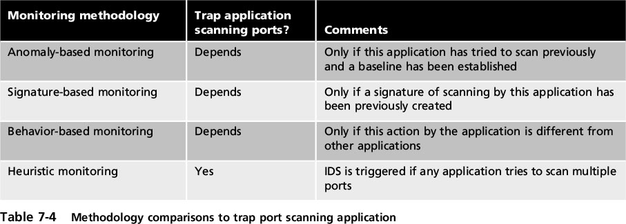
Network Security Hardware
Notes:
Network Security Hardware
Table 7-4 Methodology comparisons to trap port scanning application

Slide 34
Network Security Hardware
Two basic types of IDS exist
Host intrusion detection system (HIDS)
A software-based app that detects attack as it occurs
Installed on each system needing protection
Monitors (for anomalous activitiy):
System calls and file system access
Can recognize unauthorized Registry modification
Host input and output communications
Notes:
Network Security Hardware
Types of IDS - two basic types if IDS exist
Host intrusion detection system (HIDS)
A software-based application that can detect an attack as it occurs
Installed on each system needing protection
Monitors:
System calls and file system access
Can recognize unauthorized Registry modification
Host input and output communications
Detects anomalous activity

Slide 35
Network Security Hardware
Disadvantages of HIDS
Can’t monitor network traffic that does not reach local system
All log data is stored locally
Resource-intensive and can slow local systems
Notes:
Network Security Hardware
Disadvantages of HIDS
Cannot monitor network traffic that does not reach local system
All log data is stored locally
Resource-intensive and can slow system

Slide 36
Network Security Hardware
Network intrusion detection system (NIDS)
Watches for attacks on the network
Sensors installed on firewalls and routers:
Gather info and report to central device
Passive NIDS will sound an alarm
May use one or more of the evaluation techniques listed in Table 7-5 (see the following slide)
Notes:
Network Security Hardware
Network intrusion detection system (NIDS)
Watches for attacks on the network
NIDS sensors installed on firewalls and routers:
Gather information and report back to central device
Passive NIDS will sound an alarm
An NIDS may use one or more of the evaluation techniques listed in Table 7-5 (see the following slide)

Slide 37
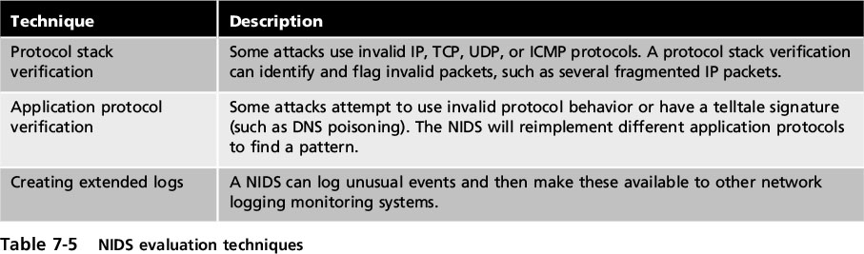
Network Security Hardware
Notes:
Network Security Hardware
Table 7-5 NDIS evaluation techniques

Slide 38
Network Security Hardware
Application-aware IDS
A specialized IDS
Uses “contextual knowledge” in real time
It can know the version of the OS or which application is running
AND what vulnerabilities are present in the systems being protected
Notes:
Network Security Hardware
Application-aware IDS
A specialized IDS
Capable of using “contextual knowledge” in real time
It can know the version of the OS or which application is running
As well as what vulnerabilities are present in the systems being protected

Slide 39
Network Security Hardware
Intrusion Prevention System (IPS)
Similar to NIDS
Monitors traffic & immediately blocks malicious attack
Located “in line” on the firewall
More quickly take action to block an attack
Application-aware IPS
Knows which apps are running as well as the underlying OS
Notes:
Network Security Hardware
Intrusion Prevention System (IPS)
Monitors network traffic to immediately block a malicious attack
Similar to NIDS
NIPS is located “in line” on the firewall
Allows the NIPS to more quickly take action to block an attack
Application-aware IPS
Knows which applications are running as well as the underlying OS

Slide 40
Network Security Hardware
Unified Threat Management (UTM) Security Appliances
Network hardware that provides multiple security functions, such as:
Antispam, antiphishing, antivirus, and antispyware
Bandwidth optimization
Content filtering
Encryption
Firewall
Instant messaging control and web filtering
Intrusion protection
Notes:
End of class 11 AM 10/12/16 1 PM
Network Security Hardware
Unified Threat Management (UTM) Security Appliances
Network hardware that provides multiple security functions, such as:
Antispam, antiphishing, antivirus, and antispyware
Bandwidth optimization
Content filtering
Encryption
Firewall
Instant messaging control and web filtering
Intrusion protection

Slide 41
Security Through Network Technologies
Routers normally drop packets with private address
Network address translation (NAT)
Allows private IP addresses to be used on public Internet
Replaces private IP address with public address
Port address translation (PAT)
Variation of NAT
Outgoing packets given same IP address but different TCP port number
Notes:
End of class 10 AM, 11 AM 2/27/17
Security Through Network Technologies
Internet routers normally drop packet with a private address
Network address translation (NAT)
Allows private IP addresses to be used on the public Internet
Replaces private IP address with public address
Port address translation (PAT)
Variation of NAT
Outgoing packets given same IP address but different TCP port number

Slide 42
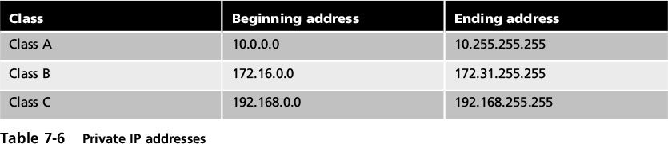
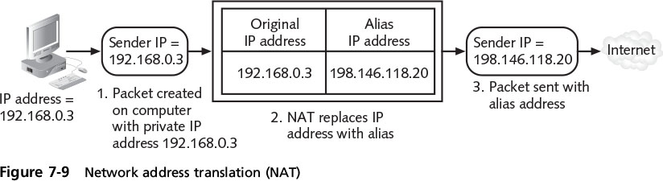
Security Through Network Technologies
Notes:
Security Through Network Technologies
Table 7-6 Private IP addresses

Slide 43
Security Through Network Technologies
Advantage of NAT
Masks IP addresses of internal devices
Attacker can’t determine actual IP address of sender
Network Access Control (NAC)
Examines current state of system or network device:
Before allowing the network connection
Device must meet set of criteria
If not met, NAC allows connection to a “quarantine” network until deficiencies corrected
Notes:
Security Through Network Technologies
Advantage of NAT
Masks IP addresses of internal devices
An attacker who captures the packet on the Internet cannot determine the actual IP address of sender
Network Access Control (NAC)
Examines current state of system or network device:
Before allowing the network connection
Device must meet set of criteria
If not met, NAC allows connection to a “quarantine” network until deficiencies corrected

Slide 44
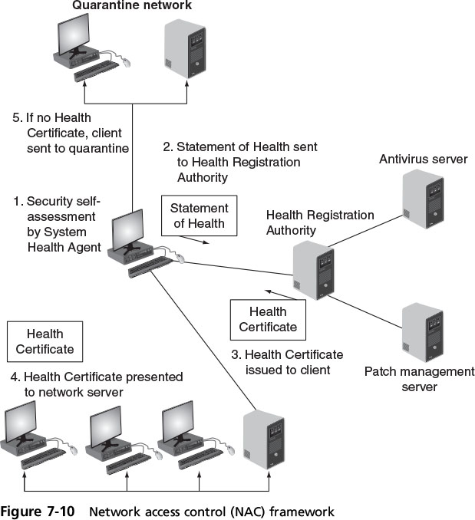
Security Through Network Technologies
Notes:
Security Through Network Technologies
Figure 7-10 Network access control (NAC) framework

Slide 45
Security Through Network Design Elements
Elements of a secure network design
Demilitarized zones
Subnetting
Virtual LANs
Remote access
Notes:
End of class 10 AM 10/12/16
Security Through Network Design Elements
Elements of a secure network design
Demilitarized zones
Subnetting
Virtual LANs
Remote access

Slide 46
Demilitarized Zone (DMZ)
DMZ - a separate network located outside secure network perimeter
Untrusted outside users can access resources within the DMZ but not the secure network
Notes:
Demilitarized Zone (DMZ)
DMZ - a separate network located outside secure network perimeter
Untrusted outside users can access DMZ but not secure network

Slide 47
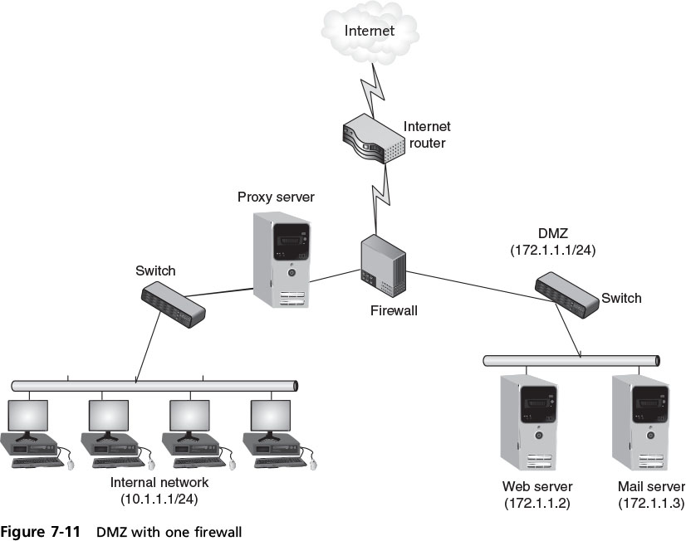
Demilitarized Zone (DMZ)
Notes:
Demilitarized Zone (DMZ)
Figure 7-11 DMZ with one firewall

Slide 48
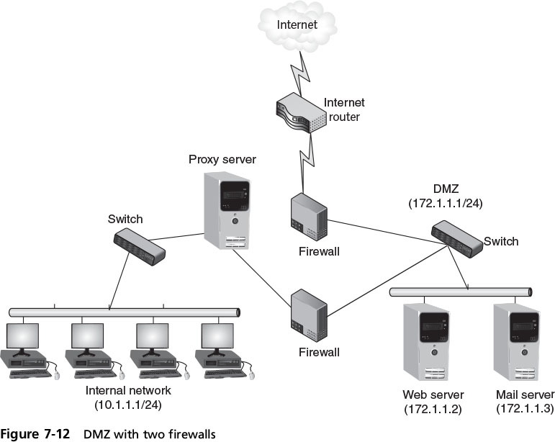
Demilitarized Zone (DMZ)
Notes:
Demilitarized Zone (DMZ)
Figure 7-12 DMZ with two firewalls

Slide 49
Subnetting
IP address is used to identify a network and a host on that network
part of address is a network address
The rest is a host address
Subnetting allows a large network to be divided into smaller subnets
Each network can contain several subnets
Subnets connected through different routers
Subnet can contain multiple hosts
Notes:
Subnetting
An IP address is used to identify a network and a host on that network
One part is a network address and one part is a host address
Subnetting allows a large network to be divided into smaller subnets
Each network can contain several subnets
Each subnet is connected through different routers
Each subnet can contain multiple hosts

Slide 50
Subnetting
Better network security by isolating groups of hosts
Admins can utilize network security tools
easier to regulate who has access in and out of a particular subnetwork
Allows admins to hide the internal network layout
More difficult for attackers to target their attacks
Obscurity!
Notes:
Subnetting
Improves network security by isolating groups of hosts
Administrators can utilize network security tools to make it easier to regulate who has access in and out of a particular subnetwork
Allows network administrators to hide the internal network layout
Makes it more difficult for attackers to target their attacks

Slide 51
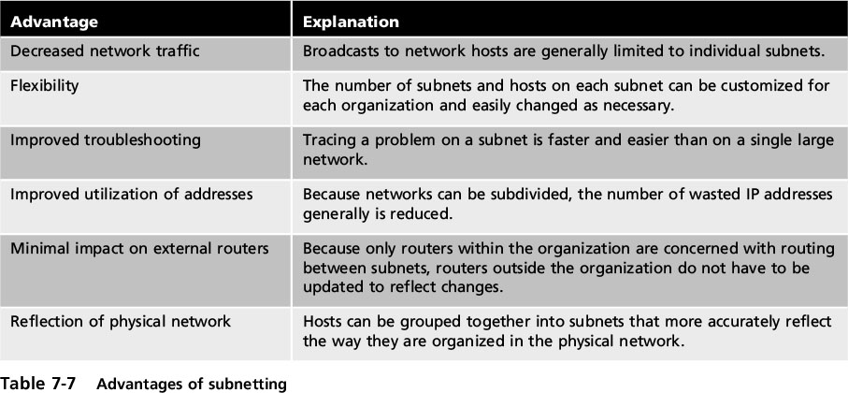
Subnetting
Notes:
Subnetting
Table 7-7 Advantages of subnetting

Slide 52
Virtual LANs (VLAN)
Scattered users are logically grouped together
Even if attached to different switches
Can isolate sensitive data to VLAN members
Communication on a VLAN
Connected to same switch, switch handles packet transfer
Special “tagging” protocol is used for communicating between switches
Notes:
Virtual LANs (VLAN)
Allow scattered users to be logically grouped together
Even if attached to different switches
Can isolate sensitive data to VLAN members
Communication on a VLAN
If connected to same switch, switch handles packet transfer
A special “tagging” protocol is used for communicating between switches

