Slide 1
Common Network Protocols
Protocols
Rules for communication
Essential for proper comms between network devices
Transmission Control Protocol/Internet Protocol (TCP/IP)
Most common protocol suite used for local area networks and the Internet
Several protocols that all function together
Notes:
Common Network Protocols
Protocols
Rules for communication
Essential for proper communication between network devices
Transmission Control Protocol/Internet Protocol (TCP/IP)
Most common protocol suite used for local area networks and the Internet
Comprises several protocols that all function together

Slide 2
Common Network Protocols
IP
Protocol that functions primarily at Open Systems Interconnection (OSI) Network Layer (Layer 3)
Provides network addressing and routing
TCP
Transport Layer (Layer 4) protocol
Establishes connections and ensures reliable data transport between devices
TCP/IP uses a four layer architecture
Network Interface, Internet, Transport, Application
Notes:
Common Network Protocols
IP
Protocol that functions primarily at Open Systems Interconnection (OSI) Network Layer (Layer 3)
Provides network addressing and routing
TCP
Transport Layer (Layer 4) protocol
Establishes connections and ensures reliable data transport between devices
TCP/IP uses a four layer architecture
Network Interface, Internet, Transport, Application

Slide 3
Common Network Protocols
Several basic TCP/IP Protocols:
Internet Control Message Protocol (ICMP)
Simple Network Management Protocol (SNMP)
Domain Name System (DNS)
File transfer and storage protocols
NetBIOS
Telnet
A new and more secure version of IP is designed to replace the current version
Notes:
Common Network Protocols
Several basic TCP/IP Protocols:
Internet Control Message Protocol (ICMP)
Simple Network Management Protocol (SNMP)
Domain Name System (DNS)
File transfer and storage protocols
NetBIOS
Telnet
A new and more secure version of IP is designed to replace the current version

Slide 4
Internet Control Message Protocol (ICMP)
ICMP
Used by devices to communicate updates or error information to other devices
Messages are divided into two classes:
Informational and query messages
Error messages
Notes:
Internet Control Message Protocol (ICMP)
ICMP
Used by devices to communicate updates or error information to other devices
ICMP messages are divided into two classes:
Informational and query messages
Error messages

Slide 5
Internet Control Message Protocol (ICMP)
ICMP message fields
Type
Identifies general message category
Code
Gives additional information about the Type field
Checksum
Verifies message integrity
Message Body
Contains information about the specific ICMP message
Notes:
Internet Control Message Protocol (ICMP)
ICMP message fields
Type
Identifies general message category
Code
Gives additional information about the Type field
Checksum
Verifies message integrity
Message Body
Contains information about the specific ICMP message

Slide 6
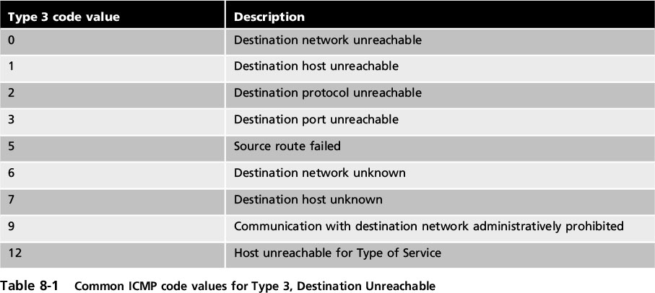
Internet Control Message Protocol (ICMP)
Notes:
Internet Control Message Protocol (ICMP)
Table 8-1 Common ICMP code values for Type 3, Destination Unreachable

Slide 7
Internet Control Message Protocol (ICMP)
Attacks that that advantage of ICMP
Network discovery
Smurf attack
ICMP redirect attack
Ping of death
Notes:
Internet Control Message Protocol (ICMP)
Attacks that that advantage of ICMP
Network discovery
Smurf attack
ICMP redirect attack
Ping of death

Slide 8
Simple Network Management Protocol (SNMP)
Use: manage network equipment.
Supported by most equipment manufacturers
Allows admins to remotely monitor, manage, and configure devices
Functions by exchanging management information between network devices
Each SNMP-managed device has an agent or a service
Listens for and executes commands
Notes:
End of class 3/1/17
Simple Network Management Protocol (SNMP)
Used to manage network equipment and is supported by most network equipment manufacturers
Allows administrators to remotely monitor, manage, and configure network devices
Functions by exchanging management information between network devices
Each SNMP-managed device has an agent or a service
Listens for and executes commands

Slide 9
Simple Network Management Protocol (SNMP)
Agents are password protected
Password is known as a community string
Security vulnerabilities were present in SMNP versions 1 and 2
Community strings were transmitted as clear text!
Version 3 uses usernames and passwords along with encryption to address vulnerabilities
Notes:
Simple Network Management Protocol (SNMP)
Agents are password protected
Password is known as a community string
Security vulnerabilities were present in SMNP versions 1 and 2
Version 3 uses usernames and passwords along with encryption to address vulnerabilities

Slide 10
Domain Name System (DNS)
TCP/IP protocol that maps IP addresses to their symbolic name
The DNS database is hierarchical
Records contain the name of a site and a corresponding IP number
Distributed to many different servers on the Internet
Prevent bottlenecking and ensure efficiency
Notes:
Domain Name System (DNS)
A TCP/IP protocol that maps IP addresses to their symbolic name
The DNS database is organized as a hierarchy
Database consists of the name of a site and a corresponding IP number
Database is distributed to many different servers on the Internet
To prevent bottlenecking and to ensure efficiency

Slide 11
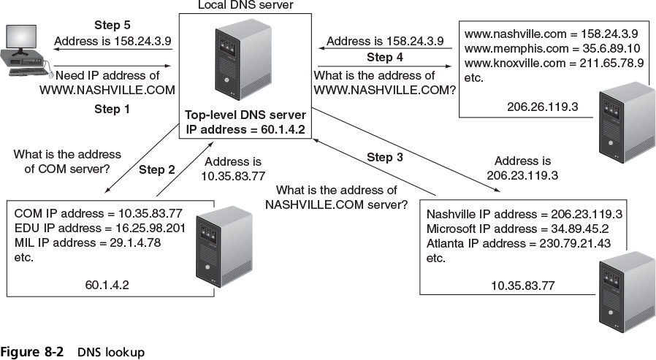
Domain Name System (DNS)
Notes:
Domain Name System (DNS)
Figure 8-2 DNS look up

Slide 12
Domain Name System (DNS)
DNS is often the focus of attacks
DNS poisoning substitutes fraudulent IP address
Can be in local host table or external DNS server
Newest DNS software prevents DNS poisoning
Attacker asks the valid DNS for a zone transfer
A zone transfer allows attacker access to network, hardware, and operating system information
Notes:
Domain Name System (DNS)
DNS is often the focus of attacks
DNS poisoning substitutes fraudulent IP address
Can be done in local host table or external DNS server
Latest edition of DNS software prevents DNS poisoning
Attacker asks the valid DNS for a zone transfer
A zone transfer allows attacker access to network, hardware, and operating system information

Slide 13
File Transfer Protocols
TCP/IP protocols are used for transferring files
File transfer protocol (FTP) - used to connect to an FTP “server”
Methods for using FTP on local host computer
From a command prompt
Using a web browser
Using an FTP client
FTP uses two ports
Port 21 is the FTP control part
Port 20 is the data port
Notes:
File Transfer Protocols
TCP/IP protocols are used for transferring files
File transfer protocol (FTP) - used to connect to an FTP server
Trivial file transfer protocol (TFTP) - a “light” version of FTP that uses a small amount of memory
Methods for using FTP on local host computer
From a command prompt
Using a web browser
Using an FTP client

Slide 14
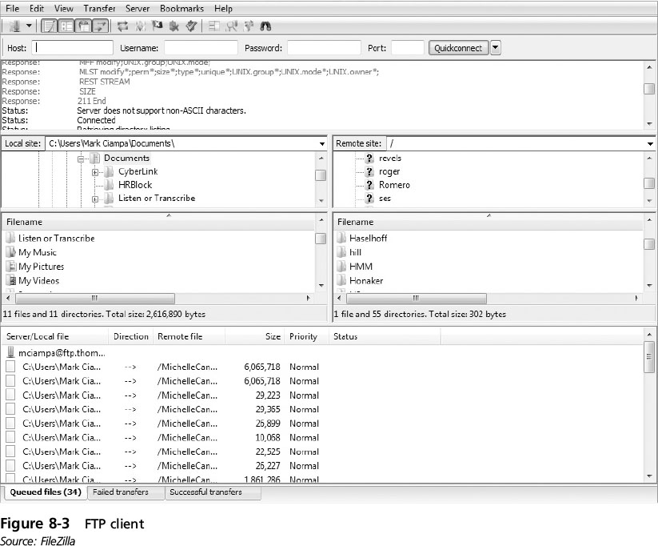
File Transfer Protocols
Notes:
10/17/16 end of class 10 AM
File Transfer Protocols
Figure 8-3 FTP client

Slide 15
File Transfer Protocols
FTP vulnerabilities
Does not use encryption
Vulnerable to man-in-the-middle attacks
Secure transmission options over FTP
Secure sockets layer (FTPS) encrypts commands
Uses SSL or TLS to encrypt commands sent over the control port (port 21); data port may not be encrypted
Secure FTP (SFTP)
Uses only a single TCP port instead of two ports
All data and commands are encrypted
Notes:
File Transfer Protocols
FTP vulnerabilities
Does not use encryption
Files transferred using FTP are vulnerable to man-in-the-middle attacks
Secure transmission options over FTP
Secure sockets layer (FTPS) encrypts commands
Uses SSL or TLS to encrypt commands sent over the control port (port 21); data port may not be encrypted
Secure FTP (SFTP)
Uses only a single TCP port instead of two ports
All data and commands are encrypted

Slide 16
File Transfer Protocols (cont’d.)
Secure Copy Protocol (SCP)
An enhanced version of Remote Copy Protocol (RCP)
Encrypts files and commands
File transfer cannot be interrupted and then resumed in the same session
Session must be completely terminated and restarted
Found mainly on Linux and UNIX platforms
Notes:
File Transfer Protocols (cont’d.)
Secure Copy Protocol (SCP)
An enhanced version of Remote Copy Protocol (RCP)
Encrypts files and commands
File transfer cannot be interrupted and then resumed in the same session
Session must be completely terminated and restarted
Found mainly on Linux and UNIX platforms

Slide 17
Storage Protocols
As storage capacities have grown, most organizations have turned to using a storage area network (SAN)
A dedicated network storage facility that provides access to data storage over a high-speed network
iSCSI (Internet Small Computer System Interface) - an IP-based storage networking standard for linking data storage facilities
Can transmit data over LANs, WANs, and the Internet
Notes:
Storage Protocols
As storage capacities have grown, most organizations have turned to using a storage area network (SAN)
A dedicated network storage facility that provides access to data storage over a high-speed network
iSCSI (Internet Small Computer System Interface) - an IP-based storage networking standard for linking data storage facilities
Can transmit data over LANs, WANs, and the Internet

Slide 18
Storage Protocols
Fibre Channel (FC) - a high-speed storage network protocol that can transmit up to 16 Gbps
Fibre Channel over Ethernet (FCoE)
A variation of FC that encapsulates Fibre Channel frames over Ethernet networks
Allows FC to use fast Ethernet networks while preserving the FC protocol
FC zones - a built-in security mechanism
There are two types:
FC hard zone - based on port number
FC soft zone - based on device ID (cross-port)
Notes:
End of class 10/19/16 11 AM 1PM
Storage Protocols
Fibre Channel (FC) - a high-speed storage network protocol that can transmit up to 16 Gbps
Fibre Channel over Ethernet (FCoE)
A variation of FC that encapsulates Fibre Channel frames over Ethernet networks
Allows FC to use fast Ethernet networks while preserving the FC protocol
FC zones - a built-in security mechanism
There are two types:
FC hard zone
FC soft zone

Slide 19
NetBIOS
NetBIOS (Network Basic Input/Output System)
A transport protocol used by Microsoft Windows systems
Allows applications on separate computers to communicate over a LAN
An attacker who determines that NetBIOS is running can use an application to gather information regarding the network in order to design an attack
It is recommended to disable NetBIOS or use only if necessary on specific devices that require it
Notes:
NetBIOS
NetBIOS (Network Basic Input/Output System)
A transport protocol used by Microsoft Windows systems
Allows applications on separate computers to communicate over a LAN
An attacker who determines that NetBIOS is running can use an application to gather information regarding the network in order to design an attack
It is recommended to disable NetBIOS or used only if necessary on specific devices that require it

Slide 20
Telnet
Telnet
An older TCP/IP protocol for text-based communication
Also a terminal emulation application that runs on a local computer
Connects to a server on a network
Telnet does not encrypt data and many security weaknesses have been uncovered within the protocol
It is recommended that Secure Shell (SSH) be used instead of Telnet
Notes:
Telnet
Telnet
An older TCP/IP protocol for text-based communication
Also a terminal emulation application that runs on a local computer
Connects to a server on a network
Telnet does not encrypt data and many security weaknesses have been uncovered within the protocol
It is recommended that Secure Shell (SSH) be used instead of Telnet

Slide 21
IPv6
Current version of IP protocol is version 4 (IPv4)
Developed in 1981
Number of available IP address is limited to 4.3 billion
This is no longer sufficient for the number of devices that are connected to the Internet
Has security weaknesses
Internet Protocol version 6 (IPv6)
Next generation of IP protocol
Addresses weaknesses of IPv4
Notes:
IPv6
Current version of IP protocol is version 4 (IPv4)
Developed in 1981
Number of available IP address is limited to 4.3 billion
This is no longer sufficient for the number of devices that are connected to the Internet
Has security weaknesses
Internet Protocol version 6 (IPv6)
Next generation of IP protocol
Addresses weaknesses of IPv4

Slide 22
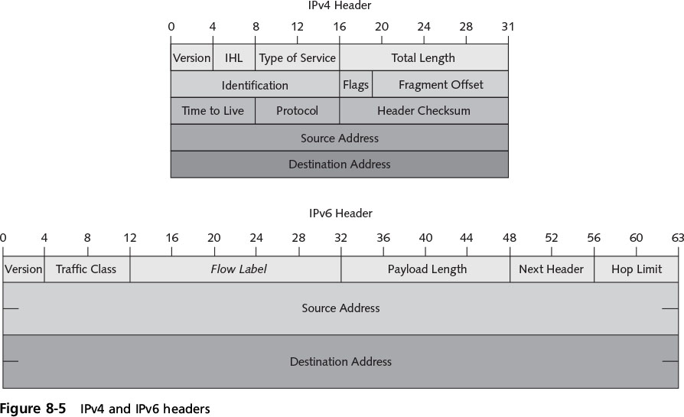
IPv6
Notes:
IPv6
Figure 8-5 IPv4 and IPv6 headers

Slide 23
IPv6
IPv6 provides enhanced security features
Cryptographic protocols provide secure data communication
New authentication headers prevent IP packets from being altered
Notes:
End of class 10 AM 3/3/17
IPv6
IPv6 provides enhanced security features
Cryptographic protocols provide secure data communication
New authentication headers prevent IP packets from being altered

Slide 24
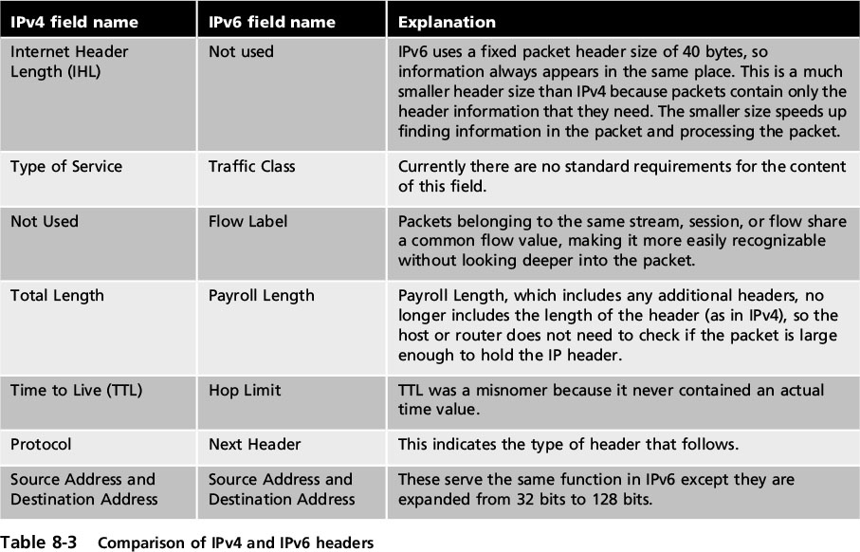
IPv6
Notes:
IPv6
Table 8-3 Comparison of IPv4 and IPv6 headers

Slide 25
Network Administration Principles
Administering a secure network can be challenging
Rule-based management approach
Relies on following procedures and rules
Procedural rules are the authoritative and prescribed direction for conduct
Procedural rules dictate technical rules
Technical rules address:
Device security
Monitoring and analyzing logs
Network design management
Port security
Notes:
Network Administration Principles
Administering a secure network can be challenging
Rule-based management approach
Relies on following procedures and rules
Procedural rules are the authoritative and prescribed direction for conduct
Procedural rules dictate technical rules
Technical rules address:
Device security
Monitoring and analyzing logs
Network design management
Port security

Slide 26
Device Security
Device security involves:
Establishing a secure router configuration
Implementing flood guards
Secure router configuration
Router operates at Network Layer (Layer 3)
Forwards packets across computer networks
Routers can perform a security function
Can be configured to filter out specific types of network traffic
Notes:
Device Security
Device security involves:
Establishing a secure router configuration
Implementing flood guards
Secure router configuration
Router operates at Network Layer (Layer 3)
Forwards packets across computer networks
Routers can perform a security function
Can be configured to filter out specific types of network traffic

Slide 27
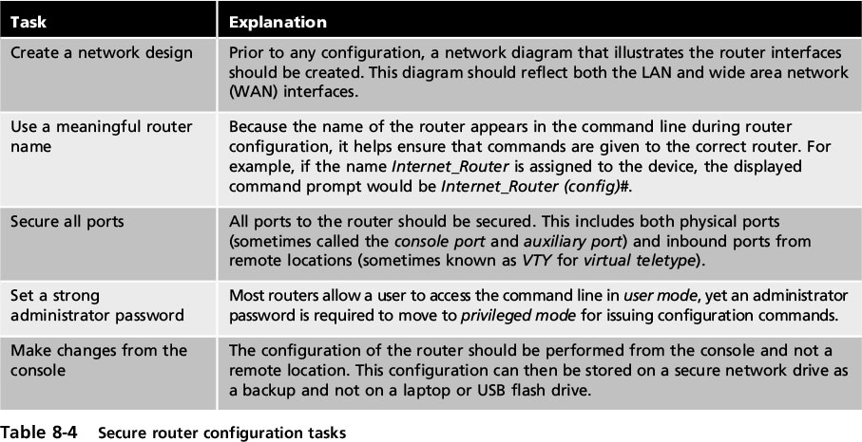
Device Security
Notes:
End of class 10/19/16 10 AM
Device Security
Table 8-4 Secure router configuration tasks

Slide 28
Device Security
Flood guard
Protects against denial of service (DoS) attacks
SYN flood attack
A type of DoS attack that takes advantage of the procedures for initiating a session
A flood guard controls a device’s tolerance for unanswered service requests
Administrator can set a maximum number of “developing” connections
Commonly found on firewalls, IDSs, and IPSs
Notes:
Device Security
Flood guard
Protects against denial of service (DoS) attacks
SYN flood attack
A type of DoS attack that takes advantage of the procedures for initiating a session
A flood guard controls a device’s tolerance for unanswered service requests
Administrator can set a maximum number of “developing” connections
Commonly found on firewalls, IDSs, and IPSs

Slide 29
Monitoring and Analyzing Logs
Security logs
Can reveal types of attacks that are being directed at the network and if attacks were successful
Access logs
Provide details regarding requests for specific files
Audit logs
Used to record which user performed an action
Event logs
Document any unsuccessful events and the most significant successful events
Notes:
Monitoring and Analyzing Logs
Security logs
Can reveal types of attacks that are being directed at the network and if attacks were successful
Access logs
Provide details regarding requests for specific files
Audit logs
Used to record which user performed an action
Event logs
Document any unsuccessful events and the most significant successful events

Slide 30
Monitoring and Analyzing Logs
A routine review of logs helps to:
Identify security incidents
Policy violations
Fraudulent activity
Operational problems
Logs can be useful for:
Performing auditing analysis
Supporting the organization’s internal investigations
Identifying operational trends and long-term problems
Notes:
Monitoring and Analyzing Logs
A routine review of logs helps to:
Identify security incidents
Policy violations
Fraudulent activity
Operational problems
Logs can be useful for:
Performing auditing analysis
Supporting the organization’s internal investigations
Identifying operational trends and long-term problems

Slide 31
Monitoring and Analyzing Logs
Logs can provide documentation that the organization is complying with laws and regulatory requirements
Firewall log items to be examined
IP addresses rejected and dropped
Probes to ports that have no application services on them
Source-routed packets
Suspicious outbound connections
Unsuccessful logins
Notes:
Monitoring and Analyzing Logs
Logs can provide documentation that the organization is complying with laws and regulatory requirements
Firewall log items to be examined
IP addresses rejected and dropped
Probes to ports that have no application services on them
Source-routed packets
Suspicious outbound connections
Unsuccessful logins

Slide 32
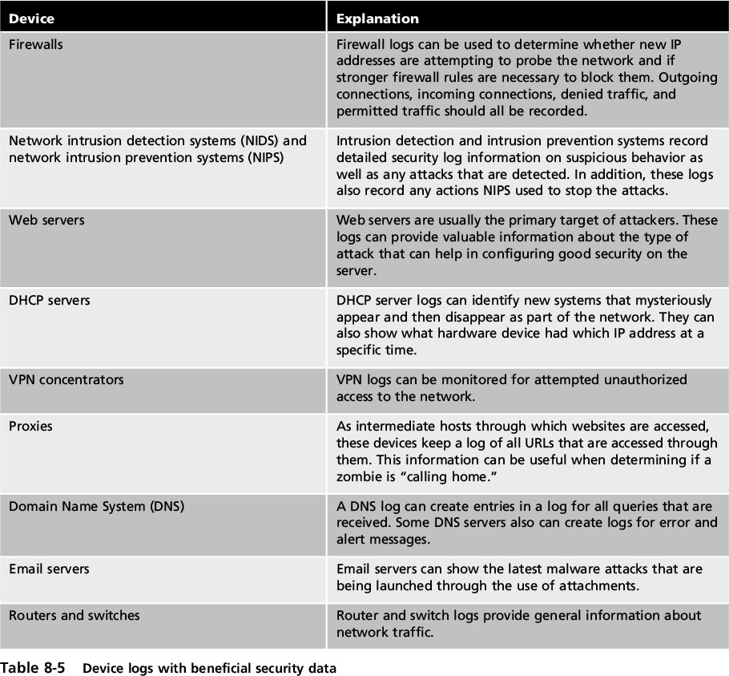
Monitoring and Analyzing Logs
Notes:
Monitoring and Analyzing Logs
Table 8-5 Device logs with beneficial security data

Slide 33
Monitoring and Analyzing Logs
Problems with log management:
Multiple devices generating logs
Very large volumes of data
Different log formats
A solution to log management is to use a centralized device log analyzer
Notes:
Monitoring and Analyzing Logs
Problems with log management:
Multiple devices generating logs
Very large volumes of data
Different log formats
A solution to log management is to use a centralized device log analyzer

Slide 34
Network Design Management
Several network design management principles should be followed to ensure a secure network
Network separation
Provides separation between different parts of the network
Example: order entry network segment cannot access the network that controls heating and cooling
Option to accomplish network separation
Physically separate users by connecting them to different switches and routers
Notes:
10/21 End of class 11 AM Network Design Management
Several network design management principles should be followed to ensure a secure network
Network separation
Provides separation between different parts of the network
Example: order entry network segment cannot access the network that controls heating and cooling
Option to accomplish network separation
Physically separate users by connecting them to different switches and routers

Slide 35
Network Design Management
Loop protection
Refer to Figure 8-7 for a description of a broadcast storm
Host Z wants to send frames to Host X
Switch A floods network with the packet
Packet travels down the network segments to the Switches B and C
Switches B and C add Host Z to their lookup tables
Both switches flood Segment 2 looking for Host X
They receive each other’s packets and flood them back out again
Notes:
Network Design Management
Loop protection
Refer to Figure 8-7 for a description of a broadcast storm
Host Z wants to send frames to Host X
Switch A floods network with the packet
Packet travels down the network segments to the Switches B and C
Switches B and C add Host Z to their lookup tables
Both switches flood Segment 2 looking for Host X
They receive each other’s packets and flood them back out again

Slide 36
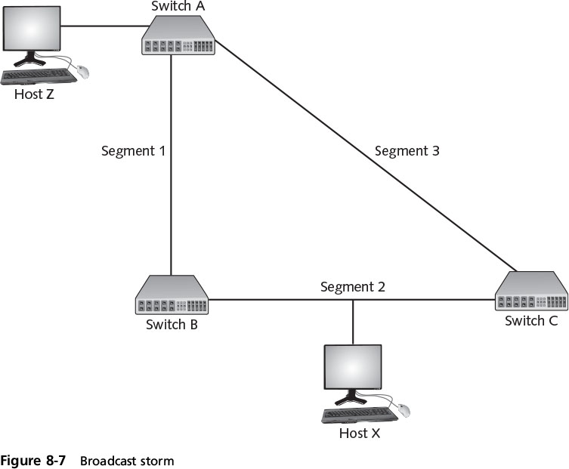
Network Design Management
Notes:
Network Design Management
Figure 8-7 Broadcast storm

Slide 37
Network Design Management
Loop protection can prevent broadcast storms
Uses IEEE 802.1d spanning tree algorithm (STA)
Determines which switch has multiple ways to communicate with host
Determines best path and blocks other paths
Virtual LAN (VLAN) management
Network may be segmented into logical groups of physical devices through VLAN
Scattered users may be logically grouped together:
Regardless of which switch they are attached to
Notes:
End of class 10/21/16 10 AM
Network Design Management
Loop protection can prevent broadcast storms
Uses IEEE 802.1d spanning tree algorithm (STA)
Determines which switch has multiple ways to communicate with host
Determines best path and blocks other paths
Virtual LAN (VLAN) management
Network may be segmented into logical groups of physical devices through VLAN
Scattered users may be logically grouped together:
Regardless of which switch they are attached to

Slide 38
Network Design Management
General principles for managing VLANs
Configure empty switch ports to connect to an unused VLAN
Change any default VLAN names
Configure the ports on the switches that pass tagged VLAN packets to explicitly forward specific tags
Configure VLANs so that public devices are not on a private VLAN
Notes:
Network Design Management
General principles for managing VLANs
Configure empty switch ports to connect to an unused VLAN
Change any default VLAN names
Configure the ports on the switches that pass tagged VLAN packets to explicitly forward specific tags
Configure VLANs so that public devices are not on a private VLAN

Slide 39
Port Security
Disabling unused interfaces
Turn off ports on a network device that are not required
A switch or router without port security allows attackers to connect to unused ports and attack the network
All interfaces should be secured before switch is deployed
The network administrator should issue shutdown command to each unused port
Notes:
Port Security
Disabling unused interfaces
Turn off ports not required on a network device that are not required
A switch or router without port security allows attackers to connect to unused ports and attack the network
All interfaces should be secured before switch is deployed
The network administrator should issue shutdown command to each unused port

Slide 40
Port Security
MAC limiting and filtering
Filters and limits the number of media access control (MAC) addresses allowed on a single port
Port can be set to limit of 1
Specific MAC address can be assigned to a port
Enables only single authorized host to connect
Notes:
Port Security
MAC limiting and filtering
Filters and limits the number of media access control (MAC) addresses allowed on a single port
Port can be set to limit of 1
Specific MAC address can be assigned to a port
Enables only single authorized host to connect

Slide 41
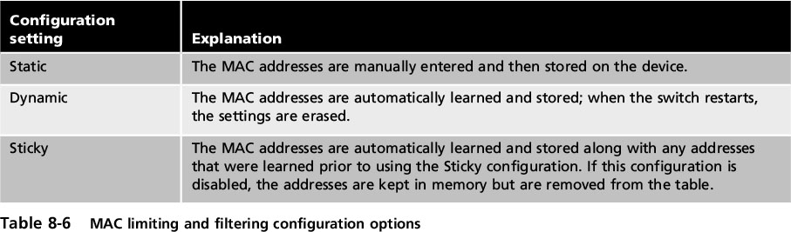
Port Security
Notes:
Port Security
Table 8-6 MAC limiting and filtering configuration options

Slide 42
Port Security
IEEE 802.1x
Standard that provides the highest degree of port security
Implements port-based authentication
Blocks all traffic on a port-by-port basis:
Until client is authenticated
Notes:
Port Security
IEEE 802.1x
Standard that provides the highest degree of port security
Implements port-based authentication
Blocks all traffic on a port-by-port basis:
Until client is authenticated

Slide 43
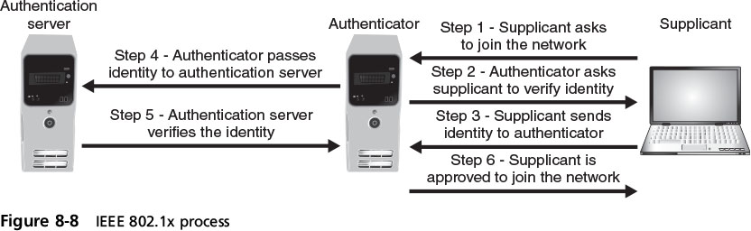
Port Security
Notes:
Port Security
Figure 8-8 IEEE 802.1x process

Slide 44
Securing Network Applications and Platforms
Several network applications and platforms require special security considerations:
IP telephony
Virtualization
Cloud computing
Notes:
Securing Network Applications and Platforms
Several network applications and platforms require special security considerations:
IP telephony
Virtualization
Cloud computing

Slide 45
IP Telephony
A shift to an all digital technology infrastructure is underway
Converges voice and data traffic over a single IP network
IP telephony adds digital voice clients and new voice applications to a data based network
An IP telephony application can be easily developed that personalizes the treatment of incoming calls
Calls can be selectively forwarded or blocked
Notes:
IP Telephony
A shift to an all digital technology infrastructure is underway
Converges voice and data traffic over a single IP network
IP telephony adds digital voice clients and new voice applications to a data based network
An IP telephony application can be easily developed that personalizes the treatment of incoming calls
Calls can be selectively forwarded or blocked

Slide 46
IP Telephony
IP telephony advantages
Cost savings
Simplified management
Application development
Reduced infrastructure requirements
Reduced regulatory requirements
Increased user productivity
Notes:
IP Telephony
IP telephony advantages
Cost savings
Simplified management
Application development
Reduced infrastructure requirements
Reduced regulatory requirements
Increased user productivity

Slide 47
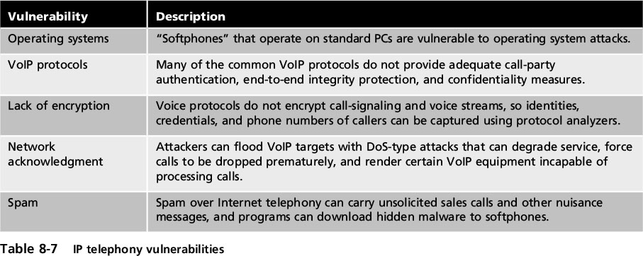
IP Telephony
Notes:
IP Telephony
Table 8-7 IP technology vulnerabilities

Slide 48
Virtualization
Virtualization
A means of managing and presenting computer resources without regard to physical layout or location
Host virtualization
An entire operating system environment is simulated
Virtual machine - a simulated software-based emulation of a computer
The host system runs a hypervisor that manages the virtual operating systems and supports one or more guest systems
Notes:
Virtualization
Virtualization
A means of managing and presenting computer resources without regard to physical layout or location
Host virtualization
An entire operating system environment is simulated
Virtual machine - a simulated software-based emulation of a computer
The host system runs a hypervisor that manages the virtual operating systems and supports one or more guest systems

Slide 49
Virtualization
Virtualization advantages
New virtual server machines can be made available (host availability) and resources can easily be expanded or contracted as needed (host elasticity)
Can reduce costs
Fewer physical computers must be purchased and maintained
Can provided uninterrupted server access to users
Supports live migration which allows a virtual machine to be moved to a different physical computer with no impact to users
Notes:
Virtualization
Virtualization advantages
New virtual server machines can be made available (host availability) and resources can easily be expanded or contracted as needed (host elasticity)
Can reduce costs
Fewer physical computers must be purchased and maintained
Can provided uninterrupted server access to users
Supports live migration which allows a virtual machine to be moved to a different physical computer with no impact to users

Slide 50
Virtualization
Virtualization advantages (cont’d.)
Test latest patches by downloading on a virtual machine before installing on production computers
A snapshot of a particular state of a virtual machine can be saved for later use
Testing the existing security configuration (security control testing) can be performed using a simulated network environment
A suspicious program can be loaded into an isolated virtual machine and executed (sandboxing)
If malware, only the virtual machine will be impacted
Notes:
End of class 3/6/17
Virtualization
Virtualization advantages (cont’d.)
Test latest patches by downloading on a virtual machine before installing on production computers
A snapshot of a particular state of a virtual machine can be saved for later use
Testing the existing security configuration (security control testing) can be performed using a simulated network environment
A suspicious program can be loaded into an isolated virtual machine and executed (sandboxing)
If malware, only the virtual machine will be impacted

Slide 51
Virtualization
Security for virtualized environments:
A guest OS that has remained dormant may not contain the latest patches and security updates
Not all hypervisors have the necessary security controls to keep out attackers
Existing security tools were designed for single physical servers and do not always adapt well to multiple virtual machines
Virtual machines must be protected from outside network and other virtual machines on the same computer
Notes:
Virtualization
Security for virtualized environments:
A guest OS that has remained dormant may not contain the latest patches and security updates
Not all hypervisors have the necessary security controls to keep out attackers
Existing security tools were designed for single physical servers and do not always adapt well to multiple virtual machines
Virtual machines must be protected from outside network and other virtual machines on the same computer

Slide 52
Cloud Computing
Cloud computing
A model for enabling convenient, on-demand network access to a shared pool of configurable computing resources
It is a pay-per-use computing model
Customers pay for only the resources they need
Types of clouds
Public cloud
Community cloud
Private cloud
Hybrid cloud
Notes:
Cloud Computing
Cloud computing
A model for enabling convenient, on-demand network access to a shared pool of configurable computing resources
It is a pay-per-use computing model
Customers pay for only the resources they need
Types of clouds
Public cloud
Community cloud
Private cloud
Hybrid cloud

Slide 53
Cloud Computing
Three service models of cloud computing
Software as a Service (SaaS)
Vendor provides access to software applications running on a cloud infrastructure
Platform as a Service (PaaS)
Consumers install and run their own specialized apps on cloud computing network
Infrastructure as a Service (IaaS)
Vendor allows customers to deploy and run their own software, including OSs and applications
Notes:
Cloud Computing
Three service models of cloud computing
Software as a Service (SaaS)
Vendor provides access to the vendor’s software applications running on a cloud infrastructure
Platform as a Service (PaaS)
Consumers install and run their own specialized applications on the cloud computing network
Infrastructure as a Service (IaaS)
Vendor allows customers to deploy and run their own software, including OSs and applications

Slide 54
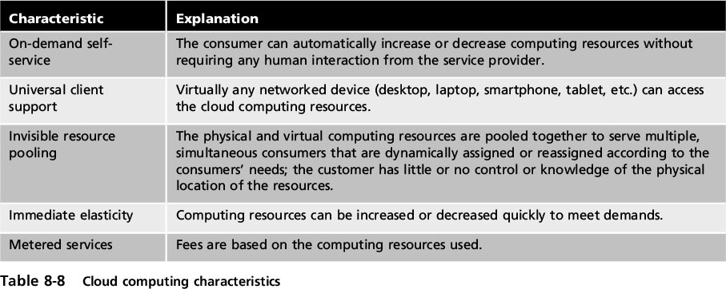
Cloud Computing
Notes:
Cloud Computing
Table 8-8 Cloud computing characteristics

Slide 55
Cloud Computing
Cloud computing security challenges
Cloud provider must guarantee means to approve authorized users and deny imposters
Transmissions from the cloud must be protected
Customers’ data must be isolated from other customers
The highest level of application availability and security must be maintained
Notes:
Cloud Computing
Cloud computing security challenges
Cloud provider must guarantee means to approve authorized users and deny imposters
Transmissions from the cloud must be protected
Customers’ data must be isolated from other customers
The highest level of application availability and security must be maintained

