Slide 1
Types of Mobile Devices
Characteristics of mobile devices:
Small form factor
Wireless data NIC for accessing the Internet
Mobile OS
Apps acquired through different means,
downloaded from the Web
provided by the wireless data carrier
Data synchronization possible with separate computer or remote servers
Local non-removable data storage
Notes:
Types of Mobile Devices
Characteristics of mobile devices:
Small form factor
Wireless data NIC for accessing the Internet
Mobile OS
Apps that can be acquired through different means, such as downloaded from the Web or provided by the wireless data carrier
Data synchronization capabilities with a separate computer or remote servers
Local nonremovable data storage

Slide 2
Types of Mobile Devices
Optional features that may be found on mobile devices:
Digital camera(s)
Global Positioning System (GPS)
Microphone
Removable storage media
Support for using the device as removable storage for another computing device
Wireless cellular connection
Wireless personal area network interfaces like Bluetooth or NFC
Notes:
Types of Mobile Devices
Optional features that may be found on mobile devices:
Digital camera(s)
Global Positioning System (GPS)
Microphone
Removable storage media
Support for using the device itself as removable storage for another computing device
Wireless cellular connection
Wireless personal area network interfaces like Bluetooth or near field communications

Slide 3
Portable Computers
Portable computers
Similar hardware and the same OS/application software found on a desktop computers
Primary difference
Smaller self-contained devices
easily transported from one location to another
while operating on battery power
Laptop
Regarded as the earliest portable computer
Multiple hardware ports and may accommodate limited hardware upgrades
Notes:
Portable Computers
Portable computers
Have similar hardware and run the same OS and application software found on a desktop computer
Primary difference
Portable computers are smaller self-contained devices that can easily be transported from one location to another while operating on battery power
Laptop
Regarded as the earliest portable computer
Have multiple hardware ports and may accommodate limited hardware upgrades

Slide 4
Portable Computers
Notebook computers
Smaller version of a laptop computer
Typically lighter than laptops
Small enough to fit inside a briefcase
Include only basic, frequently used features
Limited number of hardware ports
Do not include optical drives
Often cannot be upgraded
Notes:
Portable Computers
Notebook computers
A smaller version of a laptop computer
Typically weigh less than laptops and are small enough to fit inside a briefcase
Designed to include only basic, frequently used features
Have a limited number of hardware ports
Do not include optical drives
Often cannot be upgraded

Slide 5
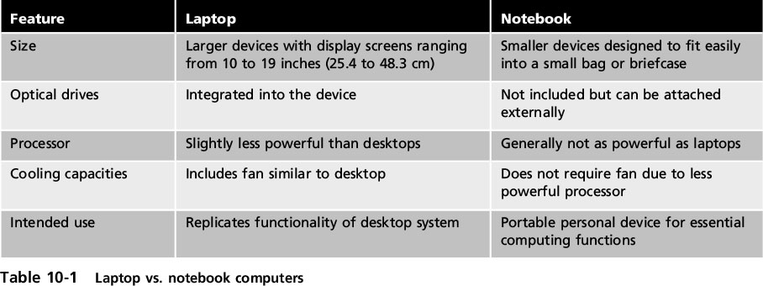
Portable Computers
Notes:
Portable Computers
Table 10-1 Laptop vs. notebook computers

Slide 6
Portable Computers
Subnotebook computers
Sometimes called an ultrabook (Intel/Windows) or air (Apple)
Smaller than notebooks
low-power processors
solid state drives (SSDs)
HDMI port
limited number of USB hardware ports
Notes:
10 AM 10/31 11 AM
Portable Computers
Subnotebook computers
Sometimes called an ultrabook (Intel/Windows) or air (Apple)
Smaller than notebooks and use low-power processors and solid state drives (SSDs)
Generally have a high-definition multimedia interface (HDMI) port and a limited number of USB hardware ports

Slide 7
Portable Computers
Web-based computer
Contains a limited version of the Linux OS and a web browser
Has an integrated media player
Designed to be used primarily while connected to the Internet
No traditional applications can be installed
No user files stored locally
Accesses web apps and saves user files on the Internet
Notes:
Portable Computers
Web-based computer
Contains a limited version of the Linux OS and a web browser
Has an integrated media player
Designed to be used primarily while connected to the Internet
No traditional applications can be installed
No user files are stored locally
Accesses web apps and saves user files on the Internet

Slide 8
Tablets
Tablets
Generally larger than smartphones and smaller than notebooks
Typically no built-in keyboard
Rely on a touch screen
Primary display device with limited user input
Most popular OSs for tablets are Apple iOS, Google Android, and Microsoft Windows
Notes:
Tablets
Tablets
Portable computing devices generally larger than smartphones and smaller than notebooks
Generally lack a built-in keyboard
Rely on a touch screen
Primary display device with limited user input
Most popular OSs for tablets are Apple iOS, Google Android, and Microsoft Windows

Slide 9
Smartphones
Smartphone
Has all the tools that a feature phone has
Also includes an OS!
allows it to run apps and access the Internet
Considered handheld personal computers
Because of their ability to run apps
Vs A feature phone:
traditional cellular phone with limited features,
camera, MP3 music player, ability to send and receive short message service (SMS) text messages
Notes:
Smartphones
Smartphone
Has all the tools that a feature phone has but also includes an OS that allows it to run apps and access the Internet
A feature phone is a traditional cellular phone with limited features, such as camera, MP3 music player, and the ability to send and receive short message service (SMS) text messages
Considered handheld personal computers
Because of their ability to run apps

Slide 10
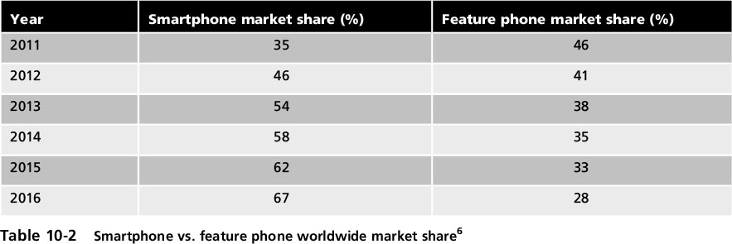
Smartphones
Notes:
Smartphones
Table 10-2 Smartphone vs. feature phone worldwide market share

Slide 11
Wearable Technology
Wearable technology
Devices that can be worn by the user instead of carried
Examples of wearable technology:
Optical head-mounted display
“Google Glass” can be activated in response to a user’s voice commands
Smart watch
Can serve as an accessory to a smartphone to view messages
Notes:
Wearable Technology
Wearable technology
Devices that can be worn by the user instead of carried
Examples of wearable technology:
Optical head-mounted display
“Google Glass” can be activated in response to a user’s voice commands
Smart watch
Can serve as an accessory to a smartphone to view messages

Slide 12
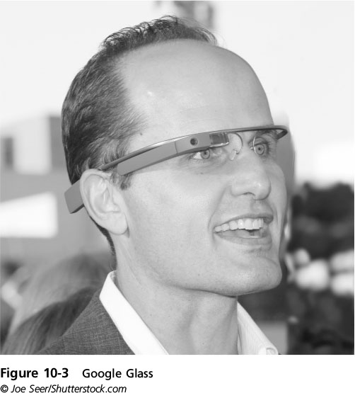
Wearable Technology
Notes:
Wearable Technology
Figure 10-3 Google Glass

Slide 13
Legacy Devices
Several mobile devices are no longer widely in use
Personal digital assistant (PDA)
Intended to replace paper systems
Often included:
an appointment calendar, address book, “to-do” list, calculator, and notepad
Replaced by smartphones
Netbook
Small, inexpensive, and lightweight computer
Small screen
Could not be upgraded
Lost popularity with introduction of tablet computers
Notes:
Legacy Devices
Several mobile devices are no longer widely in use
Personal digital assistant (PDA)
Intended to replace paper systems
Often included an appointment calendar, address book, “to-do” list, calculator, and notepad
Fell out of favor as smartphones gained in popularity
Netbook
A small, inexpensive, and lightweight computer
Featured small screens and could not be upgraded
Lost popularity with introduction of tablet computers

Slide 14
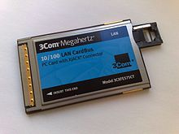
Mobile Device Removable Storage
Mobile devices
Use flash memory for permanent storage
Can be electrically erased and reused
Most devices also support removable data storage, which includes:
Large form factor and small form factor storage
Large Form Factor Storage
Credit card-sized slides into a slot on computer
Originally known as PCMCIA cards and later name was changed to PC Card
Notes:
Mobile Device Removable Storage
Mobile devices
Use flash memory for storage
Can be electrically erased and reused
Most devices also support removable data storage, which includes:
Large form factor and small form factor storage
Large Form Factor Storage
A credit card-sized peripheral that slides into a slot on a laptop computer
Originally known as PCMCIA cards and later name was changed to PC Card

Slide 15
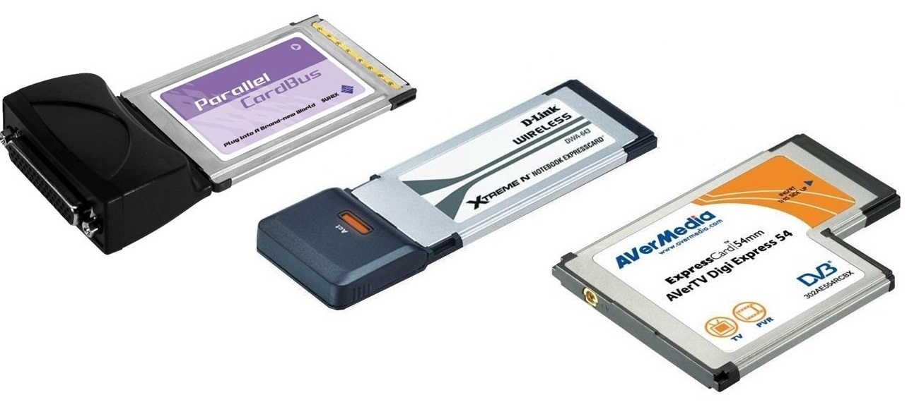
Mobile Device Removable Storage
The PC Card standard defines three form factors for three types of PC Cards
Cards differ only in their thickness
See Table 10-3 for comparisons of the three types
CardBus
Enhanced type of PC Card includes a bus mastering feature
Being replaced by ExpressCard technology
Higher-performance expansion in a smaller size
Notes:
Mobile Device Removable Storage
The PC Card standard defines three form factors for three types of PC Cards
Cards differ only in their thickness
See Table 10-3 for comparisons of the three types
CardBus
An enhanced type of PC Card that includes a bus mastering feature
PC Card and CardBus are being replaced by ExpressCard technology
Delivers higher-performance modular expansion in a smaller size

Slide 16

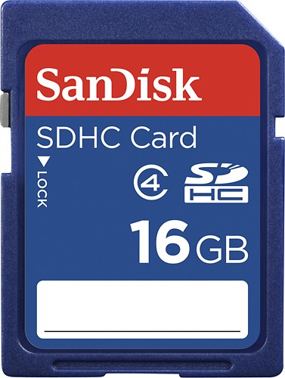
Mobile Device Removable Storage
Small Form Factor Storage
CompactFlash(CF) generally used as a mass storage device
Secure Digital (SD) card includes four card “families” available in three different form factors with different speed ratings
Standard-Capacity (SDSC)
High-Capacity (SDHC)
eXtended-Capacity (SDXC)
Secure Digital Input Output (SDIO)
Notes:
Mobile Device Removable Storage
Small Form Factor Storage
CompactFlash(CF) generally used as a mass storage device
Secure Digital (SD) card includes four card “families” available in three different form factors with different speed ratings
Standard-Capacity (SDSC)
High-Capacity (SDHC)
eXtended-Capacity (SDXC)
Secure Digital Input Output (SDIO)

Slide 17
Mobile Device Removable Storage
Three sizes of SD cards:
Full SD - typically used in PCs, video cameras, digital cameras, other large electronic devices
miniSD and microSD - commonly used in smaller devices like smartphones and tablets
SD speed classes were designed to support video recording
There are two types of speed classes:
Standard and ultra high speed (UHS)
Notes:
Mobile Device Removable Storage
Three sizes of SD cards:
Full SD - typically used in PCs, video cameras, digital cameras, other large electronic devices
miniSD and microSD - commonly used in smaller devices like smartphones and tablets
SD speed classes were designed to support video recording
There are two types of speed classes:
Standard and ultra high speed (UHS)

Slide 18
Mobile Device Risks
Mobile device security risks:
Limited physical security
Connecting to public networks
Location tracking
Installing unsecured applications
Accessing untrusted content
Bring your own device (BYOD) risks
Notes:
Mobile Device Risks
Mobile device security risks:
Limited physical security
Connecting to public networks
Location tracking
Installing unsecured applications
Accessing untrusted content
Bring your own device (BYOD) risks

Slide 19
Limited Physical Security
A mobile device is stolen on average once every 50 seconds
One-third of all laptops stolen in the U.S. go missing from public schools
Consumer-owned laptops are most often in August and September and November and December
Laptop theft is prevalent at airports
Users must guard against shoulder surfing
Strangers who want to view sensitive information
Notes:
Limited Physical Security
A mobile device is stolen on average once every 50 seconds
One-third of all laptops stolen in the U.S. go missing from public schools
Consumer-owned laptops are most often in August and September and November and December
Laptop theft is prevalent at airports
Users must guard against shoulder surfing
Strangers who want to view sensitive information

Slide 20
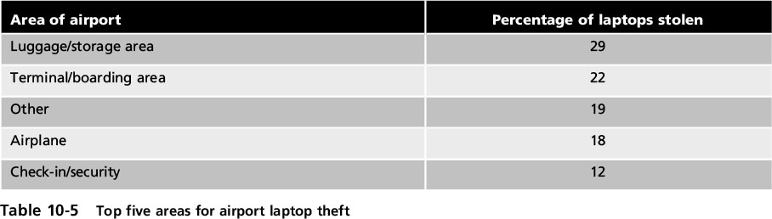
Limited Physical Security
Notes:
Limited Physical Security
Table 10-5 Top five areas for airport laptop theft

Slide 21
Connecting to Public Networks
Many mobile devices use public external networks for Internet access
Attackers can eavesdrop on the data transmissions and view sensitive information
Open networks may be susceptible to man-in-the-middle or replay attacks
Notes:
Connecting to Public Networks
Many mobile devices use public external networks for Internet access
Attackers can eavesdrop on the data transmissions and view sensitive information
Open networks may be susceptible to man-in-the-middle or replay attacks

Slide 22
Location Tracking
Location services
Can identify the location of a person carrying a mobile device
Used extensively by social media, navigation systems, weather systems, and other mobile-aware applications
Mobile devices using location services are at risk of targeted physical attacks
Attacker can follow user in order to steal the device or inflict harm upon the person
Notes:
Location Tracking
Location services
Can identify the location of a person carrying a mobile device
Used extensively by social media, navigation systems, weather systems, and other mobile-aware applications
Mobile devices using location services are at risk of targeted physical attacks
Attacker can follow user in order to steal the device or inflict harm upon the person

Slide 23
Installing Unsecured Applications
Mobile devices are designed to easily locate, acquire, and install apps from a variety of sources
Many apps do not include security features
Mobile OSs have different levels of security
Apple iOS
A closed and proprietary architecture
More difficult for attackers to create an app that could compromise it
Uses its App Store as the sole source for distributing apps
Notes:
Installing Unsecured Applications
Mobile devices are designed to easily locate, acquire, and install apps from a variety of sources
Many apps do not include security features
Mobile OSs have different levels of security
Apple iOS
A closed and proprietary architecture
More difficult for attackers to create an app that could compromise it
Uses its App Store as the sole source for distributing apps

Slide 24
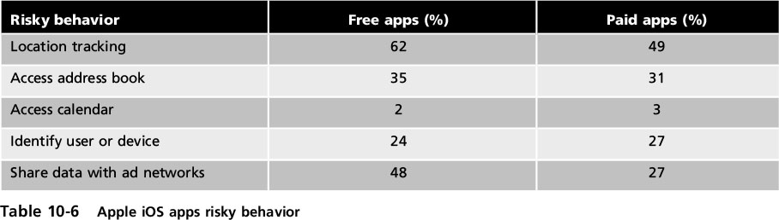
Installing Unsecured Applications
Apple iOS (cont’d)
A recent study compared the top 200 iOS and Android apps
Found that iOS apps exhibited a greater percentage of risky behaviors than Android apps
Notes:
Installing Unsecured Applications
Apple iOS (cont’d)
A recent study compared the top 200 iOS and Android apps
Found that iOS apps exhibited a greater percentage of risky behaviors than Android apps
Table 10-6 Apple iOS apps risky behavior

Slide 25
Installing Unsecured Applications
Google Android
Not proprietary and open for anyone to use or modify
Apps downloaded from Google Play store or from unofficial third-party websites
This makes Android apps highly risky
Most malicious apps designed to trick users into downloading costly services or steal user data
Notes:
11/2 1PM
Installing Unsecured Applications
Google Android
Not proprietary and open for anyone to use or modify
Apps can be downloaded from the Google Play store or from an unofficial third-party website (sideloading)
This makes Android apps highly risky
Most malicious apps are designed to trick users into downloading costly services or may steal user data

Slide 26
Accessing Untrusted Content
Quick Response (QR) codes
A matrix or two-dimensional barcode
can be read by an imaging device
Applications for these codes include:
Product tracking, item identification, time tracking, document management, and general marketing
Attacker can create an ad listing a reputable website but QR code that contains a malicious URL
Code directs a user’s browser to attacker’s website or a site that downloads malware
Notes:
End of class 10 AM 3/15/17
Accessing Untrusted Content
Quick Response (QR) codes
A matrix or two-dimensional barcode which can be read by an imaging device
Applications for these codes include:
Product tracking, item identification, time tracking, document management, and general marketing
An attacker can create an advertisement listing a reputable website but include a QR code that contains a malicious URL
Code directs a user’s browser to the attacker’s imposter website or to a site that downloads malware

Slide 27
Bring Your Own Device (BYOD) Risks
Bring Your Own Device (BYOD) policy
Allows users to use own mobile device for business or organizational purposes
Risks associated with BYOD:
Users may erase the installed/built-in limitations on their smartphone
Often shared with family members and friends
Technical support staff has to support hundreds of different mobile devices
If an employee is let go, difficult to erase any corporate data from personal mobile device
Notes:
End of class 11 AM 11/2
Bring Your Own Device (BYOD) Risks
Bring Your Own Device (BYOD) policy
Allows users to use their own personal mobile device for business or organizational purposes
Risks associated with BYOD:
Users may erase the installed built-in limitations on their smartphone
Often shared with family members and friends
Technical support staff may have to support hundreds of different mobile devices
If an employee is let go, it may be difficult to erase any corporate data from personal mobile device

Slide 28
Securing Mobile Devices
Steps to securing mobile devices:
Initial setup of the device
Its ongoing management
Deal with theft or loss of the device
Notes:
Securing Mobile Devices
Steps to securing mobile devices:
Initial setup of the device
Its ongoing management
Deal with theft or loss of the device

Slide 29
Device Setup
Disable Unused Features
Disable unused features and turn off those that do not support the business use of the phone
Disable Bluetooth wireless data communication
In order to prevent bluejacking and bluesnarfing
Enable Lock Screen after inactivity
Prevents device from being used until the user enters the correct passcode
Notes:
Device Setup
Disable Unused Features
It is important to disable unused features and turn off those that do not support the business use of the phone
Should disable Bluetooth wireless data communication
In order to prevent bluejacking and bluesnarfing
Enable Lock Screen
Lock screen prevents device from being used until the user enters the correct passcode
Set screen to lock after a period of inactivity

Slide 30
Device Setup
Enable Lock Screen (cont’d)
After a number of failed attempts to enter passcode, additional security protections will occur:
Extend lockout period
Reset to factory settings
Most devices have options for the type of passcode
A popular option is to draw or swipe a specific pattern connecting dots
Least effective code is a short PIN
Notes:
Device Setup
Enable Lock Screen (cont’d)
After a specific number of failed attempts to enter a passcode, additional security protections will occur:
Extend lockout period
Reset to factory settings
Most devices have different options for the type of passcode
A popular option is to draw or swipe a specific pattern connecting dots
Least effective code is a short PIN

Slide 31
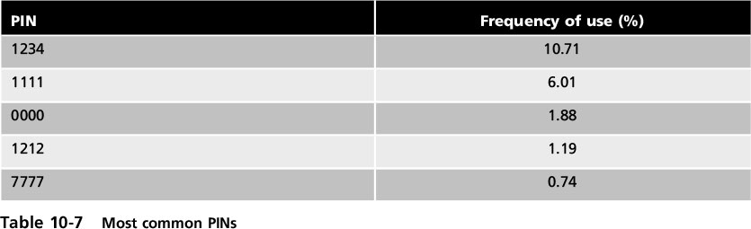
Device Setup
Notes:
Device Setup
Table 10-7 Most Common PINs

Slide 32
Device Setup
Use Encryption
Neither iOS or Android provide native cryptography,
third-party apps must be installed to provide encryption
Two encryption options:
Full device encryption
Separating data storage into containers and encrypt only sensitive data
Notes:
Device Setup
Use Encryption
Neither iOS or Android provide native cryptography, so third-party apps must be installed to provide encryption
Two encryption options:
Full device encryption
Separating data storage into containers and encrypt only the sensitive data

Slide 33
Device Setup
Control Access
A key to securing mobile devices
reduce access to the device and its data by
limiting who is authorized to use the information
At a higher corporate level decisions must be made on who can access the data before it is downloaded onto a mobile device
Many organizations are beginning to focus their efforts on the data instead of just the device by extending data loss prevention to mobile devices
Notes:
End of class 11/2/16 10 AM
Control Access
A key to securing mobile devices is to control access to the device and its data by limiting who is authorized to use the information
At a higher corporate level decisions must be made on who can access the data before it is downloaded onto a mobile device
Many organizations are beginning to focus their efforts on the data instead of just the device by extending data loss prevention to mobile devices

Slide 34
Device and App Management
Mobile Device Management (MDM)
Tools that allow a device to be managed remotely by an organization
Usually involve:
A server component that sends out management commands to mobile devices
A client component to receive and implement the management commands
An administrator can perform over the air (OTA) updates or configuration changes to one device
Notes:
Device and App Management
Mobile Device Management (MDM)
Tools that allow a device to be managed remotely by an organization
Usually involve:
A server component that sends out management commands to mobile devices
A client component to receive and implement the management commands
An administrator can perform over the air (OTA) updates or configuration changes to one device

Slide 35
Device and App Management
Some features that MDM tools provide:
Rapidly enroll new mobile devices (on-boarding) and quickly remove devices (off-boarding)
Apply or modify default device settings
Enforce encryption settings, antivirus updates, and patch management
Display an acceptable use policy that requires consent before allowing access
Configure email, calendar, contacts, Wi-Fi, and VPN profiles OTA
Discover devices accessing enterprise systems
Notes:
Device and App Management
Some features that MDM tools provide:
Rapidly enroll new mobile devices (on-boarding) and quickly remove devices (off-boarding)
Apply or modify default device settings
Enforce encryption settings, antivirus updates, and patch management
Display an acceptable use policy that requires consent before allowing access
Configure email, calendar, contacts, Wi-Fi, and VPN profiles OTA
Discover devices accessing enterprise systems

Slide 36
Device and App Management
Some features that MDM tools provide (cont’d):
Approve or quarantine new mobile devices
Distribute and manage public and corporate apps
Securely share and update documents and corporate policies
Detect and restrict jailbroken and rooted devices
Selectively erase corporate data
Facilitate asset tracking and inventory control
Notes:
Device and App Management
Some features that MDM tools provide (cont’d):
Approve or quarantine new mobile devices
Distribute and manage public and corporate apps
Securely share and update documents and corporate policies
Detect and restrict jailbroken and rotted devices
Selectively erase corporate data
Facilitate asset tracking and inventory control

Slide 37
Device and App Management
Mobile Application Management (MAM)
Also called application control
Tools and services responsible for distributing and controlling access to apps
Initially controlled apps through app wrapping
Sets up a “dynamic” library of software routines and adds to an existing program to restrict parts of an app
Using a MAM originally required the use of an MDM as well
Newer versions of mobile OSs have MAM incorporated into the software itself
Notes:
Device and App Management
Mobile Application Management (MAM)
Also called application control
Tools and services responsible for distributing and controlling access to apps
Initially controlled apps through app wrapping
Sets up a “dynamic” library of software routines and adds to an existing program to restrict parts of an app
Using a MAM originally required the use of an MDM as well
Newer versions of mobile OSs have MAM incorporated into the software itself

Slide 38
Device Loss or Theft
To reduce the risk of theft or loss:
Keep the mobile device out of sight when traveling
Always maintain awareness of your surroundings
When holding the device, use both hands to make it difficult for a thief to snatch
Don’t use device on escalators or near train doors
If a device is lost or stolen, it may be necessary to perform a remote wiping, which erases sensitive data stored on the device
Notes:
Device Loss or Theft
To reduce the risk of theft or loss:
Keep the mobile device out of sight when traveling in a high-risk area
Always maintain awareness of your surroundings
When holding the device, use both hands to make it difficult for a thief to snatch
Do not use the device on escalators or near train doors
If a device is lost or stolen, it may be necessary to perform a remote wiping, which erases sensitive data stored on the device

Slide 39
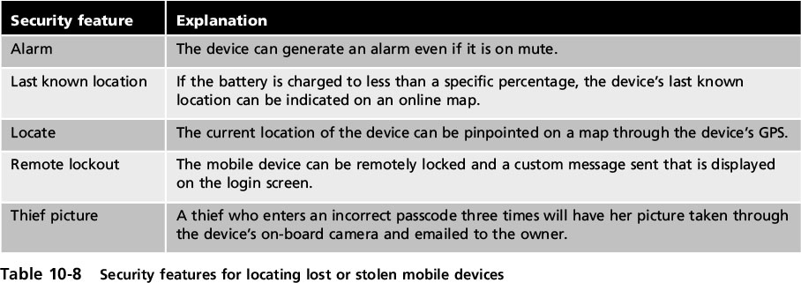
Device Loss or Theft
Notes:
Device Loss or Theft
Table 10-8 Security features for locating lost or stolen mobile devices

Slide 40
Mobile Device App Security
Apps on the device should be secured also
Apps can require that the user provide authentication (such as a passcode) before access is granted
MDMs can support:
Application whitelisting - ensures that only preapproved apps can run on the device
Geo-fencing - uses the device’s GPS to define geographical boundaries where the app can be used
Credential management - stores authentication information
Notes:
Mobile Device App Security
Apps on the device should be secured also
Apps can require that the user provide authentication (such as a passcode) before access is granted
MDMs can support:
Application whitelisting - ensures that only preapproved apps can run on the device
Geo-fencing - uses the device’s GPS to define geographical boundaries where the app can be used
Credential management - stores authentication information

Slide 41
BYOD Security
Benefits of BYOD for companies:
Management flexibility
Less oversight
Cost savings
Increased employee performance
Simplified IT infrastructure
Reduced internal service
MDMs and MAMs are important in managing BYOD devices
Notes:
BYOD Security
Benefits of BYOD for companies:
Management flexibility
Less oversight
Cost savings
Increased employee performance
Simplified IT infrastructure
Reduced internal service
MDMs and MAMs are important in managing BYOD devices

