Slide 1
What Is Access Control?
Access Control
Granting or denying approval to use specific resources
Physical access control
Consists of fencing, hardware door locks, and mantraps to limit contact with devices
Technical access control
Consists of technology restrictions that limit users on computers from accessing data
There are four standard access control models
Notes:
What Is Access Control?
Access Control
Granting or denying approval to use specific resources
Physical access control
Consists of fencing, hardware door locks, and mantraps to limit contact with devices
Technical access control
Consists of technology restrictions that limit users on computers from accessing data
There are four standard access control models

Slide 2
Access Control Terminology
Identification
Presenting credentials
Example: delivery driver presenting employee badge
Authentication
Checking the credentials
Example: examining the delivery driver’s badge
Authorization
Granting permission to take action
Example: allowing delivery driver to pick up package
Notes:
Access Control Terminology
Identification
Presenting credentials
Example: delivery driver presenting employee badge
Authentication
Checking the credentials
Example: examining the delivery driver’s badge
Authorization
Granting permission to take action
Example: allowing delivery driver to pick up package

Slide 3
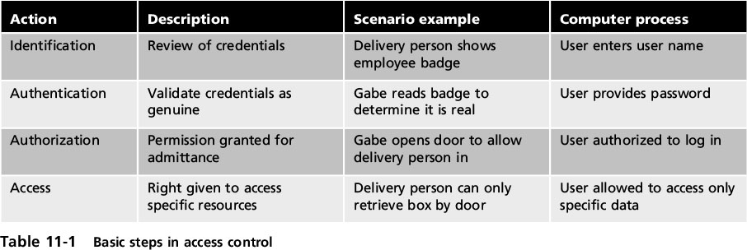
Access Control Terminology
Notes:
Access Control Terminology
Table 11-1 Basic steps in access control

Slide 4
Access Control Terminology
Object
A specific resource
Example: file or hardware device
Subject
A user or process functioning on behalf of a user
Example: computer user
Operation
The action taken by the subject over an object
Example: deleting a file
Notes:
Access Control Terminology
Object
A specific resource
Example: file or hardware device
Subject
A user or process functioning on behalf of a user
Example: computer user
Operation
The action taken by the subject over an object
Example: deleting a file

Slide 5
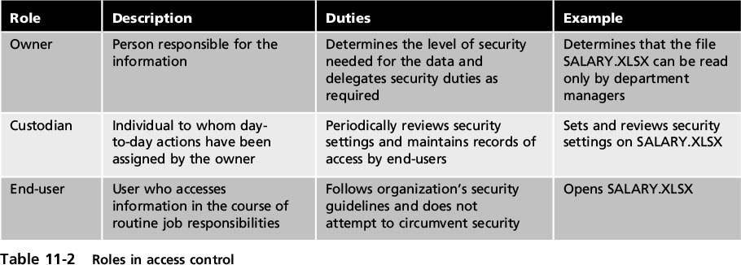
Access Control Terminology
Notes:
Access Control Terminology
Table 11-2 Roles in access control

Slide 6
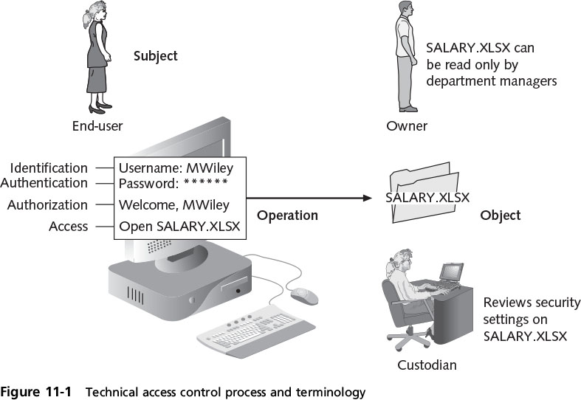
Access Control Terminology
Notes:
Access Control Terminology
Figure 11-1 Technical access control process and terminology

Slide 7
Access Control Models
Access control model
Standards that provide a predefined framework for hardware or software developers
Use the appropriate model to configure the necessary level of control
Four major access control models
Discretionary Access Control (DAC)
Mandatory Access Control (MAC)
Role Based Access Control (RBAC)
Rule Based Access Control (RBAC)
Notes:
Access Control Models
Access control model
Standards that provide a predefined framework for hardware or software developers
Use the appropriate model to configure the necessary level of control
Four major access control models
Discretionary Access Control (DAC)
Mandatory Access Control (MAC)
Role Based Access Control (RBAC)
Rule Based Access Control (RBAC)

Slide 8
Access Control Models
Discretionary Access Control (DAC)
Least restrictive model
Every object has an owner
Owners have total control over their objects
Owners can give permissions to other subjects over their objects
Used on operating systems such as most types of UNIX and Microsoft Windows
Notes:
Access Control Models
Discretionary Access Control (DAC)
Least restrictive model
Every object has an owner
Owners have total control over their objects
Owners can give permissions to other subjects over their objects
Used on operating systems such as most types of UNIX and Microsoft Windows

Slide 9
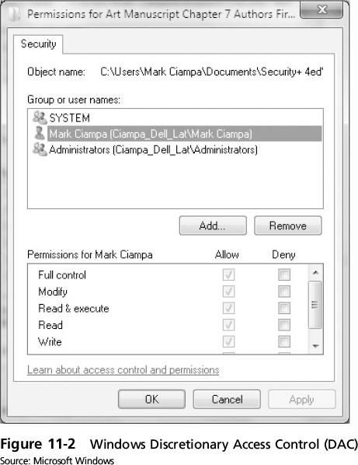
Access Control Models
Notes:
Access Control Models
Figure 11-2 Windows Discretionary Access Control (DAC)

Slide 10
Access Control Models
DAC weaknesses
Relies on decisions by end user to set proper security level
Incorrect permissions may be granted
Subject’s permissions will be “inherited” by any programs the subject executes
Malware downloaded onto a user’s computer that uses the DAC model would then run at the same high level as the user’s privileges
Notes:
Access Control Models
DAC weaknesses
Relies on decisions by end user to set proper security level
Incorrect permissions may be granted
Subject’s permissions will be “inherited” by any programs the subject executes
Malware downloaded onto a user’s computer that uses the DAC model would then run at the same high level as the user’s privileges

Slide 11
Access Control Models
Mandatory Access Control (MAC)
Most restrictive access control model
Typically found in military settings
Two elements
Labels - Every entity is an object and is assigned a classification label that represents the relative importance of the object
Subjects are assigned a privilege label (clearance)
Levels - a hierarchy based on the labels is used
Top secret has a higher level than secret, which has a higher level than confidential
Notes:
Access Control Models
Mandatory Access Control (MAC)
Most restrictive access control model
Typically found in military settings
Two elements
Labels - Every entity is an object and is assigned a classification label that represents the relative importance of the object
Subjects are assigned a privilege label (clearance)
Levels - a hierarchy based on the labels is used
Top secret has a higher level than secret, which has a higher level than confidential

Slide 12
Access Control Models
MAC grants permissions by matching object labels with subject labels
Labels indicate level of privilege
To determine if file may be opened:
Object and subject labels are compared
The subject must have equal or greater level than object to be granted access
Two major implementations of MAC
Lattice model
Bell-LaPadula model
Notes:
Access Control Models
MAC grants permissions by matching object labels with subject labels
Labels indicate level of privilege
To determine if file may be opened:
Object and subject labels are compared
The subject must have equal or greater level than object to be granted access
Two major implementations of MAC
Lattice model
Bell-LaPadula model

Slide 13
Access Control Models
Microsoft Windows uses a MAC implementation called Mandatory Integrity Control (MIC)
A security identifier (SID) is issued to the user, group, or session
Each time a user logs in, the SID is retrieved from the database for that user
SID is used to identify user with subsequent interactions with Windows
Windows links the SID to an integrity level
User Access Control (UAC) - a Windows feature that controls user access to resources
Notes:
Access Control Models
Microsoft Windows uses a MAC implementation called Mandatory Integrity Control (MIC)
A security identifier (SID) is issued to the user, group, or session
Each time a user logs in, the SID is retrieved from the database for that user
SID is used to identify user with subsequent interactions with Windows
Windows links the SID to an integrity level
User Access Control (UAC) - a Windows feature that controls user access to resources

Slide 14
Access Control Models
Role Based Access Control (RBAC)
Also called Non-Discretionary Access Control
Access permissions are based on user’s job function
RBAC assigns permissions to particular roles in an organization
Users are assigned to those roles
Rule Based Access Control (RBAC)
Dynamically assigns roles to subjects based on a set of rules defined by a custodian
Notes:
Access Control Models
Role Based Access Control (RBAC)
Also called Non-Discretionary Access Control
Access permissions are based on user’s job function
RBAC assigns permissions to particular roles in an organization
Users are assigned to those roles
Rule Based Access Control (RBAC)
Dynamically assigns roles to subjects based on a set of rules defined by a custodian

Slide 15
Access Control Models
Rule Based Access Control (cont’d.)
Each resource object contains access properties based on the rules
When user attempts access, system checks object’s rules to determine access permission
Often used for managing user access to one or more systems
Business changes may trigger application of the rules specifying access changes
Notes:
Access Control Models
Rule Based Access Control (cont’d.)
Each resource object contains access properties based on the rules
When user attempts access, system checks object’s rules to determine access permission
Often used for managing user access to one or more systems
Business changes may trigger application of the rules specifying access changes

Slide 16
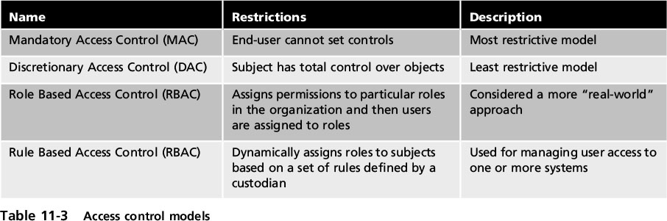
Access Control Models
Notes:
Access Control Models
Table 11-3 Access control models

Slide 17
Best Practices for Access Control
Establishing best practices for limiting access
Can help secure systems and data
Examples of best practices
Separation of duties
Job rotation
Least privilege
Implicit deny
Mandatory vacations
Notes:
End of class 10 AM 11/9 11 AM
Best Practices for Access Control
Establishing best practices for limiting access
Can help secure systems and data
Examples of best practices
Separation of duties
Job rotation
Least privilege
Implicit deny
Mandatory vacations

Slide 18
Course survey!
http://svy.mk/2eongaZ

Slide 19
Best Practices for Access Control
Separation of duties
Fraud can result from single user being trusted with complete control of a process
Requires two or more people responsible for functions related to handling money
The system is not vulnerable to actions of a single person
Job rotation
Individuals periodically moved between job responsibilities
Notes:
1 PM end of class 11/9
Best Practices for Access Control
Separation of duties
Fraud can result from single user being trusted with complete control of a process
Requires two or more people responsible for functions related to handling money
The system is not vulnerable to actions of a single person
Job rotation
Individuals periodically moved between job responsibilities

Slide 20
Best Practices for Access Control
Job rotation (cont’d.)
Employees can rotate within 1 department or across departments
Advantages of job rotation
Limits amount of time individuals are in a position to manipulate security configurations
Helps expose potential avenues for fraud
Individuals have different perspectives and may uncover vulnerabilities
Reduces employee burnout
Notes:
Best Practices for Access Control
Job rotation (cont’d.)
Employees can rotate within their department or across departments
Advantages of job rotation
Limits amount of time individuals are in a position to manipulate security configurations
Helps expose potential avenues for fraud
Individuals have different perspectives and may uncover vulnerabilities
Reduces employee burnout

Slide 21
Best Practices for Access Control
Least privilege
Limiting access to information based on what is needed to perform a job function
Helps reduce attack surface by eliminating unnecessary privileges
Should apply to users and to processes running on the system
Processes should run at minimum security level needed to correctly function
Notes:
Best Practices for Access Control
Least privilege
Limiting access to information based on what is needed to perform a job function
Helps reduce attack surface by eliminating unnecessary privileges
Should apply to users and to processes running on the system
Processes should run at minimum security level needed to correctly function

Slide 22
Best Practices for Access Control
Implicit deny
If a condition is not explicitly met, access request is rejected
Example: network router rejects access to all except conditions matching the rule restrictions
Mandatory vacations
Limits fraud, because perpetrator must be present daily to hide fraudulent actions
Audit of employee’s activities usually scheduled during vacation for sensitive positions
Notes:
Best Practices for Access Control
Implicit deny
If a condition is not explicitly met, access request is rejected
Example: network router rejects access to all except conditions matching the rule restrictions
Mandatory vacations
Limits fraud, because perpetrator must be present daily to hide fraudulent actions
Audit of employee’s activities usually scheduled during vacation for sensitive positions

Slide 23
Implementing Access Control
Technologies used to implement access control
Access control lists
Group Policy
Account restrictions
Notes:
End of class 10 am, 11 am 3/29/17
Implementing Access Control
Technologies used to implement access control
Access control lists
Group Policy
Account restrictions

Slide 24
Access Control Lists
Access control list (ACL)
A set of permissions attached to an object
Specifies which subjects may access the object and what operations they can perform
When a subject requests to perform an operation:
System checks ACL for an approved entry
ACLs are usually viewed in relation to operating system files
Notes:
Access Control Lists
Access control list (ACL)
A set of permissions attached to an object
Specifies which subjects may access the object and what operations they can perform
When a subject requests to perform an operation:
System checks ACL for an approved entry
ACLs are usually viewed in relation to operating system files

Slide 25
Access Control Lists
Each entry in the ACL table is called access control entry (ACE)
ACE structure (Windows)
Security identifier (SID) for the user or group account or logon session
Access mask that specifies access rights controlled by ACE
Flag that indicates type of ACE
Set of flags that determine whether objects can inherit permissions
Notes:
Access Control Lists
Each entry in the ACL table is called access control entry (ACE)
ACE structure (Windows)
Security identifier (SID) for the user or group account or logon session
Access mask that specifies access rights controlled by ACE
Flag that indicates type of ACE
Set of flags that determine whether objects can inherit permissions

Slide 26
Group Policies
Group Policy
A Microsoft Windows feature that provides centralized management and configuration of computers and remote users using Active Directory (AD)
Usually used in enterprise environments
Settings stored in Group Policy Objects (GPOs)
Local Group Policy
Has fewer options than a Group Policy
Used to configure settings for systems not part of AD
Notes:
Group Policies
Group Policy
A Microsoft Windows feature that provides centralized management and configuration of computers and remote users using Active Directory (AD)
Usually used in enterprise environments
Settings stored in Group Policy Objects (GPOs)
Local Group Policy
Has fewer options than a Group Policy
Used to configure settings for systems not part of AD

Slide 27
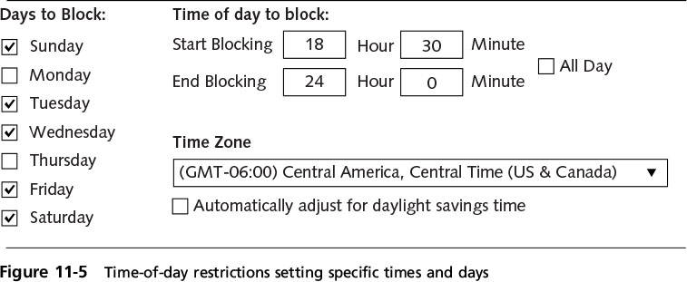
Account Restrictions
Time of day restrictions
Limits the time of day a user may log onto a system
Time blocks for permitted access are chosen
Can be set on individual systems
Notes:
Account Restrictions
Time of day restrictions
Limits the time of day a user may log onto a system
Time blocks for permitted access are chosen
Can be set on individual systems
Figure 11-5 Time-of-day restrictions setting specific times and days

Slide 28
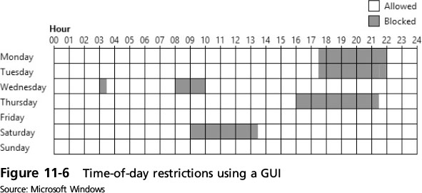
Account Restrictions
Notes:
Account Restrictions
Figure 6-11 Time-of-day restrictions using GUI

Slide 29
Account Restrictions
Account expiration
Orphaned accounts: accounts that remain active after an employee has left the organization
Dormant accounts: not accessed for a lengthy period of time
Recommendations for dealing with orphaned or dormant accounts
Establish a formal process
Terminate access immediately
Monitor logs
Notes:
Account Restrictions
Account expiration
Orphaned accounts: accounts that remain active after an employee has left the organization
Dormant accounts: not accessed for a lengthy period of time
Recommendations for dealing with orphaned or dormant accounts
Establish a formal process
Terminate access immediately
Monitor logs

Slide 30
Account Restrictions
Orphaned accounts remain a problem in today’s organizations
Account expiration
Sets a user’s account to expire
Password expiration sets a time when user must create a new password
Different from account expiration
Account expiration can be a set date, or a number of days of inactivity
Notes:
Account Restrictions
Orphaned accounts remain a problem in today’s organizations
Account expiration
Sets a user’s account to expire
Password expiration sets a time when user must create a new password
Different from account expiration
Account expiration can be a set date, or a number of days of inactivity

Slide 31
Authentication Services
Authentication
Process of verifying credentials
Authentication services provided on a network
Dedicated authentication server
A server that performs authentication, authorization, and accounting is called a AAA server
Common types of authentication and AAA servers
RADIUS, Kerberos, Terminal Access Control Access Control Systems (TACACS), generic servers built on the Lightweight Directory Access Protocol (LDAP), Security Assertion and Markup Language (SAML)
Notes:
Authentication Services
Authentication
Process of verifying credentials
Authentication services provided on a network
Dedicated authentication server
A server that performs authentication, authorization, and accounting is called a AAA server
Common types of authentication and AAA servers
RADIUS, Kerberos, Terminal Access Control Access Control Systems (TACACS), generic servers built on the Lightweight Directory Access Protocol (LDAP), Security Assertion and Markup Language (SAML)

Slide 32
RADIUS
Remote Authentication Dial In User Service
Developed in 1992
Became an industry standard
Suitable for high volume service control applications
Such as dial-in access to corporate network
Still in use today
RADIUS client
Typically a device such as a wireless AP
Responsible for sending user credentials and connection parameters to the RADIUS server
Notes:
RADIUS
Remote Authentication Dial In User Service
Developed in 1992
Became an industry standard
Suitable for high volume service control applications
Such as dial-in access to corporate network
Still in use today
RADIUS client
Typically a device such as a wireless AP
Responsible for sending user credentials and connection parameters to the RADIUS server

Slide 33
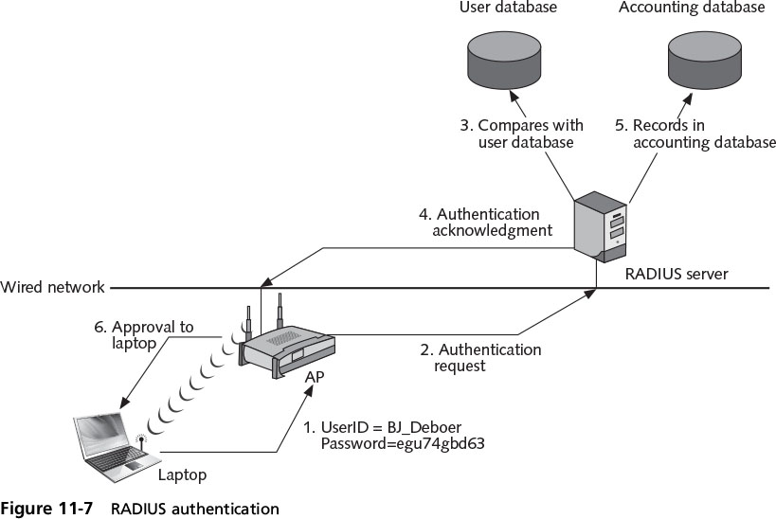
RADIUS
Notes:
RADIUS
Figure 11-7 RADIUS authentication

Slide 34
RADIUS
RADIUS user profiles are stored in a central database that all remote servers can share
Advantages of a central service
Increases security due to a single administered network point
Easier to track usage for billing and keeping network statistics
Notes:
RADIUS
RADIUS user profiles are stored in a central database that all remote servers can share
Advantages of a central service
Increases security due to a single administered network point
Easier to track usage for billing and keeping network statistics

Slide 35
Kerberos
Authentication system developed at MIT
Uses encryption and authentication for security
Most often used in educational and government settings
Works like using a driver’s license to cash a check
Kerberos ticket characteristics:
Difficult to copy
Contains information linking it to the user
User presents ticket to network for a service
Expires in a few hours or a day
Notes:
Kerberos
Authentication system developed at MIT
Uses encryption and authentication for security
Most often used in educational and government settings
Works like using a driver’s license to cash a check
Kerberos ticket characteristics:
Difficult to copy
Contains information linking it to the user
User presents ticket to network for a service
Expires in a few hours or a day

Slide 36
Terminal Access Control Access Control System (TACACS)
Authentication service similar to RADIUS
Commonly used on UNIX devices
Communicates by forwarding user authentication information to a centralized server
The current version is TACACS+
Notes:
Terminal Access Control Access Control System (TACACS)
Authentication service similar to RADIUS
Commonly used on UNIX devices
Communicates by forwarding user authentication information to a centralized server
The current version is TACACS+

Slide 37
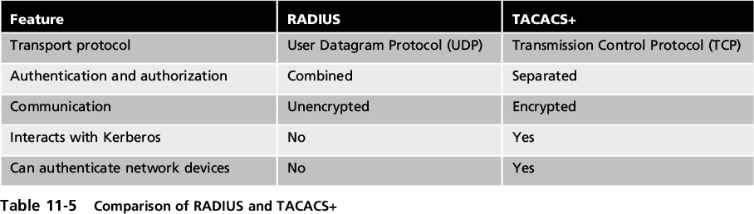
Terminal Access Control Access Control System (TACACS)
Notes:
Terminal Access Control Access Control System (TACACS)
Table 11-5 Comparison of RADIUS and TACAS+

Slide 38
Lightweight Directory Access Protocol (LDAP)
A directory service is a database stored on a network
Contains information about users and network devices
Keeps track of network resources and user’s privileges to those resources
Grants or denies access based on its information
Standard for directory services
X.500
Notes:
Lightweight Directory Access Protocol (LDAP)
A directory service is a database stored on a network
Contains information about users and network devices
Keeps track of network resources and user’s privileges to those resources
Grants or denies access based on its information
Standard for directory services
X.500

Slide 39
Lightweight Directory Access Protocol
X.500 standard defines protocol for client application to access the DAP
LDAP
A simpler subset of DAP
Designed to run over TCP/IP
Encodes protocol elements in simpler way than X.500
LDAP traffic is transmitted in cleartext
Can be made secure by using SSL or TLS
Known as Secure LDAP or LDAP over SSL (LDAPS)
Notes:
Lightweight Directory Access Protocol
X.500 standard defines protocol for client application to access the DAP
LDAP
A simpler subset of DAP
Designed to run over TCP/IP
Encodes protocol elements in simpler way than X.500
LDAP traffic is transmitted in cleartext
Can be made secure by using SSL or TLS
Known as Secure LDAP or LDAP over SSL (LDAPS)

Slide 40
Lightweight Directory Access Protocol
Weakness of LDAP
Can be subject to LDAP injection attacks
Similar to SQL injection attacks
Occurs when user input is not properly filtered
Notes:
Lightweight Directory Access Protocol
Weakness of LDAP
Can be subject to LDAP injection attacks
Similar to SQL injection attacks
Occurs when user input is not properly filtered

Slide 41
Security Assertion Markup Language (SAML)
SAML
An Extensible Markup Language (XML) standard that allows secure web domains to exchange user authentication and authorization data
Allows a user’s login credentials to be stored with a single identity provider instead of being stored on each web service provider’s server
Used extensively for online e-commerce business-to-business (B2B) and business-to-customer (B2C) transactions
Notes:
Security Assertion Markup Language (SAML)
SAML
An Extensible Markup Language (XML) standard that allows secure web domains to exchange user authentication and authorization data
Allows a user’s login credentials to be stored with a single identity provider instead of being stored on each web service provider’s server
Used extensively for online e-commerce business-to-business (B2B) and business-to-customer (B2C) transactions

Slide 42
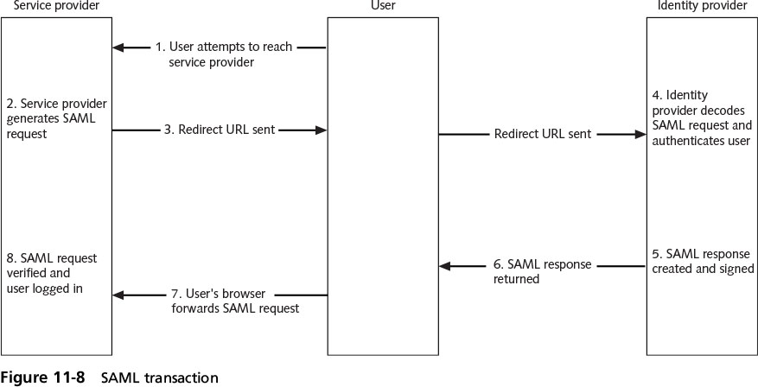
Security Assertion Markup Language (SAML)
Notes:
Security Assertion Markup Language (SAML)
Figure 11-8 SAML transaction

