Slide 1
Authentication Credentials
Types of authentication credentials
Where you are
Example: a military base
What you have
Example: key fob to lock your car
What you are
Example: facial characteristics recognized
What you know
Example: combination to health club locker
What you do
Example: do something to prove authenticity
Notes:
Authentication Credentials
Types of authentication credentials
Where you are
Example: a military base
What you have
Example: key fob to lock your car
What you are
Example: facial characteristics recognized
What you know
Example: combination to health club locker
What you do
Example: do something to prove authenticity

Slide 2
What You Know: Passwords
User logging in
Asked to identify himself
enters username
Asked to authenticate
enters password
Passwords most common type of authentication
Provide weak protection
Actions can be taken to strengthen passwords
Notes:
What You Know: Passwords
User logging in to a system
Asked to identify himself
User enters username
User asked to authenticate
User enters password
Passwords are the most common type of authentication today
Passwords provide only weak protection
Actions can be taken to strengthen passwords

Slide 3
Password Weaknesses
Weakness of is linked to human memory
Can memorize only a limited number of items
Long, complex = most effective
Most difficult to memorize
Must remember passwords for different accounts
Security policies mandate passwords must expire
Users must repeatedly memorize passwords
Notes:
Password Weaknesses
Weakness of passwords is linked to human memory
Humans can memorize only a limited number of items
Long, complex passwords are most effective
Most difficult to memorize
Users must remember passwords for many different accounts
Security policies mandate passwords must expire
Users must repeatedly memorize passwords

Slide 4
Password Weaknesses
Users take shortcuts
Using weak passwords
Examples: common words, short password, or personal information
Reuse the same password for multiple accounts
Easier for attacker who compromises one account to access others
Notes:
Password Weaknesses
Users often take shortcuts
Using a weak password
Examples: common words, short password, or personal information
Reuse the same password for multiple accounts
Easier for attacker who compromises one account to access others

Slide 5
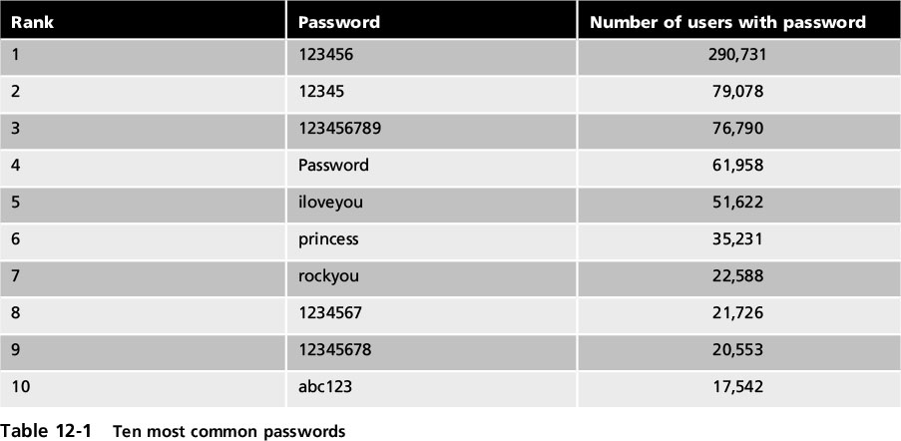
Password Weaknesses
Notes:
Password Weaknesses
Table 12-1 Ten most common passwords

Slide 6
Attacks on Passwords
Attacks used to discover passwords:
Social engineering
Phishing, shoulder surfing, dumpster diving
Capturing
Keylogger, protocol analyzer
Man-in-the-middle and replay attacks
Resetting
Attacker gains access to computer /resets password
Notes:
Attacks on Passwords
Attacks that can be used to discover passwords:
Social engineering
Phishing, shoulder surfing, dumpster diving
Capturing
Keylogger, protocol analyzer
Man-in-the-middle and replay attacks
Resetting
Attacker gains physical access to computer and resets password

Slide 7
Attacks on Passwords
Offline cracking
Used by most password attacks today
Attackers steal file of password digests
Compare with their own digests they have created
Offline cracking methods
Brute force
Every possible combination of letters, numbers, and characters used to create digests of passwords and matched against stolen file
Slowest, most thorough method
Notes:
Attacks on Passwords
Offline cracking
Method used by most password attacks today
Attackers steal file of password digests
Compare with their own digests they have created
Offline cracking types
Brute force
Every possible combination of letters, numbers, and characters used to create encrypted passwords and matched against stolen file
Slowest, most thorough method

Slide 8
Attacks on Passwords
Automated brute force attack program parameters
Password length
Character set
Language
Pattern
Skips - groups of letters that aren’t likely to be in a password
Dictionary attack
Attacker creates digests of common dictionary words
Compares against stolen digest file
Notes:
Attacks on Passwords
Automated brute force attack program parameters
Password length
Character set
Language
Pattern
Skips
Dictionary attack
Attacker creates digests of common dictionary words
Compares against stolen digest file

Slide 9
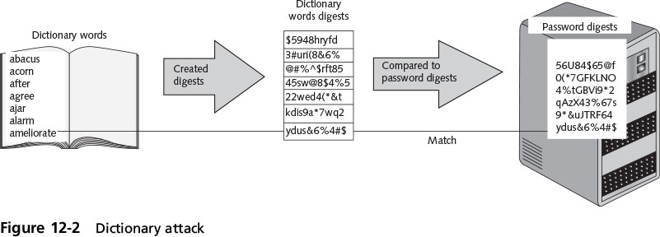
Attacks on Passwords
Notes:
Attacks on Passwords
Figure 12-2 Dictionary attack

Slide 10
Attacks on Passwords
Pre-image attack
A dictionary attack that uses a set of dictionary words and compares it with the stolen digests
Birthday attack
The search for any two digests that are the same
Notes:
Attacks on Passwords
Pre-image attack
A dictionary attack that uses a set of dictionary words and compares it with the stolen digests
Birthday attack
The search for any two digests that are the same

Slide 11
Attacks on Passwords
Hybrid attack
Combines a dictionary attack with a brute force attack and will slightly alter dictionary words
Adding numbers to the end of the password
Spelling words backward
Slightly misspelling words
Including special characters
Rainbow tables
Creates a large pre-generated data set of candidate digests
Notes:
Attacks on Passwords
Hybrid attack
Combines a dictionary attack with a brute force attack and will slightly alter dictionary words
Adding numbers to the end of the password
Spelling words backward
Slightly misspelling words
Including special characters
Rainbow tables
Creates a large pregenerated data set of candidate digests

Slide 12
Attacks on Passwords
Steps for using a rainbow table
Creating the table
Chain of plaintext passwords
Encrypt initial password
Feed into a function that produces different plaintext passwords
Repeat for a set number of rounds
Using the table to crack a password
Run encrypted password though same procedure used to create initial table
Results in initial chain password
Notes:
Attacks on Passwords
Steps for using a rainbow table
Creating the table
Chain of plaintext passwords
Encrypt initial password
Feed into a function that produces different plaintext passwords
Repeat for a set number of rounds
Using the table to crack a password
Run encrypted password though same procedure used to create initial table
Results in initial chain password

Slide 13
Attacks on Passwords
Using the table to crack a password (cont’d.)
Repeat, starting with this initial password until original encryption is found
Password used at last iteration is the cracked password
Rainbow table advantages over other attack methods
Can be used repeatedly
Faster than dictionary attacks
Less memory on the attacking machine is required
Notes:
End of class 4/5/17
Attacks on Passwords
Using the table to crack a password (cont’d.)
Repeat, starting with this initial password until original encryption is found
Password used at last iteration is the cracked password
Rainbow table advantages over other attack methods
Can be used repeatedly
Faster than dictionary attacks
Less memory on the attacking machine is required

Slide 14
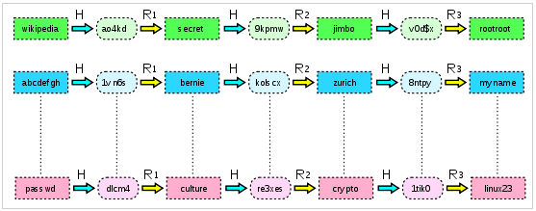
Attacks on Passwords (Rainbow Table)
Problem
We have:
a password hash function H
finite set of passwords P
Passwords are stored/used as h = H(p)
Attacker NEEDS p…steals a list of hashed passwords {h1, h2, etc}
Pre-compute a data structure for all passwords
given h, find p where H(p) = h
Simplest way:
Compute H(p) for all p in P
Space cost is high!
Better way?
Chains:

Slide 15
Attacks on Passwords (Rainbow Table)
Rainbow Table
Hash chain
Reduction function R maps hash value back to some password
Steps for using a rainbow table
Creating the table
choose a subset of initial passwords from P
compute chains of some fixed length k for each
store only the first and last password in each chain

Slide 16

Attacks on Passwords
Using the table to crack a password:
given a hash value h
Apply the reduction function R(h)
Check each chain in the table
If at any point we observe R(h) matching one of the endpoints in the table, we get the corresponding starting point and use it to recreate the chain.
Notes:
Reference: http://en.wikipedia.org/wiki/Rainbow_table

Slide 17
Attacks on Passwords
Build chains from passwords:
a →H→ 4 →R→ c →H→ 27 →R→ h →H→ 19 →R→ k
b →H→ 6 →R→ z →H→ 17 →R→ m→H→ 9 →R→ q
d →H→ 81 →R→ y →H→ 13 →R→ w→H→ 2 →R→ t
Store a lookup table of start/end points:
a → k
b → q
c → t
Stolen hash of password: 27
Run chain: 27 →R→h→H→19→R→k FOUND CHAIN!
We know that the pwd is on the a chain
Start at a→H→4→R→c→H→27 pwd is c!!!

Slide 18
Attacks on Passwords
Password Collections
It is estimated that over 100 million passwords were stolen and published online in one year
Websites now host lists of leaked passwords along with statistical analysis
Password mask attacks can significantly reduce the amount of time needed to break a password
Compared to a raw brute force attack
Notes:
Attacks on Passwords
Password Collections
It is estimated that over 100 million passwords were stolen and published online in one year
Websites now host lists of leaked passwords along with statistical analysis
Password mask attacks can significantly reduce the amount of time needed to break a password
Compared to a raw brute force attack

Slide 19
Password Defenses
Four primary defenses against password attacks:
Password complexity
Credential management
Password hashing algorithms
Salts
Notes:
Password Defenses
Four primary defenses against password attacks:
Password complexity
Credential management
Password hashing algorithms
Salts

Slide 20
Password Defenses
Password Complexity
One insight into creating complex passwords is to examine password attack methods
Most passwords consist of:
Root
Attachment
Prefix or suffix
Attack program method
Tests password against 1000 common passwords
Notes:
11/16 11 AM
Password Defenses
Password Complexity
One insight into creating complex passwords is to examine password attack methods
Most passwords consist of:
Root
Attachment
Prefix or suffix
Attack program method
Tests password against 1000 common passwords

Slide 21
Password Defenses
Attack program method (cont’d.)
Combines common passwords with common suffixes
Uses 5000 common dictionary words, 10,000 names, 100,000 comprehensive dictionary words
Uses lowercase, initial uppercase, all uppercase, and final character uppercase
Makes common substitutions for letters in the dictionary words
Examples: $ for s, @ for a
Notes:
11/16 1 PM
Password Defenses
Attack program method (cont’d.)
Combines common passwords with common suffixes
Uses 5000 common dictionary words, 10,000 names, 100,000 comprehensive dictionary words
Uses lowercase, initial uppercase, all uppercase, and final character uppercase
Makes common substitutions for letters in the dictionary words
Examples: $ for s, @ for a

Slide 22
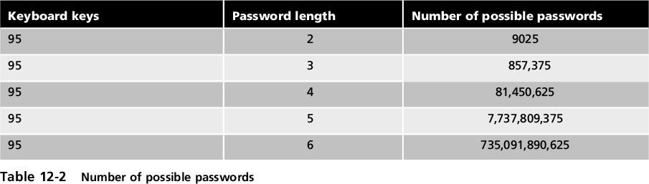
Password Defenses
General observations to create strong passwords
Do not use dictionary words or phonetic words
Do not repeat characters or use sequences
Do not use birthdays, family member or pet names, addresses or any personal information
Do not use short passwords
Notes:
End of class 11/16 10 AM
Password Defenses
General observations to create strong passwords
Do not use dictionary words or phonetic words
Do not repeat characters or use sequences
Do not use birthdays, family member or pet names, addresses or any personal information
Do not use short passwords
Table 12-2 Number of possible passwords

Slide 23
Password Defenses
Credential Management
One important defense: prevent attacker from capturing the password digest files
Defenses against theft of digest files:
Do not leave computer unattended
Screensavers should be set to resume with a password
Password protect the ROM BIOS
Physically lock the computer case so it cannot be opened
Notes:
Password Defenses
Credential Management
One important defense: prevent attacker from capturing the password digest files
Defenses against theft of digest files:
Do not leave computer unattended
Screensavers should be set to resume with a password
Password protect the ROM BIOS
Physically lock the computer case so it cannot be opened

Slide 24
Password Defenses
Good password management practices
Change passwords frequently
Do not reuse old passwords
Never write password down
Use unique passwords for each account
Set up temporary password for another user’s access
Do not allow computer to automatically sign in to an account
Notes:
Password Defenses
Good password management practices
Change passwords frequently
Do not reuse old passwords
Never write password down
Use unique passwords for each account
Set up temporary password for another user’s access
Do not allow computer to automatically sign in to an account

Slide 25
Password Defenses
Good password management practices (cont’d.)
Do not enter passwords on public access computers
Never enter a password while connected to an unencrypted wireless network
Password management applications
Programs that let a user create and store multiple strong passwords in a single file protected by one strong master password
Many include enhanced encryption, in-memory protection that prevents OS cache from being exposed to reveal retrieved passwords
Notes:
Password Defenses
Good password management practices (cont’d.)
Do not enter passwords on public access computers
Never enter a password while connected to an unencrypted wireless network
Password management applications
Programs that let a user create and store multiple strong passwords in a single file protected by one strong master password
Many include enhanced encryption, in-memory protection that prevents OS cache from being exposed to reveal retrieved passwords

Slide 26
Password Defenses
Password Hashing Algorithms
Microsoft Windows OS has passwords in two ways
LM (LAN Manager) hash - uses a cryptographic one-way function where the password itself is the key
NTLM (New Technology LAN Manager) hash - addresses security issues in the LM hash
Current version is NTLMv2
Key stretching - a hashing algorithm that requires significantly more time than standard hashing algorithms to create the digest
bcrypt and PBKDF2 are two popular options
Notes:
Password Defenses
Password Hashing Algorithms
Microsoft Windows OS has passwords in two ways
LM (LAN Manager) hash - uses a cryptographic one-way function where the password itself is the key
NTLM (New Technology LAN Manager) hash - addresses security issues in the LM hash
Current version is NTLMv2
Key stretching - a hashing algorithm that requires significantly more time than standard hashing algorithms to create the digest
bcrypt and PBKDF2 are two popular options

Slide 27
Password Defenses
Salts
Consists of a random string that is used in hash algorithms
Passwords can be protected by adding a random string to the user’s cleartext password before it is hashed
Make dictionary attacks and brute force attacks much slower and limit the impact of rainbow tables
Notes:
Password Defenses
Salts
Consists of a random string that is used in hash algorithms
Passwords can be protected by adding a random strong to the user’s cleartext password before it is hashed
Make dictionary attacks and brute force attacks much slower and limit the impact of rainbow tables

Slide 28
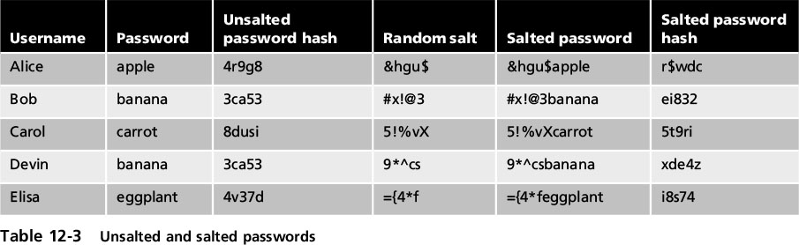
Password Defenses
Notes:
Password Defenses
Table 12-3 Unsalted and salted passwords

Slide 29
What You Have: Tokens, Cards, and Cell Phones
Multifactor authentication
When a user is using more than one type of authentication credential
Example: what a user knows and what a user has could be used together for authentication
Single-factor authentication
Using just one type of authentication
Notes:
What You Have: Tokens, Cards, and Cell Phones
Multifactor authentication
When a user is using more than one type of authentication credential
Example: what a user knows and what a user has could be used together for authentication
Single-factor authentication
Using just one type of authentication

Slide 30
What You Have: Tokens, Cards, and Cell Phones
Tokens
Small devices with a window display
Used to create a one-time password (OTP)
Authentication code that can be used only once or for a limited period of time
Two types of OTPs
Time-based one-time password (TOTP)
Synched with an authentication server
Code is generated from an algorithm
Code changes every 30 to 60 seconds
Notes:
What You Have: Tokens, Cards, and Cell Phones
Tokens
Small devices with a window display
Used to create a one-time password (OTP)
Authentication code that can be used only once or for a limited period of time
Two types of OTPs
Time-based one-time password (TOTP)
Synched with an authentication server
Code is generated from an algorithm
Code changes every 30 to 60 seconds

Slide 31
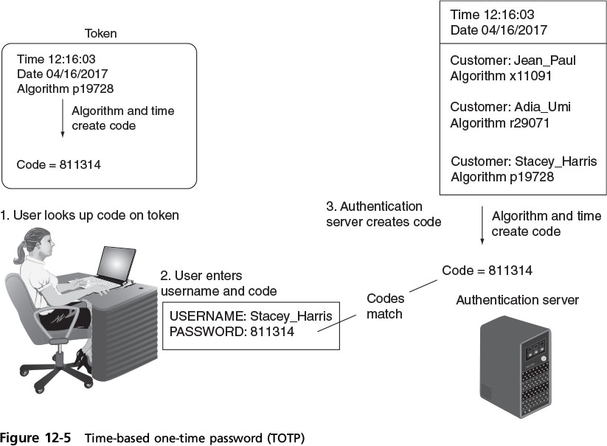
What You Have: Tokens, Cards, and Cell Phones
Notes:
What You Have: Tokens, Cards, and Cell Phones
Figure 12-5 Time-based one-time password (TOTP)

Slide 32
What You Have: Tokens, Cards, and Cell Phones
Two types of OTPs (cont’d)
HMAC-based one-time password (HOTP)
“Event-driven” and changes when a specific event occurs
Advantages over passwords
Token code changes frequently
Attacker would have to crack code within time limit
User may not know if password has been stolen
If token is stolen, it becomes obvious and steps could be taken to disable account
Notes:
What You Have: Tokens, Cards, and Cell Phones
Two types of OTPs (cont’d)
HMAC-based one-time password (HOTP)
“Event-driven” and changes when a specific event occurs
Advantages over passwords
Token code changes frequently
Attacker would have to crack code within time limit
User may not know if password has been stolen
If token is stolen, it becomes obvious and steps could be taken to disable account

Slide 33
What You Have: Tokens, Cards, and Cell Phones
Cards
Smart card contains integrated circuit chip that holds information
Contact pad allows electronic access to chip contents
Contactless cards
Require no physical access to the card
Common access card (CAC)
Issued by US Department of Defense
Bar code, magnetic strip, and bearer’s picture
Notes:
What You Have: Tokens, Cards, and Cell Phones
Cards
Smart card contains integrated circuit chip that holds information
Contact pad allows electronic access to chip contents
Contactless cards
Require no physical access to the card
Common access card (CAC)
Issued by US Department of Defense
Bar code, magnetic strip, and bearer’s picture

Slide 34
What You Have: Tokens, Cards, and Cell Phones
Cards (cont’d)
The smart card standard covering all U.S. government employees is the Personal Identity Verification (PIV) standard
Cell Phones
Increasingly replacing tokens and cards
A code can be sent to a user’s cell phone through an app on the device
Allow a user to send a request via the phone to receive an HOTP authorization code
Notes:
What You Have: Tokens, Cards, and Cell Phones
Cards (cont’d)
The smart card standard covering all U.S. government employees is the Personal Identity Verification (PIV) standard
Cell Phones
Increasingly replacing tokens and cards
A code can be sent to a user’s cell phone through an app on the device
Allow a user to send a request via the phone to receive an HOTP authorization code

Slide 35
What You Are: Biometrics
Standard biometrics
Uses a person’s unique physical characteristics for authentication
Fingerprint scanners are the most common type
Face, hand, or eye characteristics also used
Fingerprint scanner types
Static fingerprint scanner
Takes a picture and compares with image on file
Dynamic fingerprint scanner
Uses small slit or opening
Notes:
What You Are: Biometrics
Standard biometrics
Uses a person’s unique physical characteristics for authentication
Fingerprint scanners are the most common type
Face, hand, or eye characteristics also used
Fingerprint scanner types
Static fingerprint scanner
Takes a picture and compares with image on file
Dynamic fingerprint scanner
Uses small slit or opening

Slide 36
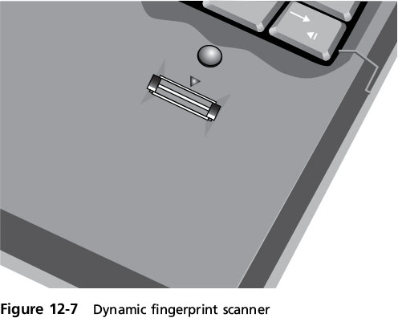
What You Are: Biometrics
Notes:
What You Are: Biometrics
Figure 12-7 Dynamic fingerprint scanner

Slide 37
What You Are: Biometrics
Disadvantages of standard biometrics
Cost of hardware scanning devices
Readers have some amount of error
Reject authorized users
Accept unauthorized users
Cognitive biometrics
Relates to perception, thought process, and understanding of the user
Easier for user to remember because it is based on user’s life experiences
Notes:
End of class 4/7/17
What You Are: Biometrics
Disadvantages of standard biometrics
Cost of hardware scanning devices
Readers have some amount of error
Reject authorized users
Accept unauthorized users
Cognitive biometrics
Relates to perception, thought process, and understanding of the user
Easier for user to remember because it is based on user’s life experiences

Slide 38
What You Are: Biometrics
Cognitive biometrics (cont’d.)
Difficult for an attacker to imitate
Picture gesture authentication (PGA)
A user reproduces gestures seen on a previous photograph
Example: identifying specific faces
Predicted to become a key element of authentication in the future
Notes:
What You Are: Biometrics
Cognitive biometrics (cont’d.)
Difficult for an attacker to imitate
Picture gesture authentication (PGA)
A user reproduces gestures seen on a previous photograph
Example: identifying specific faces
Predicted to become a key element of authentication in the future

Slide 39
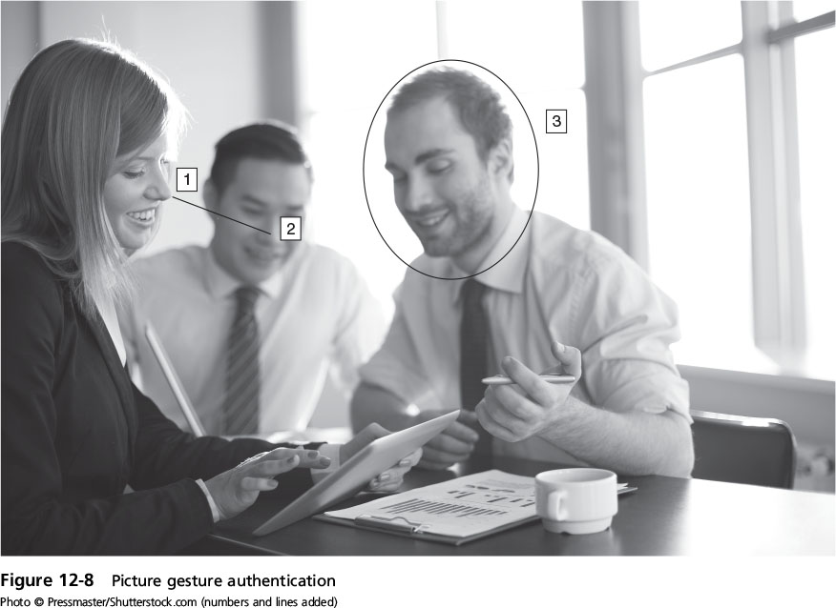
What You Are: Biometrics
Notes:
What You Are: Biometrics
Figure 12-8 Picture gesture authentication

Slide 40
What You Do: Behavioral Biometrics
Behavioral biometrics
Authenticates by normal actions the user performs
Two examples of behavioral biometrics
Keystroke dynamics
Voice recognition
Notes:
What You Do: Behavioral Biometrics
Behavioral biometrics
Authenticates by normal actions the user performs
Two examples of behavioral biometrics
Keystroke dynamics
Voice recognition

Slide 41
What You Are: Behavioral Biometrics
Keystroke dynamics
Attempts to recognize user’s typing rhythm
All users type at a different pace
Provides up to 98 percent accuracy
Uses two unique typing variables
Dwell time (time it takes to press and release a key)
Flight time (time between keystrokes)
Holds a great amount of potential
It requires no specialized hardware
Notes:
What You Are: Behavioral Biometrics
Keystroke dynamics
Attempts to recognize user’s typing rhythm
All users type at a different pace
Provides up to 98 percent accuracy
Uses two unique typing variables
Dwell time (time it takes to press and release a key)
Flight time (time between keystrokes)
Holds a great amount of potential
It requires no specialized hardware

Slide 42
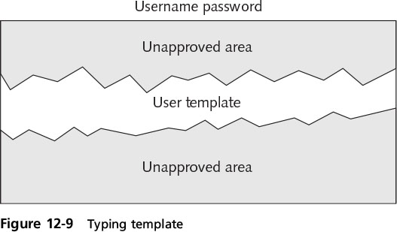
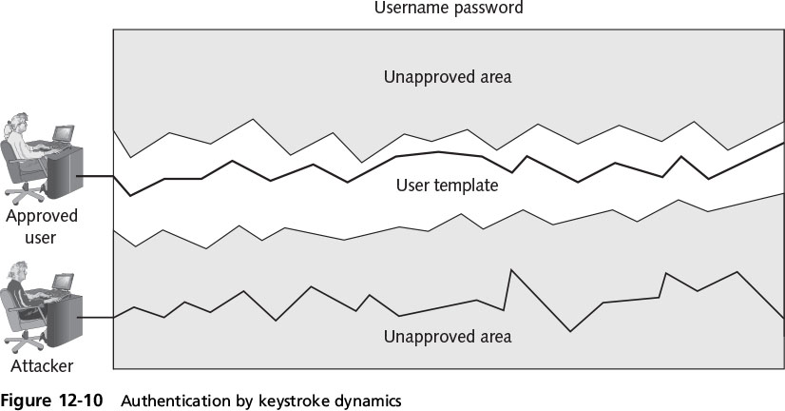
What You Are: Behavioral Biometrics
Notes:
What You Are: Behavioral Biometrics
Figure 12-10 Authentication by keystroke dynamics

Slide 43
What You Are: Behavioral Biometrics
Voice recognition
Several characteristics make each person’s voice unique
Voice template can be created
Difficult for an attacker to authenticate using a recording of user’s voice
Phonetic cadence of putting words together is part of real speech pattern
Notes:
What You Are: Behavioral Biometrics
Voice recognition
Several characteristics make each person’s voice unique
Voice template can be created
Difficult for an attacker to authenticate using a recording of user’s voice
Phonetic cadence of putting words together is part of real speech pattern

Slide 44
Where You Are: Geolocation
Geolocation
The identification of the location of a person or object using technology
Can indicate if an attacker is trying to perform a malicious action from a location different from the normal location of the user
Many websites will not allow a user to access an account if the computer is located in a different state
Some websites may require a second type of authentication
A code sent as a text message to a cell phone number on file
Notes:
End of class 11/18 1 PM
Where You Are: Geolocation
Geolocation
The identification of the location of a person or object using technology
Can indicate if an attacker is trying to perform a malicious action from a location different from the normal location of the user
Many websites will not allow a user to access an account if the computer is located in a different state
Some websites may require a second type of authentication
A code sent as a text message to a cell phone number on file

Slide 45
Single Sign-On
Identity management
Using a single authentication credential shared across multiple networks
It is called federated identity management (FIM) when networks are owned by different organizations
Single sign-on (SSO) holds promise to reduce burden of usernames and passwords to just one
Examples of popular SSOs:
Microsoft Account, OpenID, and OAuth
Notes:
End of class 11/18 10 AM 11 AM
Single Sign-On
Identity management
Using a single authentication credential shared across multiple networks
It is called federated identity management (FIM) when networks are owned by different organizations
Single sign-on (SSO) holds promise to reduce burden of usernames and passwords to just one
Examples of popular SSOs:
Microsoft Account, OpenID, and OAuth

Slide 46
Microsoft Account
Introduced in 1999 as .NET passport
Name changed to Microsoft Passport Network, then Windows Live ID in 2006
Designed as an SSO for Web commerce
Today it is known as Microsoft Account
Authentication process
User enters username and password
Once, authenticated, the user is given a time limited “global” cookie stored on computer with encrypted ID tag
Notes:
Microsoft Account
Introduced in 1999 as .NET passport
Name changed to Microsoft Passport Network, then Windows Live ID in 2006
Designed as an SSO for Web commerce
Today it is known as Microsoft Account
Authentication process
User enters username and password
Once, authenticated, the user is given a time limited “global” cookie stored on computer with encrypted ID tag

Slide 47
Microsoft Account
Authentication process (cont’d.)
ID tag sent to website the user wants to log into
Web site uses ID tag for authentication
Web site stores encrypted, time-limited “local” cookie on user’s computer
The use of “global” and “local” cookies is the basis of Microsoft Account
Cookies are erased when the user logs out of her Microsoft account
Notes:
Microsoft Account
Authentication process (cont’d.)
ID tag sent to website the user wants to log into
Web site uses ID tag for authentication
Web site stores encrypted, time-limited “local” cookie on user’s computer
The use of “global” and “local” cookies is the basis of Microsoft Account
Cookies are erased when the user logs out of her Microsoft account

Slide 48
OpenID
A decentralized open source FIM
Does not require specific software to be installed on the desktop
URL-based identity system
OpenID provides a means to prove a user owns the URL
Authentication process
User goes to free site and given OpenID account of Me.myopenID.com
Notes:
OpenID
A decentralized open source FIM
Does not require specific software to be installed on the desktop
URL-based identity system
OpenID provides a means to prove a user owns the URL
Authentication process
User goes to free site and given OpenID account of Me.myopenID.com

Slide 49
OpenID
Authentication process (cont’d.)
User visits Web commerce or other site and signs in using his Open ID
Site redirects user to MyOpenID.com where he enters password to authenticate
MyOpenID.com sends him back to Web site, now authenticated
Security weaknesses
Relies on DNS which may have own weaknesses
Not considered strong enough for most banking and e-commerce Web sites
Notes:
OpenID
Authentication process (cont’d.)
User visits Web commerce or other site and signs in using his Open ID
Site redirects user to MyOpenID.com where he enters password to authenticate
MyOpenID.com sends him back to Web site, now authenticated
Security weaknesses
Relies on DNS which may have own weaknesses
Not considered strong enough for most banking and e-commerce Web sites

Slide 50
Open Authorization (OAuth)
Permits users to share resources stored on one site with a second site
Without forwarding authentication credentials
Allows seamless data sharing among sites
Relies on token credentials
Replaces need to transfer user’s username and password
Tokens are for specific resources on a site
For a limited time period
Notes:
Open Authorization (OAuth)
Permits users to share resources stored on one site with a second site
Without forwarding authentication credentials
Allows seamless data sharing among sites
Relies on token credentials
Replaces need to transfer user’s username and password
Tokens are for specific resources on a site
For a limited time period

Slide 51
Account Management
Managing user account passwords
Can be done by setting password rules
Too cumbersome to manage on a user-by-user basis
Security risk if one user setting is overlooked
Preferred approach: assign privileges by group
Microsoft Windows group password settings
Password Policy Settings
Account Lockout Policy
Notes:
Account Management
Managing user account passwords
Can be done by setting password rules
Too cumbersome to manage on a user-by-user basis
Security risk if one user setting is overlooked
Preferred approach: assign privileges by group
Microsoft Windows group password settings
Password Policy Settings
Account Lockout Policy

Slide 52
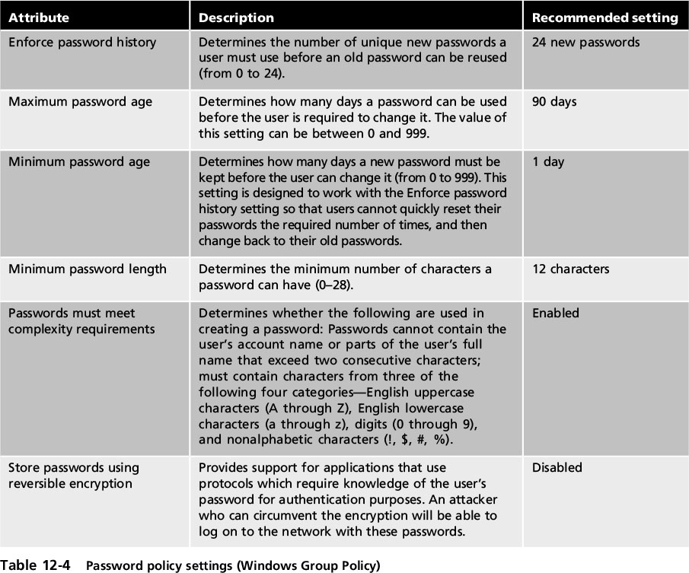
Account Management
Notes:
Account Management
Table 12-4 Password policy settings (Windows Group Policy)

Slide 53
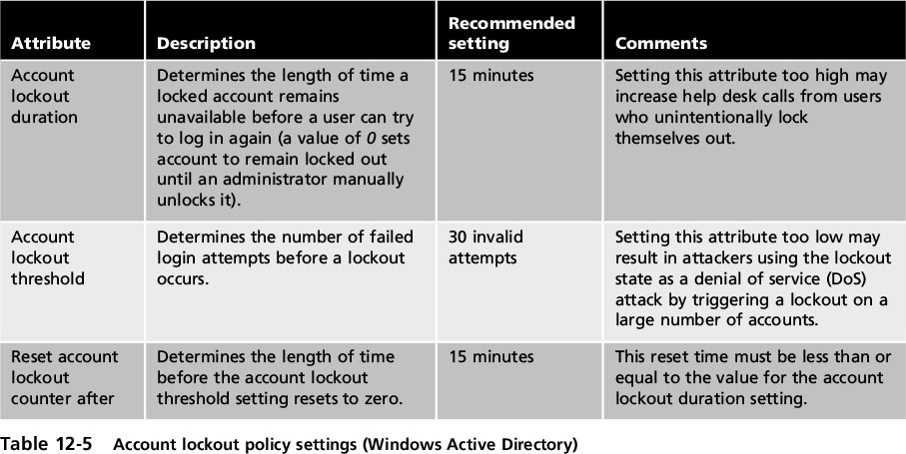
Account Management
Notes:
Account Management
Table 12-5 Account lockout policy settings (Windows Active Directory)

Slide 54
Account Management
Transitive trust
A two-way relationship that is automatically created between parent and child domains in a Microsoft Active Directory Forest
When a new domain is created, it shares resources with its parent domain by default
Can enable an authenticated user to access resources in both the child and the parent
Notes:
Account Management
Transitive trust
A two-way relationship that is automatically created between parent and child domains in a Microsoft Active Directory Forest
When a new domain is created, it shares resources with its parent domain by default
Can enable an authenticated user to access resources in both the child and the parent

