Slide 1
Insights into Market Dynamics: Exploring Job Openings, Applicant Trends
Team 04

Slide 2
Team Members
Mounica Seelam - S559228
Harshitha Chowdary Alapati - S561420
Swarupa Jinne - S558943
Supriya Bodapati - S562040

Slide 3
Contents
Introduction
Data Set
Goals and Implementation
Conclusion

Slide 4
Introduction
Our project is to use PySpark to analyze workforce data and get important insights into several aspects of the job market.
We want to create a complete data analytics platform by combining job opening data, applicant patterns, and company profiles.
We use powerful data mining tools to uncover patterns, estimate future job demand, and analyze the efficiency of companies in attracting people.
This program not only benefits job searchers by allowing them to make more informed decisions, but it also helps recruiters optimize their hiring techniques.

Slide 5
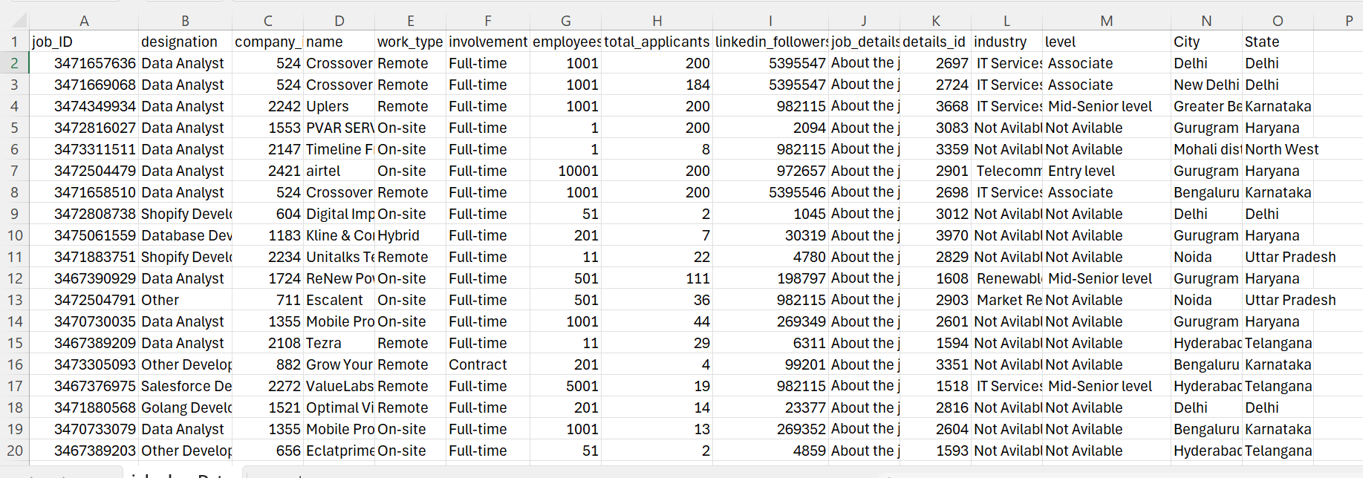
Data Set
Link to dataset: https://www.kaggle.com/datasets/shashankshukla123123/linkedin-job-cleandata

Slide 6
Understanding the data set
Attribute | Description
job_ID | Unique identifier for each job listing.
designation | The title or position of the job.
company_id | Unique identifier for each company.
name | Name of the company offering the job.
work_type | Indicates whether the job is remote or on-site.
involvement | The level of involvement required for the job (e.g., Full-time, Part-time).
employees_count | The count of employees in the company.
total_applicants | The total number of applicants for the job.

Slide 7
Understanding the data set(contd…)
Attribute | Description
Linkedin_followers | The number of followers on the company's LinkedIn page.
job_details | Description of the job and its responsibilities.
details_id | Unique identifier for the job details.
industry | The industry or sector to which the company belongs.
level | The experience level or seniority associated with the job.
City | The city where the job is located.
State | The state where the job is located.

Slide 8
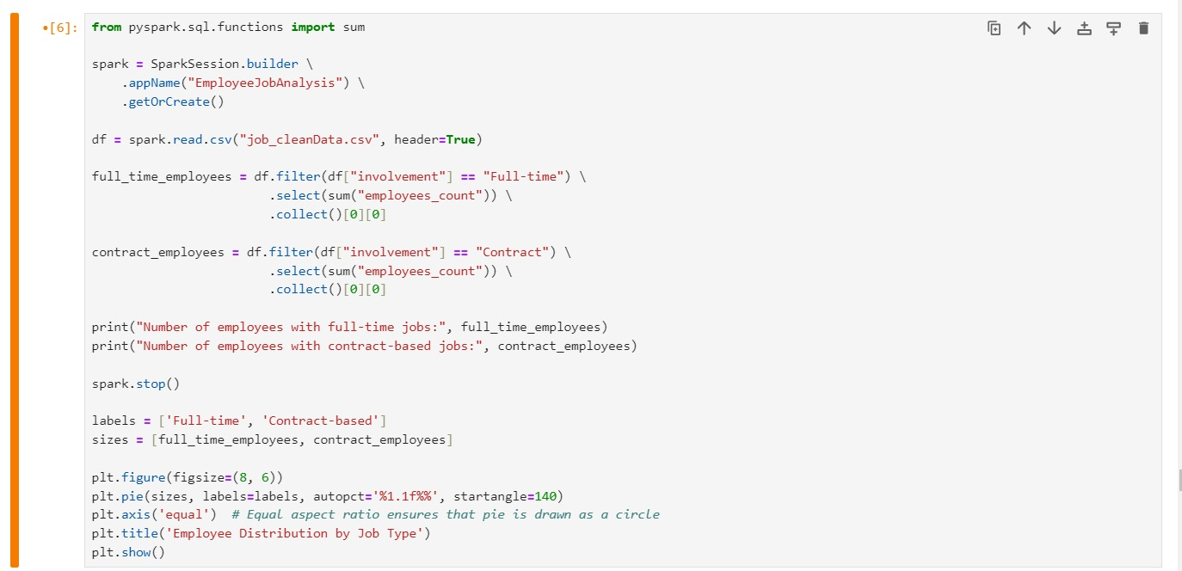
Goals and Implementation
How many employees have full-time and contract-based jobs?

Slide 9
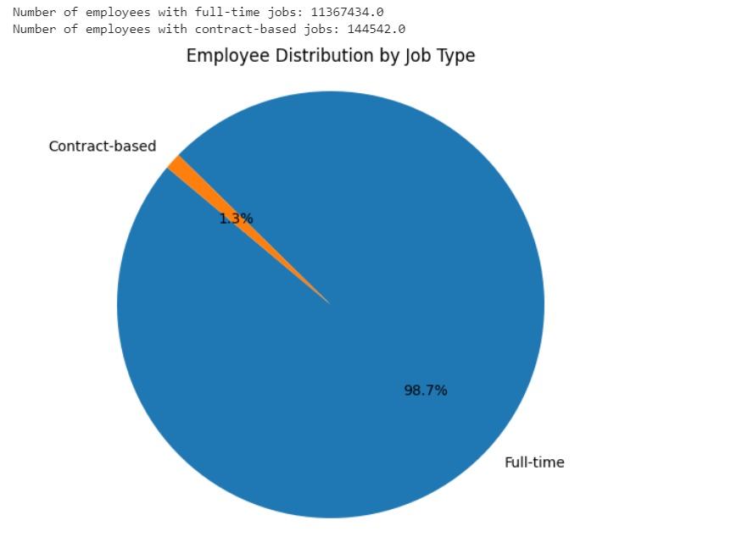
Goals and Implementation(contd…)
Output:

Slide 10
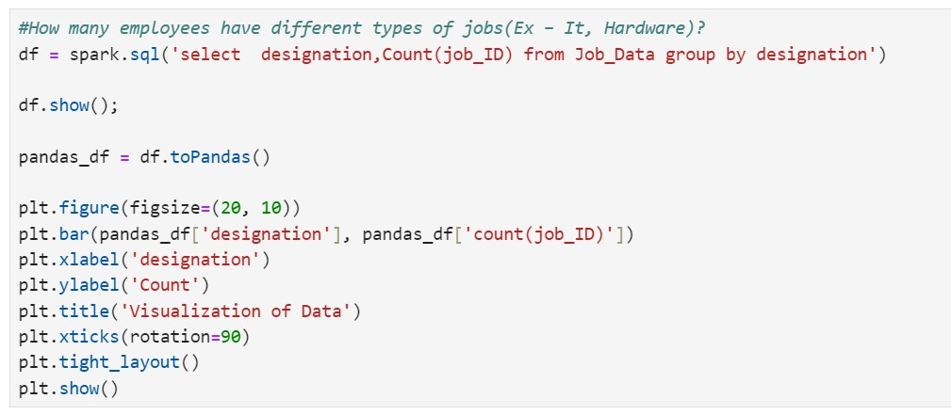
Goals and Implementation(contd…)
How many employees have different types of jobs(Ex – It, Hardware)?

Slide 11
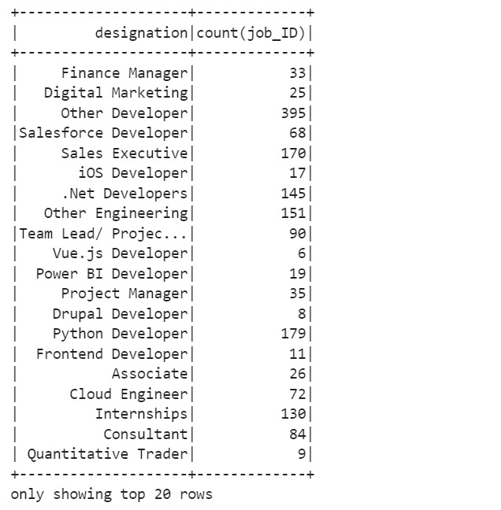
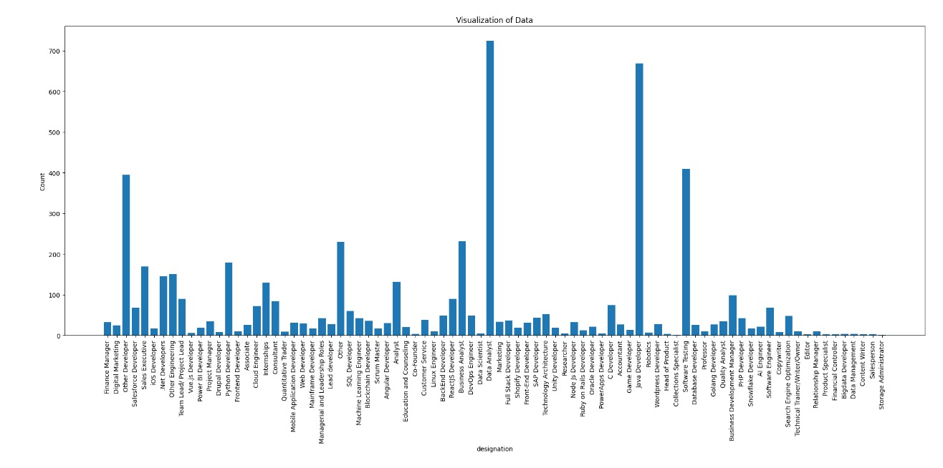
Goals and Implementation(contd…)
output
Visualization

Slide 12
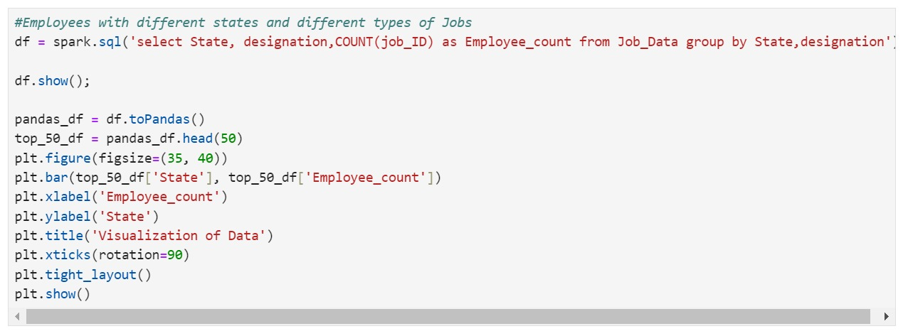
Goals and Implementation(contd…)
Employees with different states and different types of Jobs

Slide 13
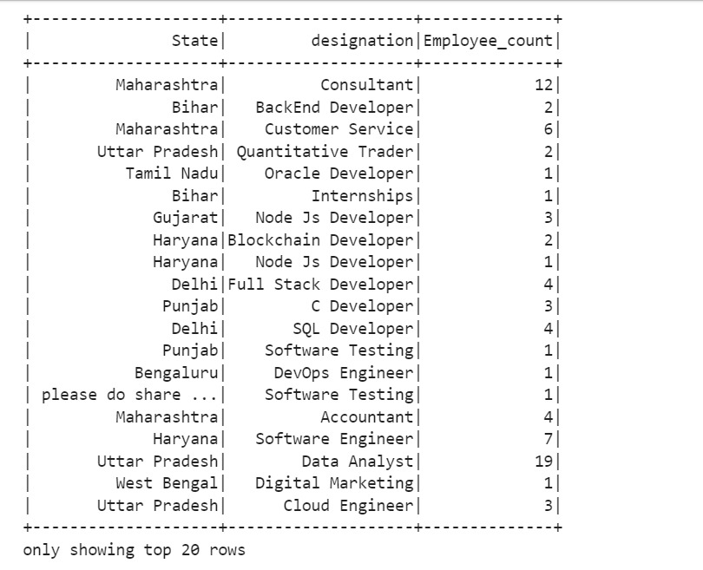
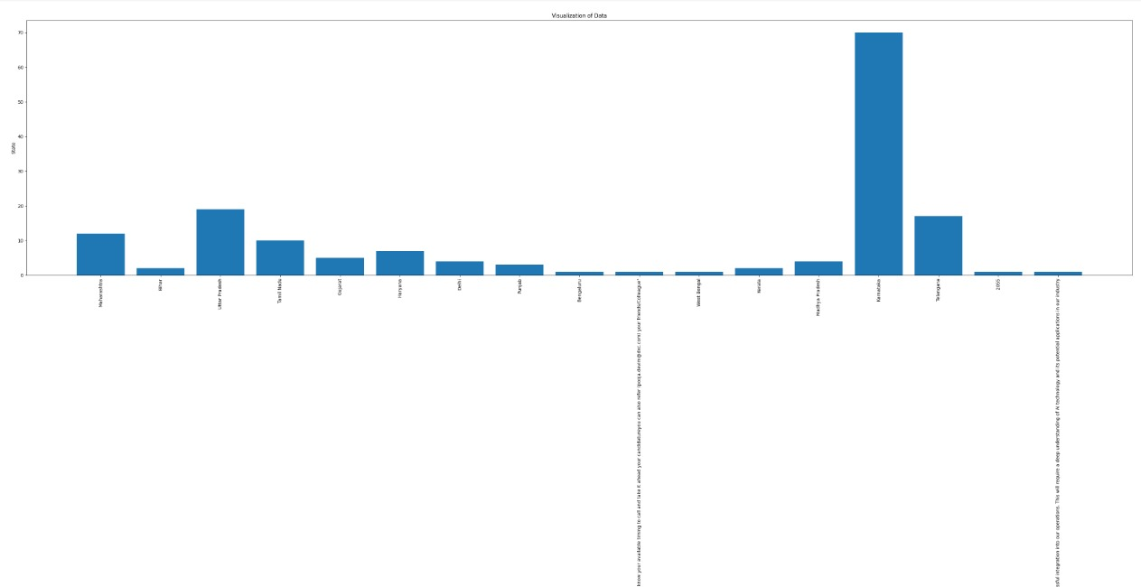
Goals and Implementation(contd…)
output
visualization

Slide 14
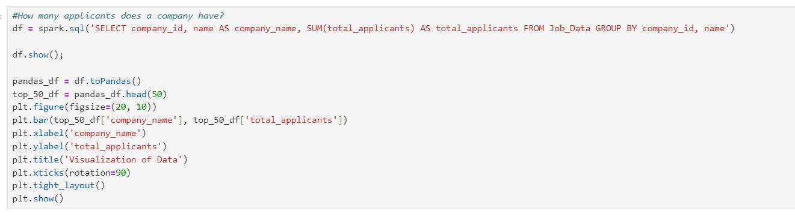
Goals and Implementation(contd…)
How many applicants does a company have?

Slide 15
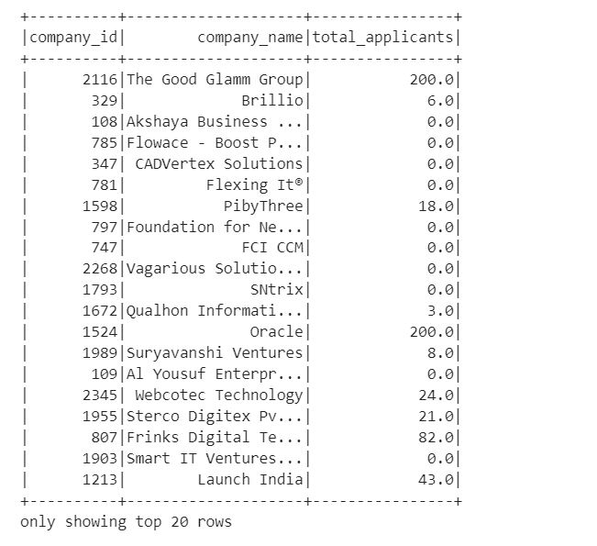
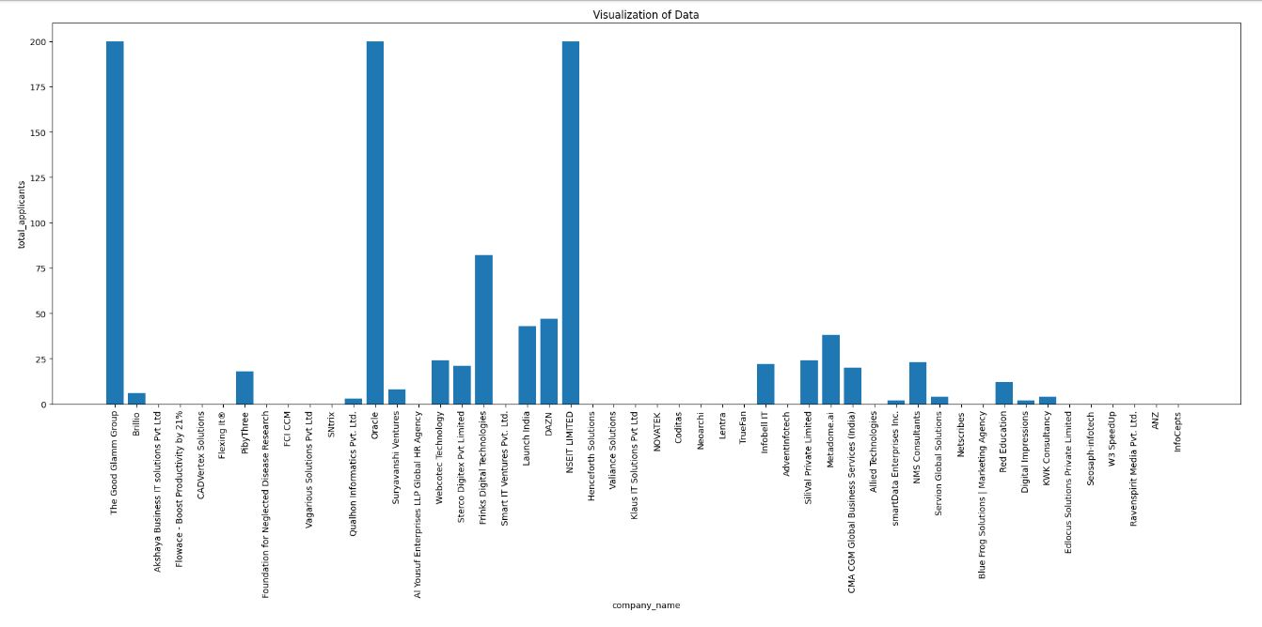
Goals and Implementation(contd…)
Output
Visualization

Slide 16
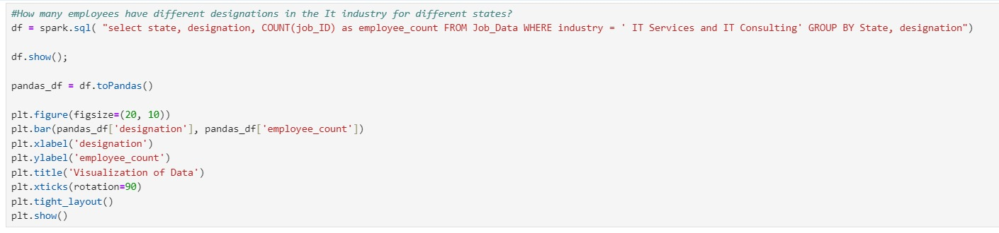
Goals and Implementation(contd…)
How many employees have different designations in the It industry for different states?

Slide 17
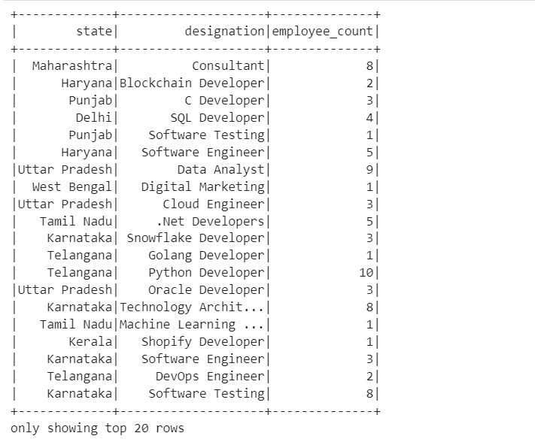
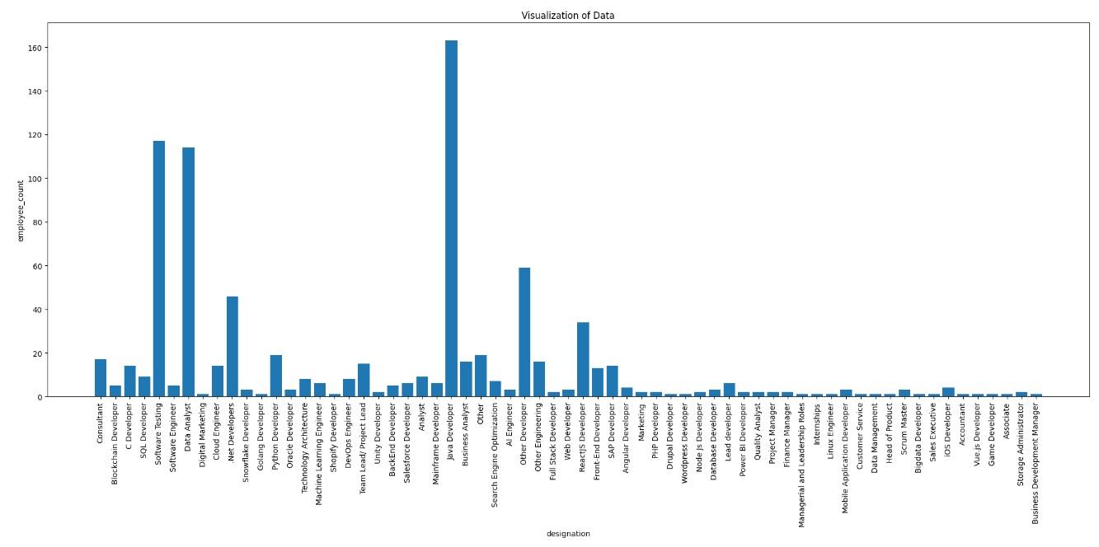
Goals and Implementation(contd…)
Output
Visualization

Slide 18
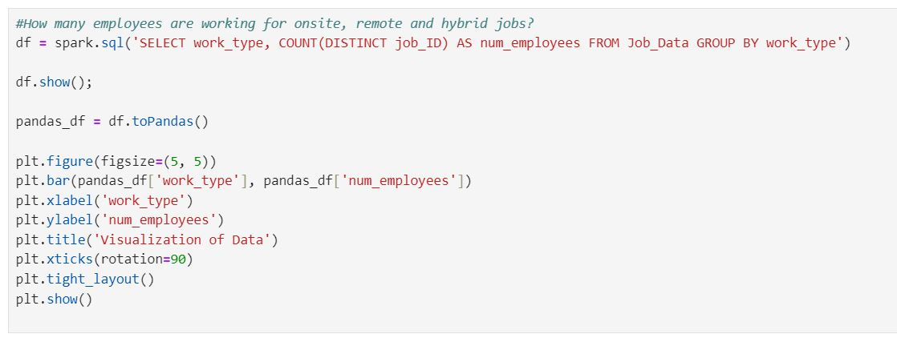
Goals and Implementation(contd…)
How many employees are working for onsite and remote jobs?

Slide 19
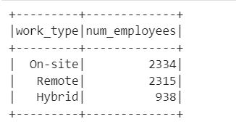
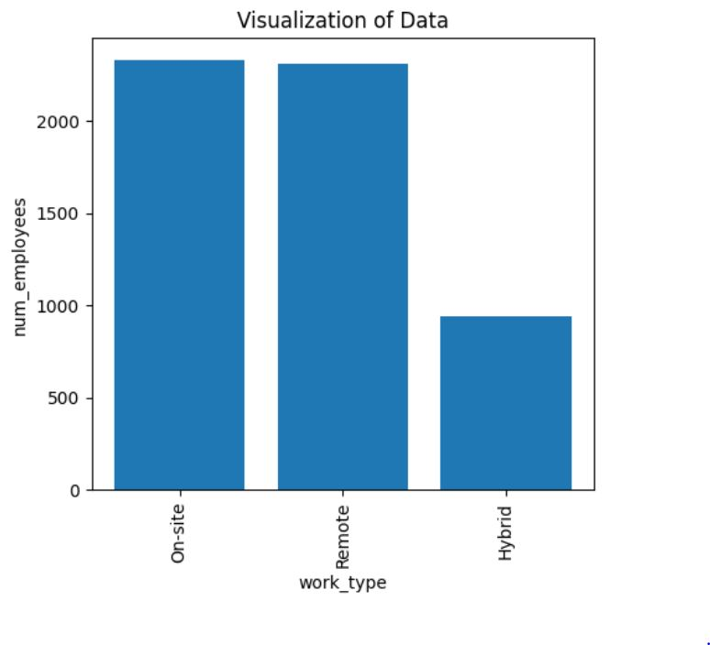
Goals and Implementation(contd…)
Output
Visualization

Slide 20
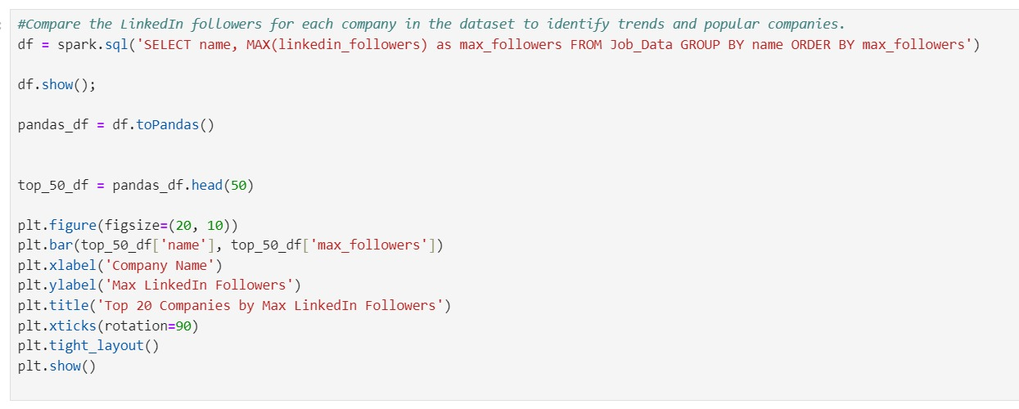
Goals and Implementation(contd…)
Compare the LinkedIn followers for each company in the dataset to identify trends and popular companies.

Slide 21
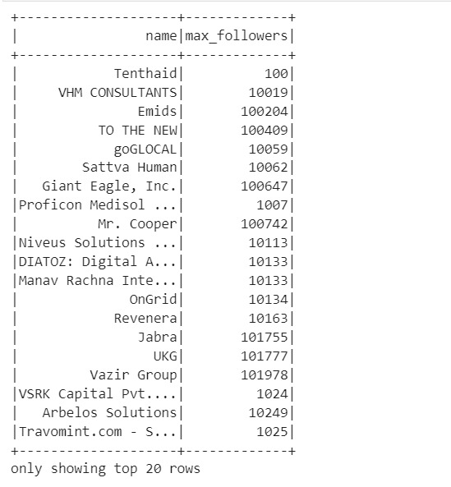
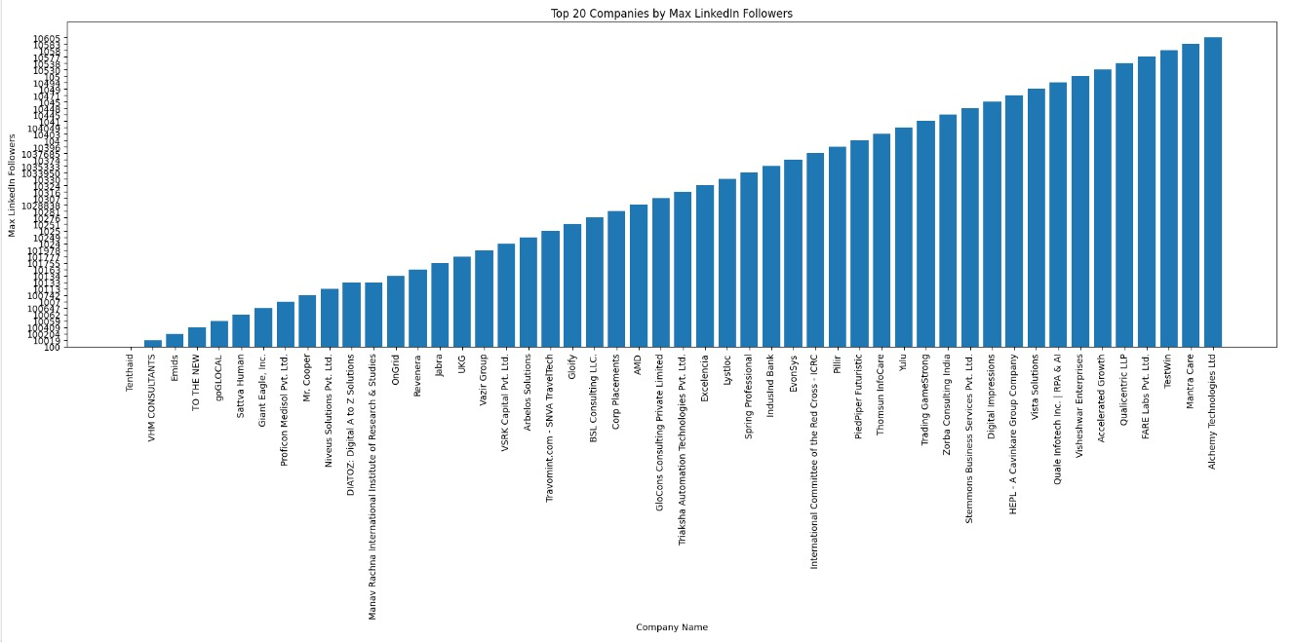
Goals and Implementation(contd…)
Output
Visualization

Slide 22
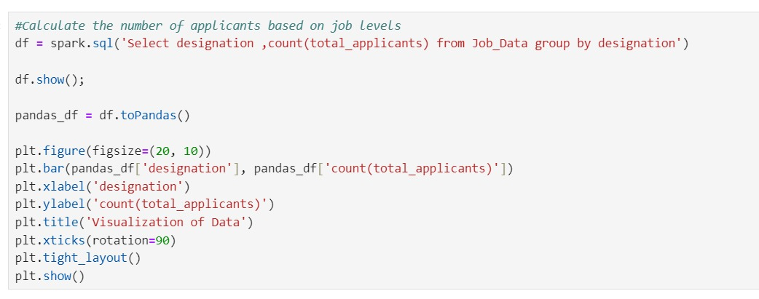
Goals and Implementation(contd…)
Calculate the number of applicants based on job levels.

Slide 23
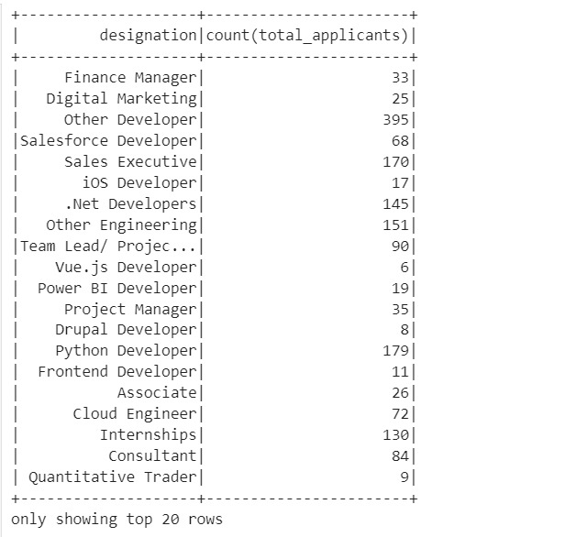
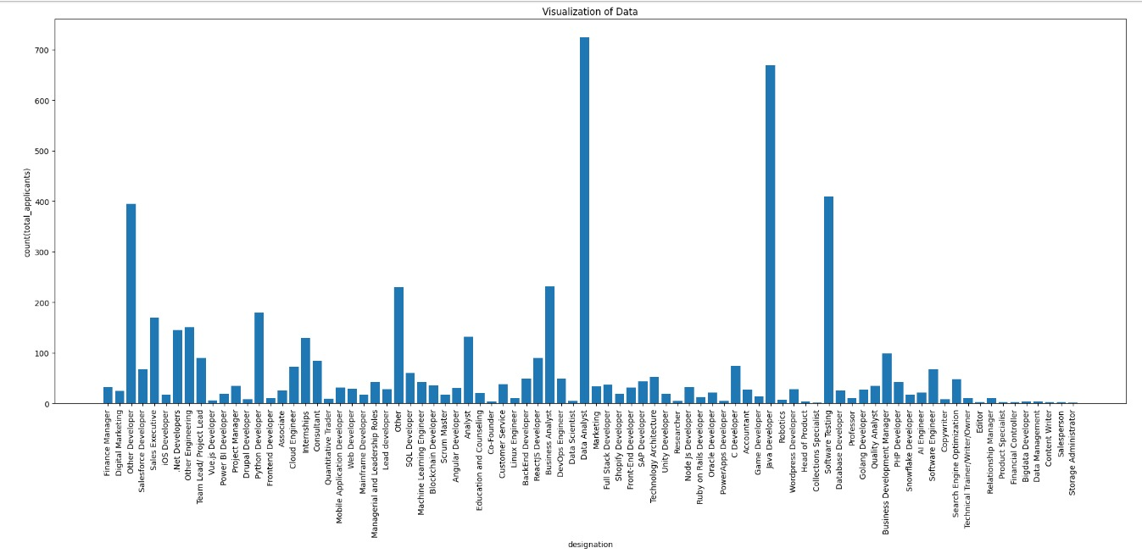
Goals and Implementation(contd…)
Output
Visulaization

Slide 24
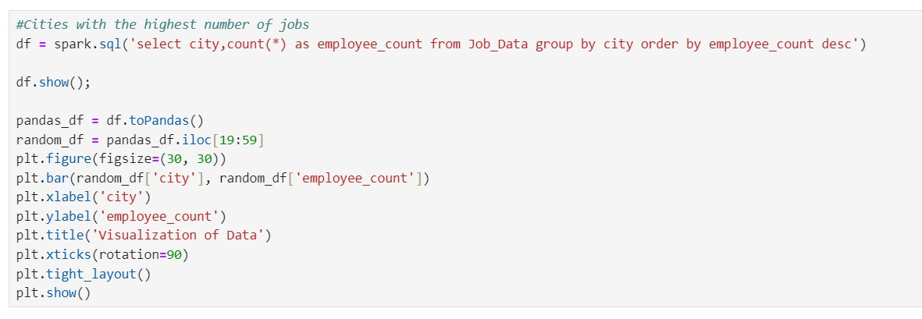
Goals and Implementation(contd…)
Cities with the highest number of jobs.

Slide 25
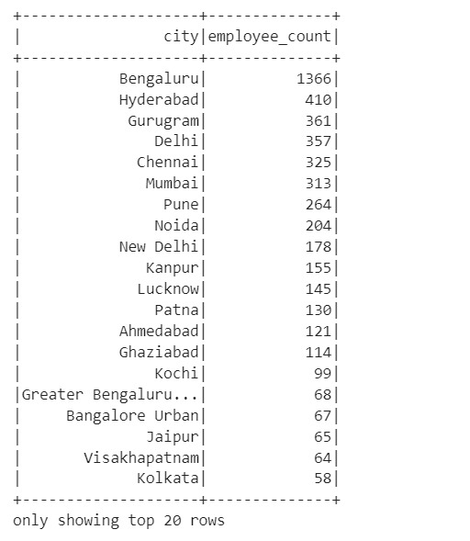
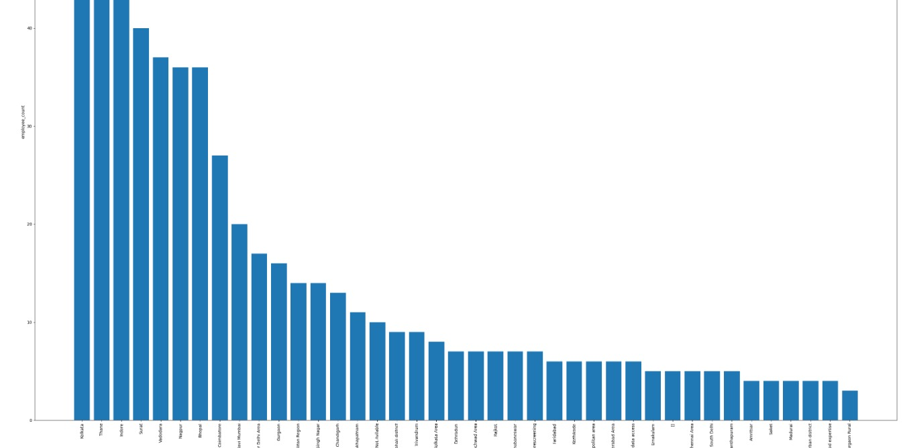
Goals and Implementation(contd…)
Output
Visualization

Slide 26
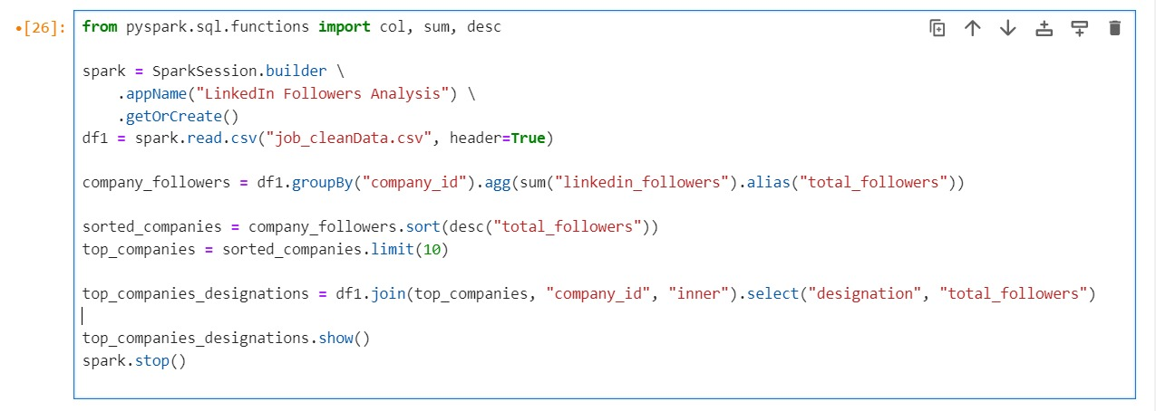
Goals and Implementation(contd…)
Designations among companies with the highest LinkedIn followers.

Slide 27
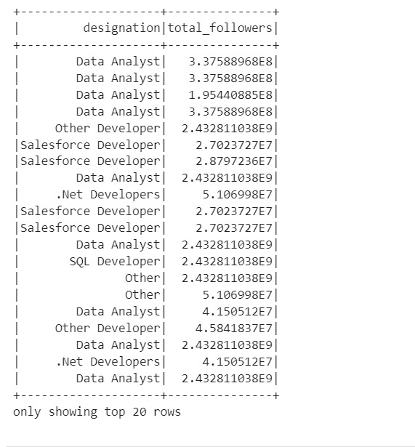
Goals and Implementation(contd…)
Output:

Slide 28
Conclusion
Using PySpark, the project gave useful insights on industry trends, job types, demographics, and corporate popularity.
The project helps HR and talent acquisition professionals make educated decisions by analyzing job opportunities, applicant patterns, and business profiles.
It improves personnel planning, recruiting techniques, and corporate positioning.
Continuous monitoring and study of sophisticated analytics will improve prediction capacities and ensure relevance in a changing workforce scenario.

Slide 29


