Slide 1

Blood Bank System
Client: Dr. Mark Chai
Team Members: 1. Naga Lakshmi Konanki – s562695
2. Meghana Gade – s559865
3. Anuradha Gudimetla – s558919
4. Meghala Anumolu – s559964
5. Kalpana Bolla – s559962
6. Greeshma Jale – s555082

Slide 2
Project Outline
The Blood Bank System is a comprehensive platform designed to facilitate seamless interactions among donors, patients, and blood banks. For donors, the system offers user-friendly authentication processes, detailed profile management capturing vital information, and efficient request handling.
Patients benefit from an intuitive interface for searching and viewing potential donors, live chat capabilities, and scheduling options. The system ensures robust administration with features like profile management, oversight of donation relationships, and dedicated customer support/chat functionality.
With a focus on security, the system implements secure authentication methods and data encryption. The project encompasses thorough testing phases, including unit testing and user acceptance testing, and outlines a deployment plan for both the mobile app and backend systems.
Future enhancements and maintenance considerations are also integrated, ensuring the long-term viability and adaptability of the Blood Donation Management System.

Slide 3

Introduction
In the evolving landscape of healthcare technology, the Blood Donation Management System stands as a pivotal solution, addressing the critical need for efficient coordination among donors, patients, and blood banks.
Recognizing the significance of timely and well-managed blood donations, this system aims to streamline the donation process, enhance user experiences, and contribute to the overall effectiveness of blood transfusion services.
By leveraging modern technologies and frameworks, the platform ensures secure and user-friendly authentication for donors and patients, detailed profile management, and real-time communication channels. Administered by robust administrative features, including oversight of donation relationships and customer support, the system embodies a comprehensive approach to blood donation management.

Slide 4
Problem Statement
Old-fashioned System: The local blood bank relies on manual methods and paperwork, making it tough to connect donors with patients efficiently.
Scattered Information: Donor details are all over paper files, making it hard for staff to quickly find important information like availability, blood types, and health history.
Inventory Challenges: Counting blood units manually and using paper logs makes tracking supply and identifying shortages or expired units on time difficult.
Need for Digital Upgrade: The blood bank needs a simple mobile app to work better. This would help manage inventory, track requests, coordinate with donors, and analyze data. However, the cost and training should be considered.

Slide 5
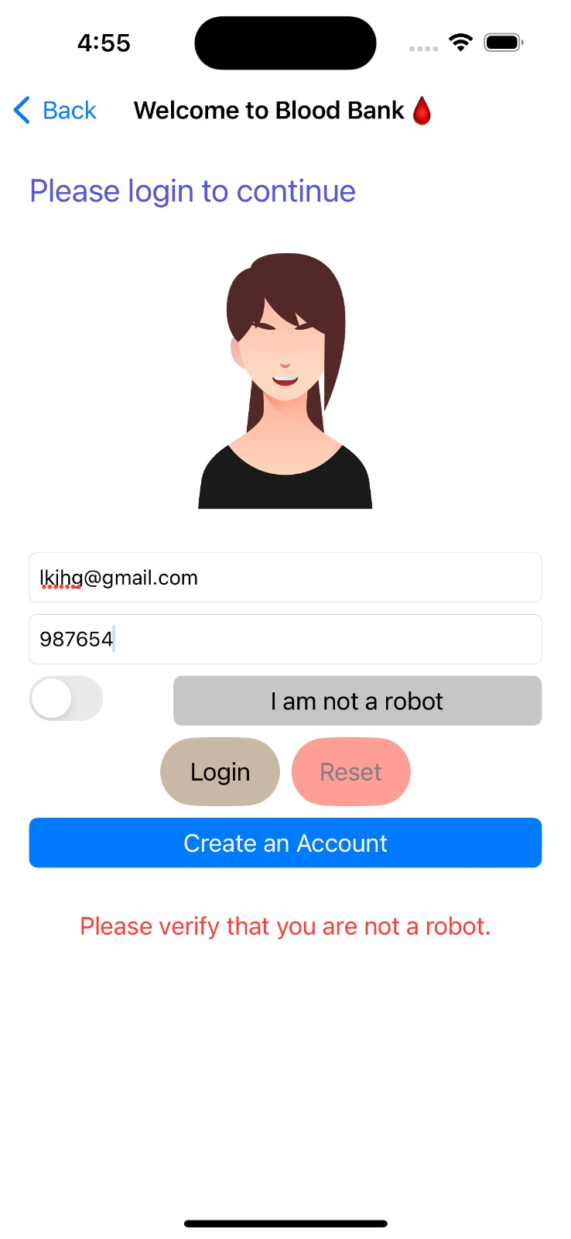
Use Cases
1. Donor Registration:
Donor signs up by entering name, contact, and blood type.
System checks details, creates a new account and tells the donor.
2. Find Patients:
Donor looks for patients by location and blood type.
System shows related patient requests.
Donor picks a request to learn more.
3. Manage Donor Profile:
Donor logs in, and edits contact and health info.

Slide 6
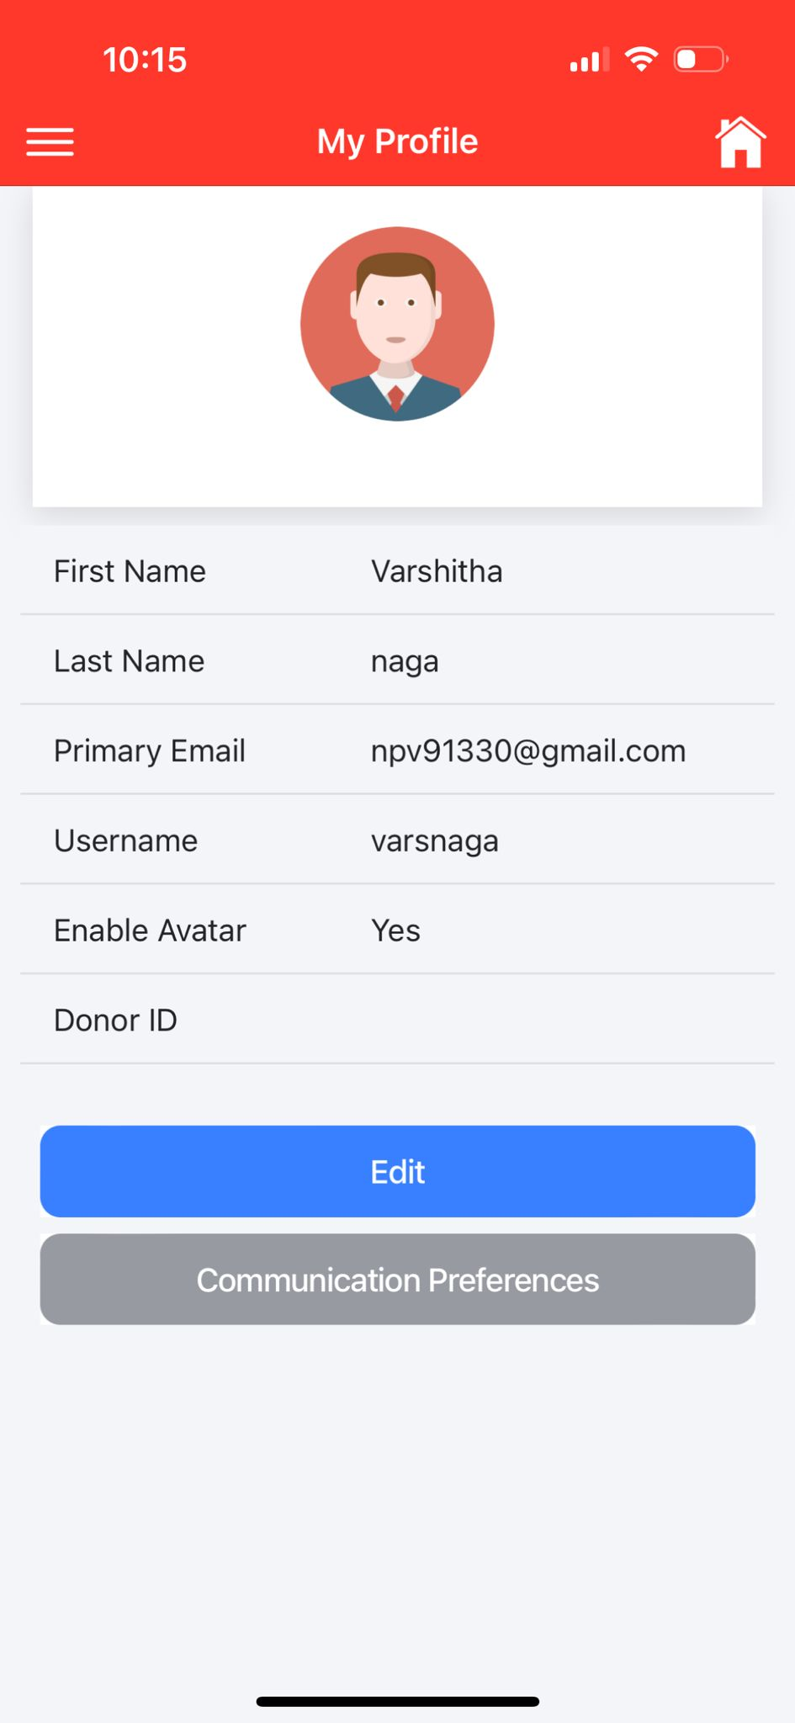
4. Patient Registration:
Patient signs up, giving name, contact, and blood type.
System checks, creates a new account and confirms.
5. Request Blood:
Patient logs in and specifies blood needs.
System validates and notifies matching donors.
6. Manage Patient Profile:
Patient logs in, and updates contact and health info.

Slide 7
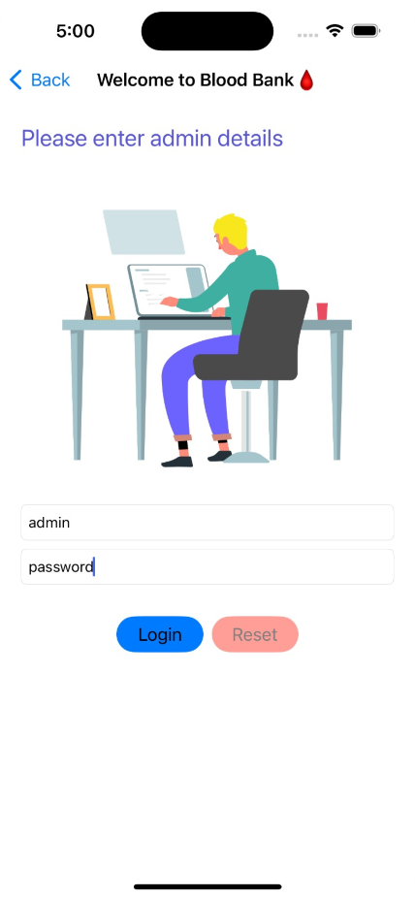
7. Admin Handles Donors:
Admin logs in, and searches for donors.
Views and updates donor details.
System saves updates.
8. Admin Handles Patients:
Admin logs in, and searches for patients.
Views and updates patient details.
System saves updates.
9. Admin Manages Blood Supply:
Admin logs in, and checks blood levels.
Updates inventory with new donations.
System saves changes.

Slide 8

Functional Requirements
Essential Features:
Users and admins must easily sign up.
Donors and patients need to manage their profiles.
Secure logins are a must for everyone.
Key Functions:
Keep a secure list of authorized blood donors and control the blood supply.
Let authorized staff handle and update donor info.

Slide 9
Desirable Features:
Make it easy for donors with a simple interface.
Allow donors to schedule blood donation appointments.
Enable chatting between those giving and receiving blood.
Let users share feedback and rate their donation experiences.
Optional Features:
Explore features like tracking where donated blood goes.
Consider linking with social media for donation updates.
Think about a scheduler for blood donations and wearable device integration.
If possible, create a loyalty program to encourage more donations.

Slide 10
Non-Functional Requirements
Smooth Performance:
The app should respond quickly and work smoothly, even with many users.
It must use memory efficiently for a seamless experience on different iPhones and iPads.
Handling Growth:
As more people use the app, it should still perform well.
It should easily add resources or parts to keep working smoothly as more people and data are added.
Reliable and User-Friendly:
The app should work consistently without crashes.
It needs to be user-friendly, with clear instructions for people of all tech levels.
If something goes wrong, the app should guide users and prevent any data loss.

Slide 11
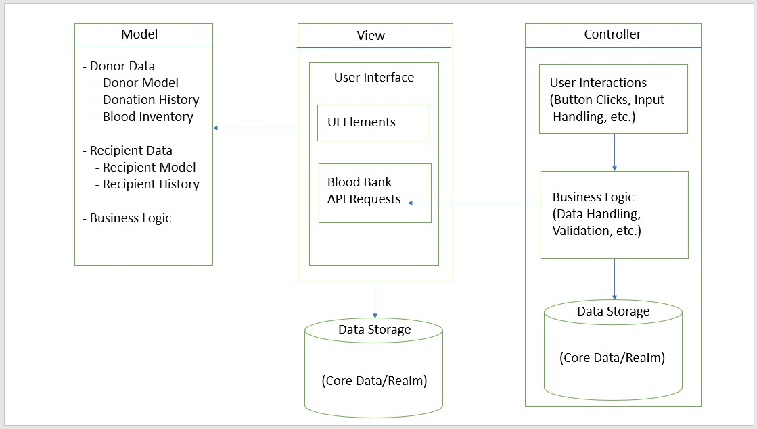
Architecture Diagram
Model Components:
Encompasses Donor Model, Donation History, Blood Inventory, and Business Logic for handling various aspects of data and logic.
Controller and View:
Controller manages user interactions, coordinating data flow between the View (UI elements) and the Model. Data Storage (Core Data or Realm) interacts with Business Logic in both the Controller and Model.

Slide 12
Architecture Plan
Platforms and Technologies:
Frontend Development: iOS using Swift (Xcode).
Backend Development, Database: JSON for flexibility in handling varied data types.
Third-Party Libraries:
Authentication: Firebase Authentication for secure login.
Real-time Communication: fSocket.IO for live chat and notifications.
FAQ and Chat Functionality: Twilio or integrated email and chat support.
Hosting Strategy and Requirements:
Cloud Hosting: AWS (Amazon Web Services) for scalability.

Slide 13
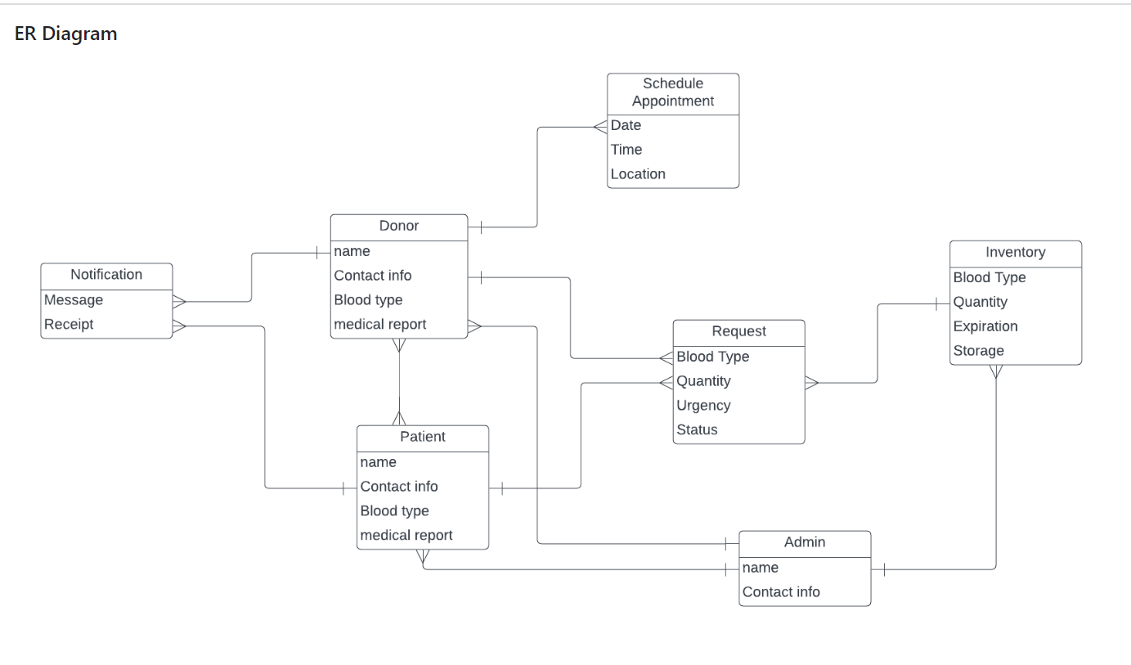
Data Management Plan
The key data entities needed are:
Donor: name, contact info, blood type, medical report
Patient: name, contact info, blood type needed, medical report
Request: blood type, quantity, urgency, status
Appointment: date, time, location
Notification: message, recipient
Inventory: blood type, quantity, expiration, storage

Slide 14
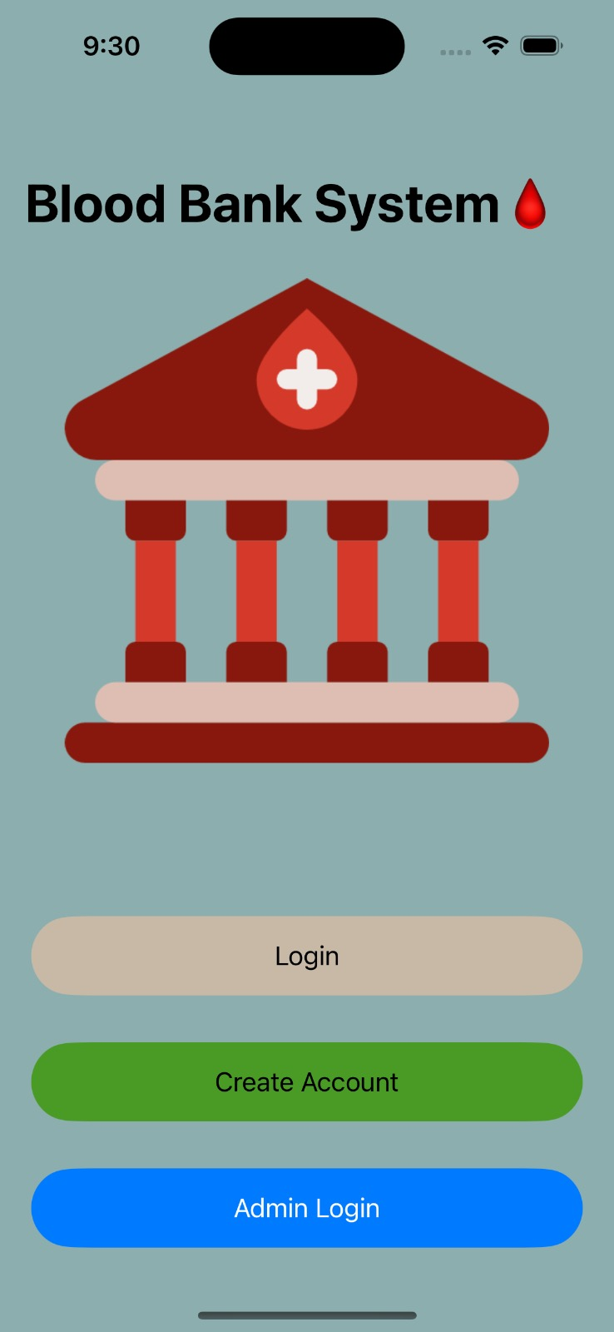
GUI
In the iOS Blood Bank System, We have developed secure user login and registration pages, incorporating Firebase for efficient authentication. The admin section facilitates easy management.
Donor’s benefit from a robust profile system, featuring management tools and an editing option. Additionally, the system allows donors to schedule appointments using location services, enhancing convenience.
To enhance communication, users can set preferences for email and mobile number notifications, ensuring a seamless and user-friendly experience.

Slide 15
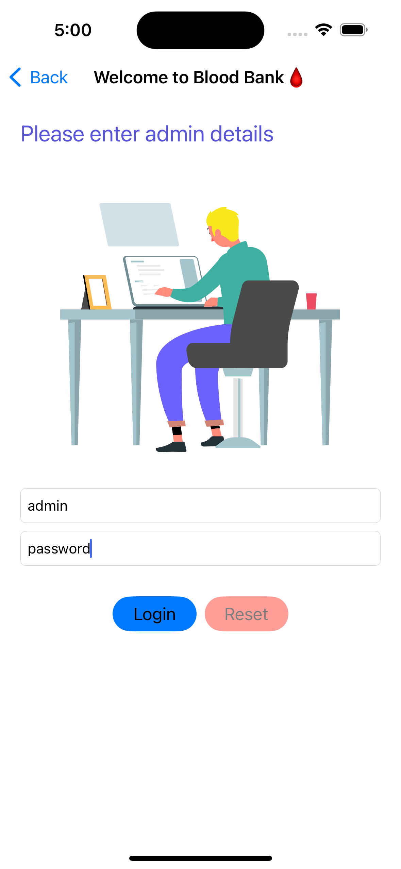
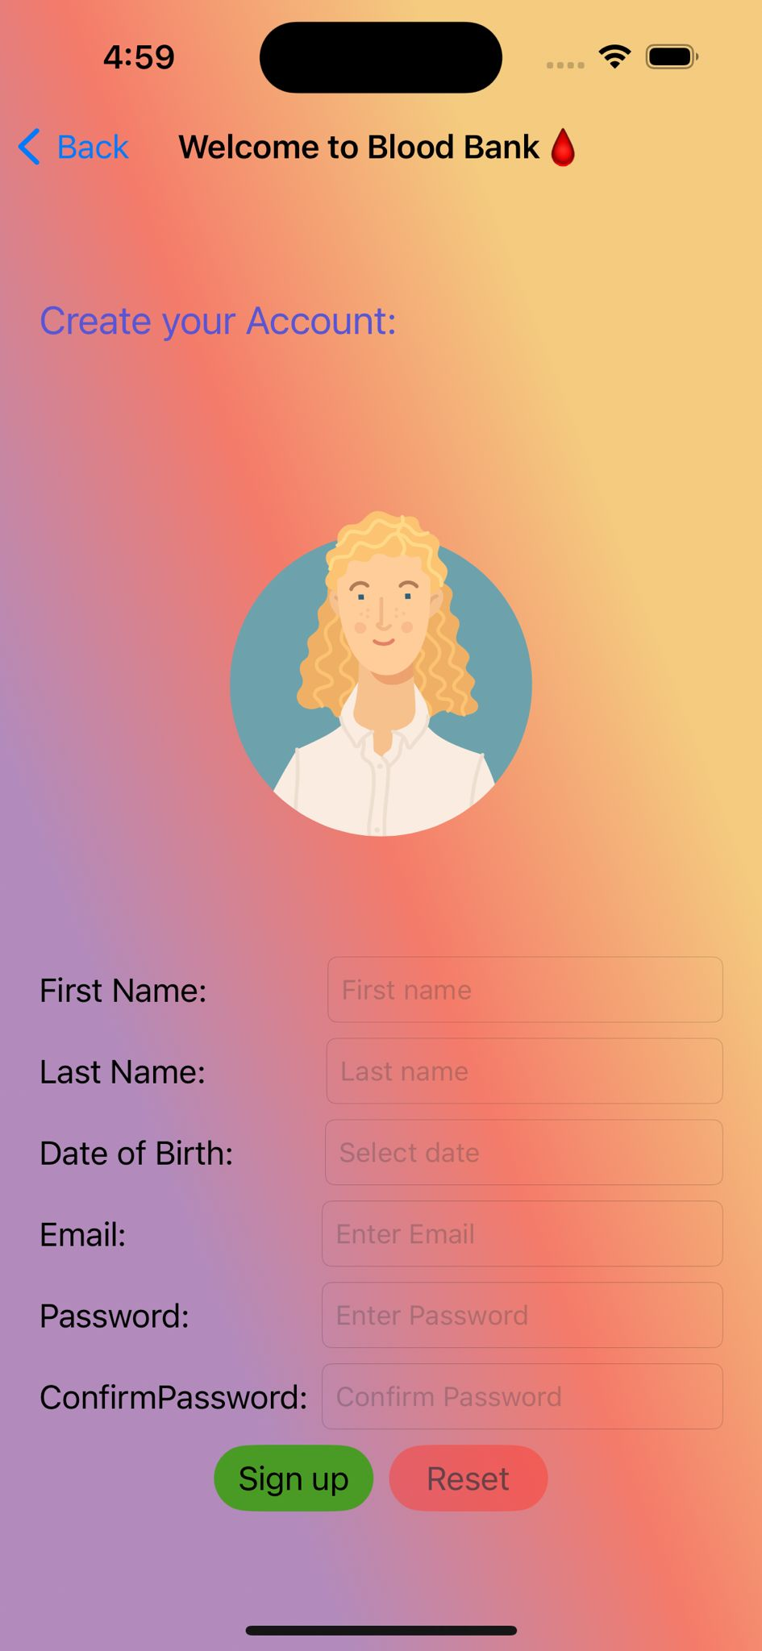
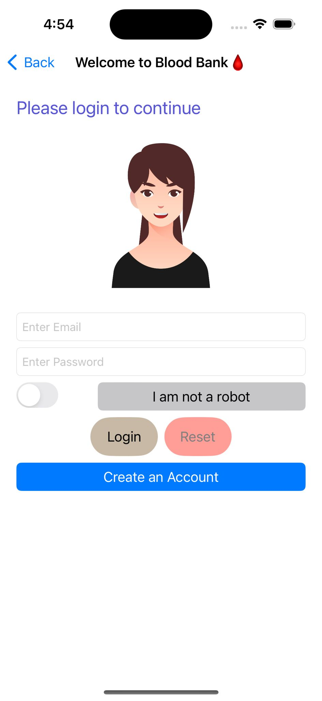
GUI – Admin, Registration and Login Pages

Slide 16
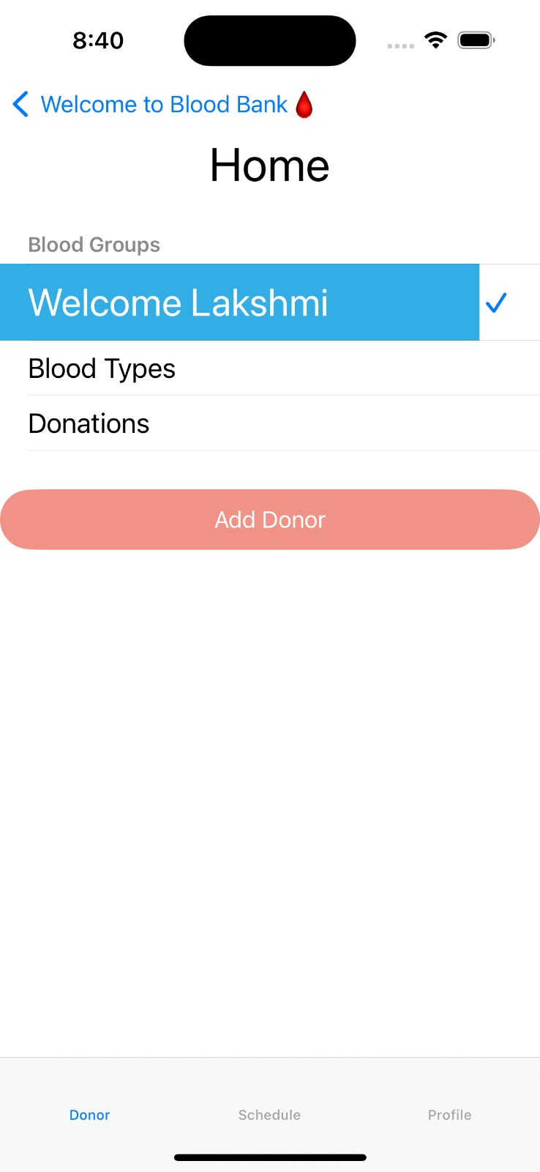
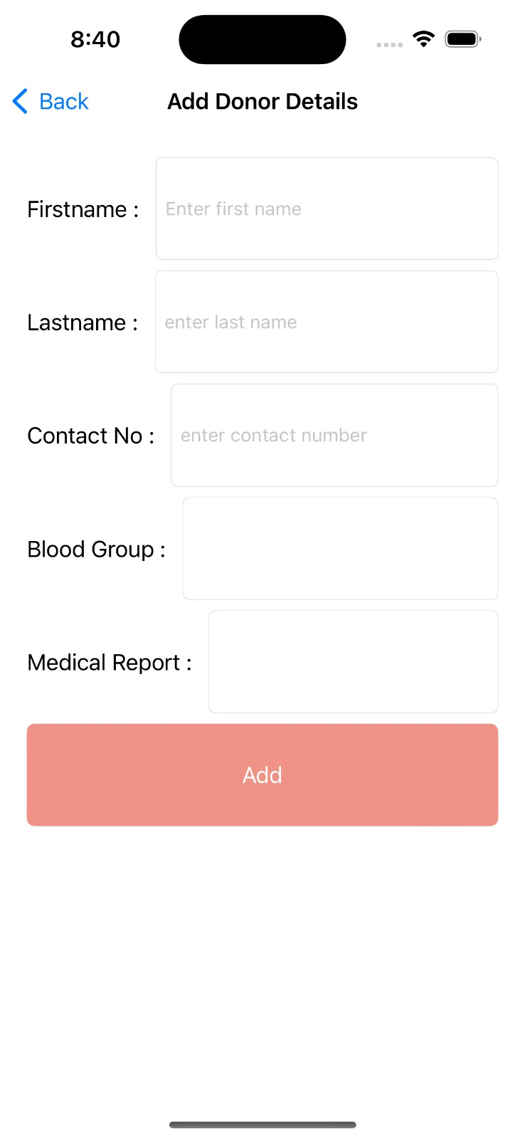
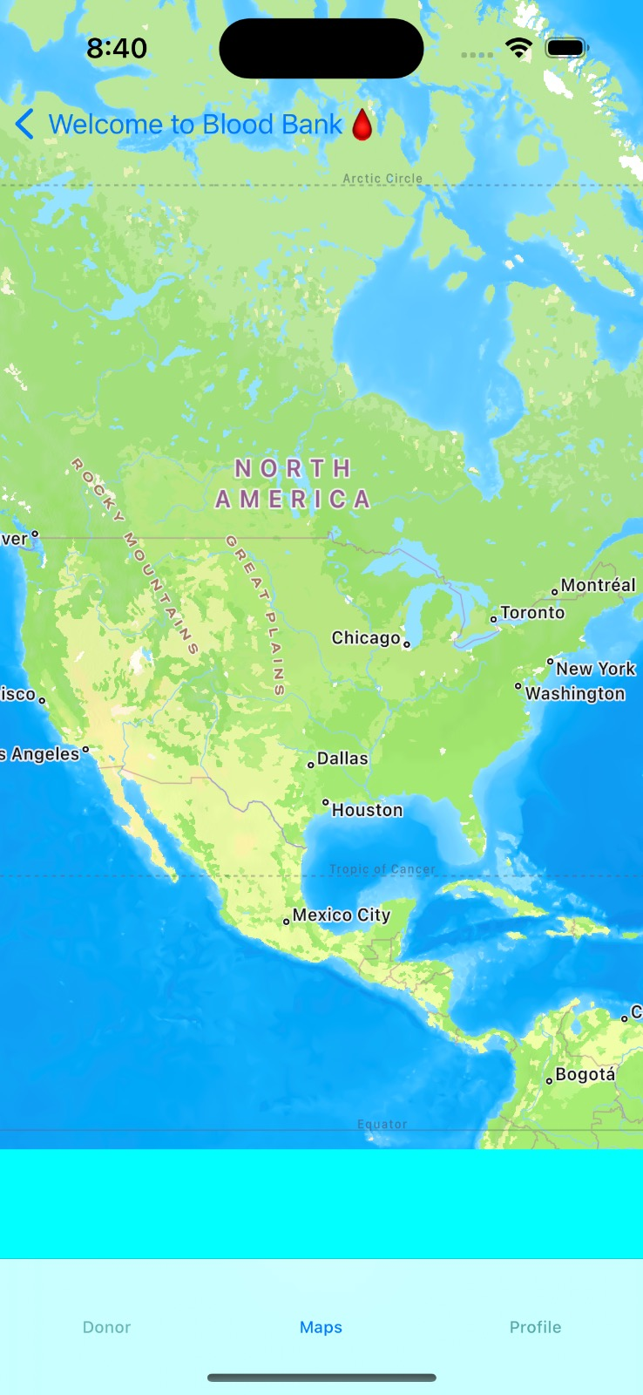
GUI - Donor home page, Services and Schedule button that uses our location

Slide 17
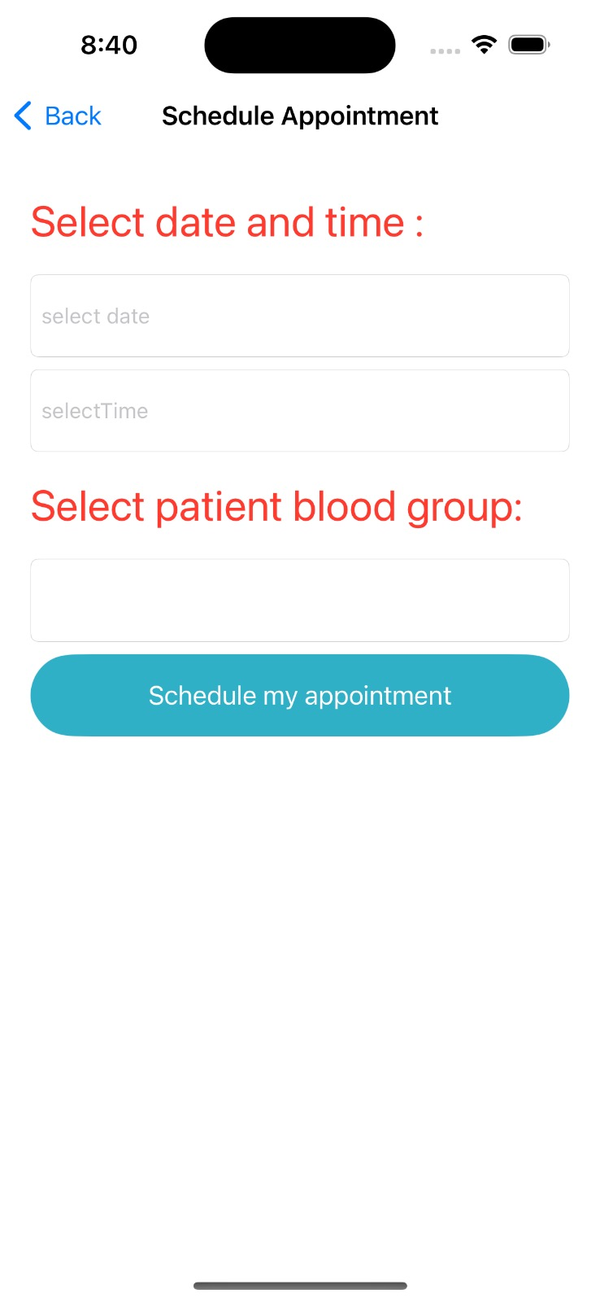
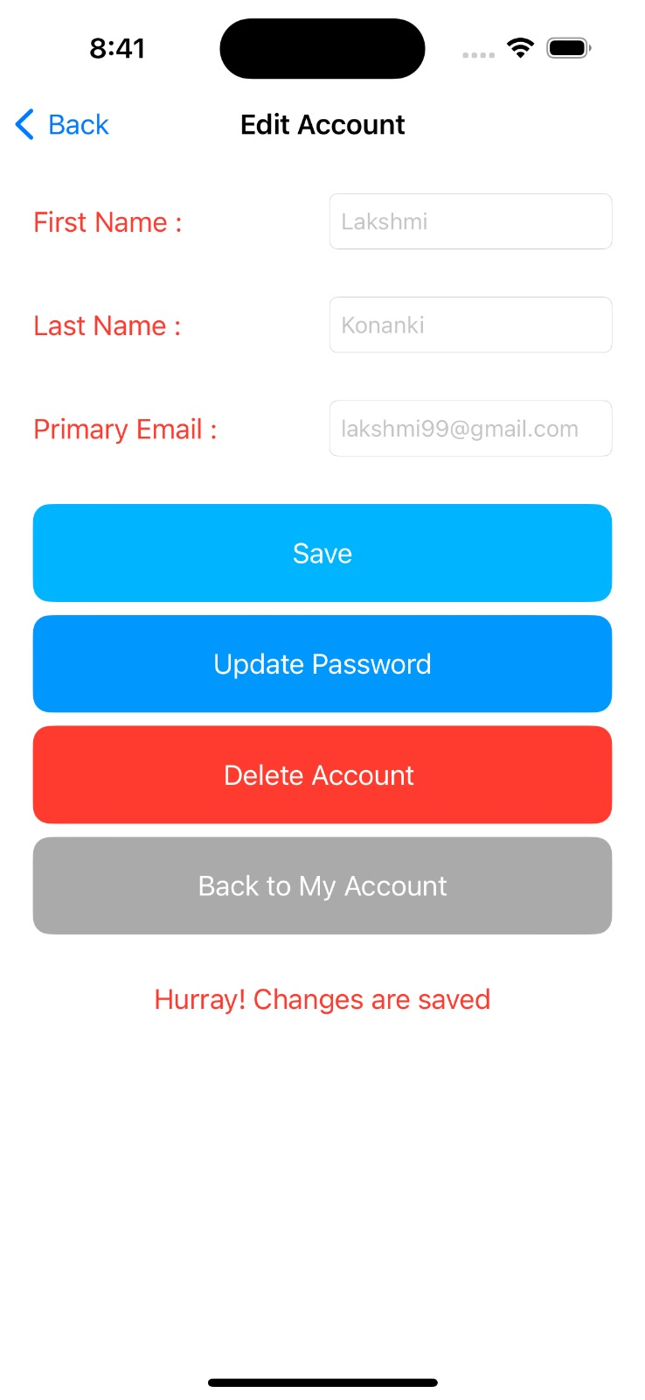
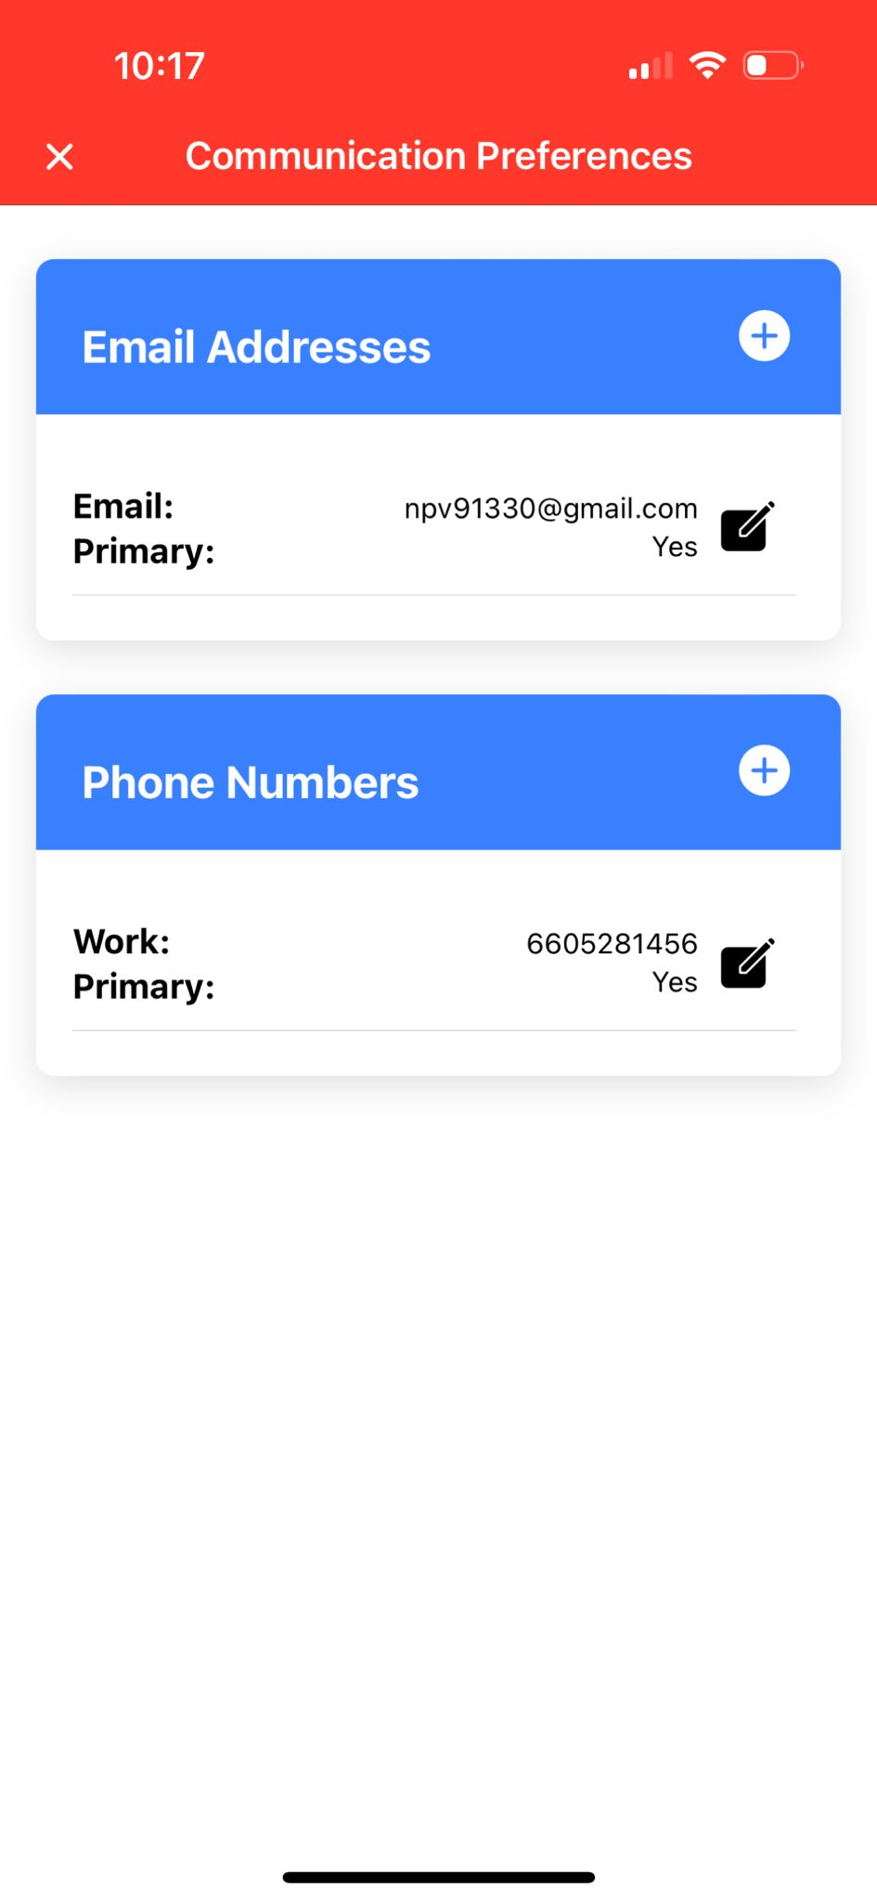
GUI – Donor Profile Management & Communication Services

Slide 18
What has been accomplished?
With features such as username/password fields, error handling to privacy laws, an iOS login page for a Blood Bank app ensures secure access to critical health data.
The registration screen of the Blood Bank iOS app makes it easier for new users to join by gathering crucial personal and contact information, providing secure access.
The front page of the Blood Bank iOS app prominently displays separate areas for Accepters and Donors, simplifying access to crucial blood donation services i.e., Scheduling appointments, profile management, communication preferences, etc.

Slide 19
Spring 2024 Plan
Patient Profiles
Allow patients to create profiles, manage their history, and receive notifications for blood drives or urgent donation needs and live chats and notifications along with providing FAQs.
Real-time updates
Implement a feature to provide real-time updates on blood availability, ensuring accurate and up-to-date information for users.

Slide 20

THANK YOU

