Slide 1
Flight Delays and Cancellations
From a Kaggle dataset

Slide 2
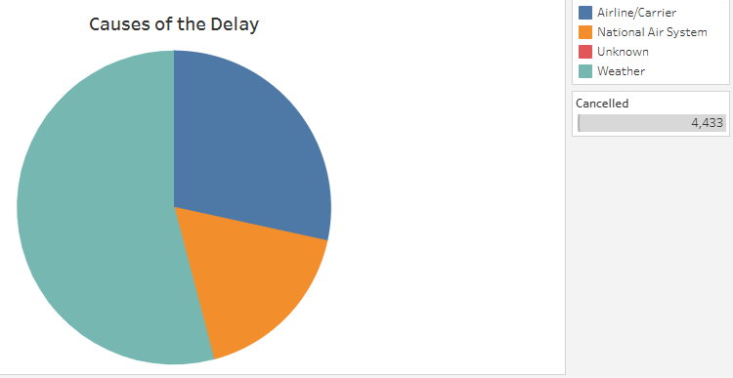
What causes delays?
Here I used Pie chart to detect which of the 4 causes of delays has the most effect over the flights
Airline National
air system
Null
weather
The result is show that the weather has the most effect for flights delays
Notes:
https://public.tableau.com/authoring/UdacityProject_17328633327120/Sheet1/Cancellation%20Reason%20Assignment#1

Slide 3
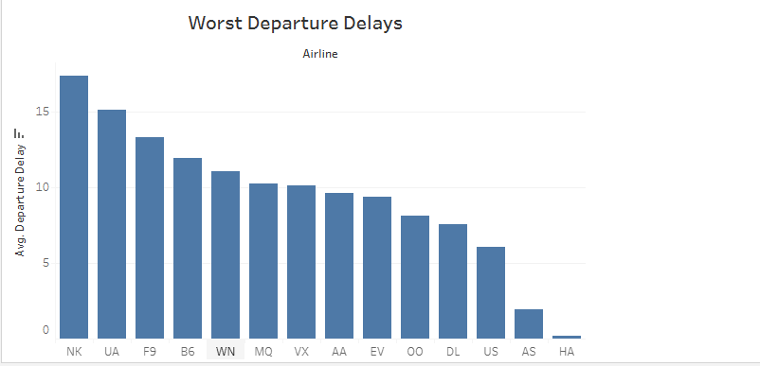
Which airlines have the worst departure delays?
Column chart is used here to measure worst departure delays for airlines. NK airlines has the Worst Departure delay according to the findings.
https://public.tableau.com/authoring/UdacityProject_17328633327120/Story1/Worst%20Departure%20Delays#1
Notes:
https://public.tableau.com/authoring/UdacityProject_17328633327120/Sheet1/AVG%20of%20Weather%20Delay%20for%20Airlines.#1

Slide 4
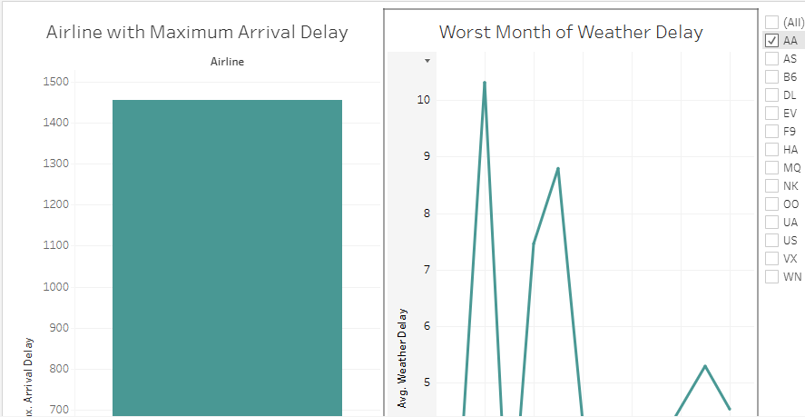
Dashboard for Airline with maximum arrival delay and worst month of weather delay
I used column charts to measure maximum arrival delay for each Airline, and line chart to describe worst month of weather delay.
I provide filter for Airlines to easy choose which its intended to see its delay.
Notes:
https://public.tableau.com/authoring/UdacityProject_17328633327120/Story1/Worst%20Month%20of%20Weather%20Delay#1

