Slide 1
Credit Risk Classification Using Machine Learning Strahinja Nakić 500809487 July 28, 2025

Slide 2
Predict whether borrowers are good or bad credit risks Use simple, interpretable models Apply models suitable for risk/compliance work environments Evaluate performance using accuracy, recall, confusion matrix, and cross-validation
Project Objective

Slide 3
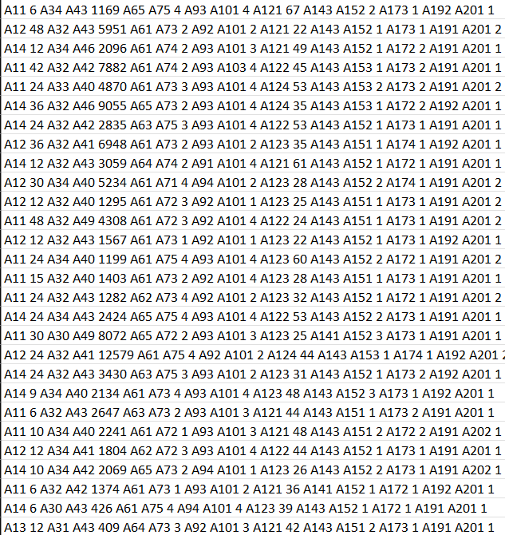
Dataset Overview
Dataset: German Credit Dataset from UCI
1000 rows, 20 features, binary target
Includes both numerical and categorical data
No header row — columns manually assigned
Source: UCI Machine Learning Repository. The German Credit dataset contains 1,000 observations across 20 features and a binary credit risk label. It is a common benchmark dataset for credit scoring analysis and machine learning classification problems.

Slide 4
Preprocessing and Cleaning
Target converted to binary (1 = good, 0 = bad)
All categorical features label encoded
Features scaled using StandardScaler
Data split using stratified 80/20 train-test split
This flowchart visually summarizes the data preparation pipeline. Raw categorical data is first label encoded, then scaled to ensure feature uniformity, and finally split into training and testing sets to support model development.

Slide 5
Research Questions
?
Can basic models effectively predict creditworthiness?
Which model performs best on our dataset?
Can interpretable models meet risk analysis standards?

Slide 6
Chosen Models
Model | Benefit of using this Model | Key Findings
Logistic Regression | Easiest to interpret | Best recall of 0.864
Decision Tree | Handles more complex non-linear patterns | Good baseline model
Naïve Bayes | Simple and performs well with basic tasks | Very lightweight and extremely fast
Logistic Regression: Interpretable and widely used
Decision Tree: Handles non-linear relationships
Naive Bayes: Lightweight and fast
Chosen for simplicity, clarity, and real-world use

Slide 7
Evaluation Metrics
Metric | What is being Measured | Why this is Important
Accuracy | Correct Predictions/Total Predictions | Generate Model Performance
Recall | True Positives / (True Positives + False Negatives) | Catches the “Good” borrowers
Confusion Matrix | Breakdown of Predicted vs Actual Outcomes | See type of errors made
Accuracy
Recall (emphasized due to class imbalance)
Confusion Matrix
5-Fold Cross-Validation Score

Slide 8
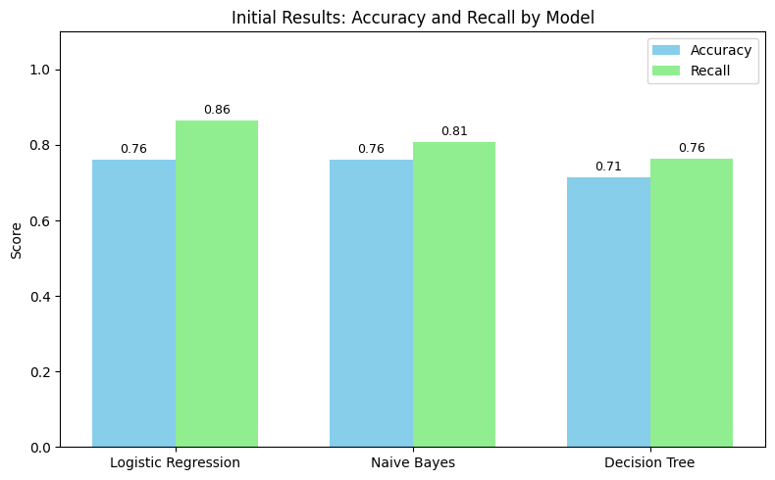
Initial Results
Logistic Regression: 76% accuracy, 0.864 recall
Naive Bayes: 76% accuracy, 0.807 recall
Decision Tree: Lower accuracy, good baseline
All evaluated with cross-validation
Initial performance results of each model. Logistic Regression achieved 76% accuracy and 0.864 recall, followed closely by Naive Bayes. Decision Tree performed as a solid baseline model with lower overall scores but reasonable recall.

Slide 9
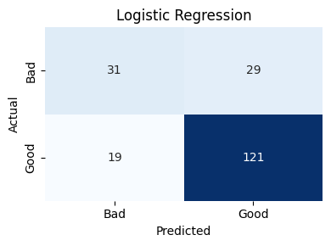
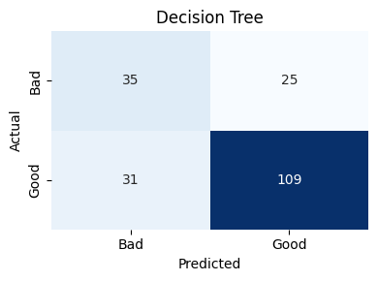
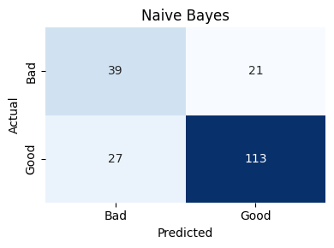
Visualizations
Confusion Matrices for all models
Bar Chart: Accuracy and Recall
Visuals support performance comparison
Enhances clarity of results
Confusion matrices for each model show the breakdown of true positives, true negatives, false positives, and false negatives. This allows for a deeper understanding of each model’s classification behavior, especially in the context of class imbalance (good vs. bad credit).

Slide 10
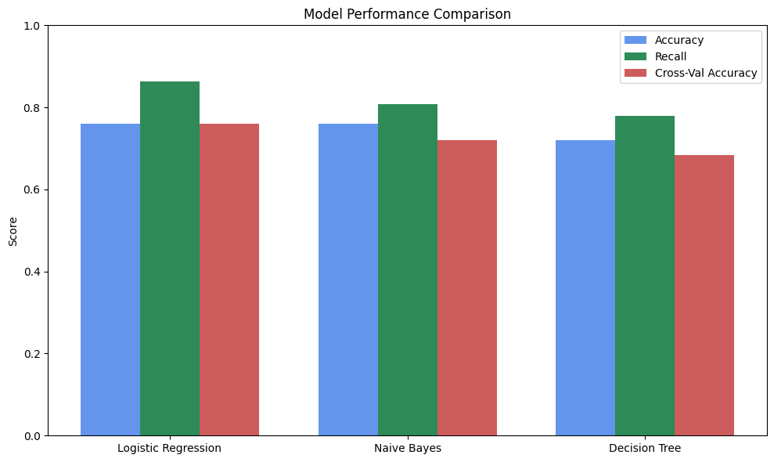
Interpretation
Logistic Regression had highest recall
Prioritizing recall helps avoid false negatives
Simple models performed well
Effective data preparation made a difference
This bar chart compares model performance using Accuracy and Recall. Logistic Regression and Naive Bayes performed similarly in both metrics, while Decision Tree had slightly lower scores. Recall is emphasized due to the importance of identifying good credit risks correctly.

Slide 11
Limitations and Challenges
Small dataset
Many categorical features
No hyperparameter tuning
Limited feature depth

Slide 12
Conclusion and Future Work
Simple models can still produce strong results
Supports idea that interpretable ML is suitable for risk work
Future work:
Feature engineering
Handle imbalance
Try ensemble models

