Slide 1

Agricultural Knowledge Graph
A Semantic Approach to Smart Farming
Siddharth Srivastava | Ulster University
Date-04/01/2026
Student ID: B00964278
Ulster University | MSc Artificial Intelligence | Agricultural Knowledge Graph

Slide 2
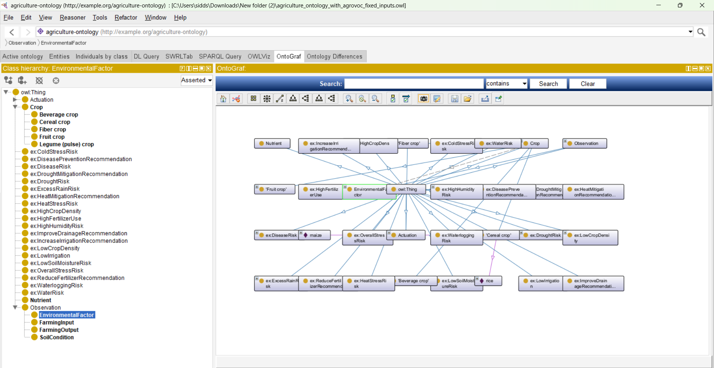
Ontology Overview (OntoGraf)
Shows the complete Agricultural Knowledge Graph with Crop as the central entity connected to observations, risks, and recommendations.
Ulster University | MSc Artificial Intelligence | Agricultural Knowledge Graph

Slide 3
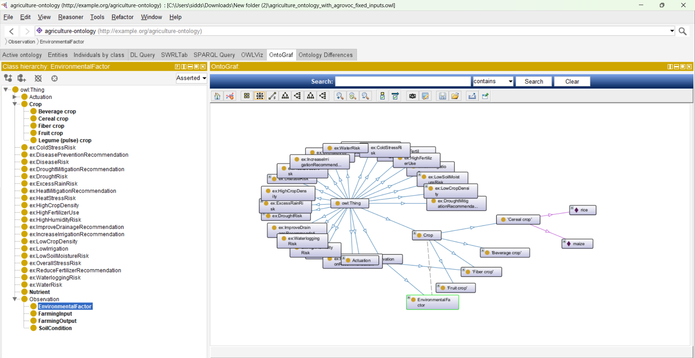
Crop Individuals & Data Population
Illustrates real crop instances populated in the ontology such as rice, cotton, banana, and maize.
Ulster University | MSc Artificial Intelligence | Agricultural Knowledge Graph

Slide 4
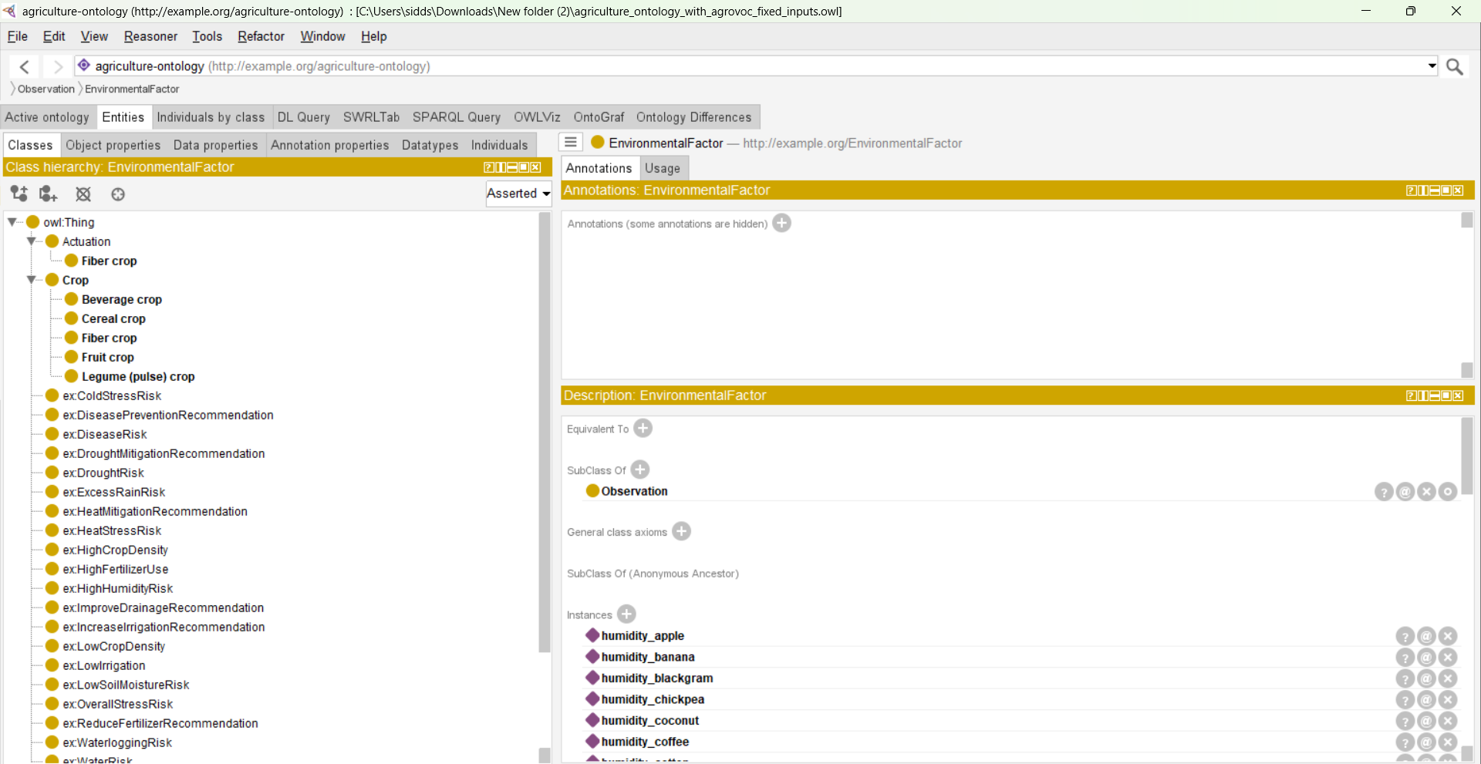
Class Hierarchy Design
EnvironmentalFactor modeled as a subclass of Observation to support extensibility and reuse.
Ulster University | MSc Artificial Intelligence | Agricultural Knowledge Graph

Slide 5
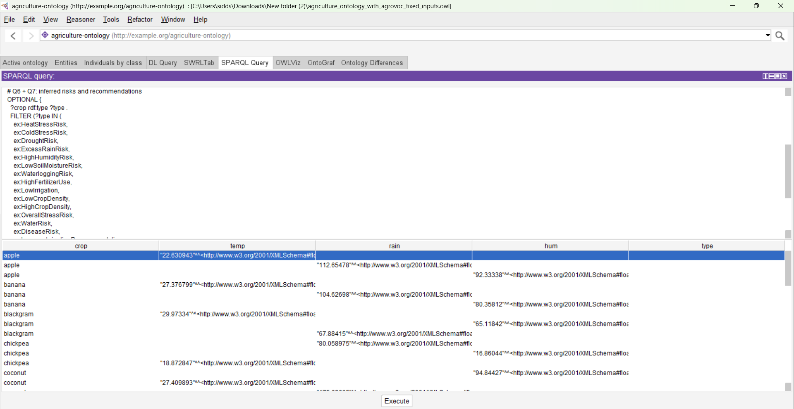
Rule-Based Reasoning with SWRL
Expert SWRL rules infer drought, heat stress, disease, and waterlogging risks.
Ulster University | MSc Artificial Intelligence | Agricultural Knowledge Graph

Slide 6
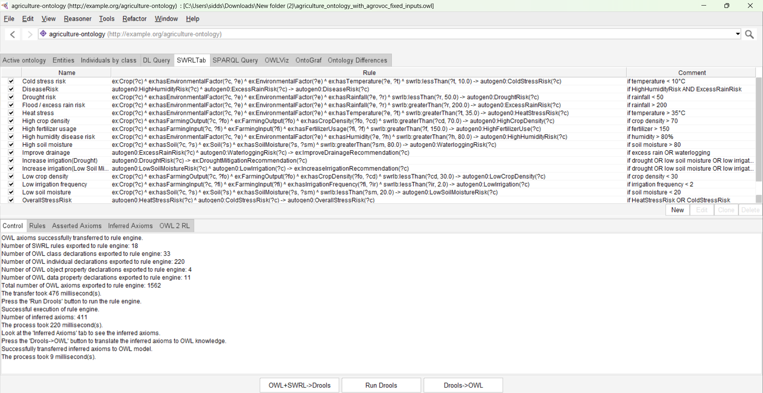
SPARQL Query & Results
SPARQL queries retrieve both asserted environmental data and inferred risks.
Ulster University | MSc Artificial Intelligence | Agricultural Knowledge Graph

Slide 7
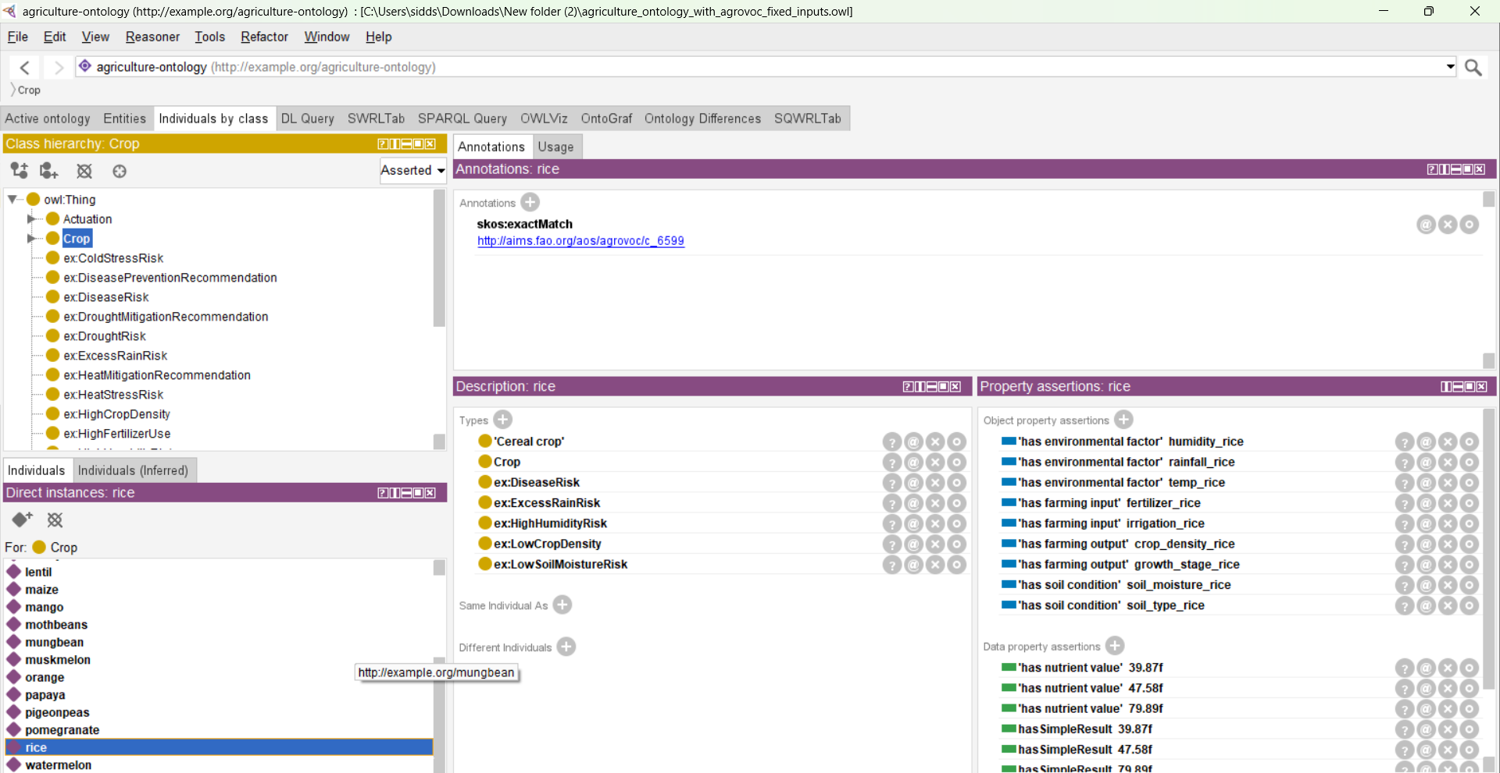
Rice Case Study – Inferred Risks
Rice crop individual showing multiple inferred agronomic risks after reasoning.
Ulster University | MSc Artificial Intelligence | Agricultural Knowledge Graph

Slide 8
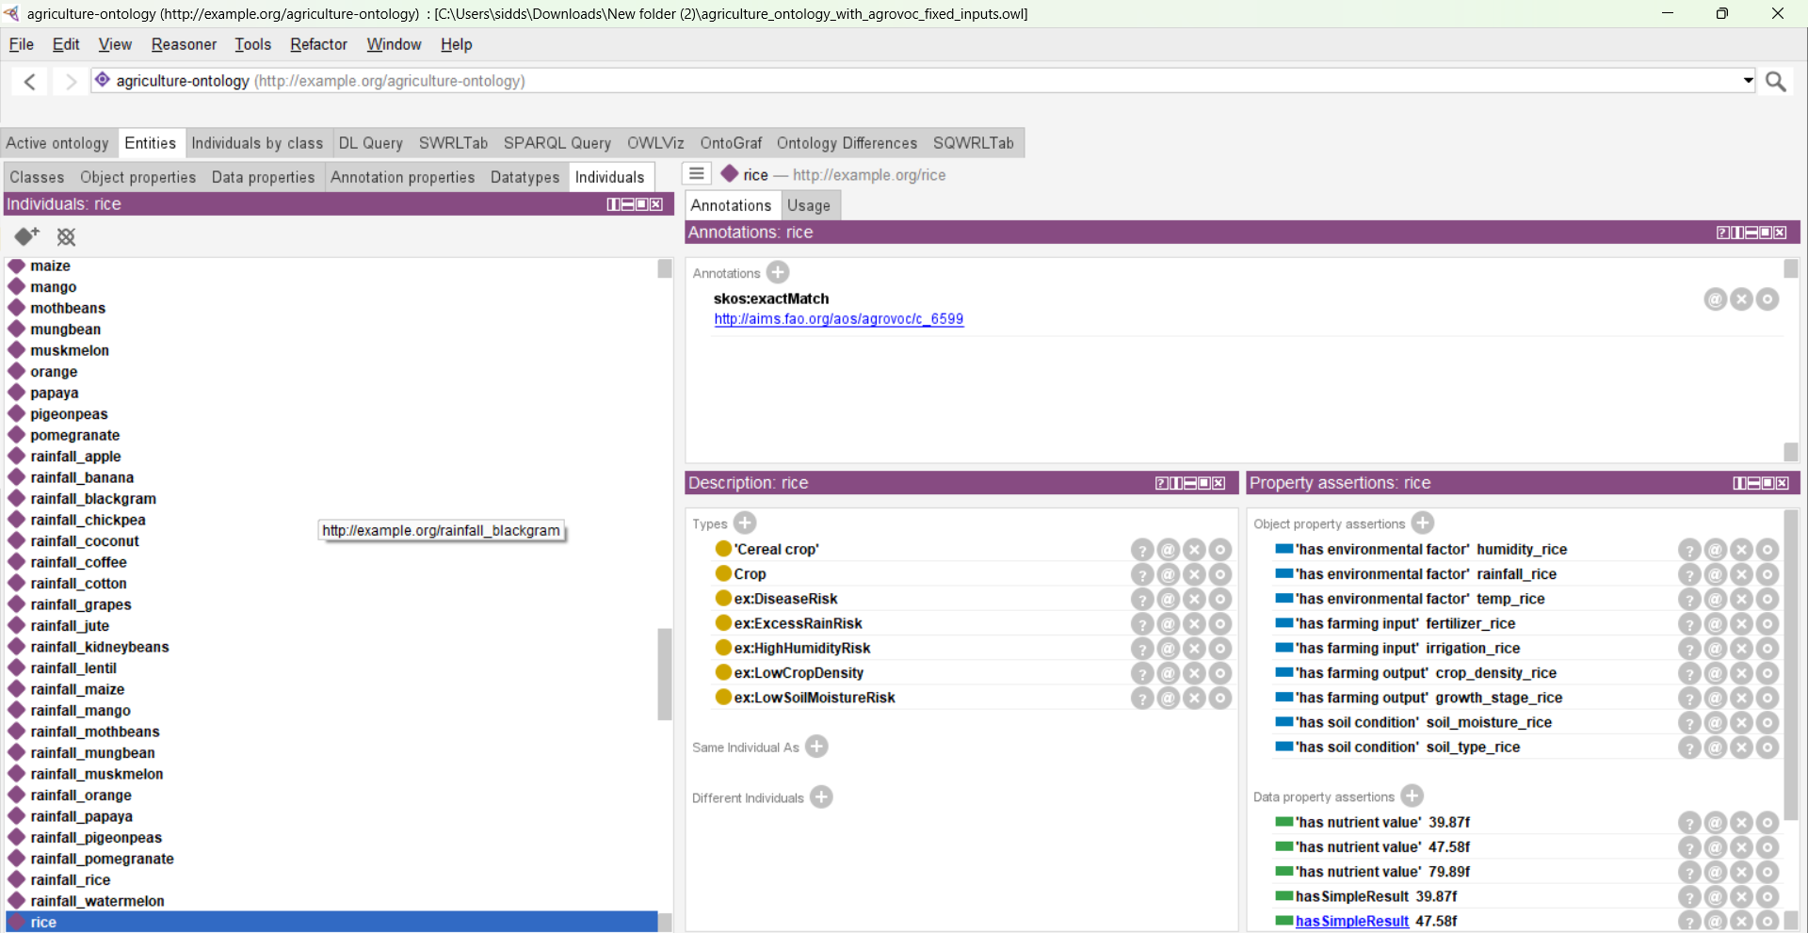
Rice Case Study – AGROVOC Alignment
Semantic alignment of rice with FAO AGROVOC using skos:exactMatch.
Ulster University | MSc Artificial Intelligence | Agricultural Knowledge Graph

Slide 9
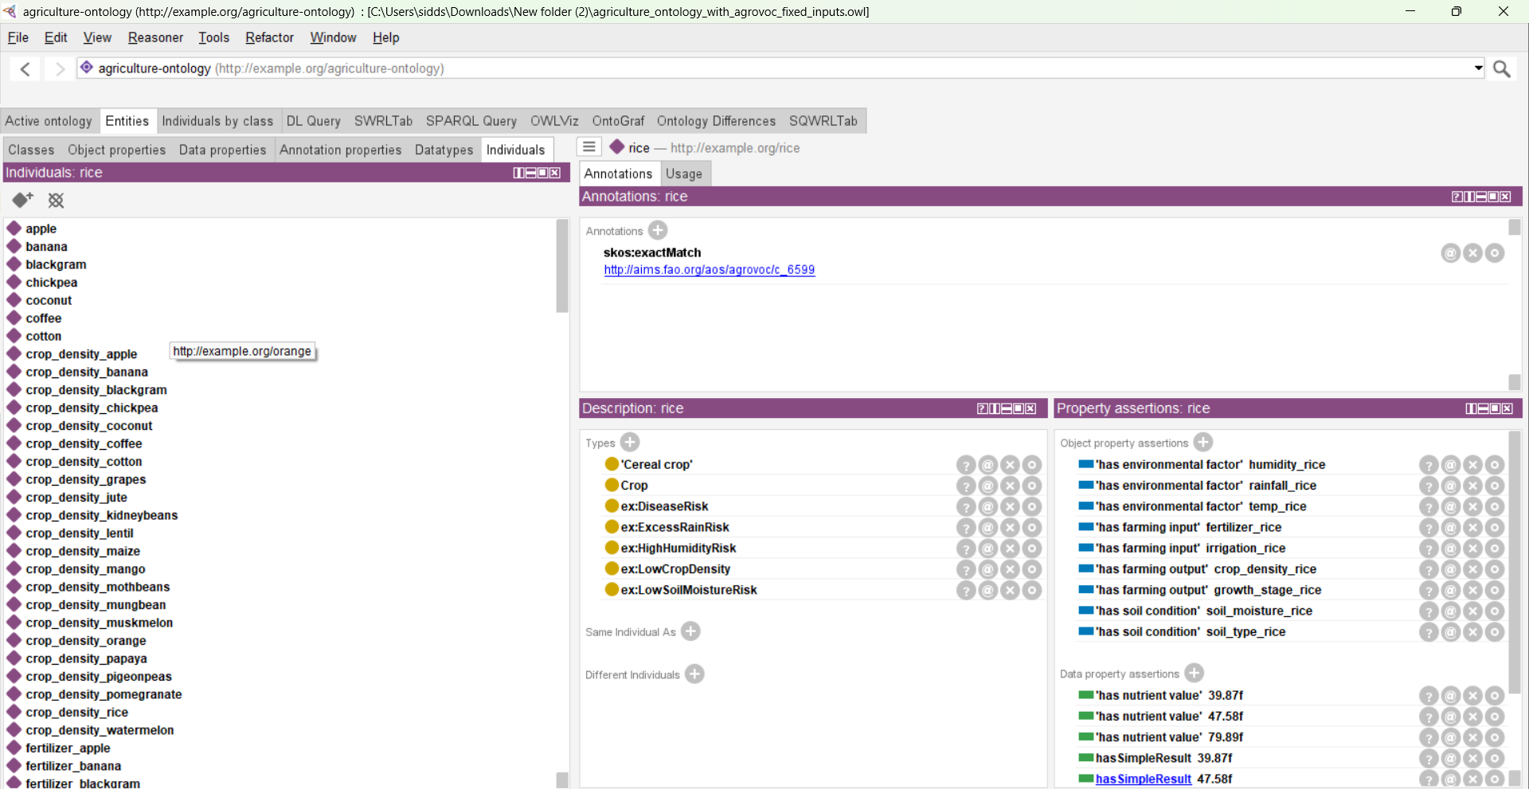
Rice Case Study – Properties & Data
Environmental, soil, and farming input data associated with rice.
Ulster University | MSc Artificial Intelligence | Agricultural Knowledge Graph

Slide 10
Conclusion
• Semantic integration of heterogeneous agricultural data
• Explainable reasoning using SWRL rules
• Interoperability through AGROVOC alignment
• Strong foundation for smart farming decision support
Ulster University | MSc Artificial Intelligence | Agricultural Knowledge Graph

