Slide 1






Round 1 Idea Submission
4Bytes
Mohit(Leader), Manya Juneja,Gaurav Bhatt, Rudra Narayan
HEALTHCARE
Technology for Menstrual Waste Segregation and Disposal

Slide 2
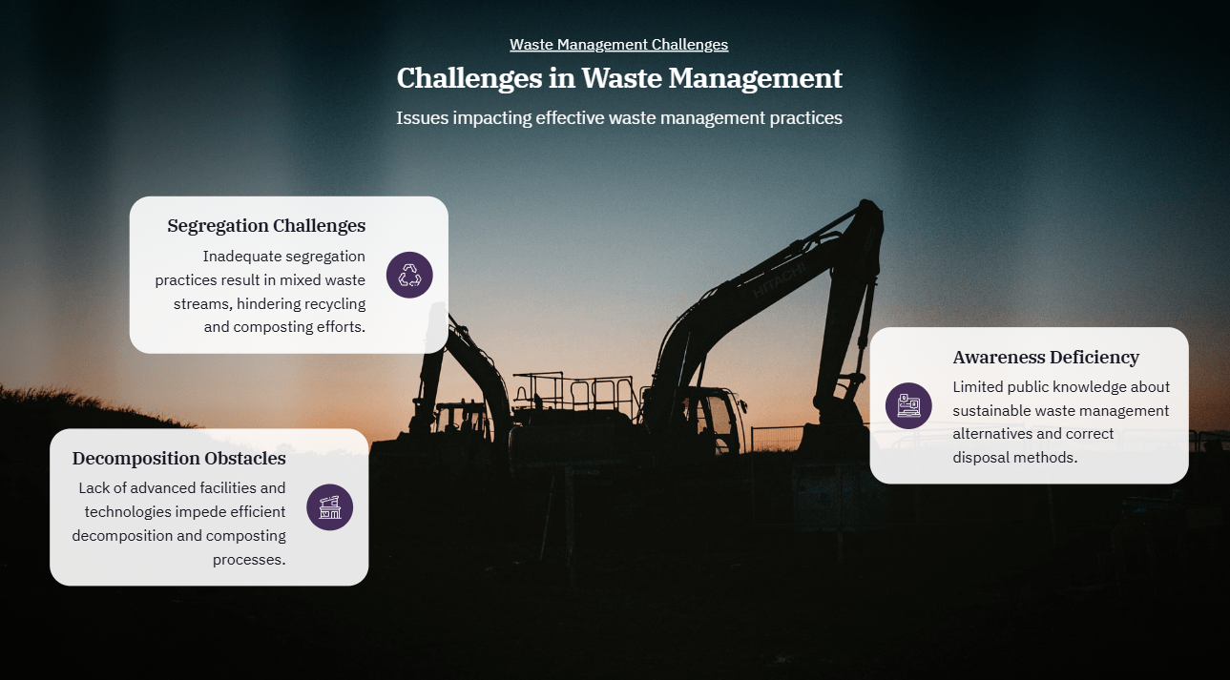
4Bytes
IDEA TITLE
Transforming Menstrual Waste: Integrating Segregation, Decomposition, and Awareness
Our project tackles the environmental issue of menstrual waste by creating a unified system that integrates waste segregation, decomposition processes, and public awareness initiatives.

Slide 3

4Bytes
TECHNICAL APPROACH
Technologies collectively form the foundation of modern web development, enabling the creation of visually appealing, interactive, data-driven web applications. HTML and CSS set the structure and style, JavaScript adds interactivity, SQL manages data, and React provides a framework for building complex user interfaces efficiently.

Slide 4
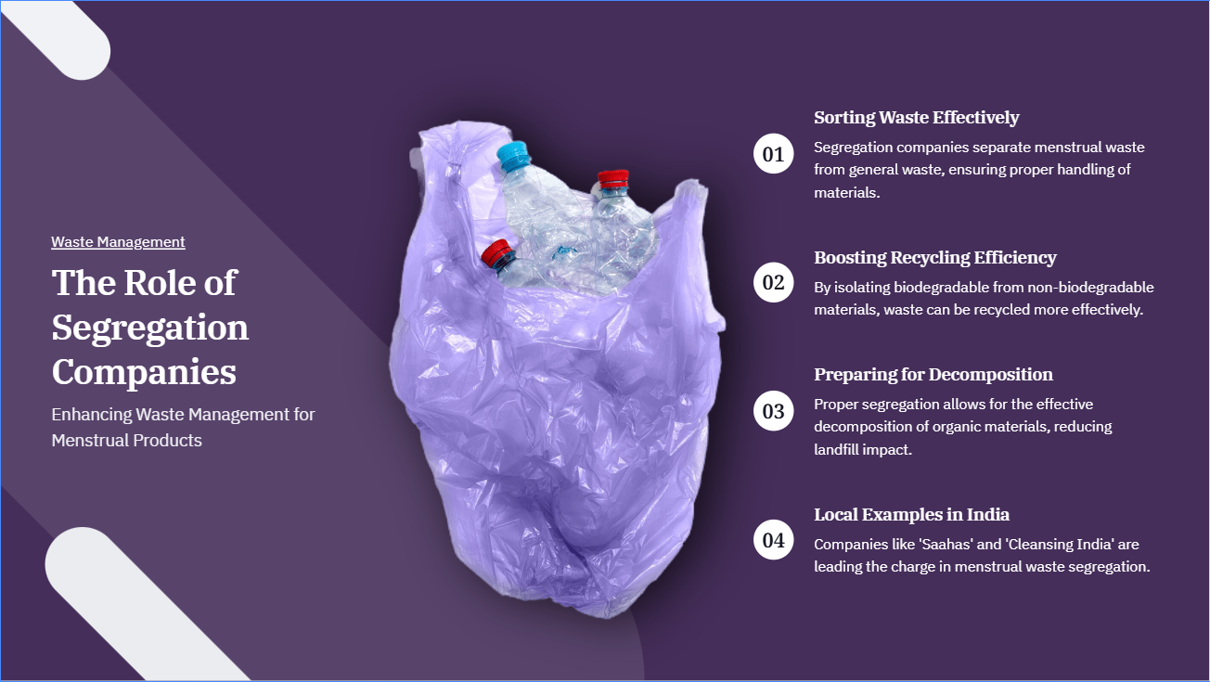
4Bytes
METHODOLOGY

Slide 5
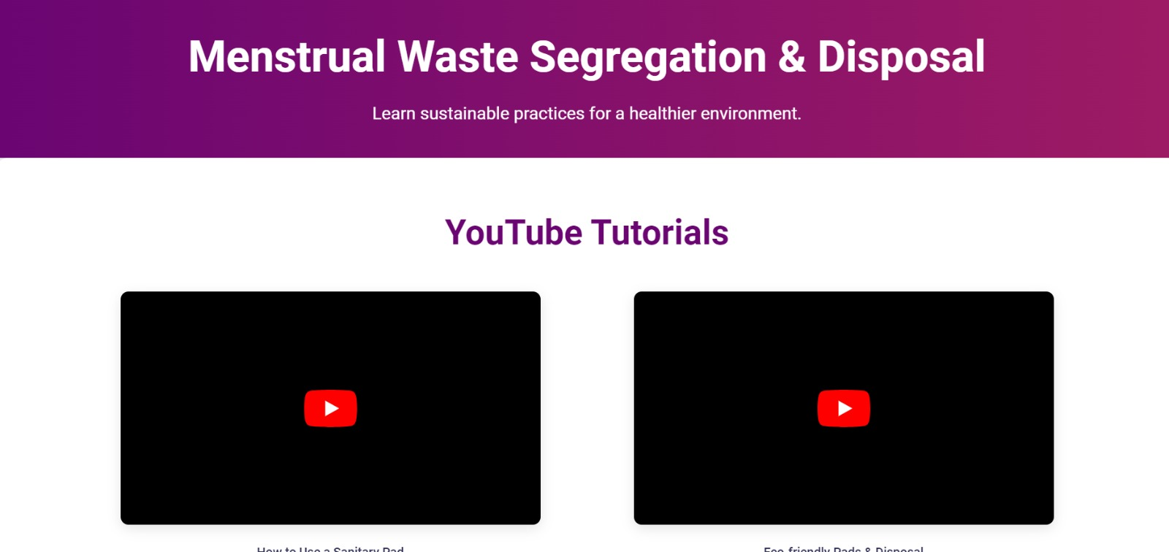
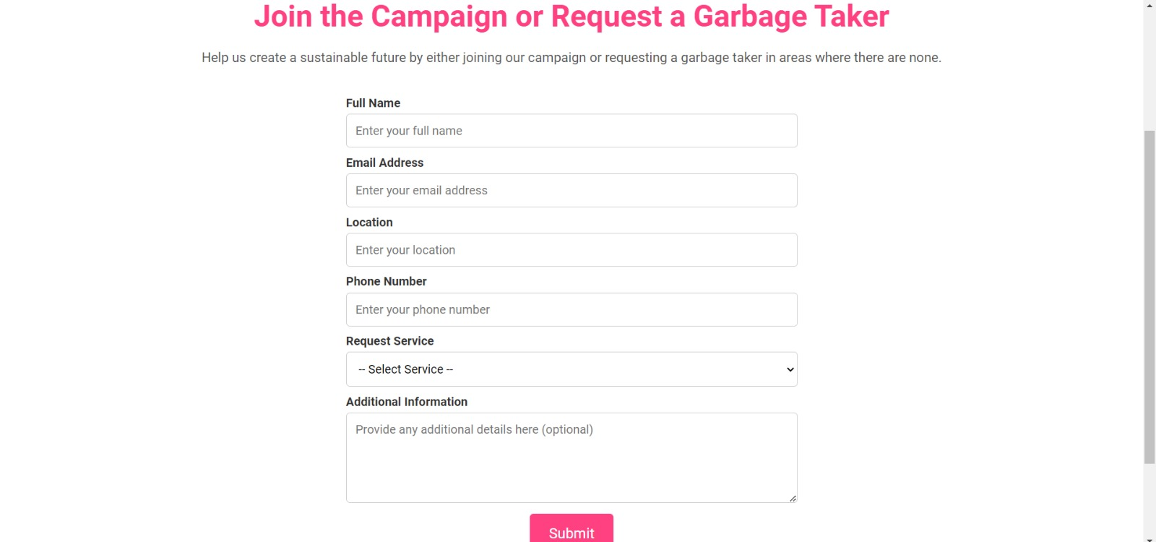
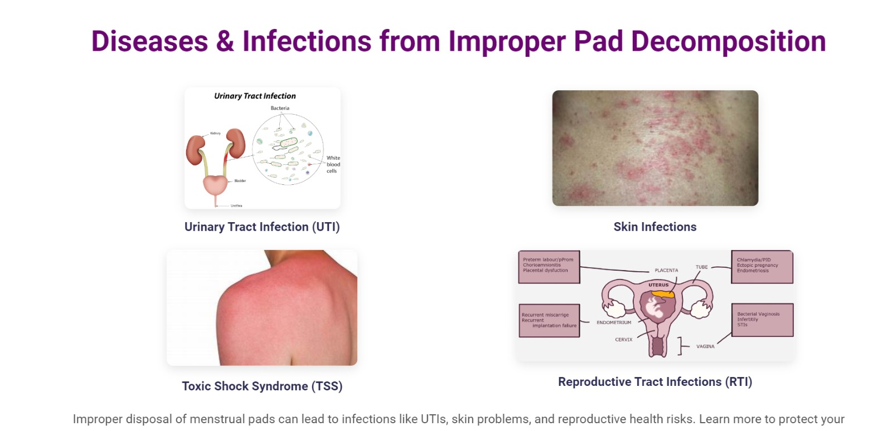
Our project
Interactive dashboard
Form

Slide 6
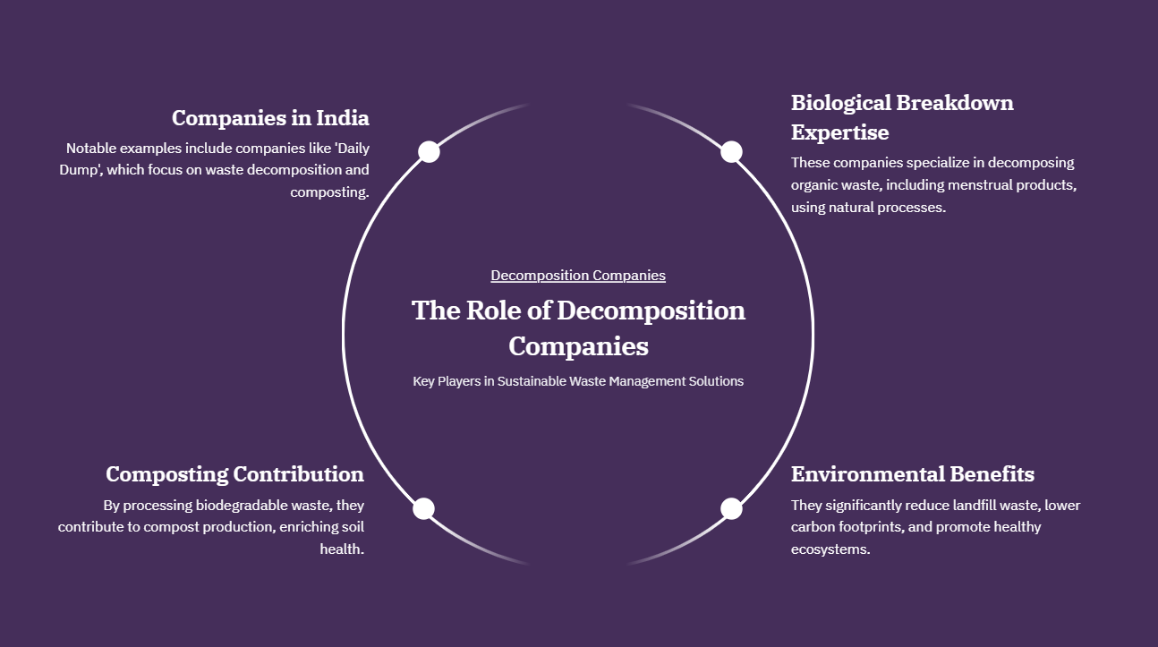
4Bytes

Slide 7
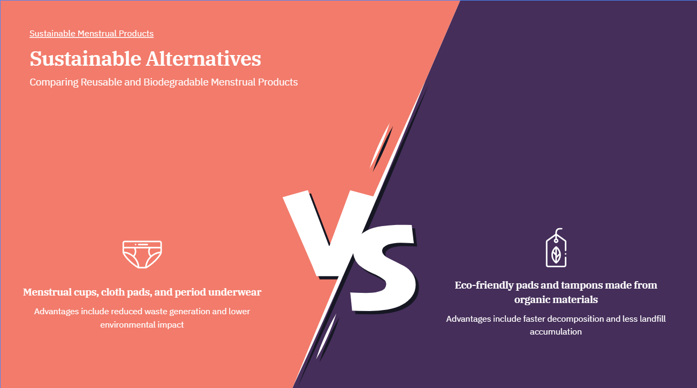
4Bytes

Slide 8
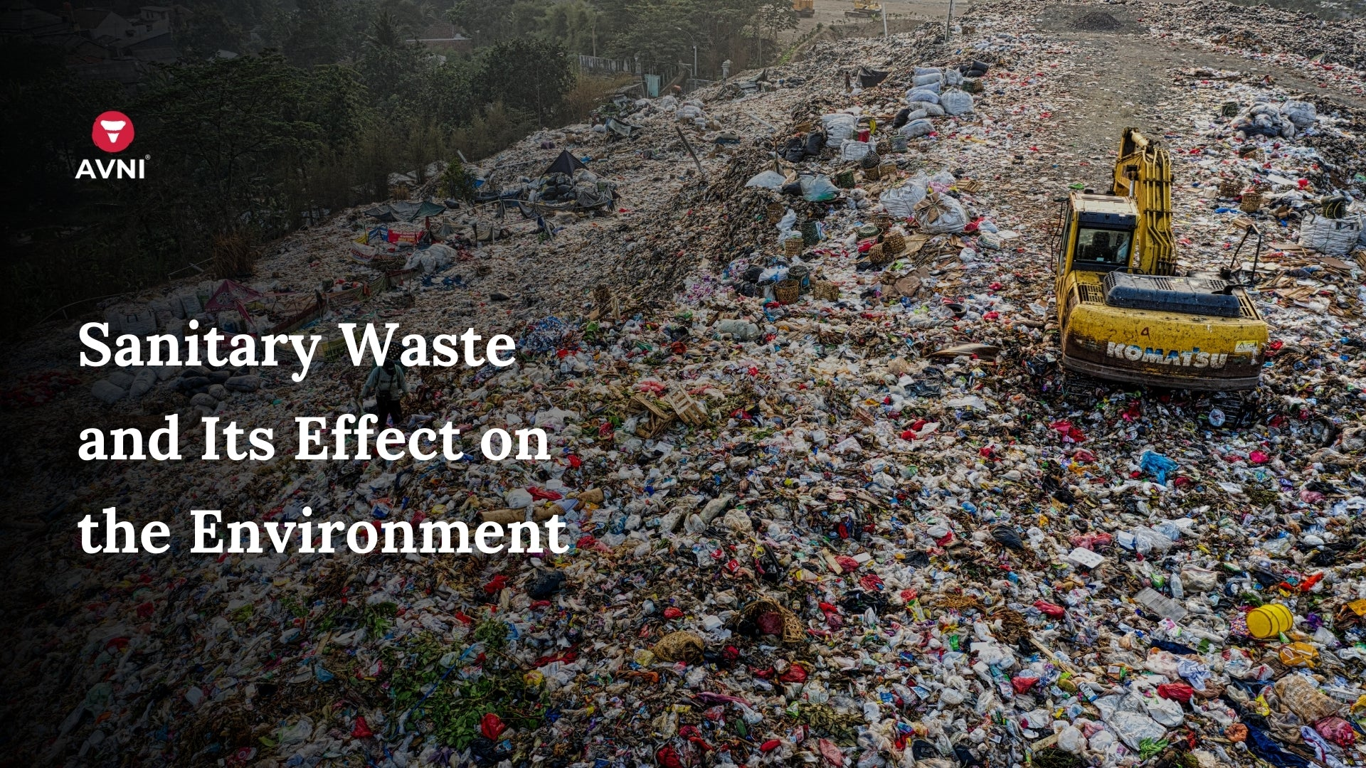
4Bytes
IMPACT AND BENEFITS
Impact and Benefits
1. Environmental Impact:
Reduced Landfill Waste: Effective waste segregation and advanced decomposition techniques decrease the amount of menstrual waste ending up in landfills.
Lower Pollution Levels: By promoting sustainable products and using modern decomposition methods, we lessen plastic pollution and mitigate harmful environmental effects.
2. Public Health:
Enhanced Hygiene: Proper disposal and treatment of menstrual waste improve public health by reducing exposure to unsanitary conditions.
Healthier Products: The shift towards eco-friendly menstrual products reduces health risks associated with traditional, non-biodegradable options.

Slide 9
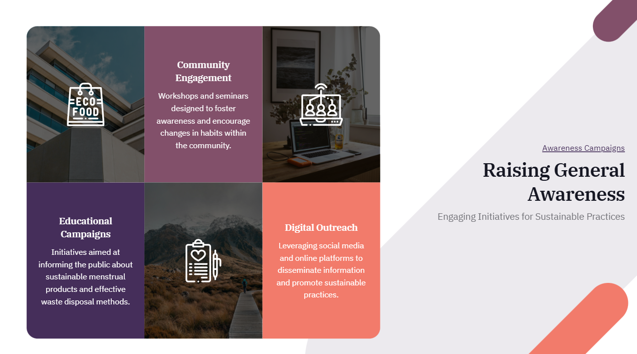
4Bytes

Slide 10
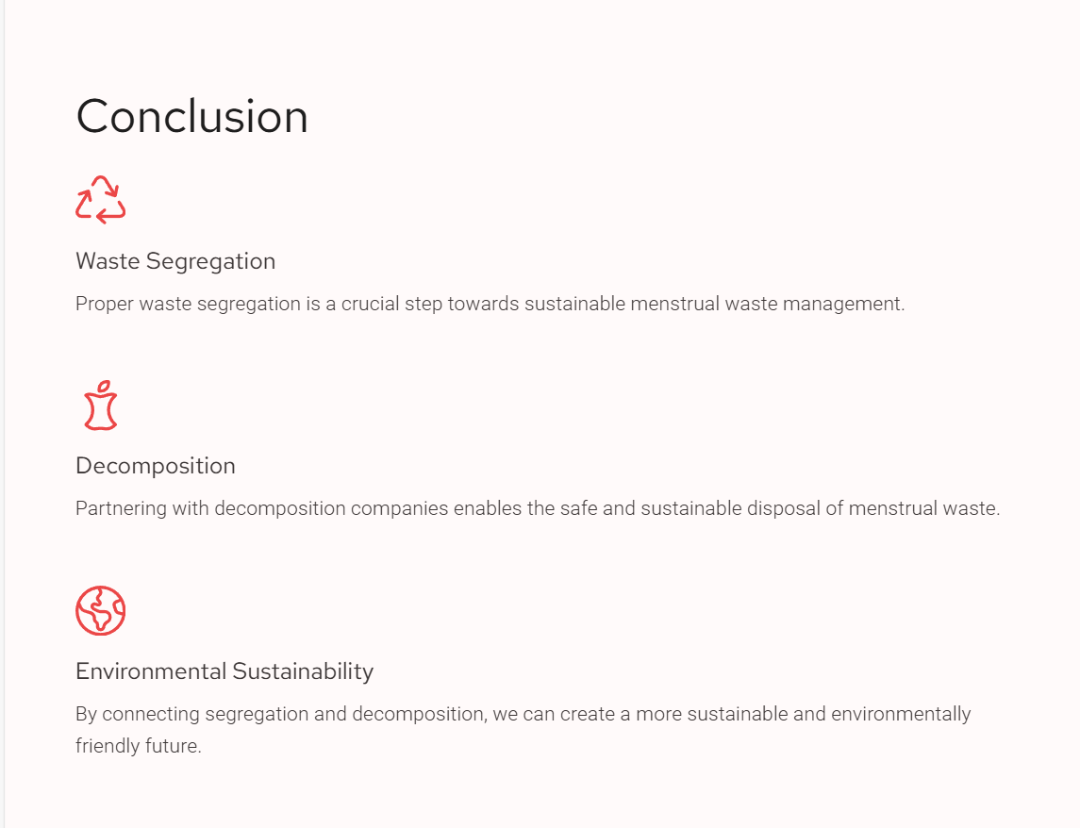
4Bytes

