Slide 1
CloudCord – A Cloud-Native, Scalable Discord Alternative

Slide 2
About us
CloudCord is a cloud-native, microservices-based real-time communication platform that enables seamless text and voice collaboration with high availability, scalability, and security for enterprise and community use.

Slide 3
Non-Functional Requirements – Key Considerations
Fault Tolerance: The system should follow best practices for microservices architecture to ensure that the failure of one service has minimal impact on the rest of the platform
Security: User data should be securely stored and transmitted to prevent unauthorized access.
Scalability: If a service’s resource usage exceeds 50% for at least 1 minute, the system should automatically scale resources to maintain performance during peak usage.
Performance: The system should respond to user requests within 2 seconds under normal load conditions.
Testing: The system should run automated tests for every code change in the CI/CD pipeline to ensure functionality and stability before deployment.

Slide 4
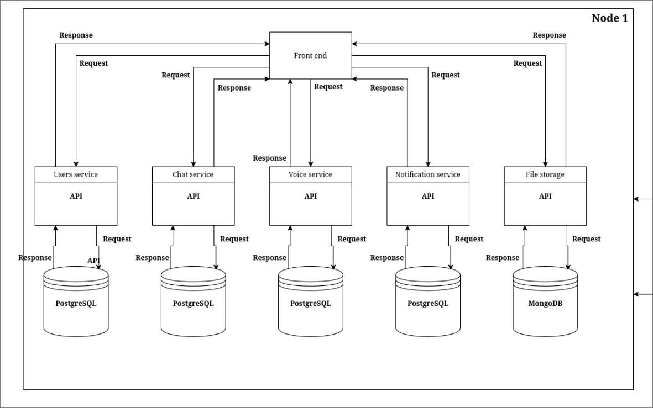
Desing diagram

Slide 5
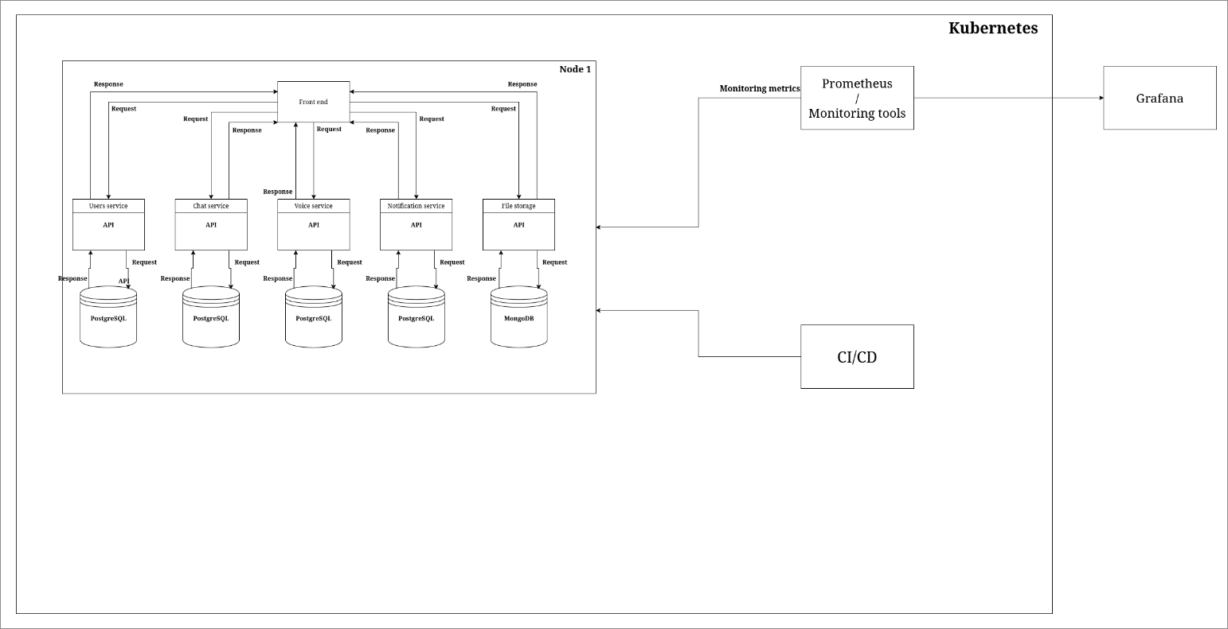

Slide 6
Initial Architecture & Technology Stack
Backend (Golang) - High-performance microservices
Frontend (React) - Modern, responsive UI
WebSockets & WebRTC - Real-time messaging & voice/video
Database (PostgreSQL & MongoDB) - Relational storage + unstructured storage
Cloud Deployment (Kubernetes + Docker) - Scalable infrastructure
CI/CD - Automated testing and deployment
Monitoring (Prometheus + Grafana) - Live metrics and health tracking

Slide 7

Thank you
Stefan-Nikola Stanev

