Slide 1
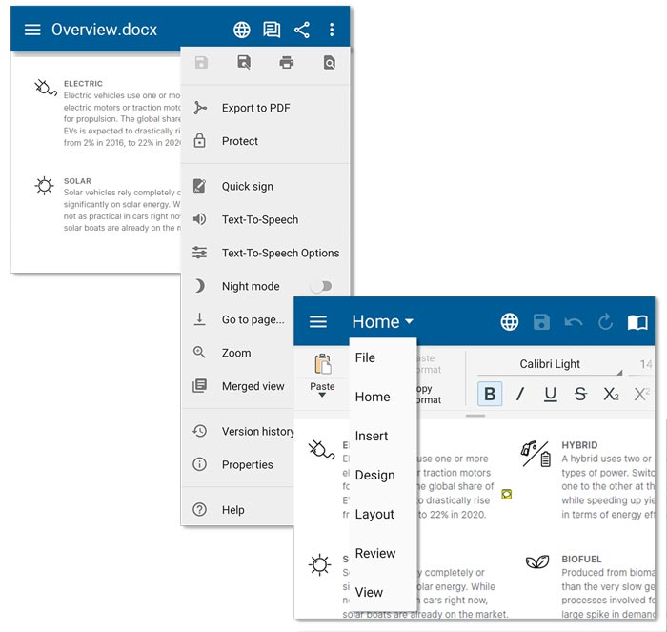




Learn more about each OfficeSuite component's
primary features
Common control menus:
Files are automatically opened in View mode. At the upper right-hand corner you’ll find a few common options for all document types. Press the three dot menu for even more features:
  Share
  Web page view – to make reading easy on any screen size
  Export to PDF
  Print
  Help – to contact our Help Center
To start editing, double tap on your document and activate Edit mode. You will see a new set of features:
  Save
  Back
  Refresh
  Read mode
To scroll through the toolbar and use all available editing options go
to the upper left-hand button Home. Tap on it and find a dropdown menu.

Slide 2

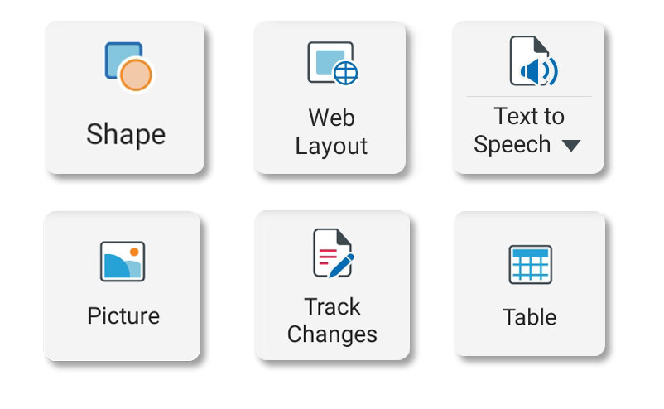
Documents
Text-to-Speech in multiple languages
To find it, go to the Home tab and swipe left. You can select one of 9 languages and control the speech rate.
Format Painter
The Format Painter is a handy way to quickly reapply formatting such as color, border style and font style or size in different places.
Find the paintbrush icon in the Home tab to start using it.
Advanced Features
Web/Page view
Track Changes
Insert headers and footers
Insert tables, charts, images, shapes
Attach to PDF and more

Slide 3

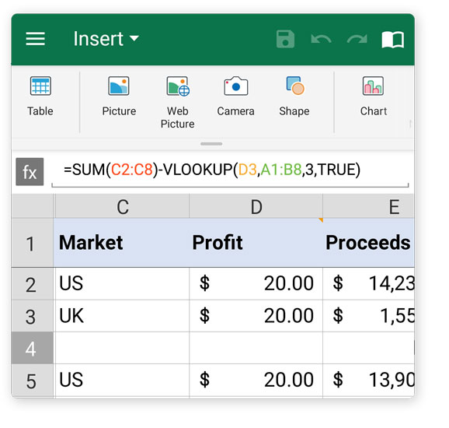
Sheets
250+ advanced formulas & functions
Select tab Formulas – choose from six different sub-groups
Insert and Customize charts and tables
Go to the Insert tab, swipe left for a Table and right to find Chart and many other features.
In-Depth Cell Management
Format cell styles
Conditional formatting
Data validation
Sort, filter, group
Numeric keyboard and more

Slide 4

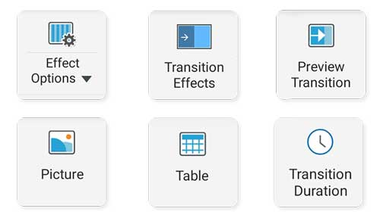
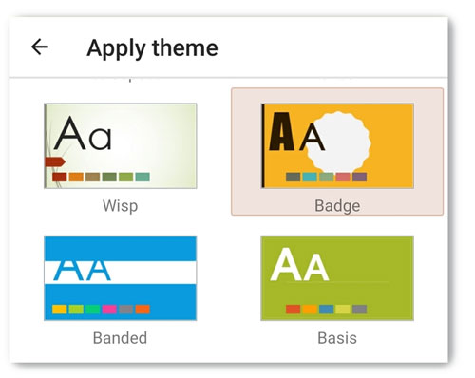
Slides
Slide Customization
Insert tables, images, audio and video
Add transitions and animations
Rehearse timings
Beautiful Themes
Go to tab Design and choose from the different ready-to-use themes.
Change layout and slide size at will.
Specialized Presenter mode
Go to the Slideshow tab to find everything you need to prepare for an advanced presentation.

Slide 5

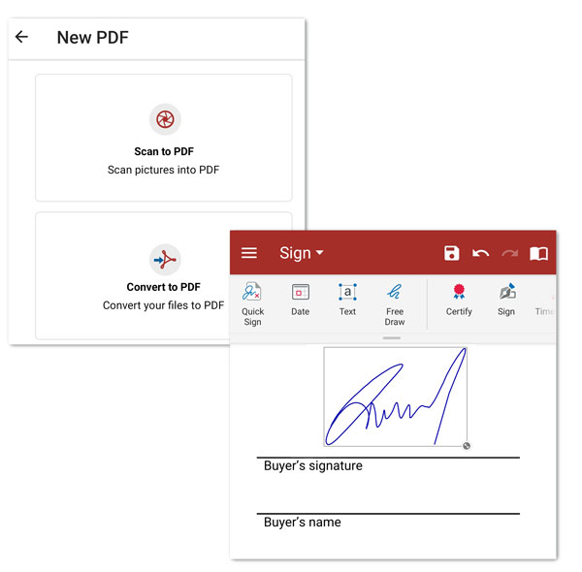
PDF
Convert to PDF or Sign a PDF document
Just go to the PDF icon in the app's Home menu, tap on it and find shortcuts to Convert to PDF and Fill and sign.
Fill out forms and annotate them
Go to the Review tab to Highlight, add text box or write a Note. If you want to track all annotations go to tab View > Annotations.
Export PDF to Word and Excel
Choose the Home tab, scroll left and find the Export to section.

