Slide 1
Euclidean minimum spanning tree
Speaker: 許文弘

Slide 2
Outline
Euclidean minimum spanning tree (EMST)
Review on (generalized) Prim’s algorithm
O(n log n) reduction to Voronoi diagram
O(n) reduction to Voronoi diagram
Using EMST to approximate ETSP

Slide 3
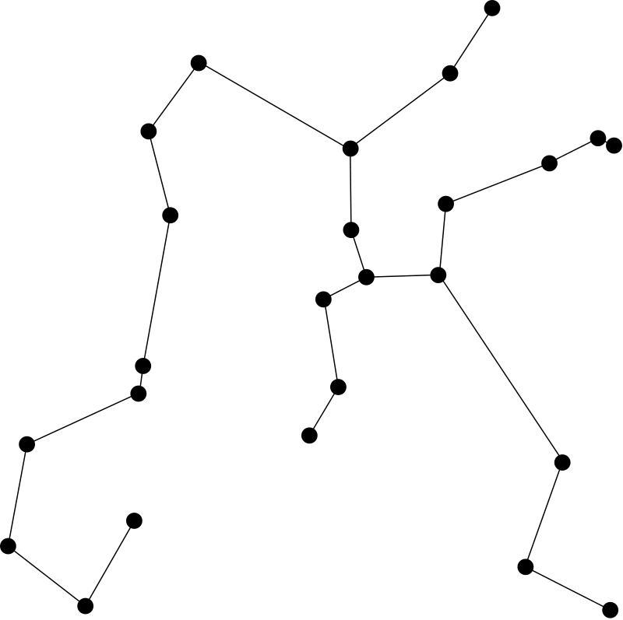
Problem statement
Given a set S of n points in the plane, construct a tree of minimum total length whose vertices are the given points
EMST can be seen as a special case of MST:
Each vertex is a point
Each edge is a line segment
There is an edge between each pair of vertices

Slide 4
Difference between MST & EMST
Property 1: there is an edge between any two vertices
→ θ(n²) edges
Property 2: the weight of an edge is the distance of its endpoints
Property 3: triangle inequality

Slide 5
A lower bound
Sorting can be reduced to EMST in O(n) time:
Given n numbers (a₁, a₂, ..., a_{n}), construct n points (a₁, 0), (a₂, 0), ..., (a_{n}, 0)
The unique EMST represents a sorted linked list
→ Finding EMST requires Ω(n log n) time
(a₂,0)
(a₄,0)
(a₃,0)
(a₁,0)

Slide 6
Outline
Euclidean minimum spanning tree (EMST)
Review on (generalized) Prim’s algorithm
O(n log n) reduction to Voronoi diagram
O(n) reduction to Voronoi diagram
Using EMST to approximate ETSP

Slide 7
Prim’s algorithm
V₁
V₂
Prim's algorithm is based on the following observation
Lemma 6.1:
Let G = (V, E) be a (general) graph with weighted edges and let {V₁, V₂} be a partition of V.
There is an MST of G which contains the shortest among the edges with one extreme in V₁ and the other in V₂.
shortest

Slide 8
Remark
The textbook does not provide a proof for Lemma 6.1
In the following, I will try to prove it

Slide 9
Proof
Let s and t be the shortest edge between V₁ and V₂
Let T be an MST which dost not contain (s, t)
Since T is an ST, there is a path P from s to t in T
Note that P and (s, t) form a cycle
V₁
V₂
T
s
t

Slide 10
Proof
Note that P starts at a vertex in V₁, and ends at a vertex in V₂
There must be an edge (x, y) ∈ P connecting V₁ and V₂
By replacing (x, y) with (s, t), we obtain an MST containing (s, t)
V₁
V₂
T
s
t
x
y

Slide 11
Prim’s algorithm
By lemma 6.1, we have following MST algorithm for general graphs:
Initially, each vertex is an individual tree
For i = 1 to i = |V| – 1, do:
1) Select any tree T in the forest
2) Find the shortest edge e = (u, v), u ∈ T, v ∉ T
3) If T' is the tree containing v,
merge T and T' by binding them with e
The resulting tree is the MST
1
3
3
5
5
4
5
7
8

Slide 12
Remark
Lemma 6.1 does not directly imply the correctness of Prim's algorithm
It shows that each individual selected edge is in some MST
This does not imply that all selected edge are in one MST
It is standard to modify Lemma 6.1 to show the latter (skipped)

Slide 13
Outline
Euclidean minimum spanning tree (EMST)
Review on (generalized) Prim’s algorithm
O(n log n) reduction to Voronoi diagram
O(n) reduction to Voronoi diagram
Using EMST to approximate ETSP

Slide 14
Observation
Suppose, in an iteration of Prim's algorithm, we add an edge (p, q), where p is in the selected tree T
(p, q) is the shortest edge leaving T
T
p
q

Slide 15
Observation
Consider the locus of p
It seems that q must define an edge of the locus
(equivalently, (p, q) is an edge of the Delaunay triangulation)
p
q

Slide 16

Lemma 6.2
Let E be the set of edges in the Delaunay triangulation of S.
For any partition {S₁, S₂} of S, if $\overline{pq}$ is the shortest edge between S₁ and S₂, then $\overline{pq}$ ∈ E.
S₁
S₂
shortest

Slide 17
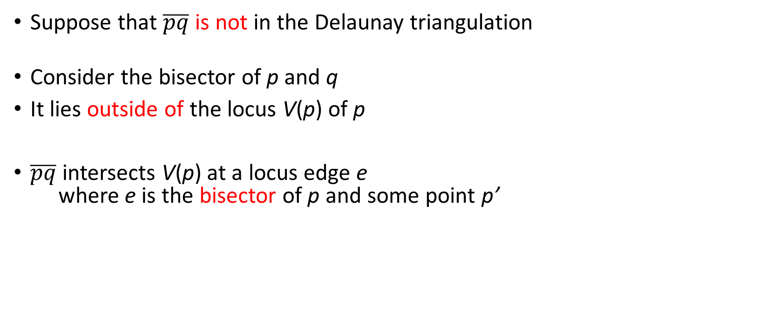
Proof
Suppose that $\overline{pq}$ is not in the Delaunay triangulation
Consider the bisector of p and q
It lies outside of the locus V(p) of p
$\overline{pq}$ intersects V(p) at a locus edge e where e is the bisector of p and some point p’
q ∈ S₂
locus V(p)
shortest edge
p’
p ∈ S1
e

Slide 18
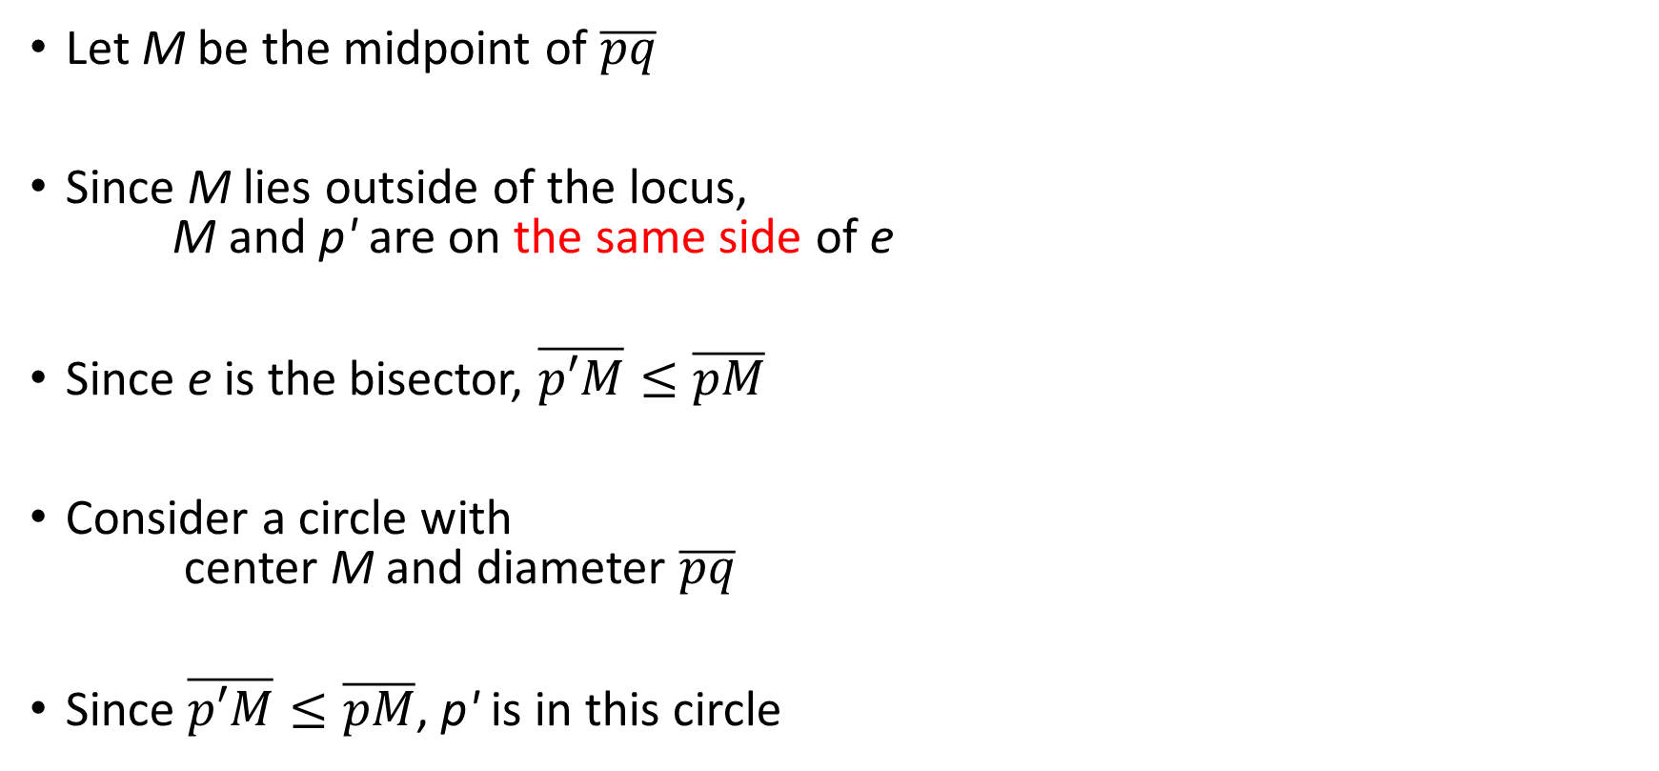
Proof
Let M be the midpoint of $\overline{pq}$
Since M lies outside of the locus, M and p' are on the same side of e
Since e is the bisector, $\overline{p′M}≤\overline{pM}$
Consider a circle with center M and diameter $\overline{pq}$
Since $\overline{p′M}≤\overline{pM}$, p' is in this circle
q
M
p’
p
e

Slide 19
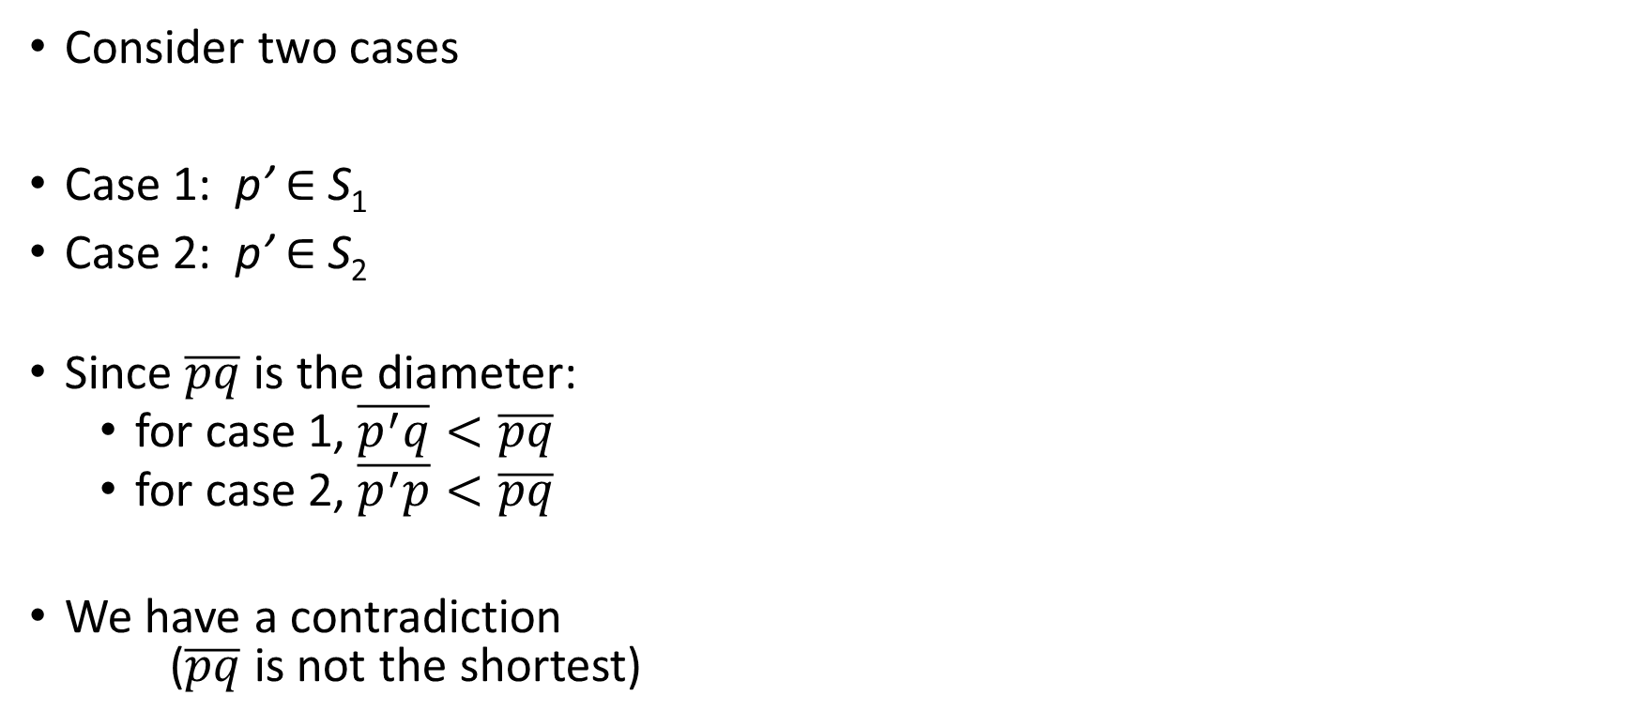
Proof
Consider two cases
Case 1: p’ ∈ S₁
Case 2: p’ ∈ S₂
Since $\overline{pq}$ is the diameter:
for case 1, $\overline{p^{′}q}<\overline{pq}$
for case 2, $\overline{p^{′}p}<\overline{pq}$
We have a contradiction ($\overline{pq}$ is not the shortest)
q ∈ S₂
M
p’
p ∈ S1
e

Slide 20
An O(n log n) approach
Lemma 6.1 and 6.2 show that there is an EMST whose edges are all in the Delaunay triangulation
This implies a simple algorithm:
Compute the Delaunay triangulation Δ of S
Run any O(E log E) time MST algorithm on Δ
Since Δ is planar, E = O(n)
Time complexity = O(n log n) (optimal!)

Slide 21
Outline
Euclidean minimum spanning tree (EMST)
Review on (generalized) Prim’s algorithm
O(n log n) reduction to Voronoi diagram
O(n) reduction to Voronoi diagram
Using EMST to approximate ETSP

Slide 22
O(n) reduction
Although the O(n log n)-time algorithm is optimal, it is still interesting to find an O(n) reduction to Voronoi diagram
First, I will introduce another O(n log n)-time algorithm

Slide 23
Recall: Prim’s algorithm
1
3
3
5
5
4
Initially, each point is an individual tree
For i = 1 to i = |V| – 1, do:
1) Select any tree T in the forest.
2) Find the shortest edge (u, v), u ∈ T, v ∉ T
3) Let T’ be the tree containing v, merge T and T’
The time complexity depends on how steps 1, 2, 3 are done
5
7
8

Slide 24
Uniform selection rule
We will use uniform selection rule to implement step 1
In this rule, trees "take turns to grow"
More precisely, all trees line up in a queue
In each round, we select the tree at the queue front
After steps 2-3, the tree is placed at the rear of the queue
Front
T1
T4
T2
T3

Slide 25
Example
Front
Queue:
T1
T4
T2
T3
T4
T3
T2
T1

Slide 26
Example
Queue:
T1
T4
T2
T3
T4
T3
T2
Examine each red edge to find the shortest one.
T1

Slide 27
Example
Queue:
T4
T3
T5
T4
T3
T5

Slide 28
Prim’s algorithm with uniform selection rule
Initially, all single node trees are placed in a queue Q
While |Q| ≥ 2:
1) T ← Q
2) Find the shortest edge (u, v), u ∈ T, v ∉ T by
examining all edges adjacent to T
3) Find the tree T’ containing v, delete T’ from Q
4) Let T* = merge(T, T’), place T* at the back of Q
Front
T1
T4
T2
T3

Slide 29
Analysis
Initially, all single node trees are placed in a queue Q
While |Q| ≥ 2:
1) T ← Q
2) Find the shortest edge (u, v), u ∈ T, v ∉ T by
examining all edges adjacent to T
3) Find the tree T’ containing v, delete T’ from Q
4) Let T* = merge(T, T’), place T* at the back of Q
O(n) for each iteration?

Slide 30
Observation
Queue:
T1
T4
T2
T3
Once a tree is selected, it becomes the last one in the queue
Edges of this tree will not be examined "frequently"
→ amortized analysis
T4
T3
T2
T1

Slide 31
Analysis
For each tree T, we define a value stage(T) as follows:
Initially, each single node tree T has stage(T) = 0.
When merging two trees, let stage(T*) = min(stage(T), stage(T’)) + 1
T
T'
T*
0
1
1
merge

Slide 32
What will the queue look like?
Front
Front
0
0
0
0
0
0
0
0
0
0
1
merge
merge
Front
Front
Front
1
1
0
1
1
0
0
1
1
merge
merge

Slide 33
What will the queue look like?
Front
j
j
j
j
j+1
j+1
j+1
．．．
1 or more tree in stage j
0 or more trees in stage j + 1
(By induction)

Slide 34
Observation
We say stage j begins when the first tree with stage j is selected
We say stage j has been completed when the last tree with stage = j is removed from the queue
j
j
j
j
j+1
j+1
stage j begins
stage j has been completed

Slide 35
Observation
T3
T4
T2
T1
When a tree T is selected, we examine its vertices and adjacent edges to find the shortest edge
Observation 1: during a fixed stage j, each vertex is examined at most once
Reason: After a vertex is examined in stage j, it becomes in a tree of stage j + 1

Slide 36
Each vertex is examined at most once
Queue:
j
j
j
j
j
j
j+1
T4
T3
T4
T3
T2
T5
T1

Slide 37
Observation
T3
T4
T2
T1
Note that an edge is examined only when one of its endpoints is examined
By Observation 1, we have the following
Observation 2: In a fixed stage, each edge is examined at most twice

Slide 38
Observation
Observation 3: In the beginning of a stage j, Q contains at most n / 2^{j} trees
(since each tree of stage j contains 2 or more trees of stage j − 1)
Thus, there are O(log n) stages
j
Front
j
j
j
j
j
j−1
j−1
j−1

Slide 39
Analysis (cont’d)
Initially, all single node trees are placed in a queue Q
While |Q| ≥ 2:
1) T ← Q
2) Find the shortest edge (u, v), u ∈ T, v ∉ T
3) Find the tree T’ containing v, delete T’ from Q
4) Let T* = merge(T, T’), place T* at the back of Q
O(1) for each round
O(n) for each stage
1 find root query
1 list operation
1 merge operation

Slide 40
Data structure
Queue:
T1
T2
T3
Each node keeps its position in the queue.
To handle merging, use standard disjoint set data structure
1
1
3
3
2
1
3
3

Slide 41
Remark
The textbook does not analyze the time spent on disjoint set operations
I include the analysis as it is non-trivial (especially later when we try to do the reduction in O(n))

Slide 42
Summary
Finding the shortest edge takes O(n) per stage → O(n log n)
A merge or find root operation take amortized O(log n) time → O(n log n)
Time complexity: O(n log n)
How to do this in O(n)?

Slide 43
Recall: bottlenecks
Place all the single node trees in a queue Q initially
While |Q| ≥ 2:
1) T ← Q
2) Find the shortest edge (u, v), u ∈ T, v ∉ T
3) Find the tree T’ containing v, delete T’ from Q
4) Let T* = merge(T, T’), place T* at the back of Q
Check many redundant edges
Merging two big trees costs a lot

Slide 44
Idea
As the trees grow, more and more edges become redundant
→ “clean-up” the graph after each stage
Build a new graph G* from the original graph G
1
1
3
5
3
1
8
3
2
2
3
2

Slide 45
Clean-up
Each tree is shrunk to a single vertex in G*
Delete each edge which connects two vertices of the same tree
For each pair of trees (T₁, T₂), only the shortest edge between them is added to G*
1
1
3
5
3
1
3
8
1
3
3
2
2
3
2
2

Slide 46
Clean-up
Clean-up can be done in linear time
DFS, and then sort the edges using radix sort
1
1
3
5
3
1
3
8
1
3
3
2
2
3
2
2

Slide 47
The modified algorithm
Place all single node trees in a queue Q initially
Let j = 0, stage of all trees = 0
While |Q| ≥ 2:
1) T ← Q
2) If stage(T) > j, clean up the graph, j = j + 1
3) Find shortest edge (u, v)
4) Find the tree T’
5) Let T’’ = merge(T, T’), stage(T’’) = min(stage(T), stage(T’)) + 1
6) place T’’ at the back of Q

Slide 48

Analysis
Observation: After clean-up, number of vertices equals the size of the queue
Therefore, at the beginning of stage j, the graph contains at most $\frac{n}{2^{j}}$ vertices

Slide 49

Graph contraction
Important fact: if G is planar, then G* is also planar (prove later)
Therefore, at the beginning of stage j, there are O($\frac{n}{2^{j}}$) edges!
1
1
3
5
3
1
3
8
1
3
3
2
2
3
2
2

Slide 50

Analysis
For each stage, clean-up and finding shortest edges take linear time
This two steps take a total of $O(\sum_{j=0}^{\left\lfloor \log_{2}n\right\rfloor −1}{\frac{n}{2^{j}}})=O\left(n\right)$ time
1
1
3
5
3
1
3
8
1
3
3
2
2
3
2
2

Slide 51
The modified algorithm
Place all single node trees in a queue Q initially.
Let j = 0, stage of all trees = 0
While |Q| ≥ 2:
1) T ← Q
2) If stage(T) > j, clean up the graph, j = j + 1
3) Find shortest edge (u, v).
4) Find the tree T’
5) Let T’’ = merge(T, T’), stage(T’’) = min(stage(T), stage(T’)) + 1
6) place T’’ at the back of Q
disjoint set operations take O(n log n)?

Slide 52
Analysis
Observation: When we merge two trees, one of the trees is of stage j, that is, the current stage
Note that the tree of stage j consists of a single node
Queue:
j
j
j
j
j+1

Slide 53
Analysis
If a linked list is used to implement the disjoint set:
find root can be done in O(1)
merge can be done in O(1)
Consequently, all disjoint set operations take O(n) time
a
b
c
a
c
d
b
d

Slide 54
Recall
Recall that we claimed the following:
If G is planar, then G* is also planar
Why?
1
1
3
5
3
1
3
8
1
3
3
2
2
3
2
2

Slide 55
Remark
The textbook does not provide a proof for the claim (G* is planar)
In the following, I will present two proofs
The first proof is by one of my classmates, named 日月卦長 (the proof has been modified by me)
The second proof is by me

Slide 56
Edge contraction
An edge contraction operation on an edge e = (u, v) of a graph G
1. removes u
2. for each edge w originally incident to u, adds an edge (w, v)
e
u
v
v

Slide 57
Edge contraction
G* can be constructed from G by performing edge contractions and edge removals
We claim that edge contractions preserve planarity
1
1
1
3
1
3
1
3
3
2
2
2
3
2
2

Slide 58
First proof, modified from 日月卦長’s proof
Observation: if vertices u and v share a face in a planar embedding of a planar graph, then adding the edge (u, v) preserves planarity
face
face
u
u
v
v

Slide 59
First proof, modified from 日月卦長’s proof
Let G be a planar graph
Consider a planar embedding of G
Let e = (u, v) be the edge to be contracted
u
e
v

Slide 60
First proof, modified from 日月卦長’s proof
u
e
Let G' be the graph obtained by deleting u
All faces adjacent to u are merged into a new face F
All vertices (originally) adjacent to u are now adjacent to F
v
F
v

Slide 61
First proof, modified from 日月卦長’s proof
Add edges one by one, each time between vertices sharing a face
For example, in clockwise order of the polygon bounding F
After the addition, G' is the result of contracting e
F
v
v

Slide 62
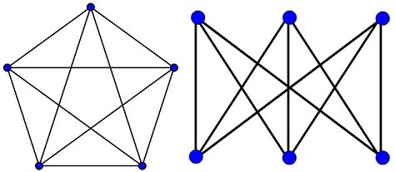
Second proof, by Wagner's theorem
Definition: A graph H is called a minor of a graph G if it can be produced from G by successive application of these reductions:
deleting an edge
contracting an edge
deleting an isolated vertex
Wagner‘s theorem: A graph G is planar if and only if its minors include neither K₅ nor K_{3,3}.
We will show that edge contractions preserve planarity by Wagner’s theorem

Slide 63
Proof
G
contraction
G'
Let G be a planar graph
Let G' be the graph obtained from G by contracting an edge
Suppose G' is not planar
By Wagner's theorem, G' has K₅ or K_{3,3} as its minor
Then, G has K₅ or K_{3,3} as its minor
Thus, G is not planar, which is a contradiction
edge removal
G''
contraction
G'''
...
K₅

Slide 64
Theorem
Theorem 6.1: An EMST of a set S of n points in the plane can be computed from the Delaunay Triangulation of S in optimal time θ(n).
Corollary 6.1: An EMST of a set S of n points in the plane can be computed in optimal time θ(n log n).

Slide 65
Outline
Euclidean minimum spanning tree (EMST)
O(n log n) reduction to Voronoi diagram
O(n) reduction to Voronoi diagram
Using EMST to approximate ETSP
→ By EMST + Euler tour
→ By EMST + Euclidean matching

Slide 66
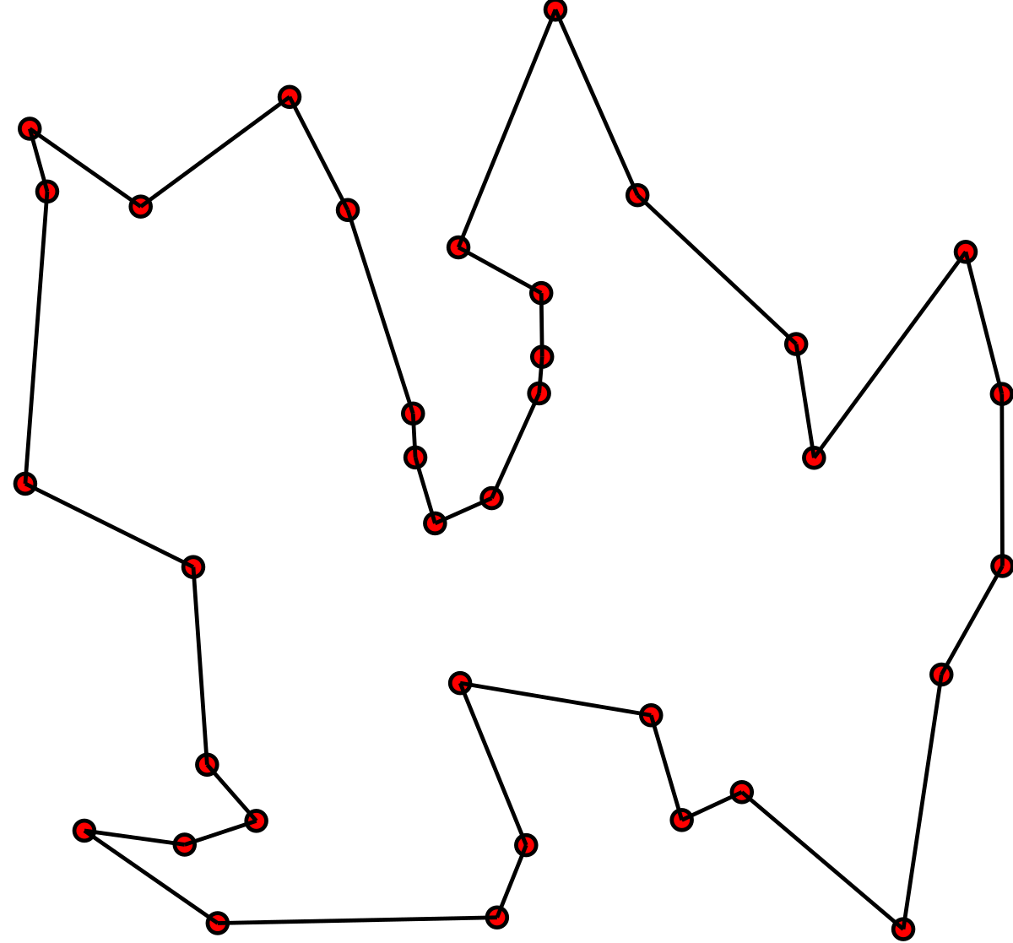
ETSP – problem statement
Euclidean traveling salesman problem
Find a shortest closed path through n given points in the plane
(Each point should be visited exactly once)
NP-hard ☹

Slide 67
Approximation by Euler tour
We now present a 2-approximation algorithm for ETSP
Let S be the set of points
Let Φ be the optimal tour of S, and T* be the EMST

Slide 68
Approximation by Euler tour
Compute W as the Euler tour of T*, which has length 2 × length(T*)
Note that W may visit a point more than once

Slide 69
Refinement
We construct a shorter tour visiting each point exactly once as follows:
Choose an arbitrary direction on W
Start from any point and traverse W
Add an edge when we visit a vertex for the first time
Length of this tour ≤ 2 length(T*)
start

Slide 70
Analysis
Let Φ be the optimal tour of S
We claim that 2 length(T*) < 2 length(Φ)
Observation: By removing an edge from Φ, we obtain a spanning tree T
→ length(Φ) > length(T) ≥ length(T*)
This completes the proof

Slide 71
Theorem
Theorem 6.2: An EMST can be used to obtain an approximate ETSP tour whose length is less than twice the length of a shortest tour.

Slide 72
Outline
Euclidean minimum spanning tree (EMST)
O(n log n) reduction to Voronoi diagram
O(n) reduction to Voronoi diagram
Using EMST to approximate ETSP
→ By EMST + Euler tour
→ By EMST + Euclidean matching

Slide 73
Approximation by Euclidean matching
Observation: If a tour contains all edges of T*, it visits all vertices of T*
Idea: Construct a tour W' which contains all edges of T*
Let X be the set of points having odd degree on T*
Note that |X| is even
green points: the set X
73

Slide 74
Approximation by Euclidean matching
X: the set of points having odd degree on T*
Let M* be a minimum Euclidean perfect matching of X
Every vertex in T* U M* has even degree
Thus, T* U M* has a Eulerian cycle W'
Compute W'
Refine W' to obtain a tour
green points: the set X

Slide 75
Analysis - time complexity
T* can be computed in O(n log n) time
M* (optimal matching) can be found in O(n³) time
(By Gabow’s implementation of Edmonds’ algorithm)
Eulerian cycle of T* U M* can be found in O(n) time
As a result, this algorithm runs in O(n³) time

Slide 76
Analysis - ratio
How about the approximation ratio?
Claim: Let Φ be the optimal tour, then: (1) length(T*) < length(Φ); and
(2) length(M*) ≤ 0.5 × length(Φ).
We proceed to prove (2)

Slide 77
Proof (textbook version with small mistakes)
If we select every other edge from Φ, we obtain two perfect matchings M₁, M₂ on S (wrong), and length(M₁) + length(M₂) = length(Φ)
The optimal tour Φ

Slide 78
Proof (textbook version with small mistakes)
One of length(M₁), length(M₂) must ≤ 0.5 length(Φ)
Assume it is M₁
Since M* is minimum, we have:
length(M*)
≤ length(M₁) (wrong)
≤ 0.5 × length(Φ).

Slide 79
Mistakes in the textbook - 1
For odd n, "selecting every other edge" does not produce two matchings

Slide 80
Mistakes in the textbook - 2
Since M* is minimum, we have length(M*) ≤ length(M₁)?
This is not true, because M* is the minimum matching of X, while M₁ is a matching of S
T*
Blue: the minimum matching of X
Red: a smaller matching of S

Slide 81
A correct version
Recall that X is the set of odd-degree points of T*
Recall that Φ visits each point of S exactly once
By refining Φ, we can obtain a tour Φ' of X
length(Φ) ≥ length(Φ')
Φ (on S)
refine
Φ' (on X)

Slide 82
A correct version
Let Φ_{X} be the optimal ETSP tour of X
By definition, length(Φ') ≥ length(Φ_{X})
Φ (on S)
refine
Φ' (on X)

Slide 83
Correct version
Instead of "selecting every other edge" on Φ, we do it on Φ_{X}
Since |X| is even, we obtain two matchings M₁ and M₂
Φ_{X}

Slide 84
Correct version
Furthermore, M₁, M₂ and M* are all matchings on X
We have the desired inequality: length(M*) ≤ length(M₁)
As before, assume length(M₁) ≤ length(M₂)
Consequently, length(M*) ≤ length(M₁)
≤ 0.5 length(Φ_{X})
≤ 0.5 length(Φ)
This completes the proof

Slide 85
Conclusion
Theorem 6.3: An approximation to TSP whose length is within 3/2 of optimal can be obtained in O(n³) time if the interpoint distance obey the triangle inequality

Slide 86
Thank you for listening!

Slide 87
Old slides
The following hidden slides are out-takes

Slide 88
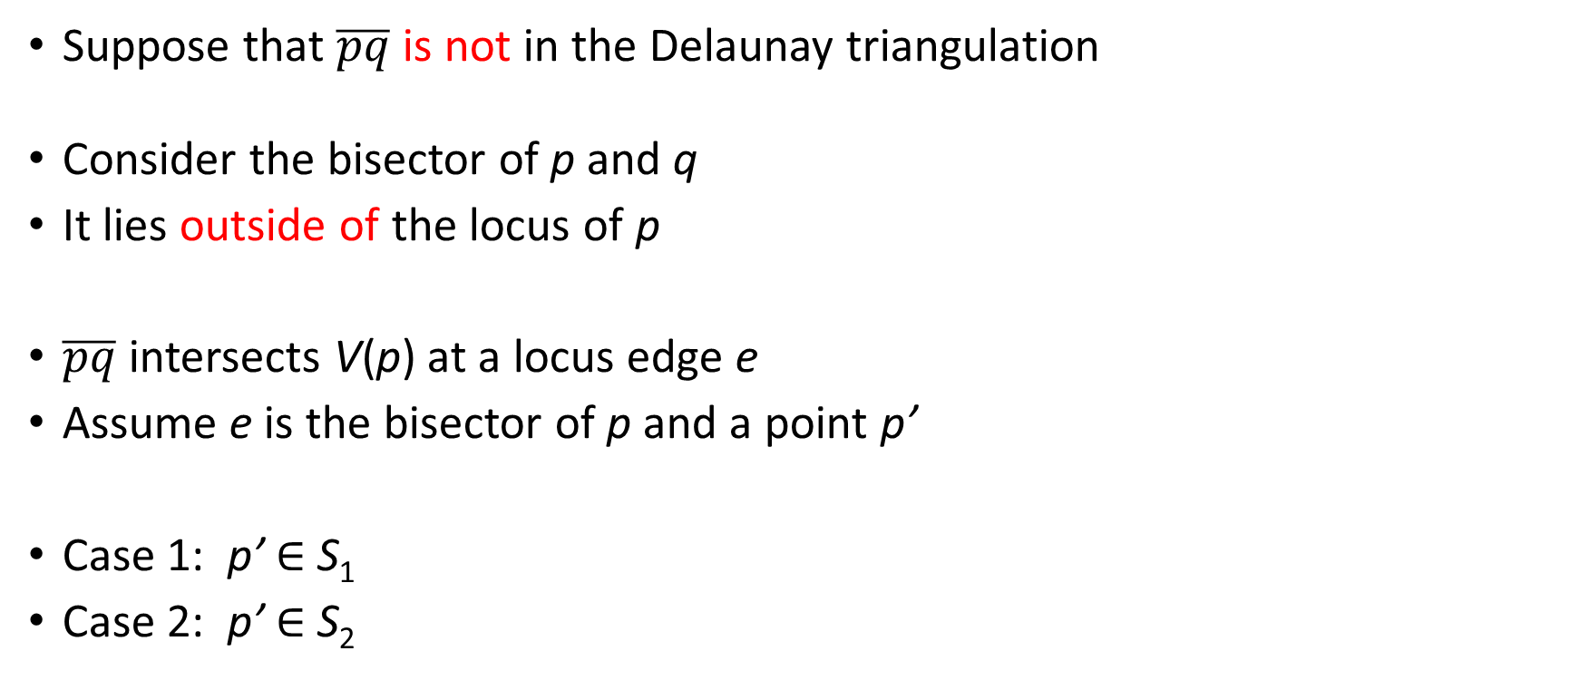
Proof
Suppose that $\overline{pq}$ is not in the Delaunay triangulation
Consider the bisector of p and q
It lies outside of the locus of p
$\overline{pq}$ intersects V(p) at a locus edge e
Assume e is the bisector of p and a point p’
Case 1: p’ ∈ S₁
Case 2: p’ ∈ S₂
q ∈ S₂
locus V(p)
shortest edge
p’
p ∈ S1
e

Slide 89
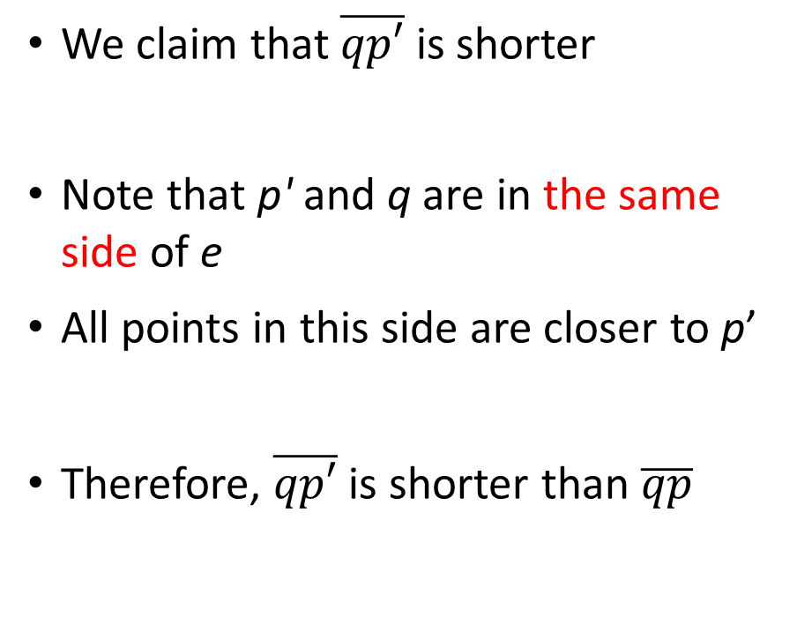
Case 1: p’ ∈ S₁
We claim that $\overline{qp′}$ is shorter
Note that p' and q are in the same side of e
All points in this side are closer to p’
Therefore, $\overline{qp′}$ is shorter than $\overline{qp}$
q ∈ S₂
p’ ∈ S₁
p ∈ S1
e

Slide 90
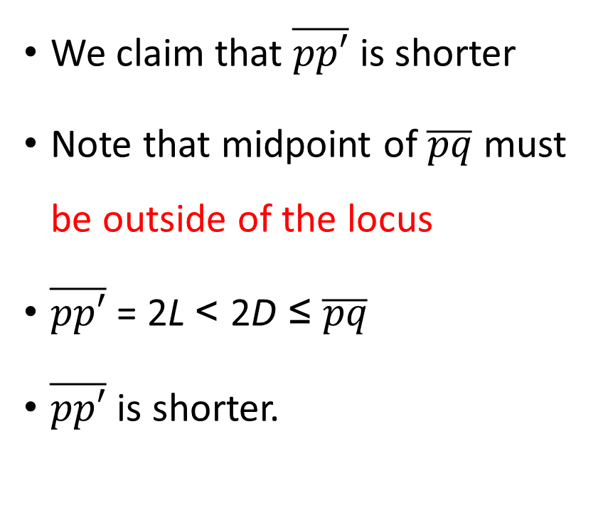
Case 2: p’ ∈ S₂
q ∈ S₂
We claim that $\overline{pp′}$ is shorter
Note that midpoint of $\overline{pq}$ must be outside of the locus
$\overline{pp′}$ = 2L < 2D ≤ $\overline{pq}$
$\overline{pp′}$ is shorter.
midpoint
D
D
L
L
p’ ∈ S₂
p ∈ S₁
e

Slide 91
Proof
Contradiction
…..
Edge contraction
G*
…..
K₅
…
…
…
G
…..
…
…
…
K_{3,3}
Edge deletion
…
Vertex deletion
Each vertex represents a graph, and each edge represents an operation.
Since G is planar, no any sequence of operations can transform G into K₅ nor K_{3,3}.
If G* isn’t planar, it can reach K₅ or K_{3,3}. This is a contradiction since G reaches G*.

Slide 92
Number of trees in the queue is halving
Front
j
j
j
j
j
j
j
j
j
j
Each stage j+1 nodes comes from 2 or more j nodes.
j+1
Front
j+1
j+1
j+1
j+1
j+1
j
j
j

Slide 93
An example
Black: EMST
Blue: Odd degree points and matching
Red: Eulerian cycle
This tour visits each edge in T* at least once

