Slide 1
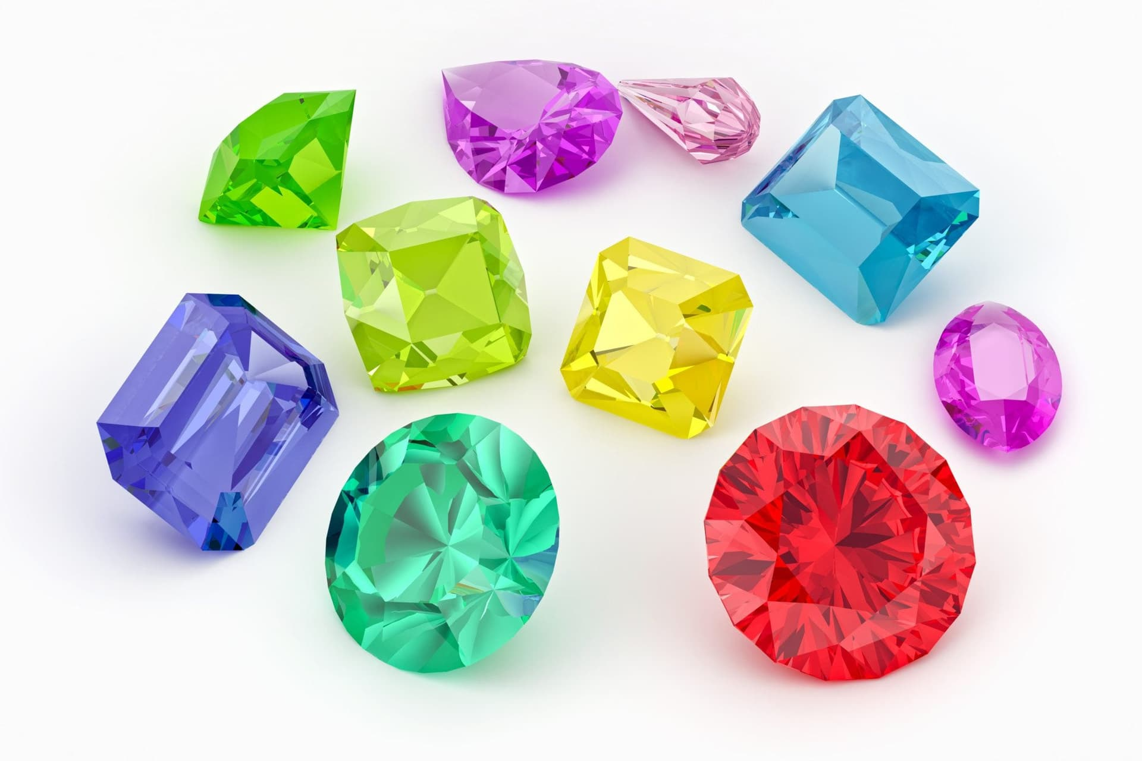
My gem collection (NAS thoughever)

Slide 2
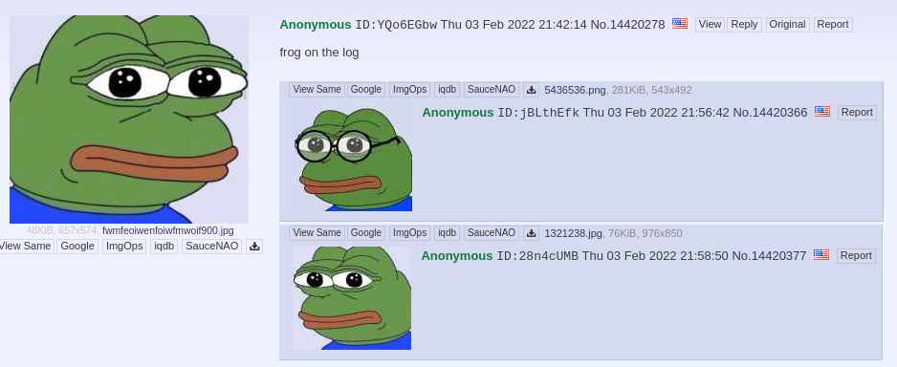
Frog on the ‘log?

Slide 3

mfw

Slide 4

>GEEEEEEEEEEEEEEEEEEEEEEEGGG

Slide 5


marge?
>mfw olevba oneshot chall

