Slide 1

WEB TECHNOLOGIES
JavaScript - Basics
Prof.Vinay Joshi and Dr.Sarasvathi V
Department of Computer Science and Engineering

Slide 2
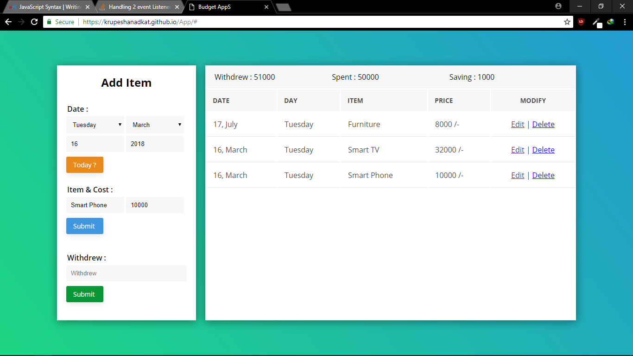
JavaScript - Basics
Introduction to JavaScript
Notes:
What you have seen so far is pages with just HTML and CSS. They are primarily static pages with contents predefined.
You have seen links been clicked and forms been submitted but loading the response in a new page.
Take an example of this page, where the contents change on the same page based on user actions and most likely without loading a new page.
This is achieved through the use of client side scripting languages like JavaScript.

Slide 3
JavaScript - Basics
Introduction to JavaScript
Client Side Scripting Language
Originally, LiveScript in NetScape Browser
JavaScript programs are run by an interpreter built into the user's web browser
Now the language has evolved with additional Server Side Scripting capabilities (like in Node.JS)

Slide 4
JavaScript - Basics
Introduction to JavaScript…(cntd.)
Client renders (displays) the response received from server (mix of HTML and JavaScript)
Browser displays HTML
And runs any JavaScript code within the HTML
dynamic programming language that can add interactivity to a website.

Slide 5
JavaScript - Basics
Introduction to JavaScript…(cntd.)
Pros and Cons of JavaScript
Pros
Allows more dynamic HTML pages, even complete web applications
Cons
Requires a JavaScript-enabled browser
Requires a client who trusts the server enough to run the code the server provides
JavaScript has some protection in place but can still cause security problems for clients

Slide 6
JavaScript - Basics
1. HTML to define the content of web pages
2. CSS to specify the layout of web pages and give a good look.
3. JavaScript to program the behaviour of web pages
Web pages are not the only place where JavaScript is used. Many desktop and server programs use JavaScript.
Node.js is the best known.
Some databases, like MongoDB and CouchDB, also use JavaScript as their programming language.

Slide 7
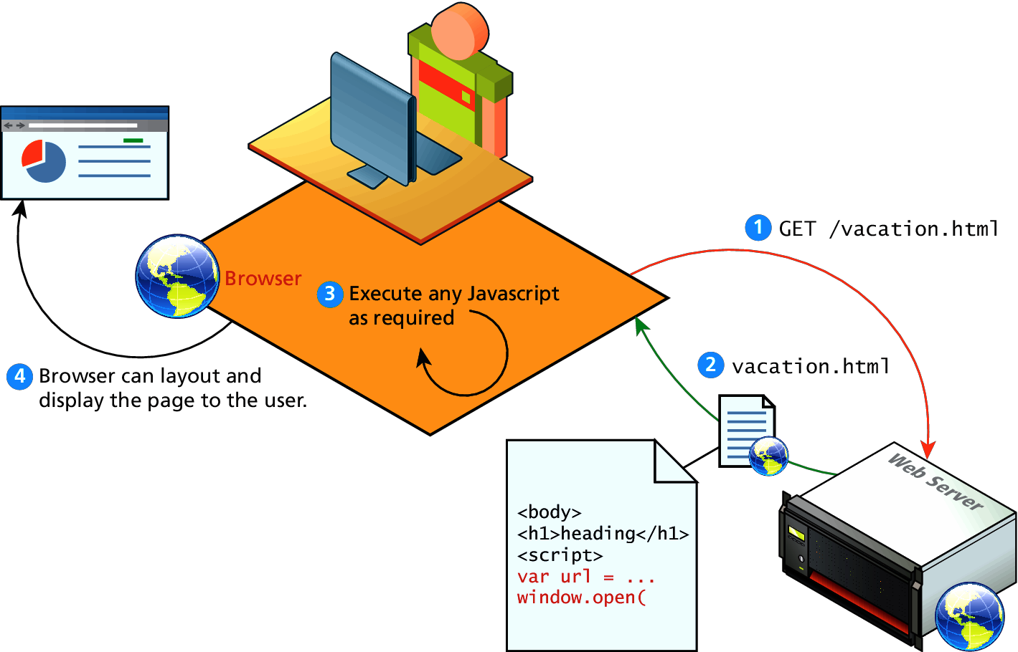
JavaScript - Basics
Client side scripting

Slide 8
JavaScript - Basics
JavaScript Code
JavaScript can be inserted into documents by using the <SCRIPT> tag
<html>
<head>
<title>Hello World in JavaScript</title>
</head>
<body>
<script type="text/javascript">
document.write("Hello World!");
</script>
</body>
</html>

Slide 9
JavaScript - Basics
JavaScript Code
Where to Put your Scripts
You can have any number of script tags at any position
Scripts can be placed in the HEAD or in the BODY
In the HEAD, scripts are run before the page is displayed
In the BODY, scripts are run as the page is displayed
In the HEAD is the right place to define functions and variables that are used by scripts within the BODY

Slide 10
JavaScript - Basics
JavaScript Code – External Scripts
Scripts can also be loaded from an external file
This is useful if you have a complicated script or set of subroutines that are used in several different documents
<script src="myscript.js"></script>
The myscript.js should not include the script tags

Slide 11
JavaScript - Basics
JavaScript Code - Debugging
Debugging JavaScript Errors
- When you’re learning or using JavaScript, it’s important to be able to track typing or other coding errors.
Browser | How to access JavaScript error messages
Apple Safari | Select Safari → Preferences → Advanced → “Show Developer menu in menu bar.” You may prefer to use the Firebug Lite JavaScript module, which many people find easier to use.
Google Chrome | Press Ctrl-Shift-J on a PC, or Command-Shift-J on a Mac.
Mozilla Firefox | Press Ctrl-Shift-J on a PC, or Command-Shift-J on a Mac.
Microsoft Internet Explorer & Edge | Press F12 to call up the DevTools Console.
Opera | Select Tools → Advanced → Error Console.

Slide 12
JavaScript - Basics
JavaScript Code - Comments
Comments in JavaScript
Single line comment : //
Multiline comments : /* */

Slide 13
JavaScript - Basics
JavaScript Code – Using Semicolon
JavaScript generally automatically inserts semicolons at the end of line
x += 10 => x += 10;
However, when you wish to place more than one statement on a line, you must separate them with semicolons, like this:
x += 10; y -= 5; z = 0
When a statement spans across multiple lines, JavaScript will not raise error if the next line has a valid symbol/literal/token
return a
+ b

Slide 14
JavaScript - Basics
JavaScript Code – Variable Declaration
The first character of a variable name can be only a-z, A-Z, $, or _ .
-- Then followed by only the letters a-z, A-Z, 0-9, the $ symbol, and the underscore _.
Variable names are case-sensitive. Count, count and COUNT are three different variables
Variable can be declared using
let (block scope)
var (function or global scope)
Const(block scope)
use without declaring (global scope)
KEYWORD | SCOPE | CAN BE REASSIGNED | CAN BE REDECLARED
var | Function | Yes | Yes
let | block | Yes | No
const | block | No | No
Notes:
Datatypes – primitive and objects

Slide 15
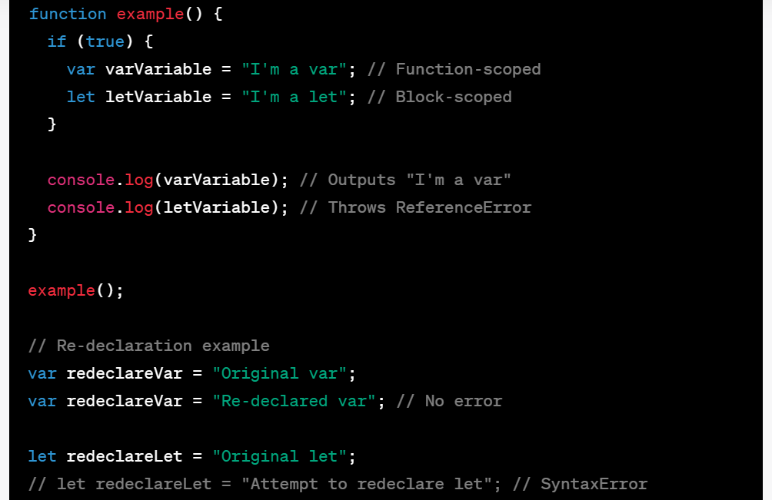
JavaScript - Basics
JavaScript Code – Datatypes
Notes:
Datatypes – primitive and objects
Objects discussed in detail in L9 and L10
Mention that objects are collection of properties (key:value) accessed as object.key or object[“key”]
Number and String objects are wrapper around number and string primitive types

Slide 16
JavaScript - Basics
JavaScript Code – Datatypes
JS is loosely typed or dynamic typed
Primitive Datatypes
number
string
boolean
null
undefined
Non-Primitive Datatypes (used with new keyword)
Object - Boolean
Number
String
Date
Array
Notes:
Datatypes – primitive and objects
Objects discussed in detail in L9 and L10
Mention that objects are collection of properties (key:value) accessed as object.key or object[“key”]
Number and String objects are wrapper around number and string primitive types

Slide 17
JavaScript – Objects
In JavaScript, almost "everything" is an object.
Booleans can be objects (if defined with the new keyword)
Numbers can be objects (if defined with the new keyword)
Strings can be objects (if defined with the new keyword)
Dates are always objects
Math are always objects
Regular expressions are always objects
Arrays are always objects
Functions are always objects
Objects are always objects
All JavaScript values, except primitives, are objects.

Slide 18
JavaScript - Basics
JavaScript Code – Operators and Constructs
JavaScript has most of the operators we're used to from C/Java
Arithmetic (+, - , *, /, %) .
Assignment (=, +=, -=, *=/=, %=, ++, --)
Logical (&&, ||, !)
Comparison (<, >, <=, >=, ==, ===,!=,!==)
Note: + also does concatenation if one of the operands is string
Constructs: if, else, while, for, switch, case

Slide 19
JavaScript - Basics
JavaScript Code – Data types
let length = 16; // Number
let lastName = "Johnson"; // String
let x = 16 + "Volvo";
Output: 16Volve
When adding a number and a string, JavaScript will treat the number as a string.
let x = "Volvo" + 16;
Output: Volve16
let x = 16 + 4 + "Volvo";
Output: 20Volve
let x = "Volvo" + 16 + 4;
Output: Volve164
In the first example, JavaScript treats 16 and 4 as numbers, until it reaches "Volvo".
In the second example, since the first operand is a string, all operands are treated as strings.

Slide 20
JavaScript - Basics
JS concatenation and Addition (+)
The + operator can also be used to add (concatenate) strings.
var txt1 = ”A"; var txt2 = ”SECTION"; var txt3 = txt1 + " " + txt2; // A SECTION
var txt1 = "What a very "; txt1 += "nice day"; // What a very nice day
var x = 5 + 5; // 10 var y = "5" + 5; //55 var z = "Hello" + 5; // Hello5

Slide 21
JavaScript - Basics
Loops
JavaScript supports different kinds of loops:
for - loops through a block of code a number of times
for/in - loops through the properties of an object
while - loops through a block of code while a specified condition is true
do/while - also loops through a block of code while a specified condition is true

Slide 22
JavaScript - Basics
For/in loop:
For/in loop:
The JavaScript for/in statement loops through the properties of an object.
var person = {fname:"John", lname:"Doe", age:25}; var text = ""; var x; for (x in person) { text += person[x]; }

Slide 23
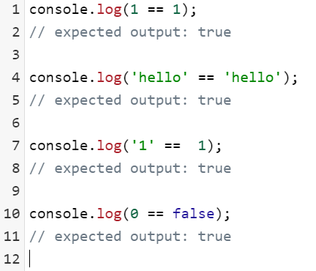
JavaScript - Basics
Equality

Slide 24
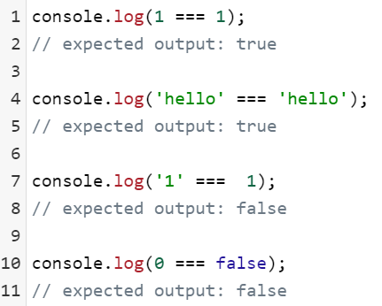
JavaScript - Basics
Strict Equality

Slide 25
THANK YOU
Prof.Vinay Joshi and Dr.Sarasvathi V
Department of Computer Science and Engineering

