Slide 1

WEB TECHNOLOGIES
JavaScript –Built in Objects
Prof. Pavan A C
Department of Computer Science and Engineering
Acknowledgement:
Teaching Assistants(Samved Suresh Jain and Sathyajit P)

Slide 2
JavaScript – Built-in Objects
Global Object
When the JavaScript interpreter starts up, there is always a single global object instance created called window. All other objects are properties of this object.
Also, all other variables and functions are properties of this global object.
For client-side JavaScript, this object is the instance window of the constructor Window.
Since everything is a property of the window object, there is a relaxation of the dot notation when referring to properties. Thus, each reference to a variable, function or object is not required to start with "window.“
Both these lines have the same effect:
window.status = "this is a test"; status = "this is a test";
Supported global objects are : Math, Number, String, Array, Date, window, document
Notes:
Touch

Slide 3
JavaScript – Built-in Objects
Array
Arrays are lists of elements indexed by a numerical value starting with 0 to length - 1.
Arrays can be created using
The new Array method:
let arr = new Array(100) – creates an array of 100 elements all undefined
let arr = new Array(10, 20) – creates an array of 2 elements - 10 & 20
Literal arrays using square brackets:
var alist = [1, “ii”, “gamma”, “4”];
Notes:
Touch

Slide 4
JavaScript – Built-in Objects
Array Length
Array length property can be modified at runtime
Hence, the length property does not necessarily indicate the number of defined values in the array
const arr = [1, 2]; //Array definition
console.log(arr);
// Output: [ 1, 2 ]
arr.length = 7; // set array length to 5 while currently 2.
console.log(arr);
// Output: [ 1, 2, <5 empty items> ]
for (i in arr)
console.log(typeof(i) + i));
// Output: string0
string1
Notes:
Touch

Slide 5
JavaScript – Built-in Objects
Array
Array Elements Can Be Objects
JavaScript variables can be objects. Arrays are special kinds of objects. We can have objects in an Array, we can have functions in an Array, we can also have other arrays in an Array.
Example:
myArray[0] = Date.now; //Array element stores date myArray[1] = myFunction; //Element stores a function reference, it has not been executed yet. myArray[2] = myCars; //Element has a another object.
Notes:
Refer notes for details on all methods

Slide 6
JavaScript – Built-in Objects
Array Methods
push– Add an element to the end of the array.
pop – Remove an element from the end of the array.
shift – Remove an element from the front of the array.
unshift – Add an element to the front of the array.
join – Return a string with array elements.
indexOf – Returns the index of an array element.
sort – Sort an array in ascending order (by default).
concat – Concatenate two arrays.
slice – Returns a subset of the array.
Notes:
Refer notes for details on all methods

Slide 7
JavaScript Basics
JavaScript Arrays - Methods
Adding Array Elements
Both the below methods add new element (WT) to the end of Courses array.
var courses=['HTML’ , 'CSS’, 'Javascript’, 'React’];
courses.push('WT');
Or
courses[Courses.length] = “WT”;

Slide 8
JavaScript Basics
JavaScript Arrays methods
1) Converting Arrays to Strings: Can be done using arr_name.toString().
Example:
const arr_1 = [1, 'a', true];
const str = arr.toString(); // comma-separated by default
console.log(str); // Output: "1,a,true"
2) The join() method also joins all array elements into a string.
Example:
const arr_2 = ['a', 'b', 'c'];
console.log(arr.join()); // Output: "a,b,c"
console.log(arr.join(' - ')); // Output:"a - b - c"
console.log(arr.join('')); //Output: "abc"

Slide 9
JavaScript Basics
JavaScript Arrays methods
3) Push and Pop: Used to add and remove elements, respectively from the end of the array.
Example:
const arr = [1, 2];
const ret_push = arr.push(3, 4); // returns new length
console.log(arr); // Output:[1, 2, 3, 4]
console.log(ret_push); //Output: 4
const ret_pop = arr.pop(); // returns removed item
console.log(arr); // Output:[1, 2, 3]
console.log(ret_pop); // Output: 4

Slide 10
JavaScript Basics
JavaScript Arrays methods
4) Shifting Methods: Similar to the Push and Pop but works on the front end of the array instead. Shift - Remove element and unshift - Add element
Example:
const arr_3 = [10, 20, 30];
const ret_shift = arr.shift(); // returns removed item
console.log(arr); // Output: [20, 30]
console.log(ret_shift); // Output: 10
const arr_4 = [10, 20];
const ret_ushift = arr.unshift(5, 7); // returns new length
console.log(arr); // Output: [5, 7, 10, 20]
console.log(ret_ushift); // Output: 4

Slide 11
JavaScript Basics
JavaScript Arrays - Methods
5) Deleting Elements: Done using delete keyword
Example:
const arr_5 = ['x', 'y', 'z'];
delete arr[1];
console.log(arr); // Output:['x', <1 empty item>, 'z']
console.log(arr.length); //Output: 3 (length unchanged)
6) Slicing the Array: Used to extract a subset of the array.
Example:
const arr_6 = ['a', 'b', 'c', 'd', 'e'];
console.log(arr.slice(1, 3)); // Output:['b', 'c'] (indices 1 and 2)
console.log(arr.slice(2)); // Output:['c', 'd', 'e'] (to end)
console.log(arr.slice(-2)); // Output:['d', 'e'] (negative indices from end)
console.log(arr); // original unchanged

Slide 12
JavaScript Basics
JavaScript Arrays - Methods
7) Splicing an Array
The splice() method changes the contents of an array by removing or replacing existing elements and/or adding new elements in place.
Example:
// Remove // Replace
const a1 = [1, 2, 3, 4]; const a3 = ['a', 'b', 'c'];
const removed = a1.splice(1, 2); // remove 2 items starting at index 1 a3.splice(1, 1, 'B'); // replace 'b' with 'B'
console.log(a1); //Output: [1, 4] console.log(a3); // Output: ['a', 'B', 'c']
console.log(removed); // Output: [2, 3]
// Insert
const a2 = [1, 4];
a2.splice(1, 0, 2, 3); // insert 2,3 at index 1 (deleteCount=0)
console.log(a2); // Output:[1, 2, 3, 4]

Slide 13
JavaScript Basics
JavaScript Arrays - splice
The splice method changes an array in place by removing, inserting, or replacing elements. Its general signature is:
splice(start, deleteCount, ...itemsToInsert)
start: Zero-based index to begin changes; negative counts from end; beyond length appends insertions and removes nothing.
deleteCount: Number of elements to remove from start; omit to remove to end; 0 or negative removes nothing.
...itemsToInsert: Elements to insert at start in given order; none means only removal; with deleteCount>0 it performs replacement.
Return value: An array of removed elements (empty array if nothing was removed).
Mutation: Modifies the original array (length and indices can change).

Slide 14
JavaScript Basics
JavaScript Arrays - Merging and Reversing Arrays
7) Merging (Concatenating) Arrays
The concat() method creates a new array by merging (concatenating) existing arrays
Example:
const a = [1, 2], b = [3, 4];
const merged1 = a.concat(b);
console.log(merged1); // Output: [1, 2, 3, 4]
8) The reverse() method reverses the elements in an array.
Example:
const arr = [1, 2, 3];
arr.reverse();
console.log(arr); // Output: [3, 2, 1] (mutates)

Slide 15
JavaScript Basics
JavaScript Arrays - Sort Method
8) Sorting an Array:
The sort() method sorts an array alphabetically.
Example:
const nums = [10, 2, 1];
nums.sort();
console.log(nums) //Output: ['1','10','2'] → as numbers: [1, 10, 2] (mutates)
const words = ['banana', 'Apple', 'cherry'];
words.sort();
console.log(words) //Output: ['Apple', 'banana', 'cherry'] (mutates)

Slide 16
JavaScript – Built-in Objects
Array – Sort
arr.sort([compareFunction])
If compareFunction is not specified, array is sorted as strings in ascending order
Example:
const nums = [10, 2, 1, 20];
//Arrow function used
nums.sort((a, b) => a - b); // nums contains: ascending order: [1, 2, 10, 20]
nums.sort((a, b) => b - a); // nums contains: descending order: [20, 10, 2, 1]
compareFunction takes two parameters say a and b and returns
1 if a > b
0 if a = b
-1 if a < b
To reverse the order modify the condition for returning 1, 0 and -1

Slide 17
JavaScript – Built-in Objects
Array – Sort compare function
compareFunction(Optional): A function that defines an alternative sort order. The function should return a negative, zero, or positive value, depending on the arguments, like:
function(a, b)
{return a-b}
When the sort() method compares two values, it sends the values to the compare function, and sorts the values according to the returned (negative, zero, positive) value.
Example:
When comparing 40 and 100, the sort() method calls the compare function(40,100).
The function calculates 40-100, and returns -60 (a negative value).
The sort function will sort 40 as a value lower than 100.

Slide 18
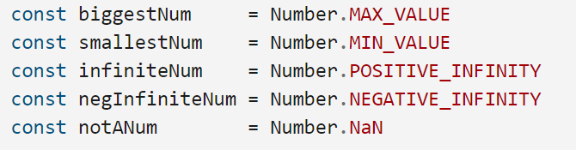
JavaScript – Built-in Objects
Number
• MAX_VALUE : represents the maximum numeric value representable in JavaScript.
• MIN_VALUE: represents the maximum numeric value representable in JavaScript.
• NaN – Not a Number
• POSITIVE_INFINITY
• NEGATIVE_INFINITY
• Operations resulting in errors return NaN
• Use isNaN(a) to test if a is NaN
• toString method converts a number to string
Notes:
Touch

Slide 19
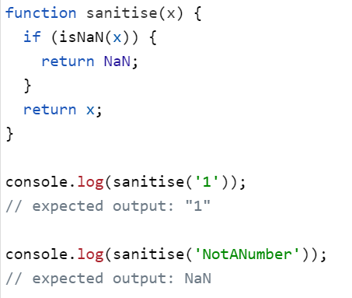
JavaScript – Built-in Objects
NaN- Not a Number
Notes:
Refer notes for details on all methods

Slide 20
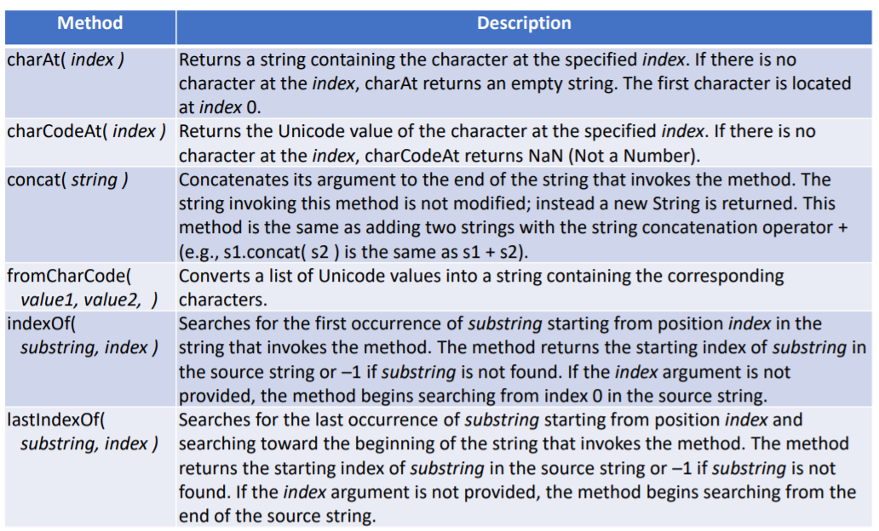
JavaScript – Built-in Objects
String Object
Notes:
Touch

Slide 21
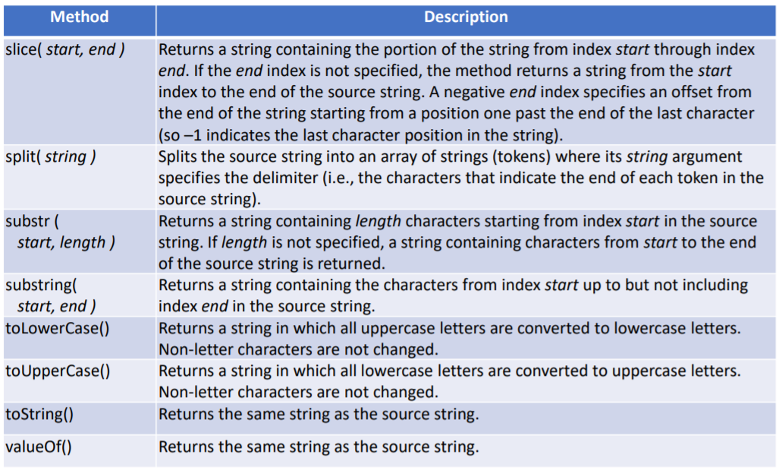
JavaScript – Built-in Objects
String Object
Notes:
Touch

Slide 22
JavaScript – Built-in Objects
Date Methods
var now= new Date();
This creates a Date object for the time at which it was created (stored as the number of milliseconds since January 1, 1970, UTC - Epoch)
toLocaleString | A string of the Date information
(get/set)Date | The day of the month
(get/set)Month | The month in the range of 0 to 11
(get/set)Day | The day of the week in the range of 0 to 6
(get/set)FullYear | The year
(get/set)Time | The number of milliseconds since January 1, 1970
(get/set)Hours | The number of the hour in the range of 0 to 23
(get/set)Minutes | The number of the minute in the range of 0 to 59
(get/set)Seconds | The number of the second in the range of 0 to 59
(get/set)Milliseconds | The number of the millisecond in the range of 0 to 999
Notes:
Refer notes for details on all methods

Slide 23
JavaScript – Built-in Objects
Math Methods
Provides static mathematical constants and functions
Math.E | Euler’s Constant (Approx. 2.718)
Math.PI | Value of PI (Approx. 3.1416)
Math.SQRT2 | Square root of 2 (Approx. 1.414)
Math.abs(x) | Returns the absolute value of x
Math.ceil(x) | Returns the smallest integer greater than or equal to x
Math.floor(x) | Returns the largest integer less than or equal to x.
Math.max([x[, y[, …]]]) | Returns the largest of zero or more numbers.
Math.min([x[, y[, …]]]) | Returns the smallest of zero or more numbers.
Math.pow(x, y) | Returns base x to the exponent power y (that is, x^{y}).
Math.random() | Returns a pseudo-random number between 0 and 1.
Notes:
Refer notes for details on all methods
To generate a random number between a and b
rand=a+Math.floor(Math.random()*(b-a))

Slide 24
JavaScript – Built-in Objects
Window – Properties and Methods
Global object containing global variables and functions declared in the page. For example, var x; can also be accessed as window.x
location | object containing location details like href, path etc.
history | object containing the browser history
localStorage | object containing a local cache for storing user info
innerHeight, innerWidth | dimensions of the display area of the browser
alert(text) | method to display a dialog box with message
prompt(text,default) | method to seek input from user, returns string
confirm(text) | method to show a confirmation dialog
setInterval, clearInterval | start/stop performing action repeatedly after an interval
setTimeout, clearTimeout | start/stop performing action once after a timeout period
Notes:
Refer notes for details on all methods

Slide 25
JavaScript – Built-in Objects
setTimeout and setInterval
setTimeout allows us to run a function once after the interval of time.
The syntax: let timerId = setTimeout(func|code, [delay], [arg1], [arg2], ...) where delay is in milliseconds.
Example: function sayHi(phrase, who) {
alert( phrase + ', ' + who );
}
setTimeout(sayHi, 1000, "Hello", "John"); // Output: Hello, John (after 1 second = 1000ms)
setInterval allows us to run a function repeatedly, starting after the interval of time, then repeating continuously at that interval.
It has the same syntax as setTimeout:
let timerId = setInterval(func|code, [delay], [arg1], [arg2], ...)
Example:
// repeat with the interval of 2 seconds
let timerId = setInterval(() => alert('tick'), 2000);
// after 5 seconds stop
setTimeout(() => { clearInterval(timerId); alert('stop'); }, 5000);
Notes:
Refer notes for details on all methods

Slide 26
JavaScript – Built-in Objects
MCQ
Which creates an array of length 100 with all elements initially undefined?
A. new Array(100)
B. Array.make(100)
C. []
D. Array(1..100)
Notes:
Refer notes for details on all methods

Slide 27
JavaScript – Built-in Objects
MCQ
Which creates an array of length 100 with all elements initially undefined?
A. new Array(100)
B. Array.make(100)
C. []
D. Array(1..100)
Notes:
Refer notes for details on all methods

Slide 28
JavaScript – Built-in Objects
MCQ
2. Which pair adds elements to the end and removes from the front in an array?
A. unshift/pop
B. push/unshift
C. unshift/push
D. push/shift
Notes:
Refer notes for details on all methods

Slide 29
JavaScript – Built-in Objects
MCQ
2. Which pair adds elements to the end and removes from the front in an array?
A. unshift/pop
B. push/unshift
C. unshift/push
D. push/shift
Notes:
Refer notes for details on all methods

Slide 30
JavaScript – Built-in Objects
MCQ
3. To sort numbers ascending correctly, use:
A. arr.sort().reverse()
B. arr.sort()
C. arr.sort((a,b)=>b-a).reverse()
D. arr.reverse().sort()
Notes:
Refer notes for details on all methods

Slide 31
JavaScript – Built-in Objects
MCQ
3. To sort numbers ascending correctly, use:
A. arr.sort().reverse()
B. arr.sort()
C. arr.sort((a,b)=>b-a).reverse()
D. arr.reverse().sort()
Notes:
Refer notes for details on all methods

Slide 32
THANK YOU
Prof. Pavan A C
Department of Computer Science and Engineering

