Slide 1

WEB TECHNOLOGIES
JavaScript Objects
Prof. Pavan A C
Department of Computer Science and Engineering
Acknowledgement:
Teaching Assistants(Samved Suresh Jain and Sathyajit P)

Slide 2


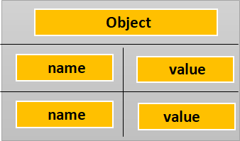

Javascript Objects
Basic Object Oriented Concepts
An object in JavaScript is a reference data type.
An object can be compared to any real world entity.
An object is an unordered list of properties consisting of a name (always a string) and a value. When the value of a property is a function, it is called a method.
Variable Object
object1
object2
MEMORY
Object
Fig 1:Object Structure
Fig 2:Object Reference
Code equivalent:
Var object1= new Object(); //Not common nowadays
Var object2 = object1;
Notes:
An object is a collection of properties, and a property is an association between a name (or key) and a value. A property's value can be a function, in which case the property is known as a method.

Slide 3
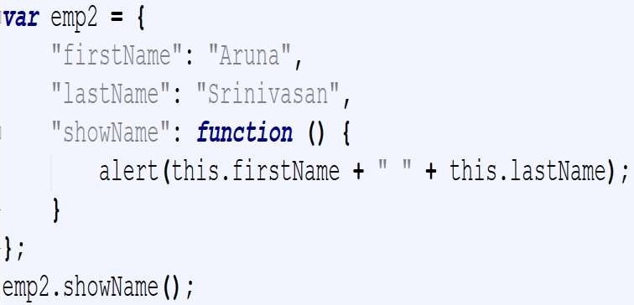
Javascript Objects
Object Literals using {key : value}
Common way to create a JS Object using {}
Output is an alert stating: Aruna Srinivasan
Specifies object members and their values inside the curly brackets as key-value pairs
A member and its value are delimited using colon (:) character.

Slide 4
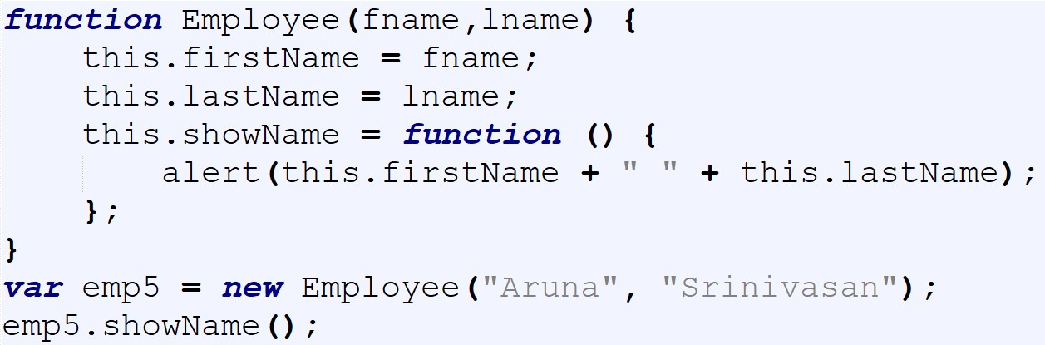
Javascript Objects
Creating an object using function Constructor
JavaScript functions are objects themselves. It can be called as a Constructor Function.
Once the function constructor is created you create object of that function using new keyword.
The function name uses camel case convention

Slide 5
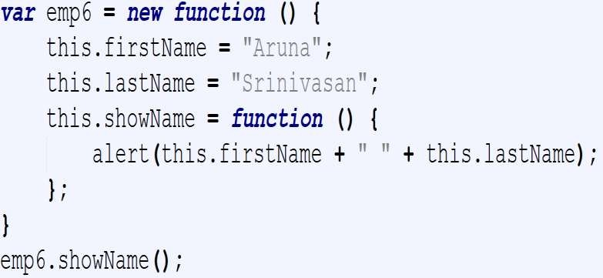
Javascript Objects
Creating an object using anonymous function
Two steps are performed here
Firstly, it creates an anonymous constructor function
Secondly, it calls new on it to create its object.

Slide 6
Javascript Objects Prototype property
Prototype property of an object holds the structure of that object
It is shared by all object instances created using that constructor
This can be used to modify/add properties to all instances after they have been created
Methods should be added to prototype since only one copy of the method is created. If methods are added to constructor, each object instance holds its own copy of the method.
Employee.prototype.showName = function(){…}

Slide 7
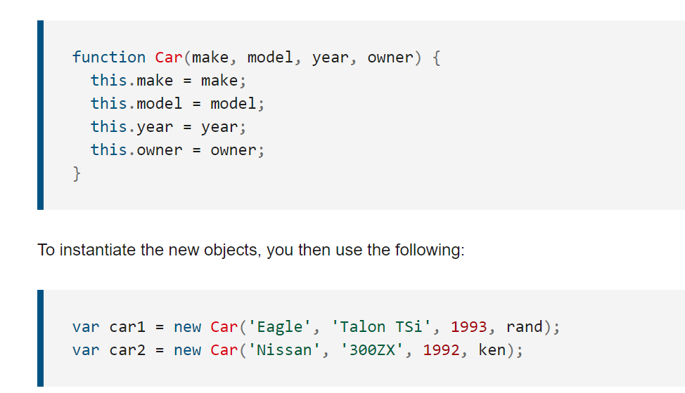
Prototype property
Javascript Objects

Slide 8
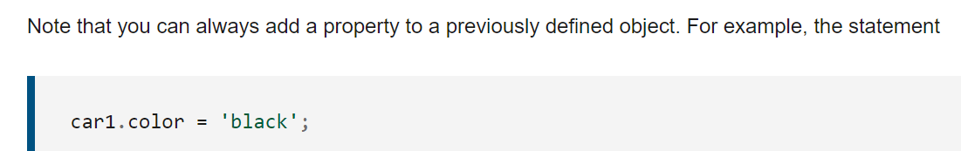
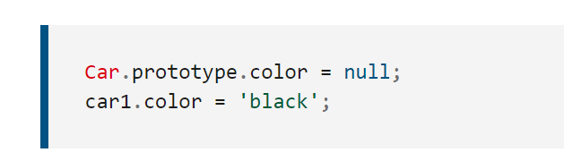
Prototype property
Javascript Objects
JavaScript prototype property allows you to add new properties to object constructors:

Slide 9
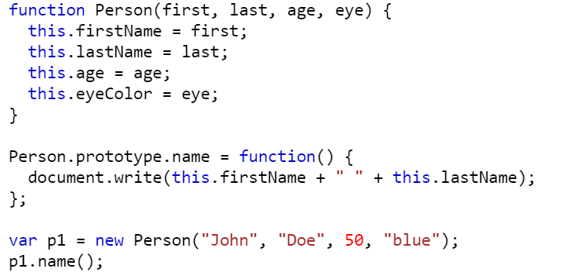
Prototype property
Javascript Objects
Code to add a new function to the prototype of object Person
Output: John Doe (in the web page)

Slide 10
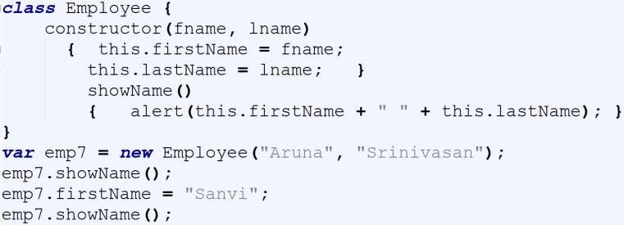
Javascript Objects
Creating an object using EcmaScript 6 Class Keyword
Output:
Before change, An alert stating: Aruna Srinivasan
After change, An alert stating: Sanvi Srinivasan
Class is first defined, then the objects of the class are created.
It internally uses the constructor/prototype based approach of creating objects.

Slide 11
Javascript Objects
MCQ
When a property value is a function, that property is called a:
A. Field
B. Accessor
C. Method
D. Closure

Slide 12
Javascript Objects
MCQ
When a property value is a function, that property is called a:
A. Field
B. Accessor
C. Method
D. Closure

Slide 13
Javascript Objects
MCQ
2. Adding methods to the prototype is preferred because:
A. It makes them private
B. It ensures only one shared copy across instances
C. It forbids reassignment
D. It avoids hoisting

Slide 14
Javascript Objects
MCQ
2. Adding methods to the prototype is preferred because:
A. It makes them private
B. It ensures only one shared copy across instances
C. It forbids reassignment
D. It avoids hoisting

Slide 15
Javascript Objects
MCQ
3. Constructor functions create objects when called with:
A. Object()
B. new
C. this()
D. create()

Slide 16
Javascript Objects
MCQ
3. Constructor functions create objects when called with:
A. Object()
B. new
C. this()
D. create()

Slide 17
THANK YOU
Prof. Pavan A C
Department of Computer Science and Engineering

